Slide 1
OSCE
Dr. Ahmed Mohamed Adam
Consultant General Surgeon

Slide 2
Question 1
Name the investigation.
Name the finding.
Possible clinical presentation.
Enumerate the plan of management.

Slide 3
Question 2
Name the type of the incision.
Spot Diagnosis.
Treatment.
1
2

Slide 4
Question 3
Mention this eye sign.
Mention other 3 eye signs in toxic goiter.
How you prepare her for surgery.
Mention 5 postoperative complications.

Slide 5
Question 4
Mention 2 Differential Diagnosis.
Best Single Investigation.
Best Treatment.

Slide 6
Question 5
Spot Diagnosis.
Mention 3 important symptoms in the history.
Describe your plan of management.

Slide 7
Question 6
Name the lesion.
Common Causes.
Other sites.
Treatment.

Slide 8
Question 7
Mention the diagnosis.
Mention 2 investigation.
What is the system affected.
Mention one bedside clinical test.
Mention 3 complications.
Mention 2 modalities of treatment.

Slide 9
Question 8
Mention the investigation.
Mention the findings.

Slide 10
Question 9
How you manage this patient.
What are the possible structures affected.
When you remove this knife.

Slide 11
Question 10
How you calculate his burned surface areas.
How you prescribe his I.V fluid.
Plan of management at casualty.

Slide 12
Question 11
Name this complication.
Mention how to prevent it.
Mention its treatment.
Mention 3 early and 3 late complications.
Omdurman Teaching Hospital Department of Plastic Surgery

Slide 13
Question 12
Prescribe the findings in this pictures.
Mention 2 possible clinical diagnosis.
You are the house officer in charge, prescribe your initial plan of management.
Prescribe the procedure done for him in details.

Slide 14
Question 13
Name this ulcer.
Describe this ulcer.
Common cause.
Best treatment.

Slide 15
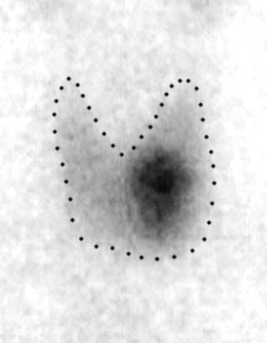
Question 14
1
Name the investigation.
Describe the finding in 1 & 2.
Describe management in each.
2

Slide 16
Question 15
Name this anomaly.
How can you diagnose it.
How you treat it.

Slide 17
Question 16
Mention the diagnosis.
How you treat it.

Slide 18
Question 17
Diagnosis.
Treatment.

Slide 19
Question 24
Name the investigation.
Mention the abnormal finding.
Gives 3 possible differential diagnosis.
Outline management of one of your differential.

Slide 20
Question 18
Name the investigation.
Finding.
Major complication.
Who you treat it.
Notes:
Major

Slide 21
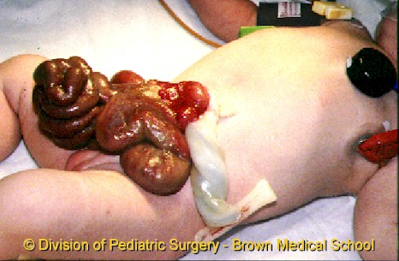
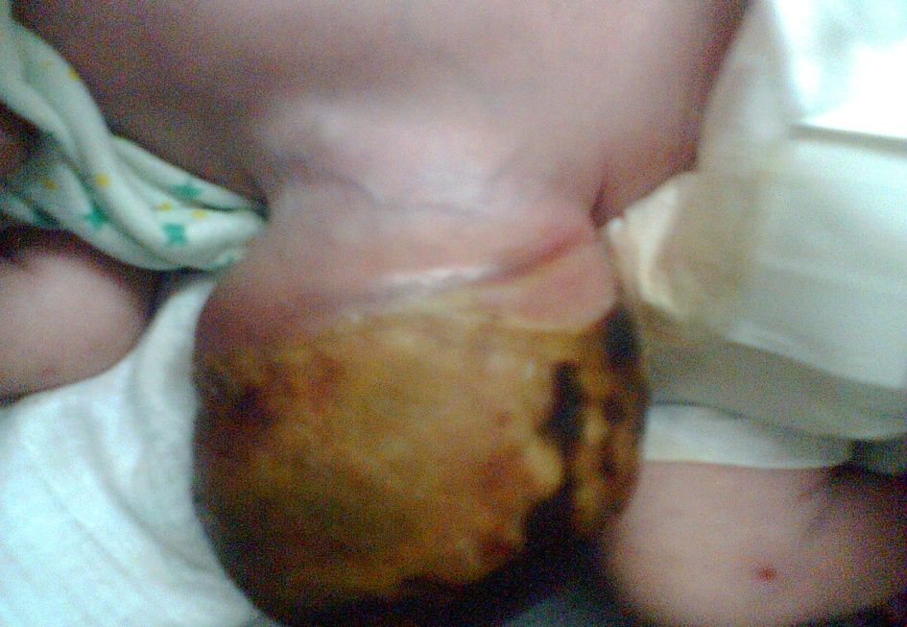
Question 19
B
Department of Pediatric Surgery Khartoum Teaching Hospital
A
Diagnosis in slide A and B.
Causes of death in slide B
What is the difference between A and B.
Treatment in A and B.
Department of Pediatric Surgery-Khartoum Teaching Hospital
A

Slide 22
Question 20
Khartoum teaching Hospital-Department of Pediatric Surgery.
Mention the diagnosis.
Mention how you are going to manage this child.

Slide 23
Question 21
Spot Diagnosis.
Mention other 3 complications.
How you are going to manage this complication.
Khartoum Teaching Hospital-Department of Pediatric Surgery

Slide 24
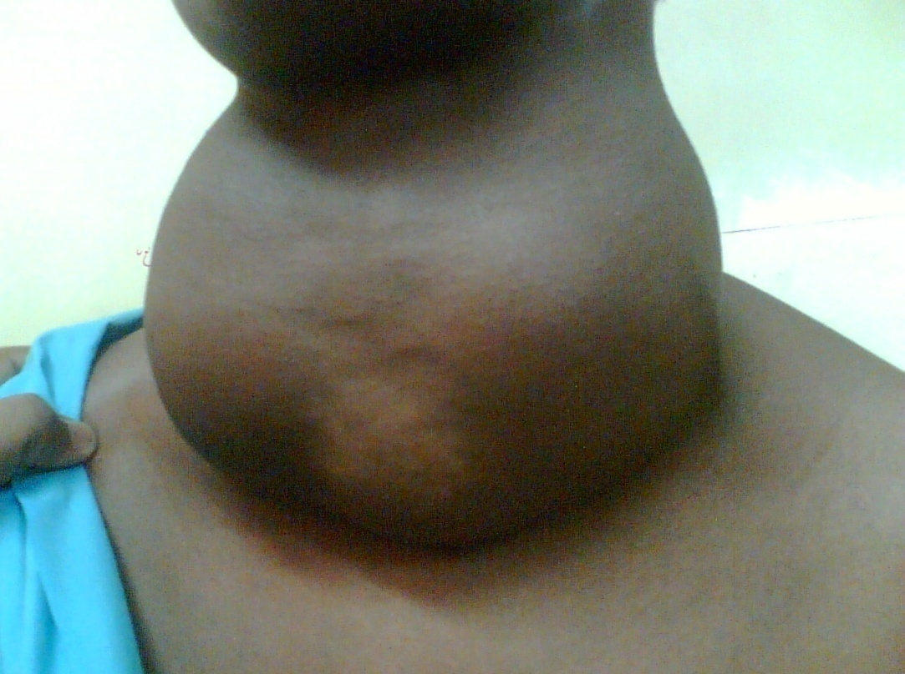
Question 22
33 years lady presented with anterior neck swelling for 2 years, which moves with swallowing, with no other systemic symptoms.
Diagnosis.
How you are going to prepare her for surgery.
Mention 3 possible intraoperative , 3 early and 3 late postoperative complications.
Mention how you are going to treat one of them.

Slide 25
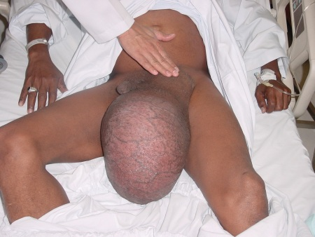
Question 23
Khartoum Teaching Hospital Department of General Surgery
Mention 3 differential diagnosis.
Most likely diagnosis.
Two important signs for one of the diagnosis.
Treatment of one of the diagnosis.
Khartoum Teaching Hospital Department of General Surgery

Slide 26
Question 25
Name the investigation.
Mention the finding.
Mention 3 surgical complications, might encountered in this patient.

Slide 27
Question 26
Name the radiological sign.
What is the most likely diagnosis.

Slide 28
Question 27
Name the investigation.
How are you going to prepare this patient for this investigation.
Mention the abnormal findings.
How are you going to deal with this problem.

Slide 29
Question 28
Name this investigation.
Describe the finding.
Gives likely 3 differential diagnosis.
If this patient developed femoral neck fracture how are you going to treat him.

