Slide 1
OSCE WEEK 2

Slide 2
Q1: This is a 11 year old child who presents to you at the Casualty.

Slide 3
Describe what you see.(2mrks)
Perform an Eye Exam on this Child(8 mrks)
On further evaluation, the above presentation was acute on onset and progression( 2 week history). List the most likely causes of this presentation.(5mrks)
Outline the priority investigations you would carry out.(3mrks)

Slide 8
Q2:

Slide 9
Spot Diagnosis?
List the various ocular manifestions/signs associated with this presentation.
List the risk factors associated with the development of above condition?

Slide 11
Q1.

Slide 12
Interpret the Xray.
Describe the clinical presentation of this fracture.
Classify the fracture.
What is the definitive management?

Slide 13
1.a) Biodata
b)Quality of xray(2 joints, 2views, 2 opinions, 2 limbs, 2 occasions, 2 evaluations.)
c) Continuity of bone( proximal femur #)
d) Pattern of fracture( Comminuted, wedge shaped)
e) Mechanism of Injury( Twisting,compression, bending, tension, High energy, Low energy, direct injury, Indirect injury)

Slide 14
Clinical presentation.
Pain, swelling, limb shortening, open/ closed injury.+ FADIR.
Winquist and Hansen classification is used for comminuted
fractures.
Displacements In Fracture Shaft Femur.
Proximal Third Fracture
• Proximal fragment flexes, abducts and externally rotates
because of gluteus medius and iliopsoas
• Distal fragment is adducted (adductor longus, minimus,
magnus and pectineus).
Middle Third Fracture
• Proximal fragments abducts relatively less because of balancing
effect of gluteus medius and adductors; but flexion and external
rotation by iliopsoas persists.
• Distal fragment is adducted.
Distal Third Fracture
• Proximal Fragment adducts (because adductor over power
gluteus medius because of long lever arm). Distal fragment is
hyperextended by gastrocnemius.
• “Lower limb injures associated with maximum shortening are
posterior dislocation of hip > fracture shaft femur > Fracture
subtrochanteric femur > Intertrochanteric fracture > Fracture
Neck Femur”.

Slide 15
Definitive management.
a)Traction.
Skeletalvtraction(russels). Perkins . Once fracture is sticky , discontinue traction and allow ptnt weight bearing in cast or function bracing or plaster spica.
b) ORIF. (plating, Knail, Interlocking Nail)
c) EXOFIX. ( Severe open #, Multiple Injuries, Severe bone loss)

Slide 16
Name the fixation technique shown. Give 2 shortcomings of this technique.

Slide 17
Bridge plate technique.
It does not resist bending force. Unstable.
It is very invasive.

Slide 18
a). Name the technique shown.
b) Give one indication.

Slide 19
Gallows traction.
Fracture shaft femur in children above 5 yrs.

Slide 20
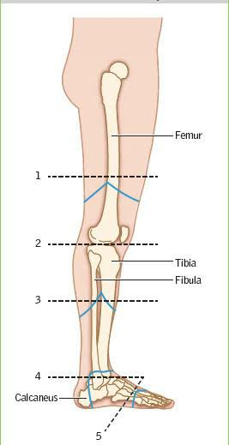
Name the amputations at the levels shown.

Slide 21
A Symes
B Chowparts
C Lishfranc.
2 Knee disarticulation

Slide 22
List the parameters in MESS score.
3 indications and 3 complications of amputations
List 6 surgical principles considered during amputation.

Slide 23
a) Shock, Age,Limb Ischemia, Skeletal and soft tissue injury.
b) Dead or dying limb, Damned Nuisance, Dangerous limb.
c) Pain( phantom limb), Psychological, Stump infections, others.
Surgical Principles.
1. Design flaps
2. Ligate vessels
3.Retract and cut nerves. Cushion under muscle or fat.
4.Myoplasty. Myodesis.
5. Cut bone.
6. Suture skin flaps together.

Slide 24
Perform a shoulder examination.

Slide 28
QUESTIONS
Interpret the above radiograph.
Describe how you will manage this patient.
What are the possible complications.
ANSWERS
QSN 1- POSTERIOR DISLOCATION OF THE LEFT HIP
Post dislocation MC 90%
Presentation- FADIR+ SHORTENING and femoral head can be palpated posteriorly(gluteal).
Vascular sign of Narath is positive.
NB. First interpret b4 stating the pathology.

Slide 29
QSN 2
The proper treatment of a dislocation or fracture-dislocation
of the hip depends primarily on the type of injury, but regardless
of the type of dislocation, some general guidelines apply: (1)
long-term results are directly related to the severity of the initial
trauma; (2) reduction, open or closed, should be performed within
12 hours; and (3) only one or two attempts at closed reduction
should be made; if these fail, open reduction is indicated to prevent
further damage to the femoral head.
REDUCTION.
Open under GA, one assistant needed.
Closed reduction; 3 assistants
Closed reduction Manoeuvres
1.Stimpsons gravity method
2.Allis maneuvre
3.Bigelows maneuvre
4. East Baltimore maneuver
NB. Familiarise yourselt with one maneuver.

Slide 30
POST REDUCTION MANAGEMENT
Depends on severity.
At leasts 2wks of traction. The mobilise on crutches but NO weight bearing till 6wks or 12wks if associated with acetabular fracture.
CT scan is the best invex to judge dislocations.
Confirm with imaging (xray) immediately after reduction.

Slide 31
QSN 3
Early complications
Sciatic nerve injury, vascular injury(sup gluteal artery) and associated # femoral shaft.
LATE COMPLICATIONS
Avascular necrosis, myositis ossificans, OA and unreduced dislocation.

Slide 33
Diagnosis and 3 findings.
Hirschprungs disease (aganglionic megacolon). Proximal dilatation, distal constriction, funnel shaped narrowing tranzition zone.
Signs and symptoms: abdominal distension, Pain, vomiting, constipation, empty rectal vault on DRE with spurt of flatus and stool upon withdrawal..
Histopathological findings: Aganglionic segment, Hypertrophied nerve bundles.

Slide 35
Inguinoscrotal Swelling.
DDX: Indirect inguinal hernia, Infantile hydrocele, Varicocele, testicular tumor, undescended testes, Epididymoochitis.

Slide 36
Phimosis.

Slide 37
Hypospadias.

Slide 38
Unilateral left sided cleft lip and palate.

Slide 39
Imperforate anus.

Slide 40
Hypospadias.

Slide 41
Double bubble sign.
Duodenal atresia.

Slide 42
Meckels Diverticulum.
Complications: Ulcerations, Bleeding, Perforation, Diverticulitis.

Slide 43
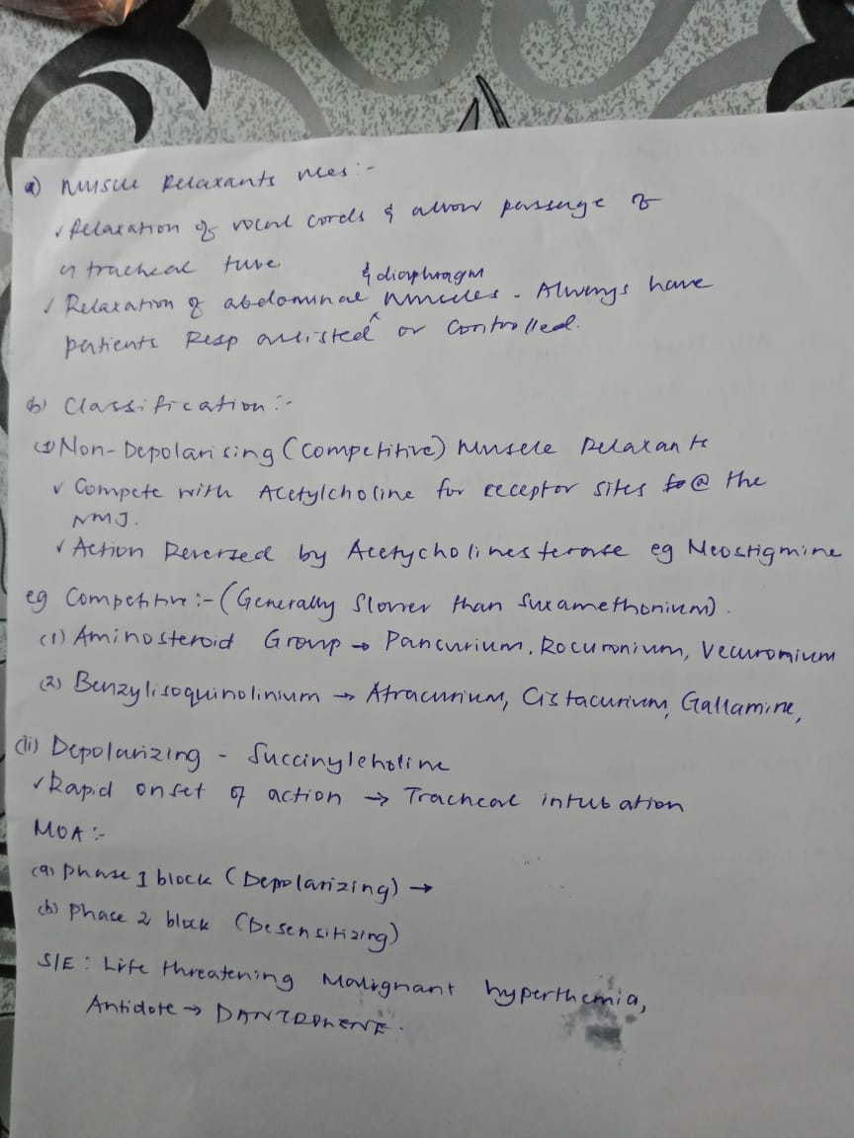

Slide 45
Cortical
Cancellous.

Slide 46
Austin mOOre implant.Fenestrated( With two holes). Non fenestrated(Thompson)

Slide 47
Intramedullary Kuntschner Nail. Clover leaf/club shaped cross section.

Slide 48
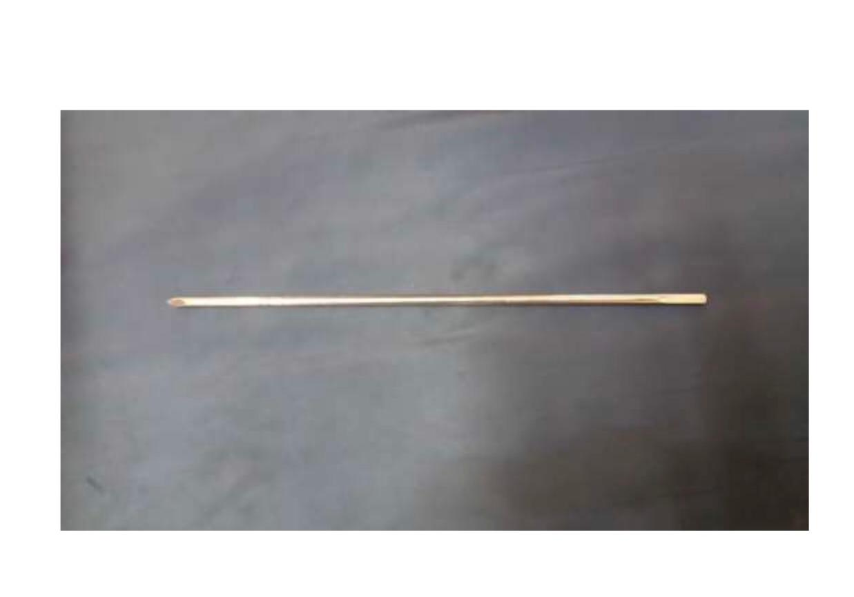
Traction pins . Deinham is threaded at the centre. Steinmann is a smooth rod with one blunt end and one end pointed

Slide 49
Osteotome( Bevelled on both sides at the tip.) Chisel( bevelled on one side at the tip.) Function: Break bone during Osteotomy.

