Slide 1
Question 1
1a) diagnosis
b)history taking and clinical examination in such condition
c)investigations and different management options
d)differentiate the two types of inguinal hernia
e)discuss the anatomy of inguinal canal

Slide 2
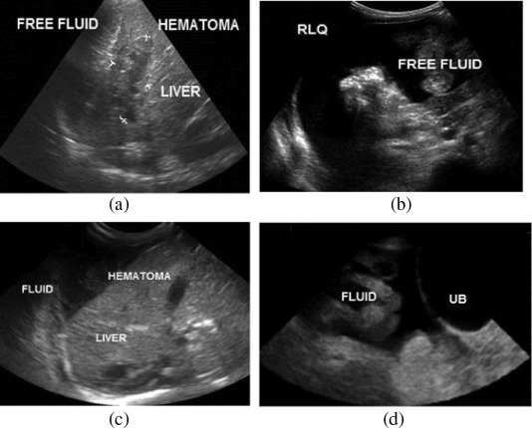
Question 2

Slide 3
Question 2
Patient was involved in RTA
2a) initial management
b) investigations and findings
c)indications for emergency laparotomy
d)3 day post op the patient developed purulent discharge from the surgical wound and fever
(1) diagnosis
(2) definition and classification of SSI
(3) surgical wound classification with example each

