Slide 1
OSCE
Dr. Ahmed Mohamed Adam
Consultant General Surgeon

Slide 2
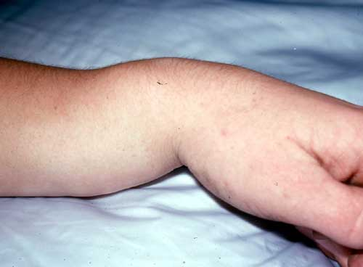
What is the deformity?
The type of fracture?
Radiological finding ?
Principle of treatment?

Slide 3
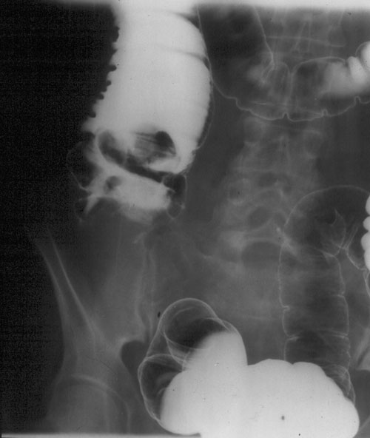
Name this study?
2 signs?
Diagnosis?
3 urgent complication
of the disease?
How to prepair for surgery?

Slide 4
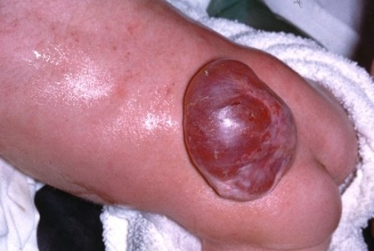
Pathology ?
Did you want to examine other parts in the body? why?
3 complications ?

Slide 5
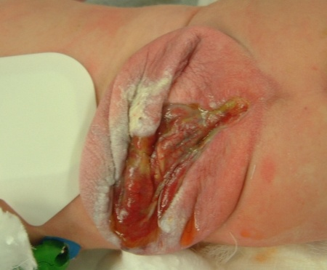

Slide 6
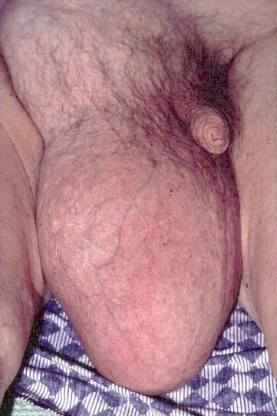
Diagnosis ?
2 signs?
3 DD?
Best treatment?
5 complications?

Slide 7
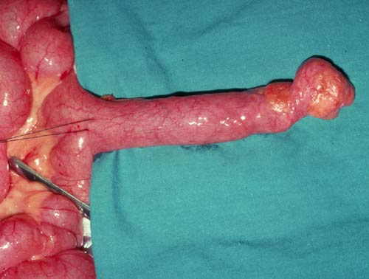
Diagnosis ?
Pathological origin?
Site
2 urgent complications?
Treatment of accidental finding?

Slide 8
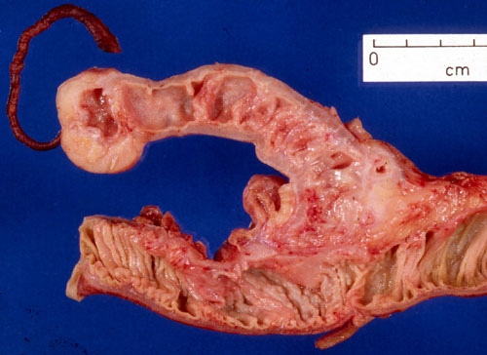

Slide 9
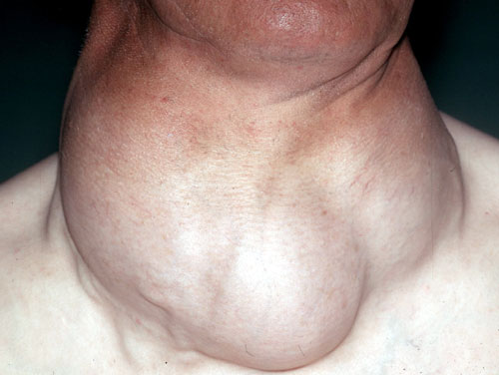
3 clinical findings?
3 invstigations give clue to the diagnosis?
2 emergency complications

Slide 10
Name the investigation?
Findings ?
Diagnosis ?
Options of treatment ?

Slide 11
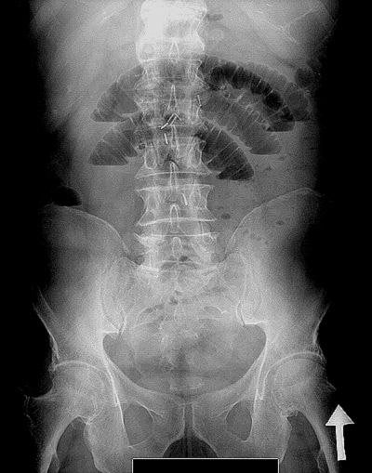
Type of investigation?
Position of the patient ?
Finding ?
Diagnosis ?

Slide 12
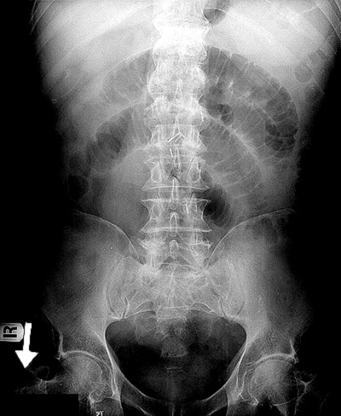

Slide 14
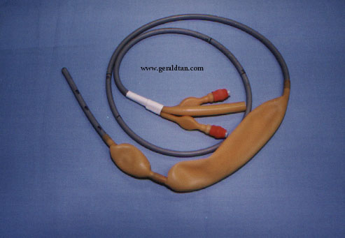
Name the item ?
How you insert it ?
Main use?
4 complications?

Slide 15
Mention the test ?
What is the diagnosis ?
2 DD?
Best treatment ?

Slide 21
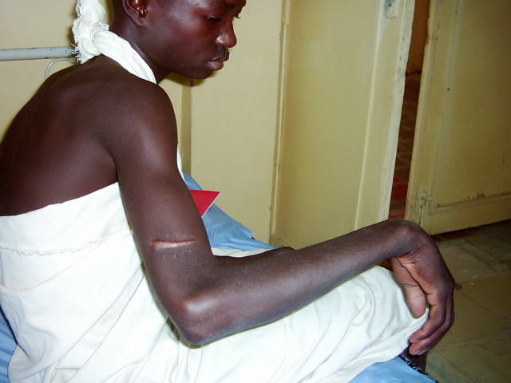
2 findings in this pt.?
Which nerve injured?
How u treat ?

Slide 22
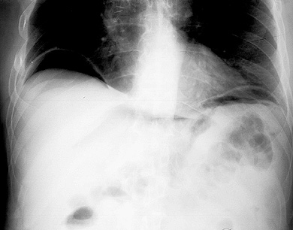
Findings in this investigation?
Mention 5 causes ?
Treatment of one of them?

Slide 23
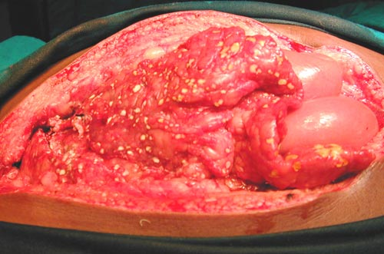
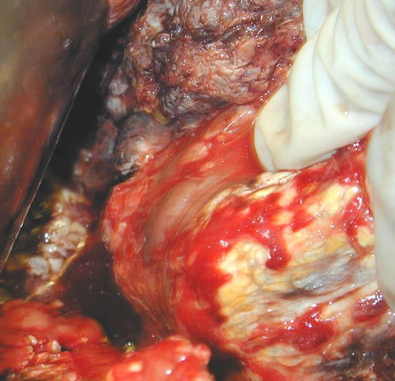
Male 45 years alcoholic with severe abdominal pain and sign of peritonitis
Possible diagnosis ?
2 abdominal wall signs?
Finding in the picture and its pathophysiology?
Three complications?

Slide 25
Name the study ?
Findings ?
Diagnosis ?
5 complications?
Surgical treatment ?

Slide 26
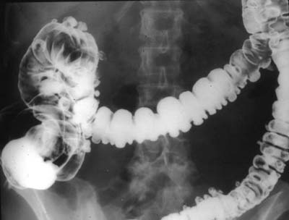

Slide 27
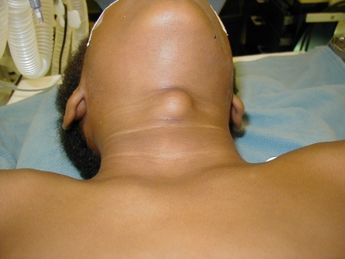
Spot diagnosis?
2 physical signs
2 investigations
Name of the surgery ?

Slide 28
Name these items ?
When you use them?
Mention the parts of one item?

Slide 29
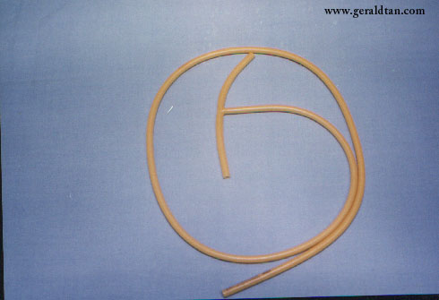
Name the item ?
Two common uses ?
Two common complications ?

Slide 30
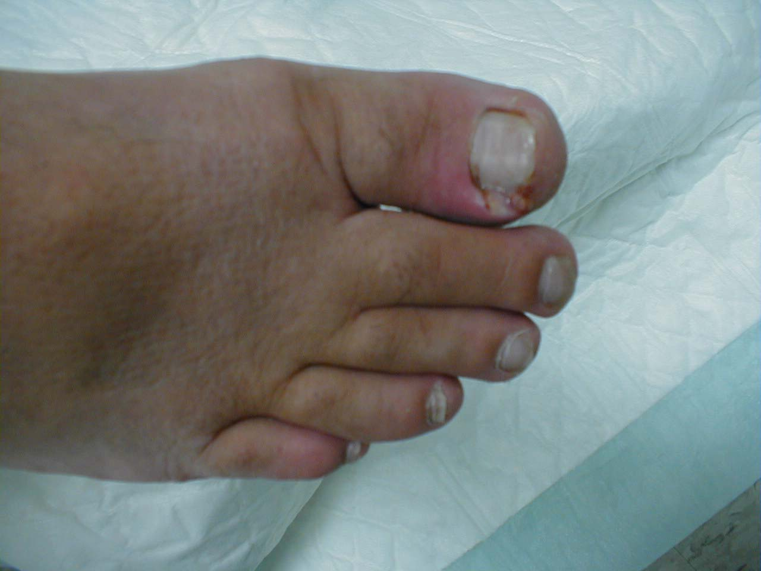
Spot diagnosis ?
Two symptoms?
Three signs?
Best treatment ?

Slide 31
Diagnosis ?
Test used to identify the site of incompetence ?
2 tests used to assess the deep system?
2 main causes ?
Non surgical treatment ?
2 dangerous complications?

Slide 32
Name the investigation?
Abnormal findings ?
Diagnosis ?
2 clinical signs?
Complication of this investigation?

Slide 33
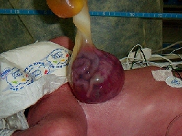
Name the diagnosis ?
Mention two complications?
Treatment in four lines?

Slide 34
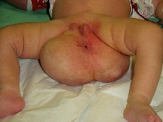
What is the pathology?
2 complications
Definitive treatment?

Slide 35
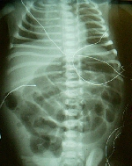
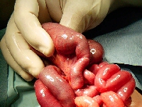
What you see on X-ray?
Pathology in the small bowel?

Slide 36
Mention 3 findings in this X-ray?

Slide 37
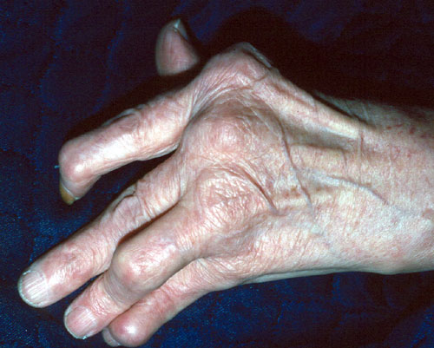
Mention 2 types of deformities?
What is the diagnosis?

Slide 38
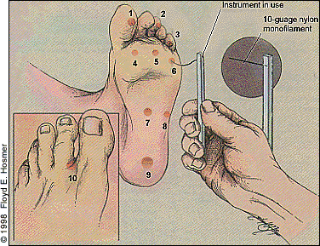
What is this test?
How do you do it?
Mention three indications?
What are these numbers indicate?

Slide 39
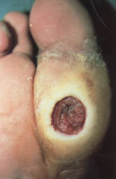
Diagnosis?
Common causes ?
Best treatment?

Slide 40
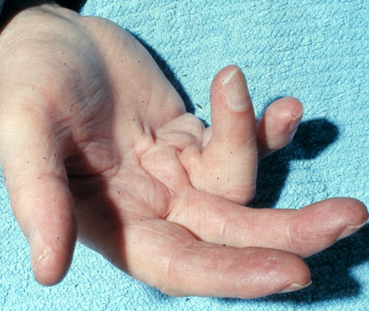
Diagnosis?
Two causes?

Slide 41
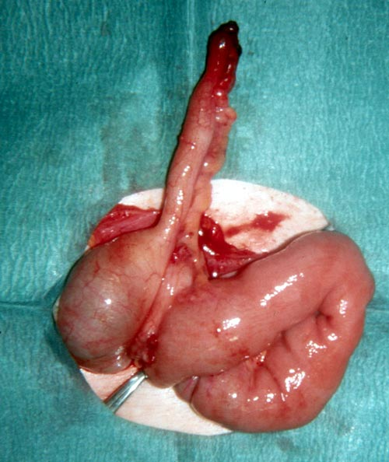
Name the intestinal parts
that is seen in the picture?
The pathology?
What called such op?
2early and 3 late complications?

Slide 42
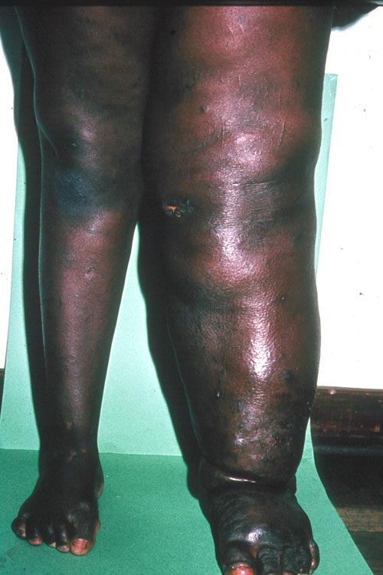
Diagnosis?
Mention 3 causes?
Mention 4 finding?
3 types of surgical
treatment?

Slide 43
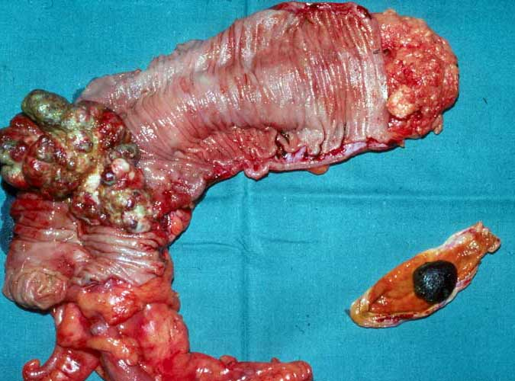
What is the specimen show?
Possible diagnosis?
2 investigation to reach the diagnosis?

Slide 44
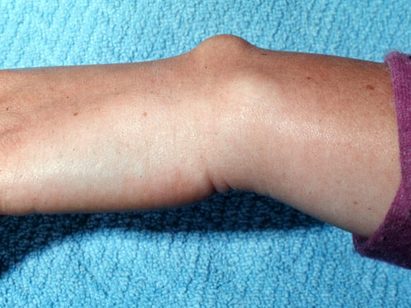
Diagnosis ?
Pathology of the disease?
2 option of treatment?

Slide 45
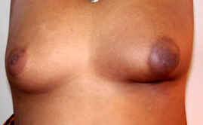
Which breast is affected?
What are the changes?
Possible diagnosis?
Best investigation?

Slide 46
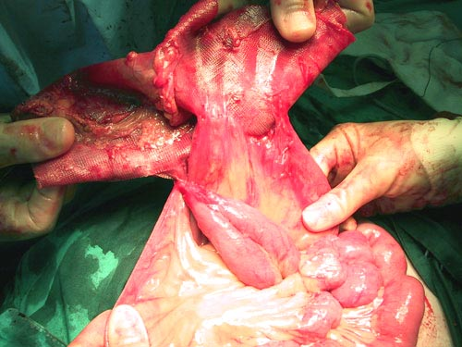
Finding ?
Possible surgical presentation?

Slide 47
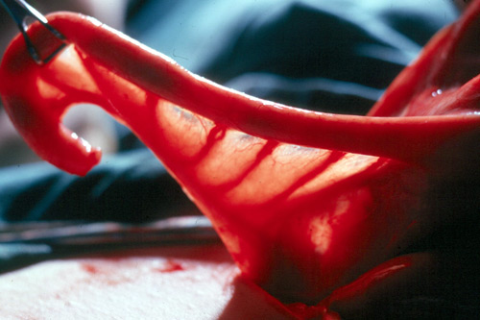
Name such anatomical structures?

Slide 48
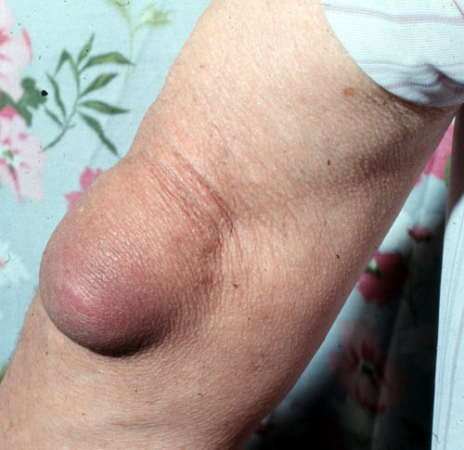
Site of the
pathology?
2 DD?

Slide 49
Left breast
pathology?
Plan of treatment

Slide 50
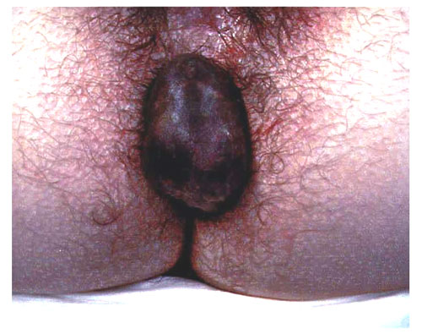
What is the diagnosis?
Pathological type?
2 complications?
Option of treatment?

Slide 51
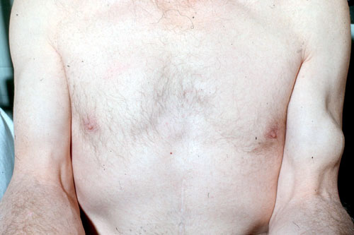
Compare between the two arms?
What is your diagnosis?

Slide 52
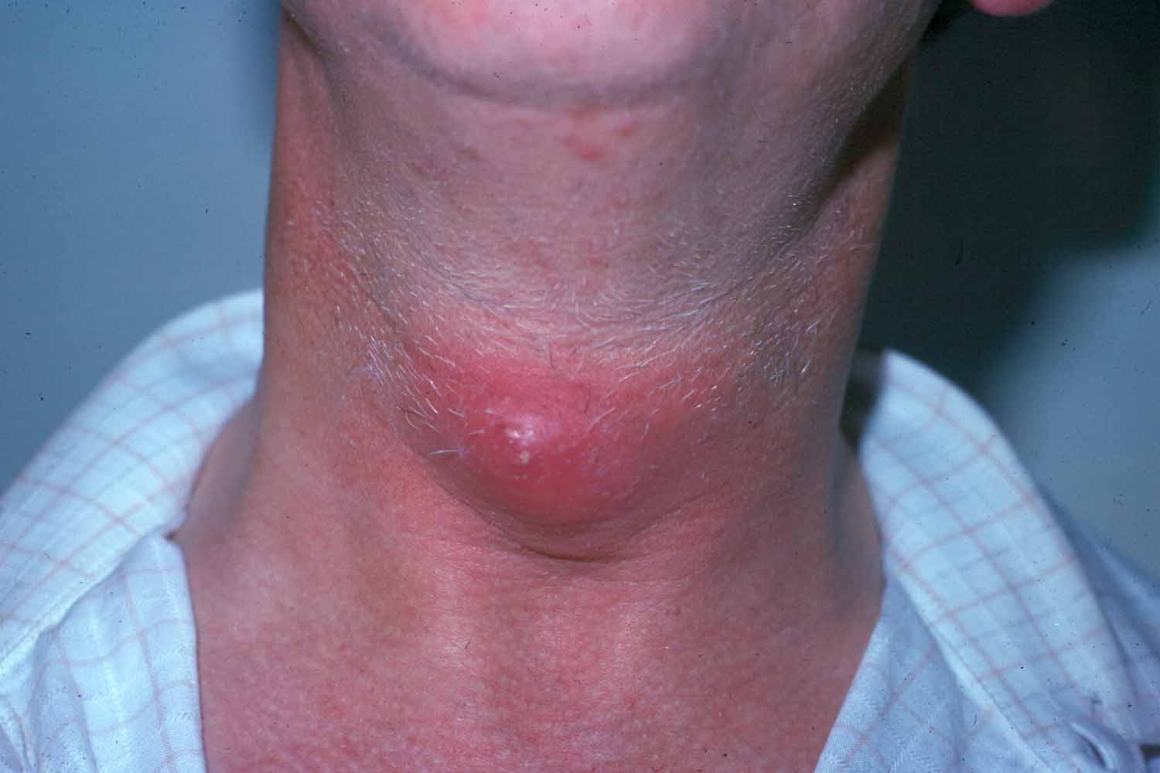
Diagnosis?
Option of treatment?
Single most important complication?

Slide 53
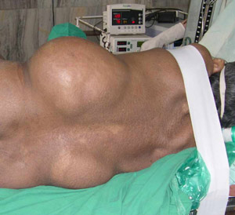
What you see in this pt.?
Best type of treatment?
Success of this treatment?
2 major complications?

Slide 54
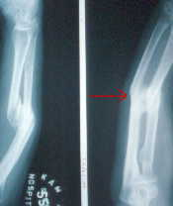
Write down 2 abnormalities ?

Slide 55
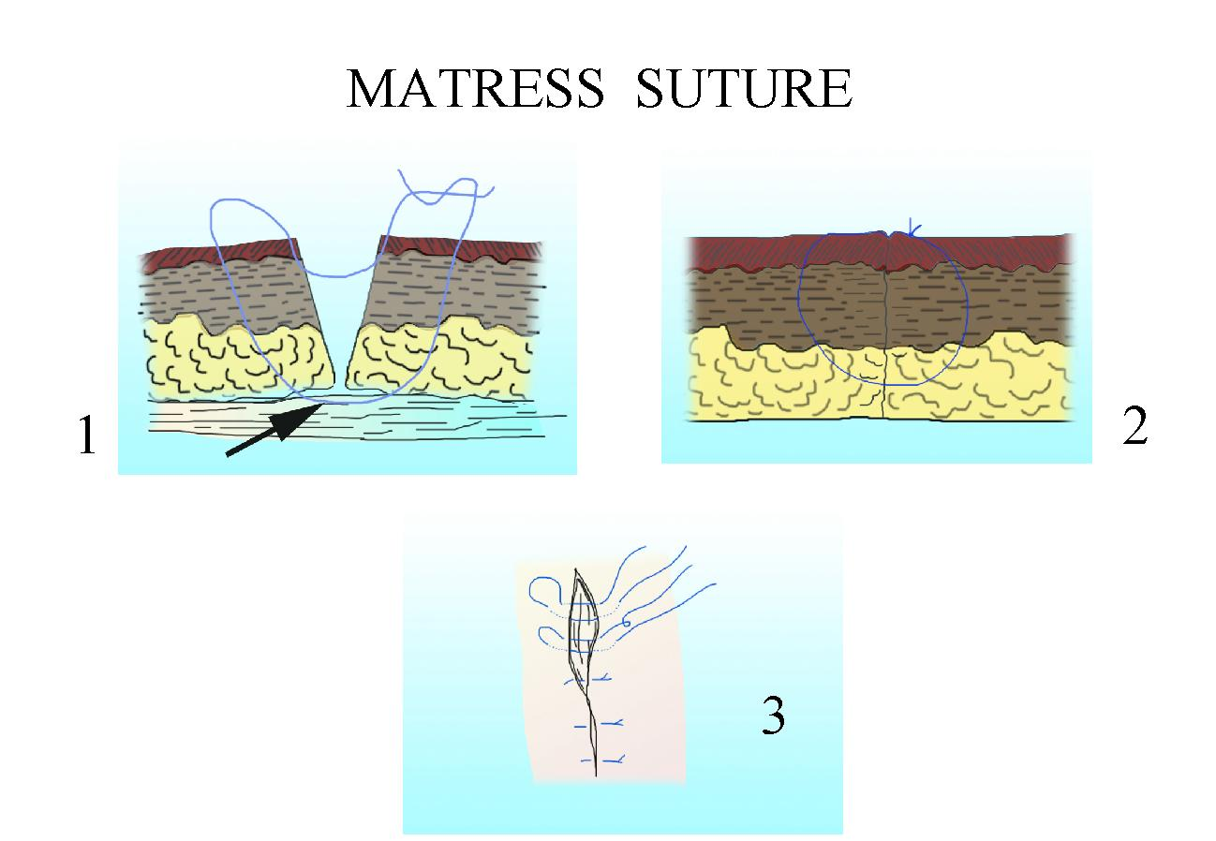
What is the aim of this type of suture
Where are you going to use?
How can you apply?

Slide 56
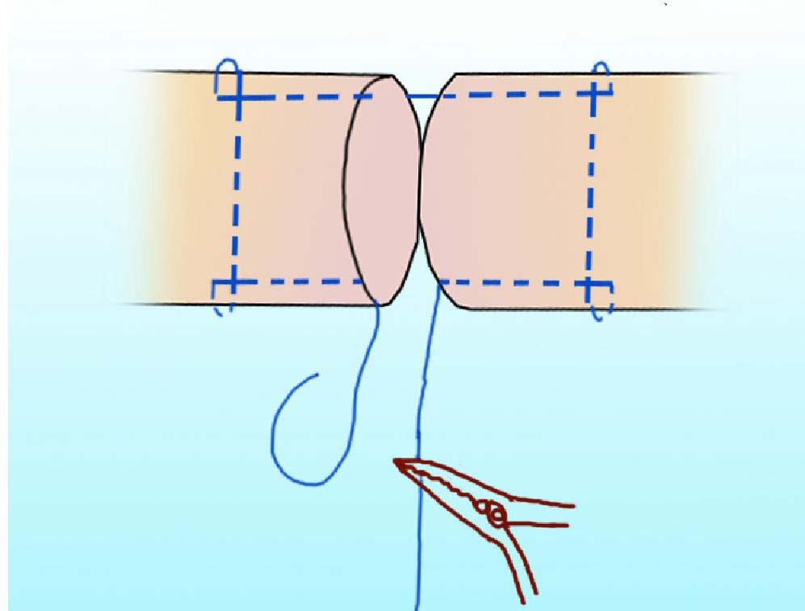
What type of suture technique?
Where it use?
Type of suture material?

Slide 57
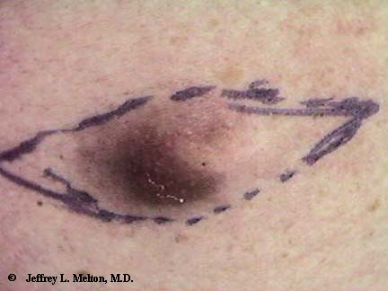
Name this type of the incision mark?
Diagnosis ?
2 complications?
Treatment ?

Slide 58
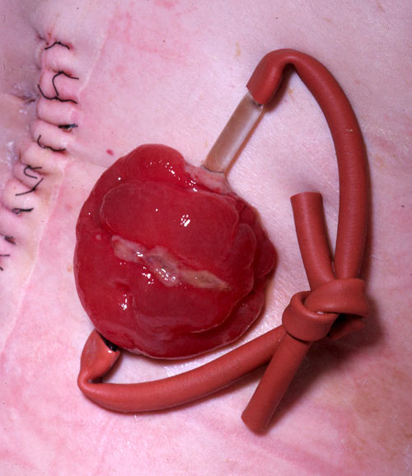
What you see
in this pic?
10 complica-
tion?

Slide 59
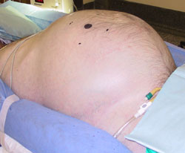
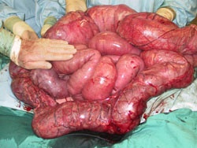
Correlate between the abdomen of the pt. and lapratomy finding?
2 DD
Best treatment for each?

Slide 60
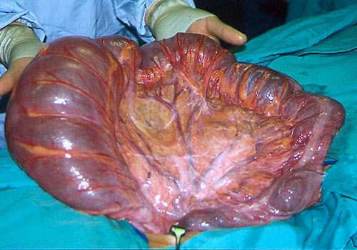
Pathology ?
Organ affected ?
2 Radiological findings?
Non surgical treatment?
2 surgical options?

Slide 61
Diagnosis ?
Indications of surgery ?
Best surgical option ?

Slide 62
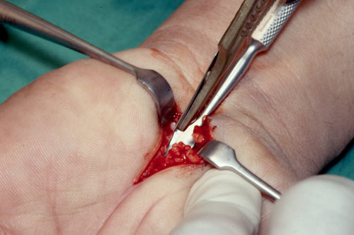
What is the pathology?
Nerve affected ?
Map the areas affected?
Best type of anesthesia ?

Slide 63
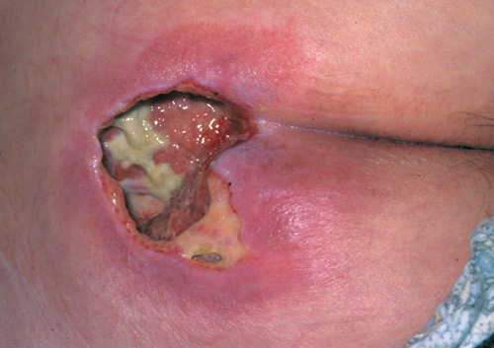
Diagnosis ?
Grades ?
Findings in the picture?
Options of treatment?

Slide 64
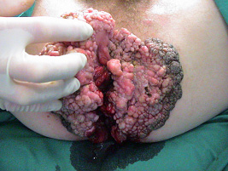
3 DD
Best treatment of one of them?

Slide 65
Diagnosis ?
Name such incision?
2 indications of such incision?

Slide 66
1
2
Diagnosis in 1 & 2
2 specific investigations for each?
Treatment for 1?
Most single danger complication in 2?

Slide 67
Degree of this burn?
Is it a danger ? Why?
Best treatment?
Are u going to admit this patient?

Slide 68
Mention 4 abnormal finding ?
Diagnosis?

Slide 69
Cardinal complain ?
Pathological finding?
Most common complication according to the site ?

Slide 70
Two abnormal findings?
Spot diagnosis ?
Surgical treatment?

Slide 71
1 year girl normal delivery , 2 months of abdominal distension and normal bowel habits
Most likely diagnosis?
2 specific investigations and their findings?
Best treatment ?
Caution during surgery ?

Slide 72
Finding on inspection?
Diagnosis ?
5 other associated anomalies?
2 option of treatment ?

Slide 73
Diagnosis?
Anatomical description
Nursing care?
2 late complications

Slide 75
Correlate between the patient 's picture and CT-sacn

Slide 76
What is the item?
Findings?
5 common causes?

Slide 77
Diagnosis ?
Treatment ?

Slide 78
2 DD?
Best treatment ?

Slide 79
Diagnosis?
Methods of re-
moval?

Slide 81
Newborn with delayed passing meconium and abdominal distension
2DD?
X-ray findings?
Defintive diagnosis?
Initial treatment?

Slide 82
This diagram showed sites of hypospadius
Which is the commonest site?
4 surgical options?
Explain one of them?

Slide 83
Name the pathology?
3 common causes?
2 DD?
2 investigations?
2 options of treatment?

Slide 84
2 DD?
Best investigation?
Best treatment?

Slide 85
4DD?
2 investigations?
Treatment ?

Slide 86
Diagnosis ?
Best investigations?
Different pathology?
Surgical treatment?
Name the incision?

Slide 87
Diagnosis ?
Age of onset?
Pathology ?
Options of treatment ?

Slide 88
Findings ?
Diagnosis?
Treatment ?

Slide 89
Abnormal findings and how can you test it?
Diagnosis ?
Mention 5 signs in the eye ?

Slide 90
Name such
investigation?
Abnormal
findings?

Slide 91
3 DD?
Investigation of choice?
Treatment ?

Slide 92
Diagnosis ?
Single most common cause ?
Best treatment ?

Slide 93
Diagnosis ?
Common areas affected ?
Modalities of treatment?

Slide 94
2 DD?
3 investigations?
Best treatment?

Slide 95
4 years boy with Hirschsprung’s disease and colostomy..
What is the abnormality ?
How u can manage it?

Slide 96
Newborn with abdominal distension
Finding on inspection
5 DD?

Slide 97
Enumerate 10 structures that may injured in this trauma??
Notes:
Enumerate 10 structures that may injured in this trauma

Slide 98
Mention 6 abnormal signs in this pt?
Possible diagnosis?
Most common cause of death?
Notes:
Mention 6 abnormal signs in this pt?
Possible diagnosis?
Most common cause of death?

Slide 99
Case of hydrocephalus
DD of the retroauricular swelling
Treatment of the possible diagnosis
Notes:
Case of hydrocephalus
DD of the retroauricular swelling
Treatment of the possible diagnosis

Slide 100
Diagnosis?
Other site can be involved?
What important thing
you are going to
look for?
Notes:
Diagnosis?
Other site can be involved?
What important thing you are going to look for?

Slide 101
Name the investigation ?
2 important finding?
Diagnosis ?
Notes:
2 important finding?
Name the investigation ?
Diagnosis ?

Slide 102
The spiral CECT shows satisfactory enhancement of pancreatic tissue, but there is some loss of marginal definition, in keeping with edema, and there is moderate swelling of Gerota's fascia (between arrowheads).

Slide 103
Mention 2 main complain of this pt?
Diagnosis ?
Non surgical treatment ?
Notes:
Mention 2 main complain of this pt?
Diagnosis ?
Non surgical treatment ?

Slide 104
Diagnosis ?
Which group of persons are usually affected?
Treatment
Notes:
Diagnosis ?
Which group of persons are usually affected?
Best treatment ?

Slide 105
Findings in the two pictures?
Possible diagnosis?
Best treatment ?

Slide 106
Name the investigation??
Diagnosis ?
Pathophysiolgy ?
5 complications

Slide 109
After stab wound to the anterior neck
Mention 2 findings?
Possible causes?

Slide 110
Diagnosis ?
2 main causes ?
3 classifications ?
3 options of treatment ?

Slide 111
Name the investigation ?
Findings ?

Slide 112
Finding on CT?
Finding on lapratomy?
Diagnosis ?

Slide 113
2 DD?
How can you differentiate between them?
Options of treatment?

Slide 114
Male pt. with long standing epigastric pain and pyrosis
Endoscopic finding?
Options of treatment ??

Slide 115
GERD
Grade 1: single erosion above gastro-esophageal mucosal junction. Grade 2: multiple, non-circumferential erosions above gastro-esophageal mucosal junction. Grade 3: circumferential erosion above mucosal junction. Grade 4: chronic change with esophageal ulceration and associated stricture. Grade 5: Barrett's esophagus with histologically confirmed intestinal differentiation within columnar epithelium.

Slide 116
Type of investigation?
Finding ?
Diagnosis ?
2 complications?

Slide 117
Diagnosis ?
5 DD?
Options of treatment?

Slide 118
Mention 5 character of non viable bowel?
How you will treat it?
3 causes of such condition?

Slide 119
Diagnosis ?
Present complication?
Best treatment ?

Slide 120
Name the study?
Findings?
Diagnosis ?
2 main symptoms?
2 main signs ?
Options of treatment?

Slide 122
Diagnosis ?
Options of treatment?

Slide 123
Investigation ?
Finding ?
Diagnosis ?
2 main causes ?

Slide 124
On examination there was a large mass in the epigastrium and the CT confirmed a pancreatic pseudocyst. This was treated by percutaneous cyst-gastrostomy

Slide 125
5 abnormal clinical findings?

Slide 126
40 years female 24h after Lap cholecystectomy
Findings ?
Cause ?
Treatment ?

Slide 127
clinical finding?
treatment ?

Slide 128
what is this?
composition?
common presentation
2 complications

Slide 129
Diagnosis ?
Pathogenesis ?
At what age are you going to operate?
Best treatment ?

Slide 130
2 DD?
Major complications ?

Slide 131
Diagnosis ?
Common site effected ?why ?
Clinical sign (single important )
Treatment

Slide 133
This is a mass excised from the back of 23 y healthy man
Diagnosis ?
Common anatomical sites ?
The 2 arrows indicates…..?
3 danger sites ?

Slide 135
Diagnosis ? Patient affected?

Slide 136
5 signs in the abdomen ?

Slide 137
What is this test ?
When you apply it?
Interpretation ?

Slide 138
43 year old male
Diagnosis ?
5 common causes ?
Ideal treatment ?

Slide 139
Abnormal eye sign?
Common 2 surgical causes?
Best investigation ?

Slide 140
2 surgical causes ?

Slide 141
Finding ?
Diagnosis ?

Slide 142
Name the investigation?
Findings ?
Common sources of this findings ?

Slide 143
Mention the investigation ?
Main causes ?
Steps in treatment ?

Slide 144
This specimen show ?
Pathology ?

Slide 145
3 DD ?
Options of treatment ?

Slide 146
2 DD?
Options of treatment ?

Slide 147
3 DD?
Important clinical examination?
Best treatment ?

Slide 148
Types of skin grafting?
Major complication ?
Best prevention ?

Slide 149
55 years with pulsating abdominal mass
Diagnosis ?
Two investigations
Indications for surgery ?

Slide 151
Type of amputation ?
5 complications?

Slide 152
Lesion in the breast ?
Common causes (2)?
Presentations ?
Treatment ?

Slide 153
Abnormal findings ?
Diagnosis

Slide 154
Pathology ?
Single common cause ?
Treatment ?

Slide 155
What is this organ ?
Mention 5 causes of such huge enlargement?
3 main differences between it and the kidney ?
2 complications after removal ?

Slide 156
After cautary mark at the shoulder region this lesion appears
Name?
Other common sites ?
Clinical marks?
Treatment ?

Slide 157
Name the item ?
3 uses ?
Sterilization method?

Slide 158
Name the item ?
Uses ?
Complications
Parts ?
How you insert it ?

Slide 159
Name the item?
When you will use it ?

Slide 160
Name the item ?
Use?
Best site ?
complications

Slide 161
Name the item?
Two main uses ?

Slide 162
This specimen show??
Major single complication ?

Slide 163
Young chap 22 years,
abdominal pain ,
vomiting, constipation,
abdomen distended
The possible cause ?
Principle of management ?

Slide 165
After episodes of severe epigastric pain , 7 days later a big cystic lesion appears in the lesser sac.
Diagnosis?
2 investigations
Treatment ?

Slide 168
Compare between the 2 films?
Diagnosis ?
Time of treatment ?
Best treatment

Slide 169
X-ray findings?
Diagnosis ?
Treatment ?

Slide 170
Young adult male exposed to hypogastric stab wound
Name and findings of the investigation?
Best single surgical treatment ?

Slide 171
2 signs of malignancy in this breast ?

Slide 172
Classification of Sutures
Absorbable - Non absorbable Synthetic - Natural Monofilament - Polyfilamement
Synthetic monofilament | Synthetic polyfilament | Natural monofilament | Natural polyfilament
Polydioxanone | Polyglycolic acid | Catgut | ---------
Polyglyconate | Polyglactin | Collagen | ---------
Polyamide | Braided Polyamide | Hair | Silk
Polypropelene | Polyester | --------- | Linen
Stainless steel | Stainless steel | --------- | Cotton
Polyvinylidene | --- ----- | --------- | ---------
Polybutylester | --------- | ---------- | ---------

Slide 173
Name this item ?
Finding ?
Diagnosis ?

Slide 174
Name this investigation?
Findings ?
Surgical treatment ?

Slide 175
Name this investigation?
Possible diagnosis?
Other superior investigation give you a clue to the diagnosis ?

Slide 176
Abnormal finding in this CT?
Possible diagnosis?

Slide 177
The investigation ?
This sign called ?
Diagnosis ?

Slide 178
2 DD
Best treatment ?

Slide 180
3 DD?
Pathology ?
Best treatment ?

Slide 181
In 56 year old female , neck swelling for 4 months
Possible diagnosis?
4 investigation give you a clue for the diagnosis ?
Best treatment ?

Slide 182
4 DD?
Treatment ?

Slide 183
Explain what you see in the four pictures?
2.In four lines write the proper treatment ?

Slide 185
What u see in the neck of this patient ?
5 DD?
Best differentiating investigation ?
Best definitive investigation ?

Slide 186
Young boy operated for acute appendicitis 3 month ago, after 8 day develop infection at the site of surgery with fecal fistula and persist as continuous sinus discharging purulent material until now.
What you see on the x-ray?
Possible causes of the infection ? Mention 3
Treatment of choice ?

Slide 187
Finding on the X-ray ?
Main clinical presentation ?
Complications ?
Best treatment ?

Slide 188
Young boy had been involved in road traffic accident
Diagnosis ?
Possible indications for surgery ?
Best investigation before surgery?
Option of treatment ?
Complications of surgery ?

Slide 189
What these pictures shows ?
In which disease you do this?
How it is significance in diagnosis?

Slide 190
Name the investigation ?
Diagnosis ?
Treatment options?

Slide 191
Clinical presentation?
Treatment ?

Slide 192
What is the item ?
Finding ?

Slide 193
Name the investigation ?
Diagnosis ?
3 clinical finding ?
Treatment ?

Slide 194
Name the investigation ?
The finding ?
Name the parasite that cause the disease?
How the man gets the infection?
Options of treatment ?

Slide 195
Give 5 DD of the epigastric mass?

Slide 196
1
2
Differentiate between 1 &2
Most likely cause in each ?
Best investigation?
Mode of onset in each ?
2 clinical manifestation for each ?

Slide 197
Describe the finding?
Most common cause?
Treatment of choice?

Slide 198
The picture shows??
Common cause ?

Slide 199
Diagnosis ?
Classifications?
Options of treatment ?

Slide 200
How to examine the axila ?
DD of axillary mass?

Slide 201
What you in this X-ray?
2 Common causes?
Ideal treatment ?

Slide 202
4th year medical student exposed to stab wound by sharp stalk
Initial management ?
When you will remove the stalk? Why?
Possible organs affected?

Slide 203
Diabetic man 45 years,
Finding by inspection ?
3 clinical remarks you look for?
3 investigations?
Treatment ?

Slide 204
What are these types of foot examination??

Slide 205
Abnormal finding?
Main cause ?
Best treatment ?

Slide 206
Changes in the rt big toe?
Name the deformity in the 2nd toe?

Slide 207
4 abnormal findings ?
Complete diagnosis ?
Treatment ?

Slide 209
Diagnosis ?
What you see around the waist of the child?

Slide 210
What congenital anomaly you see in this picture ?
How it frequent ?

Slide 211
Name this investigation ?
Abnormal findings ?
Best treatment ?

Slide 212
Diagnosis ?
Treatment ?

Slide 213
Post mastectomy for stage II left breast cancer 9 months
Abnormal findings?
Treatment?

Slide 214
Abnormal findings ?
2 DD?
Options of treatment ?

Slide 215
Compare between the left and the right foot??

Slide 216
These are two endoscopic finding of the esophagus…
What is the possible diagnosis ?
Common risk factor ?
Best treatment ?

Slide 217
DD of axillary swelling ?
Best investigation ?

Slide 218
Diagnosis ?
2 common causes ?
Treatment ?

Slide 219
Diagnosis ?
Complications ?
Treatment >

Slide 220
Diagnosis ?
Complications ?
Treatment ?

Slide 221
Mention 4 deformities in these feet?

Slide 222
What you call this type of fracture ?
How u treat it ?
2 complications?

Slide 223
Which nerve is affected ?
Pathophysiology ?
Treatment options ?

Slide 224
Diagnosis ?
Best investigation?
Treatment outline ?
2 main complications?

Slide 225
What we call this procedure ?
At what part of intestine applied
2 indications ?
2 complications ?

Slide 227
Witzel jejunostomy

Slide 228
DOUBLE CONTRAST BARIUM ENEMA

Slide 230
The primary indications for barium enema examination are:
Abnormal bowel habit, especially recent change.
Rectal bleeding with negative upper G.I. examination.
Abdominal pain.
Strong predisposing factors for colonic carcinoma.
Delineating and following the course of inflammatory bowel disease.

Slide 231
Contraindications include:
Toxic megacolon.
Suspected perforation.
Clinically acute abdomen.

Slide 232
Mechanism of this test ?
In which disease may be positive ?

Slide 233
What we call this test?
When it become positive?

Slide 234
What is the item?
Finding ?
Diagnosis ?
Main cause in this case ?
Best treatment ?

Slide 235
Name the fracture ?
Mechanism of injury ?
Treatment ?

Slide 236
Bennett's Fracture
Intra-articular fracture/dislocation of base of 1st metacarpal
Small fragment of 1st metacarpal continues to articulate with trapezium
Lateral retraction of 1st metacarpal shaft by abductor pollicis longus

Slide 237
Rolando Fracture
Comminuted
Intra-articular
Fracture through base of thumb
Prognosis: worse than Bennett's fracture (difficult to reduce)

Slide 238
Pathology ?
How it formed ?
Treatment ?

Slide 240
Name the study ?
Diagnosis ?
Main 2 causes ?
Major complication?
Non surgical treatment ?

Slide 241
Diagnosis ?
Major 3 complications ?
Ideal treatment ?

Slide 242
What is the source of this stone ?
How it reached to the ileum ?
What we call this clinical condition?
Investigation of choice?
Best treatment ?

Slide 244
How you manage this patient ?

Slide 245
What is this ?
Possible cause ?
Possible treatment ?

Slide 246
Type of fracture ?
Treatment ?

Slide 247
What it show this X-ray?
Options of treatment ?

Slide 249
Name the study ?
Findings ?
Diagnosis ?

Slide 250
Mention five sources of such lesion?
Diagnosis ?

Slide 251
3 DD?
Best investigation ?
Treatment ?

Slide 252
Diagnosis ?
2 causes ?
Management ?

Slide 253
Diagnosis ?
2 main causes ?
Best management ?

Slide 254
Nasogastric tube

Slide 255
NGT Tube Indications:
Decompress the stomach to prevent acute gastric dilatation.
Decompress the stomach, as a preparation for DPL.
Vomiting from intestinal obstruction or pyloric stenosis.
Enteric Feeding.
Prevention of GOR.
Protection of surgical anasmatosis in the esophagus
Pre-operative preparation.

Slide 260
Sengsatken-blakmore Tube

Slide 262
Indications:
Cardiac Tamponade
Penetrating chest trauma.
Pericardial effusion.
Complications:
Laceration of coronary artery or vein.
Cardiac arrhythmia.
Puncture aorta, vena cava or esophagus.
Pericarditis.

Slide 264
Chest Tube Indications:
Penumothorax
Hemothorax.
Pneumohemothorax.
Surgical emphysema.
Large pleural effusion.
Empyema.
Post-operative in thoracic surgery.

Slide 265
Complications:
Infection.
Injury to intercostals artires and veins.
Mediastinal or subcutaneous emphysema.
Local cellulites
Local hematoma.
Removal: When it stops draining.

Slide 267
DPL Indications:
Blunt abdominal trauma.
Equivocal abdominal examination.
Injury to nearby structure (chest).

Slide 272
A 10-years old boy complaining of pain in the hip

Slide 282
Abnormal finding ?

Slide 283
Diagnosis ?
Mention three common sites ?
Common associated malignancy ?

Slide 284
Acanthosis nigricans (AN) is a skin disorder characterised by darkening (hyperpigmentation) and thickening (hyperkeratosis) of the skin, occurring mainly in the folds of the skin in the armpit (axilla), groin and back of the neck.
Most common underlying cancer is tumour of the gut (90%) especially stomach cancer

Slide 285
Diagnosis ?
Classification ?
3 associated diseases ?
Plan of treatment ?

Slide 286
Pathological changes in these feet ?
Associated diseases (2)
Does it need a treatment ?? And why ?

Slide 287
Mention five surgical causes associated with this abnormality ??

Slide 288
Mention 5 clinical signs in this foot ?
Most likely cause ?
2 investigations to assess the severity of the disease ?

Slide 289
Diagnosis ?
2 major causes ?
3 methods of treatment ?
Clinical suspicious ?
X-ray findings ?

Slide 290
Diagnosis ?
Best treatment ?
Main cause of death ?

Slide 292
Mention the clinical findings ?
Possible syndromic diagnosis ?
Plan of treatment ?

Slide 294
What is the abnormality ?
2 causes ?
Treatment ?

