Slide 1
Surg III
Brian Ochieng'

Slide 2
1. A six week infant is brought to hospital with projectile nonbilous vomiting. The doctor orders an ultrasound scan and confirms presence of pyloric stenosis. He then orders some laboratory tests. The following are possible findings EXCEPT
A. Acidosis. (Answer)
B. Alkalosis
C. Hypochloremia
D. Hyponatremia
E. Hypokalemia
Discussion
Hypertrophic infantile pyloric stenosis
Hyperplasia of the muscular layers of the pylorus causing a functional gastric outlet obstruction.
It is the most common cause of gastric outlet obstruction and surgical cause of vomiting in infants.

Slide 3
Signs and symptoms
Typical: Initially nonbloody, usually nonbilous vomiting at 4-8 weeks of age, which is initially infrequent, but over several days becomes more predictable, occurring at nearly every feeding.
Slight hematemesis of either bright red flecks or a coffee ground appearance is sometimes observed.
Patients are not usually ill looking or febrile.
Visible peristalsis.
Palpable pyloric tumor. An enlarged pylorus classically described as an "olive" can be palpated in the right upper quadrant or epigastrium of the abdomen in 60-80% of infants.

Slide 4
Diagnosis
Serum electrolytes. Classical biochemical abnormality in HIPS is hypochloremia, hypokalemic metabolic alkalosis.
Ultrasonography. Is the criterion standard imaging technique. Muscle thickness 3 mm or greater, pyloric channel length 14 mm or greater (in infants younger than 30 days)
Barium upper GI study. Effective when ultrasonography is not diagnostic. Should demonstrate an elongated pylorus with antral indentation from the hypertrophied muscle. Double track sign, when thin tracks of barium are compressed between thickened pyloric mucosa, or the shoulder sign when barium collects in the dilated prepyloric antrum.
Endoscopy. Reserved for patients with atypical clinical signs when US and UGI studies are inconclusive.

Slide 5
2. A 12 year old girl complains of abdominal pain that started suddenly in the morning and has persisted 4 hours since. She is also vomiting and has not had any diarrhea. She reports no change in appetite or dysuria. She is not febrile, but is tender in the suprapubic and left iliac fossa, and the tenderness is not migratory. Laboratory tests are ordered and white blood cell count is 8 and a CRP of 4. What is the most likely diagnosis.
A. Appendicitis
B. Ovarian torsion. (Answer)
C. Meckel's diverticulum
D. Constipation
E. Mesenteric adenitis.

Slide 6
Discussion
Appendicitis: Signs and symptoms
Abdominal pain. Most common symptom. Typically begins as peri umbilical or epigastric, then migrates to the RLQ. Patients usually lie down, flex their hips and draw their knees up to reduce movement and avoid worsening pain.
Nausea: 61-92% of patients.
Anorexia: 74-78% of patients.
Vomiting: Nearly always follows onset of pain, vomiting that precedes pain suggests intestinal obstruction.
Diarrhea or constipation in as many as 18% of patients.

Slide 7
Ovarian torsion: Signs and symptoms.
Abdominal pain. Sudden onset (commonly during exercise or other agitating movement), severe, unilateral, in the lower abdomen, and worsens intermittently over several hours.
May be mild in some patients, following a more prolonged time course. Pain usually is localized over the involved side, often radiating to the back, pelvis or thigh. Bilateral lower quadrant pain in ~25% of patients. Pain can be described as sharp, stabbing or crampy.
Nausea and vomiting in ~70% of patients.
Pregnancy is associated with ~ 20% of adnexal torsion cases, ovarian tumors are implicated in 50-60% of cases.
Approximately 17% occur in premenarchal or postmenopausal women.

Slide 8
Meckel's diverticulitis
Inflamed Meckel's diverticulum.
Meckel's diverticulum is the most common congenital abnormality of the small intestine that results from Incomplete closure of the vitelline duct (omphalomesenteric duct).
Usually benign/asymptomatic, occurs on the antimesenteric border of the ileum. Occurs usually 2 feet (40-60cm) from the ileocecal valve, is found in 2% of the population, is 2 cm wide (and 3 cm long), often presents before age 2 years, and is 2 times more likely to be symptomatic in boys. It contains ectopic mucosa about half the time, usually hetero topic gastric mucosa. Pancreatic tissue may also be found.

Slide 9
Complications are usually due to bowel obstruction, hemorrhage, diverticulitis, umbilical fistula, and other umbilical lesions.
Hematochezia is the most common presenting sign in children, but is less common in adults.
Abdominal pain can precede hematochezia (which occurs due to peptic ulceration of the mucosa). Painless rectal bleeding can occur.
Obstruction is the most common complication in adults. Mechanisms of obstruction are:
Omphalomesenteric band (most frequent cause)
Internal hernia through vitelline duct remnants.
Volvulus occurring around vitelline duct remnants.
T shaped prolapse of both afferent and efferent loops of intestine through a persistent vitelline duct fistula at the umbilicus in a neonates.
Intussusception (when Meckel's diverticulum itself acts as a lead point for an ileocolic or an ileoileal Intussusception)

Slide 10
It is less prone to inflammation than the appendix as most of the diverticula have a wide mouth, have very little lymphoid tissue and are self emptying.
Clinical presentation includes abdominal pain in the periumbilical area that radiates to the right lower quadrant. Persistence of periumbilical pain or a history of bleeding per rectum may be helpful in distinguishing this entity from appendicitis.
Meckel's diverticulum can become incarcerated (Littre hernia) in the inguinal, femoral or obturator hernial sacs or even incisional defects.
Diagnosis can be made by Meckel's scanning, a technetium-99m pertechnetate scintiscan. The pertechnetate is taken up by heterotopic gastric mucosa.

Slide 11
Constipation
Is a symptom, rather than a disease.
Generally defined as when bowel movements occur three or fewer times a week and are difficult to pass.
According to Rome IV criteria for constipation, a patient must have experienced at least two of the following symptoms over the preceding 6 months:
Fewer than 3 spontaneous bowel movements per week
Straining for more than 25% of defecation attempts
Lumpy or hard stools for at least 25% of defecation attempts
Sensation of anorectal obstruction or blockage for at least 25% of defecation attempts
Sensation of incomplete defecation for at least 25% of defecation attempts.
Manual maneuvering required to defecate for at least 25% of defecation attempts.

Slide 12
Presentation
Abdominal bloating
Pain on defecation
Rectal bleeding
Spurious diarrhea
Feeling of incomplete evacuation
Digital extraction
Tenesmus
Enema retention
Low back pain
Abdominal pain is usually due to gas build up or need to have a bowel movement.

Slide 13
Mesenteric adenitis
Inflammation of the mesenteric lymph nodes, and is considered present if a cluster of three or more lymph nodes, each measuring 5 mm or greater is detected in the right lower quadrant mesentery.
Can be acute or chronic
Results when microbial agents gain access to the lymph nodes via intestinal lymphatics.
Can occur following an upper respiratory tract infection.
Clinical presentation
Abdominal pain. Often RLQ but may be more diffuse
Fever,anorexia,malaise, diarrhea
Nausea and vomiting which generally precede abdominal pain as compared to the sequence in appendicitis.
Voluntary guarding rather than rigidity.

Slide 14
3. Colonic pseudo obstruction is caused by all EXCEPT
A. Systemic illness
B. Electrolyte imbalance
C. Fecal impaction. (Answer)
D. Opioids
E. Hypothyroidism
Discussion
Colonic pseudo obstruction (Ogilvie syndrome) is a condition leading to an acute colonic distention without an underlying mechanical obstruction.
For Chronic Colonic Pseudo obstruction, the criteria is as follows:
Symptoms of recurrent bowel obstruction in the last 6 months
Abdominal bloating and/or pain in the previous 3 months
Evidence of bowel obstruction on radiographic imaging
No evidence of anatomic/structural abnormality.

Slide 15
Probably caused by increased sympathetic tone, decreased parasympathetic tone, or a combination of both.
Causes of ACPO are multifactorial. The 3 most common associations are: trauma, especially retro peritoneal, serious infection, cardiac disease (especially MI and CHF).
Other conditions commonly associated with it are:
Recent surgery (abdominal, urological, gynecologic, orthopedic, cardiac, or neurologic). Occurs usually 3-5 days post operatively.
Spinal cord injury, old age, neurologic disorders, hypothyroidism, electrolyte disturbances (hyponatremia, hypokalemia, hypocalcemia, hypercalcemia, or hypomagnesemia)
Respiratory disorders.
Renal insufficiency.
Medications e.g., narcotics, TCAs, antidepressants, phenothiazines, antiparkinsonian drugs, anesthetic agents.
Severe constipation.

Slide 16
The condition may be observed in patients with:
Intestinal hypoperistalsis syndrome
Megacystis megacolon
Amyloidosis
GI carcinoma
Guillain-Barre syndrome
Multiple myeloma
Alcohol abuse
SLE rarely
Systemic sclerosis rarely
Presentation
Abdominal pain (80%)
Obstipation (40%)
Fever (37%)

Slide 17
Physical findings
Abdominal distention (90-100%)
Abdominal tenderness (64%)
Hypoactive, high pitched, or absent bowel sounds (60%), normal or hyperactive bowel sounds (40%).
Empty rectum on digital rectal examination
Treatment
Neostigmine: prevents acetylcholine breakdown hence indirectly stimulates both nicotinic and muscarinic receptors.
Confirm that there is no mechanical obstruction before administering it.

Slide 18
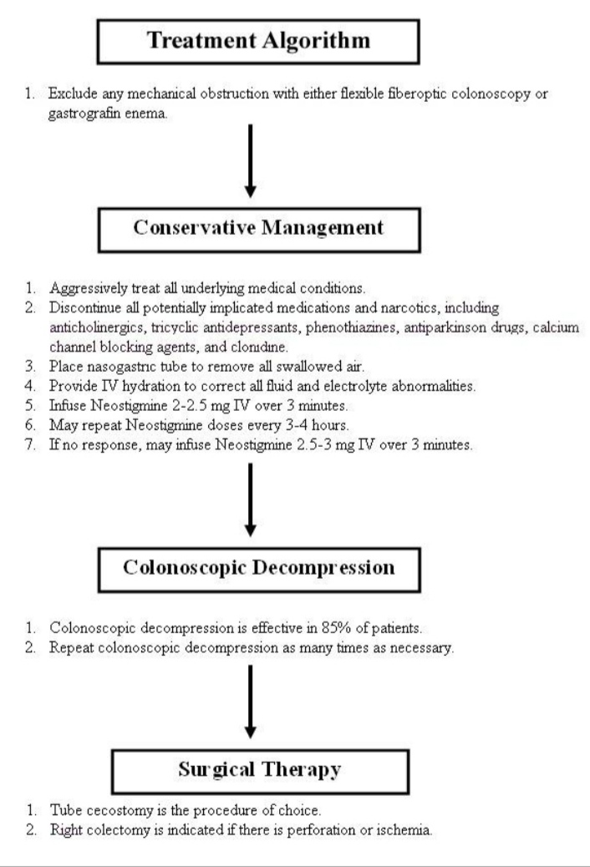

Slide 19
4. An 18 year old girl is brought to the casualty with worsening severe abdominal pain which started 6 hours ago. Her abdomen is tender particularly in the lower abdomen and there is guarding. She also has a history of Chlamydia. She has a tachycardia but her blood pressure is normal at 137/78. Which one of the following is the diagnosis you should confirm or rule out in this patient?
A. Acute appendicitis
B. Pelvic inflammatory disease
C. Acute intestinal obstruction
D. An ectopic pregnancy. (Answer)
E. Crohn's disease

Slide 20
Discussion
Acute appendicitis
Classic history of anorexia and periumbilical pain followed by nausea, RLQ pain and vomiting occurs in only 50% of cases.
Clinical presentation of appendicitis is notoriously inconsistent.
Features are:
Abdominal pain. Most common symptom. Typically starts as periumbilical or epigastric then migrates to the RLQ. Patients usually lie down, flex their hips and draw their knees up to reduce movements and to avoid worsening their pain.
Nausea in 61-92 % of patients
Anorexia, vomiting, diarrhea or constipation

Slide 21
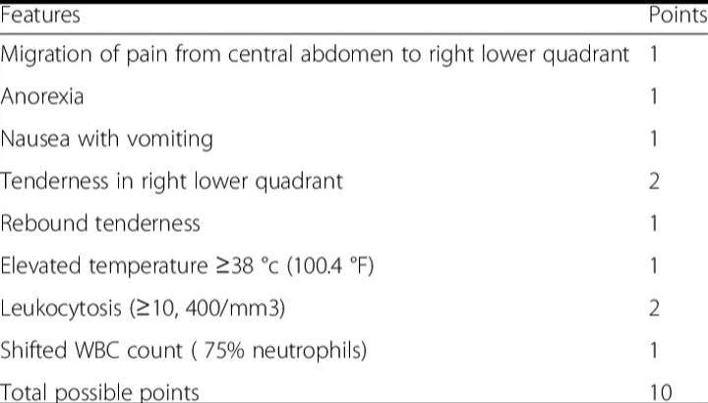
Alvorado scoring for acute appendicitis

Slide 22
Pelvic inflammatory disease
Infectious and inflammatory disorder of the upper female genital tract, including the uterus, fallopian tubes, and adjacent pelvic structures.
Classic high risk patient is a menstruating woman younger than 25 years, has multiple sex partners, does not use contraceptives, and lives in an area with high STD prevalence.
Chlamydia trachomatis is the predominant causative organism.
Differential diagnosis includes: appendicitis, cervicitis, urinary tract infection, endometriosis, ovarian torsion and adnexal tumors.
Ectopic pregnancy can be mistaken for PID, indeed PID is the most common incorrect diagnosis in cases of ectopic pregnancy. A pregnancy test is mandatory in the workup of women of childbearing age who have lower abdominal pain.

Slide 23
Complications include: chronic pelvic pain, infertility, ectopic pregnancy.
Clinical presentation
Lower abdominal pain. Dull, aching, or crampy, bilateral, and constant, begins a few days after the onset of the LMP and tends to be accentuated by motion, exercise, or coitus, usually lasts less than 7 days.
Abnormal vaginal discharge. Present in ~75% of cases.
Unanticipated vaginal bleeding. Often postcoital, is reported in about 40% of cases.
Temperature > 38 degrees Celsius. Found in 30% of cases.
Nausea and vomiting manifest late.
Abnormal Uterine Bleeding in 33% of patients.
Rebound lower abdominal tenderness and involuntary guarding may be noted and suggest associated peritonitis.

Slide 24
Acute intestinal obstruction: Symptoms include
Abdominal pain
Abdominal distention
Nausea, vomiting
Constipation/absence of flatus
Fever and tachycardia. Late findings, may be associated with strangulation.
Ectopic pregnancy
Classic triad of ectopic pregnancy is: pain, amenorrhea, and vaginal bleeding (occurs in only about 50% of patients)
Others: presence of peritoneal signs, cervical motion tenderness, unilateral or bilateral abdominal or pelvic tenderness, usually much worse on affected side.
Abdominal rigidity, involuntary guarding and severe tenderness as well as evidence of hypovolemic shock, such as orthostatic blood pressure changes and tachycardia should alert the clinician to a surgical emergency.

Slide 25
Crohns disease
Idiopathic, chronic inflammatory process that can affect any part of the gastrointestinal tract from the mouth to the anus.
Characteristic presentation is: abdominal pain which is crumpy, in the lower right quadrant or periumbilical, often relieved by defecation. May be diffuse and constant, prolonged nonbloody diarrhea with weight loss and possible malabsorption syndrome. If colon is involved, the diarrhea may contain blood, mucus and pus.
Other signs and symptoms are: rectal bleeding, fever, weight loss, anorexia, nausea and vomiting, malnutrition, vitamin deficiencies, generalized fatigability, bone loss, growth failure especially in children.
Extra intestinal manifestations include: skin tags, fistula, abscesses, ulcers, nephrolithiasis, hydronephrosis, enterovesical fistula, arthritis, arthralgia, sacroilitis, ankylosing spondylitis, psoriatic arthritis, reactive arthritis, aphthous ulcers, erythema nodosum, pyoderma gangrenosum, episcleritis, iritis, hypercoagulable state, primary sclerosing cholangitis.
END

