Slide 1
SURGERY MCQs
ANORECTAL MALFORMATIONS
CHOLECYSTITIS

Slide 2
ANORECTAL MALFORMATION
The following lesions are developmentally similar except:
A. Rectal urethral fistula
B. Imperforate anus
C. Recto vestibular fistula
D. Persistent cloaca
E. Rectal atresia

Slide 3
EMBRYOLOGY
From the 4th to 7th week, the Primitive cloaca is divided by the urorectal septum into:
Ventral cloaca (Urogenital sinus)- Gives rise to bladder, urethra & vestibule of the vagina.
Dorsal cloaca (Anorectal canal)- Gives rise to rectum and anal canal which fuses with the proctodeum to give rise to the anus

Slide 4
EMBRYOLOGY
Failure of the urorectal septum to form results in a fistula btn bowel and urinary tract / vagina.
Complete or partial failure of the anal membrane to resorb results in an anal agenesis or stenosis.
Develop during the first 2 months
Males are more affected.

Slide 6
RECTAL ATRESIA
Considered separate from imperforate anus or anal atresia because, in rectal atresia, the anus is present and normal, but a variable rectal segment is atretic.
An in utero ischemic accident explains the pathogenesis of this rectal malformation. (Local vascular abnormality)

Slide 7
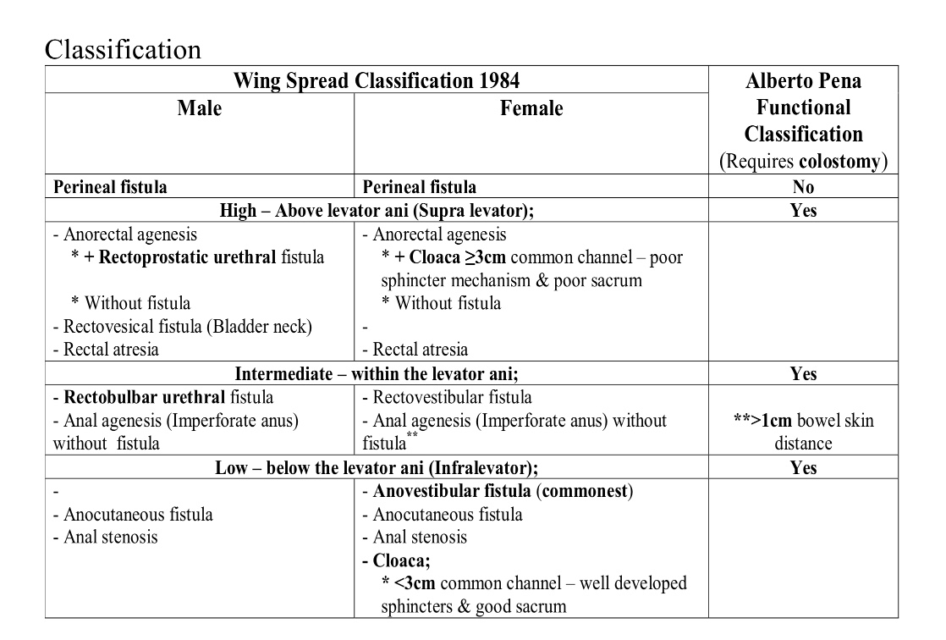

Slide 10
Anorectal anomaly with no fistula
Uncommon in females
Most have Down’s syndrome
Short distance between blind ending rectum and well formed anal pit.
Well formed sphincters

Slide 11
INVESTIGATIONS
Clinical examination
Laboratory tests- CBC, Blood typing and UECs for all children requiring operation.
Urinalysis to determine the presence of a rectourinary fistula in all cases where diagnosis can’t be made based solely on physical examination.

Slide 12
INVESTIGATIONS
Cross table lateral plain xray
Early perineal USG to confirm type of anomaly
Abdominal USG & Echo to rule out associated anomalies
CT &MRI to reveal integrity of sphincter muscles

Slide 14
ANORECTAL MALFORMATION
Which of the following lesions will require colostomy as an emergency life saving procedure?
A. Imperforate anus in males and females
B. Perineal fistula in both sexes
C. Recto vestibular fistula
D. Recto urethral fistula
E. Persistent cloaca

Slide 15
MANAGEMENT
The presence of meconium in the urine and a flat bottom are considered indications to create a protective colostomy.
High anomalies require more urgent colostomy.
In high fistula, later, a pull through operation through puborectalis and anastomosis of rectal pouch to create the anal canal is done.
Closure of colostomy is done later.

Slide 16
MANAGEMENT
Posterior sagittal anorectoplasty is also done
In low fistula, single stage reconstruction is done under G/A
Anoplasty
Anovestibuloplasty
Anal dilatation
Incision of anal membrane

Slide 17
CHOLECYSTITIS
Mrs. Joseph, a 47 year lady is complaining of epigastric and right hypochondrial pain. She has nausea and has been vomiting for the last 24 hours. She recalls that the symptoms started when she was eating a cheese cake. The pain did not respond to OTC antacids and prokinetic drugs which she tried. On examination she was an obese lady. Her liver enzymes are marginally elevated. Which one of the following is the most appropriate next investigation?

Slide 18
CHOLECYSTITIS
A. Erect abdominal x-ray
B. Endoscopy
C. Ultrasound scan of the abdomen
D. HI breath test for H. pylori
E. CT abdomen

Slide 19
CHOLECYSTITIS
Inflammation of the gall bladder most commonly due to an obstruction of the cystic duct by gallstones arising from the gall bladder (Cholelithiass)
Presents as in above question.
Physical examination reveals Fever, Tachycardia, Tenderness in the RUQ or epigastric region (Often with guarding/ rebound tenderness), Palpable gall bladder and jaundice.
Elderly and Diabetic patients may present with vague symptoms and without pain/ fever; and may complicate rapidly without warning.

Slide 20
RISK FACTORS
Fair
Fat
Fertile
Female
In her Forties
With Fetus
On oral contraceptives or oestrogen replacement

Slide 21
DIAGNOSIS
CBC- Leukocytosis with a left shift
ALT & AST may be elevated
Bilirubin and alkaline phosphatase assays may reveal evidence of CBD obstruction.
Amylase may be mildly elevated
Imaging- Radiography, Ultrasonography, CT, ERCP, MRI & Hepatobiliary scintigraphy.

Slide 22
INVESTIGATION
Ultrasound is the preferred initial modality
There is the presence of Cholelithiasis and the Murphy sign
Both gallbladder wall thickening (>3mm and pericholecystic fluid are secondary findings
Other less specific findings are gallbladder distension and sludge.

Slide 23
MANAGEMENT
Acute- Bowel rest, IV hydration, Correction of electrolyte abnormalities, Analgesia (e.g oxycodone/ acetaminophen) and IV antibiotics.
Emesis can be treated with antiemetics (promethazine or prochlorperazine) and nasogastric suction.
Piperacillin/ tazobactam, Ampicillin/ sulbactam or Meropenem. In life threatening cases, Imipenem/ Cilastatin
Levofloxacin and metronidazole for prophylactic coverage.

Slide 24
SURGICAL MANAGEMENT
Laparoscopic cholecystectomy
Percutaneous drainage
ERCP
Endoscopic ultrasound-guided transmural cholecystostomy
Endoscopic gallbladder drainage.

