Slide 1
SURGERY: MCQs REVISION

Slide 2
1. A 27 year old woman experiences perioral numbness in the morning after neck surgery. What is the most likely cause of her symptom?
A.Hypokalemia
B.Hypercalcemia
C.Hypocalcemia
D.Hypochloremia
E.Hyperkalemia
Answer C: Hypocalcemia. Perioral numbness is quite characteristic in hypocalcemia. There's also tingling, spasm, cramping etc. Patient could have undergone a thyroidectomy with inadvertent removal of the parathyroid glands, or a parathyroidectomy.

Slide 3
2. A 40 year old man undergoes a laparotomy for small bowel obstruction due to adhesions. During the release of the adhesions, an enterotomy is made in the obstructed but viable gut resulting in spillage of fecal material into the abdomen. This converts the wound into:
A. Clean contaminated
B. Secondary
C. Infected
D. Contaminated
E. Clean
Answer D: Contaminated. Include fresh open wounds that can result to sterile techniques or leakage from the GIT into the wound.

Slide 4
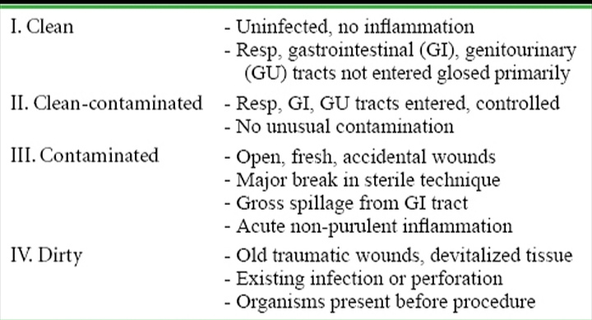
Classification of Surgical Wounds

Slide 5
3. Delayed primary wound closure would be most appropriate for the following procedure:
A. Removal of perforated appendix.
B. Repair of wound dehiscence one week after colectomy.
C. Emergency drainage of a diverticular abscess with sigmoid resection and end colostomy.
D. Partial gastrectomy for a bleeding duodenal ulcer.
E. Repair of incisional hernia 10 weeks after an elective left colectomy complicated by a wound infection and a resultant incisional hernia.
Answer E.

Slide 6
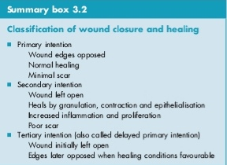
In healing by secondary intention, the edges of the wound cannot be brought together, and healing of the wound occurs from bottom of wound upwards.
Delayed primary intention is usually indicated for infected or detrimental wounds with high bacterial content, wounds with lengthy time lapse since injury, or wounds with severe crush component

Slide 7
