Slide 1
Surgery Essay Hesbon Kenneth
A 26 year old man is complaining of severe calf pain after sustaining gunshot injury to this right thigh. He is haemodynamically stable. There is a through and through injury ( entry and exit wounds) in the middle of the thigh. The ipsilateral calf is tense and the popliteal pulse is weak. Plain x-rays of the limb do not show any fracture. Discuss care of this patient under the following headings

Slide 2
Questions
Anatomy of muscle compartment of leg below the (knee)
Hard and soft signs of vascular injury
Clinical features of compartment syndrome
Further management of this patient

Slide 3
Anatomy of muscle compartment of the leg( below knee)

Slide 5
Notes:
Remember venous comminttate

Slide 6
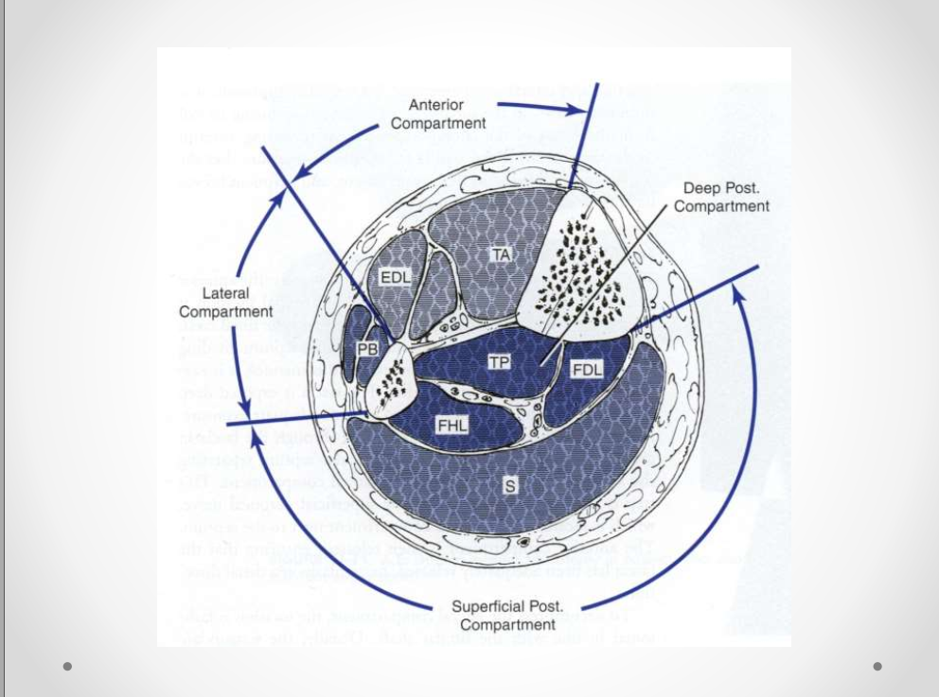

Slide 7
Vascular injury Mechanism of disruption of flow at arterial level
Causes • Road Traffic accidents • Fractures and dislocations • Trap gun • Cuts and stabs • Home accidents • Iatrogenic • Mechanism of injury – Sharp / penetrating – Blunt

Slide 8
Soft and Hard signs of vascular injury
Hard signs of vascular injury- this are signs that call for immediate intervention most of the time signifies 100% chance of vascular injury
Soft signs- signifies probability of vascular injury 10-25% hence prompt investigation

Slide 9
Hard signs
Active or pulsatile hemorrhage  Pulsatile or expanding hematoma  Signs of limb ischemia and elevated compartment pressure including the 5 "P's“:  Pallor  paresthesia  pulse deficit  paralysis  pain  Diminished or absent pulses  Bruit or thrill is( present in 45% of patients with an arteriovenous fistula)

Slide 10
Soft signs
Hypotension or shock  Neurologic deficit due to primary nerve injury occurs immediately after injury. In contrast, ischemic neuropathy is delayed in onset (minutes to hours).  Stable, non pulsatile or small hematoma  Proximity of the wound to major vascular structures ( Beware of bone fracture)

Slide 11
Immediate referral
• Hard signs – Immediate (vascular) surgery referral – Early transfer to theatre – Angiography – Immediate exploration

Slide 12
Soft signs, other injuries
• Resusitate • Apply compression • Immobilise • Reduce • Reassess – asymmetry • Consult

Slide 13
Problems with diagnosing ischaemia after trauma • Pain – Due to injury itself • Pallor – Pallor due to blood loss, Compare with contralateral limb • Absent pulse – Absent due to low blood pressure. Compare with contralateral limb • Paresthesia , paresis – Due to associated nerve, muscle injury or unresponsive

Slide 15
Clinical features of compartment syndrome
What is it?
Increase in hydrostatic pressure in closed osteofascial space resulting in decreased perfusion of muscle and nerves within compartment.
RAISED PRESSURE WITHIN A CLOSED SPACE with a potential to cause irreversible damage to the contents of the closed space.
def- Symptoms resulting from increased pressure within a limited space
compromising • circulation • function

Slide 16
Compartments are groups of muscles surrounded by inelastic fascia. • Increased pressure within a muscle compartment causes decreased blood supply to affected muscles.
• Any swelling of muscles leaves no room for expansion and blood supply is progressively shut off.
• If affected muscles are deprived of blood supply for > 6 hours, nerve and muscle tissue can be permanently damaged

Slide 17
Types of Compartment syndrome:
I. Acute compartment syndrome(ACS)  medical emergency  caused by a severe injury  can lead to permanent muscle damage. II.Chronic compartment syndrome(CCS)  known as exertional compartment syndrome  not a medical emergency  most often caused by athletic exertion.

Slide 20
Pathophysiology:
• CAUSES: • Increased Volume - internal : hemmorhage, fractures, swelling from traumatized tissue, increased fluid secondary to burns, post-ischemic swelling • Decreased volume - external: tight casts, dressings • Most common cause of hemmorhage into a compartment: fractures of the tibia, elbow, forearm or femur

Slide 22
Pathophysiology
• Autoregulatory mechanisms may compensate: – Decrease in peripheral vascular resistance – Increased extraction of oxygen • As system becomes overwhelmed: – Critical closing pressure is reached – Oxygen perfusion of muscles and nerves decreases

Slide 23
Muscle Ischemia
• 4 hours - reversible damage • 8 hours - irreversible changes • 4-8 hours – variable
• Myoglobinuria after 4 hours
– Renal failure
– Maintain a high urinary output
– Alkalinize the urine
• Cell death initiates a “vicious cycle”
– increase capillary permeability
– increased muscle swelling

Slide 24
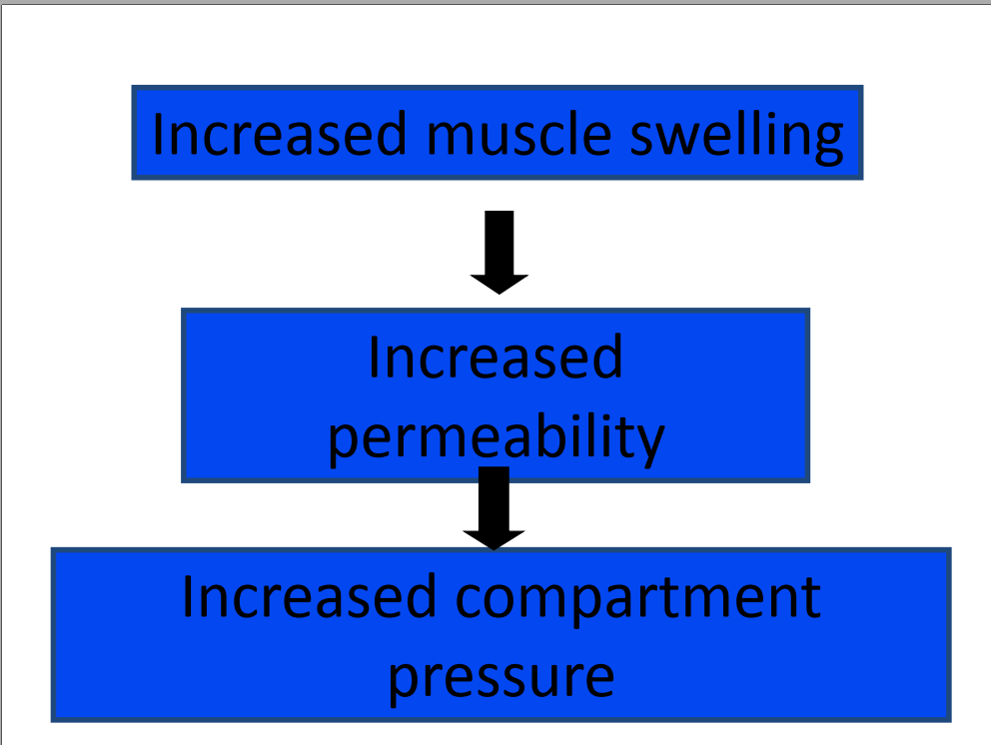

Slide 25
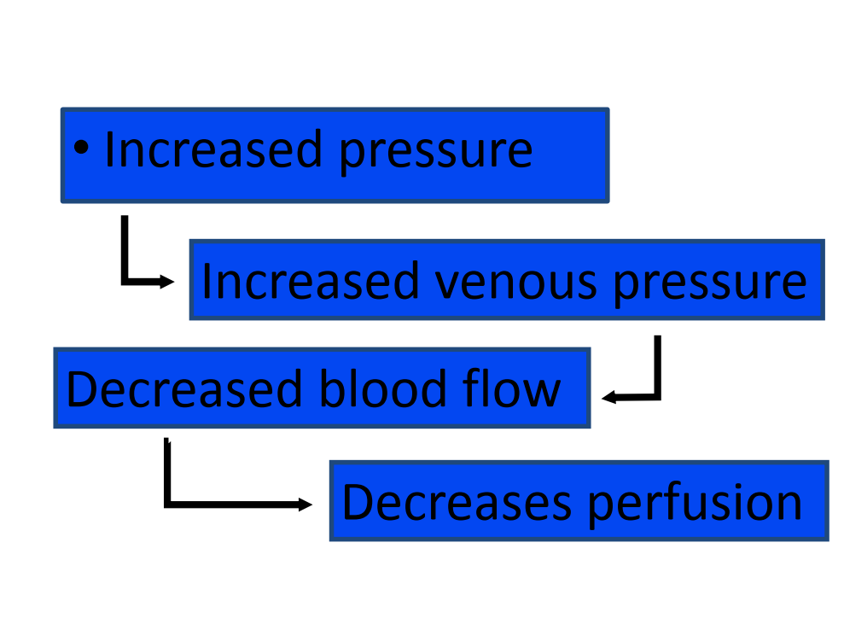

Slide 26
Nerve Ischemia
• 1 hour - normal conduction • 1- 4 hours - neuropraxic damage reversible • 8 hours - axonotmesis and irreversible change

Slide 27
Etiology
• Fractures- Tibial diphesyal # Forearm # Distal radius # • Soft Tissue Injury (Crush) • Arterial Injury –Post-ischemic swelling –Reperfusion injury
Secondary to revascularization: • Ischemia causes damage to cellular basement membrane that results in edema • With reestablishment of flow, fluid leaks into the compartment increasing thepressure. • Drug Overdose (limb compression) • Burns
Notes:
The presence of an open fracture does NOT rule out the presence of a compartment syndrome • 6-9% of open tibial fractures are associated with compartment syndromes • McQueen et al found no significant differences in compartment pressures between open and closed tibial fractures • No significant difference in pressures between tibial fractures treated with IM Nails and those treated with Ex-Fix

Slide 28
Diagnosis
• Clinical diagnosis – High index of suspicion • Syndrome – History – Physical Exam

Slide 29
Difficult Diagnosis
• Classic signs of the 5 P’s - ARE NOT RELIABLE: – pain – pallor – paralysis – pulselessness – paresthesias • These are signs of an ESTABLISHED compartment syndrome where ischemic injury has already taken place • These signs may be present in the absence of compartment syndrome.

Slide 30
Clinical Presentation: • Swelling/ Tightness of compartment • Inappropiate and uncontrolled pain • Severe pain at rest or passive stretching • Pallor/Cyanosis • Hyperesthesia/Paresthesia • Paralysis : full recovery is rare

Slide 31
Signs and symptoms
• Pain –Passive muscle stretching –Out of proportion –Progressive –Not relieved by immobilization
Palpable pulses are usually present in acute compartment syndromes unless an arterial injury occurs. • Sensory changes and paralysis do not occur until ischemia has been present for about 1 hour or more
The most important symptom of an impending compartment syndrome is PAIN DISPROPORTIONATE TO THAT EXPECTED FOR THE INJURY

Slide 32
• Pain • Compartment pressure – Confirmatory test – Don’t just measure

Slide 33
Signs and symptoms
• Pain –May be worse with elevation –Patient will not initiate motion on own • Be careful with coexisting nerve injury
Parasthesia –Secondary to nerve ischemia • Must be differentiated from nerve injury
Paralysis (Weakness) – Ischemic muscles lose function -Tense compartment on palpation -Elevated compartment pressure

Slide 34
Measuring the pressure
• Indications : High risk injuries in • polytrauma patients • patient not alert/unreliable • inconclusive physical exam findings • Technique : performed each compartments at close to the fracture site as possible (highest pressure) or maximal swelling area.

Slide 36
Tissue Pressure • Normal tissue pressure – 0-4 mm Hg – 8-10 with exertion • Absolute pressure theory – 30 mm Hg - Mubarak – 45 mm Hg - Matsen • Pressure gradient theory – < 20 mm Hg of diastolic pressure – Whitesides – < 30 mm Hg of diastolic pressure McQueen, et al

Slide 37
Whiteside’s Theory: The development of a compartment syndrome also depends on • MPP = DBP(Diastolic BP) – CP(Intracompartment P) • Muscle perfusion pressure(MPP) < 30 mmHg Tissue hypoxia hence an indication of fasciotomy

Slide 38
Management
I Non-operative
Observation
ΔPressure >30 mmHg, no clinical presentation of compartment syndrome
II Operative
Emergency fasciotomy
Positive clinical presentation
CP = 30-45 mm Hg
Δ Pressure <30 mmHg

Slide 39
Remove restricting cast: -comaprtment pressure falls by 30% is split on one side. -Falls by 65% when the cast spread after splitting -Splitting the padding reduces it by further 10 % and complete removal of cast by another 15% • Serial exams • When diagnosis made – Immediate surgery 4 compartment fasciotomy

Slide 41
Fasciotomy principles
Make and early diaganosis
Make long extensile incisions
Release all fascial compartments
Preserve neurovascular structures
Debride necrotic tissues
Provide coverage within 7-10 days

Slide 42
Treatment • Fasciotomy –One incision • With or without Fibulectomy –Two (double) incisions • All 4 compartments must be released –Not selective

Slide 48
Post fasciotomy care
Must get bone stability –IMN –exfix • ~48hrs after procedure patient should be brought back to OR for further debridement • Delayed skin closure or skin-grafting 3- 7 days after the fasciotomies
Aftercare • VAC dressings • Elevation of limb • Delayed wound closure – Split thickness skin graft

Slide 49
Complcations
Remember… • Fasciotomies are not benign • Complications are real >25% – Chronic swelling – Chronic pain – Muscle weakness – Iatrogenic NV injury – Cosmetic concerns *** BUT if they are needed do not come up with excuses to not do them !!!

Slide 50
Complications: I. Myonecrosis : after an ischemic insult of > 4 hrs. Treatment: fasciotomy + debridement of the muscles + neurolysis • May lead to myoglobinuria and eventually renal failure. • Diuresis ( by mannitol,diuretics or IV fluids ) should be prompted to increase the tubular flushing and eliminate the proteinaceous material.

Slide 51
II. Reperfusion syndrome : influx of myoglobin, potassium, and phosphorus into the circulation → characterized by hypovolemic shock and hyperkalemia • Evaluation : • Fluid loss, Shock • Acidosis • Hyperkalemia • Myoglobinuria, Renal failure • Management : • Preoperative hydration • Mannitol • Bicarbonate

Slide 52
III. Neurovascular injury IV. Infection V. Amputation VI. Death

Slide 53
-Death • Limb loss • Compartment syndrome • Reperfusion effects • Volkmann ischemic contracture • Intimal flaps and narrowing • False aneurysms • Traumatic AVF

Slide 54
asante

