Slide 1
Surgery MCQs series

Slide 2
Choose the most appropriate choice for each stem
Familial adenomatous polyposis syndrome
BRCA mutation
Down’s syndrome
MEN IIA
Long term immunosuppressive treatment after kidney surgery.
100% life time risk of colon CA A
Increased risk of peri ampullary tumours A
Increased risk of bilateral breast CA B
Increased risk of phaeochromocytoma D
Increased risk of Karposi’s sarcoma E

Slide 3
Familial adenomatous polyposis syndrome
It is inherited as an autosomal dominant neoplastic condition (chromosome no. 5).
The APC gene is a tumor suppressor gene that is located on band 5q21. ^{[5]} Its function is not completely understood
Normal APC protein promotes apoptosis in colonic cells.
If left untreated, all patients with this syndrome will develop colon cancer by age 35-40 years. In addition, an increased risk exists for the development of other malignancies.

Slide 4
It is familial with a high potential for malignant transformation. If there is no adenoma at the age of 30 years, then it is not FAP of colon. • It can be associated with duodenal or ampullary carcinomas , Gardner’s syndrome (Desmoid tumour in the abdomen, osteomas (75%) and epidermoid cysts) and also Turcot“s syndrome (FAP + brain tumour(medulloblastoma or gliomas) or sarcoma of bone. • Usually multiple (over 100).

Slide 5
Genetic Predisposition
a)Hereditary nonpolyposis colorectal cancer (HNPCC) (Lynch syndrome)-Autosomal dominant inherited syndrome that occurs because of defective mismatch repair genes on chromosomes 2, 3 and 7.
b)Familial adenomatous polyposis coli (FAP)- Autosomal dominant inherited syndrome. Defect in the APC gene resulting in development of adenomatous
intestinal polyps
-Attenuated FAP, Gardener’s syndrome & Turcot’s syndrome
c)Peutz jeghers syndrome
d)MYH associated polyposis (MAP)

Slide 6
RISK FACTORS OF COLORECTAL CANCER
SOCIODEMOGRAPHIC FACTORS
Older age (<50)
Male sex
African Americans & Jewish persons
DIET
Red meat
Fatty diet since cholesterol increases bile acid concentration which acts as a co-carcinogen
Low fiber diet-fiber causes formation of soft bulky stool that dilutes out carcinogens and decreases colonic transit time, allowing less time for harmful substances to contact the mucosa.
LIFESTYLE FACTORS
Alcohol
Cigarette smoking
Obesity and / or Physical inactivity

Slide 7
BRCA mutation
BReast CAncer gene
They are tumuor suppressor gene
BRCA1 mutation is having more risk (35-45%) than BRCA2 mutation. It is located in long arm of chromosome 17, whereas BRCA2 is located in long arm of chromosome 13

Slide 8
Risk factors for breast carcinoma • Breast carcinoma in 1st degree relative • Breast carcinoma in contralateral breast • BRCA1/BRCA2 gene mutation • Obesity and alcohol intake • Gynaecomastia in male breast • Nulliparity • Early menarche and late menopause
Incidences in carcinoma breast • 30% of all female cancers • 20% of cancer related deaths in females • 2-4% bilateral • 2-5% hereditary • Lump in the breast-commonest presentation (75%) • 10% presents with pain • 35-45% with mutation of BRCA1 gene • 70% blood spread occurs to bones

Slide 9
Down’s syndrome
also known as trisomy 21, is a genetic disordercaused by the presence of all or part of a third copy of chromosome 21
Trisomy 21 (95 percent) • an extra 21 chromosome. Instead of the normal number of 46 chromosomes in each cell, the individual with Down syndrome has 47 chromosomes. 2. Translocation (3 - 4 percent) • extra 21 chromosome is attached or translocated on to another chromosome, usually on chromosome 14, 21 or 22. 3. Mosaicism (1 percent) • some cells have 47 chromosomes and others have 46 chromosomes. Mosaicism is thought to be the result of an error in cell division soon after conception.

Slide 10
Advanced maternal age – Risk of Down
syndrome
Maternal Age Risk of Down Syndrome
15 – 29 yrs 1 : 1500
30 – 34 yrs 1 : 800
35 – 39 yrs 1 : 270
40 – 45 yrs 1 : 100
45 and above 1 : 50

Slide 11
MENS SYNDROME
MULTIPLE ENDOCRINE NEOPLASIA SYNDROME- most of the time it affects the parathyroid, pituitary hyperplasia, islet cells of pancreas, adrenals , thyroids and GI condition

Slide 12
MENS SYNDROME

Slide 14
Complication Long term immunosuppressive after kidney transplant
CVD- most common cause of death in renal transplant patient CAD,IHD
• Hypertension
• Dyslipidemia
• Diabetes
• Renal failure
• Infection- viral, bacterial, parasitic ( require vaccination for potential causative organism)
• Anemia
• Osteoporosis
• Malignancy-( SKIN CANCER MOST COMMON MALIGNANCY) Karposi sarcoma, malignant melanoma, squamous cell carcinoma, renal carcinoma, LYMPHOMA, POST TRANSPLANT LYMPHOPROLIFERATIVE DISORDERS
• Gout

Slide 15
CHOOSE THE MOST APPROPRIATE CHOICE FOR EACH STEM
LEFT HEMICOLECTOMY
ANTERIOR RESECTION
DIVERTING ILEOSTOMY
ABDOMINAL PELVIC RESECTION
RIGHT HEMICOLECTOMY
78. RECTAL CANCER 3cm from the anal verge D
79. Colon cancer at the rectosigmoid junction A
80. Descending colon perforation at colonoscopy C
81. Consent for permanent colostomy D
82. Hepatic flexure tumour E

Slide 16
colectomy
• A colectomy is a surgical procedure in which all or part of the large intestine is resected.
Types of colectomies • Right hemi colectomy • Left hemi colectomy • Transverse colectomy • Anterior resection • Abdominoperineal resection • Subtotal colectomy • Sigmoid colectomy • Proctectomy

Slide 17
Anatomy

Slide 20
Right hemicolectomy
Ascending colon, appendix and part of transverse colon • Superior mesenteric artery • Ileocolic anastomosis
Right radical hemicolectomy with ileo transverse anastomosis is done. Structures removed are terminal 30 cm of ileum, caecum and appendix, ascending colon, 1/3 of transverse colon, lymphnodes (epicolic, paracolic, intermediate)
In inoperable right sided growth, ileo-transverse anastomosis is done as a by-pass procedure.

Slide 21
Left hemicolectomy
Transverse colon and descending colon
• Inferior mesenteric artery
• Primary anastomosis
Left radical hemicolectomy is done, where in left ½ of transverse colon and descending colon is removed along with lymph nodes
Left sided stenosing type of growth can present with acute intestinal obstruction, in which case initially colostomy is done. Later, after 3-6 weeks, following proper preparation, required formal procedure is done, followed by colostomy closure after 8 weeks

Slide 22
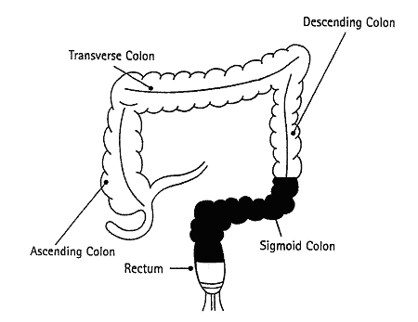
Anterior resection
sigmoid colectomy
• Sigmoid colon and part of rectum
• Primary anastomosis or
stoma formations
(Abdominal radical restorative operation) is done in growths located in the mid and upper part of the rectum, which is well-differentiated,small sized and with a clear adequate length for anastomosis after resection.

Slide 23
Criteria for anterior resection- (Low anterior resection) (LAR) • Upper and middle third rectal growth • Above peritoneal reflection • Well-differentiated tumour • < 4 cm size tumour • In females, growth 7 cm above the anal verge • T1 N0/T2 N0 tumour • Tumour without lymphatic or venous spread
Advantages: • Avoids permanent colostomy. • Sphincter is retained. • Patient’s acceptance. It is done through laparotomy. Recto-sigmoid region is resected with the tumour with adequate clearance and colo-anal anastomosis is done either by hand suturing or by staplers

Slide 24
Abdomino-perineal resection (APR)
Low rectal tumours
• Associated total mesorectal excision (TME)
• Anus closed and rectum removed
• Colostomy formation
Is the gold standard. But if tumour is well differentiated and if there is adequate margin above the anal canal, a sphincter saving anterior resection (AR) can be done
where in sigmoid, descending colon and upper rectum is mobilised per abdominally. Anal canal with perianal and perirectal tissues are dissected per anally. Retained colon is brought out as end colostomy in left iliac fossa.

Slide 25
Complications of APR are – – Bleeding. – Infection of perineal wound. – Complications of colostomy like prolapse, stenosis, and infection. – Injury to urinary system, ureter, impotence, urinary incontinence. – Operative mortality is less than 2%. APR is the treatment of choice when mesorectum is involved or when it is poorly differentiated tumour or when nodes are involved. It gives adequate clearance.

Slide 26
Hartmann’s Procedure proctosigmoidectomy
Emergency procedure
▫ Rests the bowel
▫ If anastomosis will be poor
• Sigmoid colectomy
• Oversewn rectum to form a stump
• End colectomy
• Reversible

Slide 27
is an excellent palliative procedure -done in elderly people who are not fit for major surgery like AP resection and also in locally advanced tumours. Here rectal growth is resected and upper end of the rectum is closed completely. Proximal colon is brought out as end colostomy.

Slide 28
Diverting ileostomy
Small bowel • Right sided • Spouted • Temporary – usually a loop • Permanent – usually an end ileostomy
Diverting loop ileostomy is protective to allow rectal anastomosis to heal then later reversed
-protect multiple or complicated anastomoses, the
-protection of ileorectal anastomoses in patients with inflammatory disease, and the necessity of diverting the flow of intestinal contents in patients with -fulminant inflammatory bowel disease.

Slide 29
Principles of stoma siting
• Away from bony prominence
• Away from umbilicus
• Away from previous incision site
• Away from belt line
• At the apex of fat fold
• Within rectus muscle bulk
• Visible to patient when he stands/sits
• If two separate stomas are created, avoid the
same horizontal plane

Slide 31
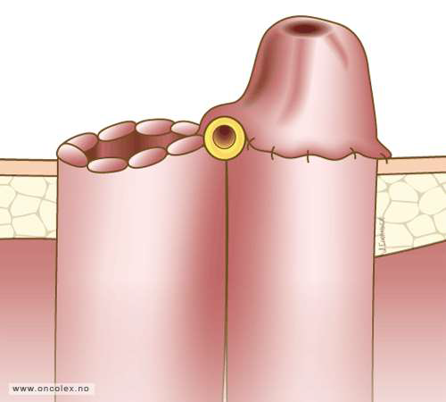
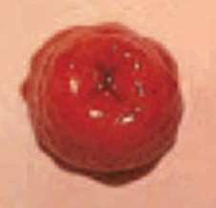
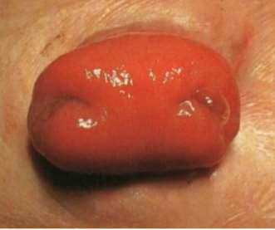
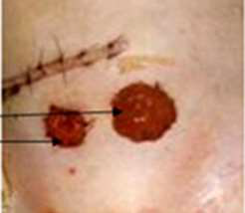

Slide 32
Pelvic evisceration (Brunschwig’s operation): It is removal of rectum with the tumour, all the lymph nodes, urinary bladder, fat, fascia, uterus, vagina, with colostomy and urinary diversion. It is neither favourable nor popular

Slide 33
Complications of surgery
• Anastomotic leak
•Infection/abscess/collection
• Bleeding
• Paralytic Ileus
• Adhesions / stricture formation
• Fistulas
Complications of stomas
• Bleeding
• Prolapse or retraction
• Stenosis
• Skin excoriation
• Parastomal hernias
• Fistulation

Slide 34
In case of right-sided colonic obstruction, right hemicolectomy with ileocolic anastomosis is done. – In case of left-sided colonic obstruction, left hemicolectomy (resection) and colo-colic anastomosis is done with a defunctioning colostomy (right-sided transverse) which is closed after 6 weeks. – Obstruction due to rectosigmoid growth with patient being severely ill—Hartmann’s operation can be done to save the life of the patient wherein distal stump after removal of the growth is closed, proximal colon is brought out as end colostomy.

