Slide 1
Surgery MCQs

Slide 2
USE THE FOLLOWING CHOICES TO ANSWER QUESTIONS 83-87, CHOOSE THE MOST APPROPRIATE CHOICE FOR EACH STEM.
A. Distended small bowel identifiable by the valvulae conniventes
B. Coffee Bean sign
C. Modest amount of gas in the pelvis
D. Peripheral, rather than central, distribution of gas
E. Prominent haustral markings
83. Intussusception – D
84. Sigmoid volvulus - B
85. Small bowel obstruction - A
86. “Closed – loop” obstruction of the colon – E
87. Obstructing rectal cancer - C

Slide 3
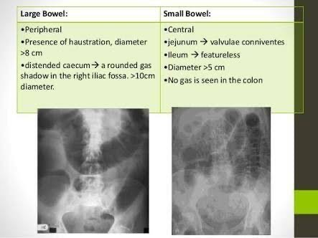

Slide 4
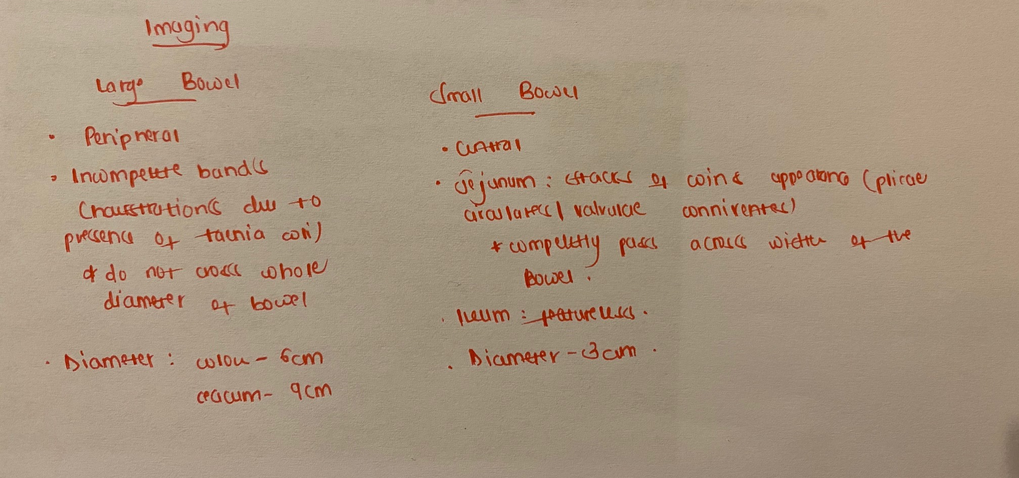

Slide 5
88. Rectal juvenile polyps:
Almost invariably undergo malignant changes
Occasionally persist into adult life
Are pre-malignant
Are not associated with pain
Are not associated with rectal bleeding

Slide 6
Juvenile polyposis syndrome
JPS is a hereditary condition that is characterized by the presence of hamartomatous polyps in the digestive tract.
Hamartomas are non-cancerous (benign) masses of normal tissue that build up in the intestines or other places. These masses are called polyps if they develop inside a body structure, such as the intestines.
The term ‘juvenile polyposis’ refers to the type of polyp (juvenile polyp) that is found after examination of the polyp under the microscope, not the age at which people are diagnosed with JPS.
Polyps may frequently develop in a person with JPS by the age of 20 yrs. The number of polyps a person has during his/her lifetime can range from around 5 to more than 100.

Slide 7
Most juvenile polyps are noncancerous, but there is increased risk of cancer of the digestive tract, such as stomach, small intestine, colon, and rectal cancers in families with JPS.
JPS is suspected when a person’s symptoms and family history fit any of the following categories:
More than 5 juvenile polyps of the colon and/or rectum
Multiple juvenile polyps throughout the digestive tract
Any number of juvenile polyps and a family history of juvenile polyps

Slide 8
JPS is a genetic condition; 2 genes linked to it, BMPR1A and SMAD4
Patients present with signs of rectal bleeding, anemia, abdominal pain, constipation, diarrhea, or other changes in the stool.
A colonoscopy, and upper endoscopy, should be done at any age 15 or earlier if there are symptoms. If the rest results are normal, they should be repeated every 1-3 years, depending on the number of polyps.
Individuals who develop large number of polyps that can not be removed during endoscopy may need to have surgery to remove part of the stomach or colon.

Slide 9
89. Which statement with regard to breast cancer is true?
A. The commonest site of metastasis is the contralateral breast
B. Local spread to the chest wall occurs earlier in female patients than male patients
C. Klinefelter’s syndrome is a predisposing factor
D. Inflammatory breast cancer is classified as locally advanced disease
E. There is no role for neo-adjuvant chemotherapy

Slide 10
The commonest site of metastases in breast cancer include: lymphnode, bones, lungs, liver brain and peritoneal cavity (pelvis and abdomen)
Inflammatory breast disease is a rare but aggressive type of locally advanced breast disease. It is often a type of invasive ductal carcinoma, but it differs from other types of breast cancer in its symptoms, outlook and treatment.

Slide 11
Symptoms include: Breast swelling, purple or red color of the skin, and dimpling or thickening of the skin of the breast so that it may look and feel like and orange peel.

Slide 12
90. Preservation of normothermia in surgical patients is important. All of the following are negative outcomes associated with perioperative hypothermia except?
A. Coagulopathy
B. Wound infection
C. Nosocomial pneumonia
D. Myocardial ischemia
E. Delayed wound healing

Slide 13
Perioperative hypothermia
Is defined as a core body temperature of < 36 degrees Celsius. It is a common consequence of anesthesia, which increases morbidity and mortality.

Slide 15
91. Which of the following is NOT a complication of urethral stricture?
A. Retention of urine
B. Urethral diverticulum
C. Peyronie’s disease
D. Peri urethral abscess
E. Urethral fistula

Slide 16
Complications of urethral strictures
Retention of urine
Urethral diverticulum
Periurethral abscess
Urethral fistula
Hydroureteronephrosis
Trabeculations, diverticula
Prostatitis
Calculus
Hernia, hemarrhoids, rectal prolapse

