Slide 1
Food Safety
and
Sanitation

Slide 2
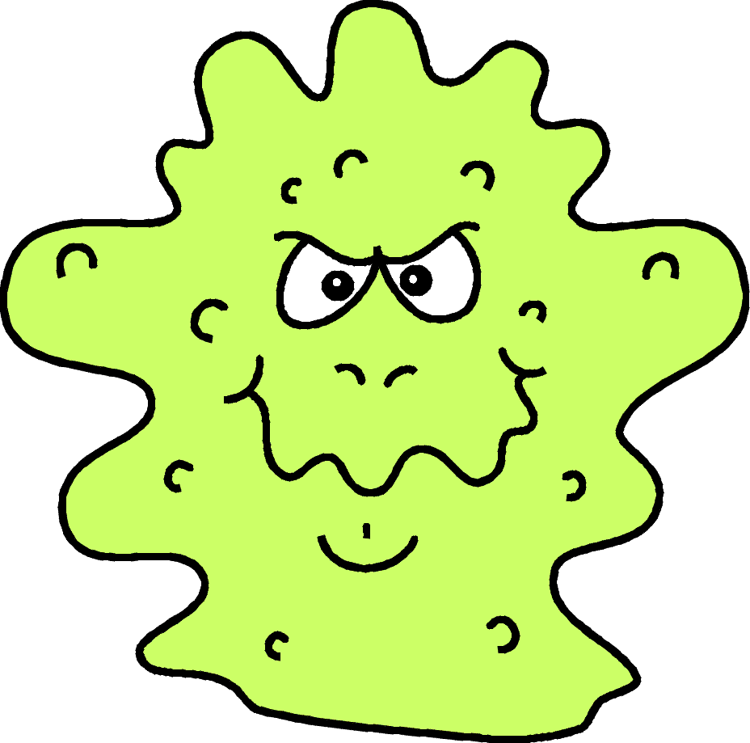
Initial questions:
Why is Food Safety and Sanitation in Child Care Settings Important?
Infants and preschool aged children are
a high-risk population for contracting
food borne illness
Their bodies have not built up adequate
immune systems to fight illness
Notes:
To start this section about food safety and sanitation, it is important to understand why food safety is so important in the child care setting.
Infants and preschool aged children are classified as a high risk population for contracting food borne illness. Their bodies have not built up adequate immune systems to fight off bacteria or infection that may enter their bodies.
As child care providers, infants and preschool aged children are in your primary care. It is your responsibility to ensure their safety, which includes serving food that is safe at meals and snacks.

Slide 3
Initial questions:
What is Food borne Illness?
Commonly known as food poisoning,
it is caused by eating food that is
contaminated by bacteria or other
harmful substances
Notes:
We are going to start this section on food safety and sanitation by addressing a few questions to get us set up for discussing the topic.
First, what is food borne illness?
Food borne illness is commonly known as food poisoning. It is caused by eating food that is contaminated by bacteria or other harmful substances.

Slide 4

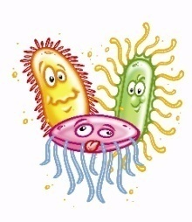
Initial questions:
What contaminates food?
Chemical hazards –cleaning supplies
Physical hazards – foreign objects, i.e. dirt, hair, glass
Biological hazards – bacteria & viruses (microorganisms)
  *Greatest threat to food safety, responsible for
  majority of food borne illness outbreaks
Notes:
What are harmful substances? What contaminates food?
There are three types of food safety hazards: Chemical, Physical and Biological.
Chemical hazards include cleaning supplies – this is why the DPI checks for cleaning supply storage and proximity to food storage when we conduct a review.
Physical hazards are foreign objects, think like dirt, hair and glass. This is why it is important for the food preparer to wear a hair net or tie their hair back when preparing meals.
Last, biological hazards are bacteria, viruses and parasites – microorganisms. These are the greatest threat to food safety, and are responsible for the majority of food borne illness outbreaks.

Slide 5

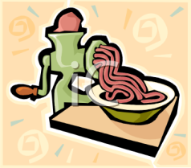
Initial questions:
How does food become contaminated?
Cross-contamination is the contamination of
a food product from another source:
People Equipment
Food
Notes:
Now that we know what contaminates food, how does food become contaminated?
Food becomes contaminated by the cross-contamination from another source. These sources are people, other food, and equipment.

Slide 6
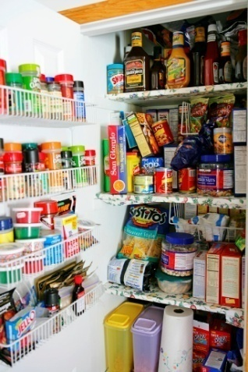

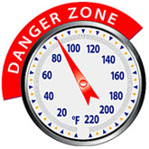
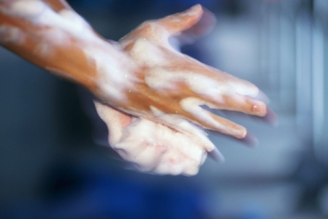
How does food become contaminated?
Bacteria also need to grow before they become a
foodborne threat
Proper food handling practices are important to reduce the likelihood that bacteria will be allowed to grow and contaminate food:
TEMPERATURE
TIME
HYGIENE
FOOD STORAGE
SANITATION
Notes:
Bacteria also need to grow before they become a food borne illness threat.
Proper food handling practices are important to reduce the likelihood that bacteria will be allowed to grow and contaminate food. Factors including how food is stored, cooking practices including the temperature to which a food is cooked, as well as how long a food is cooked for, will affect bacteria growth. Personal hygiene and sanitation practices also impact food being contaminated with bacteria.
All of these things will be discussed in further detail.

Slide 7

Initial questions:
How can I prevent cross-contamination of food and foodborne illness?
Notes:
So the question you should all be asking yourselves is, “How can I prevent cross-contamination of food and food borne illness?”

Slide 8
Preventative Measures
Good Personal Hygiene
No Bare Hand Contact With Food
Purchase Safe Food
Store Food Properly
Prepare and Cook Food Adequately
Clean and Sanitize
Notes:
The following six points address how to prevent cross-contamination and food borne illness. They will be discussed in further detail in the following slides.

Slide 9

Good Personal Hygiene
The most important tool you have to prevent
food borne illness is good personal hygiene
Bacteria like Staphylococci are found on the hair, skin,
mouth, nose and in the throat of healthy people.
According to one estimate, nearly 50 percent of healthy food handlers carry disease agents that can be transmitted by food.
Food preparers, food servers
(anyone involved with food service to children)
Do not allow people with infected cuts/sores, colds,
or other communicable diseases to prepare or serve food
Notes:
Good Personal Hygiene is the most important tool you have to prevent food borne illness.
Many of the bacteria that can lead to food borne illness from food is found on our bodies…on our hair, skin, mouth, nose and throat. Even of healthy people. And, according to one estimate, nearly 50 percent of healthy food handlers carry disease agents that can be transmitted by food.
Therefore, personal hygiene is especially important for food preparers and food servers – anyone involved with food service to children. And, people with infected cuts, sores or colds should not be allowed to prepare or serve food.
When Staphylococcus bacteria get into warm food and multiply, they produce a toxin or poison that causes illness. The toxin is not detectable by taste or smell. While the bacteria itself can be killed by temperatures of 120 F, its toxin is heat resistant; therefore, it is important to keep the staph organism from growing. Keep food clean to prevent its contamination, keep it either hot (above 140 F) or cold (below 40 F) during serving time, and as quickly as possible refrigerate or freeze leftovers and foods to be served later.
Symptoms include abdominal cramps, vomiting, severe diarrhea and exhaustion. These usually appear within one to eight hours after eating staph-infected food and last one or two days. The illness seldom is fatal.
Foods commonly involved in staphylococcal intoxication include protein foods such as ham, processed meats, tuna, chicken, sandwich fillings, cream fillings, potato and meat salads, custards, milk products and creamed potatoes. Foods that are handled frequently during preparation are prime targets for staphylococci contamination.

Slide 10
Good Personal Hygiene
Hand Washing
  The single most important means of preventing the spread of infection and illness, and cross-contamination
Proper Hand Washing Procedure:
Wet your hands with running water as hot as you can comfortably stand
Apply Soap
Vigorously scrub hands and arms for ten to fifteen seconds
Rinse thoroughly under running water
Dry hands and arms with a single-use paper towel or warm-air hand dryer
Notes:
Hand washing is the single most important means of preventing the spread of infection and illness, and cross-contamination.
Listed here is the proper hand washing procedure that should be followed.

Slide 11
Good Personal Hygiene
Hands should be washed:
Before preparing food
After using the toilet
After sneezing, coughing or blowing your nose,
After touching foods or other items that may be contaminated with bacteria or other harmful substances

Slide 12
No Bare Hand Contact with Food
Food Preparers
  SINGLE-USE gloves shall be used when working with
    Ready-to-eat food items (bread, fruits/vegetables, deli meats and cheeses, tuna fish)
    Raw animal food (chicken, pork, beef)
SINGLE-USE Gloves – one pair of gloves may not be used for multiple tasks. When interruptions occur in the operation (ex. food preparer needs to get something from refrigerator/storage room) gloves need to be replaced because they become contaminated with touching door handles, packaging, etc.
Notes:
Not directly touching food with bare hands is also important for preventing cross-contamination and food borne illness.
For food preparers, single use gloves shall be used when working with ready-to-eat foods items and raw animal foods.
Single Use gloves mean one pair of gloves cannot be used for multiple tasks. An example of this would be when the food preparer is assembling sandwiches and needs to get something out of the refrigerator. The food preparer touches the door handle with his/her glove, grabs an item out of the refrigerator, etc.. The glove must now be changed before he/she resumes making sandwiches.

Slide 13
No Bare Hand Contact with Food
Food Servers (food preparer, teacher, helper)
  Use utensils (tongs, serving spoons, spatulas) when serving or handling food
  Use SINGLE-USE gloves
  Have children serve themselves family style with utensils. Kids can also grab food themselves – opportunity to teach
  SINGLE-USE gloves – one pair of gloves may not be used for multiple tasks. When interruptions occur during food service (ex. food server needs to pick up a fork that fell on the floor, help a child push in a chair, touching anything but the prepared food) gloves need to be changed
Notes:
Similarly, food servers, anyone in your center involved with serving food to children, (this might be the food preparer, teacher or any other helper), are also not to touch food with bare hands.
Servers should use utensils like tongs, serving spoons and spatulas when serving food. Or, single-use gloves shall be used. No bare hands should ever touch food that will be eaten. Gloves would need to be changed when interruptions occur during food service. For example, the food server needs to pick up a fork that fell on the floor, help a child push in a chair, touching anything but the prepared food. Gloves need to be changed.
Lastly, to avoid the issue of touching food, have the children serve themselves family style and have them use utensils. Kids will probably also grab food with their own bare hands, but this provides a great opportunity to teach children about manners at the dinner table, taking only what they will eat and not touching everyone else’s food.

Slide 14
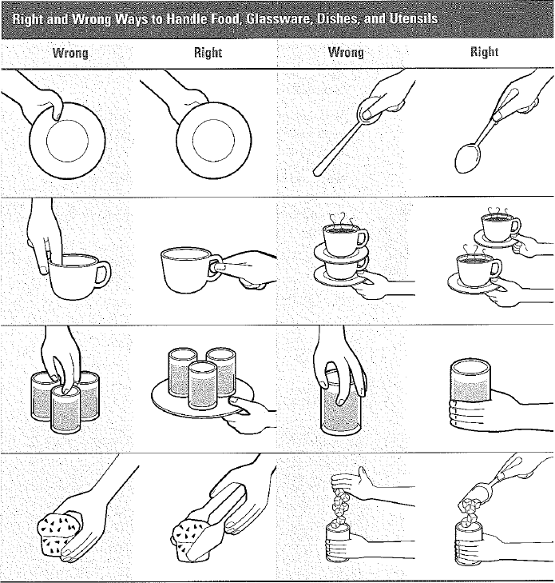
No Bare Hand Contact with Food
When handling glassware, dishes and utensils do not touch food contact areas with bare hands
Notes:
Lastly, it is important to keep bare hands from touching where food comes into contact with plates, glassware, etc. This pictures shows the wrongs and rights of touching some of these items.

Slide 15
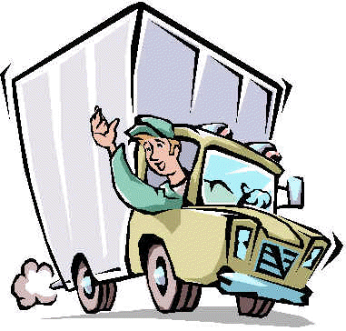
Purchase Safe Food
VENDORS
  Buy only from reputable suppliers
  Inspect deliveries carefully
  Sample temperatures of received food items
  Put refrigerated and frozen items away immediately
Notes:
First, see to it that you are purchasing safe food. If you purchase food from a vendor:
Buy only from reputable suppliers
Inspect your deliveries carefully – look at packaging, are they intact?
Sample temperatures of cold or frozen foods to make sure they are not in the danger zone
Put away refrigerated and frozen items immediately.

Slide 16
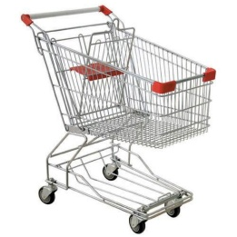
Purchase Safe Food
GROCERY STORE
  Read the label – do not buy food that is past the “sell-by,” “use-by,” or other expiration dates
  Purchase meat, poultry and dairy products last
    Ground beef should be cherry-red or purple-red if in vacuum packaging
    Place meat, poultry and seafood in plastic bags to prevent juices from dripping on other foods in the cart
    Keep raw meat, poultry and seafood separate from other food items
  Check that all food packages are intact
  Select produce that is fresh, not bruised or damaged
Notes:
If you purchase food from a grocery store:
Purchase meat, poultry and dairy products last since they need to be kept cold
Keep packages of raw meat and poultry separate from other food items
Check that all food packages are intact
Select produce that is fresh
Make sure products are refrigerated or put in freezer as soon as possible

Slide 17
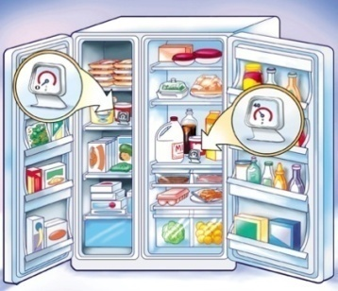
Store Food Properly
Keep out of temperature danger zone
  Refrigerator – 40°F or lower
  Freezer - 0°F or lower
Label and date food
  Leftover prepared food which was not served must be labeled and dated, refrigerated promptly and used within 36 hours, or frozen immediately for later use
  Commercially-prepared, ready-to-serve opened food items can be kept up to 7 days when they are properly stored/refrigerated
Notes:
Next, store food properly.
Keep food out of the danger zone. Your refrigerator should always be at or less than 40 degrees, and your freezer should always be at or less than 0 degrees.
Label and date food. Leftover food which has not been served must be labeled and dated and refrigerated promptly. It must then be used within 36 hours, per state licensing regulations, or frozen immediately for later use.
Commercially prepared, ready-to-serve opened food items can be kept for up to 7 days when properly labeled, dated and refrigerated.

Slide 18
Store Food Properly
Dry Storage
  Dry food should be stored in sealed containers (zip-type bags, metal, glass or food-grade plastic containers with tight-fitting covers) and shall be labeled
  Clean, dry, ventilated and lighted storerooms or areas protected from contamination by sewage, wastewater backflow, condensation, leakage or vermin
Notes:
Dry food should be stored in a designated clean, dry, ventilated and lighted area. Food should be sealed in an air tight container, zip-type bags, metal, glass or food-grade plastic container, and shall be labeled.

Slide 19
Prepare and Cook Food Adequately
Thaw Foods Properly
In Refrigerator | At 40°F or lower
Under Cold Running Water | Water must be 70°F or lower
Microwave | Food must be cooked immediately after thawing
Part of Cooking Process | Food must meet the required minimum internal cooking temperature
Notes:
Preparing and cooking food adequately is also important for preventing food borne illness.
First, when thawing frozen items, thaw foods properly.
Freezing does not kill micro-organisms.
When frozen food is thawed and exposed to temperatures in the danger zone, bacteria will grow.
Therefore, food should never be thawed at room temperature.
The four acceptable methods for thawing potentially hazardous foods are:
In the refrigerator, which should always be at 40 degrees Fahrenheit or lower.
Under cold running water, which is 70 degrees Fahrenheit or lower. Water should be continuously running and not just sitting in a container or the sink.
In the microwave. If you thaw food with this method you must cook the food immediately after thawing.
Last, part of the cooking process. For example, you take frozen ground beef out of the freezer and start to cook it in a saucepan right away. The food must meet the required minimum internal cooking temperature by the time you are done thawing and cooking the food.

Slide 20
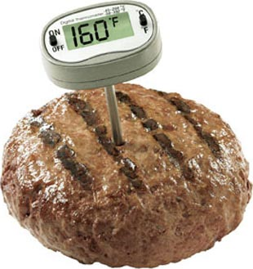
Prepare and Cook Food Adequately
Cook to Minimum Temperatures
Sample:
  165° F
    Poultry
    Stuffing/Casserole
    Hazardous food cooked in microwave (eggs, poultry, meat, fish)
Notes:
Second, when preparing and cooking food, cook to the required minimum internal temperature.
There is a handout in your folder that lists required minimum cooking temperatures for various items. The following is a sample of foods that must reach 165 degrees Fahrenheit.

Slide 21
Prepare and Cook Food Adequately
Doneness versus Safety:
  Doneness is subjective. It is the appearance, texture, color, smell and flavor of food
  Safety is cooking to the required minimum temperature to destroy bacteria. Use a food thermometer to accurately measure
Leftovers
  Heat to 165°F and bring gravies and sauces to a rolling boil before serving
  In microwave, beware of cold spots and use a food thermometer to check the temperature in several places
Notes:
Oftentimes people think they can sense when food is done cooking based on visual or other sense perception. There is a difference between doneness and food being cooked to the safe minimum internal temperature. Doneness is subjective – it is the appearance of how cooked an item is, the texture, color of food, smell or flavor. Safety is cooking to the required minimum temperature to destroy bacteria. The only way to determine safety is by using a food thermometer to accurately measure the internal temperature.
This is also important when reheating leftovers to destroy any bacteria that may have had the opportunity to grow while it was being cooled. Always reheat leftovers to 165 degrees internal temperature and bring gravies and sauces to a rolling boil. If reheating in the microwave, beware of cold spots from uneven heating and use a food thermometer to check the temperature in several places.

Slide 22
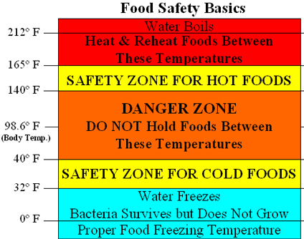
Prepare and Cook Food Adequately
Avoid the DANGER ZONE
Keep hot food hot and cold food cold!
DANGER ZONE
When cold food goes above 40° F
When hot food falls below 135° F
Bacteria can multiply rapidly in perishable food left in the danger zone for more than 2 hours
Throw away perishable food that has been left at room temperature for more than 2 hours
135°
Notes:
Whenever dealing with food you always want to make sure you avoid the danger zone.
The danger zone is between 40 and 135 degrees Fahrenheit and is the range of temperatures in which bacteria can multiply rapidly in foods. You do not want to hold food between these temperatures. Best practice is to keep cold food below 40 degrees and hot food above 135 degrees.
If hot food does fall below 135 degrees, it must be reheated to a minimum temperature of 165 degrees. And, if food falls below 135 degrees and is left there for longer than 2 hours, throw it away.
So if you are saving a plate of food for a child to eat at a later time, place it in the refrigerator and reheat at the time the child will be eating the meal. Do not make a plate and leave it on the counter. Guaranteed the food will fall into the danger zone. Do not risk the health of the child by leaving a plate out at room temperature.

Slide 23
Clean and Sanitize
Any surface that comes in contact with food must be cleaned and sanitized
Clean: Remove food and other types of soil from a surface
Sanitize: Reduce the number of microorganisms on a clean surface to safe levels
  Bleach Solution: One capful bleach (1 ½ tsp) to one gallon of water
  Other approved sanitizers
Notes:
Using contaminated equipment is also how food itself can become contaminated and unsafe.
Any surface that comes into contact with food must be clean and sanitized.
Note that cleaning and sanitizing are two different things. Cleaning is removing food and other dirt from a surface. Such as cleaning food crumbs off a table, or wiping raw chicken pieces off of a cutting board.
Sanitizing is reducing the number of microorganisms on a clean surface to safe levels. A common sanitizing solution is one capful of bleach (1 ½ tsp) to one gallon of water. Make this up and keep in labeled spray bottles. Or, you can use a sanitizer that has been approved by the Department of Health Services.

Slide 24

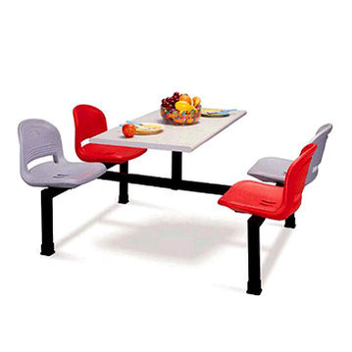
Clean and Sanitize
What surfaces?
  Kitchen counters
  Knives, mixing spoons and other utensils
  Mixing bowls and other food preparation containers
  Cutting boards
  Tables children eat on
Notes:
What surfaces are important to keep clean and sanitized?
Kitchen counters or other surface where food is being prepared.
Knives, mixing spoons and other utensils used for preparing food.
Mixing bowls and other food prep containers
Cutting boards and the tables/surfaces that children eat meals and snacks on.

Slide 25
Clean and Sanitize
Dishwashing Procedures (see next slide for illustration)
  Manual (3-compartment sink)
    Rinse, scrape or soak items before washing
    Wash in 110° - 125°F water, using soap/detergent
    Rinse by immersing in clean, hot water to remove soap/detergent or by spraying soap/detergent off, removing all traces of food and detergent. If dipping the items, change the rinse water when it becomes dirty or full of suds.
    Sanitize for minimum 2 minutes in 1 ½ teaspoons of bleach per gallon of water (or other Department of Health Services approved sanitizer)
    Air-dry Items – upside down so they will drain
Notes:
Cleaning and sanitizing dishes properly is also key to ensure that items used to prepare meals, and in some cases plates and bowls kids eat from (when not using paper plates), are free from bacteria that can grow when left to sit out at room temperature.
When washing dishes manually, you must follow this procedure. It is illustrated on the next slide.

Slide 26
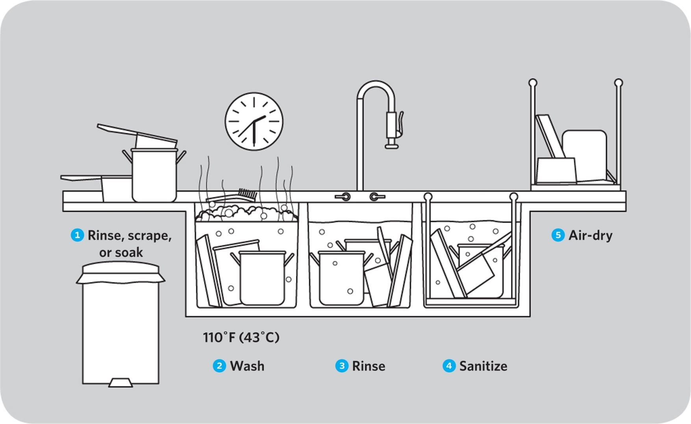

Slide 27
Clean and Sanitize
If your center has a two compartment sink, you must arrange for all three steps: Wash, rise and sanitize:
  Purchase a bucket/tub to put your sanitizing solution in and sanitize your dishes in the tub (1 ½ teaspoons of bleach per gallon of water or other Department of Health Services approved sanitizer)
  OR
  Wash and rinse dishes in the two sinks, drain the rinse sink, make a sanitizing solution and sanitize the dishes after

Slide 28
Clean and Sanitize
Dishwashing Procedures continued
  Commercial
    Dishwasher shall have a visible temperature gauge
    Wash at 130°F to 150°F for 20 seconds, rinse and sanitize at 180°F for 10 seconds or more OR use chemical sanitizer
    All dishes/utensils must be air dried
  Home-type dish washer
    After dishwasher is done, sanitize dishes/utensils by submerging for minimum 2 minutes in 1 ½ teaspoons of bleach per gallon of water (or other Department of Health Services approved sanitizer)
    All dishes/utensils must be air dried
Notes:
When using a commercial dishwasher, the dishwasher shall have a visible temperature gauge. Dishes shall be washed with water between the temperatures of 130 and 150 degrees Fahrenheit, and sanitized with water that is at least 180 degrees Fahrenheit or with a chemical sanitizer. All dishes/utensils must be air dried.
If you use a home-type dish washer that does not show how hot the washing water and sanitizer water reach, or, if it does not reach the 180 degree temperature, you must sanitize the dishes after the washing cycle is completed. Do this by submerging dishes in sanitizing solution for a minimum of 2 minutes. All dishes must be air dried.

Slide 29
Questions?

