Slide 1
GENERAL MANAGEMENT OF TRAUMA
SAMUEL
NGIGI
KIURIRE
KMTC

Slide 2
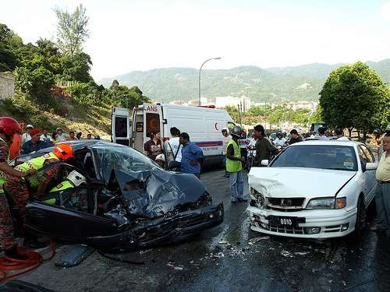
WHAT IS TRAUMA?
ϒ A serious injury to the body that maybe life-threatening
ϒ mainly from MVA

Slide 3
AIM OF MANAGEMENT
ϒ Prevent death
ϒ Mainly second
peak of death
ϒ GOLDEN HOUR!

Slide 4
Pre – hospital
STEPS IN MANAGEMENT
Triage
Hospital m(x) - ATLS

Slide 5
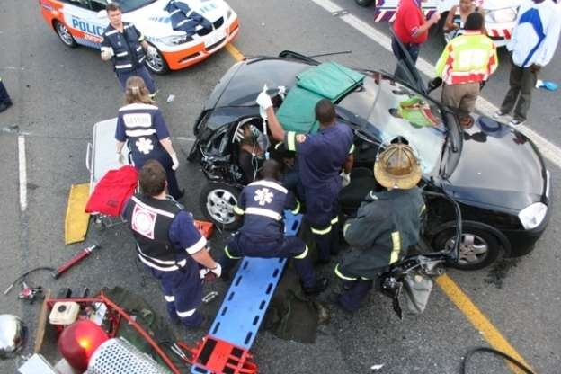
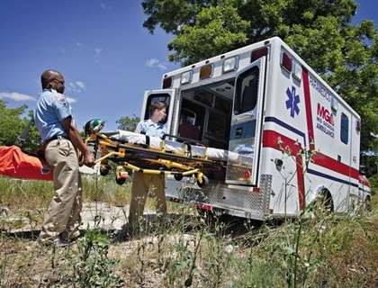
PRE-HOSPITAL
Comprehensive on site management

Slide 6
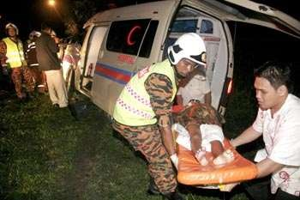
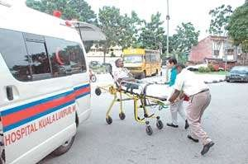
PRE-HOSPITAL
‘Scoop and run’ concept!

Slide 7
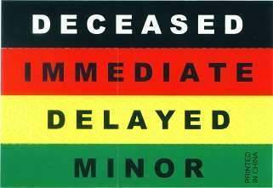
TRIAGE
ϒ A system to sort cases based on priority especially in mass
disasters

Slide 8
HOSPITAL M(X) - ATLS CONCEPT
ϒ Introduced by Ortho surgeon
ϒ Treat the life-threatening
condition first
ϒ Approach trauma in an
organized and sequential manner
ϒ Internationally recognized

Slide 9
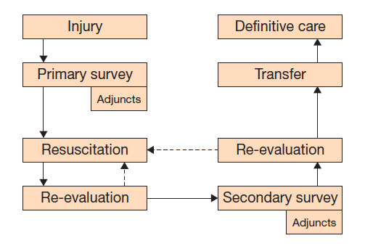
ATLS CONCEPT

Slide 10
PRIMARY SURVEY
ϒ Rapid assessment and treatment of life-threatening injuries
Airway (with c-spine)
A
Breathing
B
Circulation
C
Disability
D
Exposure
E

Slide 11
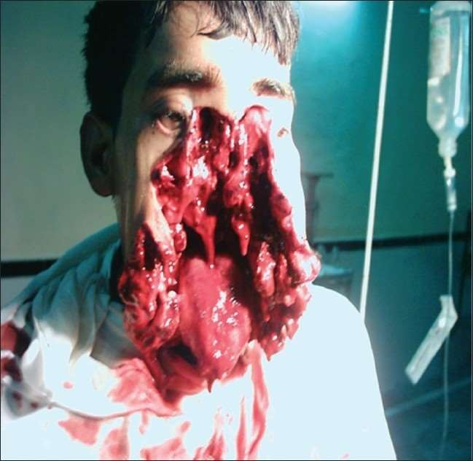
PRIMARY SURVEY

Slide 12
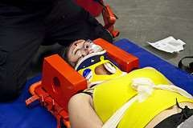
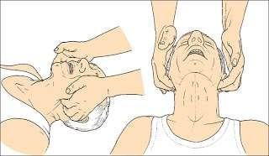
A – AIRWAY (WITH C-SPINE)

Slide 13
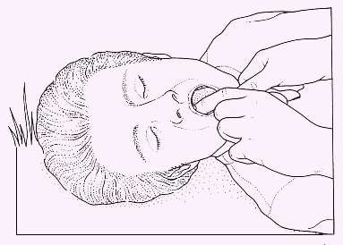
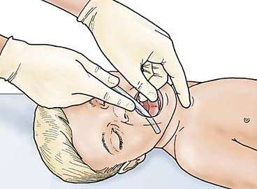
A – AIRWAY (WITH C-SPINE)

Slide 14
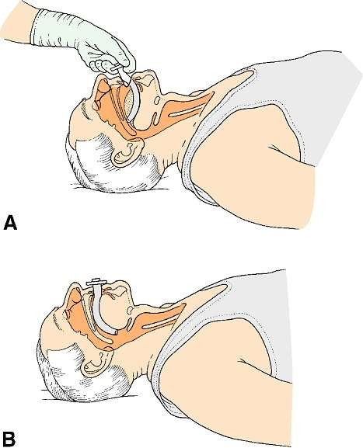

A – AIRWAY (WITH C-SPINE)
Oropharyngeal airway

Slide 15
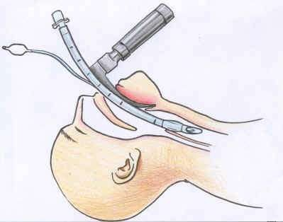
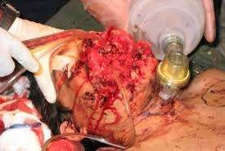
A – AIRWAY (WITH C-SPINE)

Slide 16
B - BREATHING
ϒA clear airway does not mean the patient is breathing adequately
ϒIs required to provide adequate tissue oxygenation
ϒOnce airway secure, a complete examination of the lungs MUST be done

Slide 17
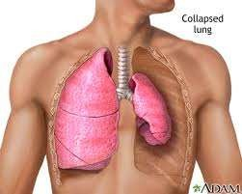
B - BREATHING
LOOK
LISTEN
FEEL

Slide 18
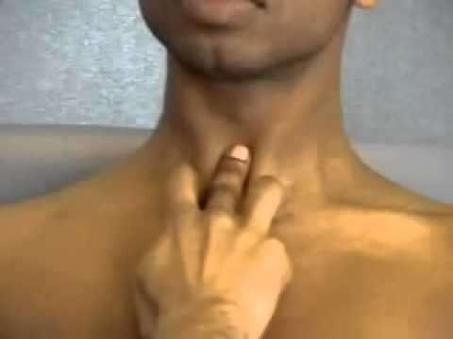
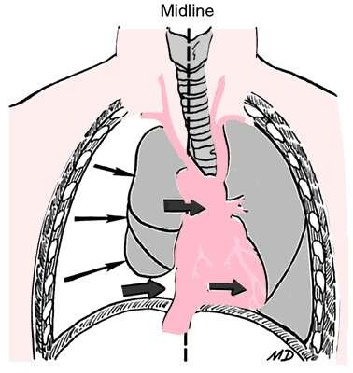
B - BREATHING
Tracheal palpation: Looking for deviation

Slide 19
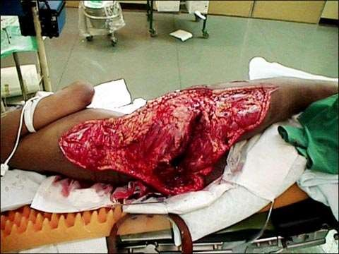
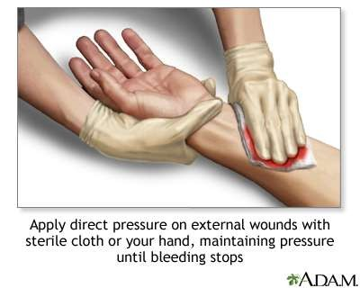
C - CIRCULATION

Slide 20
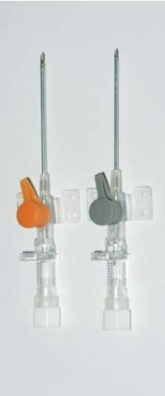
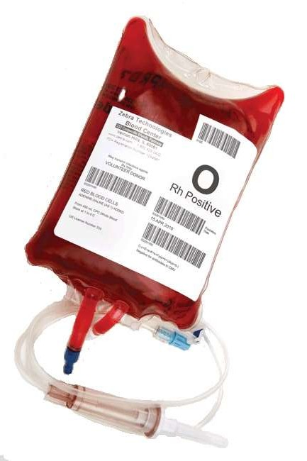
C - CIRCULATION
Insert 2 large bore branula
Send for blood!
Transfuse!

Slide 21
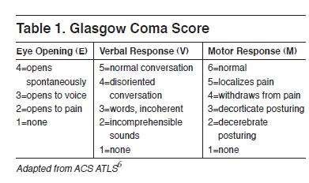
D – DISABILITY

Slide 22
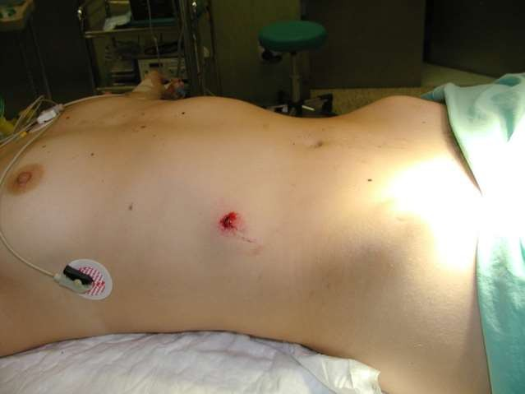
E - EXPOSURE
Not to miss anything
Ensure not hypothermic

Slide 23
ϒHistory
SECONDARY SURVEY
ϒComplete physical examination
ϒ‘tubes and fingers in every orifice’
ϒNeurological examination
ϒRe-evaluation

Slide 24
THANK YOU!

