Slide 1
Haemolytic Disorders
Samuel Ngigi K.
KMTC

Slide 2
Definition
Hemolytic Disorder; the destruction of red blood cells from the circulation before their normal life span of 100-120 days. (Compensated hemolysis)
Hemolytic anemia: when erythrocytosis cannot match the pace of red cell destruction. (Decompensated hemolysis)
Acute infection, pregnancy, folate def., renal failure
Am Fam Physician 2004;69:2599-2606.

Slide 3
Hemopoiesis
υ
υ
Regulated multi-step process
Pluripotent stem cell differentiates under regulatory effects of growth factors & hormones
Erythropoietin promotes RBC formation EPO is itself linked to O2 transport
υ
υ

Slide 4
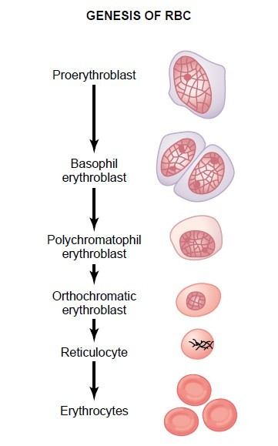

Slide 5
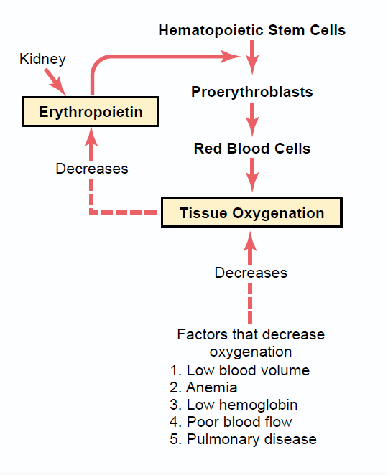
Regulation of Hemopoesis

Slide 6
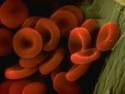
The RBC
In mammals O2 is transported bound to Hb
Mature RBCs
8µM, anucleate, biconcave, discoid shape, extremely pliable to traverse microcirculation
Membrane integrity mainted by intracellular ATP production
Contain hemoglobin (protein with 4 globin chains, each having an iron-containing porphyrin pigment called haem)
0.8-1% of RBCs replace daily
Lifespan 100-120 days

Slide 7
Hemolysis:
Pathophysiology
Following break down of RBCs:
Intravascular:
Hb liberated into plasma binds haptogloblin – forms large complex taken up and degraded by liver (low haptoglobilin indicates hemolysis)
Some Hb bound to albumin – methaemalbumin
If all haptoglobin is consumed Hb appears in urine, heamoglobinuria (“black water”)
Some stored as heamosiderin, excess causes heamosiderinuria
Extravascular hemolysis occurs in RES: no haptoglobin depletion

Slide 8
Hemolysis: Pathophysiology II
υ
Consequently
Reduced tissue oxygenation
Increased output of new RBCs
Raised reticulocyte count, normoblasts if stress severe
If catabolic pathways for Hb degradation are overwhelmed there’s
unconjugated hyperbilirubinaemia,
increased urobilinogen reabsorption in gut and excretion in urine

Slide 9
Classification of Haemolytic anemias
Intracorpuscular Defects Extracorpuscular Defects
Hereditary Enzymopathies
Familial hemolytic uremic syndrome (HUS)
Hemoglobinopathies
Membrane-cytoskeletal defects
Paroxysmal nocturnal hemoglobinuria (PNH)
Acquired
Mechanical destruction (microangiopathic)
Toxic Agents Drugs Infectious Autoimmune
Adopted from Harrison's Principles of Internal Medicine 17th Edition, 2008

Slide 10
Clinical Presentation
υ
Examination:
υ
Histrory
jaundiced or pale.
tachycardia with a flow murmur: if the anemia is pronounced.
Lymphadenopathy
hepatosplenomegaly suggest underlying lymphoproliferative disorder or malignancy;
Splenomegaly may reflect hypersplenism
complain of dyspnea
fatigue (caused by anemia)
Dark urine
back pain may be reported by patients with intravascular hemolysis.
There are other features peculiar to the cause of the hemolysis.
υ
υ
υ
υ
υ
υ
υ
υ
υ
υ

Slide 11
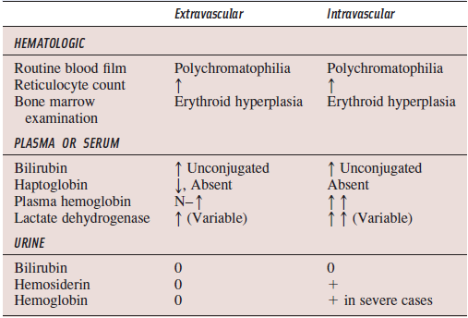

Slide 12
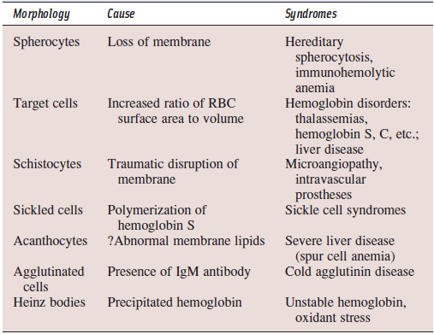
RBC Morphology in the Diagnosis of Hemolytic Anemia

Slide 13
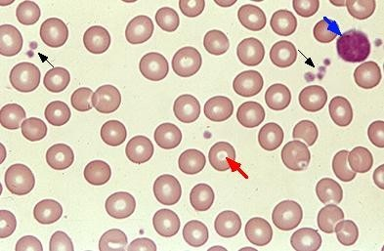
Normal Red Blood Cell

Slide 14
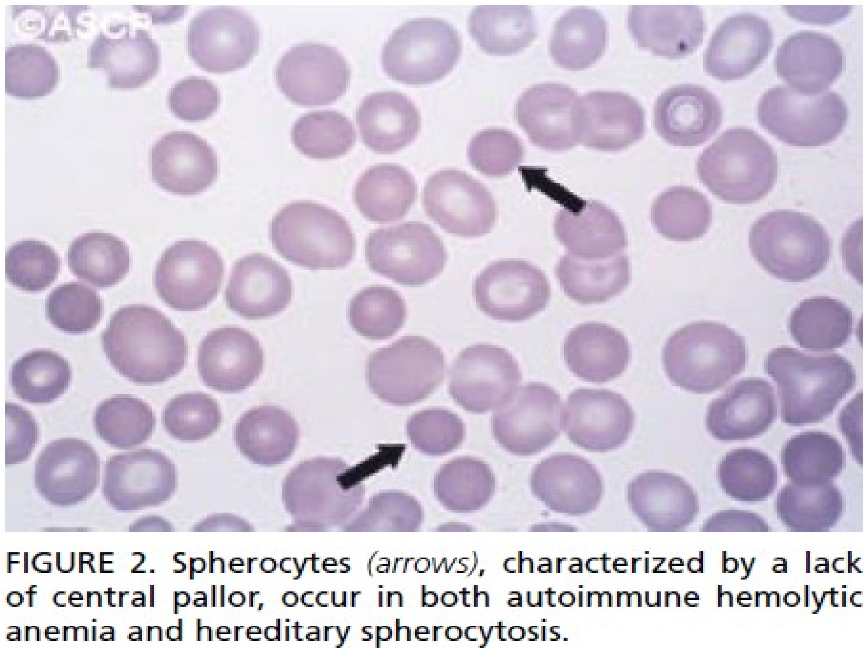

Slide 15
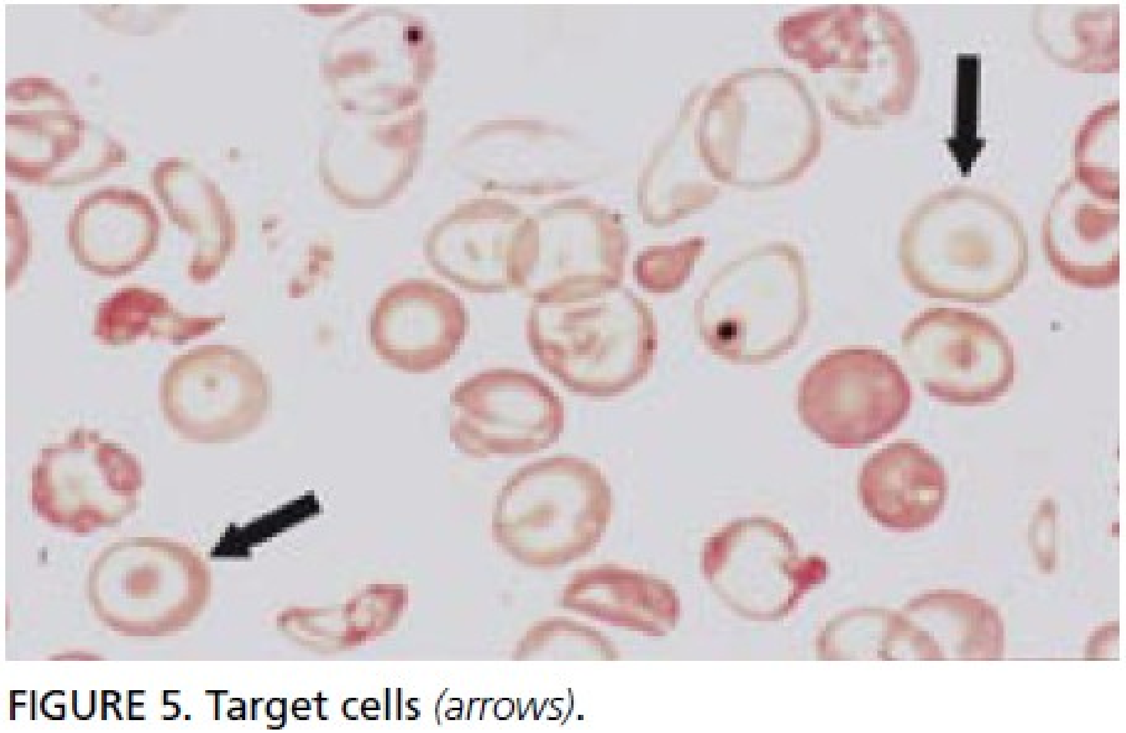

Slide 16
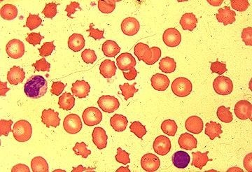
Peripheral blood smear shows multiple acanthocytes (spur cells). These cells have prominent irregular protrusions scattered over the surface in an asymmetrical pattern.

Slide 17
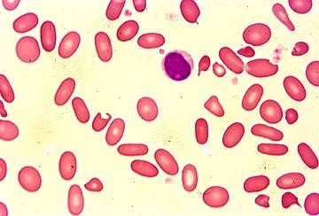
hereditary elliptocytosis shows multiple elliptocytes. The elliptocytic shape change is thought to result from repeated episodes of elliptocytic deformation that all red cells undergo as they pass through capillary beds.

Slide 18
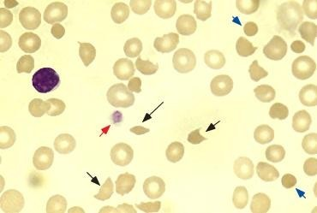
Schistocytes in microangiopathic hemolytic anemia with marked red cell fragmentation. The smear shows multiple helmet cells (small black arrows), other fragmented red cells (large black arrow); microspherocytes are also seen (blue arrows).

Slide 19
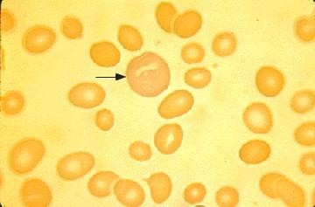
Blood smear in an anemic patient showing large, polychromatophilic "shift" cell (arrow) which is indicative of the action of erythropoietin on the bone marrow, leading to the early release of reticulocytes

Slide 20
Immune Hemolytic Anaemia (IHA)
υ
Mediated by Abs directed against Ags on the RBC surface.
Microspherocytes on a peripheral smear
Positive direct antiglobulin (Coomb’s) test are the characteristic findings.
Classified as:
autoimmune
alloimmune
drug-induced,
based on the Ag that stimulates Ab or complement- mediated destruction RBCs.
υ
υ
υ
υ

Slide 21
Auto Immune Heamolytic Anaemia
υ
Immune hemolysis in the adult is usually induced by IgG or IgM antibodies reacting specifically with antigens associated with the patient’s RBC (often called “autoantibodies”) or with alloantigens on transfused RBC (alloantibodies).

Slide 22
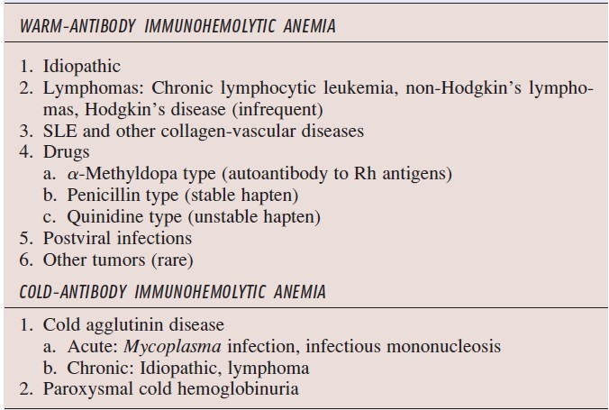
Hemolysis due to Antibodies

Slide 23
AIHA Warm Antibody Dx
Antibodies that react at body temperature (warm antibodies) are nearly always IgG, rarely IgM or IgA. Autologous warm antibodies cause autoimmune hemolytic (or immunohemolytic) anemia, warm antibody type.
υ
accounts for about 75% of cases of AIHA
Clinical findings:
occurs at all ages, but it is more adults,women.
In 25% of patients occurs as a complication of disease affecting the immune system, especially lymphoid neoplasms, collagen vascular diseases, SLE and congenital immunodeficiency diseases
υ
post-viral or Drug-related (methylydopa, penicillin& quinidine)

Slide 24
Pathogenesis
υ
υ
IgG lyse RBC by 2 mechanisms:
Immune adherence of RBC to phagocytes mediated by the antibody IgG
also enhanced by the transit of RBC into splenic cords & sinuses, which brings cells into direct contact with phagocytic cells.
Complement activation.
Involves the interaction of C3b & C4b with receptors on the macrophage; increases the immune adherence due to IgG.
υ

Slide 25
Clinical Findings
Asymptomatic (Mild)
^{υ} +ve Coombs test: insufficient antibody is present on
the RBC surface to permit the RES to recognize the cell
as abnormal.
Symptomatic patients (Moderate Dx)
moderate to severe anemia (hemoglobin levels 6.0
-10 g/dL)
Reticulocyte counts 10 to 30%
spherocytosis & splenomegaly.
Occasionally, venous thrombosis occurs.
Severe Disease
fulminant hemolysis associated
hemoglobinemia,
hemoglobinuria,
shock;
rapidly fatal

Slide 26
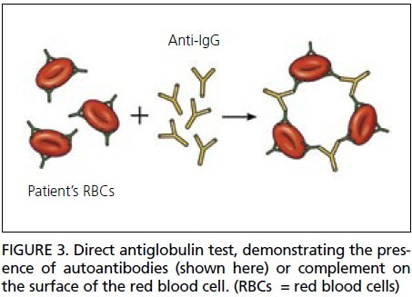
Investigations
Direct Coombs test is positive in 98% of patients; usually IgG is detected with or without C3.
thrombocytopenia also may be present (Evans syndrome).

Slide 27
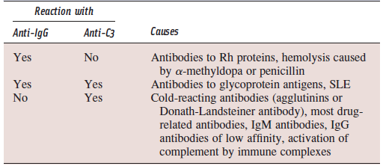
Use of the Direct Coombs Test in Diagnosing the Cause of Autoimmune Hemolytic Anemia

Slide 28
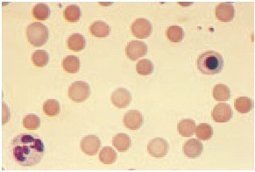
Spherocytes
Immunohemolytic anemia Microspherocytes are seen on this blood smear along with several macrocytes with a slight purple tinge (polychromasia).
The latter represent new red blood cells released early from the bone marrow.

Slide 29
Treatment
Mild degree of hemolysis usually do not require therapy.
Clinically significant hemolysis; glucocorticoids (e.g., prednisone, 1.0 mg/kg per day).
A rise in Hb noted in 3 or 4 days & occurs in most patients within 1-2 weeks.
Prednisone is continued until the Hb level has risen to normal values, & thereafter it is tapered rapidly to about 20 mg/d, then slowly over the course of several months.
Splenectomy for patients who cannot tolerate or fail to respond to glucocorticoid therapy.
Refractory to glucocorticoid therapy & splenectomy:
immunosuppressive drugs; success rate of 50% has been reported.
intravenous gamma globulin, plasmapheresis, cytotoxic agents, or danazol (Danocrine).
Aafp

Slide 30
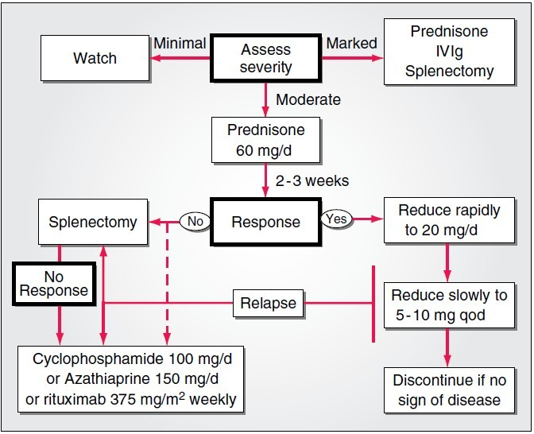

Slide 31
Prognosis
Transient in children after viral infections
Chronic in adults, many years with exacerbations & remissions.
Disease is controlled by glucocorticoid therapy alone, splenectomy, or by a combination.
Fatalities in patients:
with overwhelming hemolysis who die from anemia;
with host defenses impaired by glucocorticoids, splenectomy, and/or immunosuppressive agents.
major thrombotic events coincident with active hemolysis.

Slide 32
Cold AIHA (agglutinin Dx)
In cold hemolysis IgM auto Abs (cold agglutinins) bind RBCs at lower temp. (0° - 4°C [32° - 39.2°F]).
Pathophysiology:
Cold Abs (IgM) temporarily bind to RBC membrane, activate complement & deposit C3 on the cell surface.
C3-coated RBCs are cleared slowly by the M of the liver (extravascular hemolysis).
Less frequently, the complete complement cascade is activated, resulting in the insertion of the MAC (C5b - C9) & intravascular hemolysis.

Slide 33
Cold AIHA
Cold AIHA may occur following infections,
infectious mononucleosis
Mycoplasma pneumoniae
HIV infection can induce both warm & cold AIHA.
Treatment:
Avoidance of the cold
treatment of any underlying disorder.
Glucocorticoids, Splenectomy, rituximab; of limited value.
Transfusion therapy in AIHA is challenging, & the most compatible RBCs (i.e., those with the least cross-reacting abs) should be given. (Hematol Oncol Clin North Am 1994;8:1087-104.)

Slide 34
Drug & Toxin induced HA (DIHA)
υ
Drug induced hemolysis is classified according to 3 mechanisms :
Drug-absorption (hapten-induced)
Immune complex
Autoantibody.
These IgG- and IgM-mediated disorders produce a positive DAT and are clinically and serologically indistinct from AIHA.
υ

Slide 35
DIHA:
Drug Absorption: e.g. high-dose penicillin
Drug attached to the RBC membrane stimulates IgG
Ab production.
large amounts of drug coat the cell surface, the Ab
binds the cell membrane & causes extravascular
hemolysis.
Immune Cmplx: e.g. Quinine
Drug induces IgM ab production.
Drug-ab cmplx binds to RBC membrane & initiates
complement activation, resulting in intravascular
hemolysis.
AutoAnibody: e.g. Alpha-methyldopa
exact mechanism is unknown, the drug
perhaps by altering a RBC membrane protein &
rendering it antigenic. Transfus Med Rev 1993;7:242-54.
induces the production of antiRBC IgG abs causing
extravascular hemolysis.

Slide 36
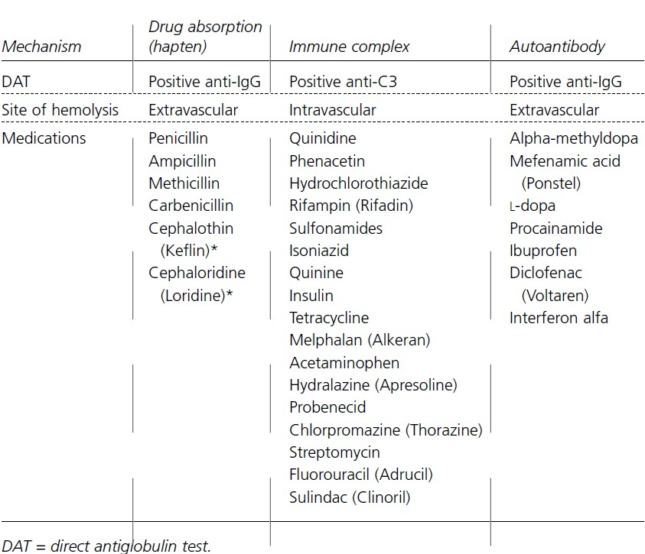
an

Slide 37
ALLOIMMUNE (TRANSFUSION) HEMOLYTIC ANEMIA
Acute transfusion reaction:
caused by ABO-incompatible RBCs.
most severe alloimmune hemolysis.
E.g. transfusion of A red cells into an O recipient (who has circulating anti-A IgM antibodies)
leads to complement fixation & a brisk intravascular hemolysis.
fever, chills, dyspnea, hypotension, & shock.
Delayed hemolytic transfusion:
occurs 3 to 10 days after a transfusion
Usually caused by low titer abs to minor RBC Ags.
On exposure to antigenic blood cells, these abs are generated rapidly & cause an extravascular hemolysis.
onset & progression are more gradual.

Slide 38
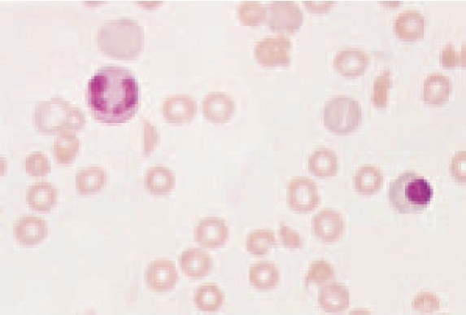
Traumatic hemolysis
υ
Mechanical trauma hemolysis occurs in 3 clinical settings:
υ
RBCs flow through small vessels over the surface of bony prominences are subject to external impact during various physical activities,
across a pressure gradient created by an abnormal heart valve or valve prosthesis (macrovascular)
υ
υ
deposition of fibrin or small platelet thrombi in the microvasculature exposes RBC to a physical impediment that fragments them (microvascular)
Helmet shaped RBC & the triangular-shaped RBCs ; morphologic evidence of mechanical damage to RBCs

Slide 39
Hereditary
υ
Enzymopathies
G6PD
Hexose monophosphate shunt
Hemoglobinopathies
Sickle cell Disease
υ
υ
Thalassaemias
υ
CytoSkeleton disorders
Hereditary Spherocytosis
Hereditary elliptocytosis

Slide 40
G6PD Def
Most common congenital shunt defect, affecting > 200 million world wide;
partially protects the patient from malaria by providing a defective home for the merozoite.
> 400 variants of G6PD have been described; considerable clinical heterogeneity
Most are missense mutations resulting in altered enzymatic properties.
sex-linked trait on X chromosome. Affected
males (hemizygotes) inherit the abnormal gene
from their mothers who are usually carriers
heterozygotes).
African and Mediterranean origin

Slide 41
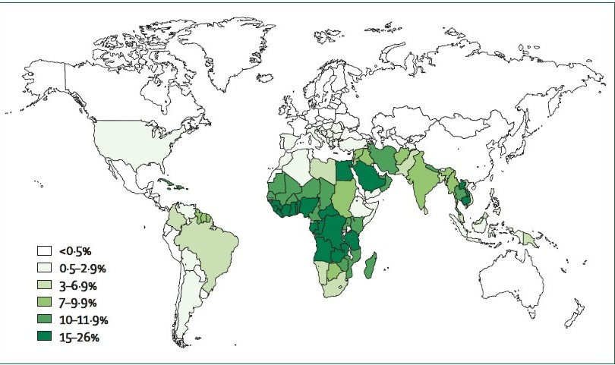

Slide 42
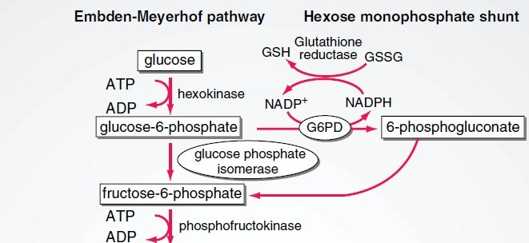
Embden-Meyerhof pathway
The Embden-Meyerhof pathway (glycolysis) generates ATP for energy & membrane maintenance. The generation of NADPH maintains hemoglobin in a reduced state. The hexose monophosphate shunt generates NADPH that is used to reduce glutathione, which protects the red cell against oxidant stress.

Slide 43
G6PD Deficiency
υ
Normal RBC are well protected against oxidant stress.
When the cells are exposed to a drug or toxin that generates oxygen radicals, glucose metabolism via the hexose-monophosphate shunt is normally increased severalfold.
Reduced glutathione (GSH)is regenerated, protecting the sulfhydryl groups of hemoglobin & the RBC membrane from oxidation. Individuals with an inherited defect in the hexose-monophosphate shunt are unable to maintain an adequate level of reduced glutathione in their RBC, hemoglobin sulfhydryl groups become oxidized, and the hemoglobin precipitates within the RBC, forming Heinz bodies.
υ
υ

Slide 44
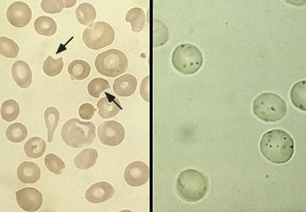
Heinz body hemolytic anemia. Left panel: red cells with characteristic bite-like deformity (arrows). Right panel: Heinz body preparation which reveals the denatured hemoglobin precipitates

Slide 45
G6PD Def: Clinical
Features
Precipitants:
environmental stress.
viral and bacterial infections.
Fava beans
drugs or toxins e.g sulfa drugs, antimalarials &
nitrofurantoin naphthalene (moth balls)
Metabolic acidosis can precipitate an episode of
hemolysis.
Acute hemolytic crisis within hours of exposure to
the oxidant stress,
hemoglobinuria
peripheral vascular collapse in severe cases.
crisis is usually self-limited, even if the exposure to the
oxidant continues. (Older cells~ 50%)
mass decreases by a maximum of 25 to 30%.

Slide 46
G6PD Def: Diagnosis & Treatment
υ
Diagnosis: Peripheral Film: supravital staining (Crystal Violet)
Heinz bodies,
“bite cells” (RBC that have lost a peripheral portion of the cell).
Multiple bites cause the formation of fragments.
A few spherocytes also may be present.
Treatment
usually self limited, no specific treatment is necessary.
Blood transfusions are rarely indicated.
Adequate urine flow should be maintained if hemoglobinuria develops during an acute hemolytic episode.
Counsel on precipitate and treatment of infecions
υ

Slide 47
Hereditary spherocytosis
υ
Autosomal dominant disorder mutations in the RBC membrane skeleton protein genes.
Weak protein backbone anchoring its lipid bilayer,
Progressive deterioration in structure;-spherocyte the characteristic abnormality seen on peripheral smear.
spherocytes are unable to pass through the splenic cords
degraded and ingested by the monocyte-macrophage system.
clinical features:
anemia, splenomegaly, and jaundice.
Chronic leg ulcers, hepatic pigment stones
υ

Slide 48
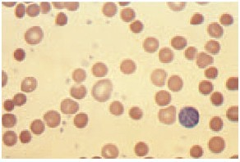
Hereditary Spherocytosis
Diagnosis:
Peripheral film Spherocyte (small cell without central pallor)
MCV is usually normal or slightly decreased
MCHC is increased to 350 to 400 g/L.
Treatment:
Splenectomy
Folate
Vaccinations (pneumoccocal, meningoccocal, H. influeanza)
Small, densely staining RBCs are seen that have los
their central area of pallor (microspherocytes).

Slide 49
Infections
Directly toxic to RBCs.
Malaria:
Plasmodium species, initiate a cycle of cell lysis and further parasitization.
Cellular invasion & the metabolic activity of the parasite alter the cell membrane, leading to splenic sequestration.
Babesia microti & Babesia divergens, tick-borne protozoa
Bartonella bacilliformis, a gram-negative bacillus transmitted by the sandfly, cause extravascular hemolysis by direct RBC invasion & membrane alteration.
Clostridium perfringens, causes hemolysis when the bacterium releases alpha toxin, a phospholipase that degrades the RBC membrane.

Slide 50
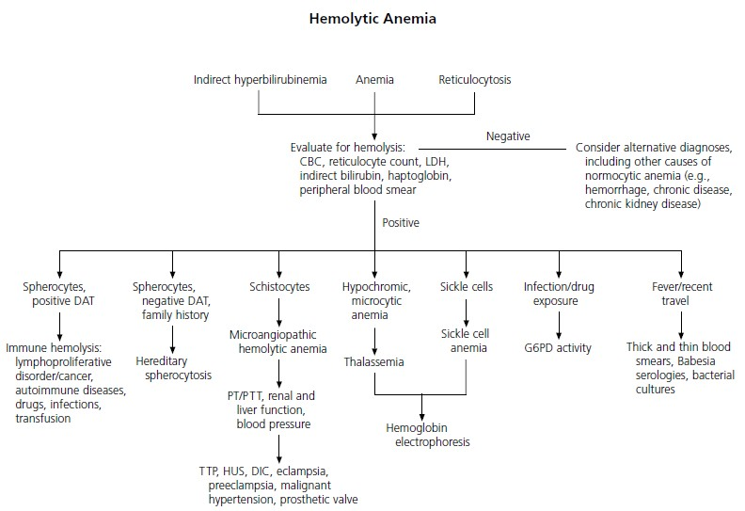

Slide 51
References
Gurpreet D, Patricia A. C, Lawrence M. T. Hemolytic Anemia, Am Fam Physician 2004;69:2599-2606.
Philip C. Hoffman Immune Hemolytic Anemia— Selected Topics Am J of Heamatol: 2006; 13-18
Weatherall et al ABC of clinical haematology :The hereditary anaemias, BMJ; 314 (7079) 492
Harrison’s Principles of Internal Medicine 17th Edition, McGraw Hill, 2008.
Williams Hematology 7th Edition, McGraw Hill, 2007.
Text book of Medical Physiology, Guyton, 11th Edition, Elsevier Saunders, 2006.

Slide 52
Thank you for Listening !!!

