Slide 1
An Introduction to Haemophilia and related bleeding disorders
By Mr Sam

Slide 2
NORMAL CLOTTING
Response to vessle injury
1. Vasoconstriction to reduce blood flow
2. Platelet plug formation (von willebrand factor binds damaged vessle and platelets)
3. Activation of clotting cascade with generation of fibrin clot formation
4. Fibrinlysis (clot breakdown)

Slide 3

CLOTTING CASCADE
Normally the ingredients, called factors, act like a row of dominoes toppling against each other to create a chain reaction.
If one of the factors is missing this chain reaction cannot proceed.

Slide 4
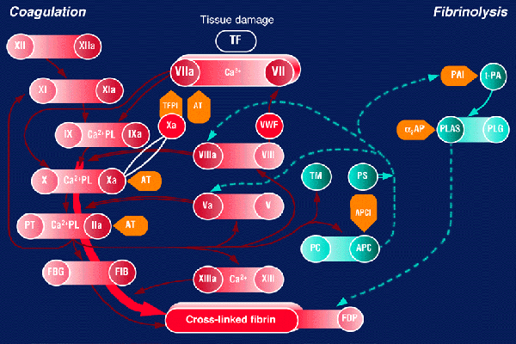
CLOTTING CASCADE

Slide 5
CLOTTING CASCADE – simplified version
Tissue factor:FVIIa
FIX FIXa
FVIIIa is cofactor
FX FXa
FII (prothrombin) FIIa (thrombin)
FVa is cofactor
Fibrinogen Fibrin
FXIIIa
Crosslinked fibrin

Slide 6
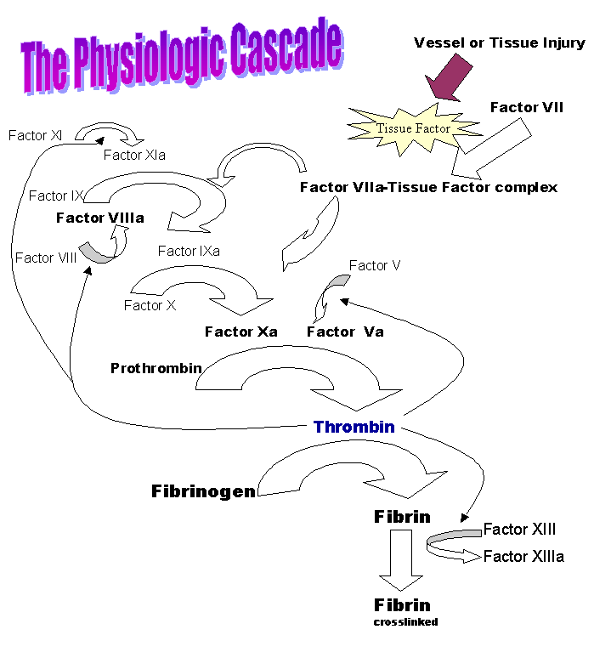

Slide 7
WHAT IS HAEMOPHILIA ?
Haemophilia : group of inherited blood disorders in which there is a life-long defect in clotting.

Slide 8

HAEMOPHILIA
A shortage of clotting factor VIII (Haemophilia A) or factor IX (Haemophilia B) halts the chain reaction with the consequence that a clot does not form.

Slide 9
Haemophilia A and B
1 in 10,000 of the population has the condition called haemophilia A. Clotting factor VIII lacks activity.
Another of the clotting ingredients is called factor IX. The activity of this factor is deficient in haemophilia B, also known as Christmas disease.
Haemophilia A is approximately five times more common than haemophilia B.

Slide 10
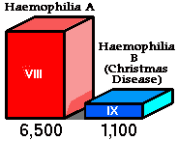
Haemophilia A and B
Both types haemophilia share the same symptoms and inheritance pattern - only blood tests can differentiate between the two.
Important to know which factor is defective so that the correct treatment can be given.
Except in very rare cases both haemophilia A and haemophilia B affect only males.
320 158
Notes:
In Ireland 330 with FVIII def, 142 with FIX def.

Slide 11
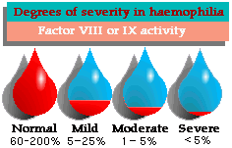
DISEASE SEVERITY
50-200% 5-50% 2-5% <1%

Slide 12
Degrees of Severity
NORMAL RANGE
50 – 150% Clotting Factor
Normal blood coagulation
MILD HAEMOPHILIA
5-50% Clotting Factor
Bleeding problems usually associated tooth extractions, surgery, severe accident.
Often not diagnosed until later in life
MODERATE HAEMOPHILIA
2-5% Clotting Factor
Bleeding usually associated with injury –knock/ deep cut.
Can present like severe haemophilia
SEVERE HAEMOPHILIA
<1% Clotting Factor
Bleeding is frequent and often spontaneous into joints, muscles, and any site including brain.
Usually diagnosed in first year of life.

Slide 13
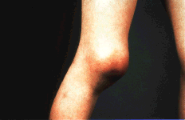
Haemarthrosis in severe haemophilia

Slide 14
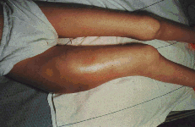
Thigh muscle bleed

Slide 15
HISTORY OF HAEMOPHILIA TREATMENT
1950’s – no treatment for haemophilia, life expectancy 15 yrs
1960’s/70’s – fresh frozen plasma, cryoprecipitate
1970’s – cryoprecipitate/ factor/ home treatment
1980’s – plasma derived factor allowed home treatment, prophylaxis but viral contamination
1990’s – recombinant factor introduced, still residual risk of infection

Slide 16
SURGERY AND HAEMOPHILIA
Factor replacement should be given pre surgery and during post op period
Factor pre physio, suture removal, drain removal
Factor levels should be taken to confirm expected rise in levels
Continuous infusion should never be switched off as levels will fall rapidly post op
No IM injections
No asprin or NSAID

Slide 17
Treatment of bleeds
Treatment given IV through vein or port
Treatment should be prompt to cease bleeding
Use of correct factor concentrate
Bed rest, ice
Analgesia

Slide 18
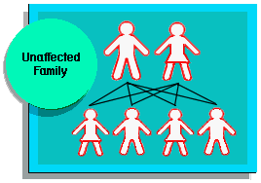
Haemophilia Inheritance
FVIII and FIX only
Two chromosomes determine the sex of an individual, X and Y.
Female XX
Male XY

Slide 19
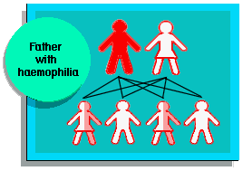
Father with Haemophilia
Genetic defect causing haemophilia on that part of X chromosome not on Y chromosone
Daughter of haemophiliac will inherit his X and be carrier.
Sons of a haemophiliac will not be affected as they inherit fathers Y chromosome which does not carry FVIII or FIX gene.

Slide 20
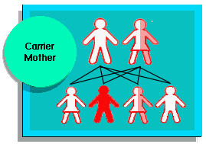
Carrier Mother (one normal gene and one defective gene)
Chances carrier mother passing defective gene to a child are 50:50.
Each daughter has 50:50 chance being a carrier
Each son has 50:50 chance of having haemophilia.

Slide 21
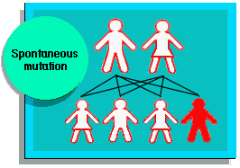
Spontaneous Mutation
In some 30% cases of haemophilia there is no known family history
Haemophilia is probably the result of spontaneous genetic mutation in these families.

Slide 22
INHIBITORS
30% of people with haemophilia develop an antibody to the clotting factor they are receiving for treatment. These antibodies are known as inhibitors.
These patients are treated with high does of FVIIa for bleeds or surgery. This overrides defect in FVIII or FIX deficiency.
Longterm management involves attempting to eradicate inhibitors by administering high dose FVIII (or FIX) in a process called immune tolerance

Slide 23
Assessment of bleeding disorder
Bleeding history
Spontaneous bleeding: easy bruising (spontaneous v post trauma) epistaxis, menorrhagia, GI, joint, muscle, CNS, atypical sites
Pregnancy related bleeding: Post partum
Surgical bleeding: return to theatre or requiring transfusion
Dental extraction: duration, requiring return to dentist, requiring packing or transfusion

Slide 24
Assessment
Laboratory investigations
FBC
PT/APTT (factors I, II, V, VII, VIII, IX, X, IX and XII)
Note factor III, IV and VI don’t exist
Von Willebrand activity
Platelet function
FXIII

Slide 25
von Willebrand’s Disease

Slide 26
vWD
Family of bleeding disorders
Caused by a deficiency or an abnormality of von Willebrand Factor

Slide 27
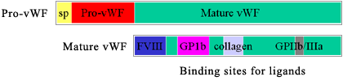
vWF
VWF gene : short arm of chromosome 12
  VWF gene is expressed in endothelial cells and megakaryocytes
vWF is produced as a propeptide which is extensively modified to produce mature vWF
  Two vWF monomers bind through disulfide bonds to form dimers
  Multiple dimers combine to form vWF multimers

Slide 28
vWF Production
Vascular endothelial cells
Megakaryocytes
Most vWF is secreted
Some vWF is stored
  Weibel-Palade bodies in endothelial cells
  Alpha granules of platelets
Constitutive and stimulus-induced pathways
Release stimuli (EC)
  Thrombin
  Histamine
  Fibrin
  C5b-9 (complement membrane attack complex)
Release stimuli (platelets)
  Thrombin
  ADP
  Collagen
Notes:
In plasma, the predominant MW is b/w 500,000-20,000,000
The bigger the multimer: more platelet and collagen binding sites more hemostatically competent

Slide 29
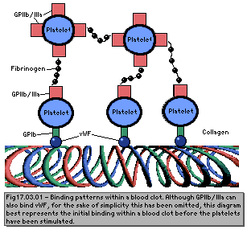
vWF Function
Adhesion
  Mediates the adhesion of platelets to sites of vascular injury (subendothelium)
    Links exposed collagen to platelets
  Mediates platelet to platelet interaction
    Binds GPIb and GPIIb-IIIa on activated platelets
    Stabilizes the hemostatic plug against shear forces

Slide 30
vW Factor Functions in Hemostasis
Carrier protein for Factor VIII (FVIII)
  Protects FVIII from proteolytic degradation
  Localizes FVIII to the site of vascular injury
  Hemophilia A: absence of FVIII

Slide 31
Frequency
Most frequent inherited bleeding disorder
  Estimated that 1% of the population has vWD
  Very wide range of clinical manifestations
  Clinically significant vWD : 125 persons per million population
  Severe disease is found in approximately 0.5-5 persons per million population
Autosomal inheritance pattern
  Males and females are affected equally

Slide 32
vWD Classification
Disease is due to either a quantitative deficiency of vWF or to functional deficiencies of vWF
  Due to vWF role as carrier protein for FVIII, inadequate amount of vWF or improperly functioning vWF can lead to a resultant decrease in the available amount of FVIII

Slide 33
vWD Classification
3 major subclasses
  Type I: Partial quantitative deficiency of vWF
    Mild-moderate disease
    70%
  Type II: Qualitative deficiency of vWF
    Mild to moderate disease
    25%
  Type III: Total or near total deficiency of vWF
    Severe disease
    5%
Additional subclass
  Acquired vWD

Slide 34
Clinical Manifestations
Most with the disease have few or no symptoms
For most with symptoms, it is a mild manageable bleeding disorder with clinically severe hemorrhage only with trauma or surgery
Types II and III: Bleeding episodes may be severe and potentially life threatening
Disease may be more pronounced in females because of menorrhagia
Bleeding often exacerbated by the ingestion of aspirin
Severity of symptoms tends to decrease with age due to increasing amounts of vWF

Slide 35
Clinical Manifestations
Epistaxis 60%
Easy bruising / hematomas 40%
Menorrhagia 35%
Gingival bleeding 35%
GI bleeding 10%
Dental extractions 50%
Trauma/wounds 35%
Post-partum 25%
Post-operative 20%

Slide 36
Acquired vWD
First described in 1970's
fewer than 300 cases reported
Usually encountered in adults with no personal or family bleeding history
Laboratory work-up most consistent with Type II vWD
Mechanisms
  Autoantibodies to vWF
  Absorption of HMW vWF multimers to tumors and activated cells
  Increased proteolysis of vWF
  Defective synthesis and release of vWF from cellular compartments
Myeloproliferative disorders, lymphoproliferative disorders, monoclonal gammopathies, CVD, and following certain infections

Slide 37
vWD Screening
PT
aPTT
(Bleeding time)

Slide 38
vWD: aPTT and PT
aPTT
  Mildly prolonged in approximately 50% of patients with vWD
    Normal PTT does not rule out vWD
  Prolongation is secondary to low levels of FVIII
PT
  Usually within reference ranges
Prolongations of both the PT and the aPTT signal a problem with acquisition of a proper specimen or a disorder other than or in addition to vWD

Slide 39
vWD and Bleeding Time
Historically, bleeding time is a test used to help diagnose vWD
  Lacks sensitivity and specificity
  Subject to wide variation
  Not currently recommended for making the diagnosis of vWD

Slide 40
vWD Diagnosis
Ristocetin
  Good for evaluating vWF function,
  Results are difficult to standardize
  Method
    Induces vWF binding to GP1b on platelets
    Ristocetin co-factor activity: measures agglutination of metabolically inactive platelets
    RIPA: metabolically active platelets
    Aggregometer is used to measure the rate of aggregation
vWF Antigen
  Quantitative immunoassay or an ELISA using an antibody to vWF
Discrepancy between the vWF:Ag value and RCoF activity suggests a qualitative defect
  Should be further investigated by characterization of the vWF multimeric distribution

Slide 41
vWD Treatment
DDAVP
Cryoprecipitate
FVIII concentrate

Slide 42
vWD and DDAVP
Treatment of choice for vWD type I
  Synthetic analogue of the antidiuretic hormone vasopressin
  Maximal rise of vWF and FVIII is observed in 30-60 minutes
  Typical maximal rise is 2- to 4-fold for vWF and 3- to 6-fold for FVIII
  Hemostatic levels of both factors are usually maintained for at least 6 hours
  Effective for some forms of Type 2 vWD
    May cause thrombocytopenia in Type 2b
  Ineffective for vWD Type 3

Slide 43
Factor VIII Concentrates
Alphanate and Humate P
Concentrates are purified to reduce the risk of blood-borne disease
Contain a near-normal complement of high molecular weight vWF multimers

Slide 44
vWD Treatment
Platelet transfusions
  May be helpful with vWD refractory to other therapies
Cryoprecipitate
  Fraction of human plasma
  Contains both FVIII and vWF
  Medical and Scientific Advisory council of the National Hemophilia Foundation no longer recommends this treatment method due to its associated risks of infection
FFP
  An additional drawback of fresh frozen plasma is the large infusion volume required

