Slide 2
INDEX
Definition
Types
Etiology
Pathogenesis
Clinical features
West Haven criteria
Differential diagnosis
Diagnosis
Investigations
Management
Complications
Prognosis
Prevention

Slide 3
DEFINITION
Portal-systemic encephalopathy is a complex organic brain syndrome characterized by disturbances in consciousness, fluctuating neurologic signs, asterixis or “flapping tremor” and distinctive electroencephalographic changes.
Acute and self-limiting or Chronic and progressive.

Slide 4
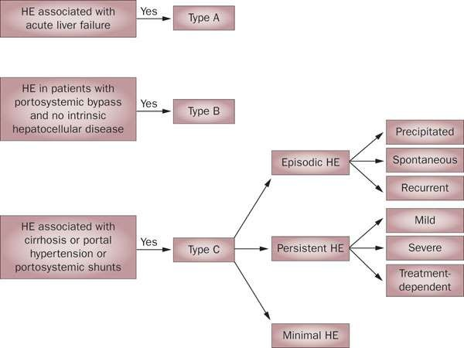
Types

Slide 5
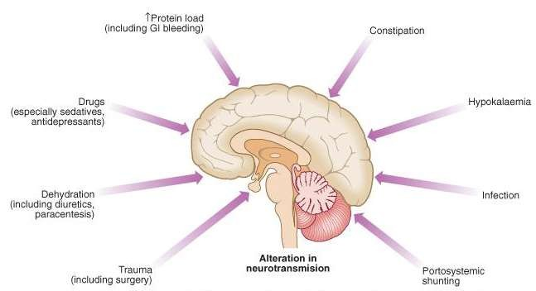
ETIOLOGY & PRECIPITATING FACTORS

Slide 6
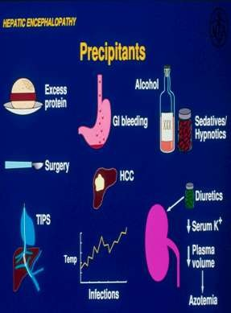
CONT..
Chronic parenchymal liver disease:
Chronic hepatitis
Cirrhosis(30-45%).
Fulminating hepatic failure:
Acute viral hepatitis
Drugs-sedatives
sedative antipsychotics alcohol intoxication
Toxins e.g. Wilson’s Disease
Notes:
Fulminating: (of a disease or symptom) having developed suddenly and severely.
"fulminating hepatic failure
Wilson's disease is a genetic disorder in which excess copper builds up in the body. Symptoms are typically related to the brain and liver. Liver-related symptoms include vomiting, weakness, fluid build up in the abdomen, swelling of the legs, yellowish skin and itchiness.
transjugular intrahepatic portosystemic shunt (TIPS)

Slide 7
CONT..
Surgical -Portal-systemic anastomoses, - portacaval shunts, or Transjugular intrahepatic portal-systemic shunting [TIPS](10- 15%).
Excessive nitrogen load- excess protein consumption, gastro- intestinal bleeding, renal failure, constipation.
Electrolyte or metabolic disturbance-hypokalaemia,
hyponatremia, alkalosis, dehydration, excess vomiting.
Infections- pneumonia, UTI, spontaneous bacterial peritonitis.
Unknown- 20-30%

Slide 8
PATHOGENESIS
Shunting of portal blood directly into systemic circulation bypassing liver.
Severe hepatocellular damage and dysfunction.
In both circumstances→toxic substances absorbed from intestine not metabolised by liver→toxins accumulate in the brain.

Slide 9
TOXIC SUBSTANCES
Ammonia(mainly)
Methionine
Mercaptans
Short-chain fatty acids
Gamma-amino butyric acid(GABA)
Octopamine
False neurotransmitter substances
Alterations in plasma levels of aromatic & branched chain aromatic acids.

Slide 10
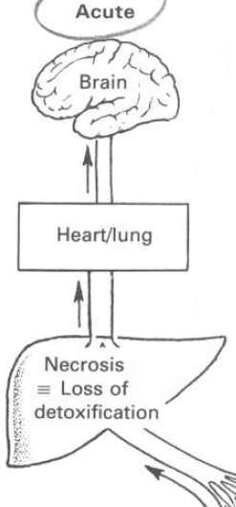
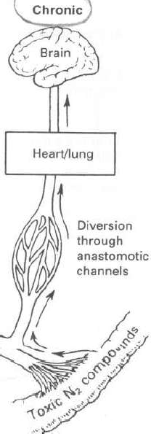
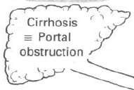
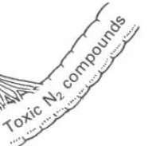
Pathogenesis (acute & chronic )
The basic cause is same in both forms but the mechanism is somewhat
different
•
Diminished detoxification of toxic intestinal nitrogenous compounds
Increased in blood NH3 etc
Toxic effect on brain
Appearance of abnormal amines in systemic circulation
Interference with
neurotransmission
Notes:
NH3 : Amonia
Amines are formally derivatives of ammonia

Slide 11
AMMONIA THEORY
Ammonia -produced by the catabolism of amino acids involving 2 reactions:
transamination (catalysed by aminotransferases)
oxidative deamination (catalyysed by L-amino acid oxidase)
Normally, ammonia is detoxified in the liver by conversion to urea by the Krebs-Henseleit cycle. Ammonia is also consumed in the conversion of glutamate to glutamine, a reaction that depends upon the activity of glutamine synthetase.
Two factors contributing to the hyperammonemia seen in cirrhosis
decreased mass of functioning hepatocytes→fewer opportunities for ammonia to be detoxified by the above processes
portosystemic shunting may divert ammonia-containing blood
away from the liver to the systemic circulation.

Slide 12
AMMONIA THEORY(cont..)
Ammonia crosses the blood–brain barrier → absorbed and metabolised by the astrocytes (cells in the brain that constitutes 30% of the cerebral cortex)
Astrocytes use ammonia when synthesising glutamine from glutamate.
Increased levels of glutamine →increase in osmotic pressure
in astrocytes→ swelling of astrocytes.

Slide 13
Astrocyte
These large star-shaped cells are essential to the functioning of the CNS because they help maintain the proper composition of the fluid surrounding the neurons.
The only cerebral cell capable of metabolizing ammonia.
In patients with HE, they adopt a characteristic morphologic feature known as ‘Alzheimer type II astrocytosis’.

Slide 14
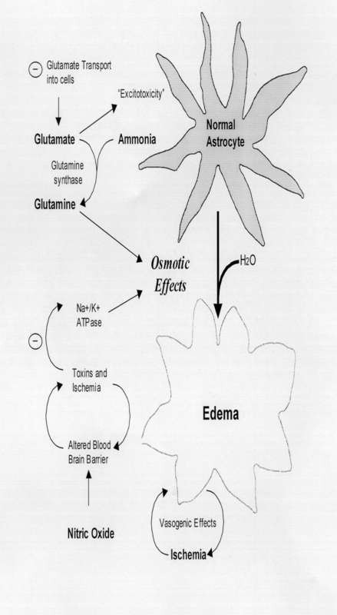
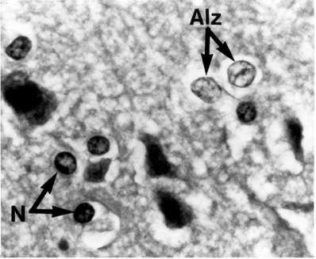

Slide 15
CLINICAL FEATURES
Disturbance in consciousness
disturbance in sleep pattern hypersomnia-earliest feature progress to inversion of sleep pattern fixed stare
impaired memory mental confusion apathy drowsiness somnolence coma
Notes:
Hypersomnia is a condition in which you feel extreme daytime sleepiness despite getting sleep that should be adequate (or more than adequate). If you have hypersomnia, you fall asleep several times during the day.
somnolence : the quality or state of being drowsy : sleepiness.

Slide 16
CLINICAL FEATURES(CONT..)
Changes in personality
childish behaviour irritability
loss of concern for family aggressive outburst euphoria
defaecation and micturating in inappropriate places
Fetor hepaticus
Notes:
Fetor hepaticus is a chronic odor in your breath. It's different from normal bad breath.

Slide 17
Fetor hepaticus
This is a sour, musty odour in the breath, due to volatile substances normally formed in the stool by bacteria.
These mercaptans if not removed by the liver are excreted through the lungs and appear in the breath.
Fetor hepaticus does not correlate with the degree or duration of encephalopathy and its absence does not exclude HE.
Notes:
Mercaptan can be defined as the class of organic compounds derived from Latin mercurium captans, which are composed of an aryl or alkyl group and a thiol group.

Slide 18
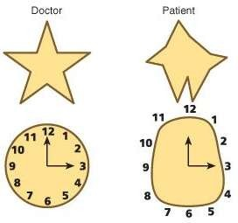
CLINICAL FEATURES(cont..)
Fluctuating Neurological signs
Slurred speech Constructional apraxia Hypertonia
Flapping tremor/ Asterixis Exaggerated tendon reflexes Bilateral extensor plantar reflex
Notes:
Apraxia is a neurological disorder characterized by the inability to perform learned (familiar) movements on command, even though the command is understood and there is a willingness to perform the movement. Both the desire and the capacity to move are present but the person simply cannot execute the act.

Slide 19
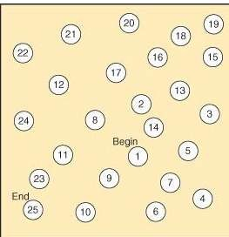
Number connection test
Useful, reliable, sensitive bedside test.
Helps to assess degree of encephalopathy and response to treatment.

Slide 20
Flapping tremor (asterixis)
A nonrhythmic, asymmetric lapse in voluntary sustained posture of extremities, head and trunk.
Due to impaired inflow of joint and other afferent information to the brainstem reticular formation resulting in lapses in posture.
Demonstrated with the patient’s arms outstretched and fingers separated or by hyperextending the wrists with the forearm fixed.
The rapid flexion-extension movements at the metacarpophalangeal and wrist joints are often accompanied by lateral movements of the digits.
Absent at rest, less marked on movement and maximum on sustained posture,
Usually bilateral, although not bilaterally synchronous, and one side may be affected more than the other.
In coma the tremor disappears.
Not specific for hepatic precoma.

Slide 21
Cont..
Asterixis is also seen in
uraemia
ventilatory failure
drug intoxication-barbiturates,
phenytoin alcoholism
Electrolyte imbalance-hypokalaemia
hypomagnesaemia hypoglycemia
•

Slide 22
ASTERIXIS

Slide 23
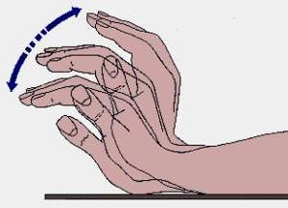
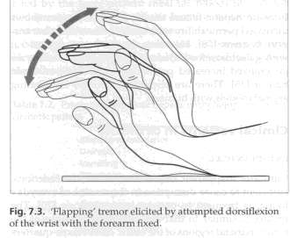
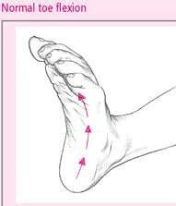
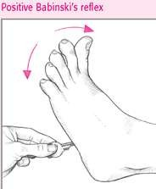

Slide 25
WEST HAVEN CRITERIA
Grade 0 | Grade 0 - Minimal hepatic encephalopathy. Lack of detectable changes in personality or behavior. Minimal changes in memory, concentration, intellectual function, and coordination. Asterixis is absent.
Grade 1 | Trivial lack of awareness. Shortened attention span. Impaired addition or subtraction. Hypersomnia, insomnia, or inversion of sleep pattern. Euphoria, depression, or irritability. Mild confusion. Slowing of ability to perform mental tasks. Asterixis can be detected.

Slide 26
Grade 2 | Lethargy or apathy. Disorientation. Inappropriate behavior. Slurred speech. Obvious asterixis. Drowsiness, lethargy, gross deficits in ability to perform mental tasks, obvious personality changes, inappropriate behavior, and intermittent disorientation, usually regarding time.
Grade 3 | Somnolent but arousable, unable to perform mental tasks, disorientation about time and place, marked confusion, amnesia, occasional fits of rage, incomprehensible speech
Grade 4 | Coma with or without response to painful stimuli

Slide 27
DIFFERENTIAL DIAGNOSIS
Intracranial lesions- subdural hematoma, intracranial bleeding, stroke, tumor, and abscess
Drug or alcohol intoxication
Toxic encephalopathy from alcohol intake, such as acute intoxication, alcohol withdrawal, and Wernicke encephalopathy
Toxic encephalopathy from drugs, such as sedative hypnotics, antidepressants, antipsychotic agents, and salicylates
Metabolic encephalopathy, such as hypoglycemia, electrolyte
imbalance, anoxia, hypercarbia, and uremia
Infections- meningitis, encephalitis, and intracranial abscess
Hyperammonemia from other causes- secondary to ureterosigmoidostomy and inherited urea cycle disorders
Postseizure encephalopathy

Slide 28
DIAGNOSIS
Usually one of exclusion. 4 Elements-
Evidence of advanced hepatocellular disease, extensive porto- systemic collateral shunts or both.
Characteristic clinical features
forgetfullness & confusion→stupor→deep coma.
Fluctuating neurological signs.
Characteristic EEG changes.

Slide 29
INVESTIGATIONS
Diagnosis is usually made clinically
No Pathognomonic liver function abnormality
Elevation of blood ammonia-in 90% cases.
Hypokalaemia
EEG (Electroencephalogram)
CSF & CT Scan
Visual evoked potential abnormailties in initial stages.
Investigations to suggest liver disease- abnormal liver function tests and/or ultrasound suggesting liver disease are required, and
ideally liver biopsy.
Other Routine Investigations – Hb%, TC, DC, ESR, RBS, Na, K, B.Urea,
S.Creatinine, Prothrombin time.
Histological examination.

Slide 30
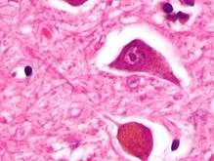
Micrograph of Alzheimer type II astrocytes

Slide 31
Investigations
CSF
Usually clear Normal pressure
Normal or increased protein concentration Normal cell count
Raised levels of Glutamic acid and glutamine.

Slide 32
Electroencephalogram
Electroencephalography shows no clear abnormalities in stage 0, even if minimal HE is present; in stages I, II and III there are triphasic waves over the frontal lobes that oscillate at 5 Hz, and in stage IV there is slow delta wave activity
Bilateral synchronous slowing of the waves frequency(with an increase in wave amplitude) from the normal -rhythm down to the range
Useful for diagnosis and to assess treatment Occur early
Non-specific. However, in a conscious patient with liver disease are virtually diagnostic.

Slide 33
Brain imaging
CT –cerebral edema in Grade 4.
CT and MRI show cerebral atrophy even with apparently well-compensated cirrhosis and results are related to the severity of the liver dysfunction.
In cirrhotic patients -increased signal in the basal ganglia in T1-weighted images, thought to be due to the deposition of manganese.
New MRI techniques provide a non-invasive means of assessment of changes in brain volume and impaired brain function
Proton magnetic resonance spectroscopy detects changes in brain biochemistry, including direct measurement of cerebral osmolytes
PET has also been used in the study of the pathophysiological mechanisms of HE.

Slide 34
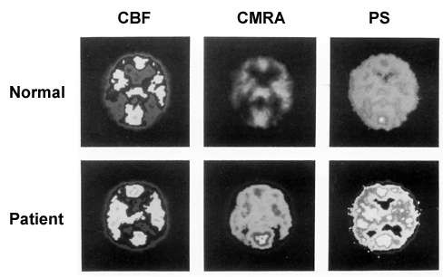
Positron emission tomography (PET) of an alcoholic cirrhotic patient with mild hepatic encephalopathy. The blood flow through the brain (i.e., cerebral blood flow [CBF]) differs only minimally between the two subjects. However, the cerebral metabolic rate for ammonia (CMRA) and the permeability– surface area product (PS)—a measure of the extent to which ammonia can pass the blood– brain barrier and enter the brain—are significantly increased in the alcoholic patient, as indicated by the wider distribution and
enhanced brightness of the light³⁵

Slide 35
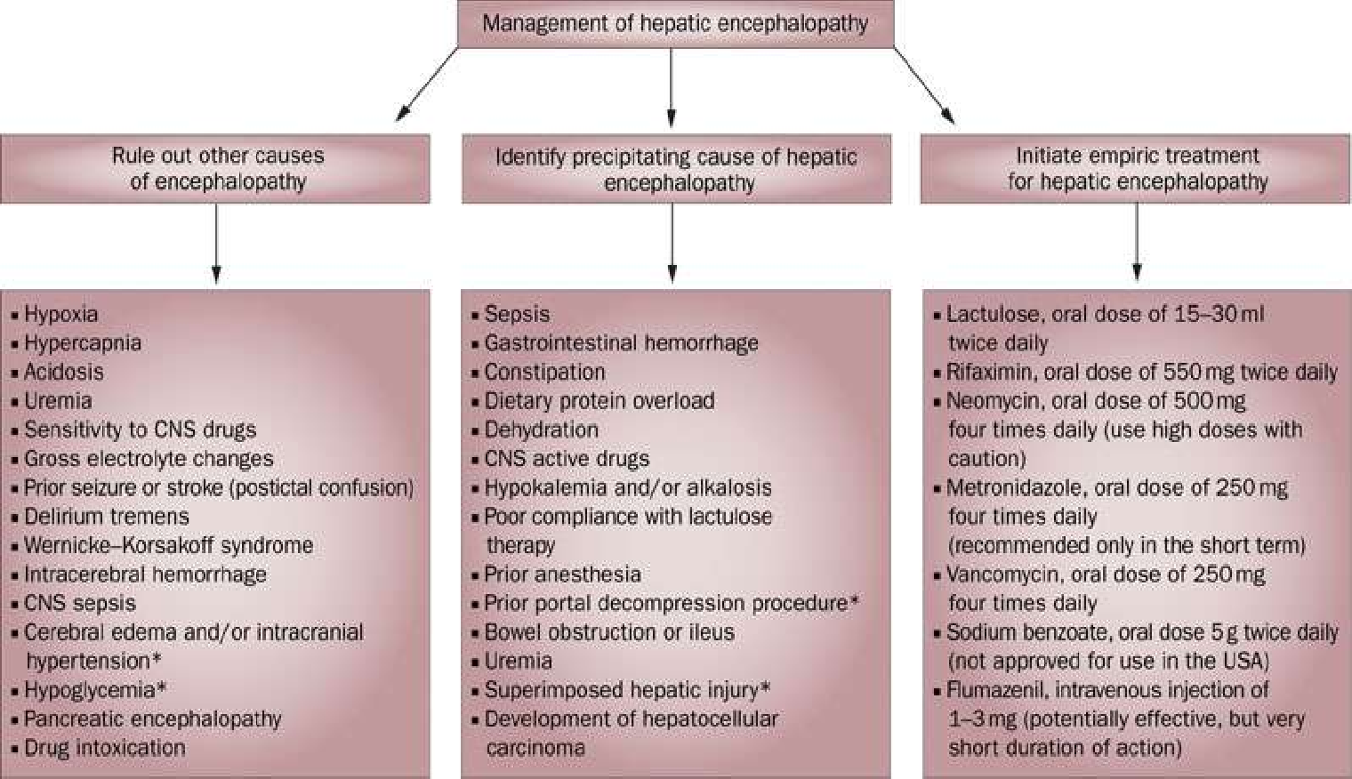
MANAGEMENT(OUTLINE)

Slide 36
MANAGEMENT
Supportive Treatment Specific Treatment aims at-
Decreasing ammonia production in colon
Elimination or treatment of precipitating factors.

Slide 37
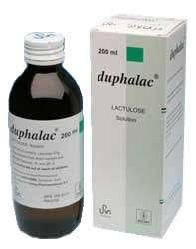
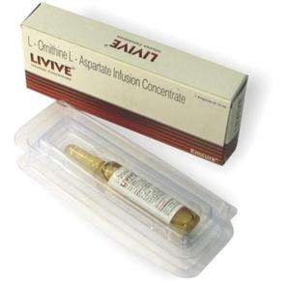
DRUGS

Slide 38
TREATMENT
Hospitalization is mandatory
ABC maintain
Remove the cause & precipitating factors
IV fluid dextrose , saline & Inj. Thiamine
Maintenance of fluid, electrolytes & calorie
Ryles tube feeding and bladder catherisation
Diet – Restriction of protein diet( now discouraged)
High glucose diet
Inj. Vitamin K

Slide 39
Cont..
Avoid constipation – Lactulose 15-30ml X 3 times a day- result aims at 2-4 stools/day.
Antibiotics :
Neomycin-causes ototoxicity and renal failure
Ampicillin
Metronidazole- causes peripheral neuropathy
Rifaximin- newer drug. Lesser side-effects.
Rifaximin-only used as a second-line treatment if lactulose is not effective or poorly tolerated. When added to lactulose, the combination of the two may be more effective than each component separately.
Liver Transplantation

Slide 40
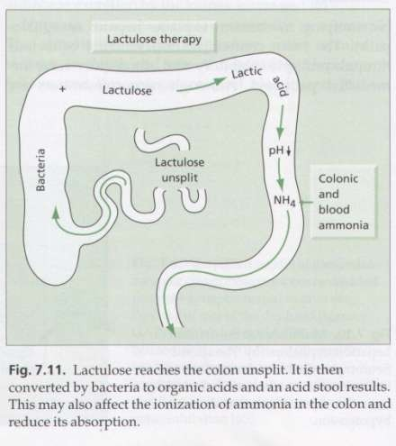
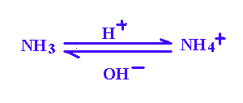
Mechanism of action of Lactulose:
A non-absorbable disaccharide
Osmotic laxative effect.
It reduces p^{H} of colonic content & thereby prevents absorption of NH₃.
Incorporates nitrogen into bacteria

Slide 41
LOLA
A preparation of L-ornithine and L- aspartate (LOLA) is used to increase the generation of urea through the urea cycle,
a metabolic pathway that removes ammonia by turning it into the neutral substance urea. It may be combined with lactulose and/or rifaximin if these alone are ineffective at controlling symptoms.

Slide 42
COMPLICATIONS
Brain herniation
Brain swelling
Increased risk of:
Cardiovascular collapse
Kidney failure
Respiratory failure
Sepsis
Permanent nervous system damage (to movement, sensation, or mental state)
Progressive, irreversible coma
Side effects of medications

Slide 43
PROGNOSIS
Acute hepatic encephalopathy may be treatable.
Chronic forms of the disorder often keep getting worse or continue to come back.
Both forms may result in irreversible coma and death. Approximately 80% (8 out of 10 patients) die if they go into a coma. Recovery and the risk of the condition returning vary from patient to patient.

Slide 44
PREVENTION
Treating liver disorders may prevent some cases of hepatic encephalopathy. Avoiding heavy drinking and intravenous drug use can prevent many liver disorders.

Slide 45
REFERENCES
Harrison’s Principles of internal Medicine-10th & 17th edition
Davidson’s Principles & Practice of Medicine- 21st edition
API- text book of Medicine-8th edition
Review of Medical physiology-Ganong-22nd edition.
Internet

