Slide 1

HISTORY TAKING
Duncan Mutugi

Slide 2

INTRODUCTION
There are many situations in which the patient may be unable to give a history (e.g., they are unconscious, delirious, demented, or dysphasic). In these situations, health care member should make an effort to speak to all who can help to fill in the gaps regarding what happened to the patient.

Slide 3

When taking a history from a source other than the patient, be sure to document clearly that this is the case and the reason(s) for the patient being unable to speak for themselves.
Useful sources of information include the following:
Relatives, guardians, and cohabitants
Close friends and roommates
Primary care physician (PCP) or other members of the
primary care team
Pharmacist
Staff at the nursing home or residential or other facility
Ambulance personnel
Anyone who witnessed the event.

Slide 4
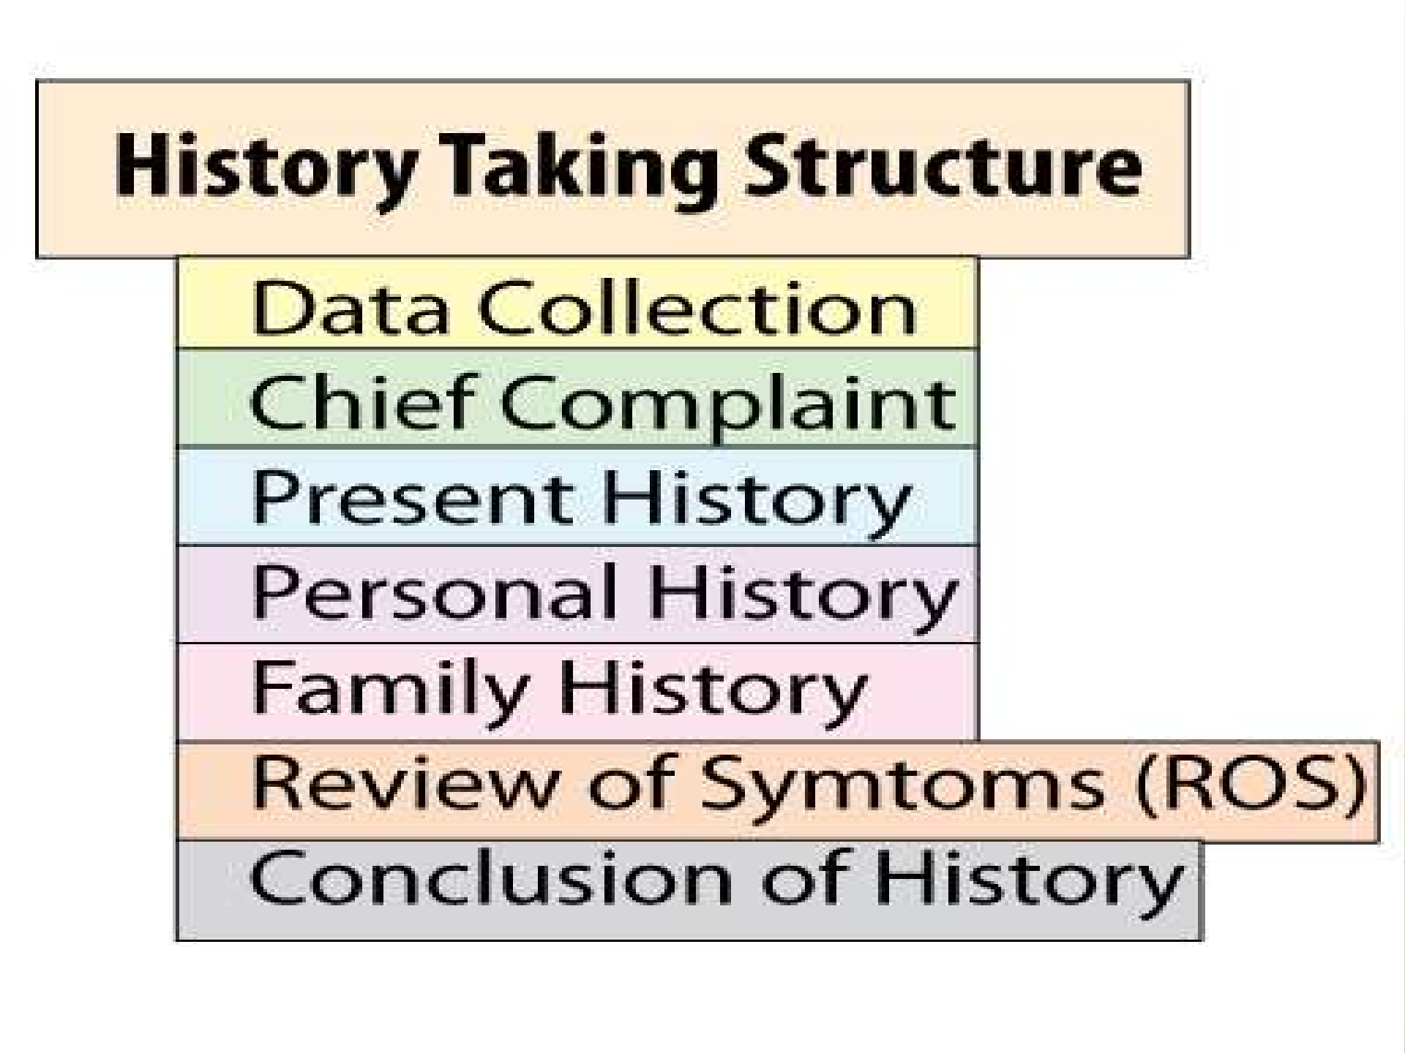

Slide 5
PATIENT PROFILE
This is the essential identifying and biographic information required by the facility.
Typically included in the PP will be the patient’s name, address, and DOB.
Other information included in the PP may include age, religion, nationality, marital status, and contact information as requested by the individual facility.

Slide 6
CHIEF COMPLAIN
This is the patient’s chief symptom(s) in their own words. It should generally be no more than a single sentence.
If the patient has several symptoms, present them
as a list that can expand on later in the history.
Ask the patient an open question, such as, “What’s the problem?” or
“What made you come to the hospital?”

Slide 7
HISTORY OF THE PRESENTING ILLNESS
Here you are asking about and documenting details of the
presenting complaint. By the end of taking the HPI, you and
readers of the record should have a clear idea about the
nature of the problem and of exactly how and when it started,
how it has progressed over time, and what impact it has had
on the patient in their general physical health, psychology,
and social and working lives. The HPI is best tackled in two phases.
First, ask an open question (as for the CC) and allow the
patient to talk through what has happened for about 2
minutes. Don’t interrupt! Encourage the patient with nonverbal
responses and take discreet notes. This allows you to make
an initial assessment of the patient in terms of education
level, personality, and anxiety. Using this information, you can
adjust your responses and interaction. It should also become
clear to you exactly what symptom the patient is most concerned about.

Slide 8
In the second phase, you should revisit the whole story, asking more detailed questions
A mnemonic for remembering the important factors in
analyzing pain or a symptom is O3PQRST.
Onset, Previous occurrences, Provoking factors, Palliative factors (including prescribed and home treatments attempted), Quality (such as characteristics of pain), Radiation (site of onset and any radiation), Severity, and Timing

Slide 9
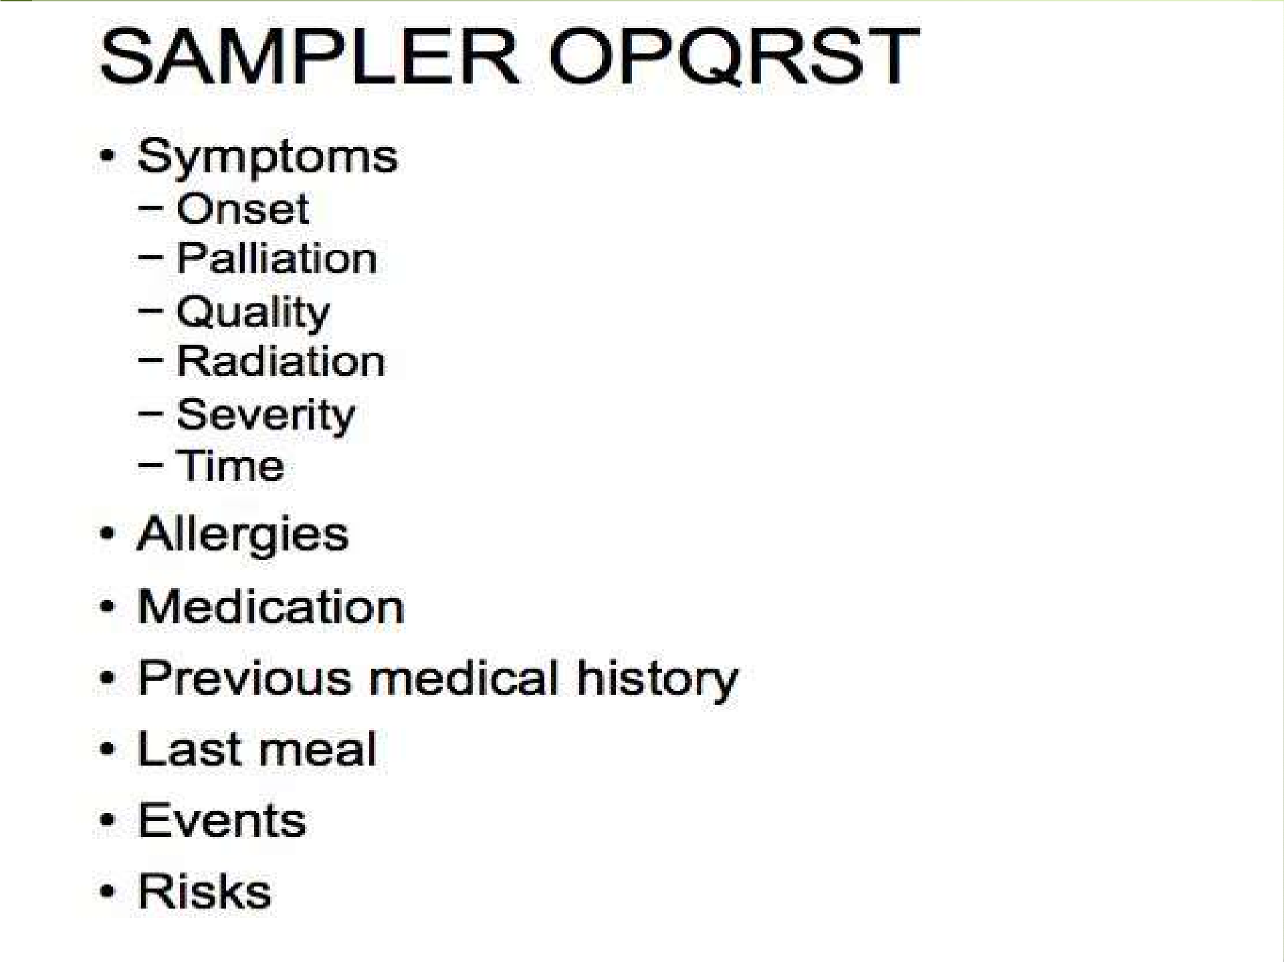

Slide 10
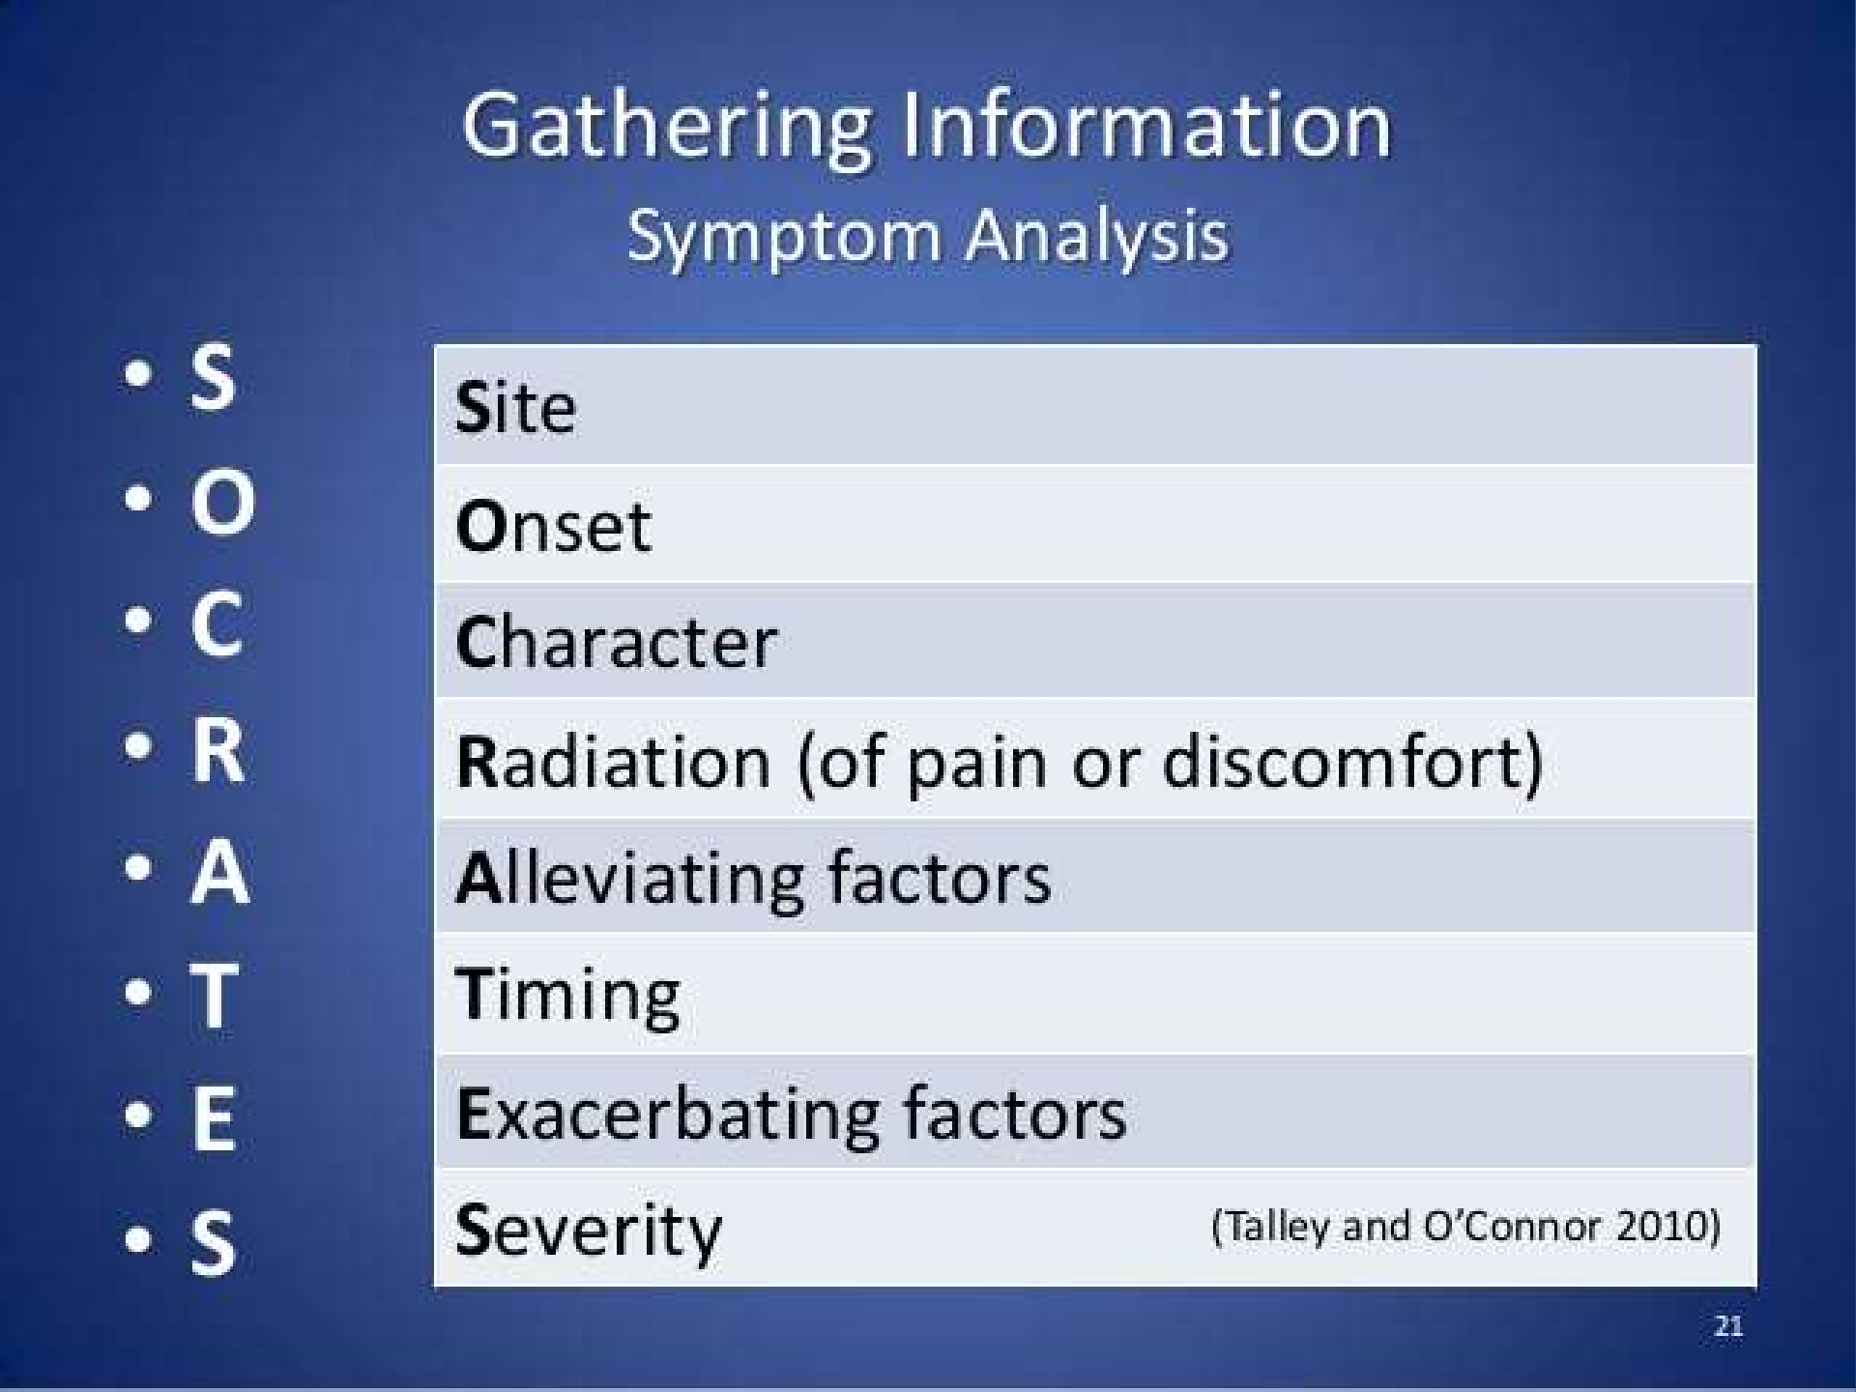

Slide 11
For pain, determine
Site (where is the pain is worst—ask the patient to point to the site with one finger)
Radiation (does the pain move anywhere else?)
Character (i.e., dull, aching, stabbing, burning)
Severity (scored out of 10, with 10 being the worst pain imaginable)
Mode and rate of onset (how did it come on—over how long?)
Duration
Frequency
Exacerbating factors
Relieving factors
Associated symptoms (e.g., nausea, dyspepsia, shortness of breath)

Slide 12
PAST MEDICAL HISTORY
Some aspects of the patient’s past illnesses or diagnoses may have already been covered. Here, you should obtain detailed information about past illnesses and surgical procedures.
When was it diagnosed?
How was it diagnosed?
How has it been treated?

Slide 13


SPECIFIC CONDITIONS TO INCLUDE IN PAST MEDICAL HISTORY
Diabetes
Rheumatic fever
Jaundice
Hypercholesterolemia
Hypertension
Angina
Myocardial infarction (MI)
Stroke or transient ischemic attack (TIA)
Asthma
Tuberculosis (TB)
Epilepsy
Anesthetic problems
Blood transfusions
Childhood illnesses and sequelae

Slide 14
ALLERGIES
Any allergies should be documented separately from the drug history because of their importance.
Ask if the patient has any allergies or is allergic to anything if they are unfamiliar with the term allergies. Be sure to probe carefully, as people will often tell you about their hay fever and forget about the rash they had when they took penicillin. Ask specifically if they have had any reactions to drugs or medication; don’t forget to inquire about food or environmental allergies.

Slide 15
DRUG HISTORY
Here you should list all the medications that the patient is taking, including the dosage and frequency of each prescription. If the patient is unsure about their medications.
Eye drops
Inhalers
Sleeping pills
Oral contraception
OTC drugs (bought at a store or pharmacy), vitamin
supplements
Herbal remedies
Illicit or “recreational” drug use

Slide 16
ALCOHOL
You should attempt to quantify, as accurately as
possible, the amount of alcohol consumed per week, and
establish if the consumption is spread out evenly over the week or concentrated in a smaller period.
Alcohol amounts of common drinks
For typical strength alcoholic beverages the following contain approximately 0.54 ounces of ethanol.
12 ounces beer
5 ounces of wine
1.5 ounces of 80 proof distilled spirits

Slide 17
SMOKING
Attempt to quantify the habit in pack-years:
1 pack-year is 20 cigarettes (1 pack) per day for 1 year (e.g., 40/day for 1 year = 2 pack-years; 10/day for 2 years = 1 pack-year).
ask about passive smoking

Slide 18
FAMILY HISTORY
The FH details the following:
Makeup of the family, including age and gender of parents, siblings, children, and extended family, as relevant Health of the family
document the age and cause of death for all deceased first-degree relatives and for other family members felt appropriate.

Slide 19
FAMILY TREE

Slide 20
SOCIAL HISTORY
This is to document the details of the patient’s personal life that are relevant to the working diagnosis, the patient’s general well-being, and recovery or convalescence. The Social History will help in understanding the impact of the illness on the patient’s functional status.
Marital status
Sexual orientation
Occupation (or previous occupations if retired)
Does the patient own their accommodation or rent it?
Are there any stairs? How many?

Slide 21
Does the patient have any aids or adaptations in
their house (e.g., rails near the bath)?
Does the patient receive any help on a daily basis?
Does the patient have relatives living nearby?
What hobbies does the patient have?
Does the patient own any pets?
Has the patient been abroad recently or spent any time abroad in the past?
Does the patient drive?

Slide 22
REVIEW OF SYSTEMS
Prior to the exam, you should perform a screening of the other body systems relevant to the chief complaint. When conducting the comprehensive exam, review of all systems is necessary and use of a cranial–caudal approach to the review may be most appropriate.
Not only is the finding of unexpected symptoms important, the absence of particular symptoms may be of even greater significance, therefore, always document significant negatives.

Slide 23
The questions asked will depend on any previous discussion(s).
General symptoms
Weight change (loss or gain), change in appetite (loss or gain), fever, lethargy, malaise
Skin symptoms
Lumps, bumps, sores, ulcers, rashes, itch
Sensory symptoms
Vision problems hearing deficits
Respiratory symptoms
Cough, sputum, hemoptysis, shortness of breath, wheeze, chest pain

Slide 24
Cardiovascular symptoms
Shortness of breath on exertion, paroxysmal nocturnal dyspnea, chest pain, palpitations, ankle swelling, orthopnea, claudication
Gastrointestinal symptoms
Dysphagia, indigestion, abdominal pain, nausea, vomiting, a change in bowel habit, constipation, diarrhea, rectal blood loss
Genitourinary symptoms
Urinary frequency, polyuria, dysuria, hematuria, nocturia, menstrual problems, impotence

Slide 25
Neurological symptoms
Headaches, dizziness, tingling, weakness, tremor, faint, seizures, convulsions, epilepsy, blackouts or other loss of consciousness
Psychological symptoms
Depression, anxiety, sleep disturbances
Endocrine symptoms
Intolerance to heat or cold
Musculoskeletal symptoms
Aches, pains, stiffness, swelling

Slide 26
