Slide 1
SKELETAL SYSTEM
Study of Skeletal system- Skeletelology
Vertebrate skeletal system is differentiated in 2 parts-
  Axial Skeleton.
  Appendicular Skeleton.

Slide 2
Axial Skeleton
Appendicular Skeleton
Includes-
  Skull
  Vertebral column
  Ribs
  Sternum
Includes-
  Girdles
    Pectoral
    Pelvic
  Limb bones
    Fore limb
    Hind limb

Slide 3
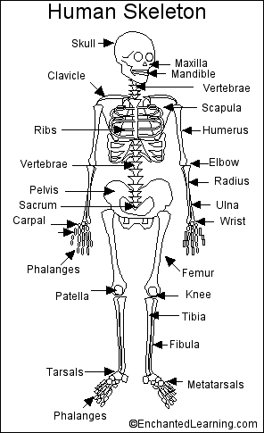
HUMAN SKELETON
Total no. of bones-
  306 in Foetus
  206 in adult
  213 in children

Slide 4
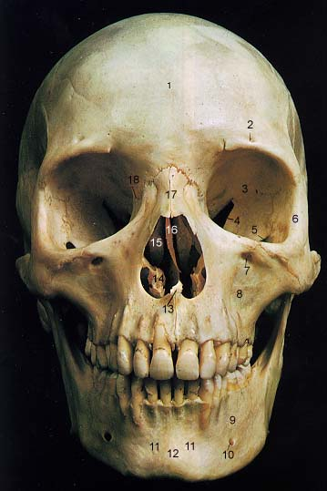
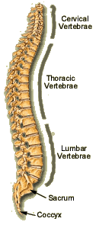
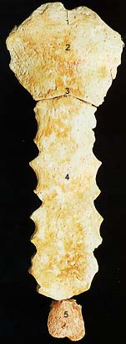
HUMAN AXIAL SKELETON
Consists of-
  80 bones in Adults,
  87 bones in children
Includes-
  Skull (29)
  Vertebral column (26)
  Ribs (24)
  Sternum (1)

Slide 5
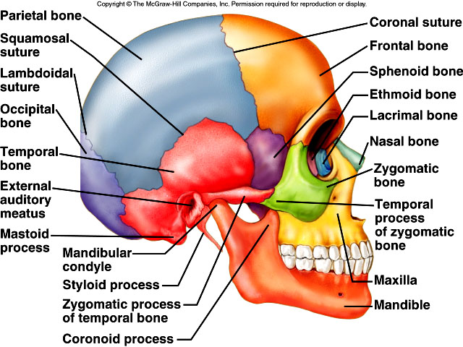
HUMAN SKULL
Study- Craniology
Human skull is dicondylic, bear two condyles and Tropibasic( Interorbital orbital septum is present between 2 orbits).
Jaw suspension is Craniostylic.

Slide 6
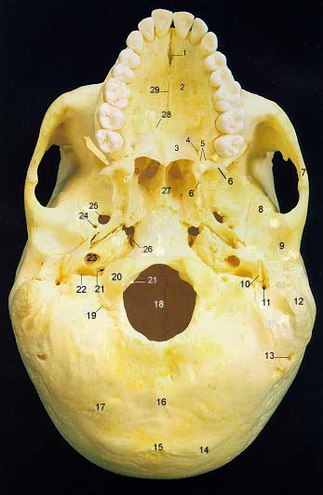
HUMAN SKULL
Total bones in skull-29
  Cranium-8
  Face-14
  Auditory or ear ossicles-6
  Hyoid or tongue bone-1

Slide 7
HUMAN SKULL……….Continued
1.Cranium (brain box) -8 bones
1 Occipital
1 Frontal
2 Parietal
2 Temporal
1 Sphenoid
1 Ethmoid

Slide 8
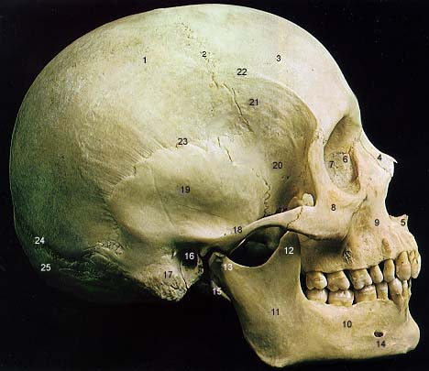
HUMAN SKULL……….Continued
Cranial bones are join together by permanent (Immovable) joints called SUTURES.
Coronal suture-between Frontal and parietal bones.

Slide 9
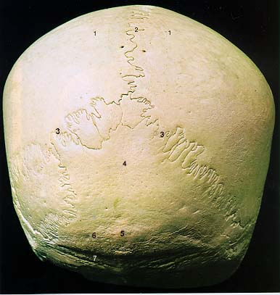
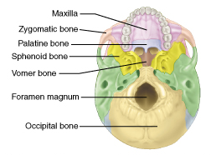
HUMAN SKULL……….Continued
Lamboidal suture-between Pareital and Temporal bones.
Cranium is characterised by presence of large called FORAMEN OF MAGNUM.

Slide 10
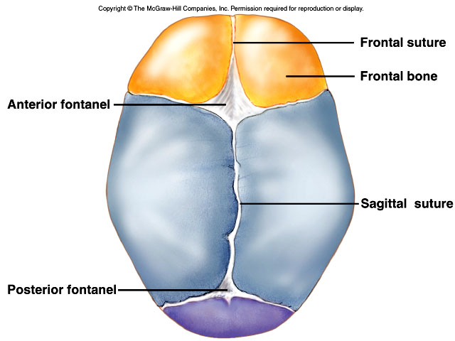
Allows for
growth

Slide 11
HUMAN SKULL……….Continued
FORAMEN OF MAGNUM is surrounded by 2 exooccipetal, 1 supra occipetal, 1 basioccipetal bones.
It is the largest foramen of human body, Spinal cord comes out through this foramen.
Pituitary gland is lodged in a depression called SELLA TURSICA in Sphenoid bone of cranium.

Slide 12
HUMAN SKULL……….Continued
Facial part -Consists of 14 bones-
  2 Nasal
  2 Inferior nasal conchae
  1 Vomar
  2 Lacrymal
  2 Zygomatic ( Cheek bones)
  2 Palatine (L Shaped)
  2 Maxilla (Upper jaw bones)
  1 Mandible (Largest bone of face & Hardest bone bone of human body)

Slide 13
HUMAN SKULL……….Continued
Sensory capsule or Ear ossicle -Consists of 6 small bones, 3 in each ear……….i.e. MIS
  1 Malleus(M) or Hammer shaped (Modified Articular)
  1 Incus (I) or Anvil shaped (Modified Quadrate)
  1 Stapes (S) or Stirrup shaped (Modified Hyomandibular)
Note-
  Joint Between Malleus & Incus – Hinge joint
  Joint Between Incus & Stapes – Ball and Socket joint
  Stapes is the smallest bone of human body.

Slide 14
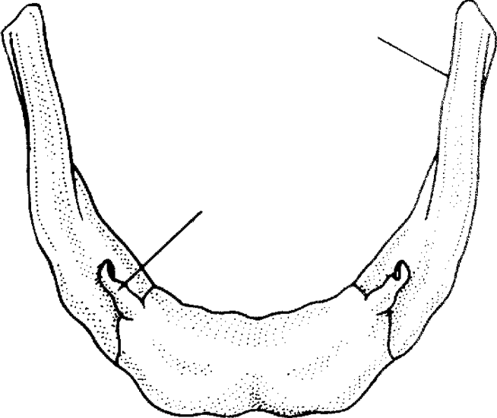
HUMAN SKULL……….Continued
Hyoid- Located on floor of buccal cavity.
Consists of –
  Body
  Greater cornu
  Lesser cornu
It is only the bone which is not articulate to any bone.
It supports our tongue and provides insertion to some tongue muscles.
Cranial capacity of modern man-1475cc.
Fig. 7.6-2 : Human hyoid bone
viewed from above
Greater corn
Greater cornu
Lesser cornu
Body

Slide 15
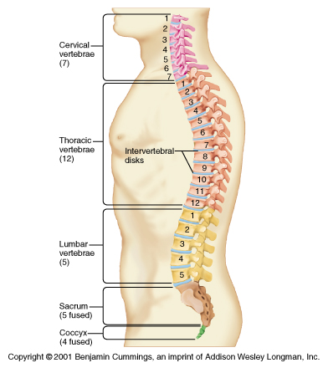
HUMAN VERTEBRAL COLUMN
Known as Back bone or Spinal bone.
Made up of 33 vertebra but some vertebra fuse together so net total is 26.

Slide 16
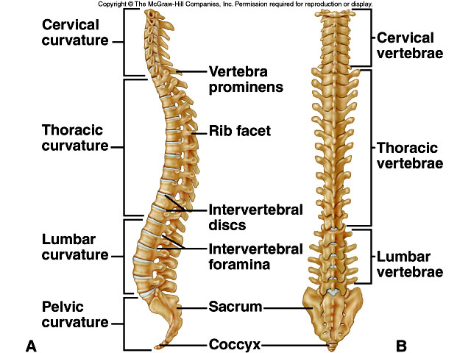

Slide 17
HUMAN VERTEBRAL COLUMN……Continued
Human vertebral column is about 70 cm long and curved like ‘S.’
There are 4 curvatures in V. Column-
Cervical and Lumber curvature are directed forward.
Thoracic and Sacral curvature are directed backward.
These curvatures help in erect posture and bipedal locomotion.

Slide 18
HUMAN VERTEBRAL COLUMN……Continued
Vertebral column is differentiated in 5 regions.
  Cervical
  Thoracic
  Lumber
  Sacral
  Caudal

Slide 19
HUMAN VERTEBRAL COLUMN……Continued
Vertebral Formula (Man )- 26(33) Vertebrae
  C7 T12 L5 S1(5) Cd1(4)
Vertebral Formula (Rabbit )- 46 Vertebrae
      C7 T12 L7 S44Cd16

Slide 20
HUMAN VERTEBRAL COLUMN……Continued
Mammals are characterized by presence of 7 cervical vertebrae.
Human, Rat, Rabbit, Giraffe all have 7 cervical vertebrae.
Exceptions-
Sea cow (Mantenee) and two toed sloth (Chloepus) have 6 cervical vertebrae.
Ant bear(Tamandua)and has 8 and three toed sloth (Bradypus) has 9 cervical vertebrae.

Slide 21
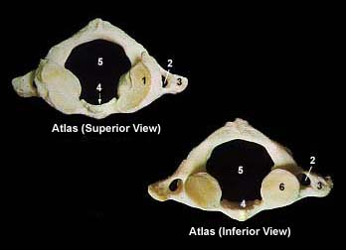
HUMAN VERTEBRAL COLUMN……Continued
First cervical vertebra is ring like and hold the skull so called ATLAS. It is also known as ‘YES BONE’.
Human atlas is characterized by absence of Centrum and spines.

Slide 22
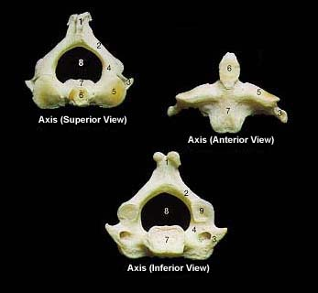
HUMAN VERTEBRAL COLUMN……Continued
Second cervical vertebra is called AXIS. It is also known as ‘NO BONE’.
Axis is characterized by presence of Odontoid process.It represents centrum pf axis.
Note-
  Axis is absent in Frog.
  Join between Atlas and Axis is BALL AND SOCKET type.
3rd - 7th Cervical vertebrae considered as ^{TYPICAL CERVICAL.}

Slide 23
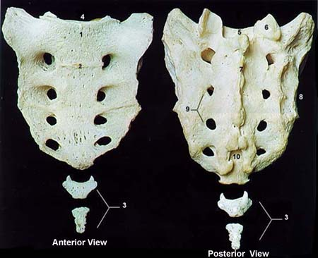
HUMAN VERTEBRAL COLUMN……Continued
Thoracic vertebrae are 12 in number. These are differentiated in anterior and posterior.
Ribs are attached to the thoracic vertebrae.
Lumber vertebrae are Largest and heaviest.
In human 4 foetal sacral vertebrae fuse together to form a SACRUM.

Slide 24
HUMAN VERTEBRAL COLUMN……Continued
All 4 caudal vertebrae join to form COCCYX.
It is considered as vestigeal in human.
Coccyx is Homologus to-
  Urostyle of frog
  Rattle of rattle snake
  Pygostyle of birds.

Slide 25
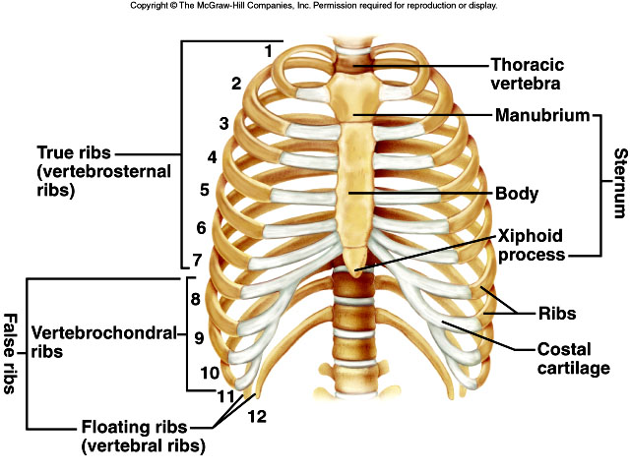

Slide 26
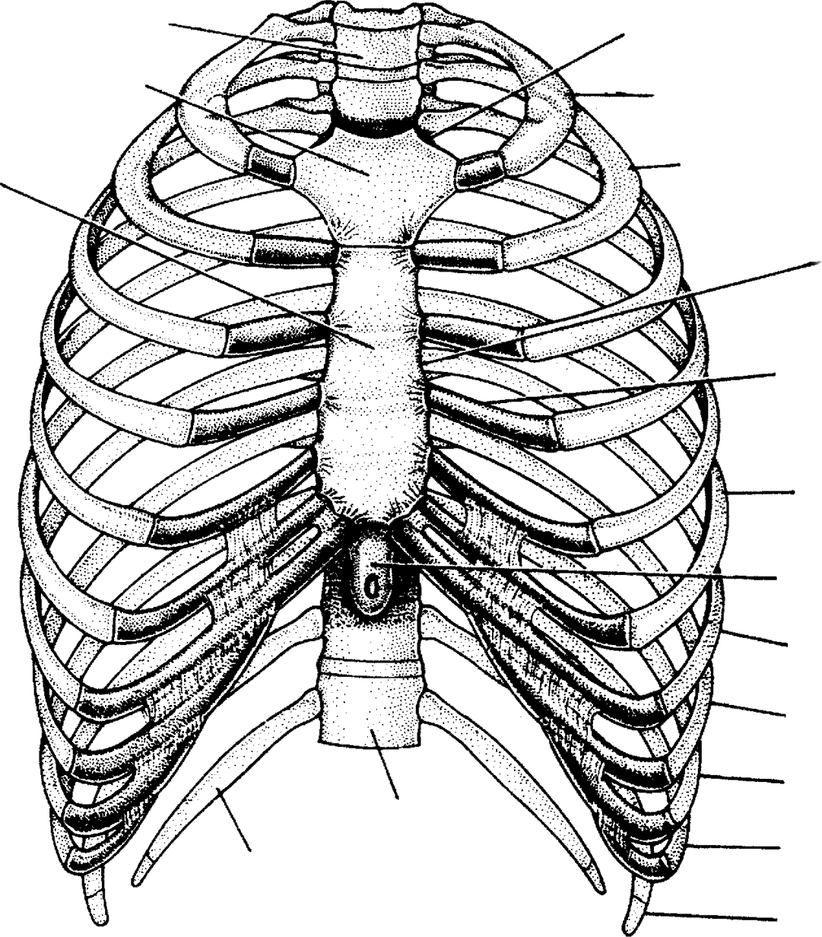
HUMAN RIBS
Ist Thoracic
vertebra
Facet for clavicle
Prosternum
Ist Rib
Mesosternum
2nd Rib
Sternum
Costal cartilage
6th Rib
Metasternum
7th Rib
8th Rib
9th Rib
12th
Thoracic
vertebra
10th Rib
12th Rib
11th Rib
Rib cage

Slide 27
HUMAN RIBS…………Continued
In human Ribs are 12 pairs.
These are 3 types-
  First 7 pairs are True ribs
  Next 3 pairs are False ribs
  Last 2 pairs are Floating ribs
Mammalian ribs are Bicephalous, means vertebral end has 2 processes i.e. Tuberculum (articulate with transverse process of vertebrae) and Capitulum (articulate with centrum of vertebrae).

Slide 28
HUMAN RIBS…………Continued
Floating ribs protect kidneys.
Note-
Uncinate process is found in avian ribs.This process provide attachment surface for flight muscles.
Cervical ribs are not ribs, these are backwardly directed processes in cervical vertebrae of birds.

Slide 29
HUMAN STERNUM
Known as Breast bone.
Support thorax on ventral side.
15 cm long.
Consists of 3 parts-
Uppermost-Manubrium
Middle-Mesosternum
Lowermost-Xiphisternum (Xiphoid cartilage)

Slide 30
HUMAN APPENDICULAR SKELETON
Total no. of bones-126
Includes-Girdles (6) and Limb bones(120)
GIRDLES-1.PECTORAL (2X2=4) 2.PELVIC GIRDLE (1X2=2)

Slide 31
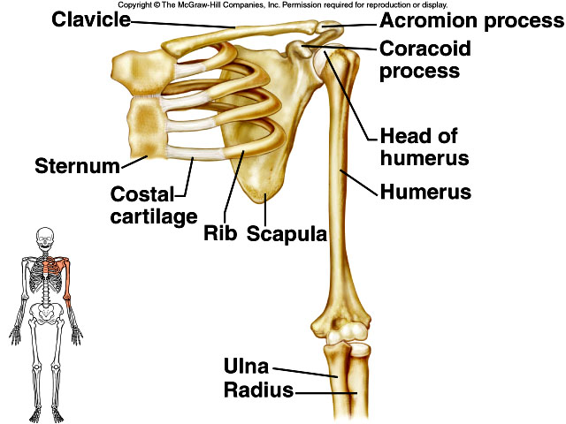

Slide 32
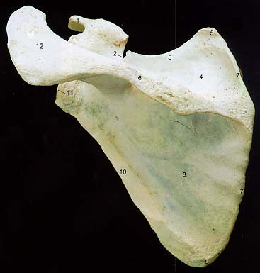
HUMAN APPENDICULAR SKELETON……Continued
PECTORAL GIRDLE
Known as Shoulder girdle.
Consists of 2 bones-
  Scapula
  Clavicle
Coracoid process and Acromian process are the parts of scapula.

Slide 33
HUMAN APPENDICULAR SKELETON……Continued
Clavicle also known as Collar bone or BEAUTY BONE.
At the junction of scapula & Clavicle a cup shaped Glenoid cavity is formed.Head of humerus articulates in this cavity.

Slide 34
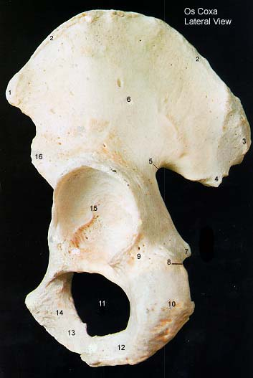
HUMAN APPENDICULAR SKELETON……Continued
PELVIC GIRDLE
Known as Hip girdle.
Each half of pelvic girdle called OSINNOMINATUM.
It is formed of 3 bones-
  Ilium
  Ischium
  Pubis

Slide 35
HUMAN APPENDICULAR SKELETON……Continued
Two pelvic girdles are joined by slightly movable joint called PUBIC SYMPHYSIS.
At the junction of 3 bone a depression, ACETABULUM is formed to hold head of femur.
Obturator foramen is formed by Ischium and Pubis.

Slide 36

Limb bones (60x2=120)
FORE LIMB-30X2=60
Includes-
1 humerus-bone of upper arm(Antibrachium).Characterized by presence of Deltoid ridge for attachment of muscles.
2 Radius-Ulna-Bones of lower arm(Brachium).Ulna is longer and outer bone.Sigmoid notch is present for trochlea of humerus.Olecranon process is formed by Ulna. Both radius and ulna have nutrient foramina.

Slide 37
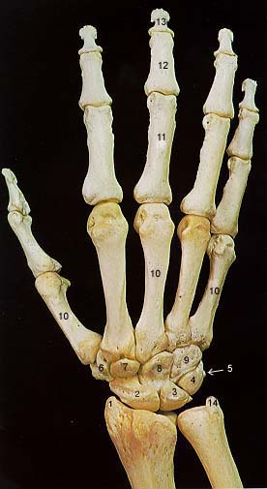
FORE LIMB……..Continued
8 Carpals-bones of wrist. These are arranged in two rows.
  1.Scaphois 2. Lunate
  3. Triquitrum 4.Pisciform(Sesamoid)
  5. Trapezium 6. Trapezoid
  7.Capitate 8. Hammate
Note-Unciform (Formed by fusion of 4th & 5th) ,Absent in Rabbit but present in Man.
R
U
S
L
T
P
T
T
C
H

Slide 38
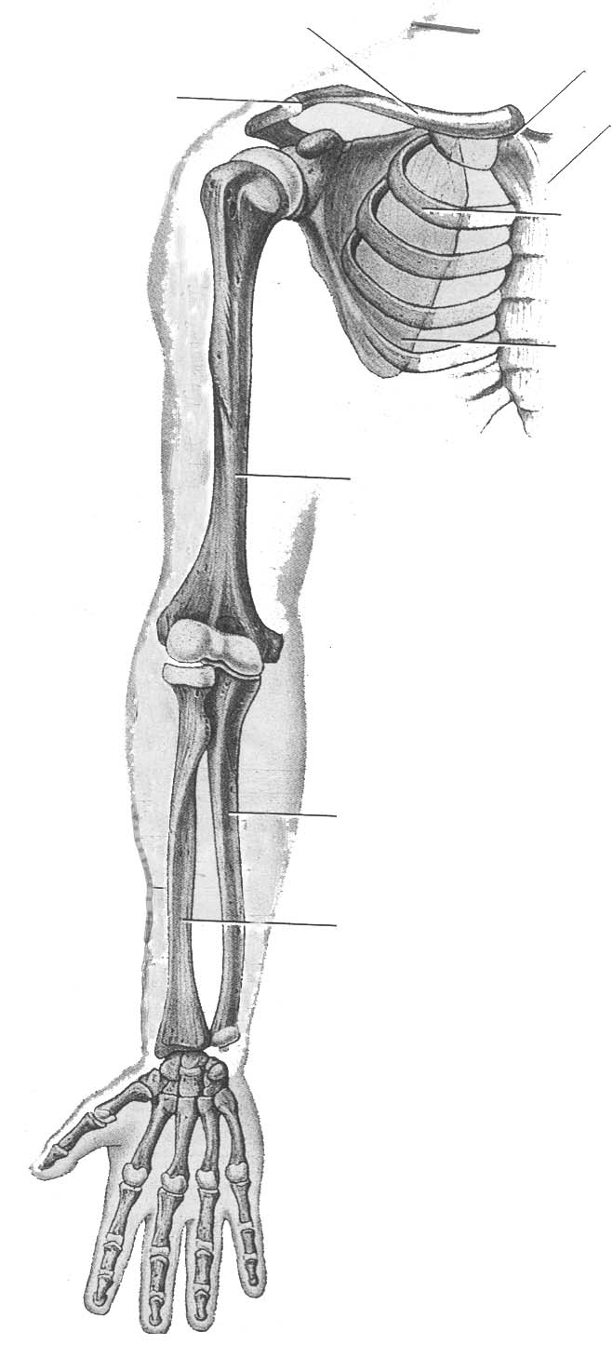
FORE LIMB………Continued
5 Meta carpals- Bones of Palm.These are thin & long.
14 Phallenges-Bones of fingers.
Phalanges Formula (14)-2,3,3,3,3
Sternoclavicular
joint
Clavicle
Acromioclavicular
joint
Sternum
Rib
Scapula
Humerus
Ulna
Radius
Carpals
Metacarpals
Phalanges

Slide 39
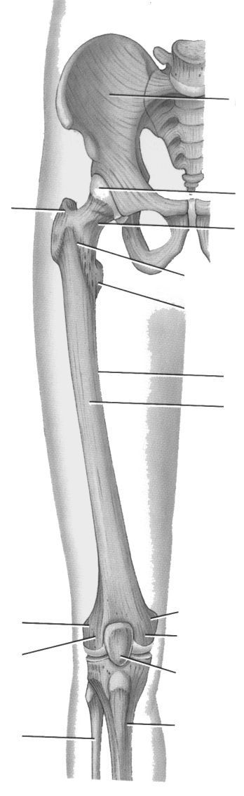
Hind Limb 30x2=60 bones
1 Femur-Thigh bone.Longest human body bone.
1 Patella-Known as knee cap.It is a sesamoid bone.Absent in newborn.Formed by ossification of ligaments.
1 Tibia-It is a bone of Shank.Known as Shin bone.
1 febula-bone of shank region.It is a thin & weak bone.

Slide 40
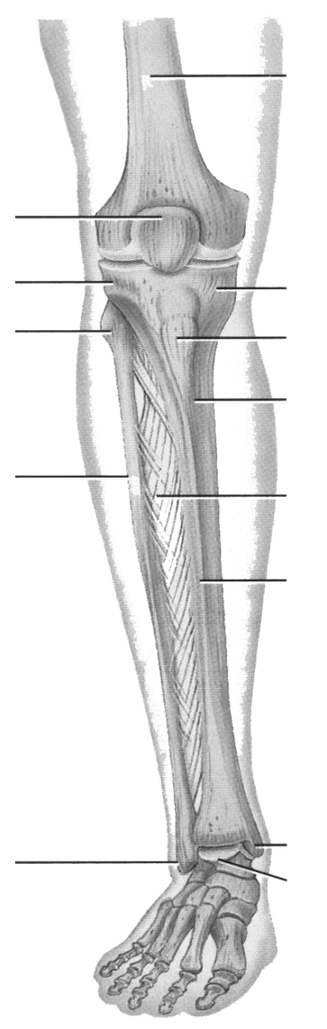
Hind Limb 30x2=60 bones
7 Tarsals- bones of Ankle.Arranged in 2+1+4 manner.
In Rabbit tarsals are 6 in number.2+1+3
Astragalus
Calcaneum
Navicular
Cuboid
+nt in human
Cuniform
-nt in Rabbit
Mesocuniform
Ectocuniform

Slide 41
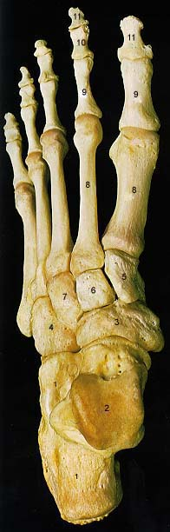
Hind Limb 30x2=60 bones
5 Metatarsals-Bones of foot or Pes Or Sole.
14 Phalanges-Bones of Toes. Phalanges formula-2,3,3,3,3.
Note –First of Fingers is called Paulux and First toe is called Hallux

