Slide 1
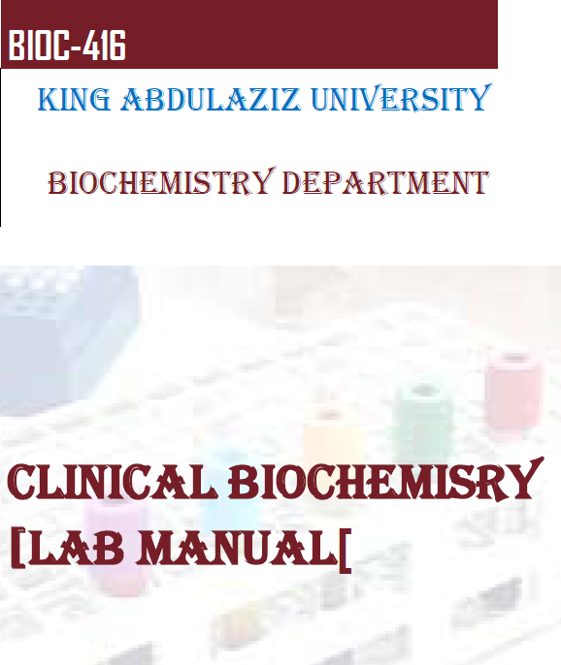

Slide 2
Introduction to Clinical Laboratories
Diagnosis begins with physical examination by a doctor or a clinician
Diagnostic tests are important steps to confirming a suspected diagnosis

Slide 3
The functional components of the clinical Laboratory
1) Clinical pathology
2) Hematology
3) Clinical biochemistry
4) Clinical microbiology
5) Serology
6) Blood bank
7) Histology and cytology

Slide 4
The purpose of Clinical biochemistry
1) to Reveal the cause of the disease
2) to Screen easy diagnosis
3) to Suggest effective treatment
4) to Assist in monitoring progress of pathological condition
5) to Help in assessing response to treatment

Slide 5
Important Note
Disinfection:
Chlorine (Sodium hypochlorite/JIK) is an universal disinfectant which is active against all microorganisms

Slide 6
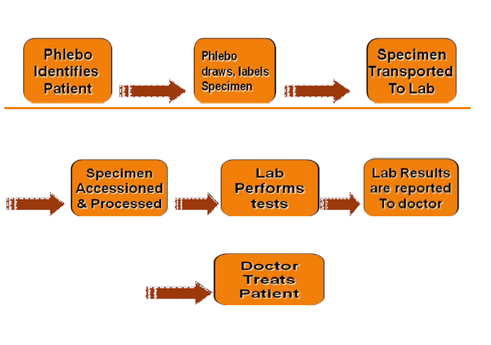
Laboratory work flow cycle:

Slide 7
The phlebotomist
The phlebotomist :
Is the technician who collects blood, should be trained to:
1) Prepare specimen collection material
2) Instruct patient appropriately
3) Collect, preserve and transport specimen carefully
4) Separate serum or plasma properly
5) Maintain proper record of collection
6) Handle the specimen carefully
7) Analyze the specimen accurately
8) Maintain proper record of reports
9) Work with appropriate safety precautions

Slide 8
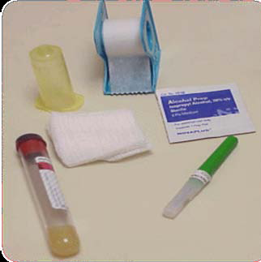
The phlebotomy equipments
1) Disposable syringes or vacutainer systems
2) Disposable lancets
3) Gauze pads or adsorbent cotton
4) Tourniquet
5) Alcohol swap
6) Waste container

Slide 9
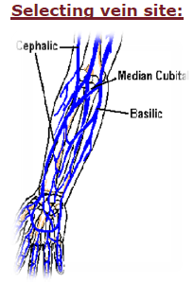
Blood collection
The median cubital vein
is the one used for
the patient.

Slide 10
Specimen rejection criteria
1- Specimen improperly labeled or unlabeled
2- Specimen improperly collected or preserved
3- Specimen submitted without properly completed request form
4- blood hemolysis

Slide 11
Hemolysis of blood
It is the liberation of hemoglobin from RBCs.
Due to hemolysis, plasma or serum assumes pink to red color.
hemolysis causes changes in measurement of a number of analysis such as:
1- Serum K
2- Serum in.org P.
3- SGOT
4- SLDH
5- Acid phosphatase

Slide 12
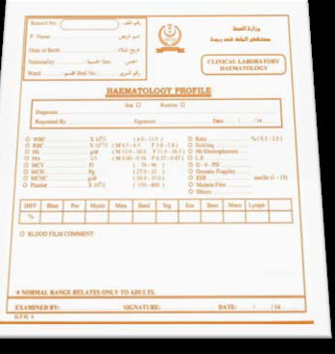
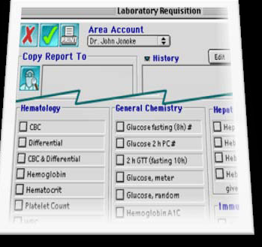
Lab request:

Slide 13
Lab request:
1. Full name: middle name should be included to avoid
2. Location: inpatient, room, unit, outpatient, address.
3. Patient's identification number: this identification can be very useful for instance in the blood bank.
4. Patient age and sex: disease prevalence may be age- or sex-linked.
5. Name(s) of the physician(s): name all of the physicians on the case; "panic values" should be called to the attention of the physician ordering the test; a physician may have some specific test guidelines for his patients.

Slide 14
Lab request:
6. Name of the test and the source:
7. Possible diagnosis: essential for evaluating laboratory results and selecting appropriate methodology; (media selection in microbiology).
8. The date and time the test is to be done: some tests must be scheduled by the laboratory; patient preparation and diet regulations need to be considered.
9. Special notation: provide relevant information to assist the laboratory--e.g., medications taken; for hormone assay, the point in the menstrual cycle when the specimen was obtained

Slide 15
Blood Testing
Three different specimens
Whole blood
Serum
plasma

Slide 16
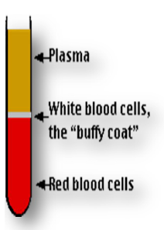
Blood
Red blood cells(RBCs)
-White blood cells(WBCs)
-Platelets
After centrifugation of blood, the blood separate into three layers

Slide 17
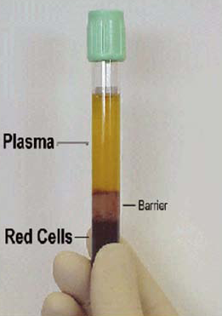
Blood plasma
Plasma is the liquid component of blood
-It is mainly composed of
water (92%)
blood proteins 7%(albumin, globulins, and fibrinogen)
inorganic electrolytes
When a blood sample is left standing without anticoagulant, it forms a coagulum or blood clot

Slide 18
Formation of The Clot
Platelets to maintain the integrity of the adherens junctions between the endothelial cells that line the blood vessels
Network of fibrin molecules
Thrombin ^{Prothrombin Ca+2 Thrombin}
Ca+2 Fibrinogen Thrombin Fibrin Clot
Clotting factors

Slide 19
Blood serum:
Serum is the same as plasma except that clotting factors (such as fibrin) have been removed.
No coagulation factors
It is obtained by letting a blood specimen clot prior to centrifugation.

Slide 20
Procedure of Plasma Preparation:
1-Draw blood from patient. Select vacutainer with an appropriate anticoagulant.
2- Mix well with anticoagulant.
3- Allow to stand for 10min.
4- Centrifuge the sample to speed separation and affect a greater packing of cells.
5- The supernatant is the plasma which can be now collected for testing purposes or stored (-20C to -80C) for subsequent analysis or use.

Slide 21
Procedure of Serum preparation:
1- Draw blood from patient. Select vacutainer with NO anticoagulant.
2- Allow to stand for 20-30min for clot formation.
3- Centrifuge the sample to speed separation and affect a greater packing of cells. Clot and cells will separate from clean serum and settle to the bottom of the vessel.
4- The supernatant is the serum which can be now collected by dropper or pipette for testing purposes or stored (-20C to -80C) for subsequent analysis or use.

Slide 22
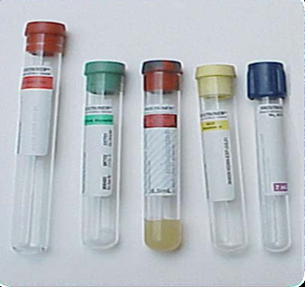
Blood collection tubes:

Slide 23
Plasma Separating Tubes (PST)
Top Color | Additives | Principle | Uses
Lavender | EDTA | -The strongest anti-coagulant Ca⁺² chelating agent - To preserve blood cells components | Hematology Blood bank (ABO) HbA1C (Glycosylated Hb)
Light Blue | Sodium Citrate | Ca⁺² chelating agent | - PT: Prothrombin Time - PTT: Partial Thromboplastin Time ( in case of unexplained bleeding and liver disease)
Green | Sodium Heparin or Lithium Heparin | Heparin binds to Thrombin and inhibits the second step in the coagulation cascade (Prothrombin Thrombin) Fibrinogen Fibrin | Enzymes Hormones Electrolytes (Na⁺, K⁺, Mg⁺, Cl⁻
Heparin

Slide 24
Top Color | Additives | Principle | Uses
Black | Sodium Citrate | Ca⁺² chelating agent | ESR ( Erythrocyte Sedimentation Rate) to test how much inflammation in the patient, unexplained fever, Arthritis, Autoimmune Disorder
Gray | -Sodium Fluoride -Potassium Oxalate | Glycolysis inhibitor Anti-Coagulant | Glucose tests
Royal Blue | Heparin Na-EDTA | Anti-Coagulant Tube should not be contaminated with metals | Toxicology Trace Elements and metals
Yellow | ACD ( Acid-Citrate Dextrose) | Anti-Coagulant | DNA Studies Paternity Test HLA Tissue Typing (Human Leukocyte Antigen) The body used this protein to differentiate the self-cells from non-self cells

Slide 25
Serum Separating Tubes (SST)
Top Tubes | Additives | Principle | Uses
Red | ------ Sometimes it has gel or silicon at the bottom of tube to reduce hemolysis | Enhancing the formation of blood clot | Serology -Antibodies -Hormones -Drugs Virology Chemistry Blood cross matching before blood transfusion
Gold | ------- It has gel at the bottom of the tube to separate serum from the blood | Serum separating from the blood through the gel in the tube | Serology Chemistry

