Slide 1
Cell Communication
Moses kepha
karu

Slide 2
…ought to know
Types of intercellular communication
Types of receptors
Intracellular cascades activated by the various groups of receptors

Slide 3
Intercellular communication
Mechanisms:
Cells can communicate with one another by chemical signals
Cells can communicate via direct interactions

Slide 4
Communication by direct interactions
Tight junctions, Zonula adherens, gap junctions which form part of intercellular connections are a means of cell communication
Provide clues for maintenance of normal cell architecture as well as organization of cells into tissues
Serve a signalling role during organ development; guiding cell proliferation and migration

Slide 5
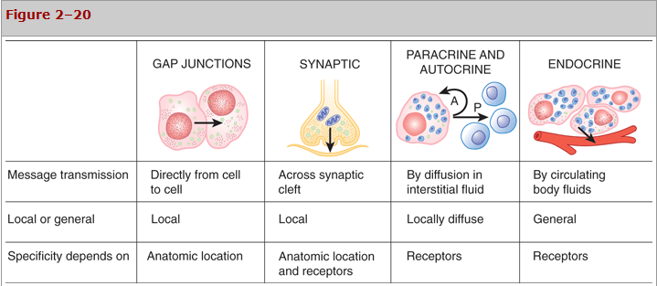
Types of intercellular communication

Slide 6
Communication by chemical signals
Cellular responses depend on the presence of receptors that specifically bind the signaling molecules.
The receptor determines the response irrespective of activating signal
Binding of signal molecules causes a conformational change in the receptor, which triggers subsequent signaling cascades

Slide 7
Steps in chemical signalling
Recognition
Transduction - generates a second messenger
Transmission – coupling to appropriate effector
Modulation of the effector – activation/deactivation of kinases/phoshatases
Response of cell to initial stimulus
Termination

Slide 8
Communication by chemical signals
Following addition;
Receptors can undergo desensitisation
Receptor downregulation
Receptor upregulation
Receptors are found on both sides of the cell membrane

Slide 9
Cell surface receptors
Are associated with impermeant signal molecules
Are membrane spanning proteins with components both outside and inside the cell surface.
Functional structure
Extracellular domain – signal binding site
Intracellular domain – activates intracellular signalling cascades

Slide 10
Plasma membrane receptors
Categorized as:
Channel-linked receptors
Enzyme-linked receptors
G-protein coupled receptors (GPCR)

Slide 11
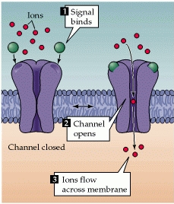
Channel linked receptors
Also known as ligand-gated ion channels
The receptor and transducing functions are carried by the same protein molecule.
Interaction of the chemical signal with the binding site of the receptor causes the opening or closing of an ion channel pore in another part of the same molecule.
The resulting ion flux changes the membrane potential of the target cell and, in some cases, can also lead to entry of Ca²⁺ ions that serve as a second messenger signal within the cell.

Slide 12
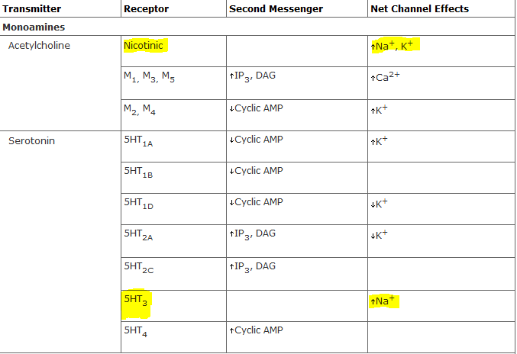
Receptor ion channels
Note: One ligand has many different types of receptors

Slide 13
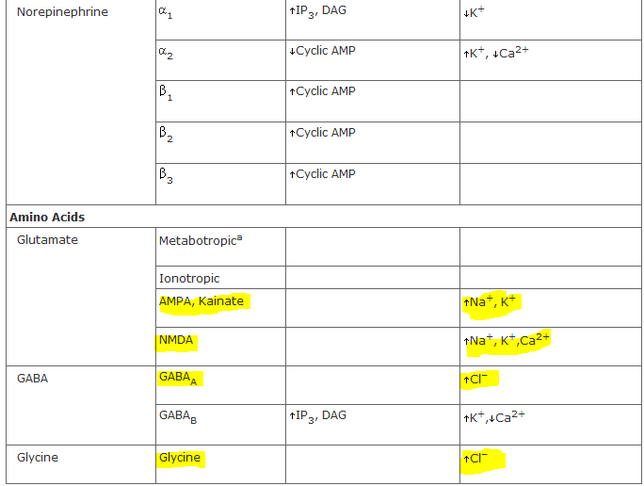
Receptor ion channels
Note: One ligand has many different types of receptors

Slide 14
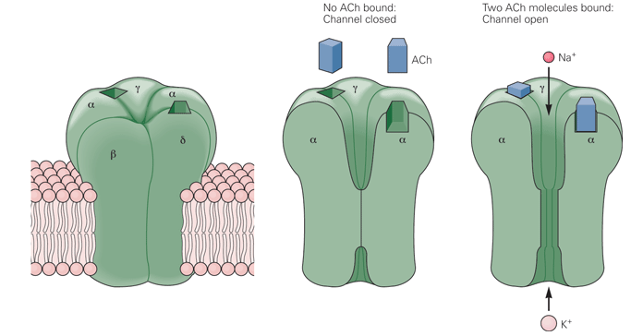
Nicotinic cholinergic receptors
Different subtypes in the brain, skeletal muscle, autonomic ganglia

Slide 15
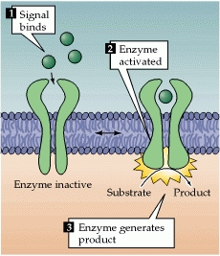
Enzyme-linked receptors
The intracellular domain of such receptors is an enzyme whose catalytic activity is regulated by the binding of an extracellular signal.
Majority are protein kinases, often tyrosine kinases, that phosphorylate intracellular target proteins, thereby changing the physiological function of the target cells.

Slide 16
Enzyme linked receptor subfamilies
Receptor tyrosine kinases for
Growth factors EDF, PDGF, ETP
Consititutes a majority of enzyme linked receptors
Tyrosine-kinase-associated receptors for
Cytokines
Prolactin, growth hormone
Receptor serine/threonine kinases for
TGF-beta (controls proliferation and differentiation of cells)
BMP (bone morphogenic protein)
Receptor guanylyl cylases for
Natriuretic peptide-ANP
Other groups exist; tyrosine phosphatases in mammals, histidine kinase associated receptors in bacteria

Slide 17
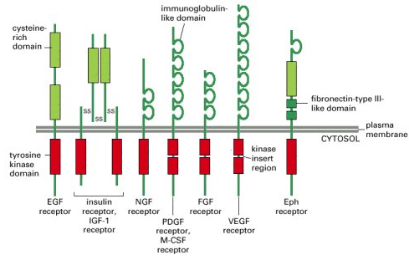
Receptor tyrosine kinases
When the receptor chains are cross-linked, the kinase domains of adjacent receptors cross-phosphorylate each other, stimulating the kinase activity of the receptor and creating docking sites for intracellular proteins
Molecular Biology of the Cell. 4th edition. Alberts B, Johnson A, Lewis J, et al. New York: Garland Science; 2002.
Notes:
A whole menagerie of intracellular signaling proteins can bind to the phosphotyrosines on activated receptor tyrosine kinases (or on special docking proteins such as IRS-1) to help to relay the signal onward. Some docked proteins are enzymes, such as phospholipase C-γ (PLC-γ), which functions in the same way as phospholipase C-β—activating the inositol phospholipid signaling pathway discussed earlier in connection with G-protein-linked receptors. Through this pathway, receptor tyrosine kinases can increase cytosolic Ca²⁺ levels

Slide 18
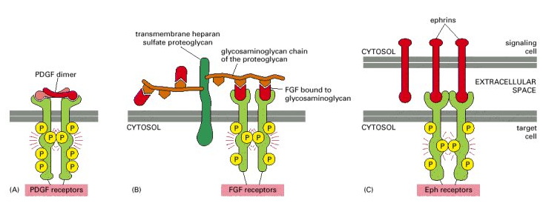
Receptor tyrosine kinases
Docking or bound intracellular proteins include enzymes (phospholipace-C>> IP3>> increase intracellular calcium) and other proteins that relay the signal forward
Notes:
A whole menagerie of intracellular signaling proteins can bind to the phosphotyrosines on activated receptor tyrosine kinases (or on special docking proteins such as IRS-1) to help to relay the signal onward. Some docked proteins are enzymes, such as phospholipase C-γ (PLC-γ), which functions in the same way as phospholipase C-β—activating the inositol phospholipid signaling pathway discussed earlier in connection with G-protein-linked receptors. Through this pathway, receptor tyrosine kinases can increase cytosolic Ca²⁺ levels.

Slide 19
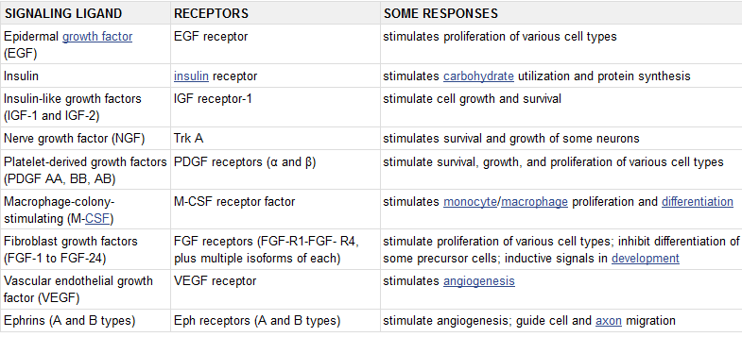
Receptor tyrosine kinases

Slide 20
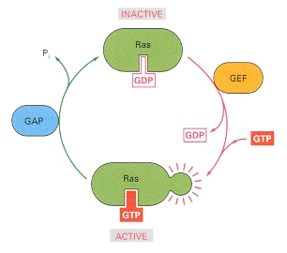
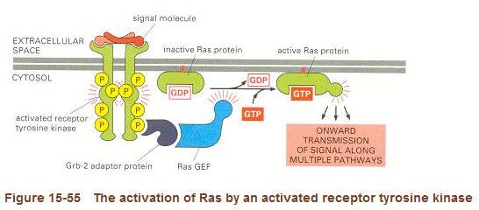
Mutant genes causing cancers (oncogenes)
GEFs – Guanine nucleotide exchange factors which activate Ras by making it give up GDP upon which it binds GTP with its subsequent activation
GAPs – GTPase activating proteins – deactivate Ras by hydrolysing the GTP to GDP to which it remains tightly bound in inactive state.
Mutant Ras is resistant to GAPs inactivation resulting in cancer, nearly 30% of cancers.

Slide 21
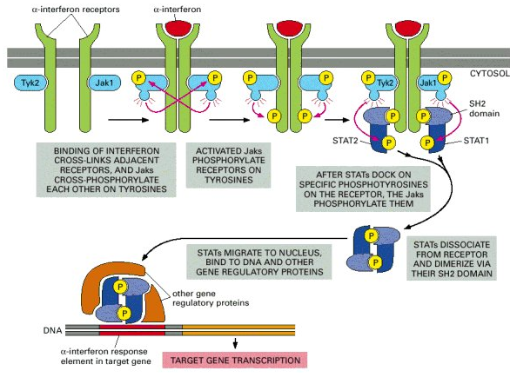
Tyrosine associated receptors
Receptors for cytokines, growth hormone, prolactin

Slide 22
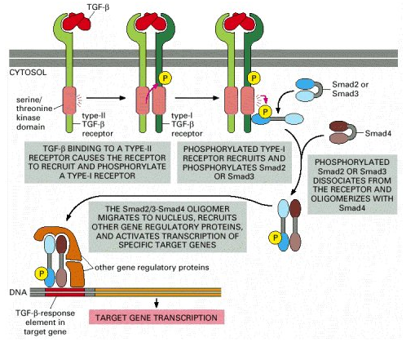
Receptor threonine/serine kinases
TGF-B, Bone morphogenic protein (BMP)

Slide 23
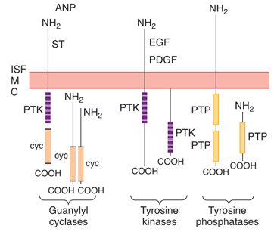
Receptor guanylyl cyclases
Receptors for Natriuretic peptides (ANP, BNP)
The ANP secreted by the atrium of the heart when BP rises, stimulates the kidneys to secrete Na⁺ and water and induces the smooth muscle cells in blood vessels walls to relax. Both of these effects tend to lower the blood pressure.

Slide 24
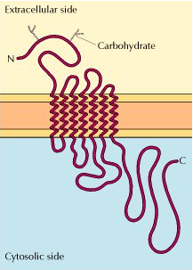
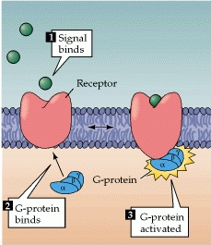
GPCR
G-protein-coupled receptors regulate intracellular reactions by an indirect mechanism involving an intermediate transducing molecule, called the GTP-binding proteins (G-proteins).
Transmembrane crossing the plasma membrane seven times thus serpentine receptors (or metabotropic receptors).
Examples: β-adrenergic receptor, the muscarininc type acetylcholine receptors, metabotropic glutamate receptors, receptors for taste, smell
Notes:
G proteins consist of three subunits, designated α, β, and γ. They are frequently called heterotrimeric G proteins to distinguish them from other guanine nucleotide-binding proteins, such as the Ras proteins.
Different G proteins associate with different receptors, so this array of G proteins couples receptors to distinct intracellular targets.
Gs – stimulates (activates) adenyl cyclase
Gi – inhibits adenyl cyclase

Slide 25
G-proteins
Two groups:
small Ras, Rab, Rho/Rac – other intracellular p/ways
Heterotrimeric – in GPCR
G proteins consist of three subunits, α, β, and γ.
Different G proteins associate with different receptors, so this array of G proteins couples receptors to distinct intracellular targets.
G protein associated with the epinephrine receptor is called G_{s} because its α subunit stimulates adenylyl cyclase. G_{i} associated receptors inhibit the enzyme decreasing cAMP levels.

Slide 26
G-protein function
The α subunit binds guanine nucleotides, which regulate G protein activity.
Resting state, α subunit is bound to GDP.
Ligand binding induces a conformational change in the receptor, causing activation of the G protein (stimulates the release of bound GDP and its exchange for GTP).
The activated GTP-bound α subunit then dissociates from the βγ complex.
The active GTP-bound α subunit and the βγ complex then interact with their targets to elicit an intracellular response.
Termination of effect: The activity of the α subunit is terminated by hydrolysis of the bound GTP, and the inactive α subunit (now with GDP bound) then reassociates with the βγ complex, ready for the cycle to start anew.

Slide 27
G-protein function
Some G proteins directly regulate ion channels.
The acetylcholine receptor on nerve and skeletal muscle cells is a ligand-gated ion channel (Na+ channel).
Heart muscle cells have a different acetylcholine receptor , which is G protein-coupled. This G protein is designated G_{i} because its α subunit inhibits adenylyl cyclase. In addition, the G_{i} βγ subunits act directly to open K⁺ channels in the plasma membrane, which has the effect of slowing heart muscle contraction.

Slide 28
Intracellular receptors
Intracellular receptors are activated by cell-permeant or lipophilic signaling molecules.
Many of these receptors lead to the activation of signaling cascades that produce new mRNA and protein within the target cell.
The activated hormone-receptor complex then binds with a specific regulatory sequence of the DNA called the hormone response element (HRE).
The HRE binding either activates or represses transcription of specific genes and formation of messenger RNA (mRNA).
Effect on protein synthesis takes minutes to days

Slide 29
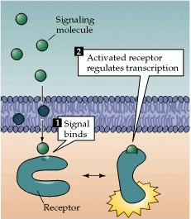
Intracellular receptor ligands
Steroid hormones – cytoplasmic receptors; adrenal, retinoid and gonadal hormones, vitamin D
Thyroid hormones – nuclear receptors

Slide 30
Second Messengers

Slide 31
The cAMP pathway
Formed from ATP by the action of adenylyl cyclase and degraded to AMP by cAMP phosphodiesterase.
Hormones such as epinephrine are coupled to adenyl cyclase via a G-protein which activates it to form cAMP
Main effects are through protein Kinase A.
cAMP activates PKA (a tetramar) by binding to its regulatory sites thereby activating its catalytic sites.

Slide 32
cAMP and calcium
Cyclic AMP mediates the phosphorylation of the sarcolemmal calcium channel, which results in an increase in the conductance of the channel.
Activated PKA phosphorylates the protein phospholamban, which when not phosphorylated, inhibits the SR calcium pump, increasing intracellular calcium stores

Slide 33
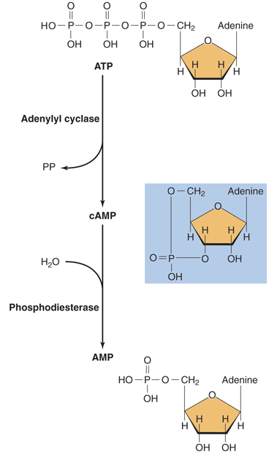
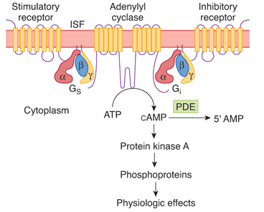
The cAMP pathway
In epinephrine mediated hyperglycemia, PKA once activated phosphorylates many molecules phosphorylase kinase which phosphorylates many more molecules of glycogen phosphorylase (activated ) and glycogen synthase (inactivated)
Note the amplification cascade from the binding of one surface receptor

Slide 34
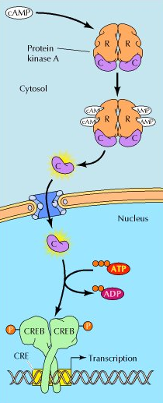
The cAMP pathway
Regulation of gene expression through the activation of transcription of cAMP-inducible genes that play important roles in controlling the proliferation, survival, and differentiation of a wide variety of cells.
The signal is carried to the nucleus by the catalytic subunit of protein kinase A following release from the regulatory subunit.

Slide 35
The cAMP pathway
cAMP can also directly regulate ion channels, independent of protein phosphorylation.
Many of the odorant receptors in sensory neurons in the nose are GPCR that stimulate adenylyl cyclase, leading to an increase in intracellular cAMP.
cAMP in this system directly opens Na⁺ channels in the plasma membrane, leading to membrane depolarization and initiation of a nerve impulse.

Slide 36
Clinical correlations
Some of the phosphodiesterase isoforms that break down cAMP are inhibited by methylxanthines such as caffeine and theophylline
PDE inhibitors increase cardiac contractility – milrinone, amrinone

Slide 37
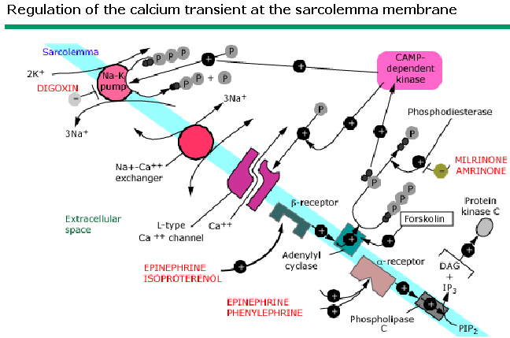
Clinical correlations
Dihydropyridines block the sarcolemmal calcium channel –L type which is itself a voltage gated channel

Slide 38
The cGMP pathway
Cyclic GMP is formed from GTP by guanylyl cyclases and degraded to GMP by a phosphodiesterase.
Different types of guanylyl cyclases are activated by both nitric oxide and peptide ligands.
Stimulation of these guanylyl cyclases leads to elevated levels of cGMP, which then mediate biological responses, such as blood vessel dilation.
The action of cGMP is frequently mediated by activation of a cGMP-dependent protein kinase, although cGMP can also act to regulate other targets, including ion channels.
cGMP mediates the action of nitroprusside and nitroglycerin which are vasodilators

Slide 39
Role of cGMP in photoreception
The best-characterized role of cGMP is in the vertebrate eye, where it serves as the second messenger responsible for converting the visual signals received as light to nerve impulses
Absorption of light by retinal activates the G protein-coupled receptor rhodopsin. The α subunit of transducin then stimulates cGMP phosphodiesterase, leading to a decrease in intracellular levels of cGMP.

Slide 40
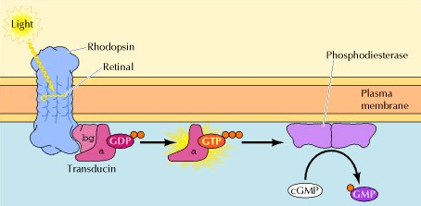
cGMP in vision

Slide 41
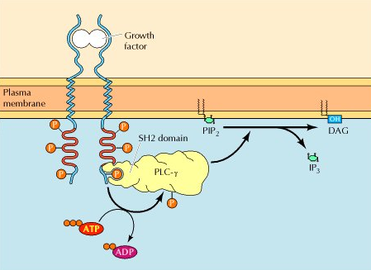
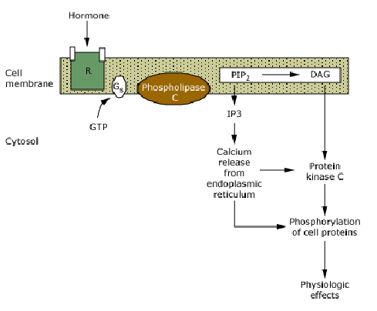
Phosphatidyl inositol pathway Inositol 1,3,5 triphosphate –IP3, Diacylglycerol
PIP2 is a minor component of the cell membrane
Signal molecules include: growth factors and hormones e.g epinephrine
PLC activated via GPCR eg adrenergic receptors or as a docking protein on a receptor protein tyrosine kinase
IP3 is released into cytosol, DAG remains assoc. with the plasma membrane

Slide 42
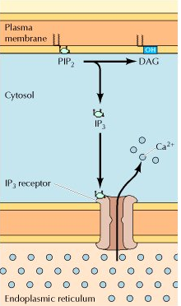
What is the effect of IP3
Intracellular calcium regulation.
How? By binding to the IP3 receptor which is a ligand gated calcium channel triggering many folds the intracellular calcium concentration.
Calcium is involved in regulation of activities of enzymes including some kinases(PKC), proliferation, neural signaling, learning, contraction, secretion

Slide 43
What is the effect of DAG
Activates protein kinase C family, many of which play important roles in the control of cell growth and differentiation.
The tumor-promoting activity of the phorbol esters is based on their ability to stimulate PKC by acting as analogs of DAG. PKC then activates other intracellular targets leading to changes in gene expression and stimulation of cell proliferation.

Slide 44
PIP3
PI 3-kinase phosphorylates the 3 position of inositol, converting PIP₂ to PIP_{3,}.
PI 3-kinase is activated by G proteins or by association with receptor protein-tyrosine kinases.
PIP3 regulates the activity of a cascade of protein kinases that are direct regulators of cell survival and transcription factors
PIP3 also regulates other protein kinases that regulate cell metabolism and protein synthesis.

Slide 45
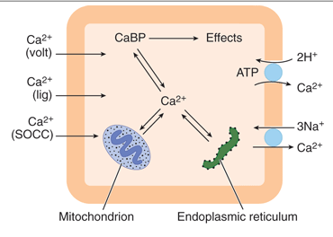
Calcium Ca⁺⁺
Regulates diverse physiological processes
Cell proliferation, neural signalling, contraction, secretion, learning
Tightly regulated intra and extracellular concentrations
Effects are determined by changes in intracellular calcium concentrations

Slide 46
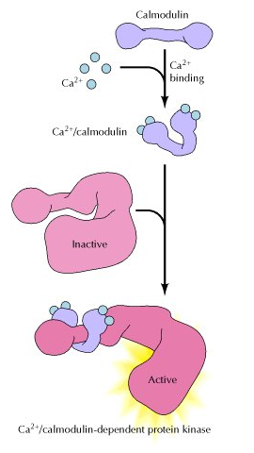
Calcium
Effects of calcium are mediated by calcium binding proteins:
Calmodulin, Troponin, Calcineurin, Calbindin
Many of the effects of Ca are mediated by the Ca-binding protein calmodulin
Calmodulin is activated by binding Ca when the concentration of cytosolic Ca increases about 5 fold

Slide 47
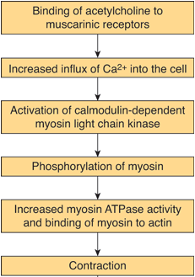
Calcium/Calmodulin
When calmodulin binds Ca²⁺, it is capable of activating five different calmodulin-dependent kinases among other proteins.
One of the kinases is myosin light-chain kinase, which phosphorylates myosin. This brings about contraction in smooth muscle.

Slide 48
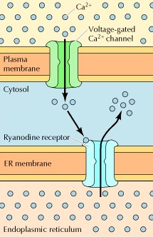
Regulation of intracellular Ca²⁺ in electrically excitable cells
Membrane depolarization opens voltage-gated Ca²⁺ channels in the plasma membrane increasing intracellular Ca²⁺ which signals the further release of Ca²⁺ from SER by opening distinct Ca²⁺ channels (ryanodine receptors) in the endoplasmic reticulum membrane.
In muscle cells, ryanodine receptors in the sarcoplasmic reticulum may also be opened directly in response to membrane depolarization.

Slide 49
Effect of Increased intracellular calcium
One effect of increases in intracellular Ca²⁺ in neurons is to trigger the release of neurotransmitters, so Ca²⁺ plays a critical role in converting electric to chemical signals in the nervous system.

Slide 50
THANK YOU

