Slide 1
KMTC/QP-07/COL
KENYA MEDICAL TRAINING COLLEGE MAKINDU CAMPUS
YEAR I SEMESTER 1
Immunology
CREDIT hours 10 hrs
FACULTY
Mutiso Raphael (Mr.)BScN
mutisorn@gmail.com

Slide 2
CONTENT
Definitions
Immunological concepts
Antibody
Antigen
complement
Types of immunity
Clinical importance
Principles of infection prevention and control

Slide 3
Concepts and Introduction
The Latin term “immunis” meaning “exempt” gave rise to the English word “immunity”,= mechanisms used by the body to protect against environmental agents that are foreign to the body.
These agents may be microorganisms or their products, foods, chemicals, drugs, pollen or animal hair.

Slide 4
Definition:
Immunity The study of the physiologic mechanisms that allow the body to recognize materials as foreign or abnormal and to neutralize or eliminate those foreign materials.
Immunology
Study of the components and function of the immune system

Slide 5
Immune system = cells, tissues, and molecules that mediate resistance to infections
Immunology = study of structure and function of the immune system
Immunity = resistance of a host to pathogens and their toxic effects
Immune response = collective and coordinated response to the introduction of foreign substances in an individual mediated by the cells and molecules of the immune system
5

Slide 6
Endemic when a small number of cases occur constantly among the population of a community e.g. Typhoid
Epidemic The disease flares up and large number of cases develop with in a community with in a short time. E.g. Influenza
Pandemic when an epidemic becomes very widespread areas in the world involving large number of people within a short period).

Slide 7
Divisions of Immunology
7

Slide 8
Immune System
Molecules, cells, tissues and organs which provide non-specific and specific protection against
Microorganisms
Microbial toxins
Tumor cells
Crucial to human survival

Slide 9
Immune response
Innate (non-specific)
Adaptive (specific)
Primary
Secondary
Immunity
State of non-specific and specific protection
Acquisition of Immunity
Natural
Artificial

Slide 10
SELECTIVITY and SPECIFICITY—
The immune system is highly selective and specific for each pathogen
1 pathogen=1 response
MEMORY— Once having met a pathogen, the immune system never forgets it.
If you are re-challenged with the same pathogen the memory response will recognize it immediately-- and destroy it or neutralize it.
With such a fabulous memory we should never get the same disease twice! Exceptions…?

Slide 11
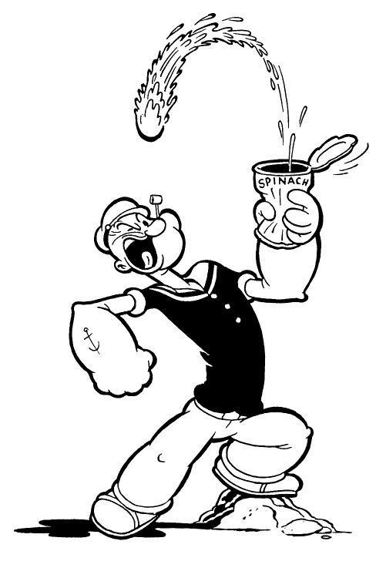
So, how do you acquire memory?
You either suffer the infection…
VACCINATE, VACCINATE, VACCINATE!
??????future
Shampoos as vaccines
using foods

Slide 12
Organs Of Immune System
Primary Lymphoid Organs
Bone Marrow and Thymus
Maturation Site
Secondary Lymphoid Organs
Spleen, lymph nodes,
MALT (mucosal associated lymph tissue)
GALT (gut associated lymph tissue)
Trap antigen, APC, Lymphocyte Proliferation

Slide 13
ORIGIN OF CELLS OF THE IMMUNE SYSTEM
Derived from common progenitor cell in bone marrow
Pluripotent hematopoietic stem cell
Progenitor Stem Cells
Erythroid lineage
Erythrocytes and Megakaryocytes
Myeloid lineage
Monocyte/macrophage, dendritic cells, PMN’s, mast cells
Lymphoid lineage
Small and large lymphocytes

Slide 14
CELLS OF INNATE AND ADAPTIVE IMMUNITY
Myeloid Lineage
Neutrophil
Principal phagocytic cell of innate immunity
Eosinophil
Principal defender against parasites
Basophil
Functions similar to eosinophils and mast cells
Referred to as
Polymorphonuclear leukocytes (PMN’s)
Nuclei are multilobed (2 to 5)
Granulocytes
Cytoplasmic granules

Slide 15
Myeloid lineage
Monocytes
Leukocytes with bean shaped or brain-like convoluted nuclei
Circulate in blood with half life of 8 hours
Precursors of tissue macrophages
Macrophages
Mononuclear phagocytic cells in tissue
Derive from blood monocytes
Participate in innate and adaptive immunity

Slide 16
Monocytes
Leukocytes with bean shaped or brain-like convoluted nuclei
Circulate in blood with half life of 8 hours
Precursors of tissue macrophages
Macrophages
Mononuclear phagocytic cells in tissue
Derive from blood monocytes
Participate in innate and adaptive immunity

Slide 17
Dendritic cells
Cells with dendriform (star shaped) morphology
Interdigitating reticular cells (synonym)
Capture and present antigens to T lymphocytes
Mast cells
Located in mucous membrane and connective tissue throughout body
Major effector cell in allergy
Modulation of initial immune response

Slide 18
Lymphoid Lineage
Large lymphocytes (large granular lymphocytes)
Natural killer (NK) cells (CD16, CD56)
Innate immunity to viruses and other intracellular pathogens
Participate in antibody-dependent cell-mediated cytotoxicity (ADCC)
Small lymphocytes
B cells (CD19)
T cells (CD3, CD4 or CD8)
Adaptive immunity
Lymphocytes refers to small lymphocytes

Slide 19
THE CLUSTER OF DIFFERENTIATION (CD)
CD markers on leukocytes
Granulocyte CD45+, CD15+
Monocyte CD45+, CD14+
T lymphocyte CD45+, CD3+
T helper lymphocyte CD45+, CD3+, CD4+
T cytotoxic lymphocyte CD45+, CD3+, CD8+
B lymphocyte CD45+, CD19+
Natural killer cell CD45+, CD16+, CD56+, CD3-

Slide 20
Types of immunity
Immunity classification
Depending on the nature of response towards the pathogen, Immune system is broadly classified into
Natural and
Acquired immunity.

Slide 21
Inborn or innate immunity: It is present at birth; This is our First Line Of Defense.
Acquired or specific: It is not present at birth but becomes part of our immune system as the lymphoid system develops.
1970: WHO defined immunity as immune response to antigen ( Foreign body) in form of
Humoral ( activation of B-lymphocytes)
Cellular (by activation of T-lymphocytes
21

Slide 22
Innate (non-adaptive)
first line of immune response
relies on mechanisms that exist before infection
Acquired (adaptive)
Second line of response (if innate fails)
relies on mechanisms that adapt after infection
handled by T- and B- lymphocytes
one cell determines one antigenic determinant
22

Slide 24
1. Natural Immunity
Innate immunity or natural immunity
The non specific immunity present from birth, It protects the body against any foreign invaders and does not show any specificity.
It is also functionally matured in a new born.
It does not become more efficient after subsequent exposures to same organism.

Slide 25
components
Anatomic
Skin
Mucous membranes
Physiologic
Temperature
pH
Chemical mediators

Slide 26
Phagocytic
Cells specialized in the process of phagocytosis
Macrophages
Reside in tissues and recruit neutrophils
Neutrophils
Enter infected tissues in large numbers
Recognize common molecules of bacterial cell surface
using a few surface receptors
Inflammatory

Slide 27
Components (Cell types) involved in immunity
The cells of the immune system include leukocytes/ white blood cells (WBC).
They developed from the bone marrow stem cells and give rise to two families of white blood cells
Myeloid cells (named after bone marrow) Basophils, Eosinophils and Neutrophils.
The monocytes give rise to macrophages when enter into the tissue space from blood circulation. Similarly, Basophil are transformed to mast cells.

Slide 28
Lymphoid cells, which take their name from the lymphatic system. Include T and B lymphocytes which get their maturation in different lymphoid organs.
B-cell maturation begins in the liver (fetal) and continues within the bone marrow as maturation progresses (adult) and
T cells complete their maturation in the thymus.

Slide 29
Mechanisms involved in Natural immunity
Skin barrier covers and protects the body as a barrier to prevent invading pathogens.
Intact skin prevents the penetration of most pathogens, by secreting lactic acid and fatty acids which lower the skin pH.
Mechanical barriers, Mucous membranes form the external layer where body is not covered with skin and it plays an important role in the prevention of pathogen entrance by trapping them.
Movement of the mucociliary process in the upper respiratory tract, the cilia in the eyelids act as escalators to remove the pathogens.

Slide 30
Secretions, Sweat has antibacterial substances and tears contain lysozyme.
Mucous secretion in nose prevents the dust and microorganism entry into the respiratory tract.
Saliva contains lysozyme, thiocyante and lactoferrin.
The HCl acid secreted in the stomach kills the microbes.
Phagocytosis, The ingestion (endocytosis) and killing of microorganisms by specialized cells called as phagocytes. Phagocytes are polymorphonuclear leukocytes (eg.Neutrophils) and mononuclear cells (Monocytes and Macrophages).

Slide 31
Opsonization -The process by which microbes are coated by a molecule called opsonin which aids attachment of microbes to the phagocytic cells which facilitates phagocytosis.
Stages of Phagocytosis
Opsonization (process by which microbes are coated by a molecule called opsonin). Attachment to the pathogen (so that pathogen movement can be restricted).
Formation of Pseudopodia (hand like projections).
Encircling of pathogen by pseudopodia leads to the formation of Phagosome.
Fusion of Phagosome with lysozyme vesicle leads to the formation of phagolysosome.
Killing of Pathogen.

Slide 32
Reticulo endothelial system (RES)
A diffuse system of cells that includes monocytes and macrophages, which are phagocytic in nature.
The role of macrophage is consider as first order defence mechanism, as it engulf and kill more pathogens efficiently. Macrophages also takes part in antigen presentation.
Apart from this, RES also involved in removing aged RBCs, denatured protein, steroids, dyes and drugs.

Slide 33
The macrophages derive the name according to their location.
Liver - Kupffer cells
Brain - Microglial cells
Kidney - Mesangial cells
Spleen - Splenic macrophages
Peritoneum - Peritoneal macrophages.
Alveoli - Alveolar macrophages.

Slide 34
Natural Killer Cells
Among the immune cells, natural killer cells (NK cells) are the most aggressive. They are first line of defense against infected and cancerous cells.
They are lymphocytes (Large granular lymphocytes, LGL) with no immunological memory and are part of the innate immune system. It attaches to the target and releases a lethal burst of chemicals called as perforins that penetrate the cell wall.
Fluids begin to leak in and out and eventually the cell explodes

Slide 35
Interferon
Interferons are proteins produced by body cells when they are invaded by viruses, is released into the bloodstream or intercellular fluid, in order to induce healthy cells to manufacture an enzyme that block viral replication.
The complement cascade consists of two separate pathways that converge in a final common pathway .
classic pathway and alternative pathway the two converge in a final common pathway . Complement System

Slide 36
Complement System
It is a group of proenzymes. They circulate in serum in inactive form.
The complement system is the part of innate immune system plays an important defense against microorganisms, especially gram-negative bacteria.
The complement system consists of a set of over twenty serum proteins which are getting activated

Slide 37
Antigen presenting cells (APC)
B cell,dendritic cells (lymphnodes), Langerhans cells (from skin) and macrophages are called as antigen presenting cells.
All these cells, process the antigen and express the antigen over the surface of its cell membrane along with a molecule called as Major Histo Compatibility Complex (MHC) class II molecule.

Slide 38
Major Histocompatability complex
A set of cell surface glycoproteins molecules.
Generally, they take part in differentiating self and non-self-antigens and the presentation of processed foreign antigen to activate the T cells.
MHC a section on chromosome # 6 containing a group of genes that produce molecules marking our own tissues as “self” (referred to as “self-antigens.”) These are referred to as HLA (human leukocyte antigens) because…

Slide 39
There are two classes of MHC proteins, MHC class I and MHC class II.
MHC class I molecule is expressed on the cell surface of all nucleated cells of the body. MHC class I molecules with processed antigen are expressed on the surface of the infected cells, which present the processed antigen to cytotoxic T cells
(CD8). MHC class II molecule are expressed on APC cell surface which present the processed antigen to Helper T cells (CD4 cells).

Slide 40
General principles
HLA antigens help the immune system to recognize pathogens and to mount an immune response
HLA-A, HLA-B, HLA-C—Class I antigens
HLA-DP, HLA-DQ, HLA-DR—Class II antigens
Class II antigens are the immune response antigens

Slide 41
Complement system
It's a set of interacting proteins released into the blood after production in the liver.
The components act together as zymogens, activating one another in cascade fashion after initiation from a variety of stimuli.
Three pathways of activation occur in the body and culminate similarly in the production of important split products that mediate inflammation, enhance phagocytosis by opsonization, and cause lysis of particles by membrane pore formation.

Slide 43
The complement system
A defensive system consisting of over 30 proteins produced by the liver and found in circulating blood serum.
Complement kills microbes in three different ways
1. opsonization
2. inflammation
3. Cytolysis

Slide 44
A Cascade system
The complement works as a cascade system.
Cascade is when one reaction triggers another reaction which trigger others and so on. These types of systems can grow exponentially very fast.

Slide 45
Cascade activation
Complement proteins are often designated by an uppercase letter C and are inactive until they are split into products.
Example: C1
When the products are split they become active. The active products are usually designated with a lower case a or b.
Example: C1a and C1b

Slide 46
Two Pathways
The complement pathway can be activated by either of two different pathways.
Classical pathway (specific immune system)
alternative (non-specific immune system)

Slide 48
Two of the pathways are considered part of the innate immune system: the alternate pathway and the lectin-binding or mannose-binding pathway (MBP).
The alternate pathway for complement activation is shown below; the MBP activates the classical complement pathway but without the use of antibody, and is therefore considered part of innate immunity.
The MBP is activated when mannose binding lectin binds to carbohydrates on the pathogen.

Slide 49
The Classical Pathway
The classical pathway is considered to be part of the specific immune response because it relies on antibodies to initiate it.
C1 becomes activated when it binds to the ends of antibodies

Slide 50
The alternative pathway
The alternative pathway is part of the non-specific defense because it does not need antibodies to initiate the pathway.
The alternative pathway is slower than the Classical pathway

Slide 51
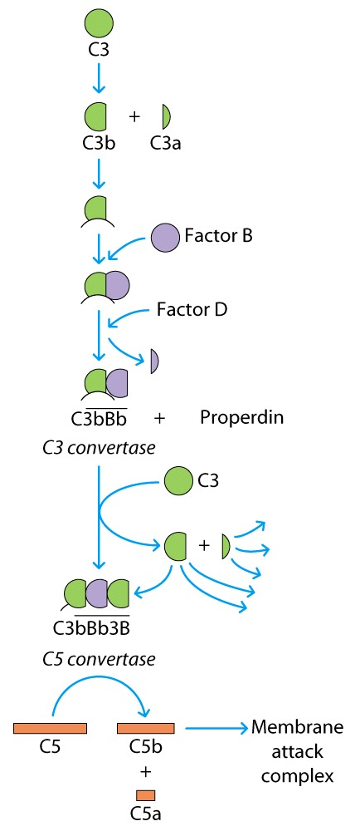
The Alternative complement pathway

Slide 52
Initiation of The Alternative pathway
C3 contains in unstable thioester bond.
This unstable bond makesC3 subject to slow spontaneous hydrolysis to C3b and C3a
The C3b is able to bind to foreign surface antigens.
Mammalian cells contain sialic acid which inactivates C3b

Slide 53
The alternative pathway of complement activation is probably the more primitive of the pathways because it is initiated by simple attraction of the early factors to the surfaces of microbes.
Bacterial polysaccharides and the lipopolysaccharide of the cell envelope of gram-negative bacteria both serve as potent, initiating stimuli.

Slide 54
Inflammation
–Vasodilation
–Capillary permeability

Slide 55
Inflammation is a response to injury, infection, autoimmune, indeed any tissue site damage.
It has two pathways -Exudative (liquid) and cellular.
Autoimmune diseases are when the white cells destroy self tissue rather than bacteria or exogenous material, often autoimmune diseases will present as inflammation

Slide 57
Assignment 1
Read and make notes on inflammation

