Slide 2
2. Acquired immunity
Producing specific cells and molecules which are directed against the foreign invaders.
It has the special ability to keep memory of first time exposure of an antigen (primary immune response) and mounts better response when there is second time exposure of same antigen (secondary immune response).
This ability of immune response forms the basis for the immunization or vaccination.

Slide 3
Acquired immunity is classified into
humoral immunity and
cell mediated immunity.
Both are evoked during antigen exposure.
The acquired immunity can be either active or passive.

Slide 4
A. Antibody-mediated (humoral) immunity
i. Humoral immunity
The humoral immune response begins with the recognition of antigen.
Though the classification separates the cell mediated and humoral immunity with different cell types they do interact to bring an effective immune response.
Specific T-cells are stimulated to produce lymphokines that are responsible for the antigen-induced B-cells proliferation and differentiation.

Slide 5
B-cells are much less mobile than T-cells, and spend much of their time in lymphoid tissue, e.g. the spleen and lymph nodes.
B-cells, unlike T-cells, recognise and bind antigen particles without having to be presented with them by an antigen-presenting cell.
Once its antigen has been detected and bound, and with the help of an activated helper T-cell, the B-cell enlarges and begins to divide (clonal expansion,).
It produces two functionally distinct types of cell, plasma cells and memory B-cells.

Slide 6
ii. Plasma cells
These secrete massive quantities of antibodies (immunoglobulins, Ig) into the blood. Antibodies are carried throughout the tissues. Plasma cells live no longer than a day and produce millions of molecules of only one type of antibody, which targets the specific antigen that originally
bound to the B-cell.
Antibodies:
bind to antigens, labelling them as targets for other defence cells such as cytotoxic T-cells and macrophages
bind to bacterial toxins, neutralising them
activate complement

Slide 7
Memory B-cells
Like memory T-cells, these cells remain in the body long after the initial episode has been dealt with, and rapidly respond to another encounter with the same antigen by stimulating the production of antibody-secreting plasma cells.
The fact that the body does not normally develop immunity to its own cells is due to the fine balance that exists between the immune reaction and its suppression.

Slide 9
Actively acquired Natural (Due to natural entry of pathogen)
Artificial (Due to artificially introduced antigen like immunization process)
Passively acquired Natural (Baby receives the antibody synthesized by the mother through mother’s milk
Artificial (Antibodies are introduced artificially) process of clonal selection specific B-cells are stimulated, the activated B-cell first develops into a B-lymphoblast, becoming much larger and shedding all surface immunoglobulin.

Slide 11
CELL-MEDIATED IMMUNITY (CMI)
Directed against intracellular microorganisms
Non-phagocytic cells and phagocytic cells
T-lymphocytes (T cells)
Differentiate into effector cells following antigen presentation by antigen presenting cells (APC’s)
Functional types of T cells
Helper (CD4 T cells)
TH1 and TH2 cells
Cytotoxic (CD8 T cells)
Regulatory
CD4 and CD8 Tregs

Slide 12
CLASSIFICATION OF ANTIBODIES (IMMUNOGLOBULINS)
Five (5) classes (isotypes)
Immunoglobulin A (IgA)
Immunoglobulin G (IgG)
Immunoglobulin M (IgM)
Immunoglobulin D (IgD)
Immunoglobulin E (IgE)
Based on structural differences in constant regions of heavy chains
Classes have specialized effector functions

Slide 13
Types of immunoglobulins
An antibody or immunoglobulin (Ig) is glycoprotein produced by B cells, which is capable of combining specifically with the antigen, which induces it.
Antibodies are divided into five major classes, IgM, IgG, IgA, IgD and IgE, based on their heavy chain constant region structure.

Slide 16
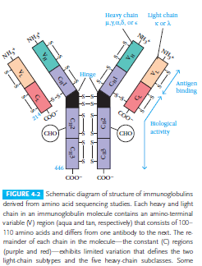

Slide 19
General structures of the five major classes of secreted antibody.
Light chains are shown in shades of pink,
disulfide bonds are indicated by thick black lines.
Note that the IgG, IgA, and IgD heavy chains (blue, orange, and green, respectively) contain four domains and a hinge region, whereas the IgM and IgE heavy chains
(purple and yellow, respectively) contain five domains but no hinge region.

Slide 20
The polymeric forms of IgM and IgA contain a polypeptide, called the J chain, that is linked by two disulfide bonds to the Fc region in two different monomers.
Serum IgM is always a pentamer; most serum IgA exists as a monomer, although dimers, trimers, and even tetramers are sometimes present.
Not shown in these figures are intrachain disulfide bonds and disulfide bonds linking light and heavy chains

Slide 21
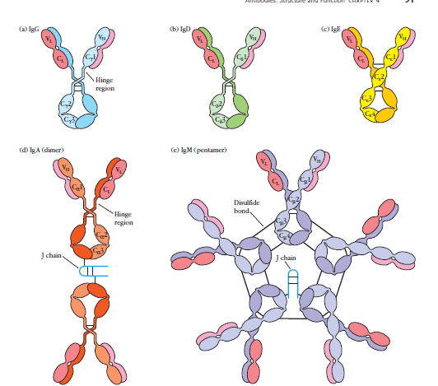

Slide 22
Immunoglobulin and their functions
IgG has two light chains either kappa or lambda and two heavy chain of g type and consists of four subclasses IgG1, IgG2, IgG3 and IgG4.
It is predominant class of immunoglobulin and account for approximately 80% in human serum.
produced particularly during the secondary immune response.
stimulates phagocytic cells, activates the complement system, binds neutrophils, and can neutralize toxins.
it is the only antibody that can cross the placenta and confer immunity on the foetus.

Slide 23
IgA
has two light chains either kappa or lambda and two heavy chain of a type and consist of two subclasses IgA1 and IgA2,
constitutes only 13% of the antibody in human serum,
predominant class of antibody in extravascular secretions.
present in secretions (tears, saliva, nasal secretions and mammary gland secretions) is secretory IgA.
found to produce immunity against tapeworms and present in the colostrums protects the baby from intestinal pathogens.

Slide 24
IgM
has two light chains either kappa or lambda and two heavy chain of m type constitutes 8% of the antibody in human serum,
it is the largest of the immunoglobulins often referred as the macroglobulin because it has more than five binding sites for antigen.
It is the first antibody to appear in the primary immune response therefore an useful indicator of recent infection.
Most of the natural antibodies like ABO blood grouping (anti-A anti-B) are of the IgM class and important in the initial activation of B-cells, macrophages, and activate the complement system.

Slide 25
IgD
has two light chains either kappa or lambda and two heavy chain of d type
constitute less than 1% of the antibody in human serum.
Plays a role in activating and suppressing lymphocyte activity and found large quantities in the cell walls of many B-cells.
has a single binding site.

Slide 26
IgE
is a reaginic antibody, has two light chains either kappa or lambda and two heavy chain of e type
constitute less than 0.003% of the antibody in human serum.
Mediator in allergic responses.
activates histamine secreting cells.
play a role in parasitic infection and mediates type one hypersensitivity

Slide 27
Immune benefits of breast milk
Antibodies of secretory IgA class
Bind to microbes in baby’s digestive tract and thereby prevent their attachment to the walls of the gut and their subsequent passage into the body’s tissues.
B12 binding protein , Reduces amount of vitamin B12, which bacteria need in order to grow.

Slide 28
Bifidus factor = Promotes growth of Lactobacillus bifidus, a harmless bacterium, in baby’s gut.
Growth of such nonpathogenic bacteria helps to crowd out dangerous varieties.
Fatty acids = Disrupt membranes surrounding certain viruses and destroy them.

Slide 29
Fibronectin= Increases antimicrobial activity of macrophages; helps to repair tissues that have been damaged by immune reactions in baby’s gut.
Hormones andgrowth factors -= Stimulate baby’s digestive tract to mature more quickly. Once the initially “leaky” membranes lining the gut mature, infants become less vulnerable to microorganisms.
Interferon = Enhances antimicrobial activity of immune cells.

Slide 30
Lactoferrin = Binds to iron, a mineral many bacteria need to survive. By reducing the available amount of iron, lactoferrin thwarts growth of pathogenic bacteria.
Lysozyme= Kills bacteria by disrupting their cell walls.
Mucins = Adhere to bacteria and viruses, thus keeping such microorganisms from attaching to mucosal surfaces.
Oligosaccharides = Bind to microorganisms and bar them from attaching to mucosal surfaces.

