Slide 1
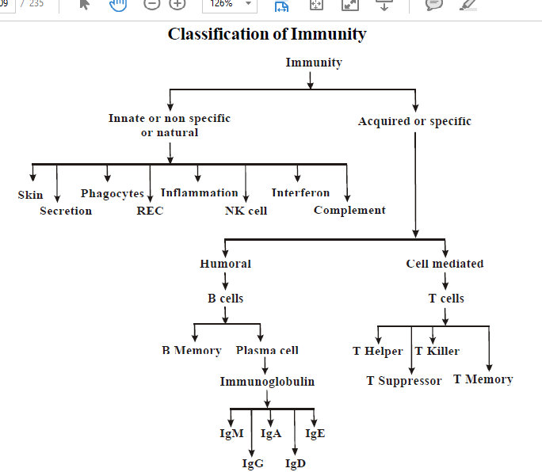

Slide 2
CELL-MEDIATED IMMUNITY (CMI)
Directed against intracellular microorganisms
  Non-phagocytic cells and phagocytic cells
T-lymphocytes (T cells)
  Differentiate into effector cells following antigen presentation by antigen presenting cells (APC’s)
Functional types of T cells
  Helper (CD4 T cells)
    TH1 and TH2 cells
  Cytotoxic (CD8 T cells)
  Regulatory
    CD4 and CD8 Tregs

Slide 3
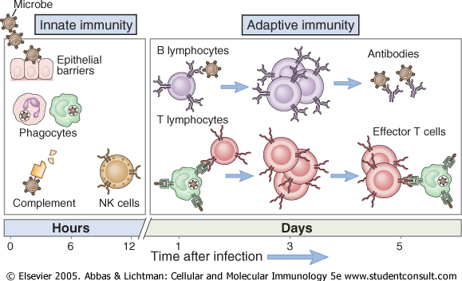

Slide 4
2. Cell-mediated immunity
T-cells that have matured in the thymus gland are released into the circulation.
When they encounter their antigen for the first time, they become sensitised to it.
If the antigen has come from outside the body, it needs to be ‘presented’ to the T-cell on the surface of an antigenpresenting cell.
There are different types of antigenpresenting cell, including macrophages.

Slide 5
Macrophages are part of the non-specific defences, because they engulf and digest antigens indiscriminately, but they are a crucial ‘link’ cell between initial non-specific defences and the immune system.
After digesting the antigen they transport the most antigenic fragment to their own cell membrane and display it on their surface.
They display (present) this antigen to the T-cell that has been processed to target that particular antigen, activating the T-cell.
If the antigen is an abnormal body cell, such as a cancer cell, it too will be displaying foreign (non-self) material on its cell membrane that will stimulate the T-cell. Whichever way the antigen is presented to the T-cell, it stimulates it to divide and proliferate (clonal expansion)

Slide 6
Four main types-Cell-mediated immunity
T-cell are produced, each of which is still directed against the original antigen, but which will tackle it in different ways.
1. Cytotoxic T-cells
These directly inactivate any cells carrying antigens. They attach themselves to the target cell and release powerful toxins, which are very effective because the two cells are so close together.
The main role of cytotoxic T-cells is in destruction of abnormal body cells, e.g. infected cells and cancer cells.

Slide 7
2. Helper T-cells
These are essential not only for cell-mediated immunity, but also antibody-mediated immunity.
Their central role in immunity is emphasised in situations where they are destroyed, as by the human immunodeficiency virus (HIV).
When helper T-cell numbers fall significantly, the whole immune system is compromised.
T-helpers are the commonest of the T-cells;

Slide 8
their main functions include
production of chemicals called cytokines, e.g. interleukins and interferons, which support and promote cytotoxic T-cells and macrophages
cooperating with B-cells to produce antibodies; although B-cell are responsible for antibody manufacture, they require to be stimulated by a helper T-cell first.

Slide 9
3. Suppressor T-cells
These cells act as ‘brakes’, turning off activated T- and B-cells. This limits the powerful and potentially damaging effects of the immune response. Suppressor T-cells are also thought to help prevent the development of auto-immunity and to protect the fetus in pregnancy.
4. Memory T-cells
These long-lived cells survive after the threat has been neutralised, and provide cell-mediated immunity by responding rapidly to another encounter with the same antigen.

Slide 11
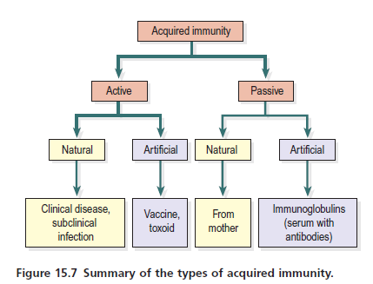

Slide 12
Active naturally acquired immunity
The body may be stimulated to produce its own antibodies by:
Having the disease. During the course of the illness, B-cells develop into plasma cells that produce antibodies in sufficient quantities to overcome the infection. After recovery, the memory B-cells produced confer immunity to future infection by the same antigen.
Having a subclinical infection. Sometimes the infection is not sufficiently severe to cause clinical disease but stimulates sufficient memory B-cells to establish immunity, e.g. hepatitis A, In other cases, subclinical infection may be too mild to stimulate an adequate response for immunity to develop.

Slide 13
Active artificially acquired immunity
This type of immunity develops in response to the administration of dead or live artificially weakened pathogens (vaccines) or deactivated toxins (toxoids). The vaccines and toxoids retain the antigenic properties that stimulate the development of immunity but they cannot cause the disease.
Many infectious diseases can be prevented by artificial immunisation. Examples are shown in . Active immunisation against some infectious disorders gives lifelong immunity, e.g. diphtheria, whooping cough or mumps.

Slide 14
In other infections the immunity may last for a number of years or for only a few weeks before revaccination is necessary.
Apparent loss of immunity may be due to infection with a different strain of the same pathogen, which has different antigenic properties but causes the same clinical illness, e.g. viruses that cause the
common cold and influenza. In older or poorly nourished individuals, lymphocyte production, especially B-cells, is reduced and the primary and secondary response may be inadequate.

Slide 15
Passive naturally acquired immunity
This type of immunity is acquired before birth by the passage of maternal antibodies across the placenta to the fetus, and to the baby in breast milk.
The variety of different antibodies provided depends on the mother’s active immunity.
The baby’s lymphocytes are not stimulated and this form of immunity is short lived.

Slide 16
Passive artificially acquired immunity
In this type, ready-made antibodies, in human or animal serum, are injected into the recipient.
The source of the antibodies may be an individual who has recovered from the infection, or animals, commonly horses, that have been artificially actively immunised.
Specific immunoglobulins (antiserum) may be administered prophylactically to prevent the development of disease in people who have been exposed to the infection, e.g. rabies, or therapeutically after the disease has developed.

Slide 17
Herd Immunity
Herd Immunity is a term that is bandied around in defense of mass and mandatory vaccination

Slide 18
Measles: Herd Immunity in the pre-vaccine era
When measles first enters a population that has not been exposed to measles before, Herd Immunity is zero and there is, initially, a very high morbidity (illness) and mortality.
This occurs in large part as a consequence of high dose exposure.
High dose exposure occurs because, in the absence of viral immunity, viral replication is unimpeded in the multiple susceptible human reservoirs in which it thrives. High doses of measles virus are transmitted from one person to the next. Added to this, socioeconomic circumstances contribute to high dose exposure.
This includes high population density (easy transmission) and poor antiviral defenses (e.g. low vitamins A, D, and C). An example is the ravage of measles in Confederate soldiers amassed in barracks and hospitals in the American Civil War

Slide 19
Over time, as measles becomes endemic (constantly circulating) in a population with typical 2-yearly epidemics, Herd Immunity increases rapidly.
Natural exposure leads to long term immunity. Immunity limits viral transmission and opportunities for viral replication. Concomitantly, developed countries have experienced an improvement in nutritional status and consequently antiviral immunity.
Dose of exposure falls and a dramatic reduction in morbidity and mortality is observed.
As a consequence of natural Herd Immunity, in the developed world measles mortality had fallen by 99.6% before measles vaccines were introduced.
A fall in morbidity will have paralleled the fall in mortality (mortality is the extreme of morbidity)

Slide 20
Let us look at an example of how natural Herd Immunity operated to provide age-appropriate immunity.
Infants less than one year of age have a limited ability to generate adequate immunity and are susceptible to serious measles infection.
In the pre-vaccine era mothers conferred good passive immunity on their infants by transplacental and breast milk transfer.
This passive immunity protected infants through a period of vulnerability until they were better able to cope with measles through the generation of their own active immunity.

Slide 21
Assignment 2
Read and make notes on
Hypersensitivity

Slide 22
Hypersensitivity (allergy)
Hypersensitivity (allergy)
Allergy is an inappropriate, powerful immune response to an antigen (allergen) that is usually harmless. Examples include house dust, animal dander and grass pollen. It is therefore usually the immune response that causes the damage to the body, not the allergen itself.
Upon initial exposure to the allergen the response entirely out of proportion to the perceived threat. It should be noted that these responses are exaggerated versions of normal immune function (secondary response, sometimes

Slide 23
symptoms are mild, although annoying, e.g. the running nose and streaming eyes of hay fever. Occasionally the reaction can be extreme, overwhelming body systems and causing death, e.g. anaphylactic shock, see below.
There are four mechanisms of hypersensitivity, which are classified according to the parts of the immune system that are involved.

Slide 24
Type I, anaphylactic hypersensitivity
This occurs in individuals with very high levels of immunoglobulin E (IgE). When exposed to an allergen, e.g.
house dust, these high levels of antibody activate mast cells and basophils , which degranulate.
The most important substance released is histamine, which constricts some smooth muscle, e.g. airway smooth muscle, causes vasodilation and increases vascular permeability (leading to exudation of fluid and proteins into the tissues).
Examples of type I reactions include the serious situation of anaphylaxis. There is profound bronchoconstriction and shock due to extensive vasodilation. The condition can lead to death.

Slide 25
Type II, cytotoxic hypersensitivity
When an antibody reacts with an antigen on a cell surface, that cell is marked for destruction by the body’s defence cells.
This is the usual procedure in the elimination of, for example, bacteria, but if the antibodies are directed against self-antigens the result is destruction of the body’s own tissues (autoimmune disease).
Type II mechanisms cause other conditions, e.g. haemolytic disease of the newborn and transfusion reactions

Slide 26
Type III, immune-complex-mediated hypersensitivity
Antibody–antigen complexes (immune complexes) are usually cleared efficiently from the blood by phagocytosis. If they are not, for example when there is phagocyte failure or an excessive production of immune complexes (e.g. in chronic infections), they can be deposited in tissues, e.g. kidneys, skin, joints and the eye, where they set up an inflammatory reaction.
The kidney is a common site of deposition because it receives a large proportion of the cardiac output and filters the blood.
Immune complexes collecting here lodge in and block the glomeruli, impairing kidney function glomerulonephritis).
Penicillin allergy is also a type III reaction; antibodies bind to penicillin (the antigen), and the symptoms are the result of deposition of immune complexes in tissues – rashes, joint pains and sometimes haematuria.

Slide 27
Type IV, delayed type hypersensitivity
Unlike types I–III, type IV hypersensitivity does not involve antibodies, but is an overreaction of T-cells to an antigen.
When an antigen is detected by memory T-cells, it provokes clonal expansion of the T-cell, and large numbers of cytotoxic T-cells are released to eliminate the antigen.
Usually this system is controlled and the T-cell response is appropriate. If not, the actively aggressive cytotoxic T-cells damage normal tissues. An example of this is contact dermatitis.
Graft and transplant rejection is also caused by T-cells; an incompatible skin graft, for instance, will become necrotic and slough off in the days following application of the graft

Slide 28
Types of Graft Tissue
Autologous grafts (or autografts) are those where tissue is moved from one location to another in the same individual (skin grafting in burns or coronary artery replacement with saphenous veins).
Isografts (or syngeneic grafts) are those transplanted between genetically identical individuals (monozygotic twins).
Allogeneic grafts are those transplanted between genetically different members of the same species (kidney transplant).
Xenogeneic grafts are those transplanted between members of different species (pig heart valves into human).

