Slide 1
HEALTH PROMOTION
BY FLORENCE KWANYA

Slide 2
Content
Definition
Principles
Illness prevention
Levels of prevention
Health restoration

Slide 3
What is health promotion
Health promotion is “a process of enabling people to increase control over their health.”
Health promotion is a way of thinking and working that considers the continual advancement and maintenance of individual and population health to be integral to the functioning of a community.
Health promotion focuses on the social determinants of health as well as on specific health issues.

Slide 4
Cont..
Health promotion is
Population based
Participatory
Inter-sectoral
Context-sensitive
Multi-level

Slide 5
PROGRAMES OR HEALTH PROMOTION
• Information dissemination.
• Health risk appraisal and wellness assessment.
• Lifestyle and behavioral change.
• Environmental control programs

Slide 6
WHY WE NEED HEALTH PROMOTION?
• Promotes quality of life
• Reduce inequalities in health
• Reduces pressure on services
• “Adds life to year, Adds year to life”.
• “Health promotion is concerned with making healthier choices, easier choices”.
• It is cost effective and efficient

Slide 7
Health Education vs Health Promotion
Health education involves giving information and teaching individuals and communities how to achieve better health. Health education seeks to motivate individuals to accept a process of behavioral change through directly influencing their values, beliefs, and attitude systems”.
In contrast, health promotion “involves social, economic, and political change to ensure the environment is conducive to health .

Slide 8
Health Promotion activity
much broader and includes:
Health Education The provision of preventative health services.
Measures to protect the physical environment and make it conducive to health
The mobilization of community resources.
The implementation of organizational policies which promote health.
Economic and regulatory activities.

Slide 9
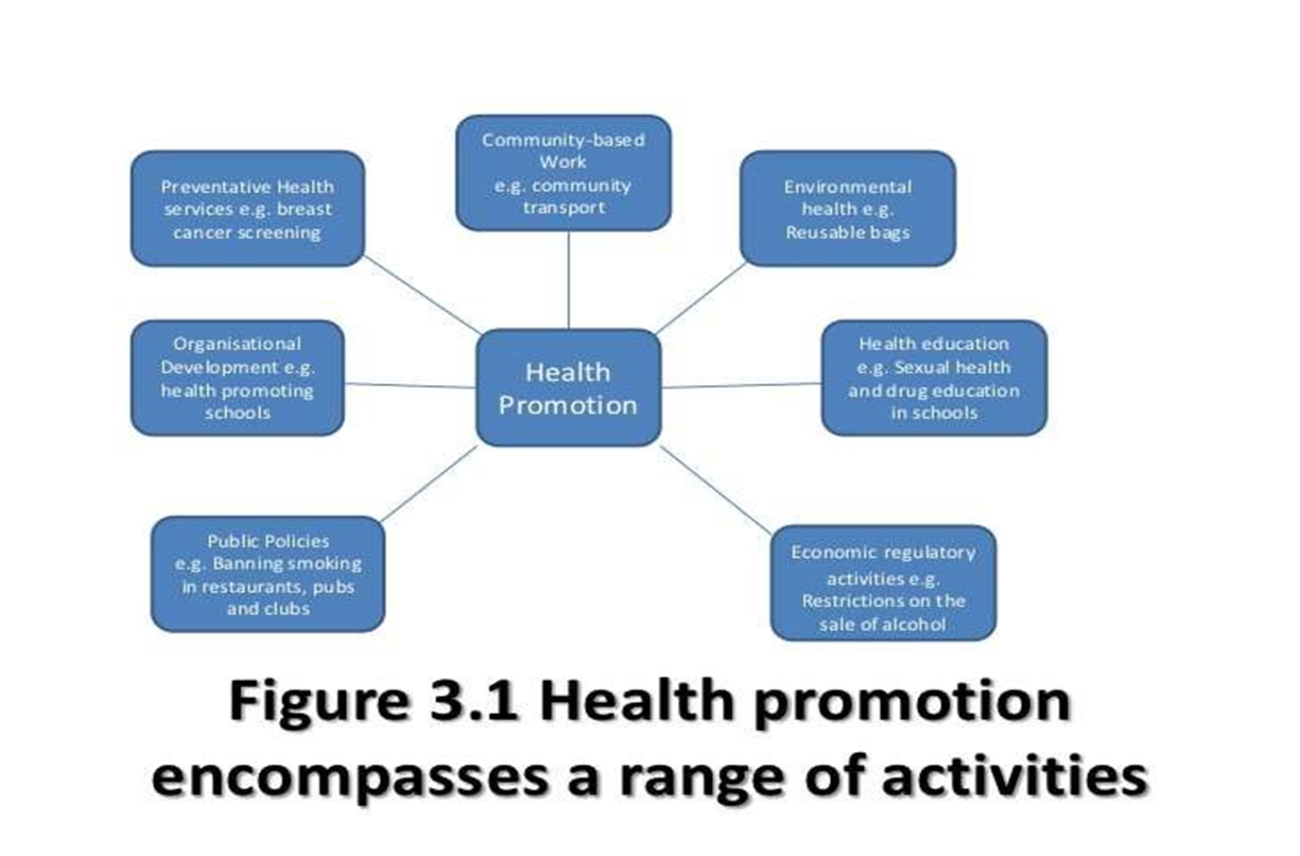
CONT..

Slide 10
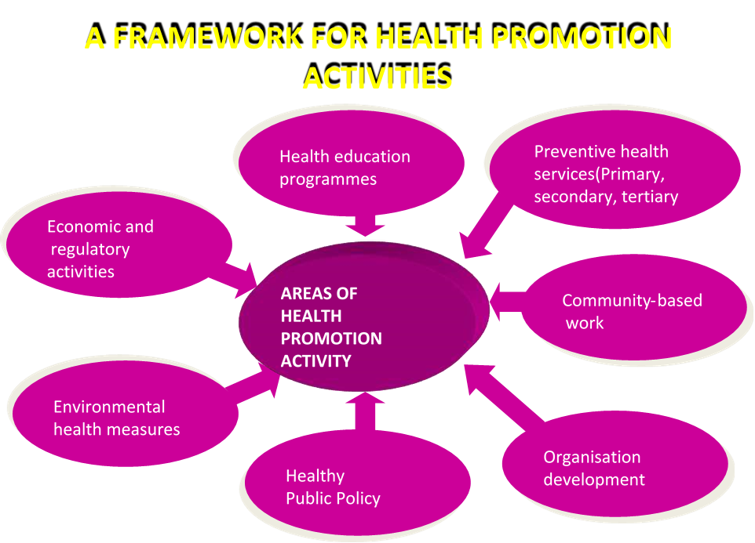

Slide 11

DETERMINANTS OF HEALTH

Slide 12
Determinants of health
CATEGORIES

Slide 13
CONT…
Genetic - Factors which determine an individuals predisposition to disease.
Biological – factors in which disease is caused by bacteria or viruses.
Lifestyle – factors in which behaviors contribute to disease. i.e. smoking, diet, alcohol, tobacco…..
Environmental – factors such as geographical, climatic :–housing , pollution , noise.
Social – factors connected with membership of particular social groups which may influence other factors. poverty, income , level of education , cultural environments.
For ex:- if you are unemployed more
likely to poor housing have limited social support stress, anxiety , depression more likely to smoke.

Slide 14
PRINCIPLES OF HEALTH PROMOTION
ACCORDING TO WHO :–
1) Health promotion involves the population as a whole in the context of their everyday life , rather than focusing on people at risk from specific disease.
2) Health promotion is directed towards action on the determinants or cause of health. This requires a close co-operation between sectors beyond health care reflecting the diversity of conditions which influence health.

Slide 15
CONT..
3)Health promotion combines diverse but complementary methods or approaches including communication, education , legislations, fiscal measures, organizational change, community development and spontaneous local activities against health hazards.
4)Health promotion aims particularly at effective and concrete public participation. This requires the further development of problemdefining and decision making life skills , both individually and collectively and the promotion of effective participation mechanism.

Slide 16
5)Health promotion is primarily a social and political venture and not medical service , although health professionals have an important role in advocating and enabling earth promotion.

Slide 17
ILLINESS PREVENTION
Disease Prevention • “Activities designed to protect patients or other members of the public from actual or potential health threats and their harmful consequences.”
• OR • “
Prevention is the action aimed at eradicating, eliminating or minimizing the impact of disease and disability.”

Slide 18
LEVELS OF DISEASE PREVENTION
1) Primordial Prevention
2) Primary Prevention
3) Secondary Prevention
4) Tertiary Prevention

Slide 19
Primordial Prevention
“This is a prevention of Development of risk Factors in a Population group , which they have not yet appeared.” • Special Attention is Given in preventing Chronic Disease.
Main Intervention is Health Education. • In this efforts are dedicated towards Discouraging people from adopting Harmful Life styles/Habits through Individual & Mass Education.

Slide 20
CONT..
Examples of Primordial prevention
National programs and policies on: Food and nutrition • Comprehensive Policies for discourage smoking , Alcohol & Drugs • To promote regular physical activity • Making major changes in lifestyle

Slide 21
Primary Prevention
• “Primary prevention can be defined as the action taken prior to the onset of disease, which removes the possibility that the disease will ever occur.” • In this Action are taken before the onset of Disease. • It signifies intervention in the pre- pathogenesis phase of a disease or health problem.

Slide 22
Primary Prevention Achieved by Achieved by
Specific protection Health promotion;
Nutritional interventions
Life style and behavioral changes
Environmental modifications
Health education Immunization

Slide 23
Approaches for Primary Prevention:
• The WHO has recommended the following approaches for the primary prevention of chronic diseases where the risk factors are established:
– A) Population (mass) strategy- is directed at the whole population irrespective of individual risk levels. • For example, studies have shown that even a small reduction in the average blood pressure or serum cholesterol of a population would produce a large reduction in the incidence of cardiovascular disease • The population approach is directed towards socio-economic, behavioral and lifestyle changes
– B) High -risk strategy- The high -risk strategy aims to bring preventive care to individuals at special risk. • This requires detection of individuals at high risk by the optimum use of clinical methods.

Slide 24
Secondary Prevention
• It is defined as “ An Action which halts the progress of a disease at its incipient stage and prevents complications.”
• The specific interventions are:
(i) early diagnosis (e.g. screening tests, breast self examination, pap smear test, radiographic examinations etc.)& Treatment
(ii) Referral
Secondary prevention attempts to arrest the disease process, restore health by seeking out unrecognized disease and treating it before irreversible pathological changes take place, and reverse communicability of infectious diseases. • It protects others in the community from acquiring the infection and thus provide at once secondary prevention for the infected ones and primary prevention for their potential contacts.

Slide 25
Objectives of Secondary Prevention
Complete cure and prevent the progression of disease process.
To prevent the spreads of disease by curing all the known cases.
To prevent the complications and sequel of disease.
To shorten the period of disability.

Slide 26
TERTIARY PREVENTION
Enable timely recovery Re-stabilize Re-train Re-motivate Re-socialize Re-integrate Principles of Rehabilitation
Assess Exposure Identify Populations at High Disease Risk (based on demography / family history, host factors..) Conduct Research on Mechanisms (including the study of genetic susceptibility) Apply Population-Based Intervention Programs Evaluate Intervention Programs Modify Existing Intervention Programs Strategy of Prevention

Slide 27
OTTAWA CHARTER
This CHARTER for action to achieve Health for All by the year 2000 and beyond.• This conference was primarily a response to growing expectations for a New public health movement around the world.08/03/12 01:03 PM Ottawa Charter for Health Promotion.
Health Promotion Health promotion is the process of enabling people to increase control over, and to improve, their health, To reach a state of complete physical, mental and social well- being, an individual or group must be able to identify and to realize aspirations, to satisfy needs, and to change or cope with the environment.

Slide 28
CONT…
The Ottawa Charter provides 5 key action areas that are widely used and are considered central to effective health promotion practice
  Building healthy public policy
  Creating supportive environment
  Strengthening community action
  Developing personal skills
  Re-orientating health services

Slide 29
Jakarta Declaration
The Jakarta Declaration( international agreement that was signed at the World Health Organization's 1997 Fourth International Conference on Health Promotion held in Jakarta on Leading Health Promotion into the 21st Century was developed at the 4th International Conference on Health Promotion in 1997
This declaration clearly confirms the importance of considering capacity building strategies and securing adequate social resources, infrastructure and responsibility when implementing health promotion interventions
  Promote social responsibility for health
  Increase investments for health development
  Consolidate and expand partnerships for health
  Increase community capacity and empower the individual
  Secure an infrastructure for health promotion

