Slide 1
Mass Casualty Management
Samuel Ngigi K.

Slide 2
Mass Casualty Incident (MCI)
An incident which generates more patients at one time than locally available resources can manage using routine procedures.
It requires exceptional emergency arrangements
and additional or extraordinary assistance.
The Objective of MCI is to move all patients to a medical facility as soon as possible.
One has to do what is practically possible for the greatest number of victims.

Slide 3
Disaster
Any occurrence that causes damage, economic disruption, loss of human life and deterioration in health and health services on a scale sufficient to warrant an extraordinary response from outside the affected area or community.

Slide 4
Characteristics of Disaster
The normal function of a community is disrupted.
Disaster exceed the coping mechanism of community.
The disruption is of such magnitude that there is an inability to return to normal functioning without external assistance.

Slide 5
Types of Disaster
NATURAL | MAN MADE
Earthquake | Road Traffic Accident
Flood | Building Collapse
Hurricane | Conventional warfare
Volcanic Eruption | Hazardous chemical incident
Drought | Nuclear & Biological incident
 | Air Craft Crash

Slide 6
Hospitals & Disaster
Hospitals serve as the major resource for the intake, evaluation & treatment of patients affected by disaster.
It is vital that hospital preparedness personnel identify vulnerable people, structures and services in their hospital community so that these can be made more resilient to the effects of disaster.

Slide 7
Issues to be addressed by Hospital
Surge capacity for additional space for treatment and evaluation.
Medication and supply stockpiles
Structural integrity
Trained staff
Response protocol and proper disaster response procedures.
Functional hospital based disaster plan

Slide 8
Role of Hospital in Disaster Management
A disaster will involve the entire hospital there will be increased demands upon equipment and personnel
The hospital’s response will have to be managed and coordinated
Staff will need to be supported throughout response and recovery.

Slide 9
Steps in MCI Management
Triage
Primary Survery
Secondary Survey
Treatment
Documentation

Slide 10
Triage
A method of quickly identifying victims who have immediately life-threatening injuries AND who have the best chance of surviving.
Aim of triage : To achieve the greatest good for the greatest number of casualty

Slide 11
Concept of “Golden Hour”
Golden Hour is a concept of trauma care developed by Dr Adams Cowley
Refers to the amount of time from injury to definitive care that should be allotted to maximize survival from traumatic injury.
Most studies have shown, if care given within first hour of injury morbidity and mortality can be reduced.

Slide 12
START Triage
START stands for Simple Triage & Rapid Treatment
Rapid approach to triaging large numbers of causalities
Clasification is based on three items
Respiratory
Perfusion
Mental status evaluation

Slide 14
GREEN
YELLOW
RED
BLACK
Ambulatory patients
(Walking wounded)
Injured
Critically Injured
Dead
Abrasions, contusions, minor lacerations
Needs medical attention, but should not decompensate rapidly if care is delayed
Obvious threat to life or limb
Complications in
their ABC’s
Unresponsive patients with no pulse
Catastrophic head injuries and / or chest injuries.
Treatment within 24 hours
Treatment within 4 hours
Treatment within 2 hours
Can be treated by other hospital personnel
Can be treated by orthopaedic surgeons
Treated by general surgery & Anesthesia team

Slide 16
Primary Survey

Slide 17
Primary Survey
The first survey done to assess the life threatening injuries and simultaneous treatment.
Primary survery must be performed in no more than 2-5 minutes.
Component of Primary survey : ABCDE

Slide 18
Primary Survey
A = Airway with C spine
B = Breathing
C = Circulation
D = Disability
E = Exposure

Slide 19
Airway
Always assume C-spine injury
C spine protection.
Assess airway. Can the patient talk & breath freely?
Signs of airway obstruction
Snoring
Stridor or abnormal breath sound
Agitation
Use of accessory muscles of ventilation
Cyanosis
Fracture (Facial & Cervical)
Injury to the neck (larynx & trachea)
Notes:
Stridor is a high-pitched, wheezing sound caused by disrupted airflow. Stridor may also be called musical breathing or extrathoracic airway obstruction. Airflow is usually disrupted by a blockage in the larynx (voice box) or trachea (windpipe).

Slide 20
Airway Management
Protect cervical spine as you maintain airway.
Head tilt & Chin lift
Manual removal of foreign body
Suction
Oropharyngeal airway
Nasopharyngeal airway
Definitive Airway
Endotracheal intubation (GCS<8)
Cricothyroidotomy
Tracheostomy
Notes:
Cricothyrotomy (also called cricothyroidotomy) is a procedure that involves placing a tube through an incision in the cricothyroid membrane to establish an airway for oxygenation and ventilation.
A tracheostomy is a medical procedure — either temporary or permanent — that involves creating an opening in the neck in order to place a tube into a person's windpipe. The tube is inserted through a cut in the neck below the vocal cords. This allows air to enter the lungs.

Slide 21
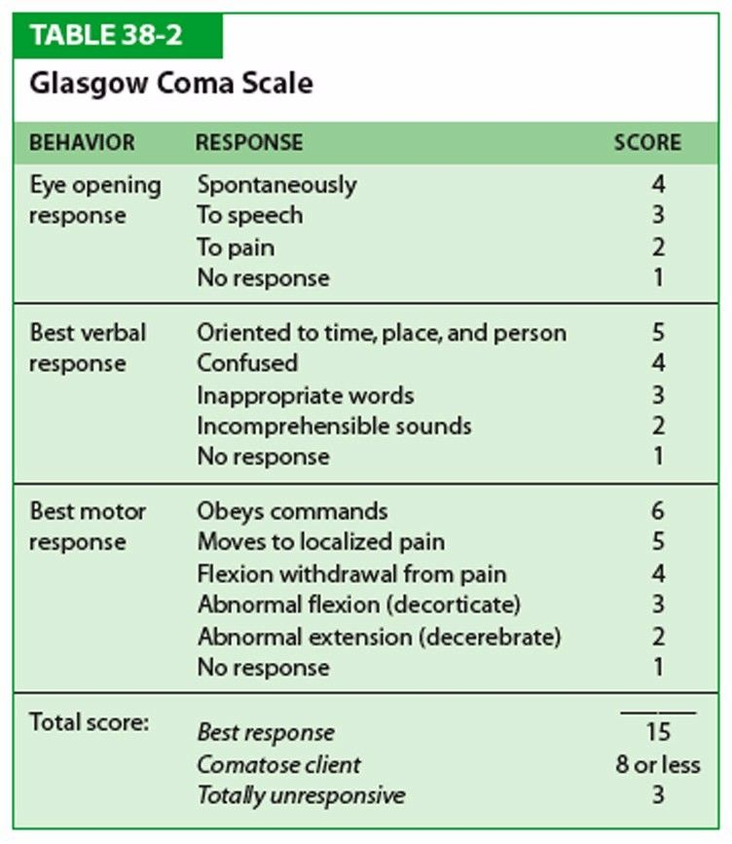

Slide 22
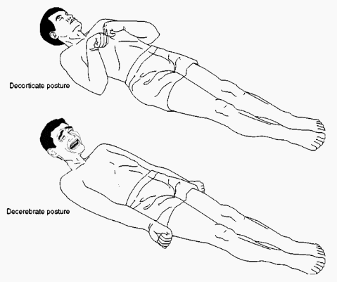

Slide 23
Airway Maintenance
Chin Lift
Jaw Thrust

Slide 24
Breathing
Establishment of adequate ventilation
Assessment
LOOK
Respiratory rate
Cyanosis
Penetrating injury
Presence of flail chest
FEEL
Tracheal Shift
Broken ribs
AUSCULTN
Abnormal sound
Decreased sound
Subcutaneous emphysema
Percussion
Use of accessory muscle
Notes:
Flail chest is a life-threatening medical condition that occurs when a segment of the rib cage breaks due to trauma and becomes detached from the rest of the chest wall. Two of the symptoms of flail chest are chest pain and shortness of breath.
Emphysema is a lung condition that causes shortness of breath. In people with emphysema, the air sacs in the lungs (alveoli) are damaged. Over time, the inner walls of the air sacs weaken and rupture — creating larger air spaces instead of many small ones.

Slide 25
Breathing Management
Oxygen via face mask
Bag & Mask Ventilation
Intercostal chest drain
Assess Ventilation
Chest movements
Pulse oximetry

Slide 26
Circulation
Is patient in shock?
Hemorrhagic
Non hemorrhagic
Assess
Pulse
Temperature
BP
Capillary Refill Time
Urine Output
Level of Consciousness
Skin color

Slide 27
Shock
Hypovolemic shock (Most common in trauma)
Assess Blood loss
Large volume of blood may be hidden in abdominal & pleural
cavity
Femoral shaft : 2 liters of blood
Pelvic fracture : 2 L
Cardiogenic Shock
Myocardial contusion
Cardiac tamponade
Penetrating wound in heart
Neurogenic Shock
Spinal cord injury
Notes:
Cardiac tamponade is a clinical syndrome caused by the accumulation of fluid in the pericardial space, resulting in reduced ventricular filling and subsequent hemodynamic compromise. The condition is a medical emergency, the complications of which include pulmonary edema, shock, and death
Neurogenic shock is a distributive type of shock resulting in low blood pressure, occasionally with a slowed heart rate, that is attributed to the disruption of the autonomic pathways within the spinal cord. It can occur after damage to the central nervous system, such as spinal cord injury and traumatic brain injury.

Slide 28
Circulatory Resuscitation Measures
Aim is to restore oxygen delivery to tissues.
2 large bore IV cannula (14- 16G)
Infusion fluid (NS) warmed to body temperature
Avoid solutions containing glucose
Monitor urine output
0.5ml/kg/hr (Minimum)
1ml/kg/hr (Adequate)
Dynamic fluid response
Arrange & Cross match blood

Slide 29
If patient is in shock
Infuse 1 L of fluid as fast as possible
20 ml/kg in children
Reassess
Still in shock?
Infuse 1 L fluid
If still in shock, Start blood transfusion or colloid
Identify site of bleeding and measure to arrest bleeding

Slide 30
Disability (Neurologic Evaluation)
Rapid neurologic evaluation
There is no time to do the GCS so a
A : Awake
V : Verbal response
P : Painful response
U : Unresponsive
Assess pupil bilaterally

Slide 31
Exposure/Environmental Control
Undress patient and look for head to toe examination
If the patient is suspected of having a neck or spinal injury in line immobilization is important.
Prevent hypothermia

Slide 32
Common Life Threatening Conditions
Airway | Obstruction
Breathing | Haemothorax
 | Tension pneumothorax
 | Flail Chest
Circulation | Hypovolemic Shock

Slide 33
Secondary Survey

Slide 34
Secondary Survey
Secondary survey is undertaken when the patient’s ABCs are stable
To identify all minor injuries missed in primary survey
If any deterioration occurs must be interrupted by Primary survey.

Slide 35
Secondary Survey
Patient History
Head to Toe examination
Complete neurological examination
Diagnostic Tests
Re-evaluation

Slide 36
Patient History
A – Allergies
M – Medication currently used
P – Pregnancy / Past Illness
L – Last Meal
E – Events

Slide 37
Head Trauma
Look for
Scalp & ocular abnormality
External ear & tympanic membrane
Periorbital soft tissue injuries
Fractures

Slide 38
Immediate recongnition of conditions
Acute extradural hematoma
Lucid Interval
Hemiparesis
Acute subdural hematoma
Base of skull fracture
Battle sign ; Racoon eyes
Cerebral concussion

Slide 40
Head Trauma
Remember..
Isolated head trauma doesn’t causes hypotension.
GCS < 8 : Severe Head Injury

Slide 41
Management of Head Trauma
Intubation & Hyperventilation
IV Fluids
Nurse in head up position

Slide 42
Chest Trauma
Examine
Clavicles & ribs fracture
Breath sounds & Heart sounds
Early deaths in thoracic trauma includes airway obstruction, cardiac tamponade & aspiration.

Slide 43
Chest Trauma
Tension pneumothorax
Haemothorax
Pulmonary contusion (Delayed deterioration in RR)
Myocardial contusion (ECG)
Cardiac tamponade (Beck’s triad) Components of Beck's Triad:
Hypotension with a narrowed pulse pressure
Jugular venous distention
Muffled heart sounds
Great vessels & Aortic rupture
Notes:
Components of Beck's Triad:
Hypotension with a narrowed pulse pressure
Jugular venous distention
Muffled heart sounds

Slide 44
Abdomen trauma
Penetrating wound
Abdomen distension
Tense and tenderness

Slide 45
Abdominal Trauma
Patient with serious accident is considered to have abdominal trauma until proved otherwise.
Unrecognized abdominal injury remains frequent preventable cause of death.
20% of patients with acute hemoperitoneum have no sign of periotneal irritation at first examination.

Slide 46
Abdominal Trauma - Management
 | STABLE | UNSTABLE
No Abdominal Sign | Observe | DPL/FAST Scan
Abdominal Sign | CT Scan | Laparotomy
Notes:
Diagnostic peritoneal lavage (DPL)
focused abdominal sonography for trauma (FAST)

Slide 47
Abdominal Trauma – Associated Injuries
Urethral Injury
– Triad : Butterfly rash in perineum, Blood in ext urethral meatus, Urinary bladder distension
Rectal injury

Slide 48
Spinal Trauma
Transport in neutral position in spinal board.

Slide 49
Limb Trauma
Look
Color
Deformity
Wound
Swelling
Feel
Tenderness
Crepitation
Temperature
Move

Slide 50
Limb Trauma – Special Issues
Active bleeding
Open Fracture
Compartment syndrome
Amputated Extremity
Notes:
Compartment syndrome is a painful condition that occurs when pressure within the muscles builds to dangerous levels. This pressure can decrease blood flow, which prevents nourishment and oxygen from reaching nerve and muscle cells. Compartment syndrome can be either acute or chronic.

Slide 51
Principles of Mass Casualty Management

Slide 52
Mass Casualty Management in ER - Principles
Policies and Procedures
Emergency or Disaster Plan
Operating Theatre
Staffing Requirements of the ER
Overcrowding
Equipment & Supplies of the ER
Contingency
Observation & Holding Area
Referral & Transfer

Slide 53
Policies & Procedures
All hospital & emergency department must have clearly written & disseminated policy & procedures.
Policy must be reviewed after each major emergency or disaster scenario.

Slide 54
Emergency or Disaster Plan
Emergency plan has to be well written and contain important elements such as triage criteria & the incident command system.
Important questions
Who needs to be prioritised for definitive care?
Who is in charge?
What are the functions of each & every member of the emergency team?

Slide 55
Operating Theatre
Access to functioning OT allows for early definitive care and minimises unwanted morbidity or preventable mortality.

Slide 56
Staffing Requirements of ER
Nurses
Nursing staff in ER must have training in triage, trauma management, disaster management.
The nursing staff must be able to
Work with emergency medical doctors and the surgeons treating injured patients.
Ensure resuscitation equipment and drugs are
available & adequate.
Help triage patients during a mass casualty incident.

Slide 57
Staffing Requirements of ER
Emergency Medicine Physicians
Emergency doctors help triage & institute initial management to injured patients while surgeons deliver definitive care.
The Trauma Team
Comprises surgeons, anesthesiologist & trauma nurses.
Delivers definitive care

Slide 58
Overcrowding
In developing countries, ER are lacking resources for day-to-day problem even before the occurrence of disaster.
Modern principles of emergency medicine don’t exist.
After a mass casualty incident, hospital is flooded with visitors which makes the working environment chaotic and difficult which needs to be controlled.

Slide 60
Equipment & Supplies
Airway devices
Oxygen tanks, nasal prongs, oropharyngeal airway devices, nasopharyngeal airway device
Intubation equipments
Management of Shock
IV cannula, crystalloids and colloid, Access to blood bank.
Emergency Drugs
The equipments & drugs should be in bulk and readily available during mass casualty incident.

Slide 62
Contingency
Planning is the key to the proper response to a mass casualty incident.
Worst case scenario must be thought through and procedures developed for each possibility.

Slide 63
Observation & Holding Area
During an influx of patients to a hospital temporary patient care areas may have to be established like lobby areas & corridors.

Slide 64
Referral & Transfer
When the hospital is flooded to its capacity, the process of referral & transfer to other hospitals must be considered.

Slide 65
Conclusion
Hospitals should be prepared in handling mass casualty incidents with well written policy and guidelines.
Triage system should be followed in ER
Well equipped ER with skilled manpower can save lives in mass casualty incident.
Initial treatment in ER by Emergency staffs is life saving whereas definitive treatment is delivered by specialist.

Slide 66
Thank you

