Slide 1
MILLENNIUM DEVELOPMENT GOALS
Written by Michael Mutisya Msc, Bsc Public Health (jkuat) , Diploma clinical medicine and surgery (Kmtc – Nrb)

Slide 2
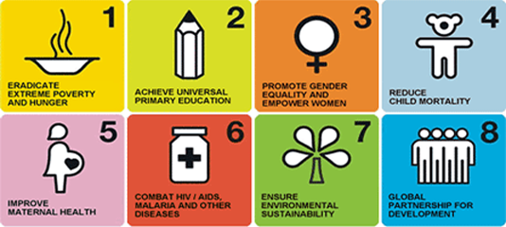

Slide 3
MDGS - GOALS
1.Eradicate extreme poverty and hunger
- Prevalence of underweight children under 5 years of age
2. Achieve universal primary education
-Net attendance ratio in primary education1 2.3 Literacy rate of 15-24 year-olds2
3. Promote gender equality and empower women
Ratio of girls to boys in primary, secondary and tertiary education
4. Reduce child mortality
Under five mortality rate4
Infant mortality rate4
- Percentage of 1 year old children immunized against measles

Slide 4
MDGs - Goals
5. Improve maternal health
Maternal mortality ratio
Percentage of births attended by skilled health personnel
Contraceptive prevalence rate7
Adolescent birth rate8
Antenatal care coverage
At least one visit
Four or more visits
Unmet need for family planning

Slide 5
MDGS - Goals
6. Combat HIV/AIDS, malaria and other diseases
6.2 Condom use at last higher-risk sex
6.3 Percentage of the population age 15-24 years with comprehensive correct knowledge of HIV/AIDS12
6.4 Ratio of school attendance of orphans to school attendance of non-orphans age 10-14 years
6.7 Percentage of children under 5 sleeping under insecticide-treated bed nets
6.8 Percentage of children under 5 with fever who are treated with appropriate antimalarial drugs14

Slide 6
Sustainable development goals
Written by Michael Mutisya Msc,Bsc public health (jkuat), Dip clinical medicine and surgery (Kmtc Nrb)

Slide 7


Slide 8
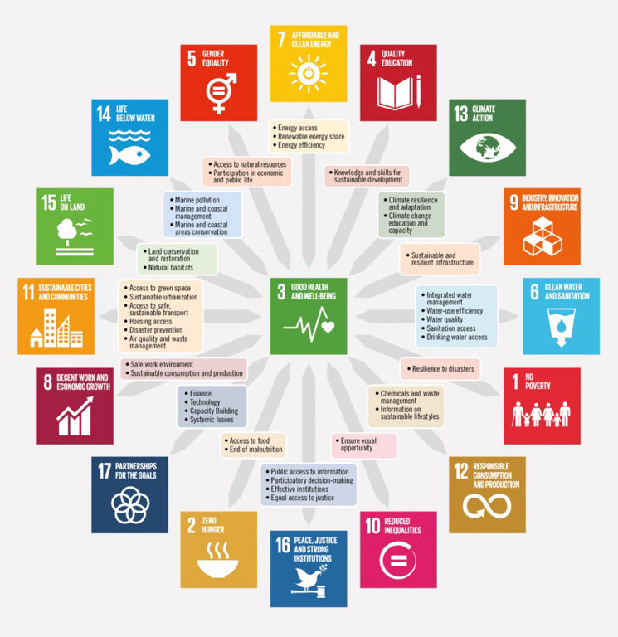

Slide 9
Sustainable development goals
GOAL 1:END POVERTY IN ALL ITS FORMS EVERYWHERE
GOAL 2: ZERO HUNGER
GOAL 3:GOOD HEALTH AND WELL-BEING
GOAL 4: QUALITY EDUCATION
GOAL 5: GENDER EQUALITY
GAOL 6: CLAEAN WATER AND SANITATION
GOAL 7: AFFORDABLE CLEAN ENERGY
GOAL 8: DECENT WORK AND ECONOMIC GROWTH
GOAL 9:BUILD RESILIENT INFRASTRUCTURE, PROMOTE SUSTAINABLE INDUSTRIALIZATION AND FASTER GROWTH

Slide 10
Sustainable development goals
GOAL 10: REDUCE INEQUALITIES
GOAL 11: SUSTAINABLE CITIES AND COMMUNITIES
GOAL 12: RESPONSIBLE CONSUMPTION AND PRODUCTION
GOAL 13: CLIMATE ACTION
GOAL 14: LIFE BELOW WATER
GOAL 15: LIFE ON LAND
GOAL 16: PEACE, JUSTICE AND STRONG INSTITUTIONS
GOAL 17: PARTNERSHIP FOR LIFE GOALS

Slide 11
Vision 2030
Written by Michael Mutisya Msc, Bsc Public Health (jkuat) , Dip clinical medicine and surgery (Kmtc Nrb)

Slide 12


Slide 13
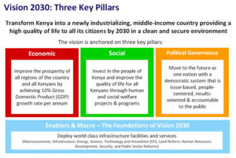

Slide 14
Vision 2030
Kenya vision 2030 is the country's new developments blue print covering the period 2008 to 2030. It aims to transform Kenya into a newly industrializing," middle-income country providing a high quality life to all citizens by the year 2030"
Development of the vision:
Was through consultative forum involving all citizens -through workshops with all stake holders in public and private sectors,civil society,the media, and NGOs.
Suggestions from leading and international experts-researchers,

Slide 15
Vision 2030
The vision is based on three pillars
1. Economic : TO maintain a sustained economic growth of 10% p.a over next 25 years.
2. Social: a just and cohesive society enjoying equitable social development in a clean and secure environment
3. Political: TO realize a democratic political system founded on issue-based politics that respects the rule of law,and protects the rights and freedoms of every individual in Kenya society.

Slide 16
1. ECONOMIC PILLAR
Macroeconomics stability for long term development .
Continuity in government reforms:-anti corruption programs,better investigations,public education and judicial reforms.
Enhanced equity and wealth creation opportunities for the poor:-investment in ASALS, youth employment women and all vulnerable groups.
Infrastructure:-railway's ports,water and sanitation facilities and telecommunication.
Energy:-encouraging more sources of energy sources and commenting Kenya to energy- surplus .
Science,technology and innovation:-research and development so as to accelerating economic development in all new industrialized areas.

Slide 17
2. SOCIAL PILLAR
Kenya's journey towards prosperity also involves the building of a just and cohesive society that enjoys equitable social development in a clean and secure environment. This quest is the basis of transformation of our society in seven key sectors.this are:
Education and training:- fund research,reduce illiteracy levels, increase enrollment of students in public and private universities.
Healthy sector:- TO improve the overall livelihoods of Kenyan,the country's aims to provide an efficient and high quality health care system with best standards. This will be done thorough a two prolonged approach.

Slide 18
Social pillar
1).Devolution of funds and management of healthy the communities; living the ministry to deal with policies and research.
2).Shifting the bias of the national health bill from curative to preventive care
Special attention will be paid to lowering the incidences of HIV/AIDS, Malaria and TB and lowering infant mortality ratio.
All this will reduce equalities in access to health care and improve key Areas where Kenya is lagging behind especially lowering mortality and infant mortality. Specific strategies will involve:
- Provisions of robust health infrastructure network

Slide 19
3. Political pillar
The political pillar envisions a countywide with a democratic system reflecting the aspirations and expectations of its people. Kenya will be a state in which equality is entrenched,irrespective of ones race, ethnicity,religion ,gender or social Economic status; a nation that not only respects but also harnesses the diversity of its people values,aspirations and traditions for the benefit of its people.
Rule of law:- increase service availability and access to justice.
Electoral and political process
Democracy and public service delivery
Transparency and accountability
Security,peace-building and conflict management

Slide 20
Kenya health strategic and implementation plan
Written by Michael Mutisya Msc Msc Public Health (jkuat) Dip Clinical medicine and surgery (Kmtc Nrb)

Slide 21
National Health Policy
Inn1994, the Ministry of Health produced kenya's Health Policy Framework (KHPF) .
This was the Government blue print for future development in the Health sector.
The aim of the policy was to ensure that health status of Kenyan population improved.
It set the out policy agenda for the health sector up to the year 2010.
This included streghthening the central public policy of ministries of health, adoption of explicit strategy to reduce the burden of diseases and Defination of cost – effective essential care package.

Slide 22
National health policy
To operationalized this Health policy framework paper, the first and second National Health Sector Plans [ NHSSP I( 1999 – 2004)] and NHSS II 2005 – 2010 were developed and implemented

Slide 23
National Health Strategic Plan
The main purpose of the NHSSP II for 2005 – 2010 were to:
Reduce the inequalities in health care
Reverse the down trend in Health related impact and outcome indicators
To decrease the burden of disease, KHSSP II shifts it emphasis to promoting health lifestyle and community healthy .
To do this, it introduced the Kenya Essential Package for Health (KEPH)

Slide 24
Kenya Essential Package For Health (KEPH)
Under the KEPH,nearly all health Programmes Centre on six phases of human development, and in this way, complement each other.
The life phases are:
Pregnancy and newborn
Early childhood ( Two weeks to five years)
Late childhood (6 – 12 years)
Youth and adolescent (13 – 24 years)
Adulthood (25 – 59 years)
Elderly (60 + years)

Slide 25
KEPH
The KEPH envisions the provisions of comprehensive, integrated curative and preventive health services, available at the first point of contact and accessible to all.
The existing vertical Programmes will come together to provide services to the various age groups.
They will also merge to provide interventions to the cohort level of care they provide.
All of the phase focus each on human development thus it enhances human health better than each could have done individually.
All services included in the KEPH ( primary health care etc) functions through a single delivery point.
But other programmes run vertically to primary health programming ( TB, Malaria, PMTCT, mental health)

Slide 26
LEVELS OF SERVICE DELIVERY
The KEPH approach also defines six service delivery levels
The government run health care include the following:
Level 6 : Tertiary hospitals
Level 5 : Secondary hospitals
Level 4 : Primary Hospitals
Level 3: Health centers, maternity and nursing homes
Level 2 : dispensaries and clinics
Level 1: community:- villages, households and individuals

Slide 27
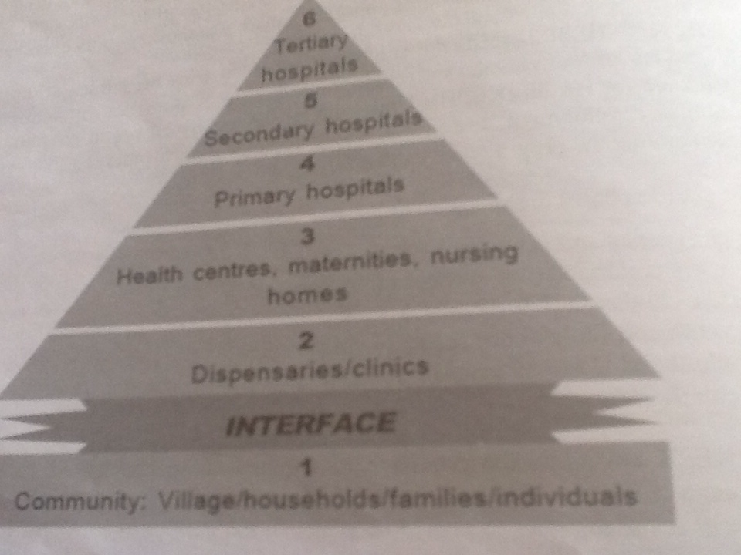
Levels of care Defined in the Kenya Essential Package for Health

