Slide 1
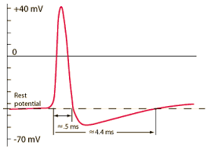
Membrane Potentials and Action Potentials
SAMUEL NGIGI KIURIRE

Slide 2
Molecular Gradients
inside
(in mM)
14
140
0.5
10⁻⁴
(pH 7.2)
10
5-15
2
75
40
outside
(in mM)
142
4
1-2
1-2
(pH 7.4)
28
110
1
4
5
Na⁺
K⁺
Mg²⁺
Ca²⁺
H⁺
HCO₃⁻
Cl⁻
SO₄²⁻
PO₃⁻
protein

Slide 3
Active Transport
inside
outside
K⁺
Na⁺
Na+
ATP
K+
3 Na⁺
2 K⁺
ADP
Remember: sodium is pumped out of the cell, potassium is pumped in...

Slide 4
Simple Diffusion
inside
outside
K⁺
K⁺
Na⁺
Na⁺

Slide 5
Membrane Potential (V_{m}):
- charge difference across the membrane -
inside
outside
…how can passive diffusion of potassium and sodium lead to development of negative membrane potential?
K⁺
K⁺
Na⁺
Na⁺

Slide 6
Simplest Case Scenario:
Let us assume that the membrane in this instance is permeable to the potassium ions but not to any other ions.
Because of the large potassium concentration gradient from inside toward outside, there is a strong tendency for extra numbers of potassium ions to diffuse outward through the membrane.
As they do so, they carry positive electrical charges to the outside, thus creating electropositivity outside the membrane and electronegativity inside because of negative anions that remain behind and do not diffuse outward with the potassium.
Within a millisecond or so, the potential difference between the inside and outside, called the diffusion potential, becomes great enough to block further net potassium diffusion to the exterior, despite the high potassium ion concentration gradient.
In the normal mammalian nerve fiber, the potential difference is about 94 millivolts, with negativity inside the fiber membrane.

Slide 7
Simplest Case Scenario:
inside
outside
If a membrane were permeable to only K⁺ then…
K⁺
K⁺
K⁺ would diffuse down its concentration gradient until the electrical potential across the membrane countered diffusion.

Slide 8
Simplest Case Scenario:
inside
outside
If a membrane were permeable to only K⁺ then…
K⁺
K⁺
The electrical potential that counters net diffusion of K⁺ is called the K⁺ equilibrium potential (E_{K}).

Slide 9
Simplest Case Scenario:
This time, the membrane is highly permeable to the sodium ions but is impermeable to all other ions.
Diffusion of the positively charged sodium ions to the inside creates a membrane potential of opposite polarity with negativity outside and positivity inside.
Again, the membrane potential rises high enough within milliseconds to block further net diffusion of sodium ions to the inside; however, this time, in the mammalian nerve fiber, the potential is about 61 millivolts positive inside the fiber.

Slide 10
Simplest Case Scenario:
inside
outside
If a membrane were permeable to only Na⁺ then…
Na⁺
Na⁺ would diffuse down its concentration gradient until potential across the membrane countered diffusion.
Na⁺
The electrical potential that counters net diffusion of Na⁺ is called the Na⁺ equilibrium potential (E_{Na}).

Slide 11
Nernst Equation
The Nernst Equation Describes the Relation of Diffusion Potential to the Ion Concentration Difference Across a Membrane.
The diffusion potential level across a membrane that exactly opposes the net diffusion of a particular ion through the membrane is called the Nernst potential for that ion.
The magnitude of the Nernst potential is determined by the ratio of the concentrations of that specific ion on the two sides of the membrane.
The greater this ratio, the greater the tendency for the ion to diffuse in one direction, and therefore the greater the Nernst potential required to prevent additional net diffusion.

Slide 12
The following equation, called the Nernst equation, can be used to calculate the Nernst potential for any univalent ion at the normal body temperature of 98.6°F (37°C):
where EMF is electromotive force and z is the electrical charge of the ion (e.g., +1 for K+).
When using this formula, it is usually assumed that the potential in the extracellular fluid outside the membrane remains at zero potential, and the Nernst potential is the potential inside the membrane.
Also, the sign of the potential is positive (+) if the ion diffusing from inside to outside is a negative ion, and it is negative (−) if the ion is positive.
Thus, when the concentration of positive potassium ions on the inside is 10 times that on the outside, the log of 10 is 1, so the Nernst potential calculates to be −61 millivolts inside the membrane.

Slide 13
The Potassium Nernst Potential
…also called the equilibrium potential
K_{i}
E_{K} = 61 log
K_{o}
Example: If K_{o} = 5 mM and K_{i} = 140 mM
E_{K} = -61 log(140/4)
E_{K} = -61 log(35)
E_{K} = -94 mV
So, if the membrane were permeable only to K+, Vm would be -94 mV

Slide 14
The Sodium Nernst Potential
Na_{i}
E_{K} = 61 log
Na_{o}
Example: If Na_{o} = 142 mM and Na_{i} = 14 mM
E_{K} = -61 log(14/142)
E_{K} = -61 log(0.1)
E_{K} = +61 mV
So, if the membrane were permeable only to Na⁺, Vm would be +61 mV

Slide 15
Resting Membrane Potential
Vm -90 to -70
0 mV
E_{K} -94
E_{Na} +61
Why is Vm so close to E_{K}?
Ans. The membrane is far more permeable to K than Na..

Slide 16
The Goldman Equation
The goldman equation is used to calculate the diffusion potential when the membrane is permeable to several different ions.
When a membrane is permeable to several different ions, the diffusion potential that develops depends on three factors:
the polarity of the electrical charge of each ion,
the permeability of the membrane (P) to each ion, and
the concentrations (C) of the respective ions on the inside (i) and outside (o) of the membrane.
Thus, the following formula, called the Goldman equation or the Goldman-Hodgkin-Katz equation, gives the calculated membrane potential on the inside of the membrane when two univalent positive ions, sodium (Na+) and potassium (K+), and one univalent negative ion, chloride (Cl−), are involved.

Slide 17
The Goldman Equation
Several key points become evident from the Goldman equation.
First, sodium, potassium, and chloride ions are the most important ions involved in the development of membrane potentials in nerve and muscle fibers, as well as in the neuronal cells in the nervous system.
Second, the quantitative importance of each of the ions in determining the voltage is proportional to the membrane permeability for that particular ion.
That is, if the membrane has zero permeability to potassium and chloride ions, the membrane potential becomes entirely dominated by the concentration gradient of sodium ions alone, and the resulting potential will be equal to the Nernst potential for sodium.
Third, a positive ion concentration gradient from inside the membrane to the outside causes electronegativity inside the membrane.
Fourth, as explained later, the permeability of the sodium and potassium channels undergoes rapid changes during transmission of a nerve impulse, whereas the permeability of the chloride channels does not change greatly during this process.
Therefore, rapid changes in sodium and potassium permeability are primarily responsible for signal transmission in neurons.

Slide 18
The Goldman-Hodgkin-Katz Equation
Take home message…
The resting membrane potential is closest to the equilibrium potential for the ion with the highest permeability!

Slide 19
RESTING MEMBRANE POTENTIAL OF NEURONS
The resting membrane potential of large nerve fibers when they are not transmitting nerve signals is about −90 millivolts.
That is, the potential inside the fiber is 90 millivolts more negative than the potential in the extracellular fluid on the outside of the fiber.

Slide 20
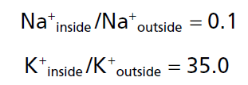
Active Transport of Sodium and Potassium Ions Through the Membrane—The Sodium-Potassium (Na+-K+) Pump.
Na+-K+ pump: Note that this is an electrogenic pump because more positive charges are pumped to the outside than to the inside (three Na+ ions to the outside for each two K+ ions to the inside), leaving a net deficit of positive ions on the inside and causing a negative potential inside the cell membrane.
The Na+-K+ pump also causes large concentration gradients for sodium and potassium across the resting nerve membrane.
These gradients are as follows:
Na+ (outside):142mEq/L
Na+ (inside):14mEq/L
K+ (outside): 4mEq/L
K+ (inside):140mEq/L
The ratios of these two respective ions from the inside to the outside are:

Slide 21
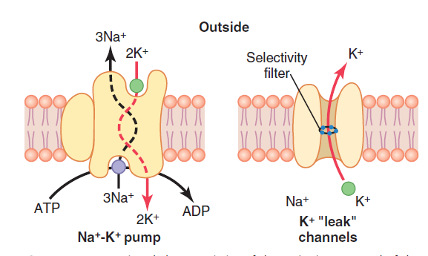

Slide 22
Leakage of Potassium Through the Nerve Cell Membrane.
A channel protein (sometimes called a tandem pore domain, potassium channel, or potassium [K+] “leak” channel) in the nerve membrane through which potassium can leak even in a resting cell.
These K+ leak channels may also leak sodium ions slightly but are far more permeable to potassium than to sodium—normally about 100 times as permeable.
This differential in permeability is a key factor in determining the level of the normal resting membrane potential.

Slide 23
ORIGIN OF THE NORMAL RESTING MEMBRANE POTENTIAL
Contribution of the Potassium Diffusion Potential.
In the Figure in the next slide, we assume that the only movement of ions through the membrane is diffusion of potassium ions, as demonstrated by the open channels between the potassium symbols (K+) inside and outside the membrane.
Because of the high ratio of potassium ions inside to outside, 35 : 1, the Nernst potential corresponding to this ratio is −94 millivolts because the logarithm of 35 is 1.54, and this multiplied by −61 millivolts is −94 millivolts.
Therefore, if potassium ions were the only factor causing the resting potential, the resting potential inside the fiber would be equal to −94 millivolts, as shown in the figure.

Slide 24
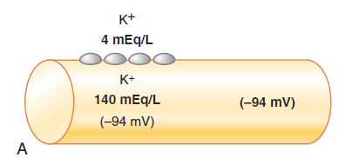

Slide 25
ORIGIN OF THE NORMAL RESTING MEMBRANE POTENTIAL cnt’d…
Contribution of Sodium Diffusion Through the Nerve Membrane.
Figure in the next slide shows the addition of slight permeability of the nerve membrane to sodium ions, caused by the minute diffusion of sodium ions through the K+-Na+ leak channels. The ratio of sodium ions from inside to outside the membrane is 0.1, which gives a calculated Nernst potential for the inside of the membrane of +61 millivolts. Also shown in this Figure is the Nernst potential for potassium diffusion of −94 millivolts.
Intuitively, one can see that if the membrane is highly permeable to potassium but only slightly permeable to sodium, it is logical that the diffusion of potassium contributes far more to the membrane potential than does the diffusion of sodium.
In the normal nerve fiber, the permeability of the membrane to potassium is about 100 times as great as its permeability to sodium.
Notes:
Using this value in the Goldman equation gives a potential inside the membrane of −86 millivolts, which is near the potassium potential shown in the figure.

Slide 26
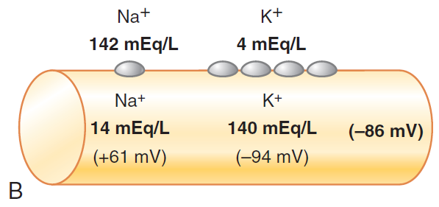

Slide 27
ORIGIN OF THE NORMAL RESTING MEMBRANE POTENTIAL cnt’d…
Contribution of the Na+-K+ Pump.
In Figure in the next slide, the Na+-K+ pump is shown to provide an additional contribution to the resting potential.
This figure shows that continuous pumping of three sodium ions to the outside occurs for each two potassium ions pumped to the inside of the membrane.
The pumping of more sodium ions to the outside than the potassium ions being pumped to the inside causes continual loss of positive charges from inside the membrane, creating an additional degree of negativity (about −4 millivolts additional) on the inside beyond that which can be accounted for by diffusion alone.
Therefore, as shown in the Figure, the net membrane potential when all these factors are operative at the same time is about −90 millivolts.

Slide 28
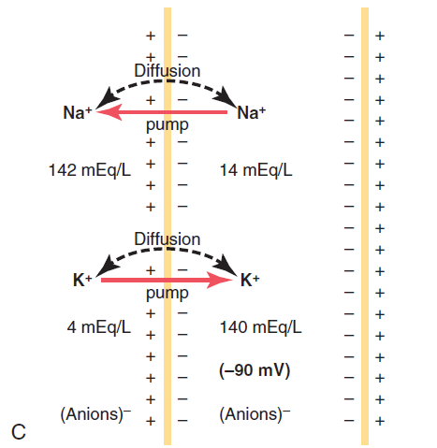

Slide 29
ORIGIN OF THE NORMAL RESTING MEMBRANE POTENTIAL cnt’d…
In summary, the diffusion potentials alone caused by potassium and sodium diffusion would give a membrane potential of about −86 millivolts, with almost all of this being determined by potassium diffusion.
An additional −4 millivolts is then contributed to the membrane potential by the continuously acting electrogenic Na+-K+ pump, giving a net membrane potential of −90 millivolts.

Slide 30
NEURON ACTION POTENTIAL
Nerve signals are transmitted by action potentials, which are rapid changes in the membrane potential that spread rapidly along the nerve fiber membrane.
Each action potential begins with a sudden change from the normal resting negative membrane potential to a positive potential and ends with an almost equally rapid change back to the negative potential.
To conduct a nerve signal, the action potential moves along the nerve fiber until it comes to the fiber’s end.

Slide 31
ACTION POTENTIAL STAGES
Resting Stage.
The resting stage is the resting membrane potential before the action potential begins.
The membrane is said to be “polarized” during this stage because of the −90 millivolts negative membrane potential that is present.

Slide 32
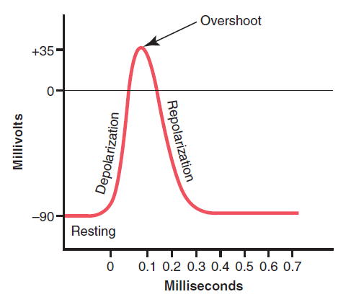

Slide 33
ACTION POTENTIAL STAGES CNT’D…
Depolarization Stage.
At this time, the membrane suddenly becomes permeable to sodium ions, allowing tremendous numbers of positively charged sodium ions to diffuse to the interior of the axon.
The normal “polarized” state of −90 millivolts is immediately neutralized by the inflowing positively charged sodium ions, with the potential rising rapidly in the positive direction—a process called depolarization.
In large nerve fibers, the great excess of positive sodium ions moving to the inside causes the membrane potential to actually “overshoot” beyond the zero level and to become somewhat positive.
In some smaller fibers, as well as in many central nervous system neurons, the potential merely approaches the zero level and does not overshoot to the positive state.

Slide 35
ACTION POTENTIAL STAGES CNT’D…
Repolarization Stage.
Within a few 10,000ths of a second after the membrane becomes highly permeable to sodium ions, the sodium channels begin to close and the potassium channels open to a greater degree than normal.
Then, rapid diffusion of potassium ions to the exterior re-establishes the normal negative resting membrane potential, which is called repolarization of the membrane.

Slide 37
Further Reading
To explain more fully the factors that cause both depolarization and repolarization, read on the special characteristics of two other types of transport channels through the nerve membrane:
the voltage-gated sodium and
potassium channels.

Slide 38
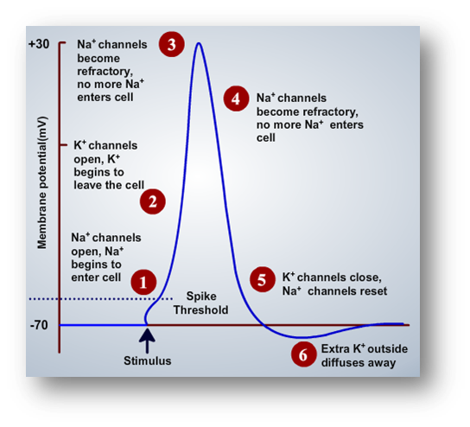

Slide 39
The End of the Presentation Thank You

