Slide 1
The Muscular System
BIO 137 Anatomy & Physiology I

Slide 2
Functions of Muscular Tissue
Like nervous tissue, muscles are excitable or "irritable”
  they have the ability to respond to a stimulus
Unlike nerves, however, muscles are also:
  Contractible (they can shorten
  in length)
  Extensible (they can extend or
  stretch)
  Elastic (they can return to their
  original shape)

Slide 3
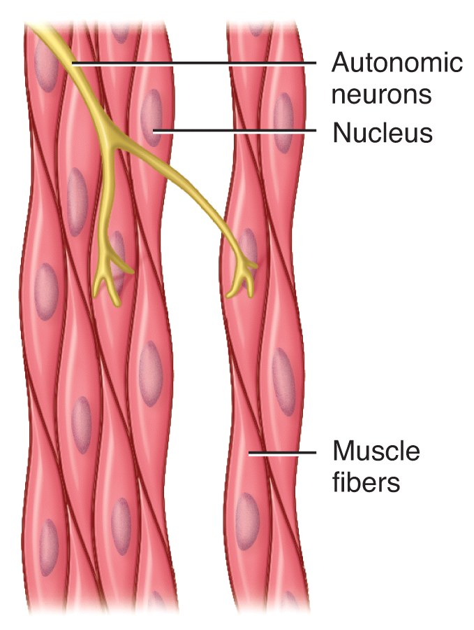
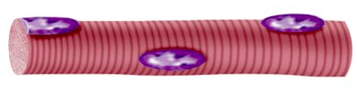
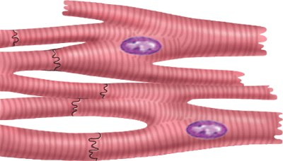
Three Types of Muscular Tissue
(a) Skeletal muscle
(b) Cardiac muscle
(c) Visceral smooth muscle

Slide 4



Three Types of Muscular Tissue
 | Location | Function | Appearance | Control
Skeletal | skeleton | movement, heat, posture | striated, multi-nucleated (eccentric), fibers parallel | voluntary
Cardiac | heart | pump blood continuously | striated, one central nucleus | involuntary
Visceral (smooth muscle) | G.I. tract, uterus, eye, blood vessels | Peristalsis, blood pressure, pupil size, erects hairs | no striations, one central nucleus | involuntary

Slide 5
Muscular System
Skeletal muscle is the only organ of the muscular system
Skeletal muscle is composed of skeletal muscle tissue and also contains nervous tissue, blood vessels and connective tissue
Half of the body’s weight is muscle tissue
  Skeletal muscle = 40% in males, 32% in females
  Cardiac muscle = 10%

Slide 6
Skeletal muscle fibers (cells) are arranged into bundles called fascicles
  Fascicles are bound by connective tissue
Four different connective tissue coverings
Deep fascia
  Surrounds entire skeletal muscle and extends beyond its length
Epimysium
  Closely surrounds skeletal muscle, binds fascicles together
Perimysium
  Surrounds each fascicle
Endomysium
  Surrounds each muscle fiber (cell)

Slide 7
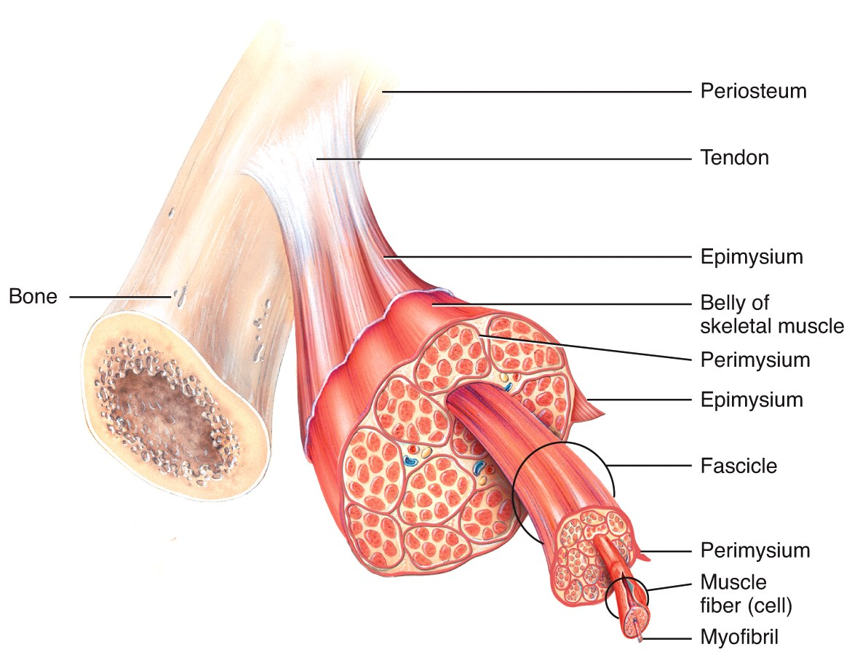
Organization of Muscle Tissue
A muscle, a fasciculus, and a fiber all visualized

Slide 8
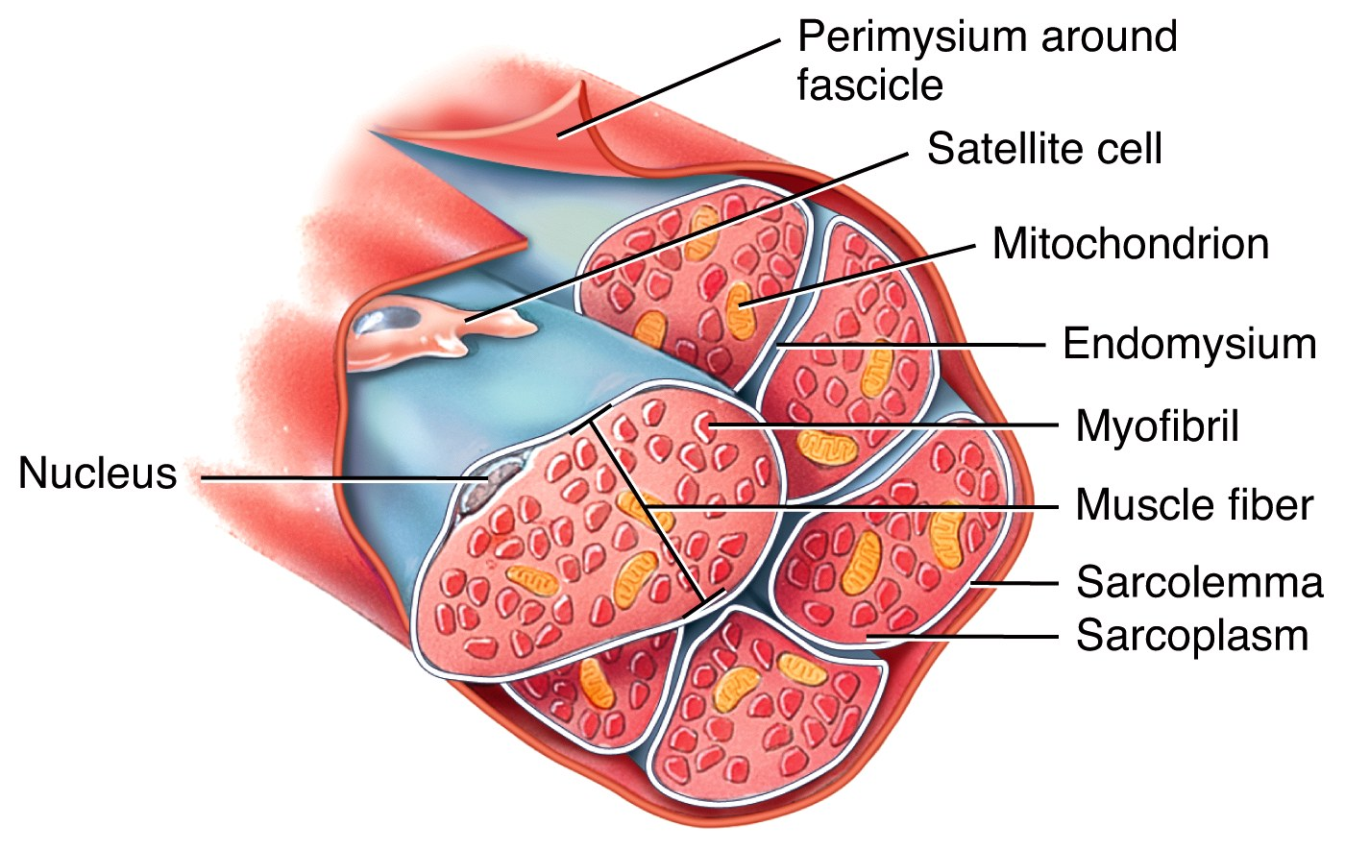
Organization of Muscle Tissue
Organization of a fasciculus

Slide 9
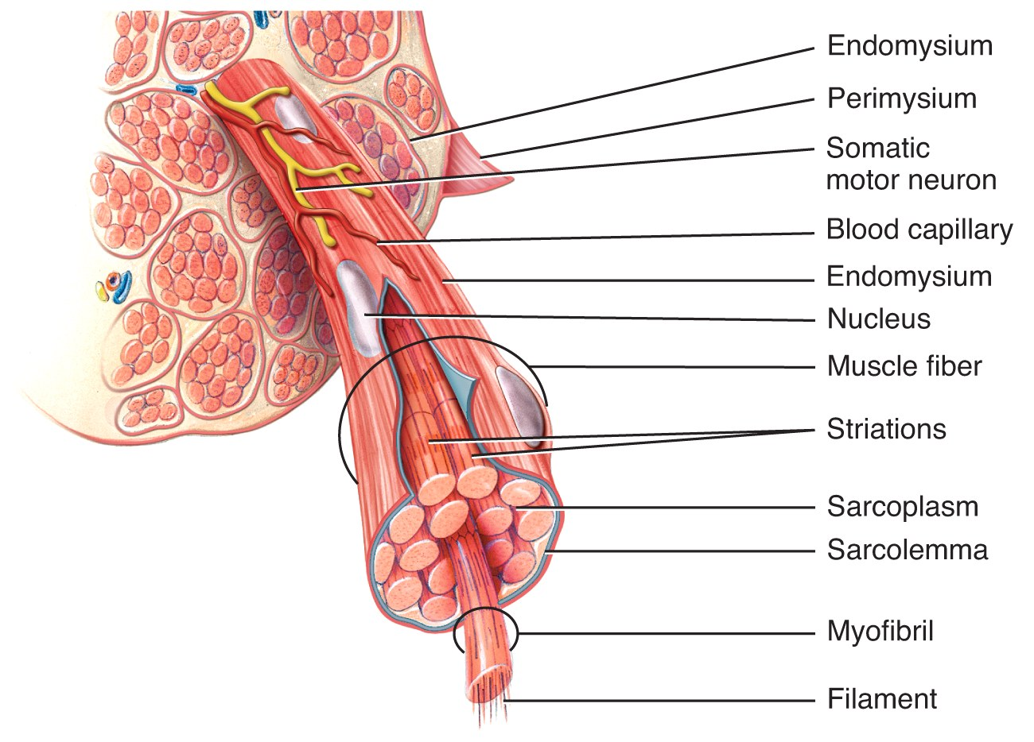
Organization of Muscle Tissue
Organization of a muscle fiber

Slide 10
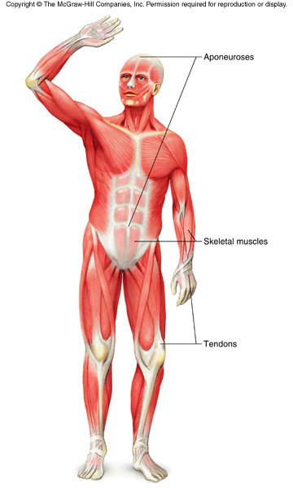
Connective Tissue Coverings
Fascia
  Surrounds an individual skeletal muscle, separating it from other muscles
  Fascia may extend beyond the ends of the muscle to become a tendon
  Fascia may connect muscle to muscle and is called an aponeurosis

Slide 11
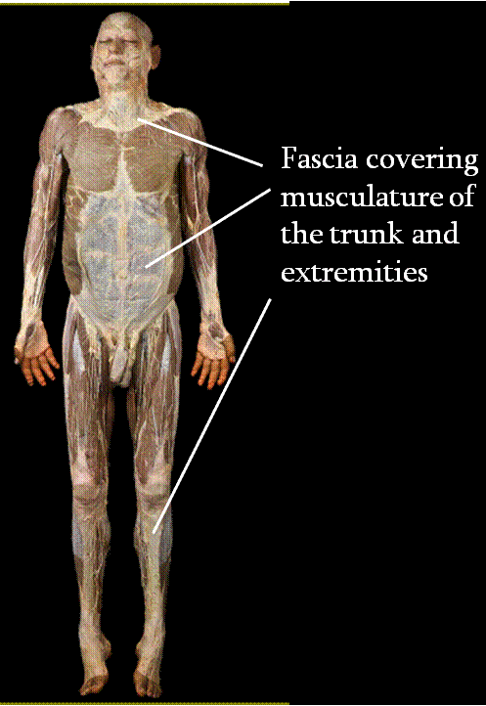
Organization of Muscle Tissue
Many large muscle groups are encased in both a superficial
and a deep fascia
Real Anatomy, John Wiley and Sons

Slide 12
Characteristics of Skeletal Muscle Tissue
Long, thin contractile fibers that are Striated
  Striations due to arrangement of thick and thin filaments
Under voluntary control
Attached to the bones of the skeleton by tendons
Allow for movement, facial expressions, breathing, swallowing, writing, talking and singing, posture, heat production, joint stability

Slide 13
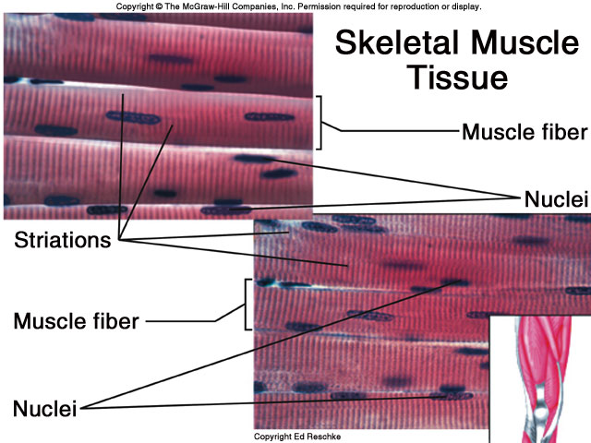

Slide 14
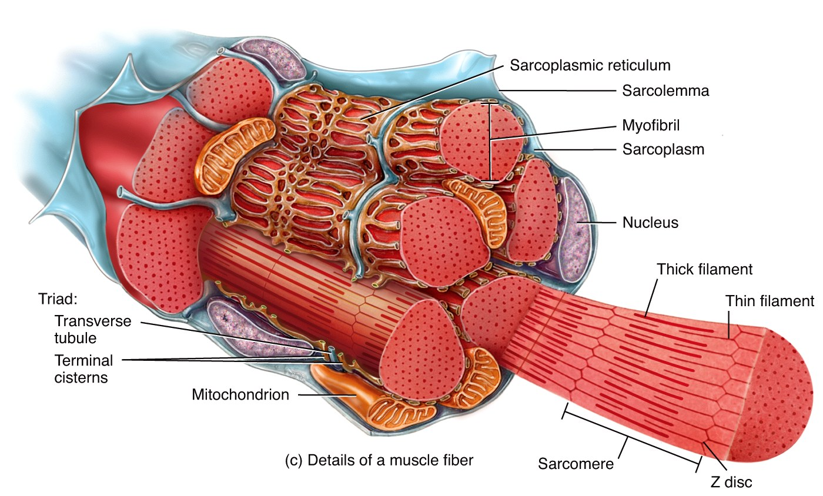
Skeletal Muscle Arrangement
A single muscle cell is a muscle fiber
  Fibers are made up of myofibrils
  Myofibrils are made up of thick and thin filaments
Sarcolemma – muscle cell membrane
Sarcoplasm
muscle cell
cytoplasm

Slide 15
Skeletal Muscle Cells
Myofibrils are striated
  Striations due to arrangement of thick and thin filaments
    Seen as alternating areas of light and dark bands
The length of each myofibril is divided into repeating units called sarcomeres
  A sarcomere is the functional unit of skeletal muscle

Slide 16
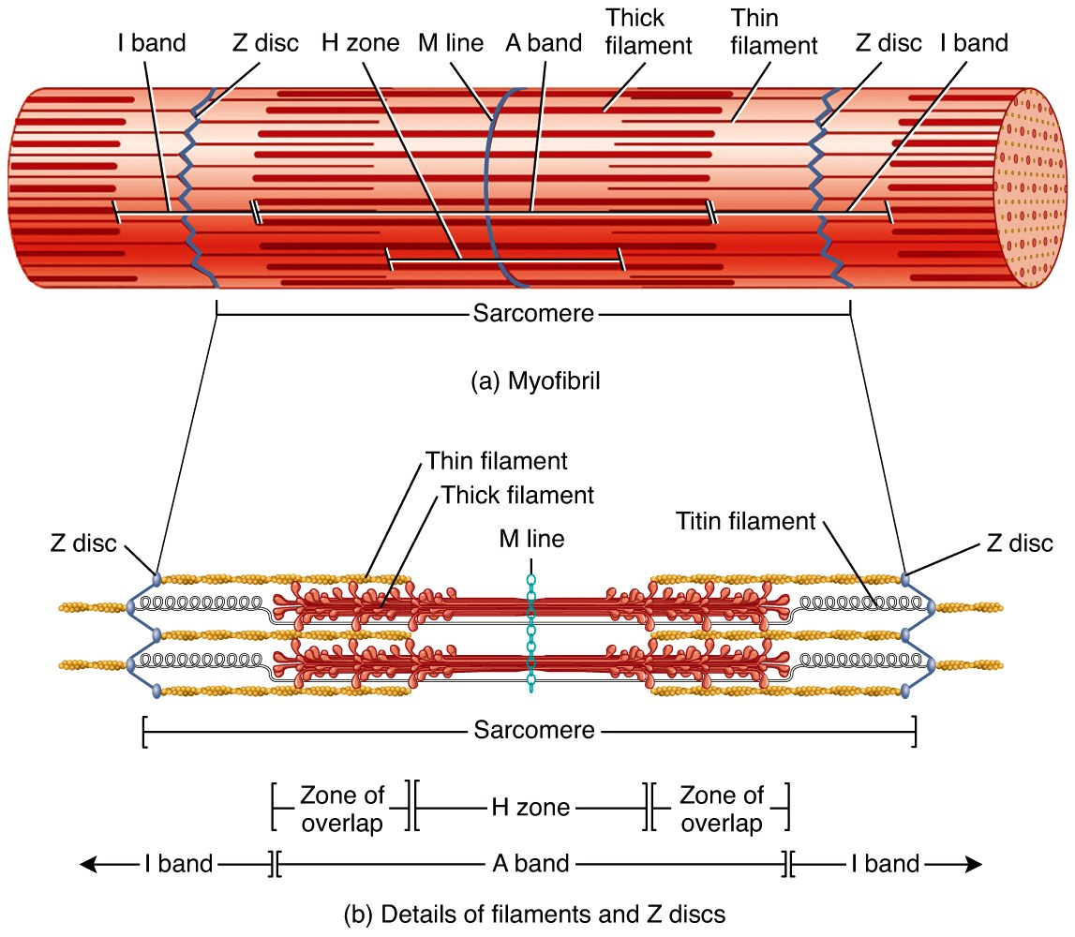
Sarcomere Arrangement

Slide 17
Sarcomere Structure
Sarcomere exists from Z-line to Z-line
A-Band is dark middle band
  Overlapping think and thin filaments
I-Band – ends of A-Band, thin filaments only
Z-line is in the middle if the I-Band
Myosin filaments are held to the Z-line by titin proteins

Slide 18
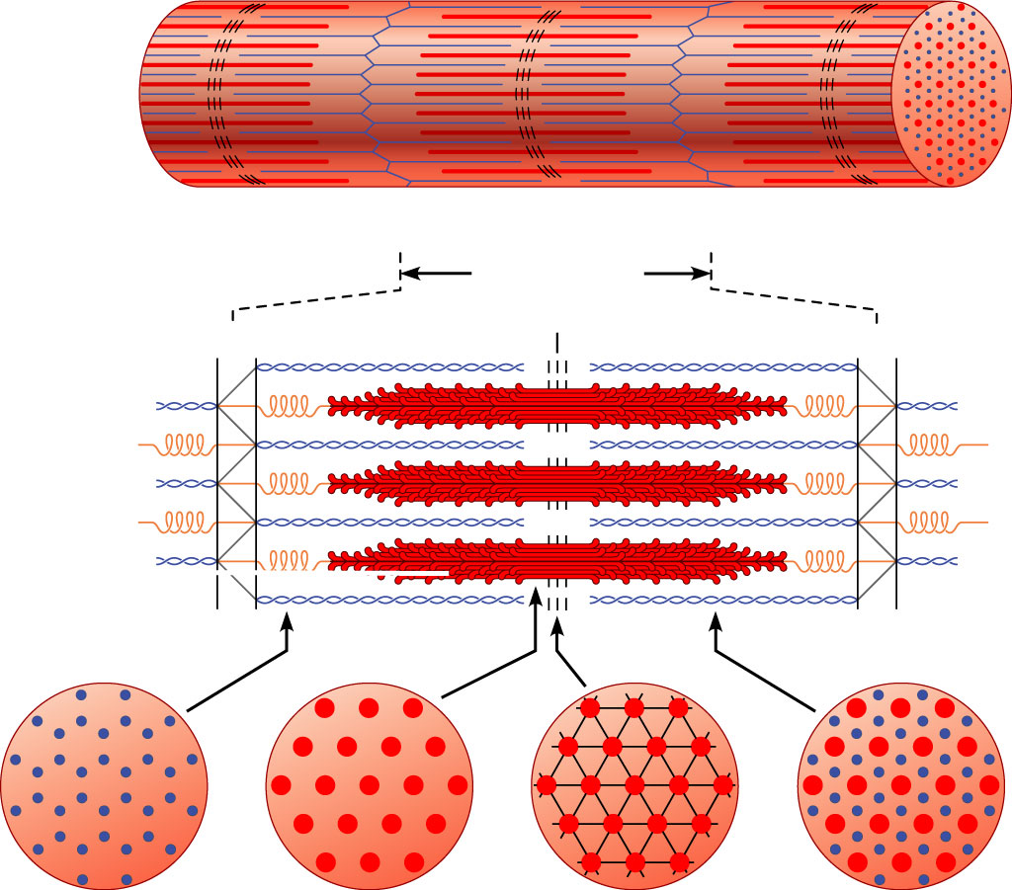
Microscopic anatomy of a skeletal muscle fiber
Z disc
H zone
Z disc
Thin (actin) filament
Thick (myosin)
filament
(c)
I band
A band
I band
M line
Sarcomere
Z disc
M line
Z disc
Thin (actin) filament
Elastic (titin)
filaments
Thick (myosin)
filament
(d)
I band
thin filaments
only
H zone
thick filaments
only
M line
thick filaments linked
by accessory proteins
Outer edge of
A band
thick and thin
filaments overlap
(e)

Slide 19
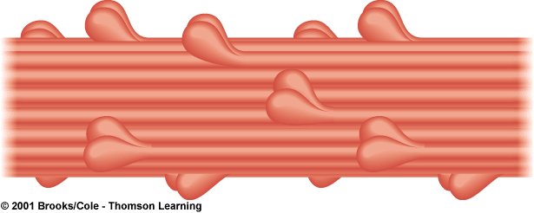
Thick Filament Structure
Composed of many myosin molecules
  Each myosin molecule has a tail region and 2 globular heads (crossbridges)

Slide 20
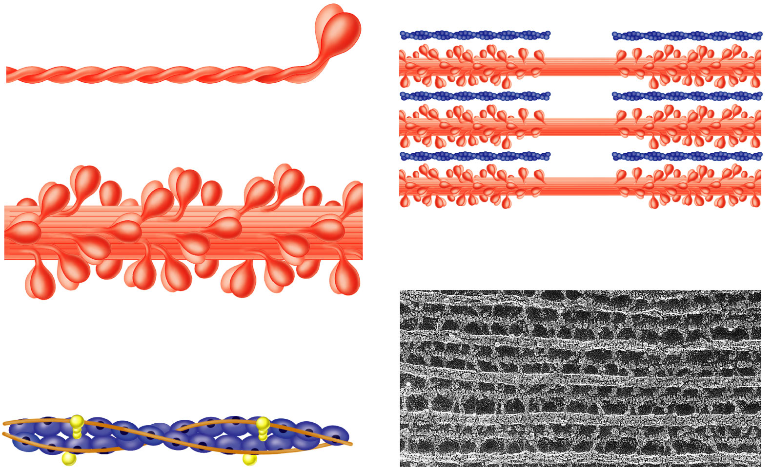
Thin Filament Structure
Composed of actin protein
  2 strands of globular actin molecules twisted into a helix
  Actin filaments have binding sites for myosin cross bridges
  Tropomyosin protein spirals around actin helix
  Troponin protein (3 subunits) is attached to actin and holds tropomyosin in place
    Call this the troponin-tropomyosin complex
Troponin complex
Tropomyosin
Actin

Slide 21
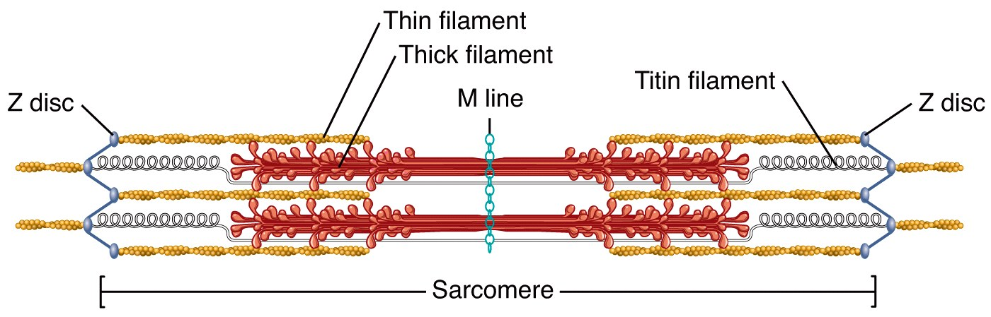

Slide 22
Specialized Organelles of Skeletal Muscle
Sarcoplasmic Reticulum (SR) – a type of ER
  Surrounds each myofibril, running parallel to it
  Stores calcium, when stimulated, calcium diffuses into sarcoplasm
Transverse Tubules (TT)
  Extends into sarcoplasm as invaginations continuous with sarcolemma
    T tubules run between cisternae of SR
  Filled with extracellular fluid
  Cisternae of SR and TT form a triad near where thick and thin filaments overlap

Slide 23
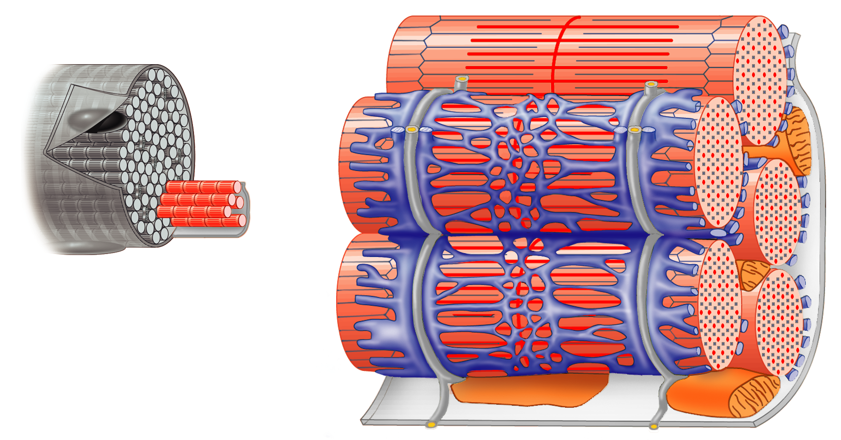
Relationship of the sarcoplasmic reticulum and T tubules to myofibrils of skeletal muscle
I band
A band
I band
Z disc
H zone
Z disc
M
line
Part of a skeletal
muscle fiber (cell)
Sarcolemma
Triad
Mitochondrion
Myofibrils
Myofibril
Tubules of
sarcoplasmic
reticulum
Sarcolemma
Terminal cisterna
of the sarcoplasmic
reticulum
T tubule

Slide 24
Skeletal Muscle Contraction

Slide 25
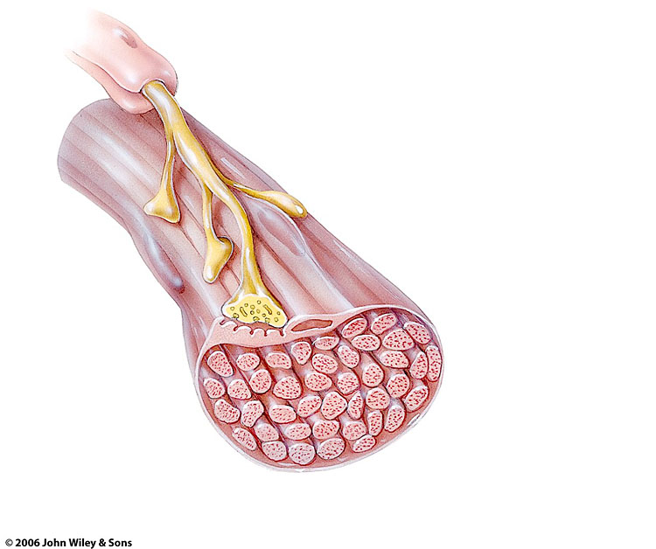
Motor Neuron
Nerve cell that innervates skeletal muscle tissue
Dendrite
  Receives information
Axon
  Transmits information
  Has vesicles containing neurotransmitter that will stimulate or inhibit muscle contraction
Neuromuscular Junction -Site where branch of motor neuron (motor nerve ending) comes in contact with sarcolemma of skeletal muscle fiber
    A type of synapse

Slide 26
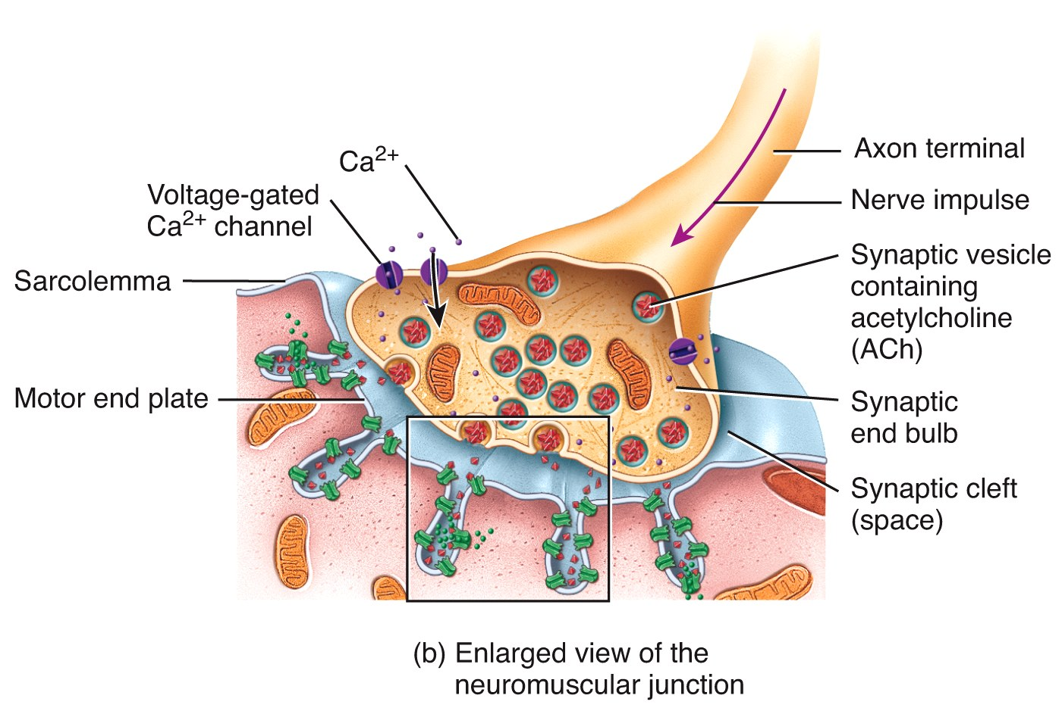
NMJ
Motor end-plate
  Sarcolemma of muscle fiber directly beneath motor nerve ending
    Contains an abundance of mitochondria and nuclei

Slide 27
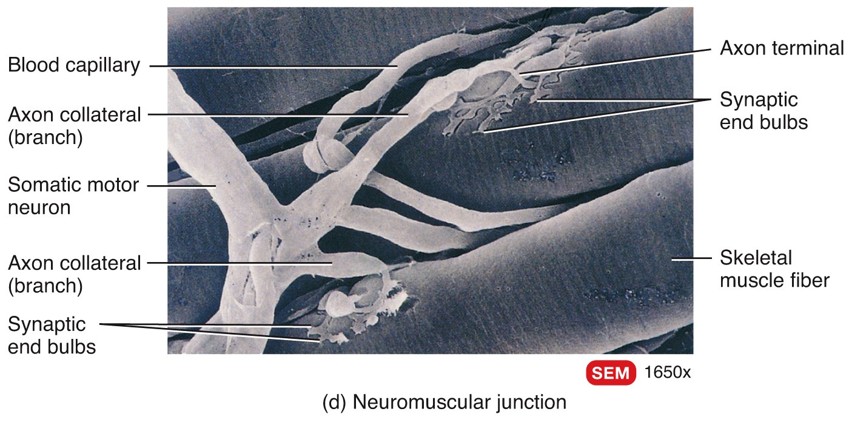
Neuromuscular Junction

Slide 28
Synapse
Junction between the axonal end of one neuron and the dendrite of another neuron OR membrane of another cell type
Synaptic cleft
  Separation that exists between the axonal ending of the motor nerve and the sarcolemma of the muscle cell fiber
The axon ending contains vesicles of neurotransmitter

Slide 29
Neurotransmitter
Chemical substance released from vesicles in the motor nerve ending (axonal ending)
  Acetylcholine (Ach) is the neurotransmitter released by motor neurons
When stimulated by a nerve impulse, Ach is released, travels across the synaptic cleft and binds receptors on the motor end plate
Stimulates contraction

Slide 30
Sliding Filament Theory
A sarcomere is the functional unit of skeletal muscle
When a skeletal muscle contracts, sarcomeres shorten
This is described by the sliding filament theory

Slide 31
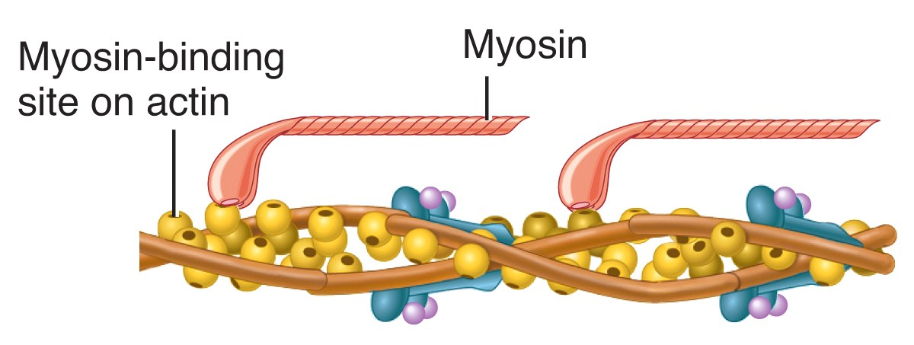
Sliding Filament Theory
Sarcomeres shorten because thick and thin filaments slide past one another
Thin filaments move towards the center of the sarcomere from both ends

Slide 32
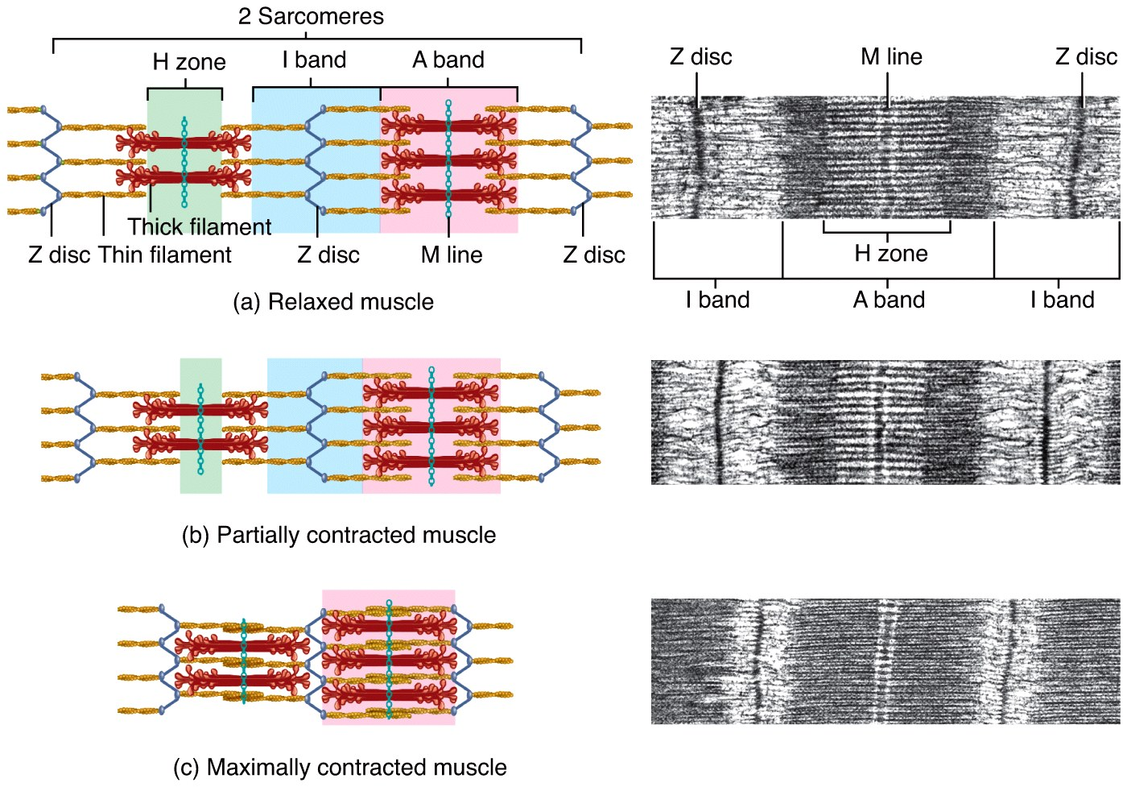
The Sliding-Filament Mechanism
The “sliding” of actin on myosin (thick filaments on thin filaments) can be broken down into a 4 step process

Slide 33
Physiology of Skeletal Muscle Contraction: Neurotransmitter Release
Motor impulse is initiated in the brain
Travels through the brain and spinal cord to a motor nerve ending
Motor nerve endings (axons) depolarize
Calcium enters the axonal endings
Calcium causes the release of acetylcholine into the neuromuscular junction (synaptic cleft)

Slide 34
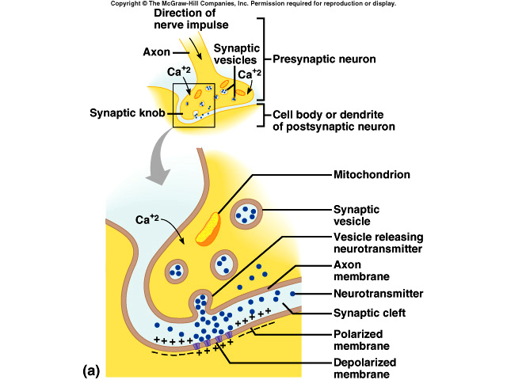

Slide 35
Physiology of Skeletal Muscle Contraction: Depolarization
ACh binds receptors on motor end plate
Depolarizes skeletal muscle fibers
  Reverses charge of membrane
Impulse travels through transverse tubules to reach all of the muscle fibers
Muscle depolarization causes release of calcium from the sarcoplasmic reticulum into the sarcoplasm

Slide 36
Relationship of the sarcoplasmic reticulum and T tubules to myofibrils of skeletal muscle
I band
A band
I band
Z disc
H zone
Z disc
M
line
Part of a skeletal
muscle fiber (cell)
Sarcolemma
Triad
Mitochondrion
Myofibrils
Myofibril
Tubules of
sarcoplasmic
reticulum
Sarcolemma
Terminal cisterna
of the sarcoplasmic
reticulum
T tubule

Slide 37
Physiology of Skeletal Muscle Contraction: Power Stroke
Calcium binds troponin (which is attached to tropomyosin
Moves tropomyosin from the myosin binding sites on actin
Myosin crossbridges (heads) bind to actin
  ATP hydrolysis supplies energy
Actin is pulled inward towards the center of the sarcomere = POWER STROKE
Sarcomeres shorten as muscle contracts

Slide 38
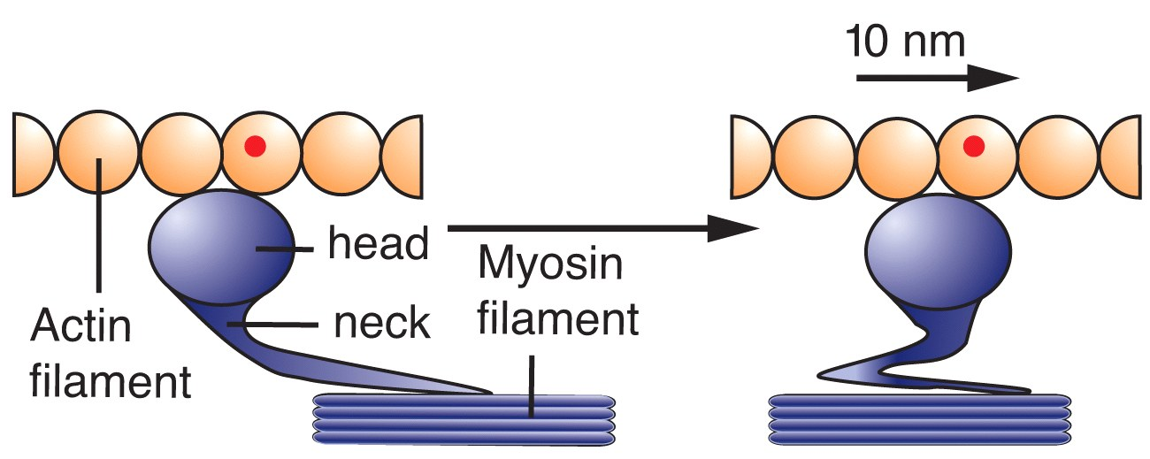
The Sliding-Filament Mechanism
With exposure of the myosin binding sites on actin (the thin filaments)—in the presence of Ca²⁺ and ATP—the thick and thin filaments “slide” on one another and the sarcomere is shortened

Slide 39
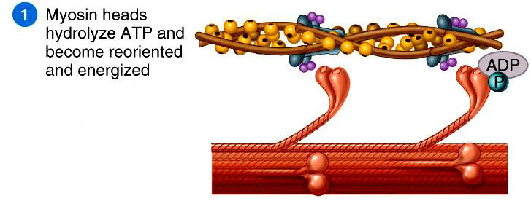
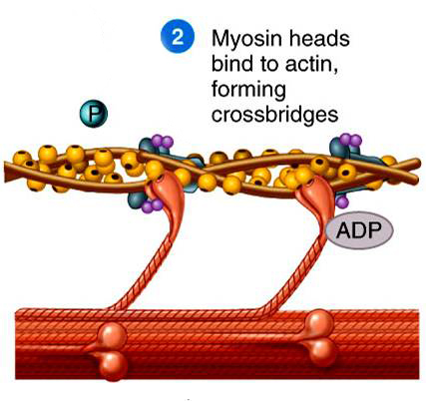
Step 1: ATP hydrolysis
Step 2: Attachment

Slide 40
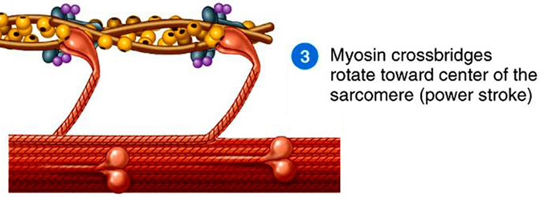
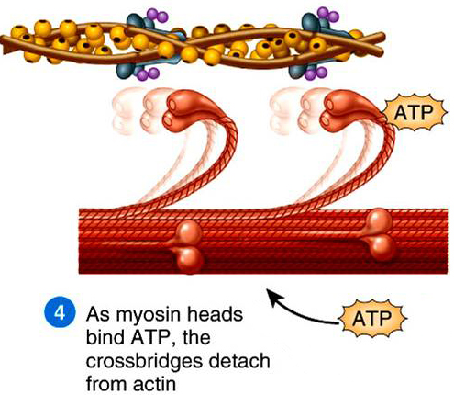
Step 3: Power Stroke
Step 4: Detachment

Slide 41
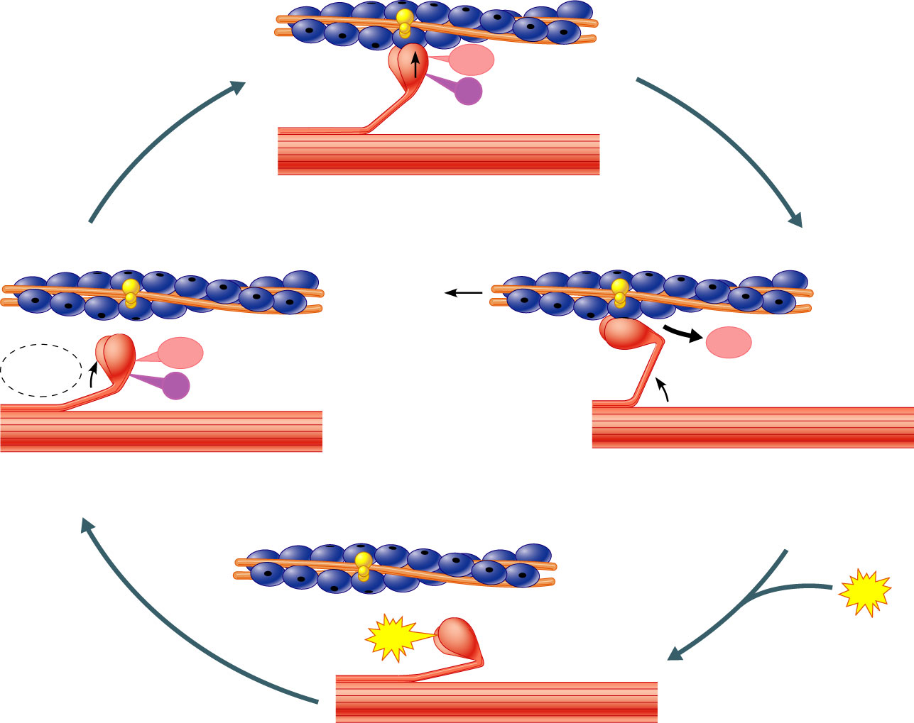
The Cross Bridge Cycle
Myosin head
(high-energy
configuration)
ADP
P_{i}
1
Myosin head attaches to the actin
myofilament, forming a cross bridge.
Thin filament
ATP
hydrolysis
ADP
Thick filament
ADP
P_{i}
4
As ATP is split into ADP and P_{i}, the myosin
head is energized (cocked into the high-energy
conformation).
2
Inorganic phosphate (P_{i}) generated in the previous
contraction cycle is released, initiating
the power (working) stroke. The myosin head
pivots and bends as it pulls on the actin filament,
sliding it toward the M line. Then ADP is released.
ATP
ATP
Myosin head
(low-energy
configuration)
3
As new ATP attaches to the myosin head, the link between
Myosin and actin weakens, and the cross bridge detaches.

Slide 42
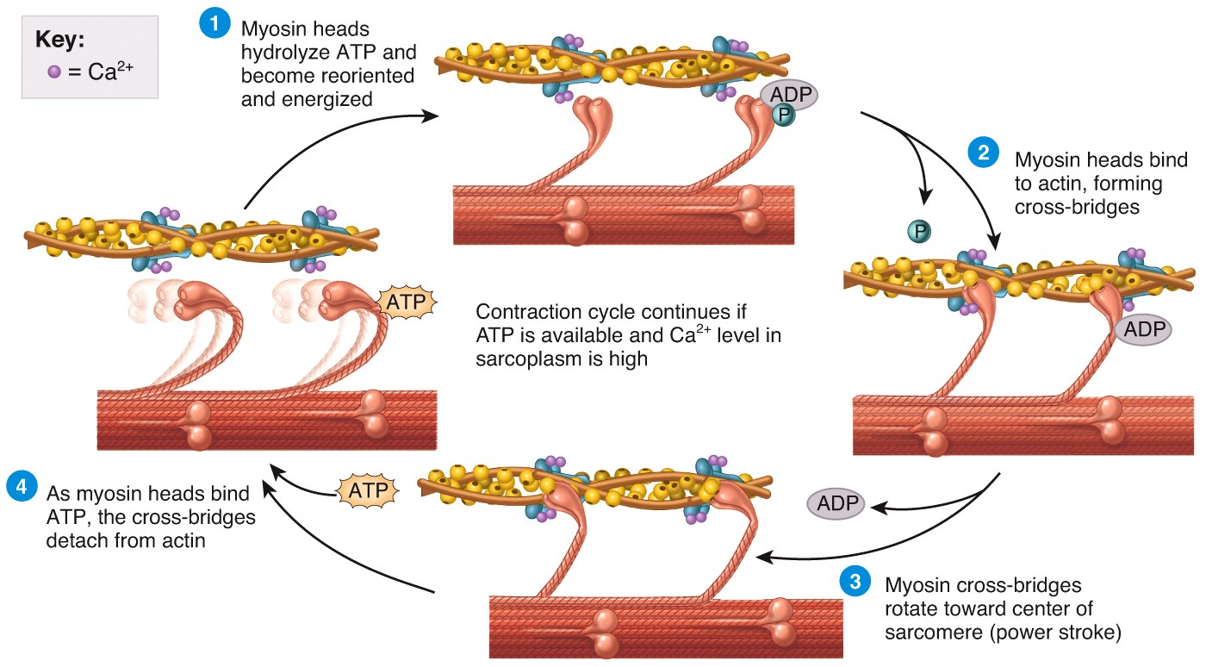
The Sliding-Filament Mechanism
Notes:
None of this occurs without intracellular Ca²⁺ release from its storage sites in the sarcoplasmic reticulum.

Slide 43
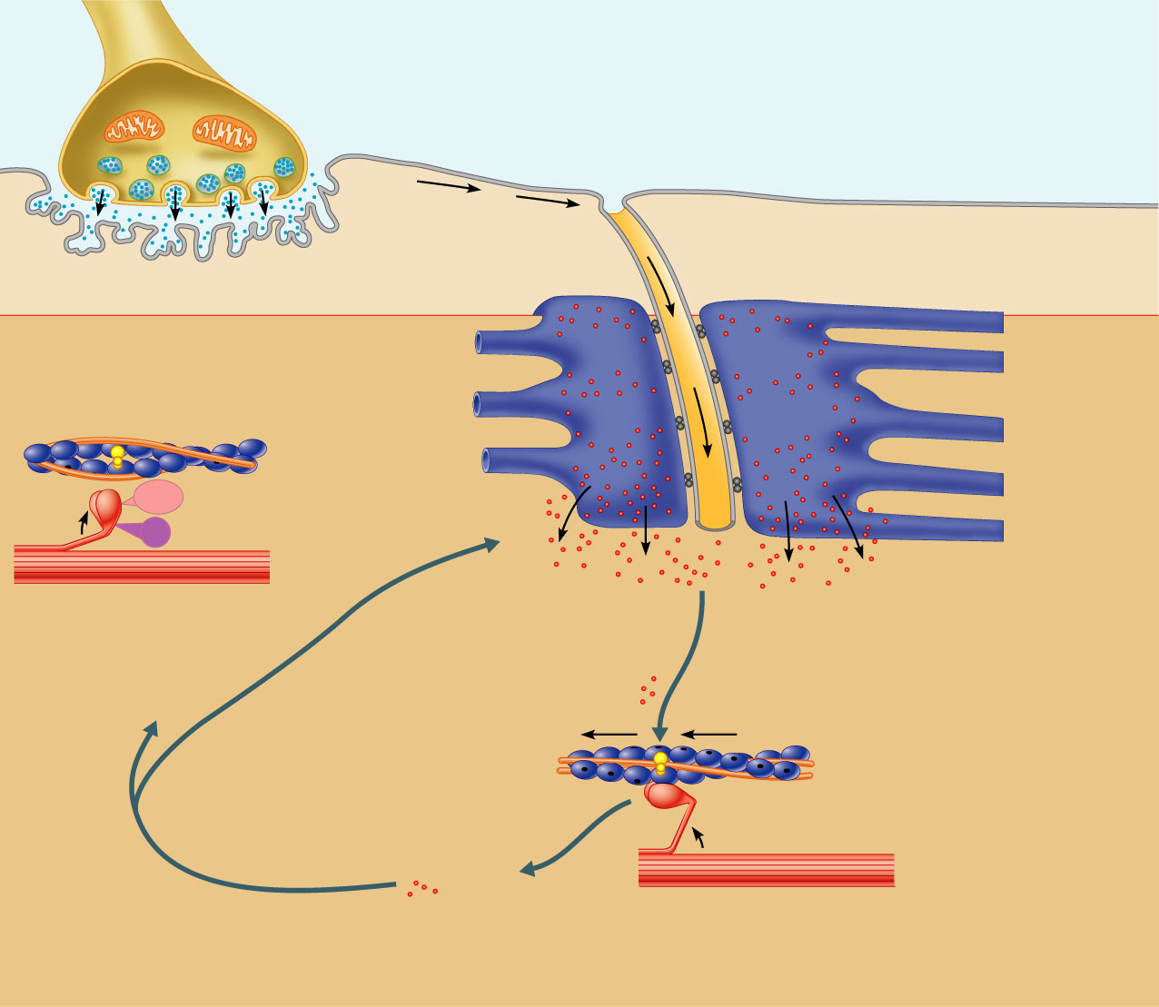
Excitation-Contraction Coupling
Axon terminal
Neurotransmitter released
diffuses across the synaptic
cleft and attaches to ACh
Synaptic
cleft
Synaptic
vesicle
Sarcolemma
T tubule
1
Net entry of Na⁺ initiates
an action potential which
is propagated along the
sarcolemma and down
the T tubules.
ACh
ACh
ACh
Ca²⁺
Ca²⁺
SR tubules (cut)
SR
2
Action potential
in T tubule activates
voltage-sensitive
receptors, which in
turn trigger Ca²⁺
release from terminal
cisternae of SR
into cytosol.
Ca²⁺
Ca²⁺
ADP
P_{i}
Ca²⁺
Ca²⁺
6
Tropomyosin blockage
restored, blocking myosin
binding sites on actin;
contraction ends and
muscle fiber relaxes.
Ca²⁺
Ca²⁺
3
Calcium ions bind to troponin;
troponin changes shape, removing
the blocking action of tropomyosin;
actin active sites exposed.
Ca²⁺
5
Removal of Ca²⁺ by active transport
into the SR after the action
potential ends.
Ca²⁺
4
Contraction; myosin heads alternately attach to
actin and detach, pulling the actin filaments toward
the center of the sarcomere; release of energy by
ATP hydrolysis powers the cycling process.

Slide 44
Muscle Relaxation Mechanism
1. Acetylcholinesterase present in the NMJ destroys ACh (preventing continual stimulation)
2. Calcium ions are transported from the sarcoplasm back into the SR
3. Linkages between myosin and actin are broken
  Requires ATP binding
THEN: The muscle fiber relaxes

Slide 45
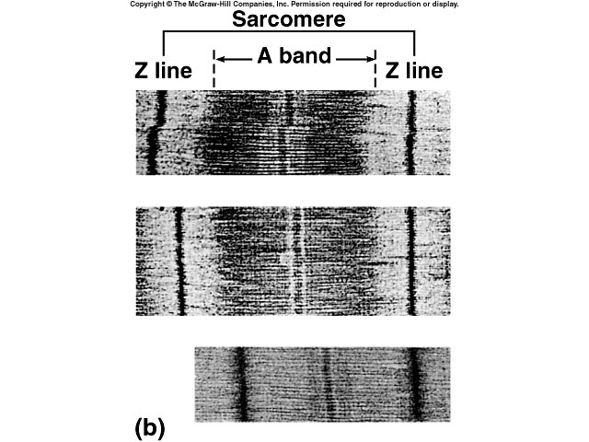
Contraction in the Sarcomere
A band stays the same
I band gets smaller
H zone gets smaller
Sarcomere shortens

Slide 46
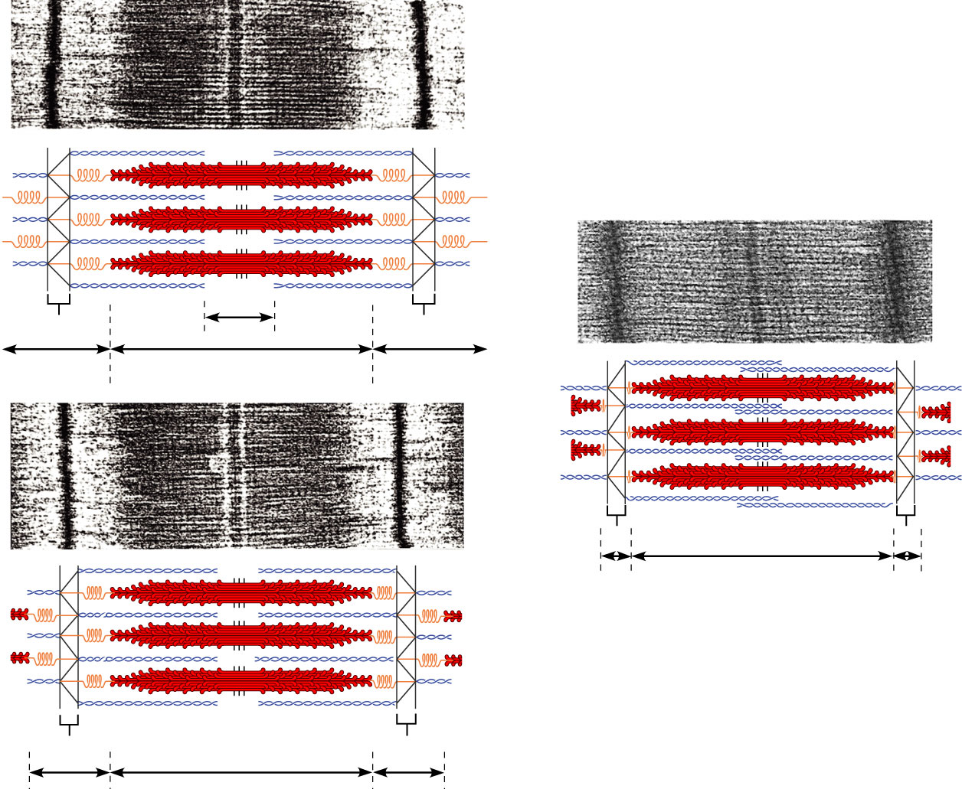
Sliding filament model of contraction
Z
H
Z
1
I
A
I
Z
Z
3
A
Z
Z
2
A

Slide 47
Energy for Contraction
Muscle cells require huge amounts of ATP energy to power contraction
The cells have only a very small store of ATP
Three pathways supply ATP to power muscle contraction

Slide 48
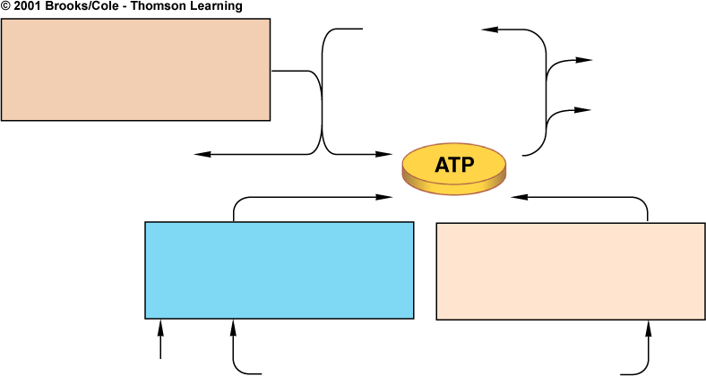
ATP Supply for Contraction
ADP + P_{i}
Pathway 1
DEPHOSPHORYLATION
CREATINE PHOSPHATE
Relaxation
Contraction
creatine
Pathway 2
AEROBIC RESPIRATION
Pathway 3
GLYCOLYSIS ALONE
oxygen
glucose from bloodstream and
from glycogen breakdown in cells

Slide 49
Energy for Contraction
ATP initially supplied from cellular respiration
If ATP is abundant, is converted to creatine phosphate and stored in skeletal muscles
When ATP is low, creatine phosphate supplies phosphate to ADP making ATP
CP & ATP stores only good for about a 10 second maximal contraction
ATP must then come from cellular respiration or glycolysis

Slide 50
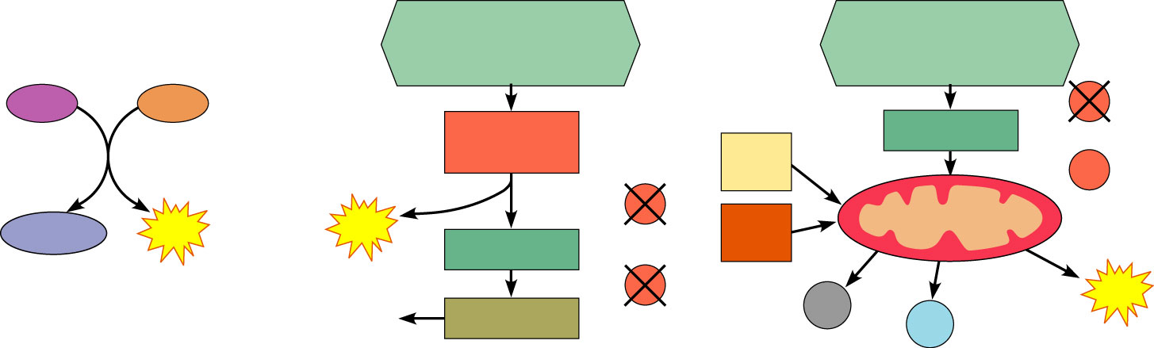
Methods of regenerating ATP during muscle activity
Glucose (from
glycogen breakdown or
delivered from blood)
Glucose (from
glycogen breakdown or
delivered from blood)
CP
ADP
O₂
Glycolysis
in cytosol
Fatty
acids
Pyruvic acid
O₂
O₂
Amino
acids
Aerobic respiration
in mitochondria
Creatine
ATP
2
ATP
Pyruvic acid
net gain
O₂
CO₂
38
ATP
Released
to blood
Lactic acid
H₂O
net gain per glucose
(a) Direct phosphorylation
[coupled reaction of creatine
phosphate (CP) and ADP]
(b) Anaerobic mechanism (glycolysis
and lactic acid formation)
(c) Aerobic mechanism (aerobic cellular
respiration)
Energy source: CP
Energy source: glucose
Energy source: glucose; pyruvic acid; free
fatty acids from adipose tissue; amino acids
from protein catabolism
Oxygen use: None
Products: 1 ATP per CP, creatine
Duration of energy provision: 15s
Oxygen use: None
Products: 2 ATP per glucose, lactic acid
Duration of energy provision: 30–60 s.
Oxygen use: Required
Products: 38 ATP per glucose, CO₂, H₂O
Duration of energy provision: Hours

Slide 51
Oxygen & Muscle Contraction
Myoglobin of muscle (similar to hemoglobin) binds to and stores oxygen
Supplies O₂ needed to make ATP for contraction

Slide 52
Exercise and Skeletal Muscles
Prolonged, moderate exercise
  ATP supplied through cellular respiration
  Once glycogen stores are depleted in muscle, glucose and fatty acid deliveries from blood are used as fuel source

Slide 53
Exercise and Contraction
In intense strenuous activity, oxygen can be depleted
Why?
Contraction of skeletal muscles decreases blood delivery to muscles
Nutrient and O₂ levels in contracting muscles decrease

Slide 54
Exercise and Skeletal Muscles
Intense, strenuous exercise
  Muscles exceed capacity of respiratory and cardiovascular systems to deliver oxygen for contraction
  ATP supplied anaerobically through glycolysis
  Pyruvate is converted to lactic acid
  Lactic acid builds up in muscles
    Causes muscles to fatigue

Slide 55
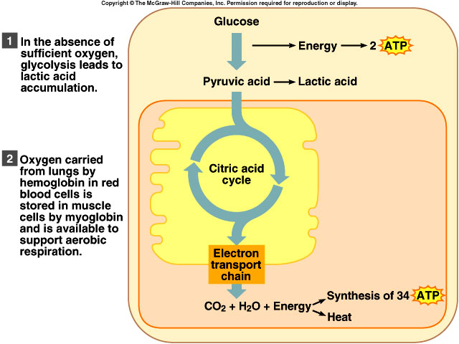

Slide 56
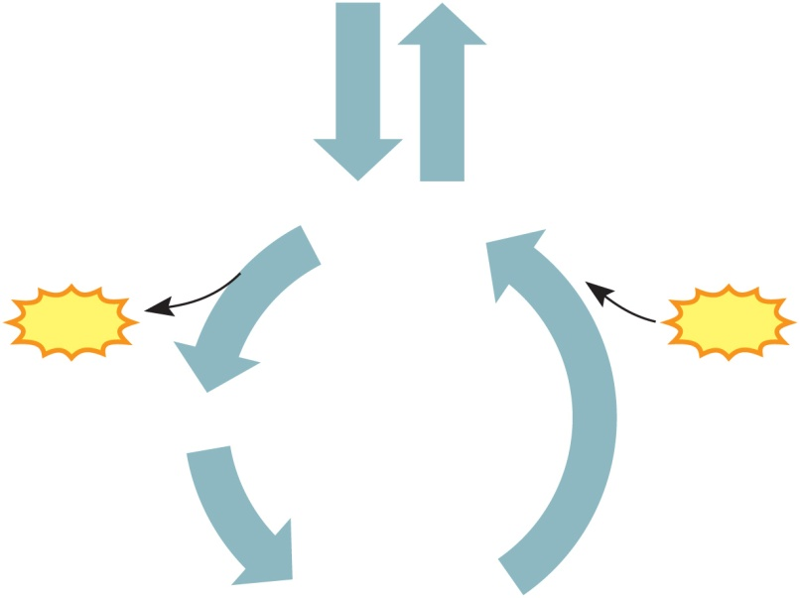
Oxygen Debt
Amount of oxygen needed by liver cells to use the accumulated lactic acid to produce glucose
Copyright © The McGraw-Hill Companies, Inc. Permission required for reproduction or display.
Oxygen not available
Glycolysis continues
Pyruvic acid converted to lactic acid
Liver converts lactic acid to glucose
  Also the amount of oxygen needed to replace O₂ levels in skeletal muscle to pre-exercise levels
Glycogen
Energy to
synthesize
Glucose
Energy
from
ATP
ATP
Pyruvic acid
Lactic acid
Glycolysis and
lactic acid formation
(in muscle)
Synthesis of glucose
from lactic acid
(in liver)

Slide 57
Heat Production
Cellular respiration is only about 40% efficient
About 60% of the energy found in a glucose is lost as heat during cellular respiration
Muscle contraction generates heat because muscles use large amounts of nutrients to make ATP, generating large amounts of heat
Heat is used to maintain body temperature

Slide 58
Glycogenolysis
Do you remember what glycogen is??????
Glycogenolysis is the breakdown of glycogen into glucose molecules
Epinephrine can trigger this pathyway too
Depends upon the presence of an enzyme – glycogen phosphorylase

Slide 59
McArdle’s Disease
Absence of the muscle glycogen phosphorylase enzyme
Individuals must rely on blood-transported fuels
  Fatty acids, protein, glucose from the liver
  These reserves take 5-10 minutes to arrive to the mitochondria
Muscles stop functioning until these fuels arrive
Autosomal Recessive Disorder

Slide 60
Symptoms of McArdle’s Disease
Premature muscle fatigue and weakness and pain during exercise
Muscles can become injured during exercise

Slide 61
McArdle’s Disease
What should an individual with McArdle’s eat?
Can they participate in intense strenuous activity?
Can they participate in Prolonged, moderate exercise?
Where does their supply of ATP come from?

