Slide 1
The Nervous System

Slide 2
Nervous System
The Nervous System (NS) is the master controlling and communicating system of the body. Every thought, action, and sensation reflects its activity.
We are what our brain has experienced; If all past sensory input could suddenly be erased, we would be unable to walk, talk, or communicate in any manner
The nervous system does not work alone to regulate and maintain body homeostasis.
While the NS controls with rapid electrical nerve impulses, the endocrine system organs produce hormones, or chemicals, that direct the body’s cells to promote the well-being of the body as a whole.

Slide 3
Divisions of the Nervous System
Structures = Anatomical classification or
Activities = Functional classification

Slide 4
Divisions of the Nervous System
Anatomical classification
The nervous system is divided on the basis of its structures
There are two subdivisions
The Central Nervous System (CNS) which consists of the brain and the spinal cord. and
The Peripheral Nervous System ( PNS) The PNS consists of nervous system structures (nerves) out side the CNS

Slide 5
Divisions of the Nervous System
Functional classification
The structures of the nervous system may be divided functionally in terms of motor activities or actions that the nerves of the PNS generate
This classification also has two subdivisions
The Somatic Nervous System allows us to consciously, or voluntarily, control our skeletal muscles. and
The Autonomic Nervous System which regulates activities that are automatic, or involuntary, such as the activation of smooth and cardiac muscles and glands

Slide 6
NERVUOS TISSUE
Even though it is complex, nervous tissue is made up of two principal types of cells
Neuroglia and
Neurons

Slide 7
NERVUOS TISSUE
Neuroglia
The neuroglia (nerve glue) include many types of cells that generally support and protect the neurons in the CNS.
In addition, each of the different types of glial cells has special functions.

Slide 8
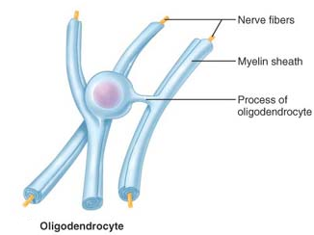
NERVUOS TISSUE
Neuroglia
Oligodendroglia deposit a fatty insulating substance around the process, or extensions of the neurons.

Slide 9
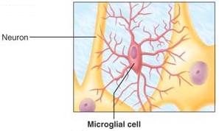
NERVUOS TISSUE
Neuroglia
Microglia are phagocytes, which dispose of debris (dead brain cells, bacteria, and the like).

Slide 10
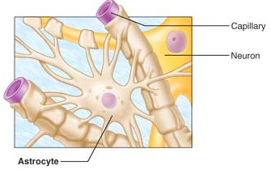
NERVUOS TISSUE
Neuroglia
Astrocytes seam to act as “feeder cells” for the delicate neurons. Forming a living barriers between the capillary blood supply and neuron, and makes exchange between
neurons and blood.
In this way they
protect the neurons
from harmful
substances
might be in the
blood.

Slide 11
Nervous Tissue: Neurons
Neurons = nerve cells
Cells specialized to transmit messages
Major regions of neurons
Cell body – nucleus and metabolic center of the cell
Processes – fibers that extend from the cell body

Slide 12
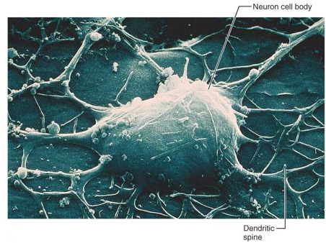
Neuron Anatomy
Cell body
Nucleus
Large nucleolus

Slide 13
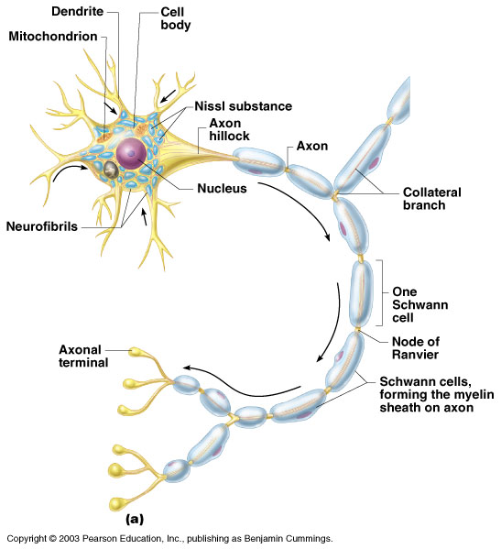
Neuron Anatomy
Extensions outside the cell body
Dendrites – conduct impulses toward the cell body
Axons – conduct impulses away from the cell body
Usually neurons have only one axon but may have many dendrites

Slide 14
Neuron Anatomy
Axons end in axonal terminals
Axonal terminals contain tiny vesicles or sacs which store neurotransmitters
Axonal terminals are separated from the next neuron by a tiny gap
Synaptic cleft – gap between adjacent neurons
Synapse – junction between nerves

Slide 15
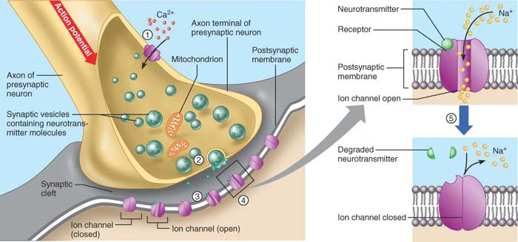
Neuron Anatomy

Slide 16
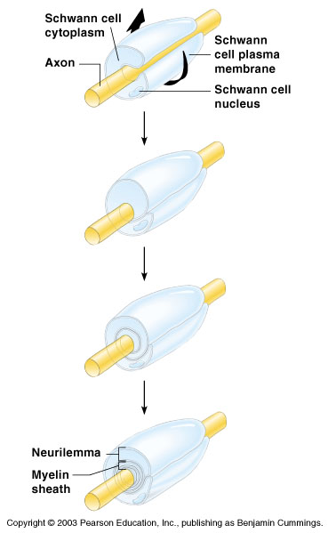
Neuron Anatomy
Most long nerve fibers are covered with a whitish fatty material (myelin)
Myelin protects and insulates the fibers and increase the rate of transmission of the nerve impulses

Slide 17
Neuron Anatomy
Schwann cells – produce myelin sheaths in jelly-roll like fashion
Neurilemma – is the exposed part of the schwann cell membrane
Nodes of Ranvier – gaps in myelin sheath along the axon

Slide 18
Nerve Cell Bodies
Most are found in the central nervous system
Gray matter – cell bodies and unmylenated fibers
Nuclei – clusters of cell bodies within the white matter of the central nervous system
Ganglia – collections of nerve cell bodies outside the central nervous system

Slide 19
Functional Classification of Neurons
Sensory (afferent) neurons
Carry impulses from the sensory receptors
Cutaneous sense organs
Proprioceptors – detect stretch or tension
Motor (efferent) neurons
Carry impulses from the central nervous system (CNS) to the viscera and/or body muscles and glands

Slide 20
Functional Classification of Neurons
Interneurons (association neurons)
Connect sensory and motor neurons in neural pathways
Found in the central nervous system

Slide 21
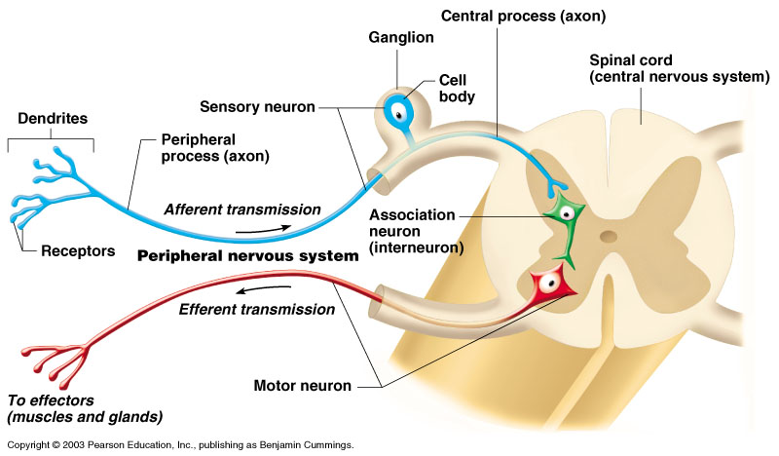
Neuron Classification

Slide 22
Physiology of Neurons
Neurons have two major functional properties:
Irritability – ability to respond to stimuli
Conductivity – ability to transmit an impulse
The plasma membrane at rest is polarized
Fewer positive ions are inside the cell than outside the cell

Slide 23
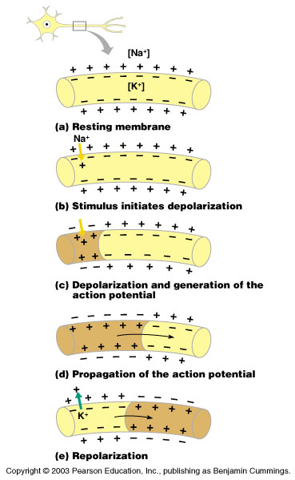
Starting a Nerve Impulse
Depolarization – a stimulus depolarizes the neuron’s membrane
A deploarized membrane allows sodium (Na+) to flow inside the membrane
The exchange of ions initiates an action potential in the neuron

Slide 24
The Action Potential
If the action potential (nerve impulse) starts, it is propagated over the entire axon
Potassium ions rush out of the neuron after sodium ions rush in, which repolarizes the membrane; until repolarization occurs, a neuron cannot start another impulse
The sodium-potassium pump restores the original configuration
This action requires ATP

Slide 25
Nerve Impulse Propagation
The impulse continues to move toward the cell body
Impulses travel faster when fibers have a myelin sheath

Slide 26
The Reflex Arc
Reflex – rapid, predictable, and involuntary responses to stimuli
Reflex arc – direct route from a sensory neuron, to an interneuron, to an effector

Slide 27
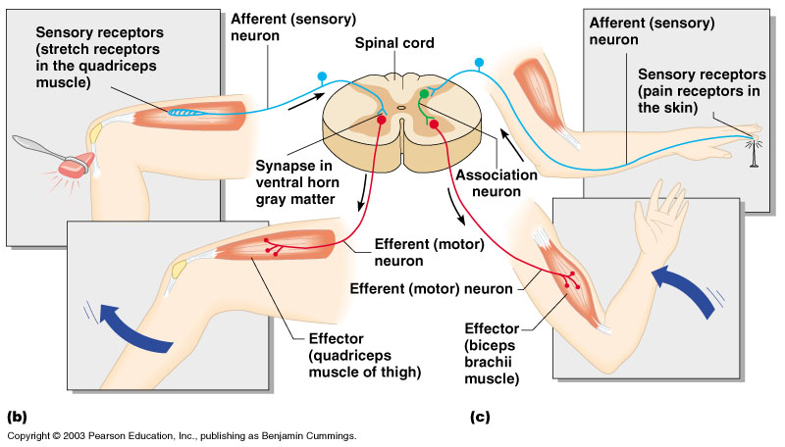
Simple Reflex Arc

Slide 28
Types of Reflexes and Regulation
Autonomic reflexes
Smooth muscle regulation
Heart and blood pressure regulation
Regulation of glands
Digestive system regulation
Somatic reflexes
Activation of skeletal muscles

Slide 29
Reflex arcs
All reflex arcs have a
Sensory receptor (which reacts to a stimulus)
An effector organ ( the muscle or gland eventually stimulated) and
Efferent and afferent neurons to connect the two

Slide 30
Reflex arcs
When reflexes are exaggerated, distorted, or absent, nervous system disorders are indicated
Reflex changes often occur before the pathologic condition has become obvious in other ways.

Slide 31
Central Nervous System (CNS)
CNS develops from the embryonic neural tube
The neural tube becomes the brain and spinal cord
The opening of the neural tube becomes the ventricles
Four chambers within the brain
Filled with cerebrospinal fluid

Slide 32
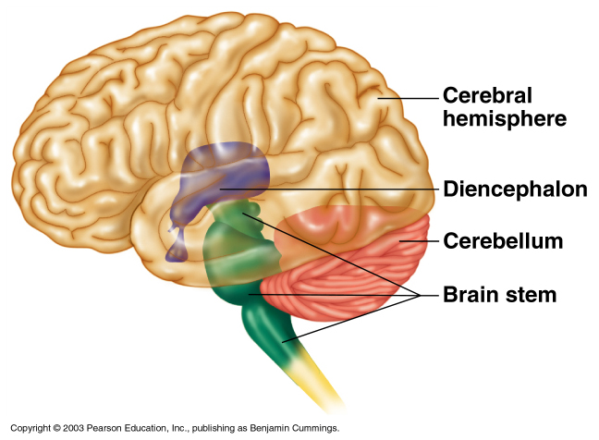
Brain
It is a gray wrinkled organ, weighing about 1kg
It will be discuss in term of three regions
Cerebral hemispheres
Brain stem
Cerebellum

Slide 33
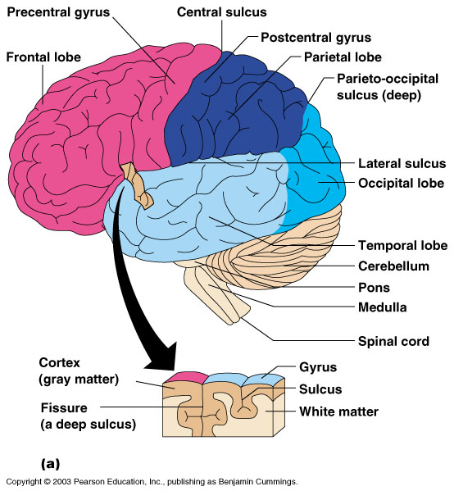
I- Cerebral Hemispheres (Cerebrum)
Paired (left and right) superior parts of the brain
Include more than half of the brain mass

Slide 34
I- Cerebral Hemispheres (Cerebrum)
The surface is made of ridges (gyri) and grooves called fissures or (sulci)
Other fissures divide each cerebral hemisphere into number of lobes

Slide 35
Specialized Area of the Cerebrum
Cerebral areas involved in special senses
Gustatory area (taste)
Visual area
Auditory area
Olfactory area

Slide 36
Specialized Area of the Cerebrum
Interpretation areas of the cerebrum
Speech/language region
Language comprehension region
General interpretation area

Slide 37
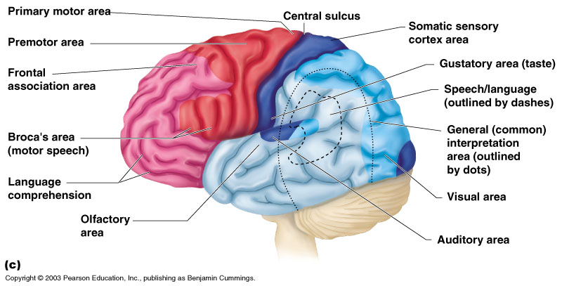
Specialized Area of the Cerebrum

Slide 38
Layers of the Cerebrum
Gray matter (cerebral cortex)
Outer layer
Composed mostly of neuron cell bodies

Slide 39
Layers of the Cerebrum
White matter (cerebral medulla)
Fiber tracts inside the gray matter
Example: corpus callosum connects hemispheres

Slide 40
Layers of the Cerebrum
Basal nuclei – internal islands of gray matter

Slide 41
II- Brain Stem
Is about the size of a thumb in diameter and 4-5 inches long
Its structures are the:
Diencephalon
Midbrain
Pons and
Medulla
Oblongata

Slide 42
II- Brain Stem
It provides a pathway for tracts to ascend and descend through
It has many small gray matter areas which form the cranial nerves
It (cranial nerves) involved in the control of vital activities such as breathing and controlling blood pressure

Slide 43
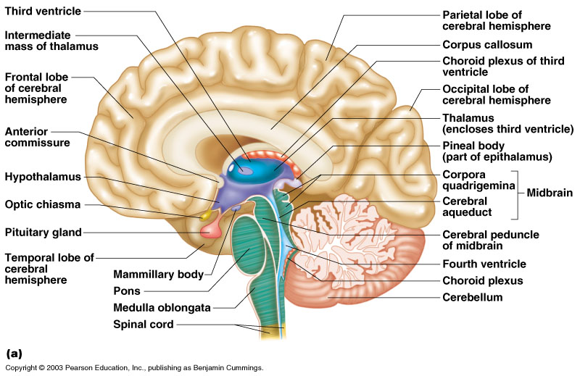
II- Brain Stem

Slide 44
Reticular Formation
Diffuse mass of gray matter along the brain stem
Reticular activating system plays a role in arousal response awake/sleep cycles and consciousness
Involved in motor control of visceral organs

Slide 45
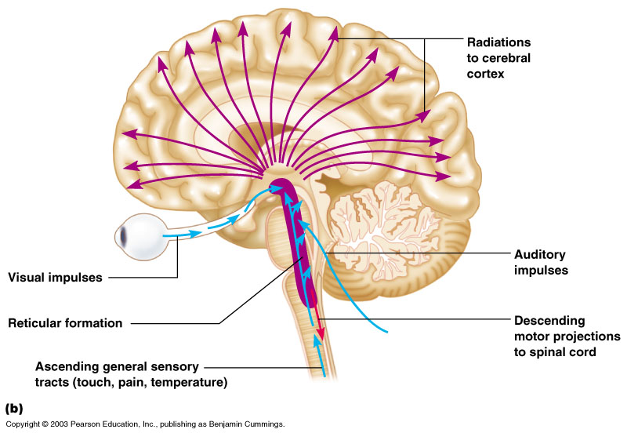
Reticular Formation

Slide 46
A- Diencephalon
The most superior part of the brain stem
Enclosed by the cerebral hemispheres
Made of three parts
Thalamus
Hypothalamus
Epithalamus

Slide 47
A- Diencephalon

Slide 48
A1- Thalamus
Consists of two large lobes of gray matter
Surrounds the third ventricle
The relay station for the sensory impulses passing upward to the sensory cortex
It makes us distinguishing between the pleasant and unpleasant impulses
Transfers impulses to the correct part of the cortex for localization and interpretation

Slide 49
A 2- Hypothalamus
Under the thalamus, makes up the floor of the diencephalon
Important autonomic nervous system center
Helps regulate body temperature
Controls water balance
Regulates metabolism

Slide 50
A 2- Hypothalamus
An important part of the limbic system (emotions such as pleasure, appetite, pain, sex, and thirst)
The pituitary gland is attached to the hypothalamus

Slide 51
A 3- Epithalamus
Forms the roof of the third ventricle
Houses the pineal body (an endocrine gland)
Includes the choroid plexus – forms cerebrospinal fluid

Slide 52
B- Midbrain
It is a relatively small part of the brain stem
The cerebral aqueduct is a tiny canal that travels through the midbrain and connects the third ventricle of the diencephalon to the fourth ventricle
It composed primarily of ascending and descending fiber tracts
Houses reflex centers for vision and hearing

Slide 53
C- Pons
It is the rounded structure that protrudes just below the midbrain
Mostly composed of fiber tracts
Includes nuclei involved in the control of breathing

Slide 54
D- Medulla Oblongata
The most inferior part of the brain stem
Continues into the spinal cord
Includes important fiber tracts
Contains important control centers
Heart rate control
Blood pressure regulation
Breathing
Swallowing
Vomiting, as well as others

Slide 55
III- Cerebellum
Two hemispheres with convoluted surfaces
Provides involuntary coordination of skeletal muscles activities and body movements
Controls balance and equilibrium

Slide 56
III- Cerebellum

Slide 57
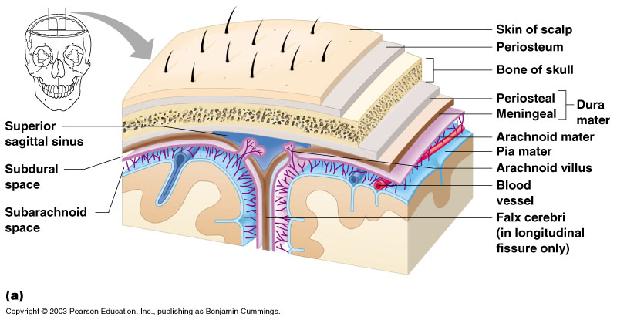
Protection of the Central Nervous System
Scalp and skin
Skull and vertebral column
Meninges

Slide 58
Protection of the Central Nervous System
Cerebrospinal fluid
Blood brain barrier

Slide 59
Meninges
Three connective membranes covering and protecting the CNS structures
Dura mater (Hard matter) is the outermost layer, it is a double-layered membrane
One of its layers is attached to the inner surface of the skull forming periosteum
The other forms the outermost brain covering and continues as dura mater of the spinal cord

Slide 60
Meninges
Arachnoid mater (Spider) is the middle meningeal layer, it is a weblike; its threadlike extensions span the subarachnoid space to attach it to the innermost membrane
The subarachnoid space is filled with cerebrospinal fluid (CSF)
Arachnoid villi are specialized projections of the arachnoid membrane which drain the CSF into the venous blood in the dural sinuses
Pia mater (Gentle mother) is a delicate membrane clings tightly to the surface of the brain (and cord) following every fold

Slide 61
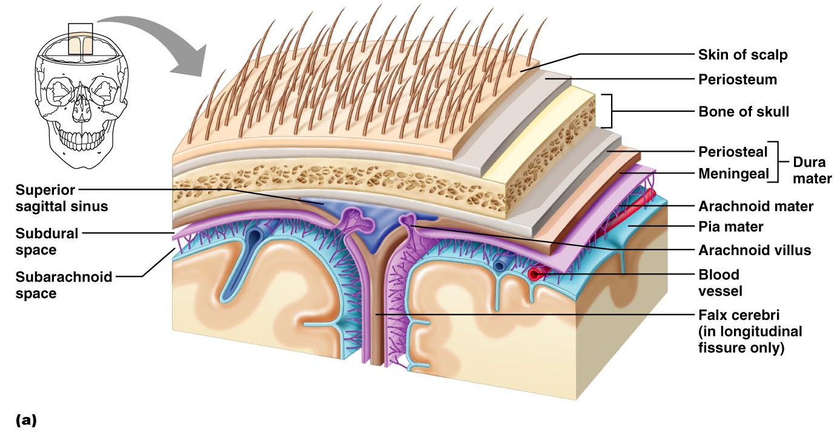
Meninges

Slide 62
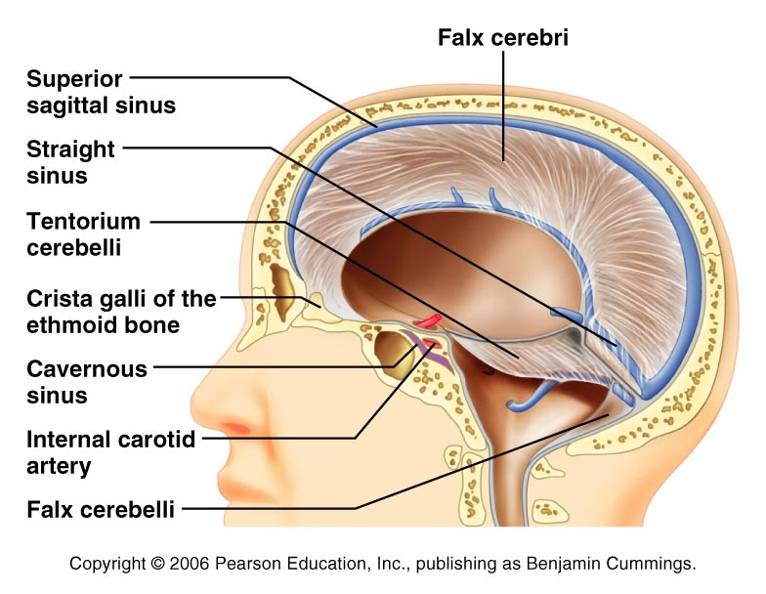
Dura Mater

Slide 63
Arachnoid Mater

Slide 64
Cerebrospinal Fluid
Similar to blood plasma composition
Formed by the choroid plexuses
Choroid plexuses are clusters of capillaries hanging from the roof in each of brain ventricles
Forms a watery cushion to protect the delicate nervous tissues from blows and other traumas
Circulated in arachnoid space, ventricles, and central canal of the spinal cord
The CSF return to the blood in the dural sinuses through the arachnoid villi

Slide 65
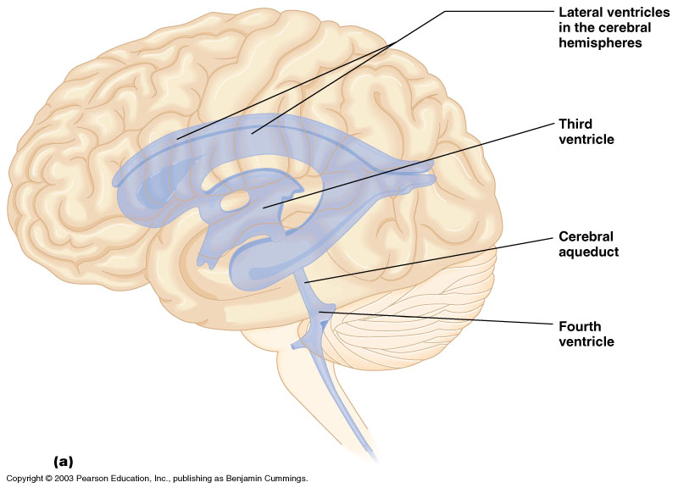
Ventricles and Location of the Cerebrospinal Fluid

Slide 66
Lateral Ventricles
Found on each side of the hemisphere below the corpus collasum
The communicate with the third ventricle via interventricular foramina

Slide 67
Third Ventricle
Found bellow the lateral ventricle
Communicates with the forth ventricle through cerebral aqueduct

Slide 68
Fourth Ventricle
Found below and behind the third ventricle
It continuous with central canal
Communicates with subarachnoid space

Slide 69
Blood Brain Barrier
Includes the least permeable capillaries of the body
Excludes many potentially harmful substances
Useless against some substances
Fats and fat soluble molecules
Respiratory gases
Alcohol
Nicotine
Anesthesia

Slide 70
Traumatic Brain Injuries
Concussion
Slight brain injury
No permanent brain damage
Contusion
Nervous tissue destruction occurs
Nervous tissue does not regenerate
Cerebral edema
Swelling from the inflammatory response
May compress and kill brain tissue

Slide 71
Cerebrovascular Accident (CVA)
Commonly called a stroke
The result of a ruptured blood vessel supplying a region of the brain
Brain tissue supplied with oxygen from that blood source dies
Loss of some functions or death may result

Slide 72
Hydrocephalus
Means water in the brain
Results from obstruction of the CSF drainage e.g. a tumor
Causes the head of new baby to enlarge because the skull bones have not yet fused
Likely to result in brain damage in adults
Treated surgically by a ventriculoperitoneal (VP) shunt

Slide 73
Alzheimer’s Disease
Progressive degenerative brain disease
Mostly seen in the elderly, but may begin in middle age
Structural changes in the brain include abnormal protein deposits and twisted fibers within neurons
Victims experience memory loss, irritability, confusion and ultimately, hallucinations and death

Slide 74
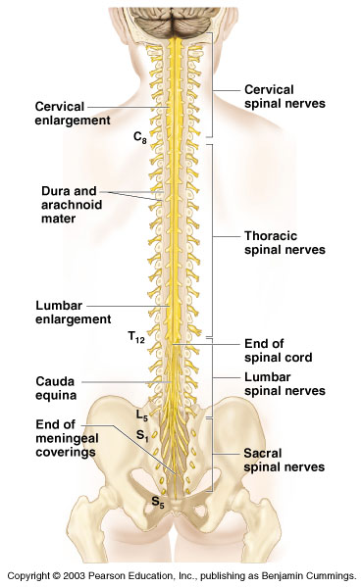
Spinal Cord
A cylindrical cord which is approximately 42-43cm long
Provides a two ways conduction pathways to and from the brain
It is a major reflex center

Slide 75
Spinal Cord
Extends from the medulla oblongata (foramen magnum) to the region of T12 or L1
In humans 31 pairs of spinal nerves arise from it
Enlargements occur in the cervical and lumbar regions
Below T12 is the cauda equina (a collection of spinal nerves)

Slide 76
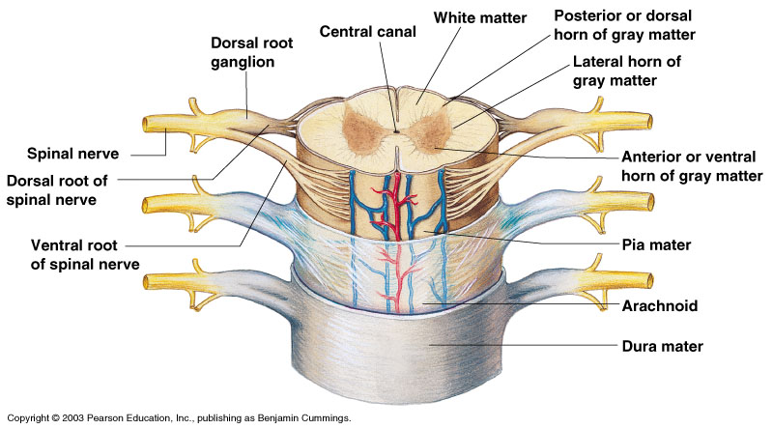
Spinal Cord Anatomy
Internal gray matter - mostly cell bodies
Dorsal (posterior) horns
Anterior (ventral) horns

Slide 77
Spinal Cord Anatomy
Central canal filled with cerebrospinal fluid

Slide 78
Spinal Cord Anatomy
Exterior white mater – conduction tracts

Slide 79
Peripheral Nervous System
Structure of a Neuron
Nerves and ganglia outside the central nervous system
Nerve = bundle of neuron fibers fond outside the CNS
Neuron fibers are wrapped in connective tissue coverings

Slide 80
Structure of a Nerves
Each fiber is surrounded by a delicate connective tissue sheath an endoneurium
Groups of fibers are bound by a coarser خشن connective tissue wrapping, the perineurium, to form bundles called fascicles
All fascicles are bounded together by a tough fibrous tissue sheath, the epineurium, to form the cordlike nerve

Slide 81
Classification of Nerves
Mixed nerves – both sensory and motor fibers
Afferent (sensory) nerves – carry impulses toward the CNS
Efferent (motor) nerves – carry impulses away from the CNS

Slide 82
Cranial Nerves
12 pairs of nerves that mostly serve the head and neck except one pair, the vagus nerves that extend to the thoracic and abdominal cavities
Numbered in order, front to back
Most are mixed nerves, but three pairs are purely sensory, these are optic, olfactory, and vestibulochclear

Slide 83
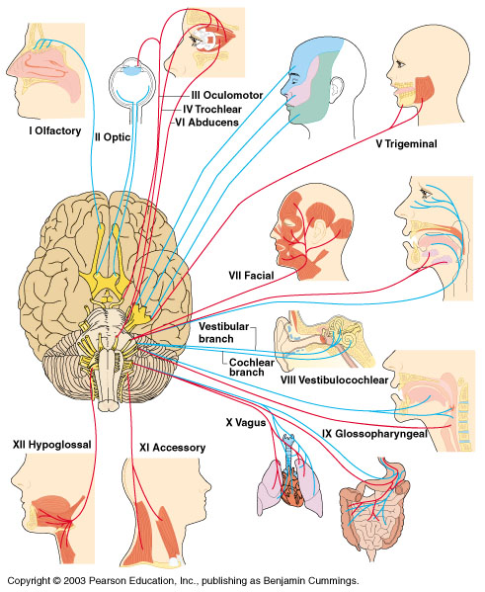
Distribution of Cranial Nerves

Slide 84
Cranial Nerves
I Olfactory nerve – sensory for smell
II Optic nerve – sensory for vision
III Oculomotor nerve – motor fibers to eye muscles
IV Trochlear – motor fiber to eye muscles

Slide 85
Cranial Nerves
V Trigeminal nerve – sensory for the face; motor fibers to chewing muscles
VI Abducens nerve – motor fibers to eye muscles
VII Facial nerve – sensory for taste; motor fibers to the face
VIII Vestibulocochlear nerve – sensory for balance and hearing

Slide 86
Cranial Nerves
IX Glossopharyngeal nerve – sensory for taste; motor fibers to the pharynx
X Vagus nerves – sensory and motor fibers for pharynx, larynx, and viscera
XI Spinal accessory nerve – motor fibers to neck and upper back
XII Hypoglossal nerve – motor fibers to tongue

Slide 87
Spinal Nerves
There is a pair of spinal nerves at the level of each vertebrae for a total of 31 pairs
Spinal nerves are formed by the combination of the ventral and dorsal roots of the spinal cord
Spinal nerves are named for the region from which they arise

Slide 88
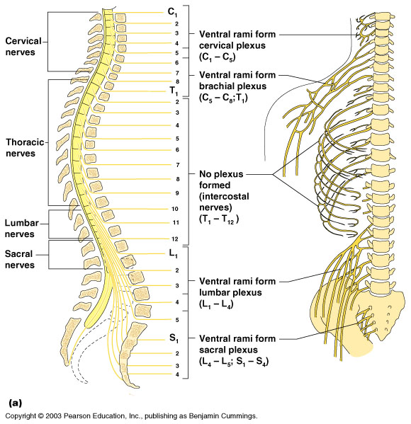
Spinal Nerves
Relationship of spinal nerves to the vertebral column
Areas of plexuses formed by the anterior rami are indicted
for the right side of the body

Slide 89
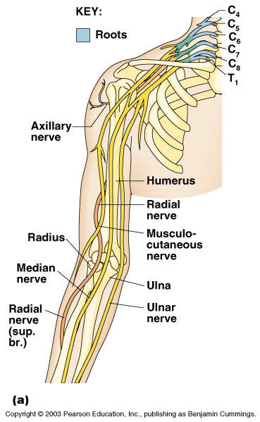
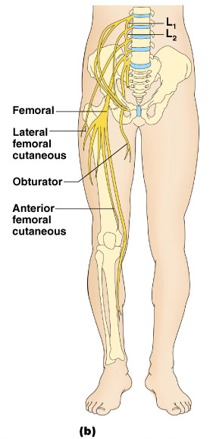
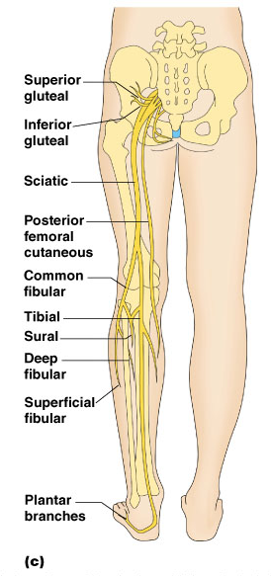
Examples of Nerve Distribution
Major nerves of the
Brachial plexus
Major nerves of the
lumbar plexus
Major nerves of the
sacral plexus

Slide 90
Autonomic Nervous System
The involuntary branch of the nervous system
Consists of only motor nerves
Divided into two divisions
Sympathetic division
Parasympathetic division

Slide 91
Differences Between Somatic and Autonomic Nervous Systems
Nerves
Somatic – one motor neuron
Autonomic – preganglionic and postganglionic nerves
Effector organs
Somatic – skeletal muscle
Autonomic – smooth muscle, cardiac muscle, and glands

Slide 92
Differences Between Somatic and Autonomic Nervous Systems
Nerurotransmitters
Somatic – always use acetylcholine
Autominic – use acetylcholine, epinephrine, or norepinephrine

Slide 93
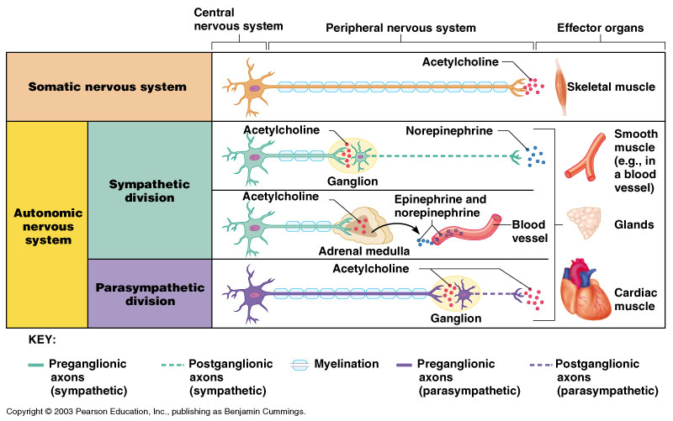
Comparison of Somatic and Autonomic Nervous Systems

Slide 94
Anatomy of the Sympathetic Division
Originates from T1 through L2
Ganglia are at the sympathetic trunk (near the spinal cord)
Short pre-ganglionic neuron and long postganglionic neuron transmit impulse from CNS to the effector
Norepinephrine and epinephrine are neurotransmitters to the effector organs

Slide 95
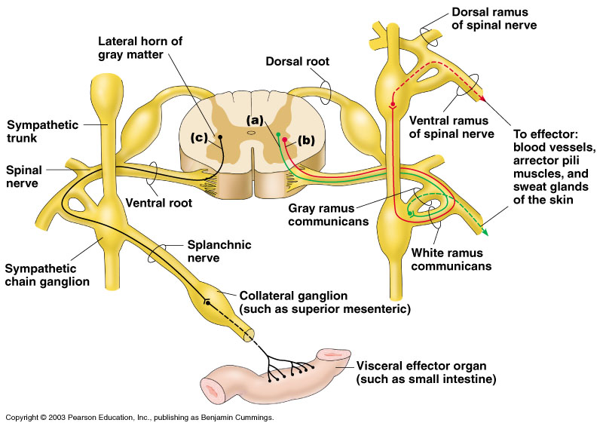
Sympathetic Pathways

Slide 96
Anatomy of the Parasympathetic Division
Originates from the brain stem and S1 through S4
Terminal ganglia are at the effector organs
Always uses acetylcholine as a neurotransmitter

Slide 97
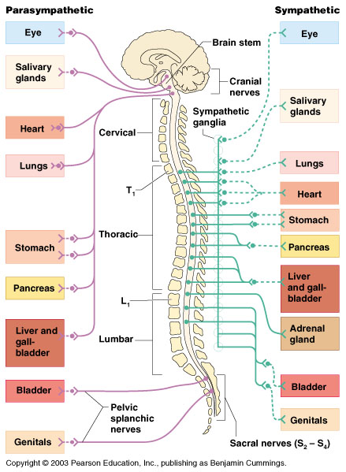
Anatomy of the Autonomic Nervous System

Slide 98
Autonomic Functioning
Sympathetic – “fight-or-flight”
Response to unusual stimulus
Takes over to increase activities
Remember as the “E” division = exercise, excitement, emergency, and embarrassment

Slide 99
Autonomic Functioning
Parasympathetic – housekeeping activites
Conserves energy
Maintains daily necessary body functions
Remember as the “D” division - digestion, defecation, and diuresis

Slide 100
Development Aspects of the Nervous System
The nervous system is formed during the first month of embryonic development
Any maternal infection can have extremely harmful effects
The hypothalamus is one of the last areas of the brain to develop

Slide 101
Development Aspects of the Nervous System
No more neurons are formed after birth, but growth and maturation continues for several years
The brain reaches maximum weight as a young adult

