Slide 1
GENERAL MEDICAL HISTORY AND PHYSICAL EXAMINITION
SAMUEL NGIGI KIURIRE

Slide 2
Outline
Introduction
Medical history
Physical examination
Conclusion

Slide 3
The Approach to the Patient
The word 'patient' is derived from the Latin patiens, meaning sufferance
Purpose of medical practice is to relieve suffering
To achieve purpose need to:
    Make a diagnosis
    Know how to approach treatment
    Design an appropriate scheme of management

Slide 4
The Approach to the Patient
Distinction between cure of disease and relief of symptoms
Clinical methods are acquired by a combination of study and experience
There is always something new to learn
Requires:
  Knowledge of disease and its patterns of presentation
  Ability to interpret a patient's symptoms and signs

Slide 5
Making a diagnosis
Two main steps:
  To establish the clinical features by history and examination (this represents the clinical database)
  To interpret the clinical database in terms of disordered function and potential causative pathologies:
    physical, mental, social, or a combination

Slide 6
SETTING THE SCENE
It is essential that both patient and clinician feel at ease, neither feels threatened by the encounter
  Does the patient smile, or appear anxious?
  Do they make good eye contact?
  Are they frightened or depressed?
  Are posture and stance normal?
  Is the patient short of breath, or wheezing?
Notes:
Wheezing: breathing with a whistling or rattling sound in the chest.

Slide 7
HISTORY TAKING
The process of information gathering:
  Immediate introduction of doctor and patient
  Referral documentation
Use simple open-ended question 'Tell me what has led to you coming here today'
Encourages the patient to give a full and free account of the current issues
Do not interrupt: Once interrupted the patient rarely completes what they were intending to say

Slide 8
HISTORY TAKING
It is vital for the doctor to steer and mould the process
Ensures information gathered is complete, coherent and, logical
It is very important to use vocabulary the patient will understand and use appropriately
During any consultation non-verbal communication is as important as what the patient says

Slide 9
The standard history framework
Name, age, sex occupation, country of birth
Presenting complaint
History of presenting complaint
Systematic enquiry
Past medical history
Allergies
Drug history
Alcohol
Smoking
Family history
Social history

Slide 10
Presenting complaint
This is the patient's chief symptom(s) in their own words
Ask the patient an open question such as What's the problem?
Remember this is the problem in the patient's words. Haemoptysis vs. coughing up blood

Slide 11
History of the presenting complaint
Ask about and document the details of the presenting complaint
Nature of the problem; exactly how and when it started
How the problem has progressed overtime
Impact on the patient: General physical health, psychology, social, and working lives

Slide 12
History of the presenting complaint
For each symptom, determine:
  The exact nature of the symptom.
  The onset:
    The date it began.
    How it began (e.g. suddenly, gradually)
    If longstanding, why is the patient seeking help now?

Slide 13
Periodicity and frequency:
  Is the symptom constant or intermittent?
Change over time:
  Is it improving or deteriorating?
Exacerbating factors:
  What makes the symptom worse?
Relieving factors:
  What makes the symptom better?
Associated symptoms.

Slide 14
Pain
Site (where is the pain worst, ask the patient to point to the site with one finger).
Radiation (does the pain move anywhere else?).
Character (i.e. dull, aching, stabbing, burning)
Severity (scored out of 10)
Mode and rate of onset (how did it come, over how long?)

Slide 15
Pain
Duration.
Frequency
Exacerbating factors
Relieving factors
Associated symptoms (e.g. nausea, dyspepsia, shortness of breath)

Slide 16
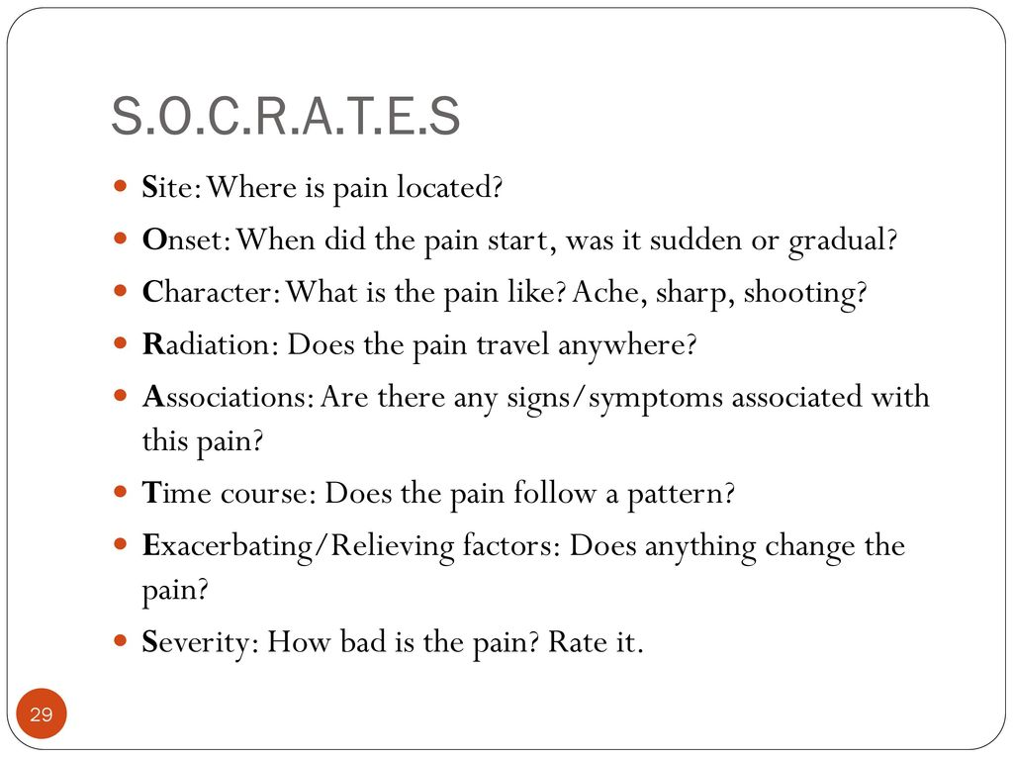

Slide 17
Systematic enquiry
Perform a brief screen of the other bodily systems
Finding symptoms that the patient had forgotten
Identifying secondary, unrelated, problems that can be addressed
General symptoms: Weight change (loss or gain), change in appetite (loss or gain), fever, lethargy, malaise

Slide 18
Systematic enquiry
Respiratory symptoms: Cough, sputum, haemoptysis, shortness of breath, wheeze, chest pain.
Cardiovascular symptoms: Shortness of breath on exertion, paroxysmal nocturnal dyspnoea, chest pain, palpitations, ankle swelling, orthopnoea, claudication
Genito-urinary symptoms; Urinary frequency, polyuria, dysuria, haematuria, nocturia, menstrual problems, impotence
Notes:
Claudication: a condition in which cramping pain in the leg is induced by exercise, typically caused by obstruction of the arteries.
Orthopnoea: shortness of breath (dyspnea) that occurs when lying flat, causing the person to have to sleep propped up in bed or sitting in a chair.

Slide 19
Systematic enquiry
Gastrointestinal symptoms: Indigestion, abdominal pain, nausea, vomiting, a change in bowel habit, constipation, diarrhoea, dysphagia
Neurological symptoms: Headaches, dizziness, tingling, weakness, tremor, fits, faints, black-outs, sphincter disturbance
Musculoskeletal: Aches, pains, stiffness, swelling
Skin: Lumps, bumps, ulcers, rashes, itch
Notes:
A tremor is an involuntary, somewhat rhythmic, muscle contraction and relaxation involving oscillations or twitching movements of one or more body parts.
A fit can be a brief moment when the person appears to be “absent” from what is going on around them, or jerking/twitching of a hand, arm or leg or jerking/twitching affecting the whole body.
Lump: a compact mass of a substance, especially one without a definite or regular shape.

Slide 20
Past medical history
Past illness and surgical procedures
  Diabetes
  Rheumatic fever
  Jaundice
  Hypercholesterolaemia.
  Hypertension
  Angina
  Myocardial infarction
  Stroke or TIA
  Asthma
  TB
  Epilepsy
  Anaesthetic problems
  Blood transfusions
Notes:
Acute rheumatic fever (ARF) is an autoimmune inflammatory process that develops as a sequela of streptococcal infection.
Elevation of total cholesterol and/or low-density lipoprotein (LDL)-cholesterol or non-high-density lipoprotein (HDL)-cholesterol (defined as the subtraction of Hypercholesterolaemia: HDL-cholesterol from total cholesterol) in the blood, is also often referred to as dyslipidaemia, to encompass the fact that it might be accompanied by a decrease in HDL-cholesterol.
Myocardial infarction (MI), commonly known as a heart attack, occurs when blood flow decreases or stops to a part of the heart, causing damage to the heart muscle.
A transient ischemic attack (TIA) is like a stroke, producing similar symptoms, but usually lasting only a few minutes and causing no permanent damage.

Slide 21
Drug history
List all the medication the patient is taking, including the dose and frequency
The patient may not consider some medications to be drugs:
    Eye-drops.
    Inhalers.
    Sleeping pills.
    Oral contraception.
    Over the counter drugs
    Herbal remedies.

Slide 22
Alcohol/Smoking
Should attempt to quantify.
Remember to ask about passive smoking
Patient may be trying to please you/ feel embarrassed about openly admitting their true consumption
Beware of appearing judgmental

Slide 23
Further Reading:
How to calculate number of pack years

Slide 24
Family history
Current family, including the age and gender of parents, siblings, children, and extended family as relevant
The health of the family
Any diagnosed conditions in other living family members
Age of death, cause of death for all deceased first degree relatives, other family members if deemed appropriate.

Slide 25
Social history
Marital status
Sexual orientation
Occupation (previous occupations if retired)
Socioeconomic status
Does the patient own any pets?
Has the patient been abroad recently or spent any time abroad in the past

Slide 26
Approaching the physical examination
  General conduct
    Doctors and medical professionals are in a position of trust.
    Assumed that you will act with professionalism, integrity, honesty, and with respect for the dignity and privacy of your patients
    Chaperone present (any intimate examination)ideally be the same gender as the patient

Slide 27
General Examination
The right approach
  One important rule is that you should always stand at the patient's right hand side.
  This gives them a feeling of control over the situation (most people are right handed)
  All the standard examination techniques are formulated with this orientation in mind

Slide 28
The examination framework
Each system examination is divided into the following categories:
  Inspection (looking)
  Palpation (feeling)
  Percussion (tapping)
  Auscultation (listening)

Slide 29
First impressions
Is the patient comfortable or distressed?
Is the patient well or ill?
Is there a recognizable syndrome or facies?
Is the patient well nourished and hydrated?
Bed-side clues
  Additional clues as to the patient's state of health in the objects around them
  Examples: Oxygen tubing, inhalers, insulin injections, glucose meter, or cigarettes

Slide 30
Vital signs
Temperature
Blood pressure
Pulse
Oxygen saturation
Respiratory rate
Blood glucose
  {Rapid and initial assessment of a patient's conscious level }

Slide 31
Pallor
Facial pallor is often a sign of severe anaemia
Inspecting the palpebral conjunctiva, nail beds and palmar skin creases
Unreliable sign in shocked patients, vascular disease
Peripheral vasoconstriction or poor blood flow causes skin and conjunctival pallor, even in the absence of blood loss

Slide 32
Cyanosis
Cyanosis refers to a bluish discoloration of the skin and mucous membranes
Due to the presence of at least 2.5g/dL of deoxygenated haemoglobin in the blood
Central cyanosis: Tongue appears blue;
V/Q mismatch: Chronic obstructive pulmonary disease, cor pulmonale and massive pulmonary embolus, L- R cardiac shunts

Slide 33
Cyanosis
Peripheral cyanosis is bluish discoloration at the extremities (fingers, toes)
It is usually due to in blood supply or a slowing of the peripheral circulation.
Arises through exposure to cold, reduced cardiac output or peripheral vascular disease.
One cannot have central cyanosis without also demonstrating peripheral cyanosis
Peripheral cyanosis, can occur alone

Slide 34
Jaundice
Yellow pigmentation of those tissues in the body which contain elastin (skin, sclera, and mucosa)
Occurs due to an increase in plasma bilirubin (visible at >35µmol/L

Slide 35
Temperature
High temperature
  Persistent pyrexia: Malignant hyperthermia, a drug fever (e.g. halothane, suxamethonium), or typhoid fever
  Intermittent pyrexia: Lymphomas and pyogenic infections such as milliary TB
  Relapsing pyrexia: Hodgkin's disease and is characterized by 4-5 days of persistent fever which then returns to baseline before rising again

Slide 36
Hydration
Mucous membranes: Inspect the tongue and mucous membranes for moisture
Skin turgor
Capillary refill
Pulse rate: a compensatory tachycardia may occur in dehydration or in fluid overload
Blood pressure
JVP; Low in dehydration, but raised in fluid overload

Slide 37
Hydration
Oedema: Useful sign of fluid overload (think right heart failure, constrictive pericarditis, hypoalbuminaemia)
Remember to test for both ankle and sacral oedema

Slide 38
Oedema
Oedema refers to fluid accumulation in the subcutaneous tissues
Ambulant patients, palpate the distal shaft of the tibia for oedema by gently compressing the area for up to 10 seconds with the thumb
Oedema may also involve the anterior abdominal wall and external genitalia
When lying down, fluid moves to the new dependent area causing a sacral pad

Slide 39
Some causes of leg swelling
Local causes
  Cellulitis (usually unilateral).
  Ruptured baker's cyst (usually unilateral).
  Occlusion of a large veins i.e. thrombophlebitis, DVT, extrinsic venous compression.
  Chronic venous insufficiency: Pigmentation induration, inflammation
  Gastrocnemius rupture: swelling and bruising around the ankle joint and foot

Slide 40
Some causes of leg swelling
Systemic causes
  Congestive cardiac failure.
  Hypoproteinaemia (nephrotic syndrome, liver cirrhosis, protein-losing enteropathy, kwashiorkor).
  Hypothyroidism.
  Hyperthyroidism.
  Drugs (e.g. corticosteroids, NSAIDs, vasodilators).

Slide 41
Lymph nodes
Site: Acute and chronic infections and metastatic carcinoma will cause localized lymphadenopathy
Number: how many nodes are enlarged?
Size: normal nodes are not palpable. Palpable nodes therefore are enlarged. Measure their length and width
Consistency: malignant lymph nodes feel firm or hard and irregular.

Slide 42
Lymph nodes
Enlarged nodes secondary to infection may feel rubbery
Tenderness: painful, tender nodes usually imply infection.
Fixation: nodes that are fixed to surrounding tissue are highly suspicious of malignancy.
Matted glands may occur in tuberculous lymphadenopathy.

Slide 43
Lymph nodes
Overlying skin: inflamed nodes may cause redness and swelling in the overlying skin.
Spread of a metastatic carcinoma into the surrounding tissue may cause oedema and surface texture changes

Slide 44
Causes of generalized lymphadenopathy
Haematological malignancies (e.g. lymphoma, acute, and chronic lymphatic leukemia).
Infections:
  Viral (e.g. HIV, infectious mononucleosis, CMV).
  Bacterial (e.g. tuberculosis, syphilis, brucellosis).
.

Slide 45
Causes of generalized lymphadenopathy
Infiltrative diseases (e.g. sarcoidosis, amyloidosis)
Autoimmune diseases (e.g. systemic lupus erythematous, rheumatoid arthritis)
Drugs (e.g. phenytoin causes a pseudo lymphoma

Slide 46
Finger Clubbing
Early clubbing: softening of the nail bed but this is very difficult to detect Progression leads to a loss of the angle at the base of the nail
Eventually to gross curvature and deformity
Clubbing leads to a loss of the diamond-shaped gap (Schamroth's sign)

Slide 47
Causes of clubbing
Pulmonary: chronic interstitial lung diseases, chronic lung infections (e.g. bronchiectasis), cystic fibrosis, lung abscess, asbestosis, fibrosing alveolitis, lung cancer.
Cardiac: cyanotic congenital heart disease, infective endocarditis.
Other: liver cirrhosis, inflammatory bowel disease

Slide 48
Nutritional status
General physical appearance
Body weight and height
Body mass index
Regional fat distribution (waist/hip circumfrence)
Mid-arm circumference

Slide 49
Conditions associated with malnutrition
Any very ill patient.
Malignancy.
Metabolic disease (e.g. renal failure).
Gastrointestinal disease (especially small bowel).
Sepsis
Trauma.
Post-surgery.
Psychosocial problems (e.g. depression, anorexia nervosa, social isolation).
Dementia

Slide 50
Conditions associated with obesity
Simple obesity (biopsychosocial)
Genetic e.g. Prader-Willi,
Endocrine (e.g. Cushing's syndrome, hypothyroidism)
Drug-induced (e.g. corticosteroids)
Hypothalamic damage due to tumour or trauma

Slide 51
Conclusion
The purpose of each clinical assessment is to establish reliable data from the history and the physical examination in order to facilitate diagnosis and plan treatment
It is therefore essential that clinical information be organized in such a way that it can be easily accessed and utilized

Slide 52
End of Presentation
Thank You

