Slide 1
Cardiovascular System
Samuel Ngigi K.

Slide 2
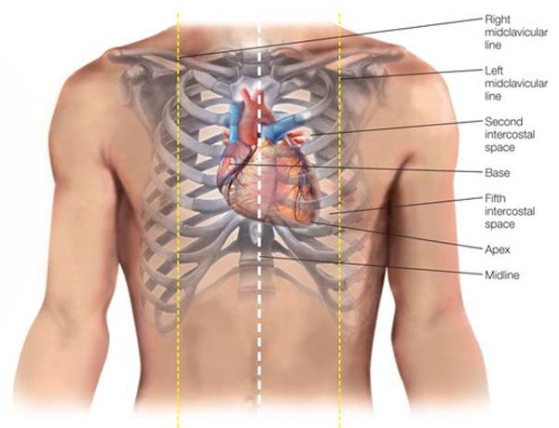
POSITION
Lies within the pericardium in middle mediastinum
Behind the body of sternum and the 2nd to 6th costal cartilages
In front of the 5th to 8th thoracic vertebrae
A third of it lies to the right of median plane and 2/3 to the left
Anterior to the vertebral column, posterior to the sternum

Slide 3
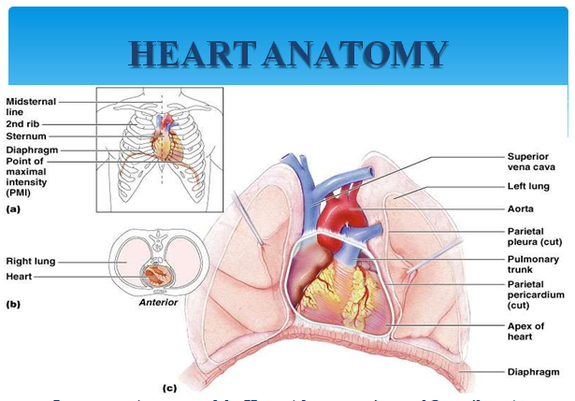

Slide 4
EXTERNAL CHARACTERISTICS
A hollow muscular organ, pyramidal in shape , somewhat larger than a closed fist; consists of four chambers (right and left atria, right and left ventricles)
Cardiac Apex is formed by left ventricle and is directed downwards and forwards to the left. It lies at the level of the fifth left intercostal space, 1~2cm medial to the left midclavicular line (9cm from the midline)

Slide 5
EXTERNAL CHARACTERISTICS
The apex beat 【point of maximum impulse (PMI)】, is the furthermost point outwards (laterally) and downwards (inferiorly) from the sternum at which the cardiac impulse can be felt.
Lateral and/or inferior displacement of the apex beat usually indicates enlargement of the heart, called cardiomegaly
Approximately the size of your fist Wt. = 250-300 grams
Cardiac base(posterior surface) is formed by the left atrium and to a small extent by the right atrium. It faces backward, upward and to the right

Slide 6
Surfaces and Borders
Two surfaces
Sternocostal surface is formed mainly by the right atrium and right ventricle, and a lesser portion of its left is formed by the left auricle and ventricle. It is directed forwards and upwards
Diaphragmatic surface is formed by the ventricles－ chiefly the left ventricle, directed backwards and downwards, and rests upon the central tendon of the diaphragm
Three borders
Right border－vertical, is formed entirely by right atrium
Left border－round, is mainly formed by the left ventricle and partly by the left auricle
Inferior border－horizontal, is formed by the right ventricle and cardiac apex

Slide 7
Grooves
Four grooves
Coronary sulcus (circular sulcus) which marks the division between atria and ventricles, contains the trunks of the coronary vessels and completely encircles the heart
Interatrial groove －separates the two atria and is hidden by pulmonary trunk and aorta in front
Interventricular grooves － anterior and posterior, mark the division between ventricles (which separates the RV from the LV),
the two grooves extend from the base of the ventricular portion to a notch called: the cardiac apical incisure

Slide 8
COVERING OF THE HEART
Pericardium – a double-walled sac around the heart
Composed of:
A superficial fibrous pericardium
A deep two-layer serous pericardium
The parietal layer lines the internal surface of the fibrous pericardium
The visceral layer or epicardium lines the surface of the heart
They are separated by the fluid-filled pericardial cavity called the pericardial cavity
Protects and anchors the heart
Prevents overfilling of the heart with blood
Allows for the heart to work in a relatively friction-free environment

Slide 9
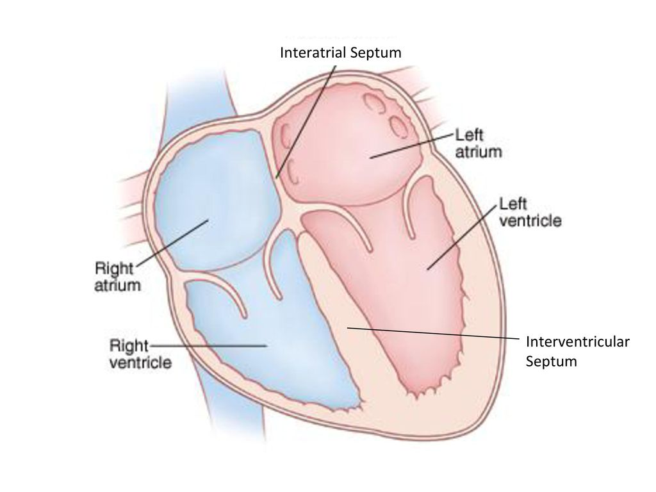
Septum
Interatrial septum
Located between right and left atria
Interventricular septum
Located between right and left ventricles

Slide 10
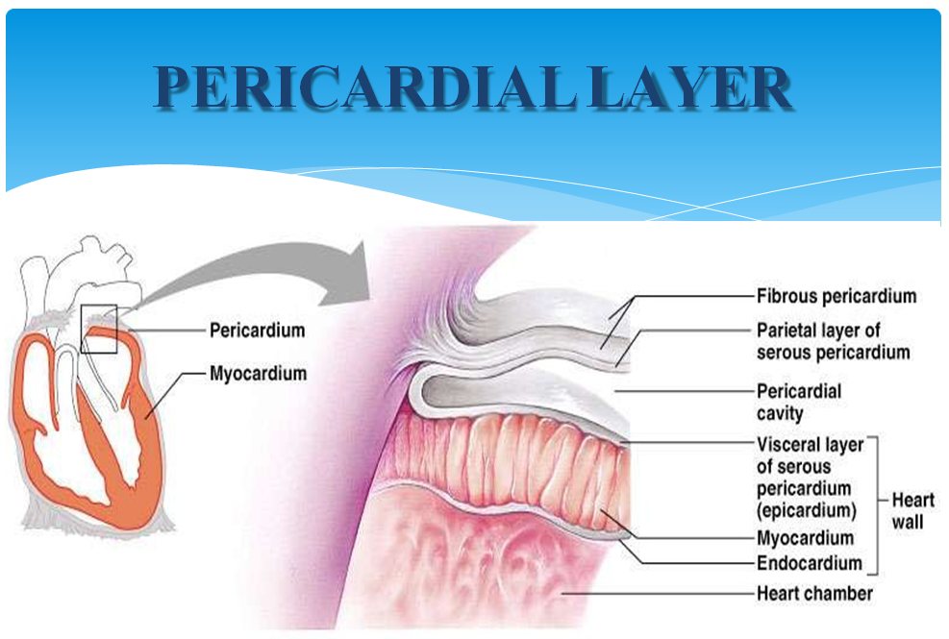
PERICARDIAL LAYER

Slide 11
LAYERS OF THE HEART WALL
Epicardium – visceral pericardium
Myocardium – cardiac muscle layer forming the bulk of the heart
Endocardium – endothelial layer of the inner myocardial surface

Slide 12
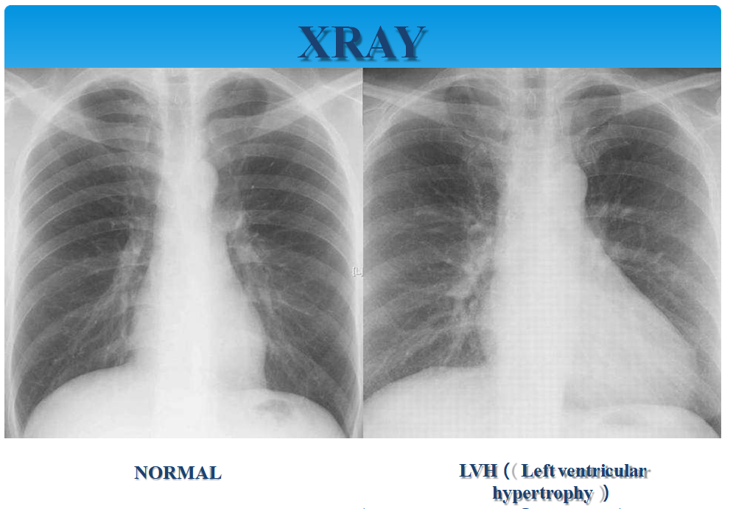

Slide 13
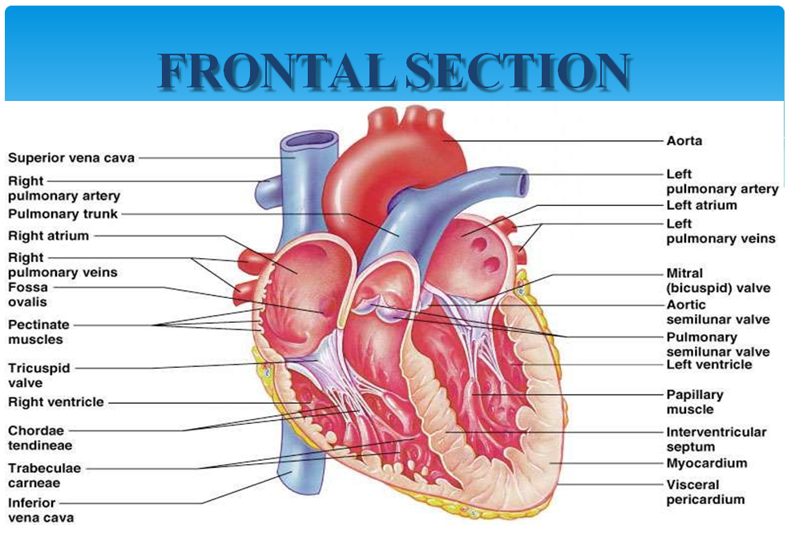

Slide 14
ATRIA OF THE HEART
Atria - receiving chambers of the heart Receive venous blood returning to heart Separated by an interatrial septum (wall)
Foramen ovale - opening in interatrial septum in fetus Fossa ovalis - remnant of foramen ovale
Pectinate muscles mark atrial walls
Pump blood into ventricles
Blood enters right atria from superior and inferior venae cavae and coronary sinus
Blood enters left atria from pulmonary veins

Slide 15
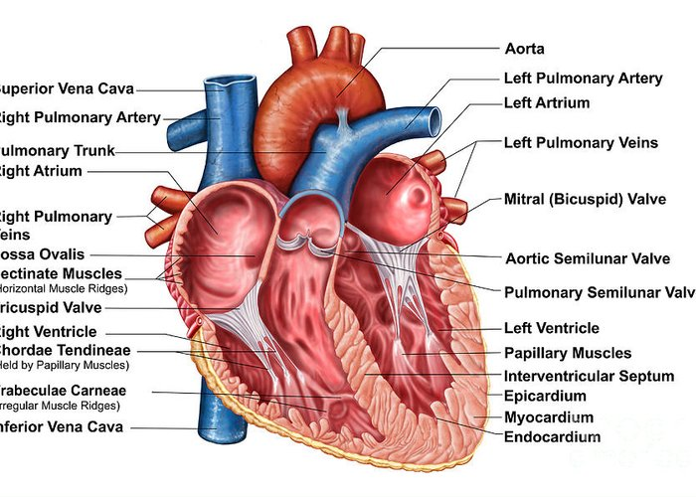

Slide 16
VENTRICLE OF THE HEART
Ventricles are the discharging chambers of the heart
Papillary muscles and trabeculae carneae muscles mark
ventricular walls
Separated by an interventricular septum
  Contains components of the conduction system
Right ventricle pumps blood into the pulmonary trunk
Left ventricle pumps blood into the aorta
  Thicker myocardium due to greater work load
    Pulmonary circulation supplied by right ventricle is a much low pressure
system requiring less energy output by ventricle
    Systemic circulation supplied by left ventricle is a higher pressure system and thus requires more forceful contractions

Slide 17
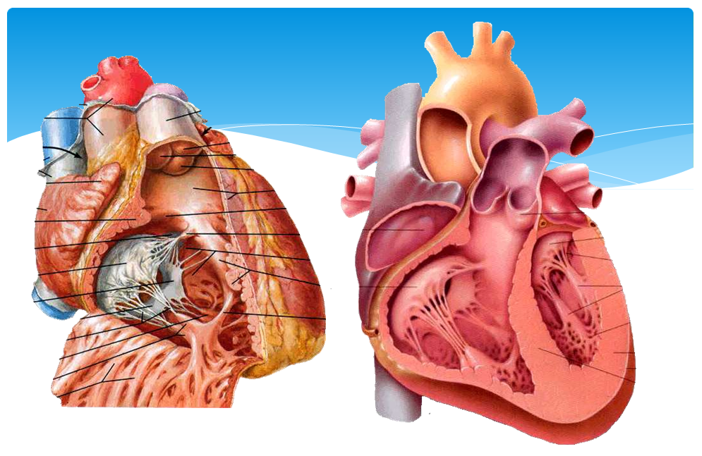

Slide 18
Left ventricle
It’s wall is three times thicker than that of right ventricle
Two parts－divided by anterior cusps of mitral valve
Inflow tract－rough walls
Outflow tract – aortic vestibule smooth area leading to aortic orifice

Slide 19
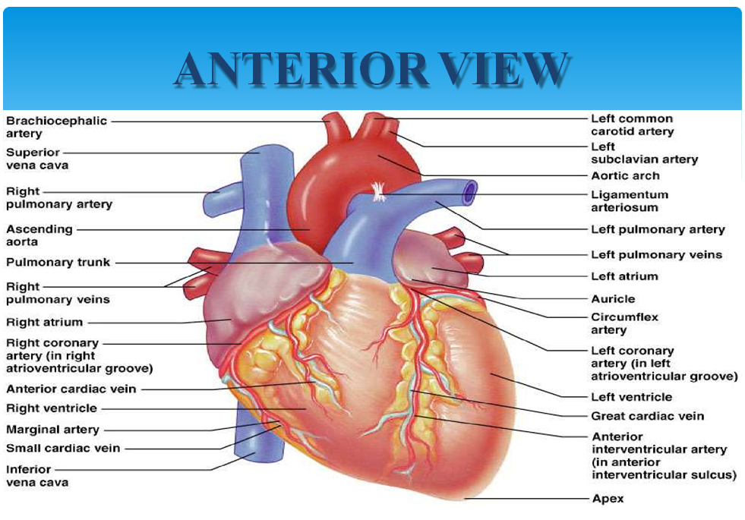

Slide 20
Assignment
Read the two major types of valves found in the heart and where they are located

Slide 21
End of presentation
Thank you

