Slide 1
FETAL BLOOD FLOW
Samuel Ngigi
KMTC

Slide 2
Introduction
Circulatory System.
The human heart begins beating during the fourth week after fertilization, contracting at a rate of about 65 beats/min.
This rate increases steadily to about 140 beats/min immediately before birth.

Slide 3
Introduction cnt’d…
Formation of Blood Cells
Nucleated red blood cells begin to be formed in the yolk sac and mesothelial layers of the placenta at about the third week of fetal development.
This is followed 1 week later (at 4 to 5 weeks) by the formation of non-nucleated red blood cells by the fetal mesenchyme and also by the endothelium of the fetal blood vessels.

Slide 4
Formation of Blood Cells cnt’d…
At 6 weeks, the liver begins to form blood cells, and in the third month, the spleen and other lymphoid tissues of the body begin forming blood cells.
Finally, from the third month on, the bone marrow gradually becomes the principal source of the red blood cells, as well as most of the white blood cells, except for continued lymphocyte and plasma cell production in lymphoid tissue.
Notes:
Lymphocyte: a form of small leucocyte (white blood cell) with a single round nucleus, occurring especially in the lymphatic system.

Slide 5
Fetal Circulation
The fetal circulation is markedly different from the adult circulation.
In the fetus, gas exchange does not occur in the lungs but in the placenta.
The placenta must therefore receive deoxygenated blood from the fetal systemic organs and return its oxygen rich venous drainage to the fetal systemic arterial circulation.

Slide 6
Fetal Circulation cnt’d…
In addition, the fetal cardiovascular system is designed in such a way that the most highly oxygenated blood is delivered to the myocardium and brain.
These circulatory adaptations are achieved in the fetus by both the preferential streaming of oxygenated blood and the presence of intracardiac and extracardiac shunts.
Thus, the fetal circulation can be defined as a ‘shunt-dependent’ circulation.

Slide 7
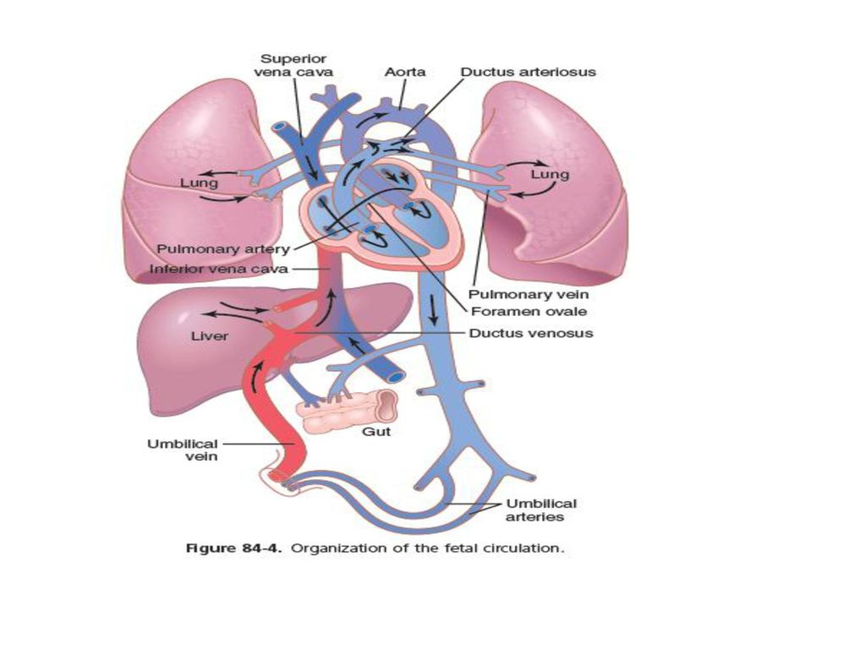

Slide 8
Fetal Circulation
Anatomy and Physiology Fetal Circulation
Umbilical cord:
-2 umbilical arteries: return de- oxygenated blood, fecal waste, CO2 to placenta
-1umbilical vein: brings oxygenated blood and nutrients to the fetus
Placenta – Where gas exchange takes place during fetal life
Fetus depends on placenta to meet O2 needs while organs continue formation.
Oxygenated blood flows from the placenta to the fetus via the umbilical vein.

Slide 9
Fetal Circulation cnt’d…
Prior to birth the foetus is not capable of respiratory function & thus relies on the maternal circulation to carry out gas, nutrient & waste exchange.
The foetal & maternal blood never mix, instead they interface at the placenta.
Consequently the liver & the lungs are non-functional, & a series of shunts exist in the foetal circulation so that these organs are almost completely by-passed.

Slide 10
Fetal Circulation cnt’d…
Shunt 1: The Ductus Venosus
Oxygenated blood travels from the placenta via the umbilical vein & most of it bypasses the liver by way of the ductus venosus.
The ductus venosus links the umbilical vein to the caudal vena cava & the flow of blood is controlled by a sphincter, enabling the proportion travelling to the heart via the liver to be altered.

Slide 11
Fetal Circulation cnt’d…
Shunt 2: The Foramen Ovale
The foramen ovale is an opening between the two atria enabling blood to be channelled directly into the systemic circulation thereby bypassing the lungs.
The septum secundum directs the majority of the blood entering the right atrium through the foramen ovale into the left atrium.
Here it mixes with a small volume of blood returning from the non-functional lungs via the pulmonary veins.

Slide 12
Fetal Circulation cnt’d…
Shunt 3: The Ductus Arteriosus
The ductus arteriosus connects the pulmonary artery to the aorta and allows equivalent ventricular function in the foetus.
The blood from the right ventricle is pumped to the pulmonary trunk where, due to the high resistance in the collapsed foetal lungs, a larger volume passes through the ductus arteriosus to the caudal aorta.
Most of the blood in the aorta is then returned to the placenta for oxygenation through the umbilical arteries.
The ductus arteriosus empties blood into the aorta after the artery to the head has branched off thus ensuring that the brain receives well-oxygenated blood.

Slide 13
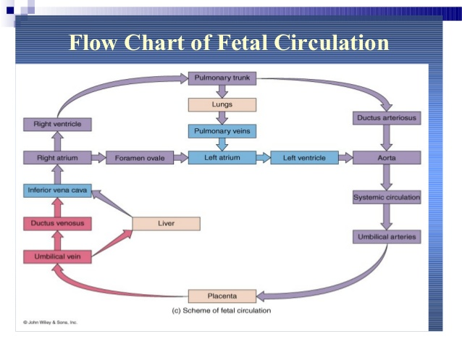

Slide 14
Circulatory Readjustments at Birth
Equally as essential as the onset of breathing at birth are immediate circulatory adjustments that allow adequate blood flow through the lungs.
In addition, circulatory adjustments during the first few hours of life cause more and more blood flow through the baby’s liver, which up to this point has had little blood flow.
To describe these readjustments, we first consider the anatomical structure of the fetal circulation.

Slide 16
Specific Anatomical Structure of the Fetal Circulation
Because the lungs are mainly nonfunctional during fetal life & because the liver is only partially functional, it is not necessary for the fetal heart to pump much blood through either the lungs or the liver.
However, the fetal heart must pump large quantities of blood through the placenta.
Therefore, special anatomical arrangements cause the fetal circulatory system to operate much differently from that of the newborn baby.

Slide 17
Specific Anatomical Structure of the Fetal Circulation cnt’d…
First, as shown in Figure 84-4, blood returning from the placenta through the umbilical vein passes through the ductus venosus, mainly bypassing the liver.
Then most of the blood entering the right atrium from the inferior venacava is directed in a straight pathway across the posterior aspect of the right atrium & through the foramen ovale directly into the left atrium.
Thus, the well-oxygenated blood from the placenta enters mainly the left side of the heart, rather than the right side, & is pumped by the left ventricle mainly into the arteries of the head & forelimbs.

Slide 18
Specific Anatomical Structure of the Fetal Circulation cnt’d…
The blood entering the right atrium from the superior vena cava is directed downward through the tricuspid valve into the right ventricle.
This blood is mainly deoxygenated blood from the head region of the fetus.
It is pumped by the right ventricle into the pulmonary artery & then mainly through the ductus arteriosus into the descending aorta, then through the two umbilical arteries into the placenta, where the deoxygenated blood becomes oxygenated.

Slide 19
Specific Anatomical Structure of the Fetal Circulation cnt’d…
Figure 84-5 shows the relative percentages of the total blood pumped by the heart that pass through the different vascular circuits of the fetus.
Approximately 55 percent of all the blood goes through the placenta, leaving only 45 percent to pass through all the tissues of the fetus.
Furthermore, during fetal life, only 12 percent of the blood flows through the lungs, whereas immediately after birth, virtually all the blood flows through the lungs.

Slide 20
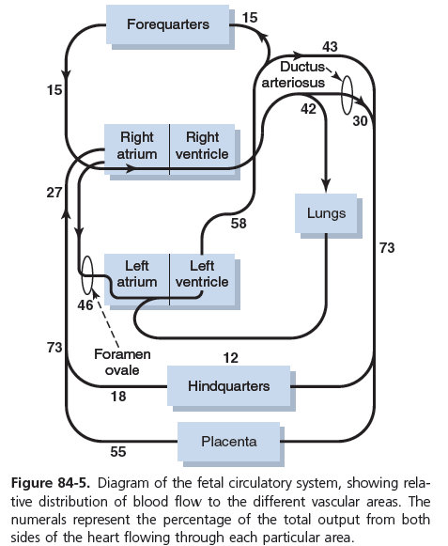

Slide 21
Changes in Fetal Circulation at Birth
Decreased Pulmonary and Increased Systemic Vascular Resistances at Birth.
The primary changes in the circulation at birth are, first, loss of the tremendous blood flow through the placenta, which approximately doubles the systemic vascular resistance at birth.
This doubling of the systemic vascular resistance increases the aortic pressure, as well as the pressures in the left ventricle and left atrium.

Slide 22
Changes in Fetal Circulation at Birth cnt’d…
Second, the pulmonary vascular resistance greatly decreases as a result of expansion of the lungs.
In the unexpanded fetal lungs, the blood vessels are compressed because of the small volume of the lungs.
Immediately on expansion, these vessels are no longer compressed & the resistance to blood flow decreases several fold.
Also, in fetal life, the hypoxia of the lungs causes considerable tonic vasoconstriction of the lung blood vessels, but vasodilation takes place when aeration of the lungs eliminates the hypoxia.
All these changes together reduce the resistance to blood flow through the lungs as much as fivefold, which reduces the pulmonary arterial pressure, right ventricular pressure, & right atrial pressure.

Slide 23
Changes in Fetal Circulation at Birth cnt’d…
Closure of the Foramen Ovale
In the foetus the foramen ovale is kept open by the higher pressure of blood in the right atrium compared to the left atrium.
At birth the blood pressure in the right atrium decreases due to termination of blood flow from the Placenta, whilst pressure in the left atrium increases due to increased pulmonary flow.
As a result, the flap of the septum primum presses against the septum secundum closing the foramen ovale.
In most individuals, the foramen ovale closes a few months after birth.
A scar remains between the two atria once the foramen ovale has closed and this is termed the fossa ovalis.

Slide 24
Changes in Fetal Circulation at Birth cnt’d…
Closure of the Ductus Arteriosus. The ductus arteriosus also closes, but for different reasons.
First, the increased systemic resistance elevates the aortic pressure while the decreased pulmonary resistance reduces the pulmonary arterial pressure. As a consequence, after birth, blood begins to flow backward from the aorta into the pulmonary artery through the ductus arteriosus, rather than in the other direction, as in fetal life.
However, after only a few hours, the muscle wall of the ductus arteriosus constricts markedly and within 1 to 8 days, the constriction is usually sufficient to stop all blood flow. This is called functional closure of the ductus arteriosus.

Slide 25
Closure of the Ductus Arteriosus cnt…
Then, during the next 1 to 4 months, the ductus arteriosus ordinarily becomes anatomically occluded by growth of fibrous tissue into its lumen.
In one of several thousand infants, the ductus fails to close, resulting in a patent ductus arteriosus. The failure of closure has been postulated to result from excessive ductus dilation caused by vasodilating prostaglandins, especially PGE2, in the ductus wall. In fact, administration of the drug indomethacin, which blocks synthesis of prostaglandins, often leads to closure.

Slide 26
Changes in Fetal Circulation at Birth cnt’d…
Closure of the Ductus Venosus. In fetal life the portal blood from the fetus’s abdomen joins the blood from the umbilical vein, and these together pass by way of the ductus venosus directly into the vena cava immediately below the heart but above the liver, thus bypassing the liver.
Immediately after birth, blood flow through the umbilical vein ceases, but most of the portal blood still flows through the ductus venosus, with only a small amount passing through the channels of the liver. However, within 1 to 3 hours the muscle wall of the ductus venosus contracts strongly and closes this avenue of flow. As a consequence, the portal venous pressure rises from near 0 to 6 to 10 mm Hg, which is enough to force portal venous blood flow through the liver sinuses. Although the ductus venosus rarely fails to close, we know little about what causes the closure.

Slide 27
Special Functional Problems in the Neonate
Circulation
Blood Volume. The blood volume of a neonate immediately after birth averages about 300 milliliters, but if the infant is left attached to the placenta for a few minutes after birth or if the umbilical cord is stripped to force blood out of its vessels into the baby, an additional 75 milliliters of blood enters the infant, to make a total of 375 milliliters.
Then, during the ensuing few hours, fluid is lost into the neonate’s tissue spaces from this blood, which increases the hematocrit but returns the blood volume once again to the normal value of about 300 milliliters.
Some pediatricians believe that this extra blood volume that results from stripping the umbilical cord can lead to mild pulmonary edema with some degree of respiratory distress, but the extra red blood cells are often valuable to the infant.

Slide 28
Circulation cnt…
Cardiac Output. The cardiac output of the neonate averages 500 ml/min, which, like respiration and body metabolism, is about twice as much in relation to body weight as in the adult. Occasionally a child is born with an especially low cardiac output caused by hemorrhage of much of its blood volume from the placenta at birth.
Arterial Pressure. The arterial pressure during the first day after birth averages about 70 mm Hg systolic and 50 mm Hg diastolic and increases slowly during the next several months to about 90/60. A much slower rise then occurs during the subsequent years until the adult pressure of 115/70 is attained at adolescence.

Slide 29
Reference
Hall, J. E. (2016). Guyton and Hall textbook of medical physiology.

Slide 30
End of presentation
Thank You for Listening

