Slide 1
Introduction to Cell Physiology
Samuel Ngigi Kiurire

Slide 2
Physiology definition
The branch of biology which deals with the functions & activities of living organisms and their parts, including all physical and chemical processes.
The organic processes or functions in an organism or in any of its parts.
Physiology is the study of life, specifically, how cells, tissues, and organisms function.

Slide 3
Importance of Physiology
Physiology is important because it is the foundation upon which we build our knowledge of what "life" is, how to treat disease, and how to cope with stresses imposed upon our bodies by different environments.
Physiological studies of normal biological function provide the basis for understanding the abnormal function seen in animal and human disease (pathophysiology) and for developing new methods for treating those diseases (translational research).

Slide 4
Cell Physiology
Basic Characteristics of Cells:
Smallest living subdivision of the human body
Diverse in structure and function
Small.
Most are microscopic
Divided into organelles
  Each organelle performs a specific function

Slide 5
Discovery of Cells
Robert Hooke (mid-1600s)
  Saw “row of empty boxes”
  Coined the term cell
Cell theory
(1839)Theodor Schwann & Matthias Schleiden
“ all living things are made of cells”
(50 yrs. later) Rudolf Virchow
“all cells come from cells”

Slide 6
Principles of Cell Theory
All living things are made of cells
Smallest living unit of structure and function of all organisms is the cell
All cells arise from preexisting cells
(this principle discarded the idea of
spontaneous generation)

Slide 7
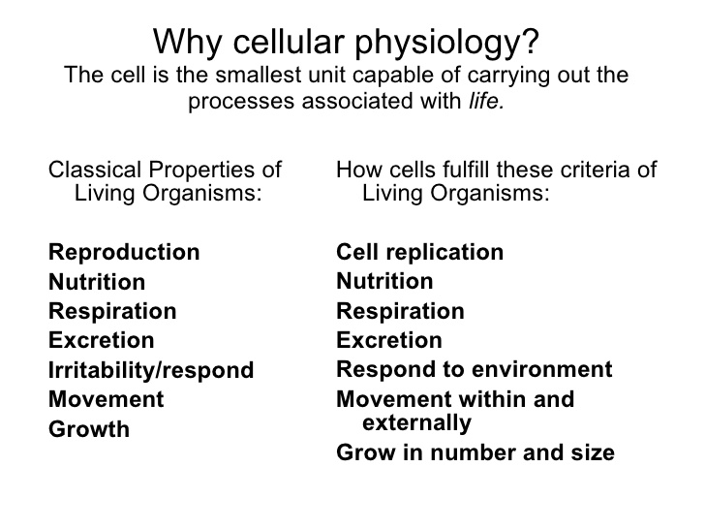

Slide 8
Characteristics of All Cells
Each Cell Has Three Primary Regions:
Plasma Membrane
Cytoplasm
Nucleus

Slide 9
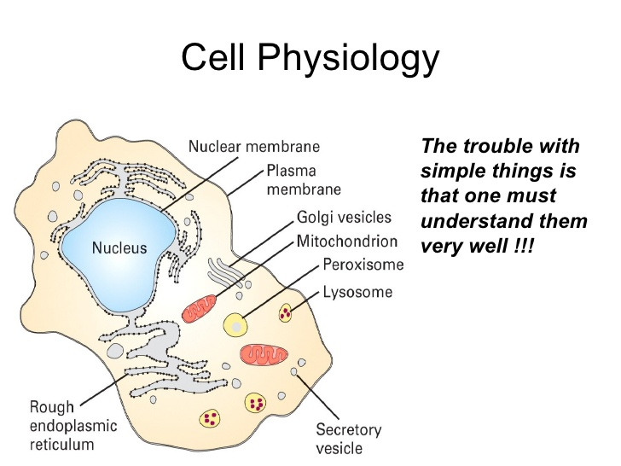

Slide 10
Cell Types
Prokaryotic
Eukaryotic

Slide 11
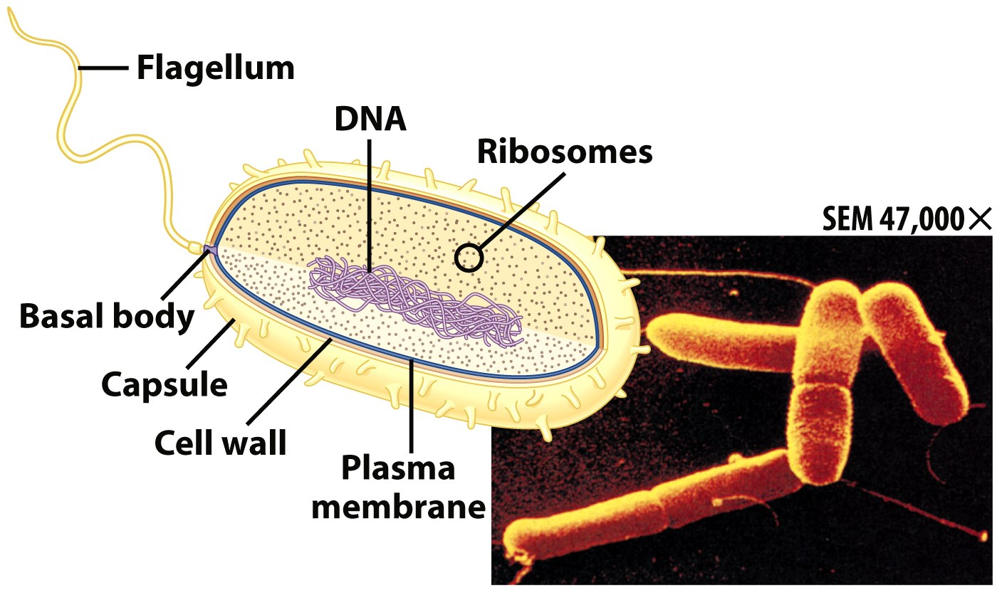
Prokaryotic Cells
First cell type on earth
Cell type of Bacteria.
No membrane bound nucleus
Nucleoid = region of DNA concentration
Organelles not bound by membranes

Slide 12
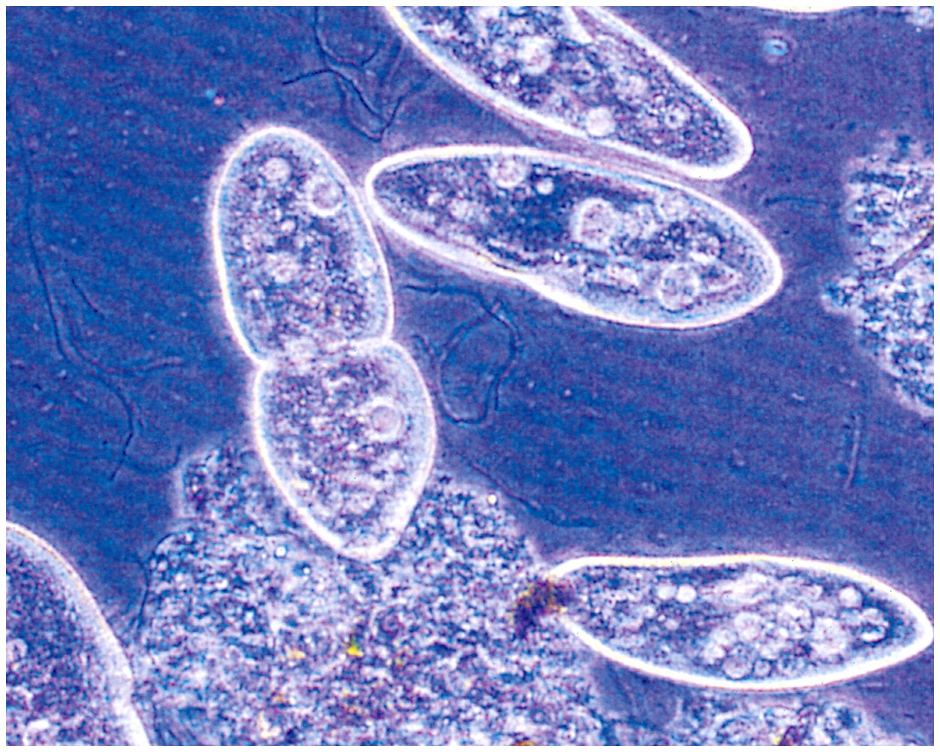
Eukaryotic Cells
Nucleus bound by membrane
Include fungi, protozoa, plant, and animal cells
Possess many organelles

Slide 13
The Plasma Membrane
Plasma membrane = outer casing of the cell
  separates intracellular environment from the extracellular environment.
Regulates movement of materials into and out of cell
  a selective mechanical barrier

Slide 14
The Plasma Membrane cntd…
Composed of
Lipids,
Proteins
and Carbohydrates
  Arranged in a lipid bilayer

Slide 15
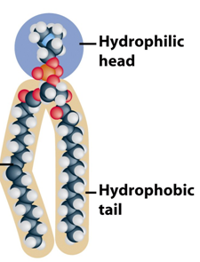
Cell Membrane Components:
Phospholipids
one end is hydrophilic
other end is hydrophobic
tend to aggregate in a lipid bilayer
  hydrophilic ends face outward, hydrophobic ends in the middle

Slide 16
Cell Membrane Components:
Proteins
Suspended in lipid bilayer
May span layer or attached only to one surface
Different functions

Slide 17
Types of Membrane Proteins
Structural Proteins
  Maintain membrane shape and integrity, movement
Channel Proteins
  Pore-like proteins
  Enable small ions to pass
Carrier proteins
  Shuttle specific substances across membrane

Slide 18
Types of Membrane Proteins cntd…
Enzymes
  Catalyze specific reactions
Receptor proteins
  Bind cellular signals
Signaling proteins / Recognition proteins
  Enable cells to identify and interact with each other

Slide 19
Cell Membrane Components:
Carbohydrates
Branched polymers attached to extracellular surface
Forms “sugar coating” (glycocalyx) of cells
Functions
  Lubricated surface
  Protect underlying proteins
  Cell recognition
Notes:
Polymers are materials made of long, repeating chains of molecules.

Slide 20
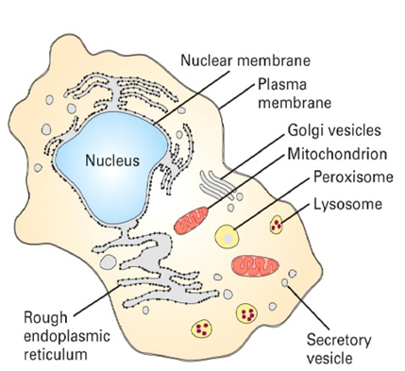

Slide 21
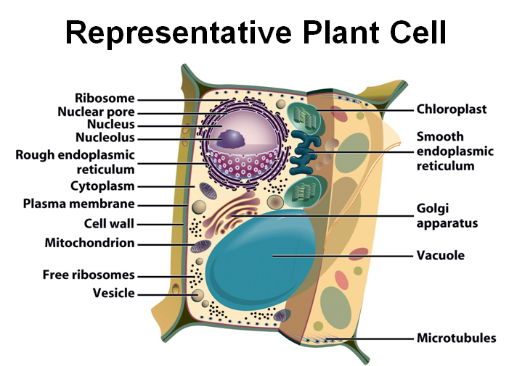

Slide 22
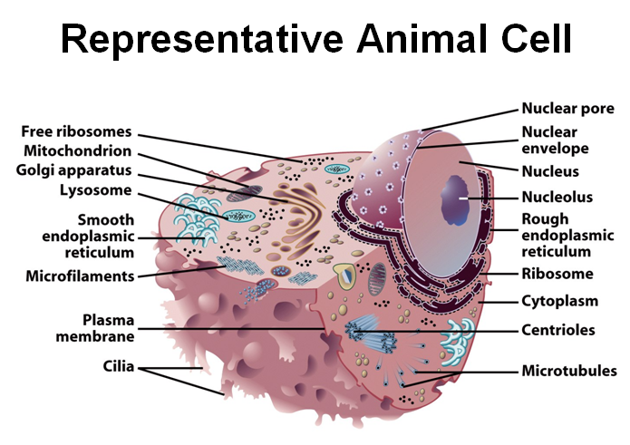

Slide 23
Cytoplasm
Viscous fluid containing organelles
components of cytoplasm
  Interconnected filaments & fibers
cytosol: semi-liquid, gel-like; contains various dissolved materials, enzymes, etc.
  storage substances

Slide 24
Cytoplasmic Organelles: Ribosomes
Large protein-RNA complexes
Found free floating in cytosol or attached to endoplasmic reticulum
synthesize proteins based on RNA codes.

Slide 25
Cytoplasmic Organelles: Endoplaasmic Reticulum (ER)
Rough Endoplasmic Reticulum (RER)
  Coated with ribosomes
  Synthesis of proteins for:
    Cell membranes
    Interior (lumen) of membrane-bound organelles
    Export out of the cell

Slide 26
Cytoplasmic Organelles: Endoplasmic Reticulum (ER)
Smooth Endoplasmic Reticulum (SER)
  No ribosomes
  Functions
    Lipid synthesis
    Ca²⁺ storage
    Vesicular release

Slide 27
Cytoplasmic Organelles:
Golgi Apparatus
Stacks of flattened sacs
Functions:
  processes ER products into final form
  sort and direct finished products to final destinations (intracellular or extracellular)
  vesicles - small membrane coated chambers used to transport materials

Slide 28
Cytoplasmic Organelles: Lysosome
Sac-like organelles which contain enzymes
Break down large molecules
  cell’s “digestive system”
Destroy bacteria, old organelles, etc.

Slide 29
Cytoplasmic Organelles: Mitochondria
Surrounded by two membranes
Possess own DNA
Power generators of the cell
Convert food energy (e.g., glucose) to usable form
  ATP
    high energy compound.
    major source of metabolic energy for the cell

Slide 30
The Nucleus
Cell's "control center"
Largest organelle
Surrounded by nuclear envelope
Contains DNA
  genetic information in form of nucleic acid polymers
  instructs synthesis of proteins

Slide 31
Further Studies
List all the organelles in a cell and state their functions.
Read other importances of Physiology.

Slide 32
End of Presentation
Thank You

