Slide 1
Cardinal Signs
Samuel Ngigi K.

Slide 2
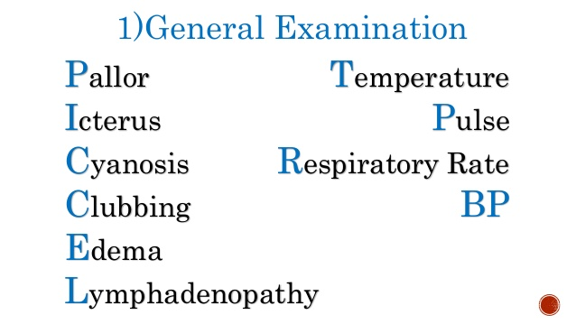
Objectives
To learn the following components of G/E

Slide 3
JAUNDICE
Jaundice implies disease of the liver or the biliary tract, although it may also occur from excessive haemolysis.
It causes yellowness of the skin and conjunctiva, and may be associated with other cutaneous and systemic features of liver disease, often with dark urine.
Although many sources confidently say that jaundice can be recognized when the serum bilirubin rises to 2 to 2.5 mg/dl, experienced clinicians often cannot see a yellow skin coloration until the serum bilirubin is at least 7 to 8 mg/dl.
In the eyes, yellowness is examined in the sclera.

Slide 4
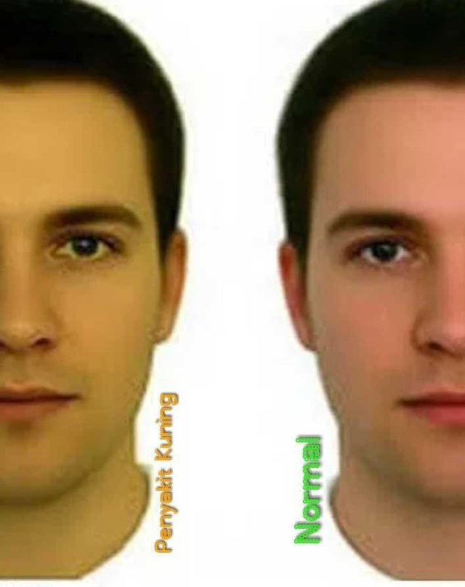
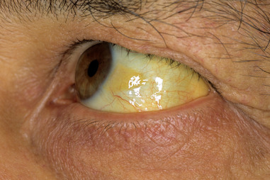

Slide 5
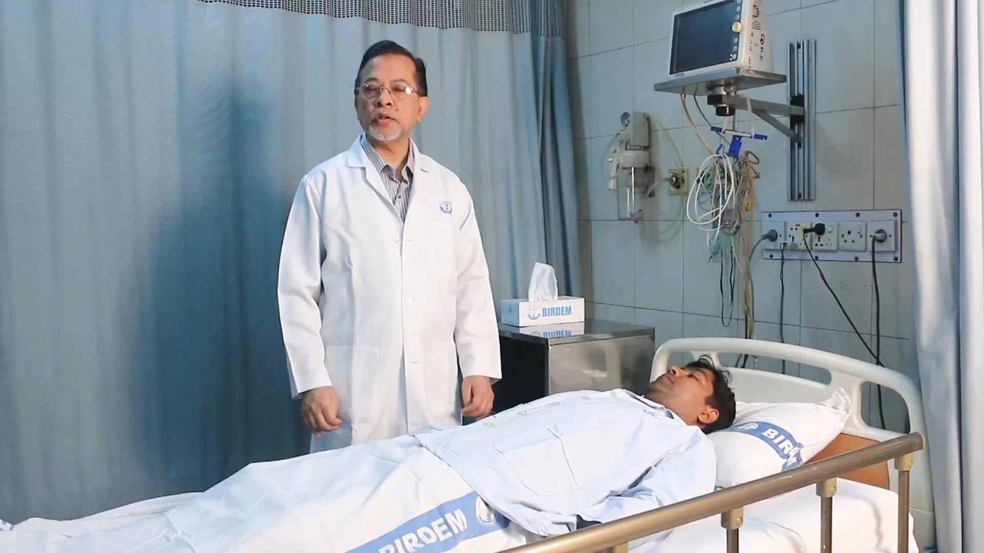

Slide 6
Cyanosis
Cyanosis is a blue discoloration of the skin and mucous membranes that occurs when the absolute concentration of deoxygenated haemoglobin is >50 g/l.
This corresponds to an arterial oxygen saturation of <90% and usually indicates underlying cardiac or pulmonary disease.
It can be difficult to detect, particularly in black and Asian patients.

Slide 7
Cyanosis cnt’d…
Central cyanosis
This is seen at the lips and tongue.
Anaemic or hypovolaemic patients rarely have central cyanosis because severe hypoxia is required to produce the necessary concentration of deoxygenated haemoglobin.
Patients with polycythaemia can become cyanosed at normal arterial oxygen saturation.
Notes:
Anemia is a condition that develops when your blood lacks enough healthy red blood cells or hemoglobin. Hemoglobin is a main part of red blood cells and binds oxygen. If you have too few or abnormal red blood cells, or your hemoglobin is abnormal or low, the cells in your body will not get enough oxygen.
Polycythaemia: an abnormally increased concentration of haemoglobin in the blood, either through reduction of plasma volume or increase in red cell numbers. It may be a primary disease of unknown cause, or a secondary condition linked to respiratory or circulatory disorder or cancer.

Slide 8
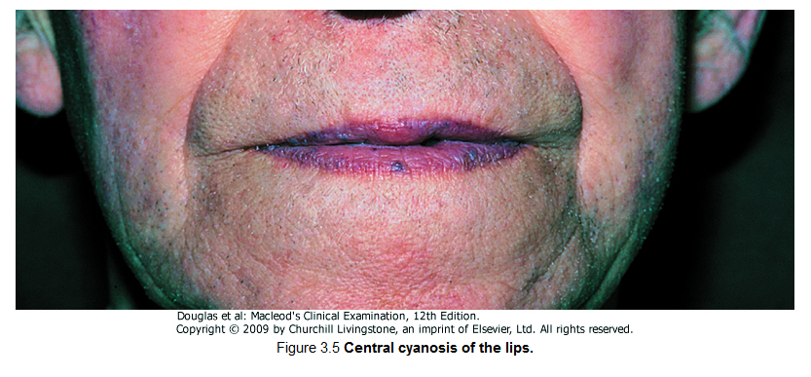

Slide 9
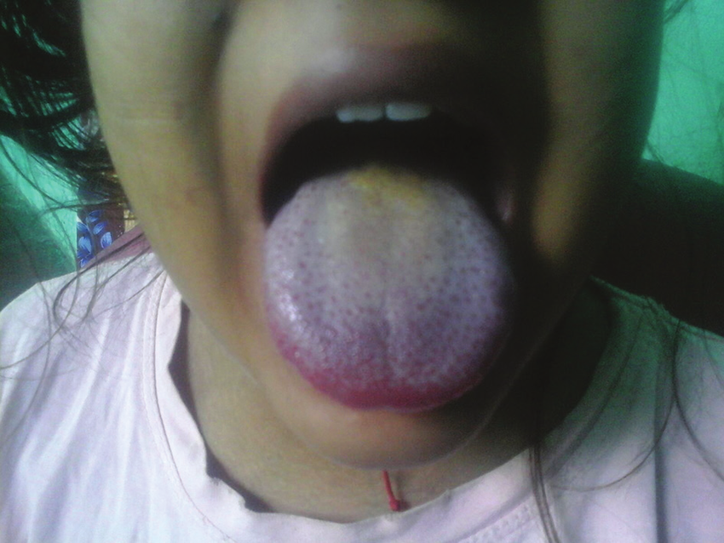

Slide 10
Cyanosis cnt’d…
Peripheral cyanosis
This occurs in the hands, feet or ears, usually when they are cold.
It is also found with central cyanosis, but is most often seen with poor peripheral circulation due to shock, heart failure, peripheral vascular disease, and venous obstruction, e.g. deep vein thrombosis.

Slide 11
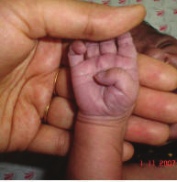

Slide 12
Edema
In the nonobese subject, approximately 60% of total body mass consists of water, of which two-thirds is within cells.
Of the one-third confined to the extracellular space, 70% is distributed in the interstitium, 20% in the vasculature, and 10% in the central nervous system, eyes, serous cavities, and intestinal lumen.

Slide 13
Edema Cnt’d…
Although modest expansion of interstitial fluid volume may not be detected, an excess of several liters causes visible and palpable swelling.
The term edema refers to a discernible excess of interstitial fluid.
Pitting edema gives way on palpation, leaving persistent impressions in the skin; brawny edema offers resistance and leaves no impressions.

Slide 14
Edema Cnt’d…
Observe for edema of the foot, ankles and legs.
Gently compress the patient's soft tissue with your thumb over both shins for a few minutes.
Observe for indentation.
Note: In bed-ridden patients, examine for edema over the sacral and coccygeal areas.
Normal:
Normally, there is no indentation.

Slide 15
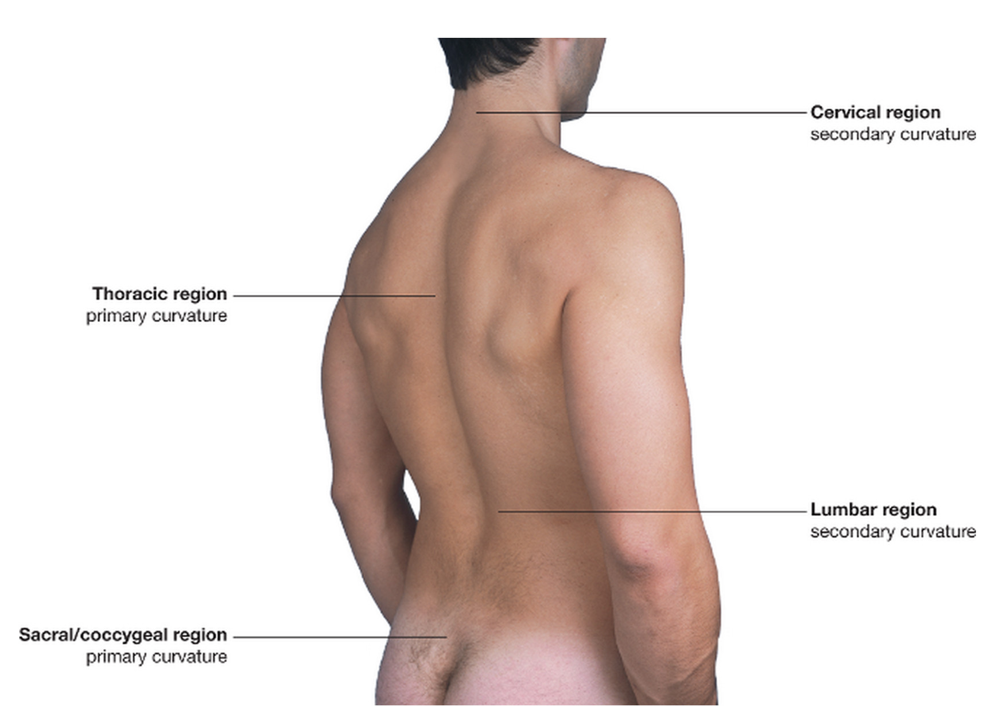

Slide 16
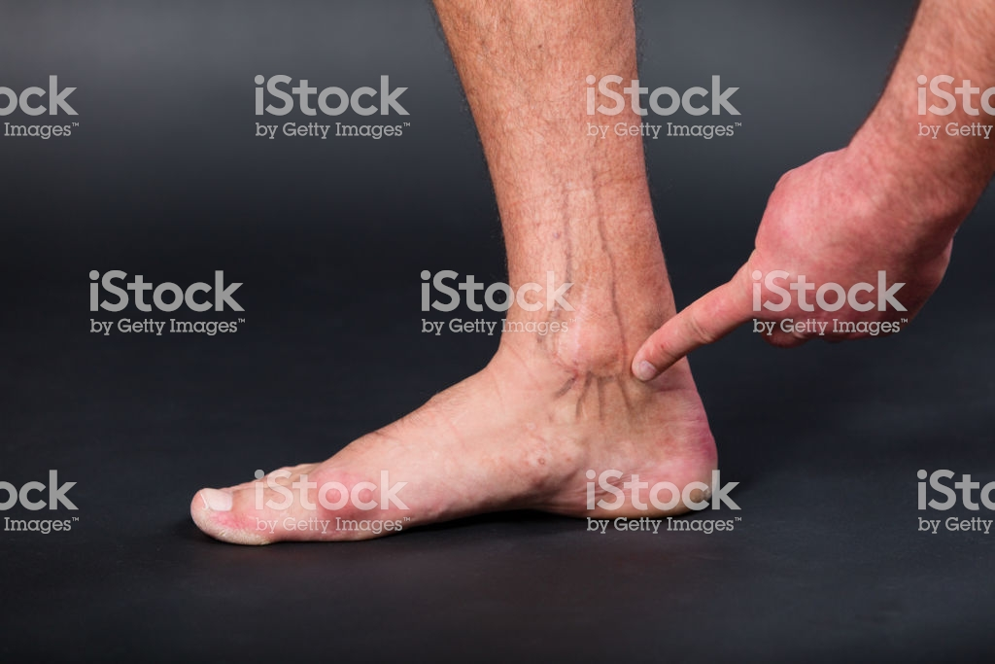
2.5 cm above the medial malleolus

Slide 17
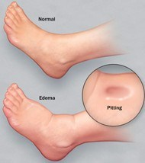
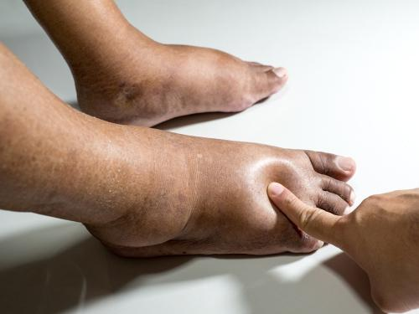

Slide 18
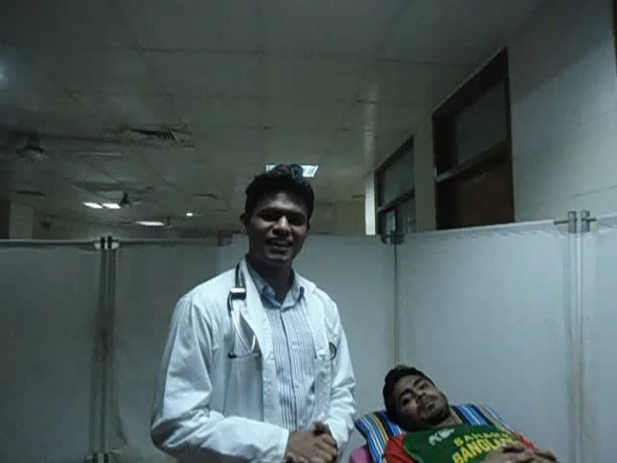

Slide 19
Finger clubbing
Finger clubbing is an important sign and may indicate intrathoracic malignancy, e.g. lung cancer, or chronic sepsis, e.g. bronchiectasis.
Autoimmune hyperthyroidism may be associated with a specific type of finger clubbing, more pronounced in the digits on the radial side of the hand.
Notes:
Bronchiectasis is a long-term condition where the airways of the lungs become abnormally widened, leading to a build-up of excess mucus that can make the lungs more vulnerable to infection. The most common symptoms of bronchiectasis include: a persistent cough that usually brings up phlegm (sputum)

Slide 20
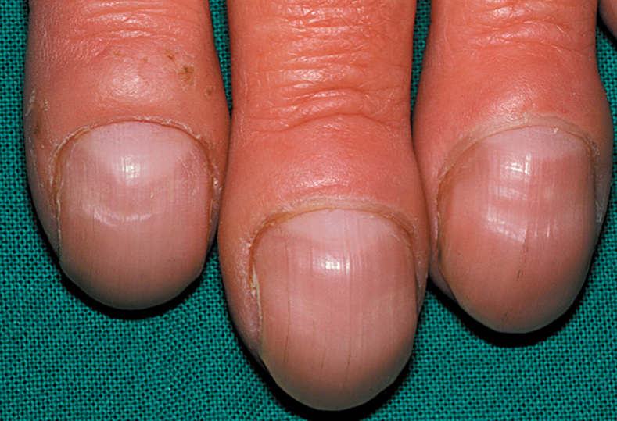

Slide 21
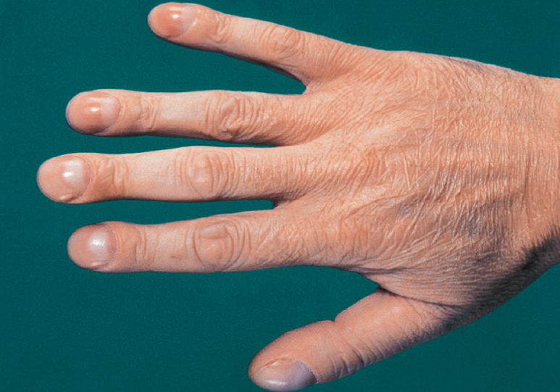

Slide 22
Lymphadenopathy
Lymph nodes may be palpable in normal people, especially in the submandibular, axilla and groin regions.
Distinguish between normal and pathological nodes.
Pathological lymphadenopathy may be local or generalized, and is of diagnostic and prognostic significance in the staging of malignancies.

Slide 23
Lymphadenopathy Cnt’d…
If lymph nodes are palpated, then the following points should be considered:
How many nodes are palpable?
What is the diameter of the nodes?
What is their consistency?
Are they discrete or confluent?
Are they mobile or fixed?
Is the skin in the vicinity of the nodes abnormal?
Notes:
Discrete: individually separate and distinct.
Confluent: flowing together or merging.

Slide 24
Lymphadenopathy Cnt’d…
Size
Normal nodes in adults are seldom >0.5 cm in diameter.
Consistency
Normal nodes feel soft.
Tenderness
Acute viral or bacterial infection, including infectious mononucleosis, dental sepsis and tonsillitis, causes tender, variably enlarged lymph nodes.
Fixation
Lymph nodes fixed to deep structures or skin suggest malignancy.

Slide 25
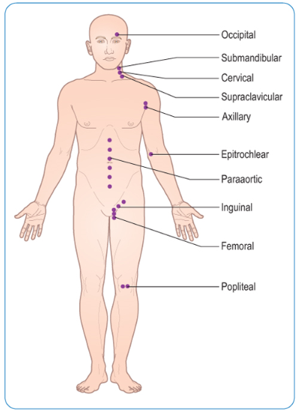

Slide 26
Lymphadenopathy Cnt’d…
Examination sequence
Inspect for visible lymphadenopathy.
Palpate one side at a time using the fingers of each hand in turn.
Compare with the nodes on the contralateral side.
Assess:
  Site
  Size
  Consistency
  Tenderness.
Determine whether the node is fixed to:
  Surrounding and deep structures
  Skin.
Measure the main nodes.

Slide 27
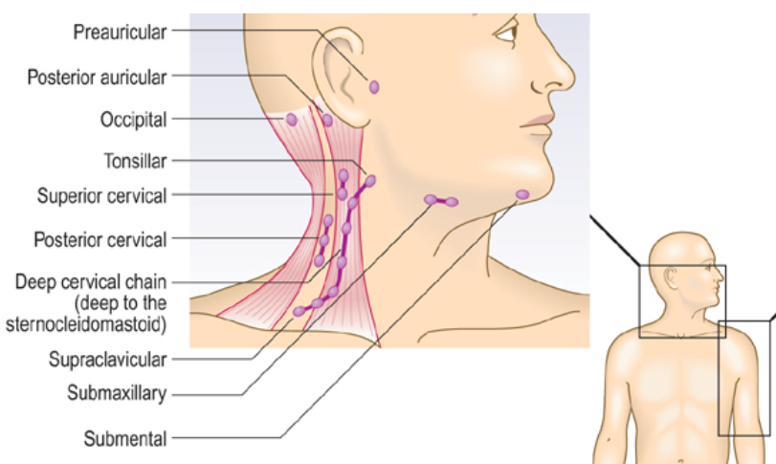

Slide 28
Lymphadenopathy Cnt’d…
Cervical nodes
Examine the cervical and axillary nodes with the patient sitting.
From behind, examine the submental, submandibular, preauricular, tonsillar, supraclavicular and deep cervical nodes in the anterior triangle of the neck.
Palpate for the scalene nodes by placing your index finger between the sternocleidomastoid muscle and clavicle. Ask the patient to tilt his head to the same side and press firmly down towards the first rib.
From the front of the patient, palpate the posterior triangles, up the back of the neck and the posterior auricular and occipital nodes.

Slide 29
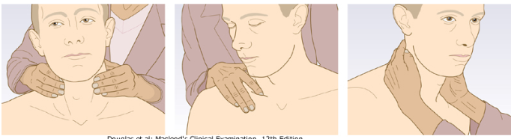
Notes:
Palpation of the cervical glands. (A) Examine the glands of the anterior triangle from behind, using both hands. (B) Examine for the scalene nodes from behind with your index finger in the angle between the sternocleidomastoid muscle and the clavicle. (C) Examine glands in the posterior triangle from the front.

Slide 30
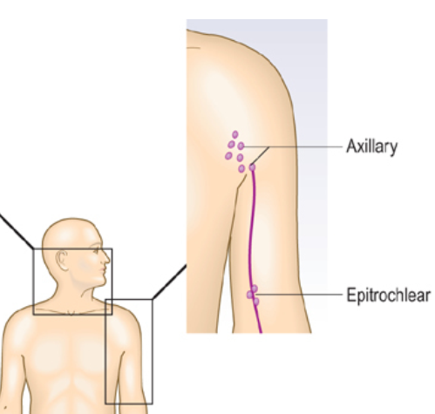

Slide 31
Lymphadenopathy Cnt’d…
Axillary nodes
From the patient's front or side, palpate the right axilla with your left hand and vice versa.
Gently place your finger tips into the apex of the axilla and then draw them downwards, feeling the medial, anterior and posterior axillary walls in turn.
Keep your nails short to avoid causing discomfort.

Slide 32
Lymphadenopathy Cnt’d…
Epitrochlear nodes
Support the patient's right wrist with your left hand, grasp his partially flexed elbow with your right hand, and use your thumb to feel for the epitrochlear node.
Examine the left epitrochlear node with your left thumb.

Slide 33
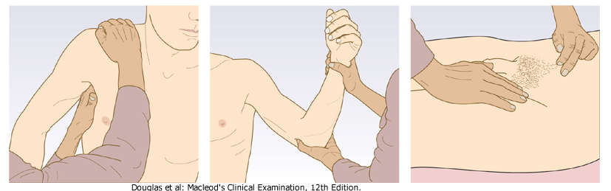
Notes:
Palpation of the axillary, epitrochlear and inguinal glands. (A) Examination for right axillary lymphadenopathy. (B) Examination of the left epitrochlear glands. (C) Examination of the left inguinal glands.

Slide 34
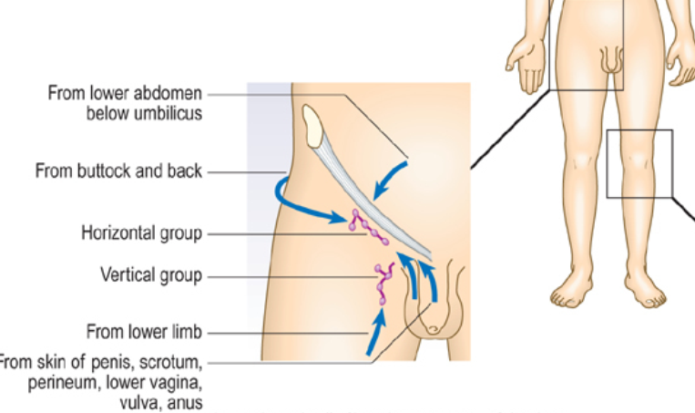

Slide 35
Lymphadenopathy Cnt’d…
Inguinal nodes
Examine for the inguinal and popliteal nodes with the patient lying down.
Palpate over the horizontal chain, which lies just below the inguinal ligament, and then over the vertical chain along the line of the saphenous vein.

Slide 36
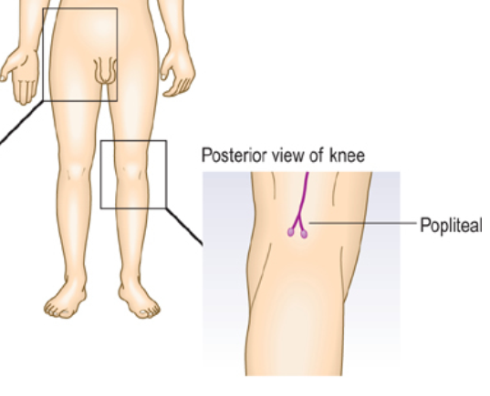

Slide 37
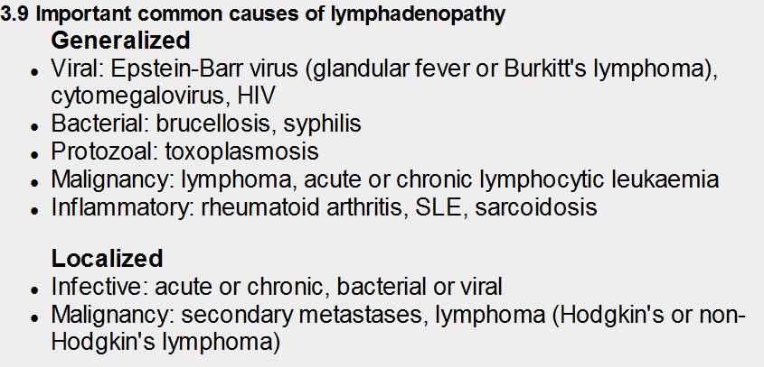

Slide 38
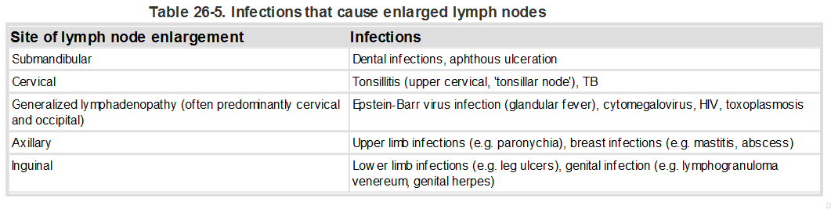

Slide 39
Pallor
Pallor is characterized by discoloring of the skin and mucous membranes due to a reduction in the amount of circulating hemoglobin.
Regions for examination: Lower palpebral conjuctiva, tip & dorsum of the tongue, soft palate, palmar or plantar creases, nailbeds, general body skin.
The colour of the mucous membranes of the mouth and conjunctivae gives a better indication, as does the colour of the creases of the palm of the hand.

Slide 40
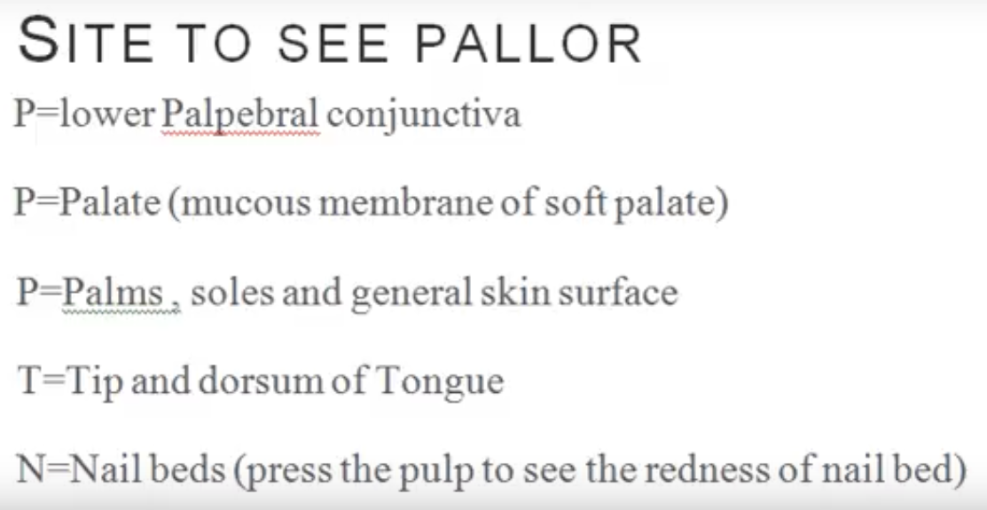

Slide 41
Pallor cnt’d…
Causes of pallor
Anemia is the most common cause of pallor.
Other causes:
Shock
Respiratory distress
Skin edema
Etc.
Graded as: +(mild pallor); ++(moderate pallor); +++(severe pallor); ++++(very severe pallor).

Slide 42
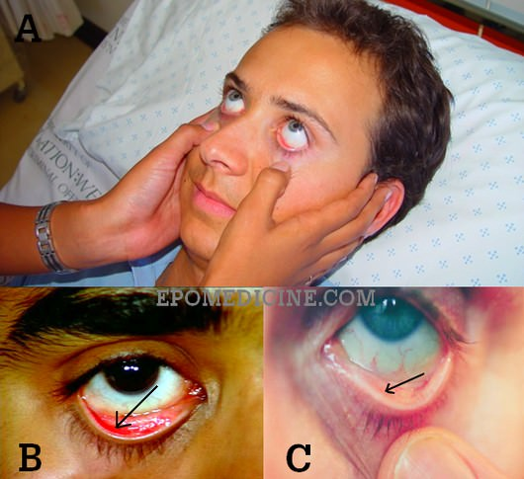

Slide 43
Dehydration
Dehydration describes a state of negative fluid balance that may be caused by numerous disease entities.
Diarrheal illnesses are the most common etiologies.
Worldwide, dehydration secondary to diarrheal illness is the leading cause of infant and child mortality.

Slide 44
Dehydration cnt’d…
Signs of dehydration:
Sunken fontanelle
Sunken eyes
Very dry skin
Rapid heartbeat
Rapid breathing
Reduced urine volume or having very yellow urine
Sleepiness, lack of energy, confusion or irritability.

Slide 45
End of Presentation
Thank You

