Slide 3
The nursing process entails gathering and analyzing data in order to identify clients strengths and potential or actual health problems and developing and continually reviewing a plan of nursing interventions to achieve mutually agreed outcomes
Critical thinking is used throughout nursing the process
Critical thinking and the creativity it requires and inspires are key elements in quality nursing care

Slide 4
Critical thinking as “ the act of thinking about thinking – PAUL (1988)
Critical thinking is reasonable, rationale, reflective, autonomous, creative, fair and inspires an attitude of inquiry that focuses on deciding what to believe or do

Slide 5
It means capable of judging carefully and accurately

Slide 6
It is thinking that results in the development of new ideas and new products – REILLY & OERMANN (1992)

Slide 7
Nurses must be critical thinkers because of the nature of the discipline and the nature of their work
Reilly & Oermann states that one can think critically about nursing without a basic knowledge of its concepts, theories and content

Slide 8
Nurses use knowledge from other subjects and fields. Eg: The nurse might use knowledge of anatomy and physiology of lungs to promote respiratory function of a patient who has dyspnoea
Nurses deals with change in stressful environments. Eg: Emergency situation, unexpected situation

Slide 9
important
Nurses
decisions.
makes
Eg: Nurses must use judgement to decide
good which
observations must be reported to physician immediately and which can be noted in the client record for the physician to address later

Slide 10
Rationality and reflection
Health, constructive skepticism Autonomy
Creative thinking
Fair thinking
Focus on what to believe and do

Slide 11
It is based on reasons and evidence rather than on preference or self interest
Eg: Vanitha decided to become a nurse after watching a Remo film in which nurses were shown as attractive and heroic
Lilly who thinks more critically asked a counselor about the job opportunities available for nurses

Slide 12
Critical thinkers do not accept or reject ideas unless they understand them
Eg: When a salesperson insisted that a new detergent powder was better than that being used on Sarah’s house. Sarah asked “ what do you mean by better? What information do you have to show that this is so?

Slide 13
Critical thinkers are not easily manipulated. They think for themselves, rather than being led by their peer group or passively accepting the beliefs of others

Slide 14
Critical thinkers create original ideas by finding connections among thoughts and concepts
Eg: Nurse Mary remembered a song her mother used to sing to her, and sang it to help comfort a frightened child in the hospital

Slide 15
Critical thinking is not biased or one sided. Critical thinkers recognize the bias and prejudice of others thinking and seek information from all points of view before taking a stand or action

Slide 16
Critical thinking is used to decide on a cause of action, make reliable observations, draw sound conclusion, solve problems and evaluate policies, claims and actions

Slide 17
four
Strader (1992) describes stages in the creative process:
Preparation stage
Incubation stage
Insight stage
Verification stage

Slide 18
The creative thinker gathers information related to the problem or concern

Slide 19
The creative thinker unconsciously considers and consciously works or possible solutions or decisions

Slide 20
During this stage, appropriate solutions emerge and are developed and the solutions believed to be most appropriate is implemented

Slide 21
During this stage, the implemented solution is evaluated for its effectiveness

Slide 22
Complex thinking process such as critical analysis, problem solving and decision making requires the use of cognitive critical thinking skills

Slide 23
It is a set of questions one can apply to a particular situation or idea to determine essential information and ideas and discard superfluous information and ideas

Slide 24
Socrates (born about 470 BC) was a greek philosopher who developed the Socratic method of question and answer.
Example:
Is this question important?
What could you assume instead? Why?
How do you know?
What effect would that have?
What are the alternatives?
What are the implications of that?

Slide 25
It is a technique one can use to look
beneath the surface, examine assumptions,
recognize and search for
inconsistencies, examine multiple points of view and differentiate what one knows from what one merely believes
Example: Nurse should employ this question method during an end of shift report, review a history, planning care

Slide 26
There are two types of skills used in critical thinking. They are:
Inductive reasoning
Deductive reasoning

Slide 27
Inductive reasoning generalizations are formed from a set of facts or observations ( specific to general)
Example: The nurse who observes that a patient has dry skin, poor skin turgor, sunken eyes and decreased urine output may make the generalization that the patient appears dehydrated

Slide 28
It is reasoning from the general to specific
Example: The nurse who uses the Maslows Hierarchy of needs might categorizes data and define clients problem in items of elimination, nutrition or protection needs

Slide 29
Paul (1995) explained the following attitudes:
Independence of thought
Fair mindedness
Insight into ego centricity and socio centricity
Intellectual humility and suspension of judgement
Intellectual courage
Integrity
Perseverance
Confidence in reason Interest in exploring both thoughts and feelings
Curiosity

Slide 30
Critical thinking requires that individuals think for themselves

Slide 31
Critical thinkers are fair minded, assessing all viewpoints with the same standards and not basing their judgments on personal or group bias or prejudice

Slide 32
Critical thinkers are open to the possibility that their personal biases or social pressures and customs could unduly affect their thinking

Slide 33
Intellectual humility means having an awareness of the limits of ones knowledge

Slide 34
One is willing to consider and examine fairly ones own ideas or views especially those to which one may have a strongly negative reaction

Slide 35
It requires that individuals apply the same rigorous standards of proof to their own knowledge and beliefs as they apply to the knowledge and beliefs of others

Slide 36
It means finding effective solutions to client and nursing problems

Slide 37
Critical thinkers believes the well reasoned thinking will lead to trust worthy conclusions

Slide 38
A critical thinkers knows that emotions can influence thinking and that after feelings underlie thoughts

Slide 39
The internal conversation going on within the mind of a critical thinker is filled with questions
Example:
Why do we believe this?
The curious individual may value tradition but is not afraid to examine traditions to be same they are still valid

Slide 40
Using critical thinking to develop a plan of nursing care requires considering the human factors that might influence the plan
Nurses must use critical thinking skills in all practice settings – acute care, ambulatory care, extended care and in the home & community

Slide 41
Fonteyn (1998)
identified 12
predominant thinking strategies used by nurses, regardless of their area of clinical practice
Recognizing a pattern
Setting priorities
Searching for information
Generating hypothesis

Slide 42
Making predications Forming relationships
Starting a preposition (if – then)
Asserting a practice role Making choices (alternatives) Judging the value
Drawing conclusions Providing explanations

Slide 43
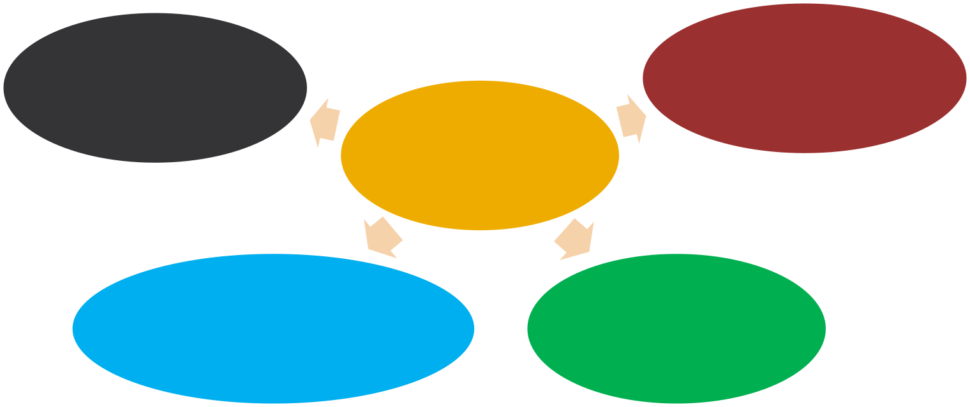
Indicates the five overlapping phases of the nursing process. Each phase depends upon the accuracy of the proceeding phases. Each phase involves critical thinking
Assessing
Evaluating
Diagnosing
Critical Thinking
Implementing
Planning

Slide 44
Nursing | process | is | a systematic
rationale | method | of | planning and
providing individualized nursing care
Nursing process is a process is used to identify, diagnose and treat human response to health and illness – American Nurses Association

Slide 45
Assessment
Evaluation
Diagnosis
Implementation
Planning

Slide 46
Collection of information about patients health condition
Identify the patients problems from collected data
Set the goal of care and started and identify appropriate nursing actions
Putting the plan
into action
Evaluate if goals are
achieved or not

Slide 47
System is open and flexible
Meet the unique needs of individual, family, group or community
It is cyclic and dynamic
Should be client centered
Should be planned and goal directed

Slide 48
It is interpersonal and collaborative
It permits creativity for the nurse and patient to solve the stated health problems
It emphasizes feedback, which leads either to re assessment of the problem or to revision of the care plan
It is universally applicable

Slide 49
It is the systematic and continuous collection of data to determine a patients current and past health status and functional status

Slide 50
To establish a data base ( all information about client)
Nursing health history
Physical Assessment
Results of laboratory & diagnostic tests
Patient’s response to health concerns or illness
Ability to manage health care needs

Slide 51
Initial Comprehensive Assessment
Problem Focused Assessment Emergency Assessment
Time Lapsed Assessment

Slide 52
Performed with in specified time after admission to a health care agency
Also called an admission assessment
Example: Nursing Admission Assessment
To evaluate health status
To identify functional health patterns
To provide an in depth comprehensive databases

Slide 53
Collects data about a problem that has already been identified
Ongoing process integrated with nursing care
Nurse determines whether problem still exist and whether the status of the problem has changes
Example: Hourly assessment of patient’s fluid intake and urine output

Slide 54
Occurs during any life threatening condition
Any physiologic or psychologic crisis of the client
Example: Rapid assessment of patient’s vital signs during cardiac arrest

Slide 55
Several months after initial assessment
Evaluate the changes in the clients health & functional status
Example:
Periodic output patient clinic visits
Home health visits
Health & development screening

Slide 56
Collection of data
Document data
Organize data
Validate data

Slide 57
It is the process of gathering information about a patients health status
Includes physical, psychological, emotion, socio cultural, spiritual factors that may affect clients health status
Includes past health history of client ( allergies, past surgeries, chronic diseases, use of folk healing methods), present problems of client (pain, nausea, vomiting etc)

Slide 58
It referred
to as
can be
symptoms or sensations and
described by that affected person or patient
Example: Pain, itching, tinnitus, feeling of worry
It referred to as signs, are detectable by an observer mainly using inspection, percussion, palpation or auscultation
Example: Pallor, Diaphoresis, Jaundice, BP – 150/100 mmhg

Slide 59
Interview
Auscultation
Percussion
Observation
Palpation

Slide 60
Listen attentively, using all your senses
Speak slowly and clearly
Use language that client understand
Clarify points that are not understood
Plan questions to follow a logical sequence

Slide 61
Ask only one question at a time
Allow the patient to clarify the asked question, if need
Do not impose your own values on the patient
Avoid using personal examples
Non verbally convey respect, concern, interest and acceptance
Use and accept silence to help the patient search for more thoughts or to organize them
Use eye contact and be calm, unhurried and sympathetic

Slide 62
Data directly gathered from the patient using interview and physical examination
Data gathered from family members, significant others, medical records/ charts, health team members and journals/ literature

Slide 63
Patient
Support peoples
Family friends
Friends
Care givers
Client records
Medical records
Diagnostic reports
Lab reports
Treatment charts
Health care professional
Physician
Nurses
Physiotherapist
Social workers

Slide 64
It uses a written or computerized format that organizes assessment data systematically
Nurse organize the information into meaningful clusters
A cluster is a set of signs and symptoms that are grouped together in a logical order
Example:
Self care need
Physiological need
Adaptation need
Coping need

Slide 65
Validation of collected data involves comparing the data with another source
Validation is the act of double checking or verifying data to confirm that they are accurate and factual

Slide 66
Ensure that data collection is complete
Ensure that objective and subjective data agree
Obtain additional data that may have been overlooked
Avoid jumping to conclusion
Differentiate cues and inferences

Slide 67
Deciding whether the data require validation
Determining ways to validate the data
Identifying areas where data are missing
Failure to validate data may result in premature closure of assessment or collection of inaccurate data

Slide 68
To complete the assessment phase, the nurse records patient data
Accurate documentation is essential and should include all data collected about the patients health status
Data are recorded in a factual manner and not interpreted by the nurse
Example: The nurse records the patient’s breakfast intake (objective data) as “ coffee 200ml, Idly – 4 Nos, Sambar – 200ml, rather than as “appetite good” ( a judgment)

Slide 69
Provides chronological source of client assessment data
Ensure that information about the client and family is easily accessible to members of the health care team
Establishes a basis for screening for proposed
diagnosis
Act as a source of information to help diagnose new
problems
Offers a basis for determining the educational needs of the client, family and significant others

Slide 70
Document legibly or print neatly in un erasable ink
Use correct grammar and spelling
Avoid wordiness that creates redundancy
Use phrases instead of sentences to record data
Record data findings objectively with sequence
Avoid short form of words
Record complete information and details for all client symptoms or experiences
Support objective data with specific observations obtained during physical examination

Slide 71
Patient said that he / she is having vomiting
On observation patient is having:
Vomiting
Nausea
Dehydration
Color of vomit is green
Active bowel sounds auscultated in all 4 quadrants'

Slide 72
Diagnosing is the second phase of the nursing process, in which the nurse interprets assessment data, identifies client strengths and health problems and formulate diagnostic statements

Slide 73
It is a
clinical judgment about family or community
individual,
responses to actual and potential health problems / life processes – NANDA - 2003
NANDA – North American Nursing Diagnosis Association

Slide 74
Characteristics of nursing diagnosis
It states a clear and concise health problem
It is derived from existing evidences about the client
It is potentially amenable to nursing therapy
It is the basis for planning and carrying out nursing care

Slide 75
There are three process:
Analyze Data
Identify the health problems, risks and strengths
Formulate diagnostic statements

Slide 76
There are five types of nursing diagnosis:
Actual Diagnosis
Risk Nursing Diagnosis
Possible Nursing Diagnosis
Syndrome Diagnosis
Wellness Diagnosis

Slide 77
It is a client problem that is present at the time of the nursing assessment.
It is based on the presence of associated signs and symptoms
Example:
Ineffective Breathing Pattern
Anxiety

Slide 78
It is a clinical judgment that a problem does not exist, but the presence of risk factors indicates that a problem is likely to develop unless nurses intervention
Example: Risk for infection, Risk for complication

Slide 79
It is one in which evidence about a health problem is incomplete or unclear
Eg: An elderly widow who lives alone is admitted to the hospital. The nurse notices that she has no visitors and is pleased with attention and conversation from the nursing staff
The nurse may write a nursing diagnosis of possible social isolation related to unknown etiology

Slide 80
It is a diagnosis that is associated with a cluster of other nursing diagnosis
Eg:
Disuse syndrome (long term bed ridden patients)
Impaired physical mobility

Slide 81
It is one indicating a healthy response of a patient who desire a higher level of wellness
Eg:
Individual coping
Family coping
Potential for enhanced spiritual well being

Slide 82
There are three components:
The problem
(Diagnostic label)
The etiology ( Related factors & risk factors)
The defining characteristics

Slide 83
the patient to health
It Describes
response problems
Eg:
Activity intolerance
Constipation

Slide 84
These are causative influenced the clients
factors that have actual or potential
response to the health problem
The related phase identifies the etiology or cause of the clients response to health problem
Eg: Activity intolerance related to generalized weakness or obesity or sedentary life style
Constipation related to inadequate fluid intake or inadequate fiber intake

Slide 85
These are the cluster of signs and symptoms that indicate the presence of particular diagnostic label
Eg: Impaired response to activity, weak, thready pulse, tachycardia, irregular pulse and shallow respiration

Slide 86
The diagnostic process uses the critical thinking skills of analyses and synthesis
This process has three stages:
Analyzing data
Identifying health problems, risk & strengths
Formulating diagnostic statements

Slide 87
It involves the following stages:
Compare data against standards
Cluster cues
Identifying gaps and inconsistencies

Slide 88
After data are analyzed, the nurse and patient can together identify strengths & problems. This is primarily a decision making process

Slide 89
Most nursing diagnosis are written as two part or three part statements
BASIC TWO PART STATEMENTS:
It is also called PE format
Problem (P) – statement response
of the patients
Etiology (E) – factors contributing to or probable causes of the response
Example: Problem (P) related to Etiology (E)
Activity intolerance related to generalized weakness or obesity

Slide 90
It is also called as PES format & includes:
Problem (P) – statement of the patient’s response
Etiology (E) – factors contributing to or probable causes of the responses
Signs & Symptoms (S) – defining characteristics evidenced by the client
Example: Problem related to etiology as evidenced by signs and symptoms
Activity intolerance related to weakness as evidenced by fatigue
generalized

Slide 91
It is a statement of nursing
It is made by a
physician and and refers to a
to a condition that that
are
judgment
refers condition nurses
only a physician can treat
licensed to treat

Slide 92
NURSING DIAGNOSIS | MEDICAL DIAGNOSIS
It is made by nurses and condition that nurses are licensed to treat | It is made by physician and a condition that only a physician can treat
It is a statement of nursing judgment | It is a statement of medical judgment
It describe a patients physical, sociocultural, psychologic and spiritual responses to an illness or a health problem | It describes a patient’s specific pathophysiologic responses to an illness

Slide 93
NURSING DIAGNOSIS | MEDICAL DIAGNOSIS
These responses vary among individuals | These responses are fairly uniform from one client to another
The patient’s nursing diagnosis change as the client’s response change | The patient’s medical diagnosis remains the same for as long as the disease process is present
Nursing diagnosis relate to the nurse’s independent functions | Nurses are obligated to carry out physician prescribed treatment (dependent function)
Eg: Tepid sponging for fever | Eg: Tab. Paracetamol 500mg for fever

Slide 94
Planning is the third phase of the nursing process, in which the nurse
and client develop
client desired outcomes and
goals/ nursing
strategies to prevent, reduce or alleviate the client’s health problem

Slide 95
Planning is a category of nursing behaviors in which client centered goals and expected outcomes are established and nursing interventions are selected

Slide 96
Initial Planning
Ongoing Planning Discharge Planning

Slide 97
It should be initiated as soon as possible after the initial assessment

Slide 98
It occurs at the beginning of a shift as the nurse plans the care to be given that day

Slide 99
It begins at first client contact and involves comprehensive and ongoing assessment to obtain information about the patients ongoing needs

Slide 100
The end product of the planning phase of the nursing process is a formal or informal plan of care
An informal care plan
Formal care plan
Standardized care plan
Individualized care plan
Kardex care plan

Slide 101
It is a plan of action that exists in the nurses mind
Eg: Nurse may think “ Mrs. Shanthi is very tired, I will need to reinforce her teaching after she is rested”

Slide 102
Is a written guide that organizes information about the clients care

Slide 103
It specify the nursing care for group of clients with common needs
Eg: All patients with fever (Pyrexia)

Slide 104
These are tailored to meet the unique needs of a specific patients
Eg: A patient with heart attack (Myocardial infarction)

Slide 105
It is a name for a system in which client information & instruction for some of the clients care are kept on a large card in a central file, making information quickly accessible
Example: about
Diet
The Kardex contains information
Activity Level
Self care/ Hygienic needs
Treatments
Procedure

Slide 106
The care plan is organized into four categories:
Nursing Diagnosis
Goal / Desired outcomes
Nursing orders or planning
Evaluation

Slide 107
The categories may vary in following care plans like:
Student care plan
Computerized care plan

Slide 108
These are the learning activity as well as plan of care, they may be more lengthy & detailed than care plan by working nurses.
They may also modify the four column (previous) plan by adding a column for rationale after the nursing order column

Slide 109
Assessment
Nursing diagnosis
Goals/ Desired outcomes
Intervention
Rationale
Implementation
Evaluation

Slide 110
The computer can generate both standardized and individualized care plans. Nurses access the patients stored care plan from a centrally located terminals at the nurses station
For individualized plan the nurse chooses the appropriate diagnosis from a menu suggested by the computer

Slide 111
There are four stages:
Setting priorties
Establishing client goals / desired outcomes
Selected nursing strategies
Writing nursing orders

Slide 112
It is the process of establishing a preferential order for nursing diagnosis and interventions
Nurses frequently use Maslow hierarchy of needs which setting priorities
Example: In this physiologic needs such as air, food and water are basic to life and receive higher priority than the need for security or activity

Slide 113
After establishing priorities, the nurse and client set goals for each nursing diagnosis
Client goals / desired outcomes: It is a specific and measurable behavior or response that reflects a clients highest possible level of wellness and independence in function

Slide 114
Short term goal
Long term goal

Slide 115
It is an objective that is expected to achieved / with in a short time, usually less than a week
Example: Client will achieve comfort with in 24 hours post operatively

Slide 116
It is an objective expected to believe
that is
over a
longer time frame, usually over weeks or months
Example: Client will adhere to post operative activity restrictions for one month

Slide 117
Client will shoulder
raise right arm to height by Friday
Client will regain full use of right arm in 6 weeks

Slide 118
GOAL: Broad (term) action
DESIRED OUTCOME:
Specific action

Slide 119
Problem of the patient:
Ineffective airway clearance
Goals: Achieve airway clearance
Desired outcomes: Lungs will be clear to auscultation during entire post operative period

Slide 120
Problem of the patient:
Impaired nutritional status
Goals: Improve nutritional status
Desired outcomes: Gain 5kg by October 30

Slide 121
It is similar to a goal
Example: Client will have effective airway clearance, as evidenced by normal breathing pattern

Slide 122
Provide direction for planning nursing interventions
Serve as criteria for evaluating client progress
Enable the patient & nurse to determine when the problem has been solved
Motivate the patient & nurse by providing sense of achievements

Slide 123
There are four components:
Subject
Verb
Conditions or modifiers
Criterion of desired performance

Slide 124
The subject, a noun, is the patient, any part of the patient or some attribute of the patient such as the patient’s pulse or urinary output

Slide 125
It specifies an action of the client is to perform
Example: What the client or patient is to do, learn or experience
Verb that observable
denote directly behaviors such as
administer, demonstrate & walk

Slide 126
Apply | Help | Select
Assist | Identify | Share
Breath | Choose | compare
Define | Demonstrate | Describe
Discuss | Explain | Give
Inject | Sleep | List
State | Move | Talk
Name | Prepare | Turn
Provide | Verbalize | Report

Slide 127
It may be added to the verb to explain the circumstances under which the behaviors is to be performed
Eg: Walks with the help of a walker

Slide 128
It indicates the standard by which a performance is evaluated or the level at which the patient will perform the specified behavior
Example:
Weighs 75 kg by April
Administer insulin using aseptic technique

Slide 129
Write goals & outcomes in terms of patient responses not nursing activities
Beginning each goal statement with “ the client will ” may help focus it on client behaviors & responses
Avoid statements that start with enable, facilitate, advice, allow, let & permit

Slide 130
Be sure that desired outcomes are realistic for the clients capabilities, limitations and designated time span
Example: The outcome “Measure insulin accurately” may be unrealistic for a client who has poor vision

Slide 131
Ensure that the goals & desired outcomes are compatible with the therapies of other professionals
Example: The outcome “ will increase the time spent out of bed by 15 minutes each day” is not compatible with a physicians prescribed therapy of bed rest

Slide 132
Make sure that each goal is derived from only one nursing diagnosis
Example: The goal “ the client will maintain effective airway clearance ”

Slide 133
Use
terms
observable,
measurable
for outcomes. Avoid
words that are vague & require interpretation or judgment by the observer
Example:
Increase daily exercises
Improve knowledge of nutrition

Slide 134
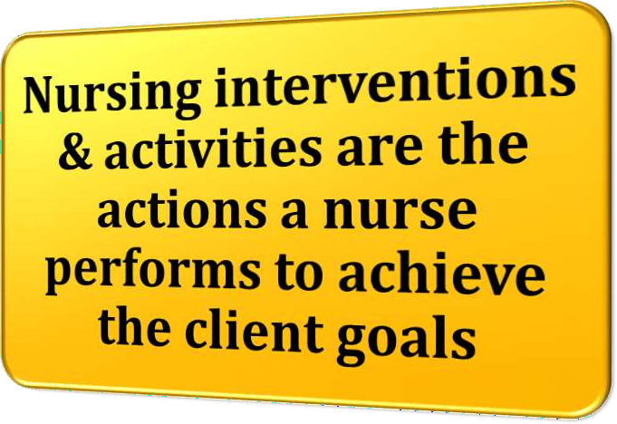

Slide 135
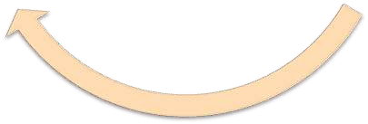
Collaborative interventions
Independent interventions
Dependent interventions

Slide 136
They include physical care, ongoing assessment, emotional support & comfort, teaching, counselling
Nurses are licensed to initiate on the basis of their knowledge & skills
It is also known as Nurse Initiated interventions

Slide 137
These | are | activities | carried | out
under | the | physicians | orders | or
supervision
It is also known as physician initiated interventions
Example:
Paracetamol for
Administer
Inj. a patients with
fever more than 101° F

Slide 138
Are the actions of nurse carries out in collaboration with other health team members, such as physical therapists, social workers, dietician & physician

Slide 139
After choosing the appropriate nursing interventions, the nurse writes them on the care plan as nursing orders
Nursing orders are instructions for the specific activities the nurse performs to help the client meet established health care goals

Slide 140
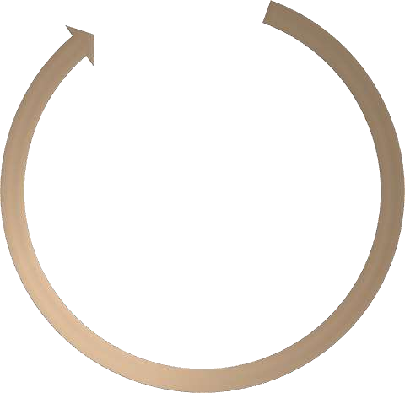
Date
Action verb
Signature
Time element
Content area

Slide 141
Nursing orders are dated when they are written and reviewed regularly at intervals that depends on the individuals need

Slide 142
The verb starts the orders and must be precise
Example:
Check the temperature of the patient
Explain the action of Tablet. Paracetamol

Slide 143
The content is the where and the what of the order

Slide 144
The time element answers when, how long or how often the nursing action is to occur

Slide 145
The signature of the nurse prescribing the order shows the nurse’s accountability and has legal significance

Slide 146
DATE | ACTION | CONTENT AREA | TIME ELEMENT | SIGNATURE
25.10.2016 | Palpate | Abdomen for firmness | Hourly x 2, then Q4H x 24 hrs | Mr. Harsha

Slide 147
It is the fourth phase of the nursing process in which the nurse puts the nursing care plan into action, continues data collection and documents the care provided

Slide 148
Assessment to make a nursing diagnosis
Assessment to gather information for a physician to make a medical diagnosis
Nurse initiated treatments in response to nursing diagnosis
Activities performed to evaluate the efforts of nursing treatments
Administrative and indirect care behaviors that support interventions

Slide 149
To implement
plan successfully, nurses need
the care
following three skills. They are
Cognitive Skills
Interpersonal Skills
Technical Skills

Slide 150
It include problem solving, decision making, critical thinking and curative thinking
It is also known as intellectual skills

Slide 151
These are all the activities, verbal & non verbal, people use when communicating directly with one another

Slide 152
These are “hands on”
skills such
as
manipulating equipment, giving injecting and bandaging, moving, lifting and repositioning clients

Slide 153
Reassessing the client
Determining the nurses need for assistance
Communicating the nursing actions
Delegating & Supervising
Implementing the nursing orders

Slide 154
Just before implementing an order, the nurse must reassess the client to make sure the intervention is still needed
Even though an order is written on the care plan, the clients condition may have changed

Slide 155
When implementing some nursing care, the nurse may require assistance for one of the following reasons:
The nurse implement
is unable to the nursing care
safely alone. Eg: Turning an obese patient in bed

Slide 156
Assistance would reduce stress on the client. Eg: Turning a person who experiences acute pain when moved
The nurse lacks the knowledge or skills to implement a particular nursing care. Eg: A student nurse is not familiar with a particular model of O2 mask need assistance the first time it is applied

Slide 157
It is important to explain to the client what will be done, what sensations to expect and what the client is expected to do

Slide 158
Nursing actions should be based on scientific knowledge, nursing research and professional standards of care
Nurses should understand clearly the orders to be implemented and question any that are not understood
Nursing actions should be adopted to the individual client
Nursing actions should always be safe

Slide 159
Nursing actions often require teaching, support and comfort
Nursing actions should be holistic
Nursing actions should respect the dignity of the client & enhance the patients self esteem
Client should be encouraged to participate actively in implementing the nursing actions

Slide 160
The nurse has two responsibilities in making work assignments:
Appropriate delegation of duties
Adequate supervision of personnel
The RN can assign some nursing care duties to an unlicensed person but cannot assign responsibility for total nursing care
Example: Assistive personnel may perform task such as measuring intake & output, but the RN is responsible for analyzing the data, planning care & evaluating outcomes

Slide 161
After carrying out the nursing orders, the nurse completes the implementing phase by recording the interventions and client responses in the nursing progress notes

Slide 162
It is the fifth and last phase of the nursing process, in which clients and health care professionals determine the client’s progress toward goal achievement and the effectiveness of the nursing care plan

Slide 163
Ongoing
Terminal
Intermittent

Slide 164
It is done while or immediately after implementing a nursing order. It enables the nurse to make on the spot modification in an intervention

Slide 165
It is performed at specified intervals ( Eg. Once a week), shows the extent of progress toward goal achievement & enables the nurse to correct any deficiencies and modify the care plan as needed

Slide 166
It indicates the clients condition at the time of discharge. It includes the status of goals achievement and evaluation of the clients self care abilities with regard to follow up care

Slide 167
Identifying desired outcomes
Collecting data
Comparing data with outcomes
Relating nursing actions to client goals/ outcomes
Drawing conclusions about problem status
Reviewing and modifying the nursing care plan

Slide 168
It is used to evaluate the client’s response to nursing care
Desired outcome serve two purposes. They are:
Establish the kind of evaluative data that need to collected
Provide a standard against which the data are judged

Slide 169
The nurse should collects both subjective and objective data so that conclusions can be drawn about whether goals have been met

Slide 170
The nurse should compare the collected data with outcomes. When determining whether a goal has been achieved, the nurse can draw one of three possible conclusions:
The goal was met
The goal was partially met
The goal was not met

Slide 171
It is determining whether the nursing actions had any relation to the outcomes
It should never be assumed that a nursing action was the cause of (or) the only factor in meeting, partially meeting (or) not meeting a goal

Slide 172
It nurse uses the judgments about goal achievement to determine whether the care plan was effective in resolving, reducing or preventing client problems

Slide 173
After drawing conclusions about the status of the clients problems, the nurse modifies the care plan as indicated
Whether or not goals were met, there are a number of decisions to make about continuing, modifying or terminating nursing care for each problem

Slide 176
Define nursing process?
List out the types of assessment?
Define diagnosis?
Enlist the types of nursing diagnosis?
What are the types of care plan?

Slide 177
Write an assignment on “NURSING PROCESS FOR PATIENTS WITH FEVER”

