Slide 1
cancer
A group of diseases characterized by uncontrolled/ unregulated growth of cells

Slide 2
Cancer incidence ;site and gender
male female
type %
Prostate 28
lung 14 14
Colon rectum 9 9
Urinary bladder 6
Uterus 6
Melanoma 5 4
Kidney/renal pelvis 5
Non-Hodgkin's lymphoma 4 4
Oropharynx 3
Ovary 3

Slide 3
Biology of cancer
2 major dysfunctions of cancer development
Defective cell proliferation
Defective cell differentiation

Slide 4
defect in cell proliferation
Cell proliferation begins from the stem cell and enters cell cycle
The time from which a cell enters cell cycle to when it divides into 2 identical cells is called generation time of the cell
A mature cell functions till it degenerates and dies

Slide 5
Cell cycle

Slide 6
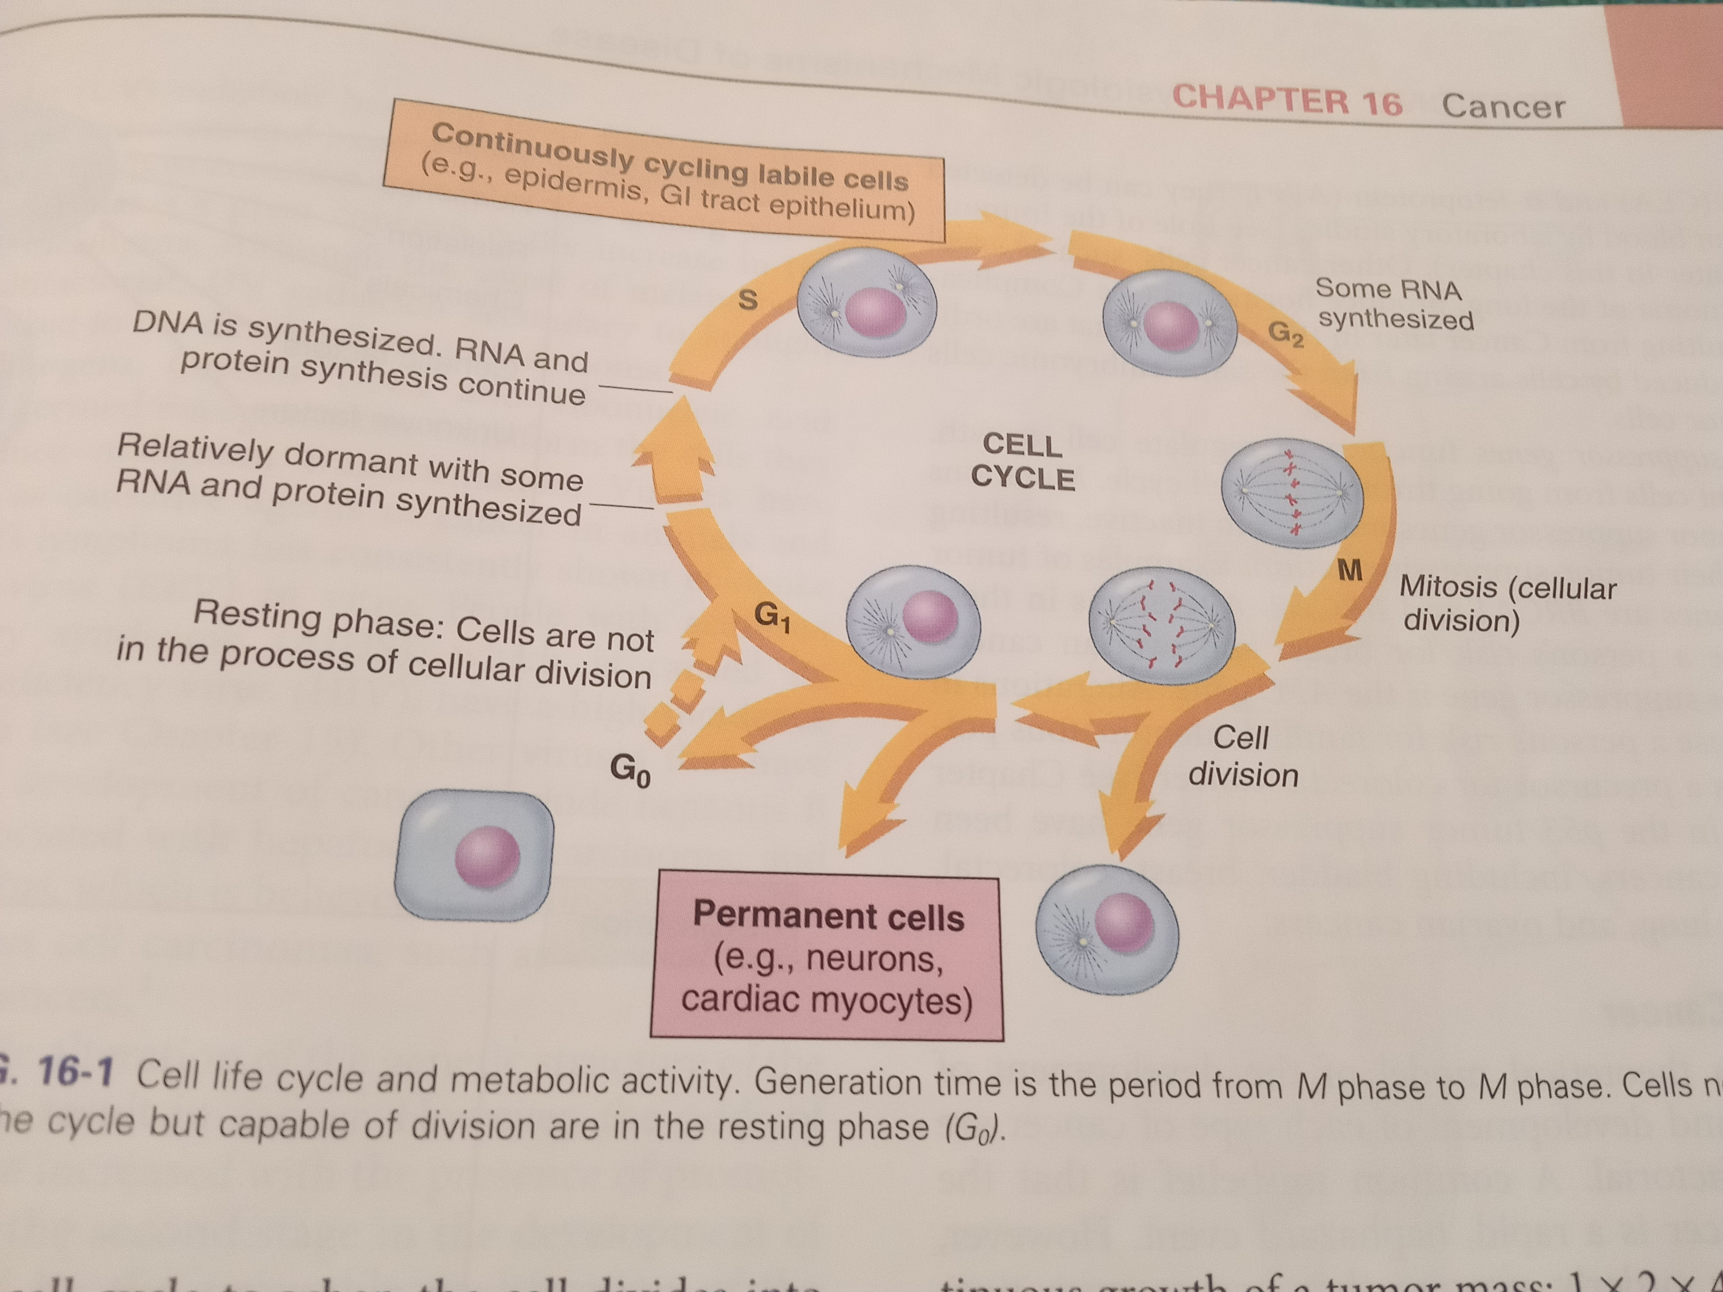
Cell cycle
Cell proliferation is controlled by intracellular mechanisms
Cell proliferating rate normally equals cell degeneration
Cell division activated when cell death occurs
Physiologic need for more cells e.g. WBC, during infection
Contact inhibition,
normal cells respect boundaries

Slide 7
Defect in cell Differentiation
Cell differentiating is an orderly process by which cells progress from immature to mature state/form
Cells mature to specialize/ preform only specific functions
In normal differentiation, cell potential is orderly locked out
The differentiated cell is stable and will not dedifferentiate
Mutations can affect tumor suppressor genes and the protooncogenes turning them into oncogenes that promote tumor growth
Protooncogenes are genetic lock that keep cells in differentiated mature functioning state/form
Oncogenes can change normal cell into a malignant one
This cell regains fetal appearance and function
Its dedifferentiated and regains potential to restart cell cycle
Tumor suppressor genes function to regulate cell growth

Slide 8
Cancer development
Mutation change in usual DNA sequence
cancer development occurs in sequence of initiation, promotion and progression
Initiation; mutation, inherited, carcinogens eg chemical, radiation, viral
Promotion; develops after initiation by presence of promoting agents
Characterized by reversible proliferation of the altered cells
An increase in altered cells further increases likelihood of additional mutations
Promoting factors , dietary fat,ciggerrate,alcohol
Progression; final stage of natural history of cancer
Increased growth rate and spread of tumor, invasiveness, metastases
Tumor angiogenesis

Slide 9
Role of immune system
Immune system has the ability to distinguish between normal(self) and abnormal (non self) cells
By means of the tumor associated antigens TAAs
Immunologic surveillance ; immune systems response to antigens of malignant cells
Involves cytotoxic T cells, natural killer cells, and macrophages and B cells
Immunologic escape is the mechanism by which cancer cells escape the immune system

Slide 10
Classification of cancer
Tumors can be classified as benign or malignant
The ability of malignant tumor to invade and metastases is the major difference between benign and malignant neoplasms
Assignment ;Compare and contrast between malignant and begin tumor

Slide 12
Tumors can also be classified according to anatomic site, histology(grading) and extent(staging)
Classification systems provide a standardized way to
- communicate the status of the cancer to all members of health care team
-assist in determining the most effective treatment plan
-evaluate the treatment plan
-predict prognosis
-compare like groups for statistical purposes

Slide 13
Anatomic classifications
Tumors identified by tissue of origin, the anatomic site and behavior of the tumor, i.e. begnin or malignant
Carcinomas originate from embryonic ectoderm ectoderm and endoderm
Sarcomas originate from the embryonic mesoderm
Lymphomas and leukemias originate from hematopoietic system
-Assignment; find out embryonic ectoderm gives rise to which tissues
- as well as endoderm ?

Slide 14
Histologic classification
Histologic grading of tumors
Evaluated pathologically based on the appearance of cells and degree of differentiation
4 grades used to evaluate many tumors , based on the degree to which abnormal cells resemble the tissue of origin
Tumors that are poorly differentiated(undifferentiated) have worse prognosis than those closer to appearance to normal tissue of origin (well differentiated)

Slide 15
Grading system
Grade 1; low grade; cells differ slightly from normal cells(mild dysplasia) and well differentiated
Grade 2 Cells are more abnormal ( moderate dysplasia), moderately differentiated, intermediate grade
Grade 3 cells very abnormal, severe dysplasia poorly differentiated high grade
Grade 4 cells are immature and primitive anaplasia and undifferentiated; cell of origin is difficult to determine, high grade
Grade x; cannot be assessed

Slide 16
Extent of disease classification
Termed as staging
Based on the anatomic extent of disease rather than cell appearance
Clinical staging determines the extent of malignancy in processes
Stage 0 cancer in situ
Stage 1tumour limited to tissue of origin; localized tumor growth
Stage 2limited local spread
Stage 3 extensive local and regional spread
Stage 4metastasis
example Leukemia do not use this staging classification

Slide 17
TNM CLASSIFICATION SYSTEM
READ ABT
Also used to determine anatomic xtent of tumor
T for tumor size and invasiveness
N, prescence or absence of lymph nodes
M Metastasis
Cant be applied to malignancies eg Luekemia; only applies to solid tumors

Slide 18
Prevention and early detection of cancer
group 1;Prepare a health talk to present to the community on the above topic
group 2;Discuss the role of a nurse in the above theme
A nurse has essential role in prevention and early detection of cancer
Eliminating risk factors reduces incidence of cancer
Early detection and prompt treatment have increased patient survival rates
egg colonoscopy in early detection of colon cancer

Slide 19
Teach the patient and public
Avoid exposure to known or suspected carcinogens
Eat balanced diet
Limit alcohol
Regular exercise
Maintain healthy weight
Adequate rest
Eliminate or reduce stressors, effective coping
Regular physical examinations to include health history, (including family history of cancer risk factors)
Follow Cancer screening guidelines e.g. for breast, colon, cervical and prostate
Learn and practice self examination
Know the 7 warning signs of cancer
Seek immediate medical care if signs present

Slide 20
Seven warning signs of Cancer
Change in bowel or bladder habits
A sore that does not heal
Sore that does not heal
Unusual bleeding or discharge from any body orifice
Thickening or lump in the breast or elsewhere
Indigestion or difficulty in swallowing
Obvious change in wart or mole
Nagging cough or hoarseness

Slide 21
Cancer diagnosis
Cytology e.g. Papanicolaou pap test, bronchial washing
Tissue biopsy
Chest x ray
Complete blood count, chemistry profile
Liver function test e.g. AST
Endoscopic examination
Radiography
Radioisotope scans
PET scan
Tumor makers e.g. PSA
Genetic markers
Molecular receptor status
Bone marrow examination

Slide 22
biopsy
The removal of tissue sample for pathologic analysis
Percutaneous biopsy for tissue easily reached through the skin
Endoscopic biopsy for intraluminal lesions and lung
When tissue/ tumor is not easily accessible a surgical procedure e.g. laparotomy, thoracotomy, craniotomy done to obtain the tumor tissue
Radiographic techniques used in conjunction with the biopsy procedure to improve tissue localization
E.g. CT, MRI, Ultrasound guided biopsy, stereotactic biopsy, fluoroscopic assisted biopsy
Various types and sizes of biopsy needles according to tissue type
Fine needle aspiration
Large core biopsy
Excision biopsy involves entire lesion surgical removal e.g. lymph node, nodule or mass
Incisional biopsy, partial excision when EXCIONAL BIOPSY NOT FEASIBLE

Slide 23
Pathologic evaluation
Done to tissue sample
The only definitive means to diagnose a malignancy
Determines whether the tissue is begin or malignant
anatomic Tissue of origin (histology)
The degree of cell differentiation (histologic grade)
Extent (size and depth of tumor)
Evidence of invasiveness
Adequacy of surgical excision( positive or negative surgical margin status)
Nuclear grade(mitotic rate) and
Special staining techniques that may provide insight on tumor treatment responsiveness, or disuse behavior
Receptor status, tumor markers

Slide 24
Treatment goals
Cure
Control
palliation

Slide 25
cure
When cure is the goal, treatment expected to eradicate the disease
Example basal cell carcinoma of the skin , by surgical removal

Slide 26
control
When the cancer cannot be completely eradicated but responsive to therapy
Just like chronic diseases e.g. dm
Example multiple myeloma, chronic lymphocytic leukemia

Slide 27
palliation
A treatment goal when relief of symptoms is goal
Using example radiation, or chemotherapy to reduce tumor size for the goal of relieving symptom such as pain of bone metastasis

Slide 28
control
Cancers that cannot be completely eradicated but responsive to anti cancer therapy
Example multiple myeloma, chronic lymphocytic leukemia
Control jus like other chronic illness e.g. dm

Slide 29
Modalities of cancer treatment
Surgical therapy
Can achieve prevention
Cure and control
Supportive and palliation
Diagnosis
rehabilitation

Slide 30
chemotherapy
Use of chemicals, to achieve
Cure control
palliation

Slide 31
Chemotherapy drugs classification
Alkylating agents
Nitrosoureas
Platinum drugs
Antimetabolites
Anti tumor antibiotics
Mitotic inhibitors
topoisomerase
Corticosteroids
Hormone therapy
miscellaneous

Slide 32
chemotherapy
Use of chemicals as systemic therapy for cancer
Mainstay cancer treatment for most solid tumors and hematologic malignancies
Can offer cure, for some cancers, control , and palliation
Fig 16

Slide 33
Effect on cells
All cells enter cell cycle for replication and proliferation
The 2 major categories of chemo therapy are ;
Cell cycle phase specific and
Cell cycle non specific
Cell cycle specific exert their effect on cells during specific phases of cell cycle e.g. phase G1, s, G2 or M
Non specific chemotherapy agents have their effect on cells during all phases of cell cycle

Slide 34
Chemotherapy preparation
Guidelines for safe handling of chemotherapy agents and training necessary for all professionals involved , to prevent occupational hazards

Slide 35
Administration methods
Route include iv, main, central vein to minimize physical discomfort, infiltration/ extravasation, and risk of infection and emotional distress
Central Venus Access Devise CVAD, placed in large vessel, used in continuous or intermittent administration
Regional administration
Intraarterial
Intraperitoneal
Intrathecal
Intravesical bladder chemotherapy

Slide 36
Chemotherapy administration
The iv route most common
Regional; directly to tumor site with reduced systemic toxicity
Intraarterial; delivers the drug to the tumor via the artery supplying the tumor
Intraperitoneal;
Intrathecal for CNS
Intravesical

Slide 37
Topical 5FU cream

Slide 38
Routes / methods of Chemotherapy Administration
Oral
Cyclophosphamide, …table

Slide 39
Effects of Chemotherapy on normal tissue
Mainly affect cells with rapid rate of proliferation
Acute effects
Delayed
Chronic
Read more. Abt the effects

Slide 40
Radiation therapy
Electromagnetic radiation, high energy ionizes atomic particles , breaks the chemical bonds in DNA
Ionizing radiation interrupts cellular growth
Used for cure, control, or for prophylaxis of cancer
Palliative radiation relieve symptoms of metastatic cancer
Treatment of oncologic emergencies e.g. superior vena cava syndrome, or spinal cord compression

Slide 41
Types of ionizing radiation
Electromagnetic rays; x rays, & gamma rays
and
particles,
electrons, protons, and neutrons

Slide 42
effect
Tissue disruption by alteration of DNA molecule
Ionizing radiation breaks the DNA helix/ strand leading to cell death
Also ionize body fluid constituents forming free radicles damaging DNA irreversibly
Cells are most vulnerable to radiation during DNA synthesis, and Mitosis( early S, and G2, and M phases of cell cycle)
Body tissues that undergo frequent cell division are most sensitive.
A radiosensitive tumor is one that can be destroyed by a dose of radiation that still allows regeneration of normal tissue cells

Slide 43
Methods/ means of radiation delivery
External and internal radiation

Slide 44
External radiation
Also called beam radiation or Teletherapy
Most common form of radiotion treatment delivwery
A linear accelerator or a megavoltage machine generates ionizing radiation

Slide 45
Internal radiation (or brachytherapy)
Involves implantation of a radioactive matrial directly into tumor interstitial or in close proximity to the tumour
May be used as primary therapy or as an adjunct therapy to boost other treatment or supplement teletherapy
Iridium 192, cesium137 are examples of radiation sources/ isotopes used
As interstitial seeds, or ribbons
May be delivered as high dose or lowdose radiation
Used commonly for head, neck, breast and gynelogical malignancies

Slide 47
Surgery as primary treatment
When surgery is the primary approach in cancer treatment; the goal is to remove the enterer tumor and any involved surrounding tissue; as much as possible/feasible
A procedure Also called debulking
2 procedures; local and wide excision
Local excision when the mass is small
Removes mass and a small margin of normal tissue at risk of tumor spread
Wide or radical excisions en-bloc dissections , remove primary tumor, lymph nodes and adjacent involved structures
Can result in disfigurement and altered functioning
Wide excision is considered if chances of cure or control are good

Slide 48
Read about video assisted endoscopic surgery

Slide 49
Diagnostic surgery
E.g. biopsy, performed to obtain tissue sample foe analysis
A biopsy is taken from actual tumor
Excisional, Incisional, and needle methods are the common methods used
Also nearby lymph nodes are also biopsied for analyzing metastasis
Choice of biopsy method is based on factors such as type of treatment anticipated, site, grading etc.
Patient and family discuss options,

Slide 50
Prophylactic surgery
Involves removing non vital tissue or organ likely to develop cancer
prophylactic cancer surgeries include;
Colectomy, mastectomy, oophorectomy., appendectomy,
Based on family/genetic history,
Symptoms, risks versus benefits, early detection, acceptance of post operative outcome

Slide 51
Palliative surgery
When cure not possible, the goal is to achieve patient comfort, promote productive and satisfying life as long as possible
Quality of life is the goal whether short or long
Honest and informative communication with the patient and family about this goal is key

Slide 52
Reconstructive/ rehabilitative surgery
May follow curative or radical diagnostic surgery;
To improve function or for cosmetic purposes

Slide 53
Read abt nursing management in cancer surgery
NB; general perioperative care applies
Goes along with specific considerations on age, organ impairment, nutritional deficits , coagulation , immunity; risking for complications
Psychosocial concerns, anxiety as in out come of diagnostic surgery

