Slide 1
OPHTHALMOLOGY

Slide 2
Course outline
Ophthalmic procedures
Inspecting the eye
Measuring visual acuity
Instilling drops and ointment,applying eye ointment,taking conjunctival swab,removing foreign body from conjuctiva

Slide 3
conditions
Refractive errors
Conjuctivitis, keratitis,uveitis,cataract,choroiditis,
Blepharitis,stye, retinitis, glaucoma
Eye tumours
trachoma

Slide 5
Functions of the various parts of the eye
Cornea: the clear front window of the eye. The cornea transmits and focuses light into the eye.
The sclera( white of the eye) helps to maintain the shape of the eyeball and protects the intraocular contents from trauma
Iris: the colored part of the eye. The iris helps regulate the amount of light that enters the eye.
Lens: the transparent structure inside the eye that focuses light rays onto the retina. It is avascular and has no nerve or pain ﬁbers. The lens enables focusing for near vision and refocusing for distance vision. The ability to focus and refocus is called accommodation.
.

Slide 6
Macula: a small area in the retina that contains special light-sensitive cells. The macula allows us to see fine details clearly.
Optic Nerve: the nerve that connects the eye to the brain. The optic nerve carries the impulses formed by the retina to the brain, which interprets them as images.
Pupil: the dark center in the middle of the iris. The pupil determines how much light is let into the eye. It changes sizes to accommodate for the amount of light that is available.
Behind the cornea lies the anterior chamber, ﬁlled with a continually replenished supply of clear aqueous humor, which nourishes the cornea

Slide 7
Retina: the nerve layer that lines the back of the eye. The retina senses light and creates impulses that are sent through the optic nerve to the brain.
Vitreous humor. : the clear, jelly-like substance that fills the middle of the eye. helps maintain the shape of the eye
The uvea consists of the iris, the ciliary body, and the choroid.
conjunctiva, which is a thin, transparent, mucous membrane that contains ﬁne blood vessels
choroid lies between the retina and the sclera. It is a vascular tissue, supplying blood to the portion of the sensory retina closest to it.
Good visual acuity depends on a healthy, functioning eyeball and an intact visual pathway

Slide 8
VISION
Vision begins when light rays are reflected off an object and enter the eyes through the cornea, the transparent outer covering of the eye. The cornea bends or refracts the rays that pass through a round hole called the pupil. The iris, or colored portion of the eye that surrounds the pupil, opens and closes (making the pupil bigger or smaller) to regulate the amount of light passing through.

Slide 10
The light rays then pass through the lens, which actually changes shape so it can further bend the rays and focus them on the retina at the back of the eye. The retina is a thin layer of tissue at the back of the eye that contains millions of tiny light-sensing nerve cells called rods and cones, which are named for their distinct shapes. Cones are concentrated in the center of the retina, in an area called the macula.

Slide 11
In bright light conditions, cones provide clear, sharp central vision and detect colors and fine details. Rods are located outside the macula and extend all the way to the outer edge of the retina. They provide peripheral or side vision. Rods also allow the eyes to detect motion and help us see in dim light and at night. These cells in the retina convert the light into electrical impulses. The optic nerve sends these impulses to the brain where an image is produced.

Slide 12
Assessment of an ophthalmic patient
Hx taking
Is visual acuity diminished?
Hx of blurred, double, or distorted vision?
Presence of pain; is it sharp or dull; is it worse when blinking?
HX of discomfort an itching sensation or more of a foreign body sensation
Are both eyes affected? •
Is there a history of discharge• What is the duration of the problem?
• Is this a recurrence of a previous condition?, How has the patient self-treated?
Aggrevating factors? •presence of any systemic diseases?
medications are used in their treatment??
Hx of ophthalmic surgery
family hx of the same symptoms or condition?

Slide 13
Observations to be made
Discharge and type
Eye lashes-crusted
Eye lids-swollen and tender
Conjunctiva- white/pale, inflamed, yellow..
Cornea-normally transparent. May be hazy or opaque
Pupil-take note of shape and size
photophobia

Slide 14
Lacrimation
Anterior chamber-aqueous humor may be hazy

Slide 15
Physical examination
Explain the assessment technique
Use a room free of interruptions
Sufficient light
Place the patient on an upright position
You should be able to visualize the underlying structures
Always compare left and right eyes

Slide 16
Equipment
Ophthalmoscope
Pen light/torch
Clean gloves
Vision occluder
Cotton tipped applicator
Snell’s chart/E chart/pictorial chart

Slide 17
Occular examination
Visual acuity
it is a measure of the ability of the eye to distinguish shapes and details of objects at a given distance
Distant vision is tested with a chart with differently sized letters read from a distance of(20 feet) six metres away. Using the Snellen’s chart.
The patient is positioned at the prescribed distance, usually 20 feet, from the chart and is asked to read the smallest line that he or she can see

Slide 18
Visual acuity is expressed as a fraction, the top number (numerator) representing the distance in meters the patient is from the chart (usually 6 meters) and the bottom (denominator) indicating the distance at which the smallest letters read by the patient, that should be read by the normal eye. For example;
each eye should be tested separately.

Slide 19
Snellen Chart

Slide 20
Patients should be encouraged to read more letters and to guess, if necessary.
. The patient should be encouraged to read every letter possible. The visual acuity (VA) is recorded in the following way. If the patient reads all ﬁve letters from the 20/20 line with the right eye (OD) and three of the ﬁve letters on the 20/15 line with the left eye (OS), the examiner writes OD 20/20, OS 20/15-2, or VA 20/20, 20/15-2.
If the patient is unable to read the largest letter on the chart (the 20/200 line), the patient should be moved toward the chart or the chart moved toward the patient, until the patient is able to identify the largest letter on the chart. If the patient can recognize only the letter E on the top line at a distance of 10 feet, the visual acuity would be recorded as 10′/200.

Slide 21
. If the patient is unable to read the 20/20 line, he or she is given a pinhole occluder and asked to read again using the eye in question
If the patient is unable to reads the top line even from one metre,he/she is asked to count fingers of the examiner and his vision is recorded as e.g. count fingers 2 i.e. the distance between you and the patient is 2 metres or count fingers face.
Abbreviated as CF 2,CF 3 or at the face.

Slide 22
When the patient fails to count fingers, the examiner moves his hand close to the patients face. If he can appreciate the hand movements, his visual acuity is recorded as HM positive.
When the patient cant distinguish hand movements, the examiner notes whether the patient can perceive light.
If yes, vision is recorded as PL positive, if no,PL negativeNPL.

Slide 23
THE EXTERNAL EYE EXAMINATION
The following is examined
The position of the eyelids is noted.
. The patient is examined for ptosis (ie, drooping eyelid) and for lid retraction (ie, too much of the eye exposed). Sometimes, the upper or lower lid turns out, affecting closure.
The lid margins and lashes should have no edema, erythema, or lesions.
scaling or crusting, and the sclera is inspected.
A normal sclera is opaque and white
. Lesions on the conjunctiva, discharge, and tearing or blinking are noted.
..

Slide 24
. pupillary response should be checked with a pen- light to be certain that the pupils are equally reactive and regular A normal pupil is black.
. The patient’s eyes are observed in primary or direct gaze, and any head tilt is noted. A tilt may indicate cranial nerve palsy.
nystagmus (ie, oscillating movement of the eyeball).
The extraocular movements of the eyes are sim- ply tested by having the patient follow the examiner’s ﬁnger or hand light through the six cardinal directions of

Slide 25
ptosis

Slide 26
Visual fields(PERIMETRY)
The visual field refers to the total area in which objects can be seen in the side (peripheral) vision while you focus your eyes on a central point.

Slide 27
How it is done
Confrontation visual field exam: This is a quick and basic check of the visual field. The health care provider sits directly in front of you. You will cover one eye, and stare straight ahead with the other. You will be asked to tell when you can see the examiner's hand.

Slide 28
Manual perimetry
involves the use of moving (kinetic) or stationary (static) stimuli or targets.
kinetic manual perimetry i.e Tangent screen or Goldmann field exam: You will sit about 3 feet from a screen with a target in the center. You will be asked to stare at the center object and let the examiner know when you can see an object that moves into your side vision. This exam creates a map of your entire peripheral vision.

Slide 29
Automated perimetry: uses stationary targets.You sit in front of a concave dome and stare at an object in the middle. You press a button when you see small flashes of light in your peripheral vision. Your responses help determine if you have a defect in your visual field.
OR
a computer projects light randomly in different areas of a hollow dome while the patient looks through a telescopic opening and depresses a button whenever he or she detects the light stimulus.

Slide 30
INTERNAL EYE
Is tested using the ophthalmoscope
Diagnostic tests
Ophthalmoscopy
Is a test that allows a health professional to see inside the fundus of the eye and other structures using an ophthalmoscope (or funduscope). It is done as part of an eye examination and may be done as part of a routine physical examination. It is crucial in determining the health of the retina and the vitreous humor.

Slide 31
Types
The direct ophthalmoscope is hand held instrument with several lenses that can magnify up to about 15 times. most commonly used during a routine physical examination.
The examiner holds the ophthalmoscope in the right hand and uses the right eye to examine the patient’s right eye. The examiner switches to the left hand and left eye when examining the patient’s left eye. During this examination, the room should be darkened, and the patient’s eye should be on the same level as the examiner’s eye.

Slide 32
ct
Examiner should assess for:
Vasculature, leisons,
Intraretinal haemorrhage, lipid incase of hypercholestremia, microaneurysms and drusens(small, hyaline, globular growth)

Slide 33
An indirect ophthalmoscope. It produces a bright and intense light. The light source is afﬁxed with a pair of binocular lenses, which are mounted on the examiner’s head. The ophthalmoscope is used with a hand-held, 20-diopter lens .it allows a better view of the fundus of the eye, and to see larger areas of the retina
Slit-lamp ophthalmoscopy:. The slit lamp is a binocular microscope mounted on a table. This instrument enables the user to examine the eye with magniﬁcation of 10 to 40 times the real image.By varying the width and intensity of the light, the anterior chamber can be examined for signs of inﬂammation. Cataracts may be evaluated by changing the angle of the light

Slide 34
Direct opthalmoscopy

Slide 35
Indirect opthalmoscopy

Slide 36
Slit-lamp ophthalmoscopy

Slide 37
TONOMETRY
Measures intraocular pressure (IOP). Normal pressure is 11-22 mm Hg
This test is used to check for glaucoma, an eye disease that can cause blindness by damaging the nerve in the back of the eye (optic nerve). Damage to the optic nerve may be caused by a buildup of fluid that does not drain properly out of the eye.
measures IOP by recording the resistance of your cornea to pressure (indentation). Eye drops to numb the surface of your eye are used.

Slide 38
uses a small probe to gently flatten part of your cornea to measure eye pressure and a microscope called a slit lamp to look at your eye. The pressure in your eye is measured by how much force is needed to flatten your cornea.

Slide 40
GONIOSCOPY
visualizes the angle of the anterior chamber to identify abnormalities in appearance and measurements. The gonioscope uses a refracting lens that can be a direct or indirect lens. The indirect lens views the mirror image of the opposite anterior chamber angle and can be used only with a slit lamp. The direct gonioscopic lens gives a direct view of the angle and its structures

Slide 41
COLOR VISION TESTING
alteration in color vision is sometimes indicative of conditions of the optic nerve,
color vision testing is often performed in a neuro-ophthalmologic workup. The most common color vision test is performed using Ishihara polychromatic plates.
These plates are bound together in a booklet. On each plate of this booklet are dots of primary colors that are integrated into a background of secondary colors. The dots are arranged in simple patterns, such as numbers or geometric shapes.
Patients with diminished color vision may be unable to identify the hidden shapes. Patients with central vision conditions (eg, macular degeneration) have more difﬁculty identifying colors than those with peripheral vision conditions (eg, glaucoma) because central vision identiﬁes color.

Slide 42
Ultrasonography
Lesions in the globe or the orbit may not be directly visible and are evaluated by ultrasonography. A probe placed against the eye aims the beam of sound. High-frequency sound waves emitted from a special transmitter are bounced back from the lesion and collected by a receiver that amplifies and displays the sound waves on a special screen.
Ultrasonography can be used to identify orbital tumors, retinal detachment, and changes in tissue composition

Slide 43
COLOR FUNDUS PHOTOGRAPHY
Technique used to detect and document retinal lesions. The patient’s pupils are widely dilated during the procedure, and visual acuity is diminished for about 30 minutes due to retinal “bleaching” by the intense ﬂashing lights.
FLUORESCEIN ANGIOGRAPHY
Evaluates clinically signiﬁcant macular edema, documents macular capillary nonperfusion, and identiﬁes retinal and choroidal neovascularization

Slide 44
REFRACTIVE ERRORS
In refractive errors, vision is impaired because a shortened or elongated eyeball prevents light rays from focusing sharply on the retina.
Patients for whom the visual image focuses precisely on the macula and who do not need eyeglasses or contact lenses are said to have emmetropia (normal vision).
myopia are said to be nearsighted. They have deeper eye- balls; the distant visual image focuses in front of, or short of, the retina. Myopic people experience blurred distance vision.
Corrected by concave lens

Slide 45
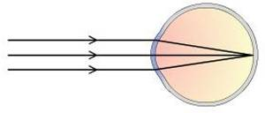
the.
Emmetropia/ NORMAL VISION. Parallel rays of light enter the eye through the cornea and are refracted to a precise point on the retina(macula).

Slide 46
HYPEROPIA
Farsightedness
is a defect of vision caused by an imperfection in the eye (often when the eyeball is too short or the lens cannot become round enough), causing difficulty focusing on near objects, and in extreme cases causing a sufferer to be unable to focus on objects at any distance
Corrected by convex lenses
Causes: sinus infections, injuries, migraines, aging or genetics.

Slide 47
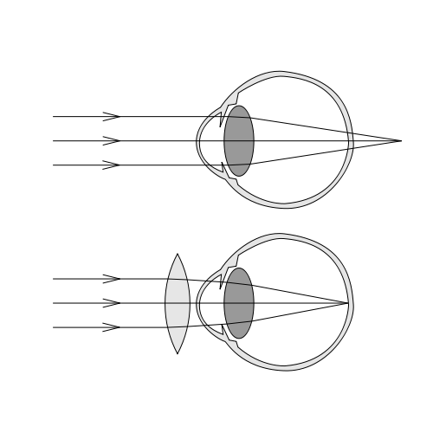
11
HYPEROPIA/HYPERMETROPIA/LONG SIGHTEDNESS. Lens is too close to the retina. Light rays converge at a point beyond the retina
CORRECTED HYPEROPIA
Convex lens

Slide 48
MYOPIA
Nearsightedness
is a condition of the eye where the light that comes in does not directly focus on the retina but infront of it.
This causes the image that one sees when looking at a distant object to be out of focus but in focus when looking at a close object.
Corrected by Concave lens

Slide 49
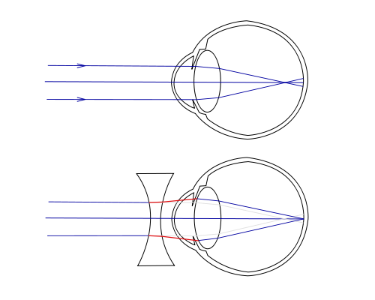
MYOPIA/SHORT-SIGHTEDNESS
Lens is too far away from the retina. Light rays converge in front before they reach the retina.
CORRECTED MYOPIA
Biconcave lens

Slide 50
PRESBYOPIA
As we grow older (above 40 years) our cilliary muscles become less elastic and cannot readily accommodate to distant and near vision.( thus occur when the elasticity of the ciliary muscles is reduced).
Leads to failing vision of near.
This is known as presbyopia (old sight). Bifocal glasses are usually prescribed to allow for two sets of lenses in one pair of glasses, one set for viewing distant objects and one for seeing close objects (Near vision not complete)

Slide 51
ASTIGMATISM
Is a visual defect resulting from
Uneven lens or
Irregular curve of the cornea
Either prevents the horizontal and vertical light rays from focusing at the same point on the retina.
causes a distortion of the visual image, acuity of distance and near vision can be decreased
Treatment
Prescription of contact lenses.
Fitting of glasses with a cylinder correction, so that light rays are brought into focus on the retina

Slide 52
STRABISMUS (SQUINT/AMBLYOPIA
(crossed eye)failure of the eye to look in the same direction at same time
Normally the axes of both eyes fall together on the same point of the object being looked at. In cases of strabismus they do not, as one eye is directed away from this point. caused by weakness of muscles of one eye.

Slide 53
NOTE: a child will not grow out of a squint-the longer it is left the more difficult it is to cure.
Causes
Paralysis due to damage to the nerves supplying the extrinsic muscles of the eyeball.
Mal-development or faulty insertion of one group of muscles
Cogenital, tumour
Uncorrected refractive error
Deflective vision in an eye(corneal scar/congenital cataract).
Eye strain( in prolonged exertion of the cilliary muscles of accommodation) (far sightedness)

Slide 54
Types
Esotropia- inward turning
Exotropia- outward turning
Hypertropia- upward turning
. Treatment
Covering of the normal eye to prevent double vision and make the child use the lazy eye.
Surgery to correct muscular deformity and return them to single vision.
Orthoptics (eye exercises) after surgery to improve the affected eye in its function of sight.
Corrective spectacles for refractive error.

Slide 55
KERATITIS
Keratitis is a condition in which the eye's cornea the front part of the eye, becomes inflamed. The condition is often marked by moderate to intense pain and usually involves impaired eyesight. May cause feelings of scratching each time individual blinks eye.

Slide 56
Signs and symptoms
Signs and symptoms
Pain
Excessive lacrimation (due reflex hyper lacrimation)
Blurred vision
Redness of eyes(occurs due to congestion of circumcorneal vessels.)
Photophobia, results from stimulation of nerve endings
Swollen lids
On examination
cloudy cornea
Signs of infection/inflammation

Slide 57
causes
Injury
Contaminated contact lenses- bacteria,fungi may inhabit the surface of contact len.cornea may become contaminated when lens is the eye
Viruses i.e herpes simplex
Bacteria that causes gonorrhea
Contaminated water

Slide 59
Management
Topical antifungal eye drops should be used for a long period (6 to 8 weeks).
These include; natamycin (5%) eye drops, fluconazol (0.2%) eye drops, nystatin (3.5%) eye ointment.
Systemic antifungal drugs may be required for severe cases of fungal keratitis.
Topical antibiotics as eye drops by day and ointment at night.
Viral keratitis –antiviral eyedrops and oral antiviral medications
Acanthamoeba keratitis-antibiotic eyedrops or corneal transplant.it may be difficult to treat

Slide 60
Systemic analgesics and anti-inflammatory drugs such as paracetamol and ibuprofen relieve the pain and decrease edema.
Vitamins (A, B-complex and C) help in early healing of ulcer.
Local application of warm moist compresses heat gives comfort, reduces pain and causes vasodilatation.
Dark goggles may be used to prevent photophobia.
Rest, good diet and fresh air may have a soothing effect.

Slide 61
INFLAMMATIONS OF THE EYE
CONJUCTIVITIS(pink eye)
This is inflammation of the conjunctiva, the mucous membrane lining, the upper and lower lids and covering the front of the eye.
Causes
Infections
Allergy
Trauma
Physical irritants
Chemical injury

Slide 62
BACTERIAL CONJUNCTIVITIS
Causes
Staphylococcus
Streptococcus
Pneumococcus
Gonococcus (requires isolation)
Haemophilus influenzae(koch-weeks bacillus)

Slide 63
”
Signs and symptoms
Redness of the conjunctiva
Swelling of the conjunctiva
Itching and burning sensation
Photophobia
Purulent discharge with crusts of dried exudates causing
A feeling of grittiness

Slide 64
Diagnosis
Through opthalmoscopy
Eye swab for culture and sensitivity
Management
Isolation to prevent spread especially of “pink eye” which is very infectious and common among school children.
Immediate treatment depending on culture and sensitivity of the organism causing the infection with;
Ointments -tetracycline 1%
Eye drops e.g. tetracortil, chloramphenicol (chloromycetin)

Slide 65
Management cont’
Systemic antibiotics (especially penicillin)
Warm or cold moist compresses
Irrigations with normal saline to remove exudates and relieve itching and burning
Follow-up on discharge
Health messages
Use of clean, individualized items (face cloths and towels)
Hygiene –keeping eyes clean by washing daily. Avoid touching them with dirty hands.

Slide 66
Viral conjunctivitis
can be acute and chronic.
The common causative organisms are adenovirus and herpes simplex virus.
The symptoms - extreme tearing, redness, foreign body sensation, watery discharge, follicles are prominent, Severe cases include pseudomembranes
It is usually preceded by symptoms of URTI.
Corneal involvement causes extreme photophobia. There is lid edema, ptosis, conjunctival hyperemia ,
These signs and symptoms vary from mild to severe and may last for 2 weeks. tends to last longer than bacterial conjunctivitis.

Slide 67
ALLERGIC CONJUNCTIVITIS
It is inflammation of conjuctiva due to hypersensitivity reaction.
The patient usually has a history of an allergy to pollens and other environmental allergens.
There is extreme itching, epiphora (ie, excessive secretion of tears), severe photophobia,stringlike mucoid discharge,formations of papillae that have a cobblestone appearance.
It is more common in children and young adults. Most affected individuals have a history of asthma or eczema.

Slide 68
management
Steroid eye drops
Vasonstrictor ie naphalozine
Sodium chromoglycate
Non steroidal antiallergic drugs

Slide 69
Inclusion conjunctivitis
affects sexually active young people who have genital chlamydial infection. Transmission is by oral- genital sex or hand-to-eye transmission.
indirect transmission has been acquired from inadequately chlorinated swimming pools. The eye lesions usually appear a week after exposure and may be associated with a nonspeciﬁc urethritis or cervicitis. The discharge is mucopurulent, follicles are present, and there is lymphadenopathy.

Slide 70
TRACHOMA
It is a spefic type of chronic conjuctivitis caused by chlamydia trachomatis.
It is the greatest single cause of serious and progressive loss of sight in the world, often leading to blindness..
It is contangious spreading through contact with eyes,eyelids, nose/throat secretions of infected people.it can be passed on by handling infected items.
Transmission – Flies, Fingers, Formites (towels etc)
Its occurrence is associated with poor socioeconomic status,poor sanitation,& hygiene,In Dry, Dusty & Dirty areas

Slide 71
Risk factors
Crowded living conditions
Poor sanitation
Age most common in children
Sex-women more affected
Areas with problems of controlling flies

Slide 72
Trachoma
WHO Five stages of development of trachoma
Inflammation-follicular- beginning of infection .five of more follicles appear on inner surface(tarsal)of upper eye lid.
Trachomotous inflammation intense- eye highly Infectious.there is pronounced thickening or swelling of upper tarsal(eyelid)
Eye lid scarring- repeated infections leads to scarring of the upper inner eyelid(tarsal).eyelid become distorted and may turn inward(entropion)

Slide 73
iv. Trachomatous trichiasis(ingrown eyelashes)- the scarred innerlining of eyelid continue to deform causing eye lashes to turn in and rub with the cornea
V. Corneal clouding(opacity)- cornea is affected by inflammation and it is seen under the eye lid. in turned eyelashes leads to clouding of cornea

Slide 74
Signs and symptoms
Irritation of the eye lids and itching,
swollen eye lids
Very red eye
Eye disharge containingpus or mucus
Photophobia and eye pain
Large follicles form in the conjunctiva, cornea and eyelids giving a granular appearance, causing thickening and congestion
The lining of the eyelids and cornea becomes scarred(herbets pits)
There is corneal ulceration and opacity

Slide 76
preventition
Face washing
Handwashing
Fly control
Poor waste management
Improved access to water

Slide 77
Management
Isolation of known cases
Antibiotic therapy to control the disease. 10 day antibiotics to make individual Chlamydia free.
Topical therapy- Local 1% tetracucline,1%erythromycin/ eye ointment for 6weeks
Systemic therapy- tetracycline or erythromycin,doxycycline per oral,azithromycin
Combined topical and systemic therapy in very severe cases
Expressing the contents of follicles
Surgeryin advanced stages i.e entropion caused by chronic disease where lid surgery is effective in everting the eye lid, correction of trichiasis to prevent conjunctival scarring

Slide 78
Hygienic measures-
health education on ocular hygiene.the use of common towel should be discouraged
Clean environment to reduce the fly population
Frequent face washing: the flies are less likely to be attracted to the child and the infected person is less likely to spread chlamydia by direct contact
Good water supply will reduce the symptoms

Slide 79
Management
Saline irrigations to remove discharge
Warm compresses for 15 minutes 4 times a day
Care must be taken to prevent spread of the infection to the other eye or other people by using clean hands and individualized items.
S-surgery
A-antibiotic
F-facial cleanliness
E-environmental cleaniliness

Slide 80
UVEITIS
The uveal tract comprises of , the iris, the cilliary body, the choroid. Inflammation of the various parts is called
Iritis: usually unilateral, characterized by pain, photophobia, blurring of vision, redness (circumcorneal flush) and constricted pupil.
Cyclitis (cilliary body)
Choroiditis (choroid)
Panuveitis involves the entire uveal tract.
Causes
Exogenous: from without e.g.. in direct infection from perforating injury i.e.. exogenous uveitis(trauma,toxins,allergy)
Endogenous: from within e.g. allergy through blood stream i.e. endogenous uveitis.

Slide 81
As a reaction to other local eye diseases e.g. scleritis
Infective organisms- bacteria, viruses, fungi, protozoa
Non ineffective systemic diseasei.e dm, rheumatoid athritis
Signs/symptoms
Iritis- blood vessels of the conjunctiva around the cornea are inflamed (circumcorneal flush).
The iris is inflamed, swollen and the pupil small. This may lead to adhesions between the posterior surface of the iris and the lens causing contraction of the pupil.

Slide 82
2. Inflammatory cells appear in the chamber, and if profuse, an exudate may be seen with the naked eye.
3. Purulent discharge
4. Photophobia
5. Headache
6. Pain (if severe, may be a complication into glaucoma)
7. Impaired vision
8. Choroiditis: inflammatory cells enter the vitreous humour producing a cloudy vision

Slide 83
Treatment
Of the systemic cause- if bacterial, antibiotics etc.
Local treatment- atropine drops to dilate the pupil and keep it dilated
Local and systemic corticosteroids
Prognosis
Non-granulomatous uveitis subsides with treatment in a few weeks though it takes a more acute course.
Granulomatous uveitis may last for months or years – usually chronic

Slide 84
DISEASES OF THE EYELID

Slide 85
BLEPHARITIS
Def: Chronic bilateral inﬂammation of the eyelid margins.
Usually occurs when tiny oil glands near the base of the eye lashes become clogged causing irritation and redness

Slide 86
.
classification
Ulcerative (staphylococcal infection). is usually ulcerative and is more serious due to the involve- ment of the base of hair follicles.
Signs and symptoms- yellow crust formation at root of cilia,small ulcers that bleed easly,irrritation,lacrimation

Slide 87
.
b) Seborrheic Blepharitis.
Occurs in patients with seborrheic dermatitis. It is characterized by oily skin and flaking from the scalp or brows. There is excessive lipid secretion on the eyelid margins which are broken down by special bacteria called Corynebacterium acnes. The breakdown products will cause inflammation of the eyelid margin.
Symptoms- redness and swelling of lid margins,irritation,lashes fall out frequently

Slide 88
causes
Suborrheic dermatitis
Infection
Clogged glands
Allergies
Dry eyes
Eye lash mites

Slide 89
CLINICAL FEATURES
Itchy eyelids
Redness of eyelids
greasy eye lids
Eye lid sticking
Flaking of skin on the lids.
Crusting at the lid margins, this is generally worse on waking.
Cysts at the lid margin (hordeolum).

Slide 90
CLINICAL FEATURES
Red and watery eye.
Gritty sensation of the eye.
Reduced vision
Tears that are frothy or bubbly in nature,
Eyelashes that grow abnormally,
Loss of eyelashes.

Slide 91
Management of blepharitis
A complete blepharitis cure may not exist.
Good eyelid hygiene and prescription medicine are often effective in managing blepharitis.
Drugs
antibiotics,steroids,medication that act on immune system(cyclosporine)
Treat underlying conditions
The single most important treatment principle is a daily routine of lid margin hygiene

Slide 92
- It involves:
Soften lid margin debris and oils: Apply a warm wet compress to the lids -- such as a washcloth with hot water -- for five to 10 minutes two to four times a day, to losen the crusty deposits..
Mechanically remove lid margin debris: After using the compresses, cleanse the eyelids with a cotton applicator stick soaked in a 4 to 1 mixture of water and baby shampoo or an over-the-counter lid-cleansing product. To wash away oily debris or scales at the base of eyelashes.
Rinse eyelids with warm water and pad with clean dry towel.

Slide 93
cont. Gently and repeatedly rub along the lid margins while the eyes are closed. Be careful to avoid rubbing or scratching your eyes.
2. Limiting or stopping the use of eye makeup, as its use will make lid hygiene more difficult or reintroduce bacteria.
3. If the patient wears contact lenses, he/she may have to temporarily discontinue wearing them during treatment.
4. If the patient has dandruff, use of a dandruff shampoo may help alleviate the symptoms.
5.Lubricate eyes by over the counter artificial tears

Slide 94
6. If bacterial infection is the cause, antibiotic drops or ointment and other medications may be prescribed along with eyelid hygiene
7.Depending on the degree of inflammation of the lid margin, a combination of topical antibiotic and steroid drops or ointments can be prescribed.
8. If the blepharitis is secondary to acne rosacea(redness due to chronic dilatation of the subcutaneous capillaries which become permanent with the formation of pustules in the affected areas), treatment with oral doxycycline together with lid-margin hygiene routine may be prescribed.

Slide 95
9 . If the blepharitis is due to allergy, identify and reduce the exposure to the offending agent. Prescription and over-the-counter drop or oral antihistamines may be used.
10. Recently, there has been some evidence that oral omega-3 fatty acids may be helpful in the treatment of blepharitis.

Slide 96
Complications
Eyelash problems. Eyelashes fall out or grow abnormally (misdirected eyelashes).
Eyelid skin problems. Scarring may occur on eyelids in response to long-term blepharitis.
Excess tearing or dry eyes. Abnormal oily secretions and other debris shed from the eyelid, such as flaking associated with dandruff, can accumulate in the tear film — the water, oil and mucus solution that forms tears. Abnormal tear film interferes with the healthy lubrication of the eyelids. This can irritate the eyes and cause dry eyes or excessive tearing.

Slide 97
Difficulty wearing contact lenses. By affecting the amount of lubrication in your eyes, wearing contact lenses may be uncomfortable.
Sty:
Chalazion: Occurs when there's a blockage in one of the small oil glands at the margin of the eyelid, just behind the eyelashes. The gland can become infected with bacteria, which causes a red, swollen eyelid. Unlike a sty, a chalazion tends to be most prominent on the inside of the eyelid.

Slide 98
Chronic pink eye. Blepharitis can lead to recurrent bouts of pink eye (conjunctivitis).
Injury to the cornea. Constant irritation from inflamed eyelids or misdirected eyelashes may cause a sore (ulcer) to develop on your cornea. Insufficient tearing could predispose you to a corneal infection.

Slide 99
STY (EXTERNAL HORDEOLUM)
Small painful lump at the edge of the eye lid.affects gland and follicles.it
Cause: staphylococcal infection of a follicle of the eyelash from blocked gland
Predisposing factors:
General poor health
Wearing of glasses
Chronic phlebartis
Habitual rubbing of eyes
Signs and symptoms
Inflammation with redness, burning and itching of the eyelids (blepharitis)
Then a small pustule forms on the lid, becomes swollen and red.
Photophobia.,eye tearing,senation of foreign body

Slide 100
It is usually painful but very uncomfortable.
CHALAZIA (INTERNAL HORDEOLUM)
They are the infections of the meibomian glands (cysts) of the small lubricating glands around the edge of the eyelids due to retained secretions often mistaken for stys, and cause more pain.
Patient present with painless swelling in the lid which is firm, non tender. when infected it becomes very painful.

Slide 101
Treatment
STY
Warm moist compresses applied regularly to help the sty to rupture and drain.
Clean eye lids
Application of chloramphenicol ointment.
Avacuation of the pus
If they don’t rupture, surgical incision

Slide 102
CHALAZION
STYE

Slide 103
CHALAZIA OR CYSTS
Warm moist compression
Antibiotic ointments e.g. chloramphenicol ointment BD and antiinflammatory drugs.
Intraleisonal injection of long acting steroids(triamcilone)
Surgical treatment if they do not clear(incision and curretage)
NOTE: frequent infections of the eyelids can be symptomatic of diabetes mellitus

Slide 104
GLAUCOMA
group of ocular conditions characterized by optic nerve damage. The optic nerve damage is related to the IOP caused by congestion of aqueous humor in the eye.
Independent ischaemia of the optic nerve is also important
Axon loss results in visual field defects and a loss of visual acuity if the central visual field is affected
Glaucoma is one of the leading causes of irreversible blindness in the world

Slide 105
Risk Factors
• Family history of glaucoma
• African American race
• Older age
• Diabetes
• Cardiovascular disease
• Migraine syndromes
• Nearsightedness (myopia)
• Eye trauma
• Prolonged use of topical or systemic corticosteroids

Slide 106
Physiology of aqueous humour
Intraocular pressure level depends on the balance between production and removal of aqueous humour.
Aqueous is produced by secretion and ultrafiltration from the cilliary processes into the posterior chamber. It then passes through the pupil into the anterior chamber to leave the eye via trabecular meshwork, schlemm’s canal and the episcleral veins(conventional pathway)

Slide 107
A small proportion of the aqueous(4%) drains across the ciliary body into the supra-choroidal space and into the venous circulation across the sclera(uveoscleral pathway)
pathophsiology
direct mechanical theory- high IOP damages the retinal layer as it passes through the optic nerve head.
indirect ischemic theory suggests that high IOP compresses the microcirculation in the optic nerve head, resulting in cell injury and death

Slide 108
Stages in development of glaucoma pathophysiology
Initiating events: precipitating factorsi.e, emotional stress, congenital narrow angles, longterm use ofpupillary dilation).
Structural alterations in the aqueous outﬂow system: due to tissue and cellular changes caused by factors that affect aqueous humor dynamics
Functional alterations: conditions such as increased IOP or impaired blood ﬂow
Optic nerve damage: atrophy of the optic nerve is charac- terized by loss of nerve ﬁbers and blood supply
Visual loss: progressive loss of vision is characterized by visual ﬁeld defects.

Slide 109
Classification
Primary glaucoma
Chronic open angle
Acute and chronic closed angle
2.Congenital glaucoma
3.Secondary glaucoma(causes

Slide 110
Primary open angle glaucoma
The drainage angle formed by the cornea and iris remains open but trabecullar meshwork is partially blocked that causes increase in intaocular pressure damaging the optic nerve
or
In open angle glaucoma, the structure of the trabecular meshwork appears normal but offers an increased resistance to the outflow of aqueous which results in an elevated ocular pressure.

Slide 111
Causes of outflow obstruction
Thickening and sclerosis of the trabecular lamellae which reduces pore size
Reduction in the number of lining trabecular cells
Increased extracellular material in the trabecular meshwork spaces
Changes in the endothelial lining of the canal schlemn.

Slide 112
Signs and symptoms
Usually progressive and asymptomatic
Raised IOP
headache
Visual field defect
Cupped optic disc

Slide 113
Treatment
Aimed at reducing intraocular pressure
Medical treatment
Prostaglandin analogues-increase passage of aqueous through the uveoscleral pathway i.e latanoprost, travoprost e.t.c
Topical adrenergic beta-blockers suppress aqueous secretion.1st choice i.e timolol
Pilocarpine lower IOP by increasing aqueous outflowb by opening spaces in trabecular meshwork.
Dorzolomade carbonic anyhydrase inhibitor decrease aqueous secretion.

Slide 114
Laser trabeculectomy
Laser burns are placed in the trabecular meshwork to improve aqueous outflow
Surgical treatment
Trabeculectomy relies on the creation of a fistula between the anterior chamber and the subconjuctival space.

Slide 115
Normal tension/low tension glaucoma
Optic nerve become damaged even though IOP is still in normal range. it may be related to sensitive optic nerve or reduced blood flow
Glaucomatous field loss and cupping of the optic disc occurs even though the intraocular pressure is not raised.
The optic nerve is unusually susceptible to the intraocular pressure and/or has an intrinsically reduced blood flow

Slide 116
Closed angle glaucoma
Results from increase in IOP due to blokage of aqueous flow by closure of a narrow angle between iris and cornea(anterior chamber).caused when iris buldges foward.
TYPES
Acute, intermediate, chronic
Acute is medical emergency

Slide 117
causes
hypermetropic eye
Narrow angle of anterior chamber
Plateu iris configuration (iris buldges foward)
Familly history
Old age >60yrs

Slide 118
management
Acetazolomide
Hyperosmotic agent
Pilocapine
Topical steroids
SURGERY
Peripheral iridotomy
trabulectomy

Slide 119
Secondary glaucoma
IOP rises due to blockage of the trabecular meshwor
The trabecular meshwork may be blocked by
Blood following a blunt trauma
Inflammatory cells(uveitis)
Pigment from the iris
Deposition of material produced by the epithelium of the lens,iris,ciliary body in the trabecular meshwork(pseudoexfolioative glaucoma)
Drugs increasing resistance of the meshwork especially steroids

Slide 120
Abnormal iris blood vessels may obstruct the angle and cause the iris to adhere to the peripheral cornea closing the angle(rubeosis iridis)
Large choroidal melanoma
Cataract
Uveitis may cause the iris to adhere to the trabecular meshwork

Slide 121
Congenital glaucoma
Cause remains uncertain
Iridocorneal angle may be developmentally abnormal and covered with a membrane which increases the outflow resistance
Clinical features
Lacrimation,photophobia, buphthalmos

Slide 122
CATARACT
It’s partial/complete opacification of the lens of the eye
Clouding of the normally clear lens of eye
The large majority of cataracts occur in older subjects as a result of cumulative exposure to environmental and other influences such as smoking,UV radiation and elevated blood sugar levels. This is refered to as age related cataract.
A smaller number are associated with specific ocular or systemic disease
Some are congenital and may be inherited

Slide 123
How it forms
As you age lenses become less flexible ,less transparent and thicker .age and other medical conditions cause proteins and fibres within lenses to break down and clump together clouding the lenses.
As cataract continues to grow the clouding becomes denser.it scatters and blocks the lights as it passes through the lens, preventing sharply defined image from reaching the retina.

Slide 124
risk factors
Ocular conditions
Trauma
Uveitis
High myopia
Retinal pigmentosa
Retinal detatcment and surgery
Prolonged use of Steroid eye drops
Intraocular tumor

Slide 125
Systemic diseases cataract
Diabetes
Renal disorders
Disorders related to lipid metabolism
Hypocalcemia
Toxic factors
prolonged use of Steroids
Alcohol and cigarrete smoking
Alkaline chemical eye burns, poisoning
Calcium, copper deposits

Slide 126
Physical factors
Excessive exposure to ionzing radiation
Dehydration associated with chronic diarrhea
Blunt trauma, perforation of the lens with a sharp object or foreign body, electric shock
Cogenital - Congenital rubella
others
Family history
Aging
obesity

Slide 127
Signs and symptoms
Visual acuity is reduced
Clouded,blurred or dim vision
Fading or yellowing colors
Need for brighter light when reading
Seeing halos around the light
A cataract appears black against the red reflex when the eye is examined with a direct ophthalmoscope
Double vision in a single eye
Painless loss of vision
Glaire and sentivity to light.
Frequent changes in eye glasses
In infants, cataract causes a failure of normal visual development

Slide 128
Treatment
Cataract surgery
Involves gaining access to the lens substance via a hole made in the anterior part of the lens capsule, removal of most of the lens fibers and epithelial cells and insertion of a plastic lens implant of appropriate optical power
The implant is held in place within the ‘capsular bag’ and the thin, transparent posterior capsule offers no obstruction to light entering the eye

Slide 129
Surgery is performed under local anesthesia
Local anesthesia is infiltrated around the globe and the lids or given topically. If social circumstances allow, the patient can attend as a day case.

Slide 130
Complications of cataract surgery
intraoperative
Retro bulbar haemorhage, subconjuctivital haemorrhage.
Vitreous loss: If the posterior capsule is damaged during the operation, the vitreous gel may come forward into the anterior chamber where it represents a risk for glaucoma or may cause retinal traction.

Slide 131
Early postoperative
Iris prolapse: The iris may protrude through the surgical incision in the immediate postoperative period. It appears as a dark area at the incision site. The pupil is distorted. This requires prompt surgical repair
Endophthalmitis:Presents with a painful red eye, reduced visual acuity and collection of white cells in the anterior chamber(hypopyon)

Slide 132
Late complications
Cystoid macular edema
Retinal detachment
Opacification of posterior capsule
If the fine nylon sutures are not removed after surgery they may break in the following months or years causing irritation and infection.
Late complications related to intraocular lens implantation
Malposition of the IOL, uveitis, Opaciﬁcation of the posterior capsule
Read on preop and post op care

Slide 133
RETINITIS(retina pigmentosa)
It is a genetic disorder that leads to inflammation of the retina,which can permanently damage the retina and lead to blindness.
It is the leading cause of blindness in patient age range 20-60yrs
CAUSES
Infectious agentsi.e toxoplasmosis,cytomegalovirus and candida

Slide 134
Signs and symptoms
Trouble seeing at night
Decreased peripheral vision
Tunnel vision
Photophobia
Blurring vision
Problem with color vision

Slide 135
dignosis
Genetic testing
Visual field testing
Electroretinography
TREATMENT
There is no single treatment
Vitamin A may slow the progression

Slide 136
RETINAL DISORDERS
The retina is composed of multiple microscopic layers:
Inner sensory retina-rods and cons
Retinal pigment epithelium-the basement membrane that joins the retina and the choroid.

Slide 137
Retinal detachment
Is the separation of the retina from the choroids and separation of the retinal pigment epithelium from the sensory layer
Types of retinal detachment
Rhegmatogenous
Most common
A hole/tear develops in the sensory retina allowing some of the vitreous to sip through the sensory retina and separate it from the retinal pigment epithelium

Slide 138
CAUSES
Myopia
Aphakic patients
Trauma
Retinal degeneration
Proliferative retinopathy i.e. weakening/dying of the retina especially in diabetes. Affects about 5-10% of patients
Age 40-60 years

Slide 139
Secondary retinal detatchment
2.Traction retinal detachment
Results from tension /pulling
Patients who develop this type of condition have developed a scar tissue from diseases like vitreous hemorrhage, retinopathy
The hemorrhage and fibrous proliferation associated with this condition exerts a pulling force on the delicate retina thus the separation of the two membranes

Slide 140
3.Combined rhegmatogenous and traction detachment
4.Exudative retinal detachment
Occurs due to retina being pulled away from the choroids
Results from the production of a serous fluid under the retina from the choroids and this may be as a result of choroiditis or macular degeneration

Slide 141
Predisposing factors to retinal detachment
Age related macular degenerative changes
Trauma
Cataract extraction
Severe myopia
Previous retinal detachment in the other eye
Family history of retinal detachment
Spontaneous vitreous traction
Diabetes
Atrophy of the vitreous body

Slide 142
Pathophysiology
Retinal layers separate from the choroids creating a subretinal space. Vitreous fluid sips between layers disrupting choroidal blood supply.
Detachment may be partial causing varying degrees of visual defect or total causing blindness in the affected eye.

Slide 143
Clinical manifestations
Recurrent flashes of light and floating spots
Progressive blurring of vision in the affected eye followed by visual field defects which is dependent on the area of detachment
Sudden painless loss of vision
Onset is sudden and because of this and mode of presentation, patients appear anxious and have fear of loss of vision
Opthalmoscopy: Areas that are grey or an opaque retina with either a hole, tear or fault

Slide 144
Management
Surgical repair to place the retina back in contact with the choroids and to seal the accompanying holes and tears
Pre-operatively give mydriatic drugs to dilate the pupils
Types of surgery
Sealing of retinal breaks by photocaogulation, Cryopex
Bring the sclerochoroid and detactched retina together- by scleral buckling

Slide 145
Pars palma virectomy- to cut the vitroretinal traction bands
Read on propertive and postoperative management

Slide 146
TUMORS OF THE EYE
BENIGN TUMORS OF THE ORBIT
Benign tumors can develop from infancy and grow rapidly or slowly and present themselves in later life.
Some benign tumors are superficial and are easily identifiable by external presentation, palpation, and x-rays, but some are deep and may require a CT scan for a more thorough and precise diagnosis.
There can be a significant proptosis,(buidging of the eyes) and visual function may be jeopardized.. Examples are cystic dermoid cysts and mucocele, hemangiomas, lymphangiomas, lacrimal tumors, and neurofibromas.
Management -To prevent recurrence, benign masses are excised completely when possible

Slide 147
BENIGN TUMORS OF THE CONJUNCTIVA
congenital- Conjunctival nevus, a benign neoplasm, is a flat, slightly elevated, brown spot that becomes pigmented during late childhood or adolescence.Keratin- and sebum-containing dermoid cysts. Dermolipoma manifests as a smooth, rounded growth in the conjunctiva near the lateral canthus. ACQURED-Papillomas are usually soft with irregular surfaces and appear on the lid margins. Treatment consists of surgical excision

Slide 148
MALIGNANT TUMORS OF THE ORBIT
Rhabdomyosarcoma is the most common malignant primary orbital tumor in childhood, but it can also develop in elderly persons.
The symptoms include sudden painless proptosis of one eye followed by lid swelling, conjunctival chemosis, and impairment of ocular motility.
. The most common site of metastasis is the lung. Management Management of these primary malignant orbital tumors involves three major therapeutic modalities: surgery, radiation therapy, and adjuvant chemotherapy.

Slide 149
TUMORS OF THE EYE
Malignant tumour of the globe.
TYPES
Melanoma: common in the iris and choroid; grows slowly but metastasizes to the liver and lungs.
though many patients do not have symptoms in the early stages, some patients complain of blurred vision or a change in eye color. A number of such tumors have been found in people with blindness who have painful eyes
Retinoblastoma: a congenital malignant neoplasm found in children and spreads easily to the brain

Slide 150
RETINOBLASTOMA
Malignant tumour of early chilhood.
Introcular tumour. Can extend to the orbit & CNS.
Developes from immature retinal cells.
Most common malignant ocular tumour in children.

Slide 151
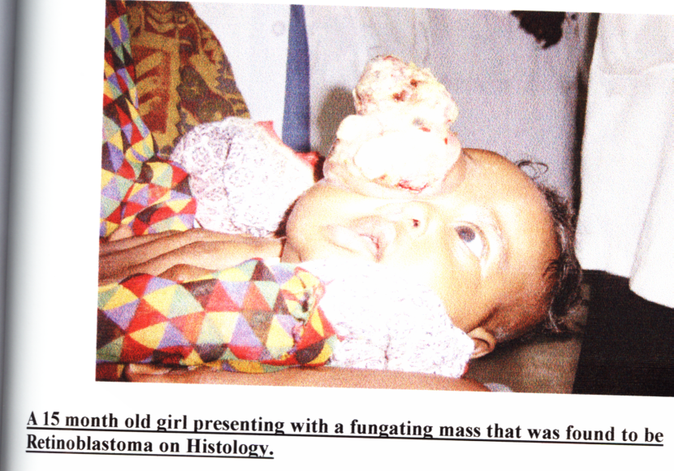

Slide 152
RETINOBLASTOMA
Bilateral in 30% of all cases.
Non-heritable in 60% of cases.
Heritable in 40% of cases.
Siblings of affected child should be examined.

Slide 153
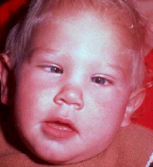
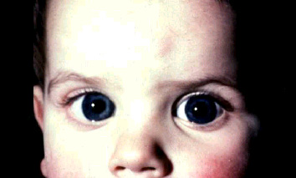
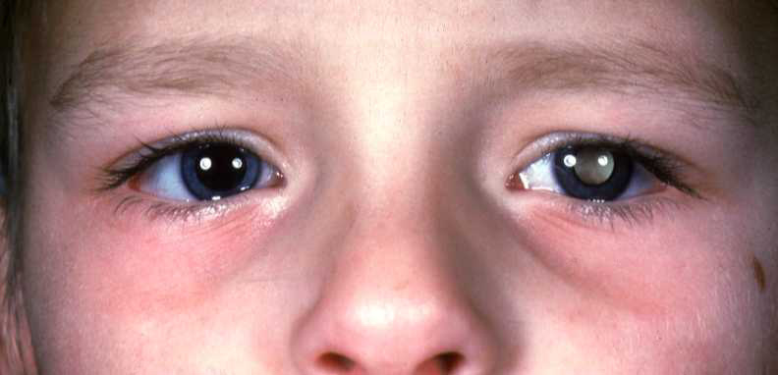
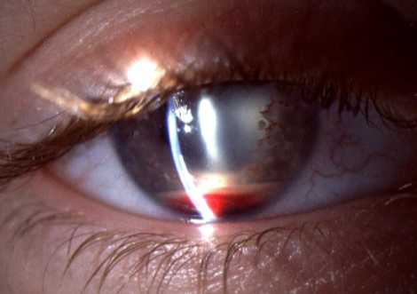
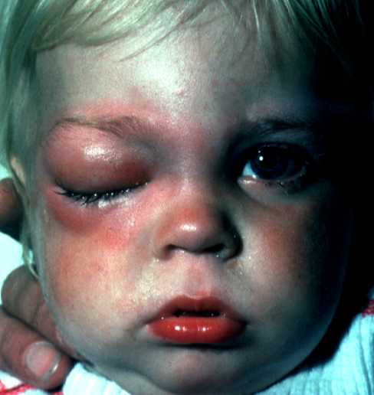
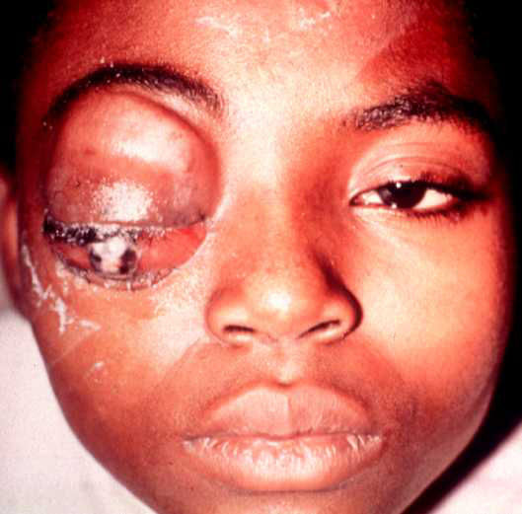
Presentations of retinoblastoma
Leukocoria - 60%
Strabismus - 20%
Secondary glaucoma
Anterior segment invasion
Orbital inflammation
Orbital invasion

Slide 154
Signs and symptoms
Leukorrhea(In retinoblastoma, white pupillary reflex (an abnormal white appearance of the pupil which reflects light).
Severe pain,redness,watery and hazy cornea
Decreased vision
Strabismus
Retinal detachment
Headache
Visual disturbances

Slide 155
RETINOBLASTOMA
TREATMENT:
Laser photocoagulation
Cryotherapy
External beam radiation
Chemotherapy
Enucleation (surgical removal of the eye).in advanced stage

Slide 156
Nursing care
Support client and family in coping with the diagnosis

Slide 157
Observe for side effects of therapy, report and attempt to alleviate them.
Post-operative care in Enucleation
Maintain pressure dressings on the eye for 1-2 days to minimize hemorrhage.
Administer prescribed analgesics for pain
Monitor for signs of meningitis as a complication (headache, neck stiffness etc.)
Single eye vision-explain that this results in loss of depth of perception (acuity) and activities needing this should be performed cautiously.
Support adaptation to changes in body image in enucleation
Explain that an artificial eye may be inserted when healing is complete (6- 8weeks)

Slide 158
What is done if the child has tumor in both eyes? In these cases, generally the worse eye is enucleated and the other eye is tried to salvage by using other methods of treatment. However, unfortunately in a few cases, both eyes may have to be removed.
Why is early detection important? The safer and less destructive procedures may be taken when the tumor is in its early stage. By detecting and treating the tumor early, we may save the life, sight and eye of the child.

Slide 159
Nursing Management
Educate on proper eye care
Hand wash
Avoid rubbing
Rx as prescribed
Post-op
Avoid valsalva maneuver
Educate!!
Enucleation – pressure dress, artificial eye
Support + family therapy

Slide 160
EYE SURGERY
Indications
Intra-ocular foreign bodies
Penetrating eye injuries
Choroidal tears
Hemorrhage
Cataract
Glaucoma
Retinal detachment
Tumors

Slide 161
Pre-operative care
Orientation of the patient to his environment after admission as his eyes may be bandaged after operation.
Pre-op. medications ordered e.g.. ophthalmic ointments/drops to be given on time
Suppository (enema) if prescribed, to evacuate the lower bowel to prevent straining immediately post-op.
Clipping of eyes (if ordered)- petroleum jelly is applied to the blades of blunt-pointed scissors so that the eyelashes will adhere to the blade and not fall into the eye.
Explanation for bandaging of both eyes post-op i.e.., the unaffected eye is covered to keep the patient from moving his eyes (i.e.. rest) during the immediate post-op. period.

Slide 162
Continuation
Washing of eyes the evening before surgery and a sterile pad applied over the eye.
Respiratory infections or allergy that may cause coughing, sneezing should be notified to the surgeon. Surgery may have to be post-poned as such violent motions can cause hemorrhage/ rupture of the surgical incision
Other general pre-op. care and as ordered

Slide 163
Post-operative care
Post-operative care
Gentleness is the key in all types of eye surgery. All movements should be slow and gentle
The patient’s head must be firmly supported when he is transferred form the operating table or stretcher to his bed.
Small pillows may be used on either side of his head to support it in the supine position.
Speech should always be soft before touching the patient. Alert them when entering the room because if he is sleeping. May be frightened and move suddenly and violently when some-one touches him.

Slide 164
Uncooperative patients and children will need someone in constant attendance to prevent them pulling off the bandages.
Nausea and subsequent vomiting may cause severe damage to delicate suture lines. All food and liquids should be withheld, surgeon notified and an emetic drug ordered/given.
Sudden pain in the eye may indicate hemorrhage. Inform the surgeon immediately.( glaucoma as a post-op. complication )
External irrigation of the eye (there should be no contact with the eyeball) or wet compresses may be ordered to remove the exudates and reduce swelling. Eyelids are cleaned with care.

Slide 165
Consult
If the patient can be turned to one or both sides
Whether he will remain flat supine or pillow allowed, how high the head of the bed should be elevated and
Whether he can feed himself, or any restrictions on fluid/food intake.
If allowed out of bed, he must take care not to bang his head or move too suddenly.
All straining and lifting must be avoided
On discharge
Relatives and the patient should be encouraged to follow these instructions at home during convalescence so as not to endanger the success of the surgery.

