Slide 1
Pharmacology II
GIT PHARMACOLOGY

Slide 2
Drugs for PUD
PPI
H2 RECEPTOR BLOCKERS
PROSTAGLANDIN ANALOGUE
CYTOPROTECTANT(ANTIACIDS;SUCRALTAFE)
LAXATIVES
ANTIDIARRHOREALS
ANTIEMETICS
H1 RECEPTOR ANTAGONISTS
ANTICHOLINERGICS

Slide 3
GIT PHARMACOLOGY
Antacids
Laxatives
Antidiarrheals
Antiemetics & Drugs for motion sickness
Antihemorrhoids
Antispasmodics
Appetite stimulants

Slide 4
GASTROINTESTINAL DISORDERS
Gastroesophageal Reflux Disease (GERD)
Peptic Ulcer Disease (PUD)
Duodenal Ulcer
Nausea
Emesis
IBS
Diarrhea
Constipation

Slide 5
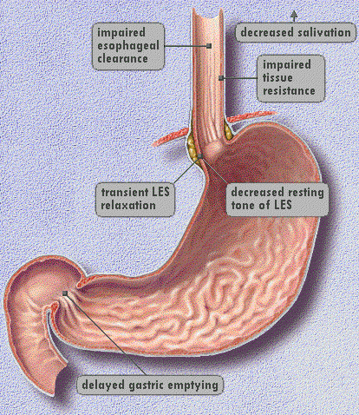
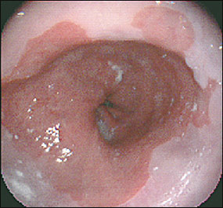
Gastroesophageal Reflux Disease (GERD)
Endoscope of Barrett’s Esophagus
(can become malignant - needs monitoring)

Slide 6
Production of Ulcers
Ulcers, open sores in the mucosal lining, occur in the stomach and intestines when:
➢Acid and pepsin activity is overactive from emotional stimulation or excessive alcohol.
➢Drugs inhibit mucus production(ulcerogenic) egNSAIDS.
➢Predisposing factors are present such as smoking, alcohol, vagal stimulation.
➢Presence of Helicobacter pylori bacteria

Slide 7
Goals of Anti-ulcer treatment
1. Reduce gastric acid secretion (antisecretory): antihistamines (H2-receptor antagonists), prostaglandins, proton pump inhibitors, anticholinergic drugs.
2. Reduce gastric acid irritation on mucosal lining by neutralize gastric acid (antacids)
3. Form a protective barrier/coat mucosal lining eg sucralfate
4. Antibiotics

Slide 8
GIT DRUGS ( PEPTIC ULCER DISEASE)
acid peptic disease includes:
peptic ulcers (gastric ulcer, duodenal ulcer , NSAIDS induced ulcers)
gasro oesophageal reflux disease,
hypersecretory states like Zollinger Ellison Syndrome (ulcerogenic tumour of the islets of Langerhans.
Principles of therapy
The aim of therapy is to;
relieve symptoms,
induced ulcer healing and cure in the long run
Decreased risk of complications
Stopping reoccurrence .

Slide 9
Classification of agents used in treatment of peptic ulcer:
Inhibition of acid secretion
H2 receptor agonist e.g. cimetidine, ranitidine, famotidine roxatidine.
Proton pump inhibitors e.g. omeprazole, pantoprazole, esomeprazole, lansoprazole.
Anticholinergics e.g. pirenzepine.
Prostaglandin analogue e.g. misoprostol.
neutralization of gastric acids
Sodium bicarbonate systemic
Non systemic: magnesium hydroxide, aluminium hydroxide, magnesium trisilicate.

Slide 10
Mucosal protective agents e.g. sucralfate, colloidal bismuth.
Anti helicobacter pylori drugs (ANTIBIOTICS) e.g. Clarithromycin, Ampicillin, Metronidazole, Tetracycline, Tinidazole
anti H. pylori drugs
Amoxicillin (Amoxil)
Bismuth (Pepto-Bismol)
Clarithromycin (Biaxin)
Metronidazole (Flagyl)
Tetracycline
Expected Pharmacological Action
Eradication of H. pylori bacteria
Therapy should include: Combination of 2 or 3 antibiotics for 14 days
The disease process is only altered by the use of antibiotics. All other medications make an environment that is conducive to healing.

Slide 11
Two weeks regimen
Tetracycline 500mg QID and metronidazole 200mg BID and Bismuth sub salylicylate.
Amoxicillin 100mg BID and clarithromycin 500mg BID+ Lansoprazole 30mgs BID.
Clarithromycin 500mg TDS +Omeprazole.
ONE WEEK REGIMEN
Clarithromycin 250mg BID + Metronidazole 400mgs + Omeprazole 20mgs BID.
Amoxicillin 500mg Bid + Clarithromycin 250mg Bid+ Omeprazole 20mg

Slide 12
Histamine2 -Receptor Antagonists
ranitidine hydrochloride (Zantac)
Cimetidine (Tagamet)
Nizatidine (Axid)
Famotidine (Pepcid)
Expected Pharmacological Action: Histamine2-receptor antagonists suppress the secretion of gastric acid by selectively blocking H2 receptors in parietal cells lining the stomach

Slide 13
Therapeutic Uses
gastric and peptic ulcers,
gastroesophageal reflux disease (GERD),
hypersecretory conditions, such as Zollinger-Ellison syndrome.
Histamine2-receptor antagonists are used in conjunction with antibiotics to treat ulcers caused by H. pylori.
Side/Adverse Effects
Cimetidine may block androgen receptors, resulting in decreased libido and impotence.
Cimetidine may cause CNS effects (lethargy, depression, confusion)
Ranitidine, nizatidine, and famotidine have few adverse effects and interactions.

Slide 14
Contraindications/Precautions
These medications are Pregnancy Risk Category B
Use in older adults can cause antiadrenergic effects (e.g., impotence) and CNS effects (e.g., confusion).
H2-receptor antagonists decrease gastric acidity, which promotes bacterial colonization of the stomach and the respiratory tract. Use cautiously in clients who are at a high risk for pneumonia, such as clients with chronic obstructive pulmonary disease (COPD).
Medication/Food Interactions
Cimetidine can inhibit medication metabolizing enzymes and thus increase the levels of warfarin, phenytoin (Dilantin), theophylline, and lidocaine.
Concurrent use of antacids can decrease absorption of histamine2 -receptor antagonists.

Slide 15
Nursing Administration
Cimetidine, ranitidine, and famotidine can be administered IV for acute situations.
Advise clients to practice good nutrition. Suggest eating six small meals rather than three large meals a day.
Inform clients that adequate rest and reduction of stress may promote healing.
Clients should avoid smoking, because smoking can delay healing.
Encourage clients to avoid aspirin and other nonsteroidal anti-inflammatory drugs (NSAIDs) unless taking low-dose aspirin therapy for prevention of cardiovascular disease.
If alcohol exacerbates symptoms, advise clients to stop drinking.

Slide 16
Availability of these medications OTC may discourage clients from seeking appropriate health care.
Encourage clients to see the provider if symptoms persist.
The medication regimen can be complex, often requiring clients to take two to three different medications for an extended period of time. Encourage clients to adhere to the medication regimen and provide support.
Ranitidine can be taken with or without food

Slide 17
Proton Pump Inhibitor
omeprazole (Prilosec)
Pantoprazole (Protonix)
Lansoprazole (Prevacid)
Rabeprazole sodium (AcipHex)
Esomeprazole (Nexium)
Expected Pharmacological Action
Proton pump inhibitors reduce gastric acid secretion by irreversibly inhibiting the enzyme that produces gastric acid.
Proton pump inhibitors reduce basal and stimulated acid production.

Slide 18
Therapeutic uses
gastric and peptic ulcers,
GERD,
hypersecretory conditions such as Zollinger-Ellison syndrome.
Complications
Insignificant side effects and adverse effects with short-term treatment
Low incidence of headache, diarrhea, and nausea/vomiting

Slide 19
Contraindications/Precautions
These medications are Pregnancy Risk Category C.
Use cautiously with children and women who are breastfeeding.
Contraindicated for clients hypersensitive to medication
These medications increase the risk for pneumonia. Omeprazole decreases gastric acid pH, which promotes bacterial colonization of the stomach and the respiratory tract. Use cautiously in clients at high risk for pneumonia, such as clients with COPD.
Long-term use of proton pump inhibitors increases the risk of gastric cancer and osteoporosis.

Slide 20
Medication/Food Interactions
Digoxin (Lanoxin) levels may be increased when used concurrently with omeprazole.
Monitor digoxin levels carefully if prescribed concurrently.
Absorption of ketoconazole (formerly Nizoral), itraconazole (Sporanox), and atazanavir (Reyataz) is extremely decreased when taken concurrently with proton pump inhibitors.
Nursing Administration
Do not crush, chew, or break sustained-release capsules.
Clients may sprinkle the contents of the capsule over food to facilitate swallowing.
Clients should take omeprazole once a day prior to eating in the morning.
Encourage clients to avoid alcohol and irritating medications such as NSAIDs.

Slide 21
Active ulcers should be treated for 4 to 6 weeks.
Pantoprazole (Protonix) can be administered to clients intravenously. In addition to low incidence of headache and diarrhea, there may be irritation at the injection site leading to thrombophlebitis. Monitor the client’s IV site for signs of inflammation (redness, swelling, local pain) and change the IV site if indicated.
Teach clients to notify the provider for any sign of obvious or occult GI bleeding such as coffee-ground emesis.
ANTICHOLINERGICS
Piperazine :
it is a selective M1 receptor blocker
Produces less effects.
Reduces acid secretion by 40 to fifty percent
Has a small therapeutic window

Slide 22
Prostaglandins analogue
They have o cytoprotective role by inhibiting acid secretion by increasing mucus and bicarbonate secretion.
Inhibit gastrin secretion and increase mucosal blood flow. misoprostol
a synthetic pge1 analogue and inhibits acid output.
ulcer heal in 4 to six weeks but relieving pain
Therapeutic Use
prevent ulceration and bleeding induced by NSAIDS

Slide 23
MUCOSAL PROTECTANT
sucralfate (Carafate)
Expected Pharmacological Action
The acidic environment of the stomach and duodenum changes sucralfate into a thick substance that adheres to an ulcer. This protects the ulcer from further injury that may be caused by acid and pepsin.
This viscous substance can stick to the ulcer for up to 6 hr.
Therapeutic Uses
promotes healing of duodenal and gastric ulcers
Poorly absorbed systemically, not used frequently due to a large doses.
Should not be used with antacids, H2 Antagonist, PPIs as it is dependent on gastric PH.

Slide 24
colloidal bismuth compounds
promote healing of duodenal and gastric ulcers.
Act by binding to an ulcer, denaturing the protein and creating a physical barrier.
Inhibition of pepsin, activation of mucous production, increase of prostaglandins.
It is effective in healing of duodenal and gastric ulcers.
Effective in non ulcer gastritis, caused by H.pylori

Slide 25
considerations
take before meals and at bed time for 4 to 8 weeks.
Poor acceptance due to blackening of tongue, dentures and stool
inconvenience of dosing used as a regimen of multiple therapy for H.Pylori not used alone.

Slide 26
LAXATIVES
This are drugs tha promote deafacation
*laxatives; mild action
*Purgative; strong action
*Classification
Bulk forming purgatives
Magnesium sulphate, magnesium hydroxide, sodium phosphate, lactulose, sodium tartrate, osmotic cathartic.
Vegetable fibres, bran
Hydrophillic colloids, methyl cellulose

Slide 27
Irritants and stimulants
Diphenylmethanes; phenolphthalein, Bisacodyl
Anthraquinone derivatives; senna, cascara
Fixed oil; castor oil
Stool softeners; docusate, mineral oil, glycerin suppositories

Slide 28
Mechanism of action of laxatives
Laxatives cause retention of fluid in colonic contents increasing bulk and softness of stool and its transit.
They may decrease absorption of water and electrolyte by acting on intestinal mucosa.
They may enhance intestinal motility reducing absorption of water.

Slide 29
Bulk forming purgatives
Osmotic or saline cathartics
They are poorly absorbed hold water through osmosis.
In addition the ions stimulate secretion and motility.
Main used salts are; magnesium sulphate, sodium sulphate, magnesium hydroxide, sodium potassium tartrate.
Sodium salts contraindicated in congestive heart failure.
Considerations
Cause after constipation therefore not used routinely
Preferred for pre-operative care before colonoscopy and in poisoning.

Slide 30
Lactulose
A synthetic disaccharide containing fructose and galactose absorbed in the GIT.
Produces soft stools within 1-3 days
Side effects; abnominal cramps, flatulence,
Contraindicated in patients requiring galactose free diet.
Vegetable fibres
Dietary fibres derived from whole grains, vegetables and fruits. They contains the indigestible portion of cell wall.
Dietary fibre act by binding water and ions in the intestine softens stool and promotes peristables. Also increases faecel mass.
Indications
Prevention and treatment of functional constipation.
Used for symptomatic relief of mild diarrhea
Adverse effects
Flatulance
Intestinal obstruction, oesophageal obstruction may occur.
Contraidication
Stenosis
Ulceration

Slide 31
Irritant and stimulant purgatives
They promote accumulation of water and electrolytes in the lumen.
Enhance intestinal motility
Increased water secretion is through activation of cAMP and synthesis of prostaglandins
Phenolpthalein and bisacodly are widely used.
Castor oil is hydrolysed to glycerol and ricinoleic acid which stimulates peristalsis. Effect in the small intestines causes rapid complete evacuation.
Side effects include; Cramping, dehydration.
Regular use bordestroys mucosa
Should be avoided in pregnant women, can intiate labour.

Slide 32
Stool softeners
Docusates
Used as an emulsifying, wetting and dispersing agent.
soften stool with 1-3days
Liquid paraffin
It’s a mineral oil.
Pharmacologically inert and acts as lubricants and softens stool.
Adverse effects of liquid paraffin
Leakage of oil past anal sphincter
Affect absorption of fat soluble vitamins.
Glcerin
Used as a suppository, produces effects within 30mins.

Slide 33
Indication of laxatives
Constipation not responding to non- pharmacological measures: fibre rich diet, regular exercise, regular bowel movements, ( bulk laxatives are the 1st choice).
Before and after surgery to produce soft stool in patients with haemorrhoids and fissures.
Contraindications
Undiagnosed abnominal pain
Appendicitis
Intestinal obstruction
Should be avoided during later stages of preganancy.

Slide 34
Anti- diarrhoeal agents
Diarrhoea is marked by frequent passage of unformed or liquid stools.
Treatment of diarrhoea
fluid and electrolyte replacement
Nutritional management
Drug therapy

Slide 35
Drug Therapy
Anti-diarrhea drugs include;
Antimotility drugs
Antisecretory drugs
Adsorbents
Antibacterial agents

Slide 36
Atimotility drugs
E.g loperamide, diphenoxylate
Loperamide
Acts mainly on GIT receptor.
Acts quickly and has a longer duration of action
Decreases GIT motility and is excreted unchanged indicated for non infective diarrhea, mild travellors diarrhea.
Adverse effects
Skin rash , abdominal cramps with excessive use paralytic ileus
Contraindication; below 4years, infective diarrhea, ulcerative colitis

Slide 37
Antisecretory drugs
Racecadotril
Enkephalinase inhibitor that increases endogenous enkephalin level and reduce intestinal hyper tension of water and electrolytes.
Used for systematic treatment of diarrhea.
Has no side effects like bloating and after constipation.
Should not be used in pregnancy, lactation and children.

Slide 38
Adsorbents
Include kaolin, pectin, methylcellulose , magnesium aluminium silicate.
They act by absorbing microorganisms and/ toxins by altering normal flora or by protecting the mucosa of the intestines.
Their efficacy is doubtful

Slide 39
Antimicrobial agents
Cholera; tetracyclines, norfloxacin/ciprofloxacin
Infections with camphylobacter; erythromycin and flouroquinolones
Amoebiasis or giardiasis; metronidazole, diloxanide furoate, ornidazole
Shigella spcs, ciprofloxacin, norfloxacin or cotrimoxazole.

Slide 40
Miscellaneous
Contain viable lactic acid bacilli.
Improve intestinal microflora
Known as probiotics
Useful in rotavirus diarrhoea and anti biotic induced diarrhoea

Slide 41
D.ANTI EMETICS
Vomitting is reflex action that results in forceful evacuation of gatric contents.
Conditions pregnancy, ulcers, motion sickness, chemotherapy.
Anti emetics
Applied to suppress or prevent vomiting.
Classification
Anti muscarinic: scopolamine (hyoscine), dicyclomine
H1 antagonist: promethazine, doxylamine,
Prokinetic drugs; metoclopramide, domperidone, cisapride, mosapride.
Neuroleptics; phenothiazines, chlorpromazine
Adjuvant antiemetics; dexamethasone, benzodiazepines

Slide 42
Prokinetic drugs(antimotion)
Metroclopramide
Effective for all types of vomiting, post- operatively, radiation, chemotherapy.
Less effective in motion sickness.
Blocks dopamine receptors, enters CNS
Side effects: extrapyramidal effects, dystonia, dyskinesia.
Indications;
Anti emetic
Dyspesia
facilitate lactation
b. Domperidone
Peripheral D2 receptor agonist .
Causes less extra pyramidal effects, doesnot cross the blood brain barrier.
Lower efficacy than metoclopramide
Uses; levodopa or bromocriptine induced vomiting.
Side effects; increased prolactin, galactorrhoea, dry mouth, rashes. Headache.

Slide 43
2. Anti muscarinic
Scopolamine (hyoscine)
Alkaloid related to atropine
Most effective in prophylaxis of motion sickness
Antimuscarinic action blocks afferent pathways for vomiting reflex.
Has short duration of action
Produces anticholinergic effects; blurred vision, dry mouth, sedation.
Not effective with vomiting of other aetiologies.

Slide 44
3. Neuroleptics
Phenothiazines: chlorpromazine
potent anti emetics in vomiting due to drug toxicity, chemotherapy.
They act by blocking the D2 receptors in the medulla oblongata chemoreceptor trigger zone.
Not effective in motion sickness
Dosage is lower than antipsychotics
Side effects; sedation, extrapyramidal effects; dyskinesia, dystonia

Slide 45
4. H1 antagonist
Doxylamie(nosic) useful in motion sickness
Modest effect on chemotherapy
Reduce extra pyramidal effects of D2 receptor antagonist.
Are antagonist therefore avoided in pregnancy.

Slide 46
Adjuvant antiemetics
Corticosteroids; dexamethasone, methylprednisolone, used to control chemotherapy vomiting.
Act by blocking prostaglandins.
Cause insomnia and hyperglycemia
Cannabinoids; tetrahydrocannabinol
active principle of marijuana
Reduce chemotherapy emesis.
For patients intolerant or refractory to others antiemetics
Side effects; hallucinations. Disorientation, vertigo, sedation

Slide 47
GASTROINTESTINAL SYSTEM DRUGS
A. DRUGS USED IN PEPTIC ULCERS
B. ANTIEMETIC AGENTS
C. ANTISPASMODICS

Slide 48
A: DRUGS FOR PEPTIC ULCERS
Classification:
♦ Reduction of gastric acid secretion
1. H₂-histamine receptor blockers
2. Proton-pump inhibitors (PPI)
3. Anticholinergic agents
♦ Neutralization of secreted acid
4. Antacids
♦ Promoting mucosal protection (cytoprotectants)
5. Prostaglandins
6. Sucralfate
♦ Eradication of H. pylori infection

Slide 49
H₂-HISTAMINE RECEPTOR ANTAGONISTS
Mxn: competitive inhibitor of histamine-2 receptors in parietal cell.
Effect:
• Reduces gastric acid secretion and volume of gastric juice
E.g. Famotidine, ranitidine, nizatidine, cimetidine
Adm: per oral & parenteral.
Uses:
Gastro-esophageal reflux disease (GERD)
Peptic ulcer disease (PUD)
Prevention of bleeding from stress-related gastritis.

Slide 50
S/E
S/E are few and minor. They include:
Diarrhoea, headache, fatigue, myalgia.
Cimetidine only causes:Gynaecomastia, impotence, galactorrhea
Hypotension & bradycardia.

Slide 51
2. PROTON PUMP INHIBITORS (PPI)
E.g. Omeprazole, lansoprazole, esomeprazole.
Mxn: inhibit H+/K+ ATPase pump, decreasing acid secretion.
Effects:
Inhibit both fasting and meal-stimulated acid
secretion (90-98% inhibition).
Reduce both volume of gastric juice and pepsin
Adm: all per oral.
NB: They are the most effective drugs used.

Slide 52
Clinical uses
DOC for GERD
PUD
NSAIDs-associated ulcers.
Zollinger-Ellison syndrome (gastrinomas).
Helicobacter pylori eradication.
S/E:
Diarrhoea, headache, abdominal pains
Impaired vitamin B12 absorption

Slide 53
3. ANTIMUSCARINIC AGENTS
Mxn: inhibit acetylcholine-mediated acid secretion.
E.g. Pirenzepine, Telenzipine
Uses: (not commonly used).
Peptic ulcer disease.

Slide 54
4. PROSTAGLANDIN ANALOGUES
Effects:
Stimulate mucus & bicarbonate secretion
Enhance mucosal blood flow
Reduce histamine mediated acid production
E.g. Misoprostol
Adm: per oral
Uses:Treatment & prevention of NSAID- induced ulcers.
S/E: diarrhoea, cramping abdominal pain.
Uterine contraction
C/I: pregnancy or suspected pregnancy.

Slide 55
5. SUCRALFATE
Mxn: forms a viscous, paste that binds selectively to ulcers for up to 6 hrs.
Effect: provide a physical barrier preventing further erosion.
Adm: per oral, 1 hour before meals.
Use: prevention of stress-related bleeding.
S/E: constipation
Other cytoprotectants: bismuth compounds

Slide 56
6. ANTACIDS
Mxn: neutralise gastric acid due to their alkaline
nature.
E.g. sodium bicarbonate (NaHCO₃), magnessium hydroxide (Mg(OH)₂, alluminium hydroxide (AL(OH)₃,magnessoum trisilicate.
Adm: per oral
S/E:
Metabolic alkalosis, belching, fluid retention (NaHCO₃)
Diarrhoea {Mg(OH)₂}
Constipation {AL(OH)₃}

Slide 57
DRUGS FOR H. pylori ERADICATION
A combination therapy is used in H.pylori associated ulcers for complete eradication.
PPI + clarithromycin + amoxicillin/metronidazole.

Slide 58
B: ANTIEMETIC AGENTS
Vomiting is controlled by vomiting centre in brainstem (rich in serotonin, histamine H₁ receptors)
Input to the vomiting centre comes from:
  Chemoreceptor trigger zone (CTZ), rich in dopamine &serotonin receptors.
  Vestibular system
  Irritation of pharynx (via vagus nerve)
  Irritation of GIT mucosa (via serotonin receptors)
  NB: Antiemetics block this input to the vomiting centre.

Slide 59
1: DOPAMINE D₂-RECEPTORS BLOCKERS.
E.g. Chlorpromazine, metochlopramide, Domperidone, haloperidol, prochlorperazine.
Adm: per oral or parenterally.
Uses:
Post-operative nausea & vomiting.
Intractable hiccup (chlorpromazine)
Chemotherapy induced nausea & vomiting.
S/E:
Sedation, galactorrhea, gynecomastia,
impotence.
Extrapyramidal syndrome.

Slide 60
2: SEROTONIN 5-HT₃-RECEPTOR BLOCKERS.
E.g. ondansetron and granisetron
Mxn: block serotonin receptors at the vomiting center, CTZ & GIT.
Adm: per oral or IV
Uses:
Chemotherapy induced nausea & vomiting
Post-operative nausea & vomiting
Post-radiation nausea 7 vomiting
S/E: headache, dizziness, constipation, hypotension, urinary retention.

Slide 61
3. CORTICOSTEROIDS
E.g. Dexamethasone, methylprednisolone
Uses:
Chemotherapy-induced nausea and vomiting
4. ANTIMUSCARINIC AGENTS
E.g. scopolamine, hyoscine
Uses: Prevention of motion sickness (taken before travelling)

Slide 62
5. ANTIHISTAMINES
Mxn: block histamine-1 receptors
E.g. cinnarizine, cyclizine, diphenhydramine, promethazine
Uses: prevention & treatment of motion sickness
S/E: dizziness, sedation, confussion, dry mouth, urinary retention.

Slide 63
C: ANTISPASMODICS
1. Antimuscarinic agents
e.g. hyoscyamine, dicyclomine.
Mxn: inhibition of muscarinic receptors in intestinal smooth muscle.
Use: relief of abdominal spasms & cramps.
S/E: dry mouth, visual disturbances, urinary retention, constipation.

Slide 64
DRUGS USED IN SURGERY
General anaesthesia
Local anaesthesia
Depolarizing and non-depolarizing muscle relaxant agents

Slide 65
III: ANAESTHETIC AGENTS
.

Slide 66
General anaesthesia
Concepts
An Ideal Anaesthetic should cause unconsciousness, analgesia, amnesia, muscle relaxation and loss of reflexes.
Anesthesia protocols involve use of:
  Premedication.
  Induction of anaesthesia: intravenous anesthetics.
  Maintainance of anaesthesia: inhaled anaesthetics and,
  Skeletal muscle relaxants.

Slide 67
Premedication
Objectives are to: relief anxiety, reduce amount of secretions, reduce volume & increase pH of gastric contents.
Benzodiazepines: used to reduce anxiety.
E.g. temazepam, midazolam, diazepam, lorazepam.
Antimuscarinic agents: to reduce secretions.
E.g. Atropine. Adm I.M or P.O.
H₂-receptor antagonists: to reduce gastric acidity. E.g. ranitidine.
NB: premedication is rarely used nowadays.

Slide 68
Intravenous Anaesthetics
Propofol: rapid onset. There is complete and rapid recovery from its effects. Also has antiemetic actions. Used for short procedures. Causes pain on injection, hypotension.
Ketamine causes “dissociative anesthesia.” can be administered booth I.M & I.V. produces minimal respiratory depression. Causes an increase in blood pressure.

Slide 69
Muscle relaxants
Mainly used to: facilitate tracheal intubation, permit artificial ventilation & relax muscles to make surgery possible.
All act by blocking transmission at the neuromuscular junction.
Two categories:
Depolarizing (non-competitive): succinylcholine (suxamethonium). Has a short duration of action (2-5 mins). Effect cannot be reversed by drugs.
Non-depolarizing (competitive): pancuronium, tubocurarine, mivacurium, vecuronium, rocuronium. Effects can be reversed by neostigmine.
General S/E of muscle relaxants: Hyperkalemia, Increased intracranial pressure, Muscle pain.

Slide 70
Anticholinergic drugs
Neuromuscular-Blocking Drugs
  important for producing complete skeletal muscle relaxation in surgery;
Nondepolarizing Group
  Prototype:Tubocurarine .
  Produces a competitive block at the end plate nicotinic receptor, causing flaccid paralysis that lasts 30–60 minutes (longer if large doses have been given).
  Other nondepolarizing blockers: Pancuronium, atracurium, vecuronium (these are shorter-acting)
Depolarizing Group
  Prototype: Succinylcholine
  These are nicotinic agonists, causing flaccid paralysis from persistent depolarization of the neuromuscular end plate
  More discussion on this in the topic on skeletal muscle relaxants

Slide 71
Anaesthesia
Anesthesia – is a reversible condition of comfort, quiescence and physiological stability in a patient before, during and after performance of a procedure.
General anesthesia – for surgical procedure to render the patient unaware / unresponsive to the painful stimuli.
Drugs producing G. Anaesthesia – are called general anaesthetics
Local anesthesia - reversible inhibition impulse generation and propagation in nerves. In sensory nerves, such an effect is desired when painful procedures must be performed, e.g., surgical or dental operations.
Drugs producing L. Anaesthesia – are called local anaesthetics
Notes:
KWI- essence.
71

Slide 72
What are General anaesthetics ?
General Anaesthetics are the drugs which produce reversible loss of all sensation and consciousness, or simply, a drug that brings about a reversible loss of consciousness.
These drugs are generally administered by an anesthesiologist in order to induce or maintain general anesthesia to facilitate surgery.
General anaesthetics are – mainly inhalation or intravenous

Slide 73
What are the Drugs used as GA ? (Classification)
Inhalation:
Gase: Nitrous Oxide
Volatile liquids:
  Ether
  Halothane
  Enflurane
  Isoflurane
  Desflurane
  Sevoflurane
Intravenous:
Inducing agents:
Thiopentone, Methohexitone sodium, propofol and etomidate
Benzodiazepines (slower acting):
Diazepam, Lorazepam, Midazolam
Dissociative anaesthesia:
Ketamine
Neurolept analgesia:
Fentanyl

Slide 74
Essential components of GA:
Triad of General Anesthesia:
  need for unconsciousness
  need for analgesia
  need for muscle relaxation
Essential components of GA:
  Loss of all sensations – pain
  Unconsciousness
  Amnesia
  Immobility and muscle relaxation
  Loss of somatic and autonomic reflexes

Slide 75
Stages of GA
Stage I: Stage of Analgesia
Starts from beginning of anaesthetic inhalation and lasts upto the loss of consciousness.
Pain is progressively abolished during this stage.
Patient remains conscious, can hear and see, and feels a dream like state.
Reflexes and respiration remain normal.
It is difficult to maintain - use is limited to short procedures only.

Slide 76
stages of GA – contd.
Stage II: Stage of Delirium and Excitement:
From loss of consciousness to beginning of regular respiration.
Excitement - patient may shout, struggle and hold his breath
Muscle tone increases, jaws are tightly closed.
breathing is jerky; vomiting, involuntary micturition or defecation may occur.
Heart rate and BP may rise and pupils dilate due to sympathetic stimulation.
No stimulus or operative procedure carried out during this stage.
Breatholding are commonly seen. Potentially dangerous responses can occur during this stage including vomiting, laryngospasm and uncontrolled movement.
This stage is not found with modern anaesthesia – preanaesthetic medication, rapid induction etc.

Slide 77
stages of GA – contd.
Stage III: Stage of Surgical anaesthesia
Extends from onset of regular respiration to cessation of spontaneous breathing. This has been divided into 4 planes:
Plane 1: Roving eye balls. This plane ends when eyes become fixed.
Plane 2: Loss of corneal and laryngeal reflexes.
Plane 3: Pupil starts dilating and light reflex is lost.
Plane 4: Intercostal paralysis, shallow abdominal respiration, dilated pupil.

Slide 78
stages of GA – contd.
Stage IV: Medullary / respiratory paralysis
Cessation of breathing failure of circulation death.
Pupils: widely dilated.
Muscles are totally flabby.
Pulse is imperceptible
BP is very low.

Slide 79
Phases of GA
There are 3 (three) phases:
Induction
Maintenance
Recovery

Slide 80
Phases of GA – contd.
Induction: It is the period of time which begins with the beginning of administration of anaesthesia to the development of surgical anaesthesia (Induction time). Induction is generally done with IV anaesthetics like Thiopentone Sodium
Maintenance: Sustaining the state of anaesthesia. Usually done with an admixture of Nitrous oxide and halogenated hydrocarbons
Recovery: At the end of surgical procedure administration of anaesthetic is stopped and consciousness regains (recovery time)

Slide 81
Introduction
General anesthesia is a state characterized by:
  unconsciousness,
  analgesia,
  amnesia,
  skeletal muscle relaxation,
  and loss of reflexes.
Drugs used as general anesthetics are;
  CNS depressants with actions that can be induced and terminated more rapidly than those of conventional sedative-hypnotics
While modern anesthetics act very rapidly and achieve deep anesthesia quickly,
  older and more slowly acting anesthetics, progressively induce dose dependent central depression in 4 distinct stages (stages of anesthesia).

Slide 82
Stages of Anesthesia
Stage 1: Analgesia
  the patient has decreased awareness of pain, sometimes with amnesia.
  Consciousness may be impaired but is not lost.
Stage 2: Disinhibition
  the patient appears to be delirious and excited.
  Amnesia occurs, reflexes are enhanced, and respiration is typically irregular; retching and incontinence may occur.
Stage 3: Surgical Anesthesia
  the patient is unconscious and has no pain reflexes;
  respiration is very regular, and blood pressure is maintained.
Stage 4: Medullary Depression
  the patient develops severe respiratory and cardiovascular depression that requires mechanical and pharmacologic support.

Slide 83
Classification of anesthetics
Inhaled: gases like nitrous oxide, halothane etc
Intravenous:
  Barbiturates
  Benzodaizepines
  Dissociative anesthetics (ketamine)
  Imidazole
  Opiods
  Phenols

Slide 84
Inhaled anesthetics
  Drugs (gases):
    Nitrous oxide, Halothane, Desflurane, Enflurane, Isoflurane, Sevoflurane
  Mechanism of action:
    Facilitate GABA-mediated inhibition
  Effects:
    increased cerebral blood flow; vasodilation; reduced cardiac output; decrease in respiratory functions

Slide 85
Intravenous anesthetics
Barbiturates:
  Drugs:
    Thiopental, Thioamylal, Methohexital
  Mechanism of action:
    facilitate GABA-mediated inhibition
  Effects:
    Cause depression of circulatory and respiratory systems
  Recovery is mainly due to redistribution from brain to other tissues owing to their high lipid solubility

Slide 86
Intravenous anesthetics
Benzodiazepines:
  Drugs:
    Midazolam
  Mechanism of action:
    facilitate GABA-mediated inhibition
  Effects:
    Cause less depressant activity on circulatory and respiratory systems than barbiturates
  Have slower onset but longer duration of action than barbiturates
  Reversal of respiratory depression is done with flumazenil

Slide 87
Intravenous anesthetics
Dissociative anesthetic:
  Drugs:
    Ketamine
  Mechanism of action:
    Blocks excitation by glutamate at N-methyl-D-aspartate (NMDA) receptors
  Effects:
    Analgesia, amnesia and catatonia but "consciousness" retained; cardiovascular (CV) stimulation
  Terminated through hepatic metabolism

Slide 88
Intravenous anesthetics
Phenols:
  Drugs: Propofol, Fospropofol
  Effects: vasodilation and hypotension; negative inotropy
Opioids:
  Drugs: Fentanyl, Alfentanil, Remifentanil, Morphine
  Mechanism of action: Interact with receptors for endogenous opioid peptides
  Effects: Marked analgesia, respiratory depression
  Respiratory depression—reversed by naloxone

Slide 89
Intravenous anesthetics
Imidazole:
  Drug: Etomidate
  Has minimal effects on CV and respiratory functions
  Has short duration due to redistribution

Slide 90
Properties of an Ideal anaesthetic agent:
For Patient:
  Pleasant, non-irritating and should not cause nausea or vomiting
  Induction and recovery should be fast
For Surgeon:
- analgesia, immobility and muscle relaxation
- nonexplosive and noninflammable

Slide 91
Properties of GA – contd.
For the anaesthetist:
- Margin of safety
- Heart, liver and other organs
- Potent
- Cheap, stable and easily stored
- Rubber tubing or soda lime
- Rapid adjustment of depth of anaesthesia

Slide 92
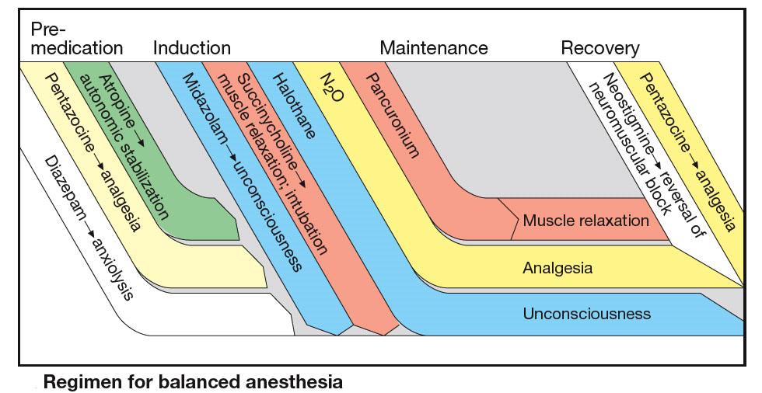

Slide 93
Local anaesthetics

Slide 94
Local anaesthesia
Some terms related to Local anaesthesia:
  Surface anaesthesia: Ointment / jelly / solutions applied on mucous membrane.
  Infiltration anaesthesia: Injection of the LA to produce analgesia over an area.
  Regional anaesthesia: spinal, epidural and IV regional anaesthesia.
  Spinal – sub-arachnoid space.
  Epidural – between spinal bone and dura matter.
  IV Regional – limited to limbs and practically upper limbs.

Slide 95
Local Anaesthesia
Loss of sensory perceptions by reversibly inhibiting the propagation of signals along nerve pathways in a specific area of the body.
LAs block generation and conduction of impulse at all parts of neurons where they come in contact.

Slide 96
Definition
Local anesthetics produce a transient and reversible loss of sensation (analgesia) in a circumscribed region of the body without loss of consciousness.
Normally, the process is completely reversible.

Slide 97
Introduction cont…
Local anesthesia
  the condition that results when sensory transmission from a local area of the body to the CNS is blocked.
The local anesthetics
  constitute a group of chemically similar agents (esters and amides) that block the sodium channels of excitable membranes.
The drugs can be administered by injection in the target area, or by topical application in some cases,
  Hence the anesthetic effect can be restricted to a localized area (e.g., the cornea or an arm).
When given intravenously, local anesthetics have effects on other tissues.

Slide 98
Local anesthetics gain access to the inner axonal membrane by
  traversing sodium channels while they are more often in an open configuration
  passage directly through the plasma membrane

Slide 99
Sequence of clinical anesthesia
Sympathetic block (vasodilatation)
Loss of pain and temperature sensation
Loss of proprioception
Loss of touch and pressure sensation
Loss of motor function

Slide 100
Anesthetic Potency
Potency = lipid solubility
Higher solubility = can use a lower concentration and reduce potential for toxicity

Slide 101
DURATION OF ACTION
Duration = protein binding
Bupivacaine 95%
Lidocaine 65%

Slide 102
Pharmacokinetics
Effective within 5 min
Duration of action – 1-1.5 h
Activity is Ph dependent
Increased action in acidic ph

Slide 103
Classification
Esters:
  Long action: tetracaine
  Short action: procaine
  Surface action: benzocaine, cocaine
Amides:
  Long action: bupivacaine, ropivacaine
  Medium action: lidocaine

Slide 104
Mechanism of action
Both esthers and amides cause blockade of Na⁺ channels
  Thus slowing, and then preventing axon potential propagation
Cocaine has intrinsic sympathomimetic actions

Slide 105
Pharmacokinetics
Amides:
  Hepatic metabolism via CYP450 in part
  Half-lives: lidocaine, prilocaine < 2 h, others 3–4 h
Esters:
  Rapid metabolism via plasma esterases;
  short half-lives

Slide 106
Clinical applications
Analgesia via;
  topical use, or injection (perineural, epidural, subarachnoid); rarely IV
  cocaine and benzocaine only given topically

Slide 107
ADVANTAGES OF LIGNOCAINE ADRENALINE COMBINATION
  Decrease systemic toxicity (↓uptake by up to 1/3)
  Prolong local anesthesia (by ~50%)
  Decrease local bleeding (improve visualization of surgical field
  DIS ADVANTAGES:
  Makes injection more painful
  Increases chances of local injury and necrosis.
  May raise BP and promote arrhythmias in susceptible individuals

Slide 108
Progression of local anesthesia
Loss of:
  1. Pain
  2. Cold
  3. Warmth
  4. Touch
  5. Deep pressure
  6. Motor function

Slide 109
PHARMACOLOGICAL ACTIONS
CNS :
  All can produce CNS stimulation followed by depression.
  Cocaine:
    Euphoria-excitement-mental Confusion-tremors-muscle Twitching-convulsions- Unconciousness -resp. Depression.
  Procaine, Lignocaine: safe at clinical doses
CVS :
  Cardiac depressant at iv doses
  Antiarrhythmic action (procainamide)

Slide 110
Techniques of administration
Topical Anesthesia
Infiltration
Conduction block
    Field block
    Nerve block
Peridural
Spinal anesthesia

Slide 111
Topical Anesthesia
Done by the administering the anesthetic to mucous membranes or skin. Relieves itching, burning and surface pain, i.e. sunburns.

Slide 112
Infiltration
Occurs by directly injecting a local anesthetic to block the nerve endings under the skin or in the subcutaneous tissue. Used mainly for surgeries, i.e. cavities being filled.

Slide 113
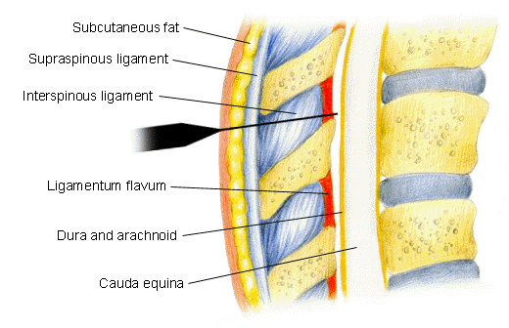
Epidural Anesthesia
This is accomplished by injecting a local anesthetic into the peridural space, a covering of the spinal cord

Slide 114
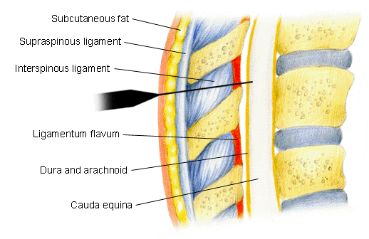
Spinal anesthesia
Here, the local anesthetic is injected into the subarachnoid space of the spinal cord

Slide 115
Toxicity
CNS Toxicity:
  Systematic absorption can lead to excitement (tremors, shivering, convulsions),
  If absorbed in even higher amounts can lead to depression (coma, respiratory arrest and death)
Cardiovascular toxicity:
  If absorbed in excess systematically can lead to depression of the cardiovascular system
Hypersensitivity: Rashes to anaphylaxis
Local reactions: Combination with vasoconstrictor
  (combination should be avoided-feet, fingers, toes, pinna, penis)

Slide 116
Prevention of toxicities
Enquire about history of allergy
Cautiously in liver and myocardial damage
Select proper site –nerve block
Use minimal ED, well diluted preferably with the vasoconstrictor
Wait after injection
Observe the face for any twitching, excitement and tachycardia if any
Observe post operatively for allergic reactions

Slide 117
ANTICONVULSANTS (ANTIEPILEPTIC) DRUGS

Slide 118
Epilepsy
Seizure
  Brief episode of abnormal electrical activity in the brain
Convulsion
  Involuntary spasmodic contractions of any or all voluntary muscles throughout the body, including skeletal and facial muscles
Epilepsy
  Chronic, recurrent pattern of seizures

Slide 119
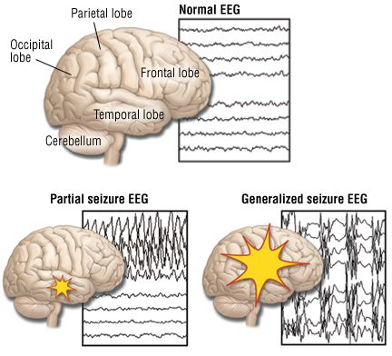

Slide 120
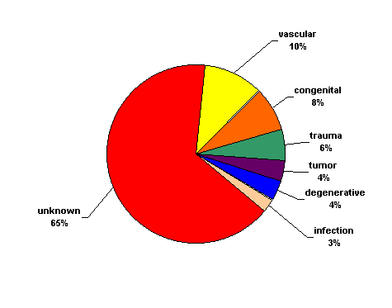
Background
Causes:
  Genetic (autosomal dominant genes)
  Congenital defects
  Severe head trauma
  Ischemic injury, tumor
  Drug abuse
  Unknown
http://www.med.uc.edu/neurology/images/

Slide 121
Nerve Cell Communication
Neurons communicate between themselves using small molecules called neurotransmitters.
These neurotransmitters modulate and regulate the electrical activity of a given neuron, and tell it when to fire an action potential or when not to.
  Glutamate = excitatory (tells the neuron to fire)
  GABA = inhibitory (dampens the neuron firing rate)
The action potential is an electrical signal that travels down the axon, and is created using sodium ions (Na+), and inhibited by potassium ions (K+).
Usually these processes work synergistically to produce normal behavior and activity.
When dysfunctional, abnormal electrical activity occurs and can produce seizures.

Slide 122
TYPES OF SEIZURES

Slide 123
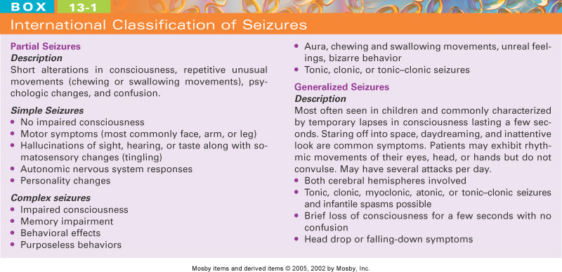

Slide 124
Partial (focal) Seizures
Excessive electrical activity in one cerebral hemisphere. -Affects only part of the body.
Simple Partial: Person may experience a range of strange or unusual sensations.
  Motor
  Sensory
  Autonomic
  Key feature: preservation of consciousness.

Slide 125
Partial (focal) Seizures
Complex Partial:
  Loss of awareness at seizure onset. Person seems dazed or confused and exhibits meaningless behaviors.
  Typically originate in frontal or temporal lobes (e.g. Temporal lobe epilepsy)

Slide 126
Generalized Seizures
Excessive electrical activity in both cerebral hemispheres.
Usually originates in the thalamus or brainstem.
Affects the whole body.
Loss of consciousness is common.

Slide 127
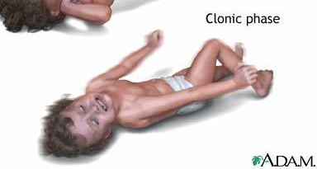
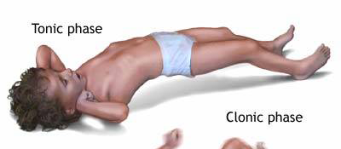
Generalized Seizures
Myoclonic: Brief shock-like muscle jerks generalized or restricted to part of one extremity.
Atonic: Sudden loss of muscle tone.
Tonic Seizures: sudden stiffening of the body, arms, or legs
Clonic Seizures: rhythmic jerking movements of the arms and legs without a tonic component
Tonic-clonic (grand mal):
  Tonic phase followed by clonic phase
http://www.nlm.nih.gov/medlineplus/ency/images/ency/fullsize/19076.jpg

Slide 128
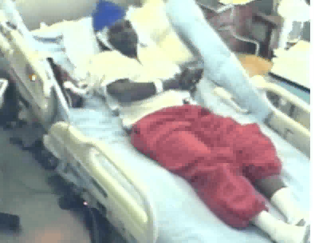
Tonic-Clonic Seizure
Can last from one to several minutes
Therapeutic intervention = lorazepam injection

Slide 129
Generalized Seizures
Absence (petit mal): Person appears to “blank out” - “Daydreaming”
  Simple Absence (primarily effects consciousness only)
  Complex Absence
  Atypical Absence (Includes physical symptoms like eye blinking or lip movements)
Lenox-Glastaut Syndrome.
  Atypical absence, atonic and myclonic
Status Epilepticus: A seizure lasting longer than 30 min, or 3 seizures without a normal period in between
  May be fatal
  Emergency intervention required

Slide 130
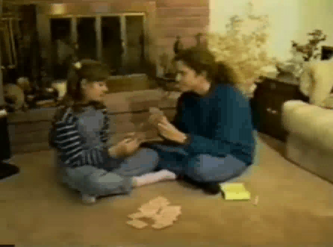
Absence Seizure
Can last from a second to several minutes

Slide 131
Antiepileptic Drug
An antiepileptic drug (AED) is a drug which decreases the frequency and/or severity of seizures in people with epilepsy
Treats the symptom of seizures, not the underlying epileptic condition
Does not prevent the development of epilepsy in individuals who have acquired a risk for seizures (e.g., after head trauma, stroke, tumor)
Goal of therapy is to maximize quality of life by eliminating seizures (or diminish seizure frequency) while minimizing adverse drug effects

Slide 132
Treatment
Try to find a cause. (e.g. fever, head trauma, drug abuse)
  Recurrent seizures that cannot be attributed to any cause are seen in patients with epilepsy.
Therapy is aimed at control
  drugs do not cure.
The type of seizure determines the choice of drug!
More than 80% of patients with epilepsy can have can have their seizures controlled with medications.

Slide 133
Treatment
Monotherapy with anticonvulsant
  Increase dose gradually until seizures are controlled or adverse effects become unacceptable.
  Multiple-drug therapy may be required.
Achieve steady-state kinetics
Monitor plasma drug levels
Avoid sudden withdrawal

Slide 134
Mechanisms of Action
3 main categories of therapeutics:
  Inhibition of voltage-gated Na+ channels to slow neuron firing.
  Enhancement of the inhibitory effects of the neurotransmitter GABA.
  Inhibition of calcium channels.
Notes:
Some drugs falls into more than one category, and some have MOAs that don’t fall into any of these categories.

Slide 135
There are Many Adverse Effects of Therapeutics!!!!
CNS Effects:
  Drowsiness, sedation, somnolence
  Depression
  Dizziness
  Slurred speech
  Ataxia
  Nystagmus
  Diploplia
  Vertigo
  Headache
  Confusion
  Tremor
  Interference with cognitive functions in learning situations
GI Effects
Dry Mouth
Nausea
Vomiting
Anorexia
Diarrhea
Rash
Fetal Abnormalities and birth defects

Slide 136
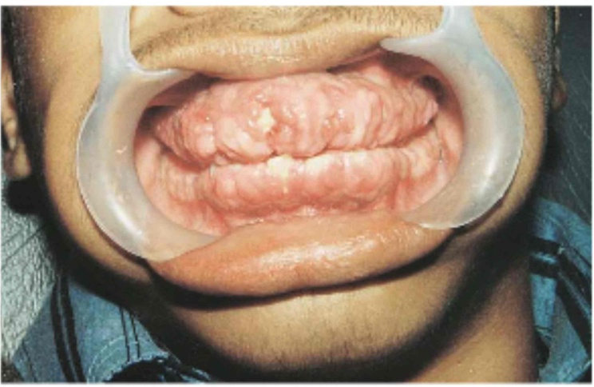
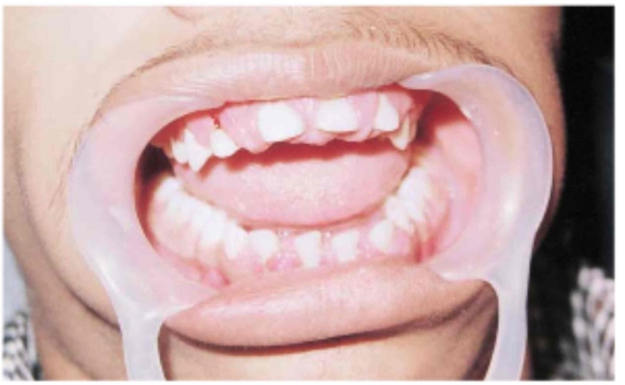
Phenytoin Induced Gingival Hyperplasia
17 year old boy treated with 300mg/day phenytoin for 2 years (unsupervised)
Partial recovery at 3 months after discontinuation
Images in Clinical Medicine (Feb 2000) 342:325

Slide 137
Long-Term Adverse
Effects of AEDs
⬧ Endocrine/Metabolic Effects
  Osteomalacia, osteoporosis
  (Vit D deficiency or other)
    carbamazepine
    barbiturates
    phenytoin
    oxcarbazepine
    valproate
  Teratogenesis (folate deficiency or other)
    barbiturates
    phenytoin
    carbamazepine
    valproate (neural tube defects)
    topiramate (cleft lip/cleft palate)
  Altered connective tissue metabolism or growth (facial coarsening, hirsutism, gingival hyperplasia or contractures)
    phenytoin
    phenobarbital
⬧ Neurologic
  Neuropathy
    phenytoin
    carbamazepine
  Cerebellar degeneration
    phenytoin
⬧ Sexual Dysfunction (polycystic ovaries et al.)
  phenytoin
  carbamazepine
  phenobarbital
  primidone

Slide 138
MECHANISM OF ACTION OF ANTIEPILEPTIC DRUGS
Antiepileptics inhibit the neuronal discharge or its spread in one or
more of the following ways:
(1) Enhancing GABA synaptic transmission: barbiturates, benzo-
diazepines, gabapentin, levetiracetam, tiagabine, vigabatrin, topira-
mate, valproate; the result is increased permeability to chloride ion,
which reduces neuronal excitability. Valproate and topiramate block
GABA transaminase and tiagabine blocks reuptake of GABA.
(2) Reducing cell membrane permeability to voltage-dependent
sodium channels: carbamazepine, lamotrigine, oxcarbazepine,
phenytoin, topiramate, valproate.
(3) Reducing cell membrane permeability to calcium T-channels:
valproate, ethosuximide; the result is diminishing of the generation
of action potential.
(4) Inhibiting excitory neurotransmitter glutamate: lamotrigine.

Slide 139
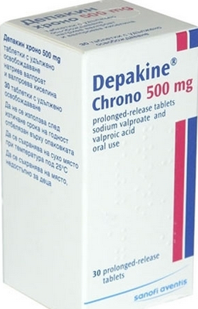
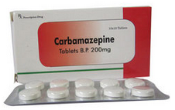
GABA
Barbiturates
Benzodiazepines
Gabapentin
Levetiracetam
Tiagabine
Topiramate
Valproate
Vigabatrin
Na⁺
Ca²⁺
Carbamazepine
Lamotrigine
Oxcarbazepine
Phenytoin
Topiramate
Valproate
Ethosuximide
Levetiracetam
Pregabalin
Valproate

Slide 140
Mechanisms of Action
GABA potentiation: Diazepam, phenobarbitone, gabapentin, tiagabine, vigabatrin.
Na⁺ ion channel block: Carbamazepine, phenytoin, valproic acid, high doses of phenobarbitone.
Ca²⁺ ion channel block: ethosuximide
& valproic acid
Glutamic acid antagonism: Felbamate, lamotrigine, topiramate.
NB: GABA= gamma amino-butyric acid.

Slide 141
Classification of antiepileptics
Older antiepileptics: Carbamazepine, clonazepam, ethosuximide, phenobarbital, phenytoin, valproic acid
Newer antiepileptics: Felbamate, gabapentin, lamotrigine, tiagabine, topiramate, vigabatrin

Slide 142
CARBAMAZEPINE
Adm: per oral.
Uses:
Partial & Tonic-clonic seizures.
Also used in trigeminal neuralgia & bipolar disorder.
Toxicities:
CNS depression (diplopia,ataxia, drowziness)
Hematotoxicity –agranulocytosis
Liver enzyme inducer,
Teratogenic.

Slide 143
PHENYTION
Adm: per oral with variable absorption
Competition for plasma protein binding
Induction of drug metabolizing enzymes.
Uses
Partial & tonic-clonic seizures.
Toxicities:
CNS depression.
Hirsutism, gingival hyperplasia, osteomalacia.
Teratogenicity (craniofacial anomalies)

Slide 144
VALPROIC ACID
Adm: per oral.
Uses: (“Broad spectrum” Antiepileptic
drug)used in:
Absence seizures
Myoclonic, partial, & tonic-clonic seizures.
Also used in bipolar disorder & migraine.
Toxicities:
GI distress,
Hepatotoxicity, inhibition of drug metabolism.
Teratogenicity (spina bifida)

Slide 145
OTHER OLDER ANTIEPILEPTIC DRUGS.
Clonazepam: Used in myoclonic seizures, anxiety states, bipolar disorder.
Causes sedation & dependence.
Ethosuximide: Only used in absence seizures.
May cause GI distress, lethargy, headache.
Phenobarbital: Used in tonic-clonic seizures & partial seizures.
Causes CNS depression, dependence, liver enzyme induction.

Slide 146
NEWER ANTIEPILEPTIC DRUGS
Felbamate: Back- up in partial seizures & myoclonic seizures.
Gabapentin: Used in partial seizures, bipolar disorder, neuropathic pain, migraine
Lamotrigine: Used in absence & partial seizures, & bipolar disorder.
Vigabatrin: Back-up in partial seizures
Topiramate, tiagabine: Back-up in partial seizures.

Slide 147
General Principles in Epilepsy Treatment
Use a single drug whenever possible and increase its dose to either seizure control or toxicity.
If a drug fails to control seizures, switch to another appropriate drug used alone and again increase the dose until seizure control occurs or toxicity intervenes.
Use two drugs only when monotherapy has failed. Some patients may have more seizures when taking two drugs, compared with one drug, because of drug interactions.

Slide 148
PRINCIPLES OF MANAGEMENT
(Clinical Parmacology – 9th Ed., 2003)
Any causative factor must be treated (cerebral neoplasm etc).
Educate the patient about the disease, duration of treatment
and need for compliance.
Avoid precipitating factor (alcohol, sleep deprivation, emotional
stress, and caffeine).
Anticipate natural variation: fits may occur around menstrual
periods in women – catamenial (monthly) epilepsy.
Give antiepileptics only if seizure type and frequency require it
(e.g. more than one fit every 6–12 months).

Slide 149
Summary

Slide 150
Anticonvulsive drugs of choice
Grand mal: I choice – valproate or Lamotrigine
Alternative – Carbamazepine, Topiramate or Phenytoin
Petit mal: I choice – Ehosuximide or valproate
Alternative – Clonazepam or Lamotrigine
Partial seizures: I choice – Carbamazepine or
valproate
Alternative – Phenytoin, Lamotrigine, Vigabatrin, Topiramate
Status epilepticus: I choice – Diazepam or Lorazepam (i.v.)
Alternative – Phenobarbital (i.m./i/v.)

Slide 151
Na+ Channel Drugs
Phenytoin (Dilantin, Phenytek)
Cabamazepine (Tegretol, Carbatrol)
Valproic Acid (Depakene, Depakote)
Lamotrigine (Lamictal)
Topiramate (Topamax)
Zonisamide (Zonegran)
Lidocaine

Slide 152
GABA Drugs
Barbiturates:
  Phenobarbital (Luminal)
  Pimidone (Mysoline)
Benzodiazepines:
  Diazepam (Valium)
  Lorazepam (Ativan)
  Clonazepam (Klonopin)
  Clorazepate (Tranxene-SD)
Tiagabine (Gabitril)
Valproic Acid (Depakene, Depakote)
Topiramate (Topamax)
Zonisamide (Zonegran)

Slide 153
Ca²⁺ Channel Drugs
Ethosuximide (Zarontin)
Valproic Acid (Depakene, Depakote)
Zonisamide (Zonegran)
Gabapentin (Neurontin)
Pregabalin (Lyrica)
Levetiracetam (Keppra)

Slide 154
Primary Generalized Tonic-Clonic (Grand Mal) Seizures
Drugs of Choice:
    Phenytoin
    Carbamazepine
    Oxcarbazepine
    Valproate
Alternatives
  Lamotrigine
  Topiramate
  Zonisamide
  Levetiracetam
  Primidone
  Phenobarbital
  Diazepam

Slide 155
Partial, Including Secondarily Generalized Seizures
Drugs of Choice:
    Phenytoin
    Carbamazepine
    Oxcarbazepine
    Valproate
Alternatives
  Lamotrigine
  Topiramate
  Zonisamide
  Levetiracetam
  Primidone
  Phenobarbital
  Gabapentin
  Pregabalin
  Tiagabine

Slide 156
Absence (Petit Mal)
Drugs of Choice:
    Ethosuximide
    Valproate
Alternatives
  Clonazepam
  Zonisamide

Slide 157
Atypical Absence, Myoclonic, Atonic Seizures
Drug of Choice:
    Valproate
Alternatives
  Clonazepam
  Topiramate
  Zonisamide
  Levetiracetam

Slide 158
CNS Depressants
HYPNOTICS AND SEDATIVES

Slide 159
SEDATIVES – reduce anxiety and exert a calming effect
Drugs that have an inhibitory effect on the
CNS to the degree that they reduce:
  Nervousness
  Excitability
  Irritability without causing sleep

Slide 160
HYPNOTICS - produces drowsiness and facilitates the onset and maintenance of a state of sleep.
Cause sleep
A sedative can become a hypnotic if it is given in large enough doses
Sedative-hypnotics—dose dependent
At low doses, calm the CNS without inducing sleep
At high doses, calm the CNS to the point of causing sleep

Slide 161
Sleep
Normal sleep is cyclic and repetitive
A sleeping person is unaware of sensory stimuli within the immediate environment
Rapid eye movement (REM) sleep
Non–rapid eye movement (non-REM) sleep
Sleep stages
REM rebound

Slide 162
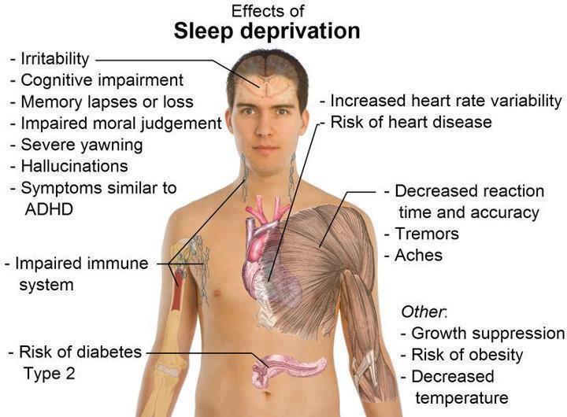

Slide 163
Gamma aminobutyric acid (GABA) is probably
the most important inhibitory transmitter in
the CNS. GABA-ergic neurons are distributed
widely in the CNS. GABA controls the state of
excitability in all brain areas and the balance
between excitatory inputs (mostly glutamatergic)
and the inhibitory GABA-ergic activity. If the balance
swings in favour of GABA, then sedation, amnesia,
muscle relaxation, and ataxia appear and nervous-
ness and anxiety are reduced. The mildest reduction
of GABA-ergic activity elicits arousal, anxiety, rest-
lessness, insomnia, and exaggerated reactivity.

Slide 164
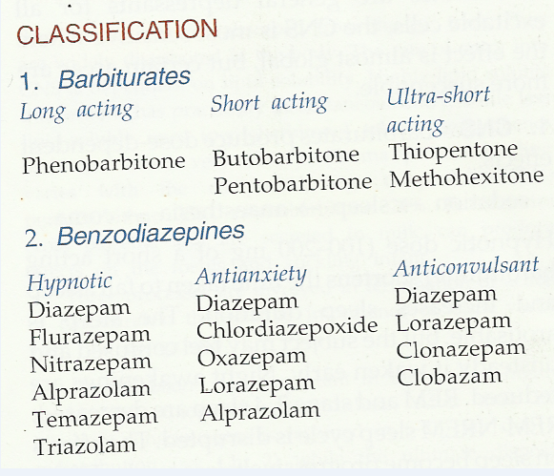

Slide 165
Barbiturates: Four Categories
Ultrashort
  Anesthesia for short surgical procedures, other uses
Short
  Sedative-hypnotic and control of convulsive conditions
Intermediate
  Sedative-hypnotic and control of convulsive conditions
Long
  Sedative-hypnotic, epileptic seizure prophylaxis, other uses

Slide 166
Barbiturates: Four Categories (cont’d)
Ultrashort
  mephohexital, thiamylal, thiopental
Short
  pentobarbital, secobarbital
Intermediate
  butabarbital
Long
  phenobarbital, mephobarbital

Slide 167
Therapeutic Index
Dosage range within which the drug is effective but above which is rapidly toxic
Barbiturates have a very narrow therapeutic index

Slide 168
Barbiturates:
Mechanism of Action
Site of action
  Brainstem (reticular formation)
By inhibiting GABA, nerve impulses traveling in the cerebral cortex are also inhibited

Slide 169
Barbiturates: Drug Effects
Low doses: sedative effects
High doses: hypnotic effects (also lower respiratory rate)
Notorious enzyme inducers
  Stimulate liver enzymes that cause the metabolism or breakdown of many drugs
  Result: shortened duration of action

Slide 170
Barbiturates: Indications
Hypnotics
Sedatives
Anticonvulsants
Anesthesia for surgical procedures

Slide 171
Barbiturates: Adverse Effects
Body System Adverse Effects
CNS Drowsiness, lethargy, vertigo, mental depression, others
Respiratory Respiratory depression, apnea, bronchospasms, cough

Slide 172
Barbiturates: Adverse Effects (cont’d)
Body System Adverse Effects
GI Nausea, vomiting, diarrhea,
constipation
Other Agranulocytosis, hypotension, Stevens- Johnson syndrome, others

Slide 173
Barbiturates: Adverse Effects (cont’d)
Reduced REM sleep, resulting in:
  Agitation
  Inability to deal with normal stress

Slide 174
Barbiturates:
Toxicity and Overdose
Overdose frequently leads to respiratory depression, and subsequently, respiratory arrest
Overdose produces CNS depression (sleep to coma and death)
Can be therapeutic
  Anesthesia induction
  Uncontrollable seizures: “phenobarbital coma”

Slide 175
Barbiturates:
Drug Interactions
Additive effects
  ETOH, antihistamines, benzodiazepines, opioids, tranquilizers
Inhibited metabolism
  MAOIs will prolong effects of barbiturates
Increased metabolism
  Reduces anticoagulant response, leading to possible clot formation

Slide 176
Common Barbiturates
butabarbital (Butisol)
pentobarbital (Nembutol)
phenobarbital (Luminal)
secobarbital (Seconal)

Slide 177
CNS Depressants: Benzodiazepines
Most frequently prescribed sedative-hypnotics
A commonly prescribed drug class
Favorable drug effect profiles

Slide 178
Benzodiazepines:
Classification
Classified as either:
  Sedative-hypnotic
  Anxiolytic (medication that relieves anxiety)

Slide 179
Benzodiazepines:
Sedative-Hypnotic Types
Long acting
  estazolam (Prosom), flurazepam (Dalmane), others
Short acting
  temazepam (Restoril)
  triazolam (Halcion)

Slide 180
CNS Depressants: Nonbenzodiazepine Hypnotics
zalepion (Sonata), zolpidem (Ambien), and eszoplicone (Lunesta)
Share many characteristics of benzodiazepines
Used to treat insomnia

Slide 181
Benzodiazepines:
Mechanism of Action
Depress CNS activity
Affect hypothalamic, thalamic, and limbic
systems of the brain
Benzodiazepine receptors
Do not suppress REM sleep as much as barbiturates do
Do not increase metabolism of other drugs

Slide 182
Benzodiazepines:
Drug Effects
Calming effect on the CNS
Useful in controlling agitation and anxiety
Reduce excessive sensory stimulation, inducing sleep
Induce skeletal muscle relaxation

Slide 183
Benzodiazepines:
Indications
Sedation
Sleep induction
Skeletal muscle relaxation
Anxiety relief
Treatment of alcohol withdrawal

Slide 184
Benzodiazepines:
Indications (cont’d)
Agitation
Depression
Epilepsy
Balanced anesthesia
Moderate/conscious sedation

Slide 185
Benzodiazepines: Adverse Effects
Mild and infrequent
Headache
Drowsiness
Dizziness
Vertigo
Lethargy
Fall hazard for frail elderly persons
“Hangover effect”

Slide 186
CNS Depressants:
Nursing Implications
Before beginning therapy, perform a thorough history regarding allergies, use of other medications, health history, and medical history
Obtain baseline vital signs and I&O, including supine and erect BPs
Assess for potential disorders or conditions that may be contraindications, and for potential drug interactions

Slide 187
Nursing Implications
Give 15 to 30 minutes before bedtime for maximum effectiveness in inducing sleep
Most benzodiazepines cause REM rebound and a tired feeling the next day; use with caution in the elderly
Patients should be instructed to avoid alcohol and other CNS depressants

Slide 188
Nursing Implications (cont’d)
Check with physician before taking any other medications, including OTC medications
Rebound insomnia may occur for a few nights after a 3- to 4-week regimen has been discontinued

Slide 189
Nursing Implications (cont’d)
Safety is important
  Keep side rails up or use bed alarms
  Do not permit smoking
  Assist patient with ambulation (especially the elderly)
  Keep call light within reach
Monitor for adverse effects

Slide 190
Nursing Implications (cont’d)
Monitor for therapeutic effects
  Increased ability to sleep at night
  Fewer awakenings
  Shorter sleep-induction time
  Few adverse effects, such as hangover effects
  Improved sense of well-being because of improved sleep

Slide 191
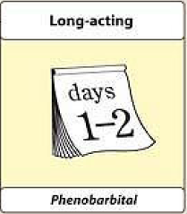
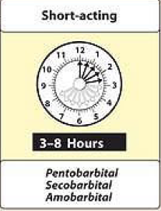
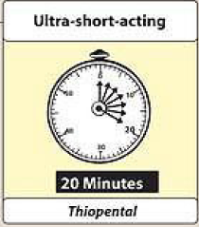
BARBITURATES CLASSIFIED ACCORDING TO THEIR DURATIONS OF ACTION

Slide 192
Barbiturates
enhance the binding of GABA to GABA_{A} receptors
Prolonging duration
Only α and β (not ϒ ) subunits are required for barbiturate action
Narrow therapeutic index
in small doses, barbiturates increase reactions to painful stimuli.
Hence, they cannot be relied on to produce sedation or sleep in the presence of even moderate pain.
Bezodiazepines
enhance the binding of GABA to GABA_{A} receptors
increasing the frequency
Unlike barbiturates, benzodiazepines do not activate GABA_{A} receptors directly

Slide 193
BARBITURATES
Mechanism of Action- Bind to specific GABA_{A} receptor subunits at CNS neuronal synapses facilitating GABA-mediated chloride ion channel opening, enhance membrane hyperpolarization.
Effects- Dose-dependent depressant effects on the CNS including
Sedation
Relief of anxiety
Amnesia
Hypnosis
Anaesthesia
Coma
Respiratory depression steeper dose-response relationship than benzodiazepines

Slide 194
BARBITURATES
ACTIONS
Depression of CNS: At low doses, the barbiturates produce sedation (calming effect, reducing excitement).
2. Respiratory depression: Barbiturates suppress the hypoxic and chemoreceptor response to CO2, and overdosage is followed by respiratory depression and death.
3. Enzyme induction: Barbiturates induce P450 microsomal enzymes in the liver.

Slide 195
BARBITURATES
PHARMACOKINETICS
All barbiturates redistribute in the body.
Barbiturates are metabolized in the liver, and inactive metabolites are excreted in the urine.
They readily cross the placenta and can depress the fetus.
Toxicity: Extensions of CNS depressant effects
dependence liability > benzodiazepines.
Interactions: Additive CNS depression with ethanol and many other drugs induction of hepatic drug-metabolizing enzymes.

Slide 196
THERAPEUTIC USES
ANESTHESIA (THIOPENTAL, METHOHEXITAL)
Selection of a barbiturate is strongly influenced by the desired duration of action.
The ultrashort-acting barbiturates, such as thiopental, are used intravenously to induce anesthesia.
ANXIETY
Barbiturates have been used as mild sedatives to relieve anxiety, nervous tension, and insomnia.
When used as hypnotics, they suppress REM sleep more than other stages. However, most have been replaced by the benzodiazepines.

Slide 197
THERAPEUTIC USES
ANTICONVULSANT: (PHENOBARBITAL, MEPHOBARBITAL)
Phenobarbital is used in long-term management of tonic-clonic seizures, status epilepticus, and eclampsia.
Phenobarbital has been regarded as the drug of choice for treatment of young children with recurrent febrile seizures.
However, phenobarbital can depress cognitive performance in children, and the drug should be used cautiously.
Phenobarbital has specific anticonvulsant activity that is distinguished from the nonspecific CNS depression.

Slide 198
ADVERSE EFFECTS
CNS: Barbiturates cause drowsiness, impaired concentration.
2. Drug hangover: Hypnotic doses of barbiturates produce a feeling of tiredness well after the patient wakes.
Barbiturates induce the P450 system.
By inducing aminolevulinic acid (ALA) synthetase, barbiturates increase porphyrin synthesis, and are contraindicated in patients with acute intermittent porphyria.

Slide 199
ADVERSE EFFECTS
Physical dependence: Abrupt withdrawal from barbiturates may cause tremors, anxiety, weakness, restlessness, nausea and vomiting, seizures, delirium, and cardiac arrest.
Poisoning: Barbiturate poisoning has been a leading cause of death resulting from drug overdoses for many decades.
It may be due to automatism.
Severe depression of respiration is coupled with central cardiovascular depression, and results in a shock-like condition with shallow, infrequent breathing.

Slide 200
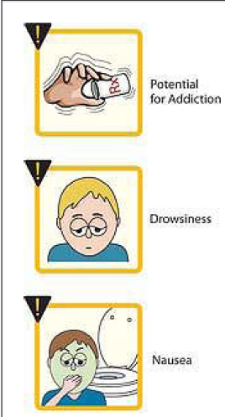
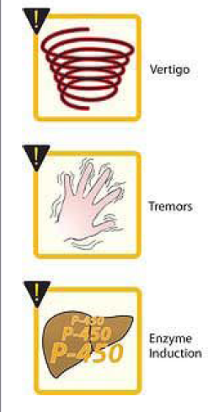
ADVERSE EFFECTS

Slide 201
THE TREATMENT OF ACUTE BARBITURATE INTOXICATION
Treatment includes artificial respiration and purging the stomach of its contents if the drug has been recently taken.
No specific barbiturate antagonist is available.
General supportive measures.
Hemodialysis or hemoperfusion is necessary only rarely.
Use of CNS stimulants is contraindicated because they increase the mortality rate.

Slide 202
THE TREATMENT OF ACUTE BARBITURATE INTOXICATION
If renal and cardiac functions are satisfactory, and the patient is hydrated, forced diuresis and alkalinization of the urine will hasten the excretion of phenobarbital.
In the event of renal failure - hemodialysis
circulatory collapse is a major threat. So hypovolemia must be corrected & blood pressure can be supported with dopamine.
Acute renal failure consequent to shock and hypoxia accounts for perhaps one-sixth of the deaths.

Slide 203
BENZODIAZEPINES

Slide 204
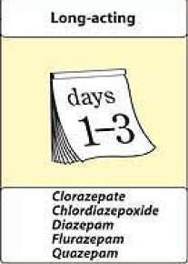
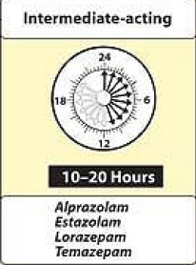
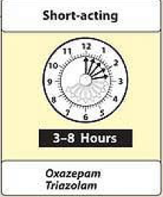
COMPARISON OF THE DURATIONS OF ACTION OF THE BENZODIAZEPINES

Slide 205
Effects of benzodiazepine
On increasing the dose sedation progresses to hypnosis and then to stupor.
But the drugs do not cause a true general anesthesia because
-awareness usually persists
-immobility sufficient to allow surgery cannot be achieved.
However at "preanesthetic" doses, there is amnesia.

Slide 206
Respiration-Hypnotic doses of benzodiazepines are without effect on respiration in normal subjects
CVS-In preanesthetic doses, all benzodiazepines decrease blood pressure and increase heart rate

Slide 207
PHARMACOKINETICS
A short elimination t_{1/2} is desirable for hypnotics, although this carries the drawback of increased abuse liability and severity of withdrawal after drug discontinuation.
Most of the BZDs are metabolized in the liver to produce active products (thus long duration of action).
After metabolism these are conjugated and are excreted via kidney.

Slide 208
ADVERSE EFFECTS
Light-headedness
Fatigue
Increased reaction time
Motor incoordination
Impairment of mental and motor functions
Confusion
Antero-grade amnesia
Cognition appears to be affected less than motor performance.
All of these effects can greatly impair driving and other psychomotor skills, especially if combined with ethanol.

Slide 209
FLUMAZENIL: A BENZODIAZEPINE RECEPTOR ANTAGONIST
competitively antagonism
Flumazenil antagonizes both the electrophysiological and behavioral effects of agonist and inverse-agonist benzodiazepines and β -carbolines.
Flumazenil is available only for intravenous administration.
On intravenous administration, flumazenil is eliminated almost entirely by hepatic metabolism to inactive products with a t_{1/2} of ~1 hour; the duration of clinical effects usually is only 30-60 minutes.

Slide 210
BDZ Actions
BDZ have no antipsychotic activity nor any analgesic action and do not affect the autonomic nervous system.
Actions
1. Reduction of anxiety: at low dose they reduce anxiety by selectively inhibiting neuronal circuits in the limbic system of the brain

Slide 211
BDZ Actions
2. Sedative and Hypnotic action: All BDZ have sedative action and some produce hypnosis at higher doses.
3. Anticonvulsant action: Several BDZ have anticonvulsant action and used to treat epilepsy and seizure disorders.
4. Muscle relaxant: The benzodiazepines relax spasticity of skeletal muscle probably by increasing presynaptic inhibition in the spinal cord.

Slide 212
Therapeutic Uses
Pharmacokinetic variation and duration of action influence the choice of BDZ
1. Anxiety disorders associated with depression: longer acting drugs such diazepam are often preferred alprazolam is effective but may cause withdrawal reactions.
2. Muscular disorders: such as muscle strain, cerebral palsy diazepam is effective.

Slide 213
Therapeutic Uses
3. Seizures: Clonazepam is useful in chronic treatment of epilepsy, whereas diazepam is the drug of choice in terminating grand mal epileptic seizures and status epilepticus.
Chlordiazepoxide, Clorazepate, diazepam and oxazepam are useful in the acute treatment of alcohol withdrawal.

Slide 214
Therapeutic Uses
4. Sleep disorders: Not all BDZ have hypnotic action although all have sedative or calming action. Drugs of choice for sleep disorders include, long acting - flurazepam, intermediate acting – temazepam and short acting triazolam

Slide 215
ANXYOLITICS
Alprazolam
Chlordiazepoxide
Buspirone
Diazepam
Lorazepam
Oxazepam
Triazolam
Phenobarbital
Halazepam
Prazepam
HYPNOTICS
Chloral hydrate
Estazolam
Flurazepam
Pentobarbital
Lorazepam
Quazepam
Triazolam
Secobarbital
Temazepam
Zolpidem

Slide 216
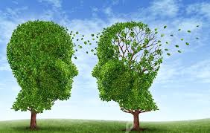
ANXIOLYTICS
(tranquilizers)

Slide 217

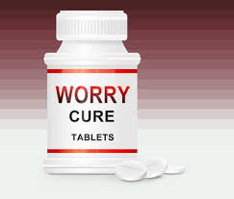
Antianxiety drugs (anxyolitics)
Anxiolytic drugs are designed for treatment of anxiety, panic disorders and phobias.
Anxiety is unpleasant emotional state characterised by uneasiness, discomfort, fear about some defined or undefined threat.

Slide 218
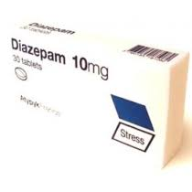
Antianxiety drugs (classification)
1.BENZODIAZEPINES
a). Short acting
Oxazepam
Triazolam
b). Intermediate acting
Lorazepam
Alprazolam
Estazolam
Temazepam
c). Long acting
Chlordiazepoxide (Chlozepidum)
Clonazepam
Clorazepate
Diazepam (Sibazonum)
Phenazepamum
Medazepam (Mezapam, Rudotel)

Slide 219
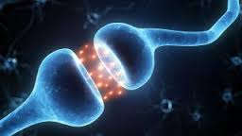
Antianxiety drugs classification cont.
2. PROPANDIOL DERIVATIVE
Meprobamate (Meprotanum)
3. DIPHENYLMETHANE DERIVATIVE
Benactyzime (Amizylum)
4. AZAPIRONES
Buspirone
Gepirone
Tofizopam (Grandaxin)
5. MISCELLANEOUS
Trimetozine (Trioxazin)
Hydroxyzine
Zolpidem

Slide 220
Medical uses of tranquilizers
Anxiolytic action
Treatment of neurosis, accompanied by fear, anxiety, exertion, increased irritability, insomnia;
In case of headache and heart pain of neurotic origin, so called organic neurosis;
In case of abstinence in alcohol and drugs addicts;
In case of diencephalons crisis (sybazon).
Tranquilizers do not diminish productive symptoms of psychosis!

Slide 221
Antipsychotics and bipolar drugs

Slide 222
Introduction
The term psychosis refers to a variety of mental disorders characterized by one or more of the following symptoms:
    Diminished and distorted capacity to process information and draw logical conclusions;
    Hallucinations, usually auditory or visual, but sometimes tactile or olfactory;
    Delusions (false believes);
    Incoherence or marked loosening of associations;
    Catatonic or disorganized behavior;
    Aggression or violence;

Slide 223
PSYCHOTROPIC DRUGS
Drugs with depressive type of action
Neuroleptics (antipsychotics)
Tranquilizers (anxiolytics)
Sedative drugs
Normotymics (tymoleptics, tymoanaleptics)
Drugs with stimulative action
Antidepressants
Psychomotor stimulants
Nootropic drugs
Drugs which increase general tone (adaptogens)

Slide 224
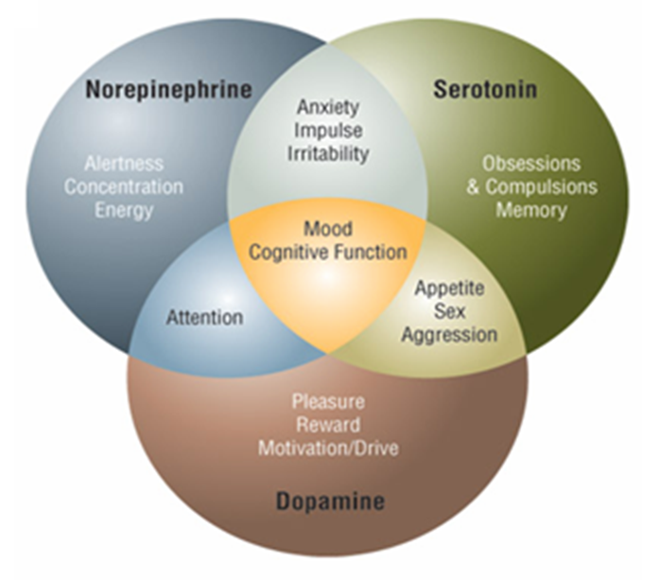
The effects of DA, 5-HT and NE on the brain functions

Slide 225
Classification of neuroleptics (cont.)
Atypical neuroleptics
Clozapine
Olanzapine
Remazopride
Risperidone
Ziprasidone

Slide 226
Mechanisms of action of neuroleptics
Antipsychotic effect of TYPICAL neuroleptics is realized via blockade of dopamine receptors, mainly D2 receptors of the mesolimbic and mesocortical pathways.
Antipsychotic effect of ATYPICAL neuroleptics is realized via blockade of serotoninergic (5-HT2), relatively selective D4 receptors and
α1- adrenoceptors.

Slide 227
Pharmacodynamic of neuroleptics
1. CNS: In normal individuals antipsychotics produce
neuroleptic syndrome – indifference to surroundings,
deficiency of thought, psychomotor slowing, emotional
quieting, reduction in initiative.
In psychotic patients neuroleptics reduce
irrational behaviour, agitation and aggresiveness.
They control psychotic symptomatology. Disturbed
thought and behaviour are gradually normalized,
anxiety is relieved. Hyperactivity, hallucinations,
and delusions are suppressed.
NB!!! The psychosedative effect is produced immediately
while the antipsychotic effect takes a week to develop.
Tolerance develops only to the psychosedative effect.

Slide 228
Pharmacodynamic of neuroleptics cont.
The thermoregulatory centre is turned off,
rendering the patient poikilothermic (body tem-
perature falls if surroundings are cold and the contrary).
The medullary, respiratory and other vital centres
are not affected, except of very high doses. It is very
difficult to produce coma with neuroleptics.
Antiemetic effect is exerted through the CTZ
( D-ergic activity). Almost all neuroleptics, except thioridazine, have this effect. However, they are ineffective in motion sickness.
Antipsychotic agents produce
a state of rigidity and immobility (catalepsy).

Slide 229
Pharmacodynamic of neuroleptics cont.
2. ANS: Neuroleptics have varying degrees of
α-adrenergic blocking activity and produce
hypotension (primarily postural). The hypotensive
effect is more marked after parenteral administration.
Anticholinergic property of neuroleptics is weak.
The phenothiazines have weak H₁-antihistaminic and
anti-5-HT actions as well. Promethazine has strong
sedative, and H₁-antihistaminic action.
3. Endocrine system: Neuroleptics consistently
increase prolactin release by blocking the inhibitory
action of DA on pituitary gland. This may result
in galactorrhea and gynecomastia. They reduce
gonadotrophins, ACTH, GH and ADH secretion.

Slide 230
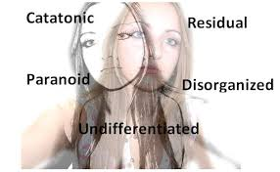
Psychiatric INDICATIONS of neuroleptics
1.Schizophrenia is the primary
indication for neuroleptics.
Unfortunately, many patients
show little response.
2.Antipsychotics are also indicated for schizoaffective
disorders, which share characteristics of both
schizophrenia and affective disorders.
The psychotic aspects of this illness require treatment
with antipsychotic drugs, which may be used with other
drugs such as antidepressants, lithium, or valproates.

Slide 231
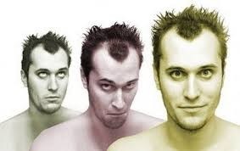

Whilst a typical antipsychotics should
provide adequate treatment of positive symptoms
including hallucinations and delusions in at least
60% of cases, patients are often left with
unresolved negative symptoms such as
apathy, flattening of affect, and alogia.
Evidence suggests that clozapine and the newer atypicals have a significant advantage over typical drugs against negative symptoms.

Slide 232
Psychiatric INDICATIONS of neuroleptics
The manic phase in bipolar affective disorder often
requires treatment with neuroleptics (chlorpromazine,
haloperidol), though lithium or valproic acid
supplemented with high-potency benzodiazepines
(e.g. lorazepam or clonazepam) may suffice
in milder cases.
!!! Recent controlled trials support the efficacy of
monotherapy with atypical antipsychotics in the
acute phase (up to 4 weeks) of mania, and
olanzapine has been approved for this indication !!!

Slide 233
Psychiatric INDICATIONS of neuroleptics
Nonmanic excited states may also be managed
by antipsychotics, often in combination with
benzodiazepines.
Other indications for the use of antipsychotics
include disturbed behavior in patients with
Alzheimer's disease, and psychotic depression.
Antipsychotics are not indicated for the treatment
of various withdrawal syndromes, e.g. opioid
withdrawal. In small doses antipsychotics have
been promoted (wrongly) for the relief of anxiety
associated with minor emotional disorders, but
the anxiolytic agents are preferred.

Slide 234
Nonpsychiatric indications
(1) Most older antipsychotics, with the exception of
thioridazine, have a strong ANTIEMETIC EFFECT.
This action is due to D₂-RECEPTOR BLOCKADE,
both centrally (in the chemoreceptor trigger zone
of the medulla) and peripherally (on receptors in
the stomach). Some drugs, such as prochlorperazine
are promoted only as antiemetics.
Phenothiazines with shorter side chains have consi-
derable H₁-receptor-blocking action and used for
(2) relief of pruritus or, in the case of promethazine,
as (3) preoperative sedatives. The butyrophenone
droperidol is used in combination with an opioid,
fentanyl, in neurolept-anaesthesia (-analgesia).

Slide 235
Adverse reactions of neuroleptics:
– behavioral effects:
The older typical antipsychotic drugs are unpleasant
to take. Many patients stop taking these drugs
because of the adverse effects, which may be
soften by giving small doses during the day and
the major portion at bedtime.
A “pseudodepression” that may be due to drug-induced akinesia usually responds to treatment with antiparkinsonian drugs.Other pseudodepressions may be due to higher doses; the decreasing the dose may relieve the symptoms.
Toxic-confusional states may occur
with very high doses of drugs that have
prominent antimuscarinic actions.

Slide 236
Adverse reactions of neuroleptics cont.
Neurologic effects:
Extrapyramidal reactions occurring early during
treatment with older agents include typical neuroleptics.
a) Parkinson's syndrome, akathisia (uncontrollable
restlessness), and acute dystonic reactions
(spastic retrocollis or torticollis).
NB!!! Parkinsonism can be treated, with conventional antiparkinsonian drugs of the antimuscarinic type or, in rare cases, with amantadine.

Slide 237
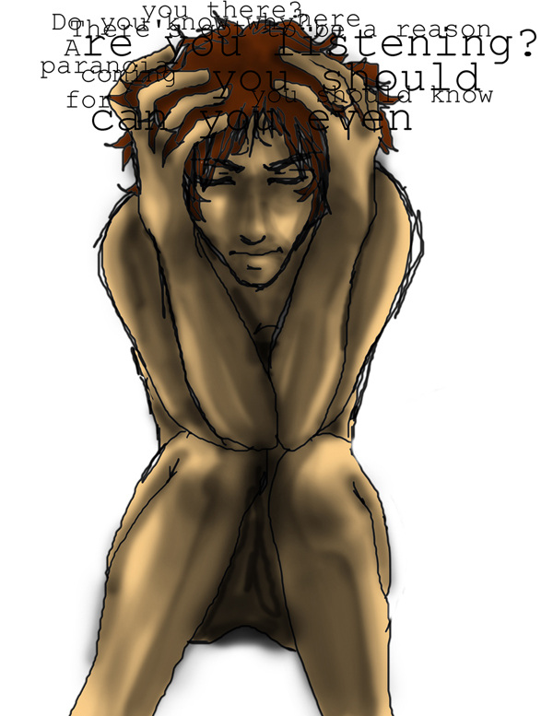
Adverse reactions of neuroleptics cont.
b)Tardive dyskinesia
- persistent involuntary
movements of mouth,
tongue or face.
Autonomic nervous system side effects
Antimuscarinic (atropine-like) adverse effects:
urinary retention, dry mouth, midriasis.
Alpha-blockade: Orthostatic hypotension or impaired
ejaculation should be managed by switching to drugs
with less marked adrenoceptor-blocking actions.

Slide 238
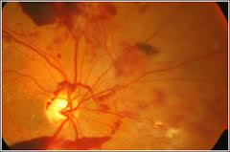
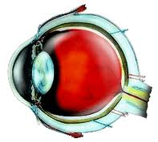
Adverse reactions of neuroleptics cont.
Ocular complications
Deposits in the anterior portions of the eye
(cornea and lens) are a common complication of
Chlorpromazine therapy.
Thioridazine is the only antipsychotic
drug that causes retinal deposits,
which in advanced cases may resemble retinitis
pigmentosa. The deposits are usually associated
with “browning” of vision. The maximum daily
dose of thioridazine has been limited to 800 mg
to reduce the possibility of this complication.

Slide 239
Adverse reactions of neuroleptics cont.
Metabolic and endocrine side effects
Weight gain is very common, especially with
clozapine and olanzapine, and requires monitoring
of food intake, especially carbohydrates.
Hyperglycemia may develop.
Hyperprolactinemia in women results in the
amenorrhea – galactorrhea syndrome and infertility; in men loss of libido, impotence, gynecomastia and infertility may result.
Toxic or allergic reactions
Agranulocytosis, cholestatic jaundice, and skin
eruptions occur rarely with the high-potency
antipsychotic drugs currently used.

Slide 240
Adverse reactions of neuroleptics cont.
Neuroleptic malignant syndrome
This life-threatening ADR occurs in patients who
are extremely sensitive to the extrapyramidal effects
of antipsychotics. The initial symptom is marked
muscle rigidity. If sweating is impaired, as it often
is during treatment with anticholinergic drugs,
fever may ensue, often reaching dangerous levels.
The stress leukocytosis and high fever associated
with this syndrome suggest an infectious process.
Autonomic instability, with altered blood pressure
and pulse rate, is often present. Creatinekinase
isoenzymes are usually elevated, reflecting
muscle damage.

Slide 241
Adverse reactions of neuroleptics cont.
Neuroleptic malignant syndrome cont.
This syndrome is believed to result from an excessively
rapid blockade of postsynaptic DA receptors. A severe
form of extrapyramidal syndrome follows.
Early in the course, vigorous treatment of the
extrapyramidal syndrome with antiparkinsonian drugs
is worthwhile.
Muscle relaxants, particularly diazepam, are often
useful. Other muscle relaxants, such as dantrolene,
or DA agonists, such as bromocriptine, have been
reported to be helpful.
If fever is present, cooling by physical measures
should be tried.

Slide 242
Introduction
The antipsychotic drugs (neuroleptics)
  Drug used in treatment of schizophrenia treatment and other psychoses and agitated states.
Older drugs have high affinity for dopamine D₂ receptors,
  whereas newer antipsychotic drugs have greater affinity for serotonin 5-HT ₂ receptors.
Neuroleptics do not cure schizophrenia and other psychoses, but rather amerliorate the associated symptoms, including
  thought disorder,
  emotional withdrawal,
  and hallucinations or delusions,
Note: many patients require prolonged therapy (years) and thus resulting to severe toxicity in some cases
Bipolar affective disorder:
  Use of newer antipsychotic drugs and antiseizure agents replacing lithium which has been the mainstay of treatment for years

Slide 243
Antipsychotic drugs
Classification:
  Classic/typical drugs
    Have higher antagonistic affinity for Dopamine D2 receptor
    Include:
      Phenothiazines: chlorpromazine, thioridazine, fluphenazine
      Butyrophenones: haloperidol
  Newer drugs
    Have higher antagonistic affinity for 5HT2 receptors
    Include:
      Olanzapine
      Clozapine
      Risperidone
      etc

Slide 244
Antipsychotic drugs
Pharmacokinetics:
Antipsychotics are lipid soluble, hence
  well absorbed when given orally, and also readily entering the central nervous system (CNS) and most other body tissues.
Many are bound extensively to plasma proteins.
They require metabolism by liver enzymes before elimination and have long plasma half-lives that permit once-daily dosing.
In some cases, other drugs that inhibit cytochrome P450 enzymes can prolong the half-lives of antipsychotic agents.
Parenteral forms of many agents (e.g, fluphenazine, haloperidol) are available for both rapid initiation of therapy and depot treatment.

Slide 245
Antipsychotic drugs
Mechanisms of action:
  The dopamine hypothesis of schizophrenia:
    proposes that the disorder is caused by a relative excess of functional activity of the neurotransmitter dopamine in specific neuronal tracts in the brain
    However, the hypothesis is not fully satisfactory, given that;
      antipsychotic drugs are only partly effective in most patients
      many effective drugs have a much higher affinity for other receptors, including serotonin receptors, than for D₂ receptors
  The mechanism of action thus differs by the category/generation of antipsychotic drugs:
    Typical/classic antipsychotic drugs: Have higher antagonistic affinity for dopamine d2 receptors
    Newer antipsychotic drugs: Have higher antagonistic affinity for 5HT2 (serotonin) receptors
  With the exception of haloperidol, all antipsychotic drugs block H₁ receptors to some degree- this feature useful in their use as antiemetics

Slide 246
Antipsychotic drugs
Clinical applications:
  Psychiatric indications:
    Schizophrenia
    Bipolar disorder (manic phase)
  Nonpsychiatric uses:
    Phenothiazines cause blockade of H₁-receptor, thus providing the basis for their use as:
      Antiemetic
      Sedatives
      Antipruritics

Slide 247
Antipsychotic drugs
Toxicities:
  1) Reversible Neurologic Effects
    These are dose-dependent extrapyramidal effects including a Parkinson-like syndrome with bradykinesia, rigidity, and tremor
    The toxicity can be reversed by reduction in dose;
      Also antagonized by co administration with muscarinic blocking agents
    Extrapyramidal effects occur more frequently with older drugs (e.g haloperidol) than newer drugs (e.g olanzapine)

Slide 248
Antipsychotic drugs
  2) Tardive Dyskinesias
    choreoathetoid movements of the muscles of the lips and buccal cavity; usually irreversible
    Tardive dyskinesias tend to develop after several years of antipsychotic drug therapy
      but have appeared as early as 6 mo
    Antimuscarinic drugs that usually ameliorate other extrapyramidal effects generally increase the severity of tardive dyskinesia symptoms
      There is no effective drug treatment for tardive dyskinesia;.

Slide 249
Antipsychotic drugs
  3) Autonomic Effects
    Result from blockade of peripheral muscarinic receptors and adrenoceptors
      They are more difficult to manage in elderly patients
    muscarinic receptor blockade results to atropine-like effects: dry mouth, constipation, urinary retention, and visual problems
    Alpha receptor blockade is associated with postural hypotension (fainting)
    Failure to ejaculate is common in men treated with the phenothiazines

Slide 250
Antipsychotic drugs
  4) Endocrine and Metabolic Effects
    Effects related to dopamine blockade in the pituitary: hyperprolactinemia, gynecomastia, the amenorrhea-galactorrhea syndrome, and infertility
      dopamine is the normal inhibitory regulator of prolactin secretion
    Diabetogenic actions (significant weight gain and hyperglycemia) associated with newer/atypical agents especially clozapine and olanzapine

Slide 251
Antipsychotic drugs
  5) Neuroleptic Malignant Syndrome
    a malignant hyperthermic syndrome that develops in patients who are particularly sensitive to the extrapyramidal effects of antipsychotic drugs
    symptoms include:
      muscle rigidity,
      impairment of sweating,
      hyperpyrexia,
      and autonomic instability, which may be life threatening.
    Drug treatment;
      prompt use of diazepam, dopamine agonists.

Slide 252
Antipsychotic drugs
  6) Sedation
    This is more marked with phenothiazines (especially chlorpromazine) than with other antipsychotics;
    Fluphenazine and haloperidol are the least sedating of the older drugs;
      aripiprazole appears to be the least sedating of the newer agents.

Slide 253
Antipsychotic drugs
Overdose toxicity:
  Hypotension: managed with fluid replacement
  Seizures:
    Most neuroleptics lower the convulsive threshold and may cause seizures, which are usually managed with diazepam or phenytoin

Slide 254
Drugs for Bipolar (Manic-Depressive) Disorder
Classification:
  Typical:
    Lithium
  Newer drugs:
    Carbamazepine
    Lamotrigine
    Valproic acid
Specific mechanisms unclear;
  Lamotrigine and valproic acid facilitate GABA inhibitory activity- refer to topic on antiseizure drugs

Slide 255
Antidepressants

Slide 256

Psychopharmacology
L MWEETWA-Pharmacologist

Slide 257
Antidepressants
Introduction
If you fail an important examination, lose a loved one or a job, or get dumped in a relationship, it is normal to feel depressed. But if you remain depressed for more than two weeks, long after the event has passed, then you may have a common clinical disorder calleddepression. Clinical depression, also called major depressive disorder, is characterized by a sad or blue mood that affects nearly every aspect of your life every day – your family and social relationships, your work or school performance, even your desire to do simple things such as exercise or go out with friends.

Slide 258
Depression Overview
What causes depression?
Like most mental disorders, the causes of depression are largely unknown. Researchers and clinicians theorize that depression is the result of three related factors – biological, psychological and social

Slide 259
Symptoms of Depression
loss of interest or pleasure in daily activities consistently for at least a 2 week period.
Depressed mood most of the day, as indicated by either the person’s own feeling (e.g., feeling sad or empty) or as observed by others (e.g., appears tearful). (In children and adolescents, this may be characterized as an irritable mood.)
Significant weight loss when not dieting or weight
Can’t sleep (insomnia) or sleeping too much (hypersomnia)
psychomotor agitation, Psychomotor retardation
Fatigue or loss of energy
Feelings of worthlessness or excessive or inappropriate guilt
Diminished ability to think or concentrate, or indecisiveness
Recurrent thoughts of death (not just fear of dying), recurrent suicidal ideation without a specific plan, or a suicide attempt or a specific plan for committing suicide

Slide 260
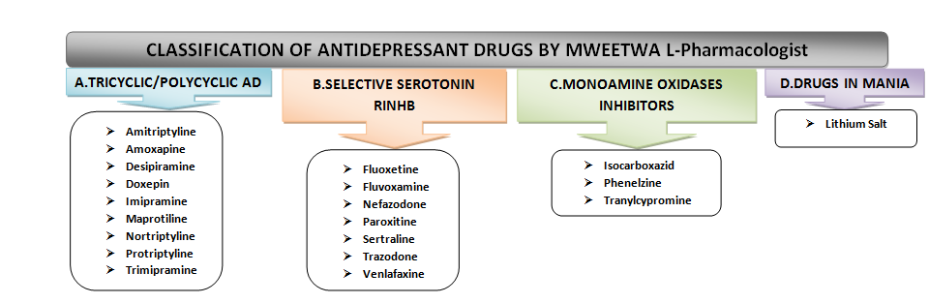
Antidepressant Drug Classification

Slide 261
AD Classification
1) Tricyclics and Tetracyclics (TCA)
Imipramine Doxepin Desipramine Amoxepine Trimipramine
Maprotiline Clomipramine Amitriptyline Nortriptyline Protriptyline
2) Monoamine Oxidase Inhibitors (MAOIs)
Tranylcypramine Phenelzine Moclobemide
3) Serotonin Selective Reuptake Inhibitors (SSRIs)
Fluoxetine Fluvoxamine
Sertraline Paroxetine Citalopram
4) Dual Serotonin and Norepinephrine Reuptake Inhibitor (SNRI)
Venlafaxine Duloxetine
5) Serotonin-2 Antogonist and Reuptake Inhibitors (SARIs)
Nefazodone Trazodone
6) Norepinephrine and Dopamine Reuptake Inhibitor (NDRI)
Bupropion
7) Noradrenergic and Specific Serotonergic Antidepressant (NaSSAs)
Mirtazapine
8) Noradrenalin Specific Reuptake Inhibitor (NRI)
Reboxetine
9) Serotonin Reuptake Enhancer
Tianeptine

Slide 262
Introduction
Major depressive disorder, or endogenous depression,
  a depression of mood without any obvious medical or situational causes,
    manifested by an inability to cope with ordinary events or experience pleasure.
The drugs used in major depressive disorder are of varied chemical structures;
  Most of these drugs exert there effects by
    Enhancing the CNS actions of norepinephrine, serotonin, or both.

Slide 263
Introduction
The Amine Hypothesis of Mood
Brain amines,
  particularly norepinephrine (NE) and serotonin (5-HT), are neurotransmitters in pathways that function in the expression of mood.
A functional decrease in the activity of such amines is thought to result in depression;
  a functional increase of activity results in mood elevation.

Slide 264
Classification
1) Tricyclic Antidepressants:
  Structurally related drugs that block reuptake transporters of both norepinephrine (NE) and serotonin (5-HT)
  Drugs:
    Amitriptylline
    Clomipramine
    Imipramine
  Block norepinephrine (NE) and 5-HT transporters
  Toxicities:
    alpha block: hypotension,
    Muscarinic block: atropine like effects
    sedation,
    weight gain;
    Overdose: arrhythmias, seizures

Slide 265
2) Selective serotonin reuptake inhibitors (SSRIs)
  Drugs that selectively inhibit serotonin (5-HT) transporters with only modest effects on other neurotransmitters
  Drugs:
    Fluoxetine
    Citalopram,
    paroxetine,
    sertraline,
  Toxicities: Sexual dysfunction

Slide 266
3) Serotonin-norepinephrine reuptake inhibitors (SNRIs)
  Drugs that block NE and 5-HT transporters,
    but lack the alpha blocking, anticholinergic and antihistaminic actions of TCAs
  Drugs:
    Venlafaxin
    Duloxetine
    Desvenlafaxine
  Toxicities:
    Anticholinergic,
    sedation,
    hypertension

Slide 267
4) 5-HT₂ antagonists
  Drugs:
    Nefazodone
    Trazodone
  Block 5-HT₂ receptors
  Toxicities: Sedation; modest alpha and H₁ blockade

Slide 268
5) Monoamine oxidase inhibitors (MAOIs)
  Drugs:
    Phenelzine
    Selegiline
    Isocarboxazid
  Inhibit MAO-A and MAO-B
  Toxicities: Hypotension, insomnia

Slide 269
6) Heterocyclics
  Antidepressants of varying chemical structures,
    the characteristics of which do not strictly conform to any of the above designations
  Drugs:
    Amoxapine
    Bupropion
    Maprotilin
    Mirtazepine
  Mirtazepine blocks presynaptic alpha₂ receptors;
    mechanism of action of others uncertain
  Toxicities:
    Lowers seizure threshold (amoxapine, bupropion);
    sedation
    and weight gain (mirtazepine)

Slide 271
Pancreatic Hormones, Antidiabetic Agents, & Glucagon

Slide 272
Introduction
The islets of Langerhans in the pancreas contain at least 4 types of endocrine cells;
  A (alpha, glucagon producing),
  B (beta, insulin, and amylin producing),
  D (delta, somatostatin producing),
  F (pancreatic polypeptide producing).
  The B (insulin-producing) cells form the majority of the above.
Diabetes mellitus (a deficiency of insulin production or effect) is the most common pancreatic disorder, where pharmacotherapy is indicated.
Treatment of diabetes:
  parenteral formulations of insulin
  oral or parenteral noninsulin antidiabetic agents.
Glucagon, which mobilizes glycogen stores in the liver can be used to treat severe hypoglycemia.

Slide 273
Diabetes Mellitus
Classification of diabetes:
  Type 1 diabetes:
    Also referred as insulin dependent; it requires treatment with insulin
    usually has its onset during childhood and results from autoimmune destruction of pancreatic B cells.
  Type 2 diabetes;
    a progressive disorder characterized by increasing insulin resistance and diminishing insulin secretory capacity.
    Usually associated with obesity and is more common than type 1 diabetes.
    usually has its onset in adulthood,
      though the incidence in children and adolescents is rising dramatically, in parallel with the increase in obesity in children and adolescents.
    Early stages of type 2 diabetes can be managed with noninsulin antidiabetic drugs; with insulin being added to the drug regimen as the disease progresses

Slide 274
Diabetes Mellitus
While the clinical history and course of the 2 types of diabetes differs considerably, treatment in both cases requires careful attention to:
  diet,
  fasting and postprandial blood glucose concentrations,
  serum concentrations of hemoglobin A_{1c},
    a glycosylated hemoglobin that serves as a marker of glycemia.

Slide 275
Antidiabetic drugs
Classification:
1) Insulin
  Rapid acting; e.g lispro
  Short acting; e.g regular
  Intermediate acting; e.g Neutral protamine Hagedorn (NPH), lente
  Slow, long acting; e.g glargine
2) Non insulin antidiabetic drugs/oral hypoglycemic agents:
  Insulin secretagogues; e.g glipizide
  Biguanides; e.g metformin
  Thiazolidinediones; e.g pioglitazone
  Alpha glucosidase inhibitors; e.g acarbose
  others

Slide 276
Insulin
Effects
Liver
  Causes increases in the storage of glucose as glycogen liver.
  also decreases protein catabolism.
Skeletal Muscle
  stimulates glycogen synthesis and protein synthesis.
Adipose Tissue
  Insulin facilitates triglyceride storage by activating plasma lipoprotein lipase,
  increasing glucose transport into cells
  Reduces intracellular lipolysis.

Slide 277
Insulin
Insulin Preparations
  The bacterial recombinant DNA technology is applied in manufacturing of Human insulin
  Available insulin types have varying rates of onset and duration of effect
    See Figure 41–1
  goals of insulin therapy:
    To control both basal and postprandial (after a meal) glucose levels
      while minimizing the risk of hypoglycemia.
    Combinations of insulin formulations with different rates of onset and duration of effect are usually applied to achieve the above goals.

Slide 278
Insulin
Rapid-Acting
  insulin lispro, insulin aspart, and insulin glulisine
  These have rapid onsets and early peaks of activity
    Thus allowing for control of postprandial glucose levels.
      Onset: 15-30 min.
      Peak: 30-90 min
      Duration: 3-5 hours
  The rapid-acting insulins are injected immediately pre-meal;
    They are the preferred insulin for continuous subcutaneous infusion devices.
    They can also be useful in emergency treatment of uncomplicated diabetic ketoacidosis

Slide 279
Insulin
Short-Acting
  Regular insulin
    used intravenously in emergencies;
    Also administered subcutaneously in ordinary maintenance regimens, alone or mixed with intermediate- or long-acting preparations:
      Onset: 30 min- 1 hour
      Peak: 2-5 hours
      Duration: 5-8 hours
    Regular insulin was the insulin indicated for controlling postprandial glucose concentrations before introduction of rapid acting insulins,
      It however requires administration 1 h or more before a meal.

Slide 280
Insulin
Intermediate-Acting
  Neutral Protamine Hagedorn insulin (NPH insulin)
    A combination of regular insulin and protamine (a highly basic protein also used to reverse the action of unfractionated heparin)
    It exhibits a delayed onset and peak of action:
      Onset: 1-2 hours
      Peak: 4-12 hours
      Duration: 18-24 hours
    Intermediate-acting insulin covers insulin needs for about half the day or overnight.
    It is often combined with regular and rapid-acting insulins.

Slide 281
Insulin
Long-Acting
  Insulin glargine and insulin detemir
  These insulins provide a peakless basal insulin level lasting more than 20 h,
    Hence controlling basal glucose levels without producing hypoglycemia.
      Onset: 30 min.-3 hours
      Peak: 10-20 hours
      Duration: 20-36 hours
    Long-acting insulin covers insulin needs for about one full day.
      It is often combined, when needed, with rapid- or short-acting insulin.

Slide 282
Insulin
Pre-Mixed insulin preparations:
  Several insulin preparations are currently available as combination of specific proportions of intermediate-acting and short-acting insulin in one bottle or insulin pen;
    the numbers appearing on the brand name indicate the percentage of each type of insulin
  Example:
    Humulin (Mixtard) 70/30: NPH /Regular
      Onset:30 min.
      Peak:2-4 hours
      Duration: 14-24 hours
    These products are generally taken twice a day before mealtime.

Slide 283
Insulin
Insulin Delivery Systems
  subcutaneous injection is the standard mode of adminstration
  Continuous subcutaneous insulin infusion devices are also available to;
    avoid the need for multiple daily injections
    provide flexibility in the scheduling of patients' daily activities.
Adverse effects of insulin

Slide 284
Insulin
Adverse effects:
  Hypoglycemia;
    The most common complication, resulting from excessive insulin effect
    This can be managed with prompt administration of glucose (sugar or candy by mouth, glucose by vein) or of glucagon (by intramuscular injection) to prevent brain damage
  Weight gain
  insulin-induced immunologic complications;
    In some cases, antibodies to insulin or noninsulin protein contaminants, may form, resulting in resistance to the action of the drug or allergic reactions.
    However with the current use of highly purified human insulins, immunologic complications are uncommon

Slide 285
Noninsulin Antidiabetic Drugs
Also called oral hypoglycemic agents (OHAs):
insulin secretagogues,
Biguanide (e.g metformin),
thiazolidinediones,
alpha-glucosidase inhibitors

Slide 286
Insulin secretagogues
Insulin secretagogues stimulate the release of endogenous insulin
  They are not effective in patients who lack functional pancreatic B cells
    Sulfonylureas represent the major class of secretagogues :
    Different sulfonyureas possess varying durations of actions see table 41-1
    1) First generation sulfonylurea drugs:
      Chlorpropamide, tolbutamide:,
      These have lower potency, greater toxicity;
      They are rarely used
    2) Second generation sulfonyureas:
      glipizide, glibenclamide/glyburide, glimepiride:
      intermediate duration of action

Slide 287
Insulin secretagogues
First generation sulfonylurea drugs
Chlopropamide (diabenese):
    Has a long duration of action- 60 hours
    Adverse effects:
      Chlopropamide is associated with prolonged hypoglycemic reactions occurring more common in elderly patients, and the drug is contraindicated in this group
      Hematologic toxicity (transient leukopenia, thrombocytopenia); occurs in < 1% of patients
      hyperemic flush (increase of blood flow to different tissues in the body) after alcohol ingestion in genetically predisposed patients
      dilutional hyponatremia (Low sodium levels due to excessive fluids)
      Weight gain
    Chlorpropamide and tolbutamide are extensively bound to serum proteins,
      and drugs that compete for protein binding may enhance their hypoglycemic effects

Slide 288
Insulin secretagogues
  Use of chlorpropamide and other first generation has diminished recently owing to their adverse effects as mentioned above;
    They are currently not included in the Kenya national clinical guidelines for management of diabetes
  Second generation sulfonyureas are preferred to the first generation sulfonyureas-see next slides

Slide 289
Insulin secretagogues
Second generation sulfonyureas;
Glyburide/glibenclamide, glipizide, and glimepiride
  These are more preferred than are the first-generation agents because they have fewer adverse effects and drug interactions.
  They should however be used with caution in
    patients with cardiovascular disease or in elderly patients, in whom hypoglycemia would be especially dangerous.
  1) Glyburide/glibenclamide:
    metabolized in the liver into products with very low hypoglycemic activity
    Duration of action: 10-24 hours
      Usually given as a given as a single morning dose (2.5-5mg daily)
    has few adverse effects other than its potential for causing hypoglycemia
    It is contraindicated in the presence of hepatic impairment and in patients with renal insufficiency.

Slide 290
Insulin secretagogues
  2) Glipizide
    90% of the drug is metabolized in the liver to inactive products, and 10% is excreted unchanged in the urine.
    Duration of action: 10-24 hours
    Usually ingested 30 minutes before breakfast for maximal effect on post prandial hyperglycemia
      absorption is delayed when the drug is taken with food
    Glipizide therapy is contraindicated in patients with
      significant hepatic or renal impairment, who would be at high risk for hypoglycemia.

Slide 291
Insulin secretagogues
3) Glimepiride
  Has a long duration of action: 12-24 hours
  Its given once-daily as monotherapy or in combination with insulin.
  It achieves blood glucose lowering with the lowest dose of any sulfonylurea compound.
  It is completely metabolized by the liver to inactive products.

Slide 292
Insulin secretagogues
4) others: Repaglinide, nateglinide:
    These are fast-acting insulin secretagogues, thus being useful for administration just before a meal to control postprandial glucose levels.
Adverse effects of insulin secretagogues:
  Hypoglycemia,
  weight gain

Slide 293
Biguanides
Metformin ,
  the primary member of the biguanide group,
  Effects: biguanides reduce postprandial and fasting glucose levels through;
      inhibiting hepatic and renal gluconeogenesis
        as a consequence of blockade of gluconeogenesis, the drug may impair the hepatic metabolism of lactic acid
      stimulation of glucose uptake and glycolysis in peripheral tissues,
      slowing of glucose absorption from the gastrointestinal tract,
      reduction of plasma glucagon levels.
      (Figure 41–3).

Slide 294
Biguanides
  Metformin also increases insulin sensitivity in patients with insulin resistance,
    Thus reducing endogenous insulin production
  Unlike insulin, secretagogues, or the thiazolidinediones, metformin does not increase weight,
    hence it is increasingly the drug of first choice in overweight patients with type 2 diabetes.
  Recent evidence suggests that
    metformin reduces the risk of diabetes in high-risk patients.
  Metformin also has an effect in
    restoring fertility in anovulatory women with polycystic ovary disease (PCOD) and evidence of insulin resistance.

Slide 295
Biguanides
Adverse effects:
  Compared to the sulfonylureas, biguanides DO NOT cause hypoglycemia.
    They also don’t cause weight gain
  Common adverse effects of biguanides:
    gastrointestinal distress (nausea, diarrhea),
    lactic acidosis,
      This occurs especially in patients with renal or liver disease, alcoholism, or conditions that predispose to tissue anoxia and lactic acid production (eg, chronic cardiopulmonary dysfunction).
  Metformin and other biguanides are contraindicated in
    patients with renal disease, alcoholism, hepatic disease, or conditions predisposing to tissue anoxia (eg, chronic cardiopulmonary dysfunction) because of an increased risk of lactic acidosis

Slide 296
Thiazolidinediones
Rosiglitazone and pioglitazone
  The thiazolidinediones increase target tissue sensitivity to insulin
  Effects: Thiazolidinediones reduce both fasting and postprandial hyperglycemia by;
    Increasing glucose uptake in muscle and adipose tissue
    (Figure 41–3)
    Inhibiting hepatic gluconeogenesis
      Also have effects on lipid metabolism and the distribution of body fat.

Slide 297
Thiazolidinediones
Use:
  They are used as monotherapy or in combination with insulin or other oral antidiabetic drugs.
  Like metformin,
    the thiazolidinediones have been shown to reduce the risk of diabetes in high-risk patients.
Adverse effects:
  Despite being efficacious in diabetes management and prevention, thiazolidinediones have several potentially life threatening adverse effects, which limit their use;
    Fluid retention, which presents as
      mild anemia and edema and with an increasing risk of cardiovascular disease: heart failure, myocardial infarction
    Hepatotoxicity
    weight gain,
    bone fractures in women,

Slide 298
alpha-Glucosidase Inhibitors
Acarbose and miglitol
  These are carbohydrate analogs acting within the intestine to inhibit alpha-glucosidase,
    alpha-glucosidase is required for the conversion of complex starches, oligosaccharides, and disaccharides to the monosaccharides that can be transported out of the intestinal lumen and into the bloodstream.
    The slowed absorption, consequently leads to reduction in postprandial hyperglycemia.
  The drugs do not have an effect on fasting blood sugar.
  Both can be used as monotherapy or in combination with other antidiabetic drugs.
  They are taken just before a meal.
  the -glucosidase inhibitors, like metformin and the thiazolidinediones have shown to be effective in preventing type 2 diabetes in prediabetic persons.

Slide 299
alpha-Glucosidase Inhibitors
Adverse effects:
  flatulence,
  diarrhea,
  abdominal pain
    resulting from increased fermentation of unabsorbed carbohydrate by bacteria in the colon.
alpha-glucosidase inhibitor induced hypoglycemia should be treated with
    oral glucose (dextrose) and not sucrose, because the absorption of sucrose will be delayed.

Slide 300
Hypothalamic & Pituitary Hormones

Slide 301
Introduction
The hypothalamus and pituitary gland produce hormones that play critical roles in regulation of:
  metabolism,
  growth,
  reproduction.
Several endocrine disorders are treated using:
  Preparations of hypothalamus and pituitary hormones,
    including products made by recombinant DNA technology
  drugs that mimic or block their effects

Slide 302
Introduction
Classification of the hypothalamic and pituitary hormones and their antagonists is often done according to the anatomic site of release of the hormone that they mimic or block:
  1) the hypothalamus;
    gonadotropin-releasing hormone (GnRH);
  2) the anterior pituitary for
    growth hormone (GH),
    the 2 gonadotropins; luteinizing hormone (LH) and follicle-stimulating hormone (FSH),
    prolactin;
  3) the posterior pituitary;
    Oxytocin
    vasopressin (antidiuretic hormone [ADH]).
The hypothalamic-pituitary endocrine system:
Figure 37-1
Table 37–1

Slide 303
Anterior Pituitary Hormones & Their Hypothalamic Regulators
Growth Hormone (GH) agonist: Somatropin
  Somatropin is a recombinant form of human GH;
  It’s a GH agonist:
      Acts through GH receptors to increase the production of insulin like growth factor-1 (IGF-1)
      GH functions:
        normal growth during childhood and adolescence
        Lifetime regulator of lipid and carbohydrate metabolism and lean body mass.
      The effects of GH are primarily mediated through production of insulin-like growth factor 1 (IGF-1) and 2 (IGF-2) in peripheral tissues
    Uses:
      Replacement in GH deficiency; leads to increased final adult height in children with certain conditions associated with short stature;
      wasting in HIV infection;
      short bowel syndrome

Slide 304
Anterior Pituitary Hormones & Their Hypothalamic Regulators
IGF-1 agonist: Mecasermin
  Mecasermin is a recombinant form of IGF-1 that stimulates IGF-1 receptors
  Use:
    Replacement in IGF-1 deficiency that is not responsive to exogenous GH
Growth hormone antagonists:
  These are used to treat conditions of excess GH;
    Acromegally resulting from Growth hormone-secreting pituitary adenomas
      Acromegally: A syndrome of growth hormone (GH) excess in adults that is characterized by abnormal growth of tissues—particularly connective tissue—metabolic abnormalities, and cardiac dysfunction
Somatostatin analogs: Octreotide
  Somatostatin inhibits the release of GH, glucagon, insulin, and gastrin
  Octreotide and other somatostatin analogs are agonists of somatostatin receptors
  Use: acromegaly, gastrinoma, glucagonoma, and other endocrine tumors

Slide 305
Anterior Pituitary Hormones & Their Hypothalamic Regulators
Follicle-Stimulating Hormone (FSH), Luteinizing Hormone, and Their Analogs
  In women,
    FSH directs follicle development,
    FSH and LH collaborate in the regulation of ovarian steroidogenesis: synthesis of estrogens and progestins
  In men,
    FSH is the primary regulator of spermatogenesis,
    LH is the main stimulus for testicular steroidogenesis: androgen production.
  Use:
    The gonadotropins and their analogs are used in combination to;
      stimulate spermatogenesis in infertile men
      induce ovulation in women with anovulation that is not responsive to less complicated treatments
  Preparations:
    Menotropins: a mixture of FSH and LH purified from the urine of postmenopausal women
      Postmenopausal women produce high levels of FSH and LH owing to the disinhibition of pituitary gonadotropin production that results from cessation of ovarian steroidogenesis
    FSH and its analogs: Urofollitropin
    LH analogs: Lutropin, Human chorionic gonadotropin (hCG)

Slide 306
Anterior Pituitary Hormones & Their Hypothalamic Regulators
Gonadotropin-Releasing Hormone (GnRH) agonist: Leuprolide
  Leuprolide is a Gonadotropin-Releasing Hormone (GnRH) agonist
  Endogenous GnRH, produced in the hypothalamus stimulates production of gonadotropins (FSH and LH) in the anterior pituitary
    However, when administered continuously as a drug, GnRH and its analogs inhibit LH and FSH release by downregulating GnRH receptors in the pituitary cells that normally release gonadotropins
  Use: Continuous GnRH agonist treatment is used to suppress endogenous gonadotropin secretion in:
    women undergoing ovulation induction with gonadotropins,
    women with gynecologic disorders that benefit from ovarian suppression (e.g, endometriosis, uterine leiomyomata),
    children with precocious puberty,
    men with advanced prostate cancer.

Slide 307
Anterior Pituitary Hormones & Their Hypothalamic Regulators
Gonadotropin-Releasing Hormone (GnRH) Antagonists: Ganirelix and cetrorelix
  These can be used during ovulation induction in place of GnRH agonists to suppress endogenous gonadotropin production.
Prolactin Antagonists (Dopamine D₂ Receptor Agonists): Bromocriptine
  Prolactin is an anterior pituitary hormone that regulates lactation
  Dopamine serves as the physiologic inhibitor of prolactin release
  Bromocriptine and other dopamine agonists inhibit prolactin release
  Use:
    hyperprolactinemia and an associated syndrome of infertility and galactorrhea resulting from prolactin-secreting adenomas

Slide 308
Posterior Pituitary Hormones
Oxytocin
  Oxytocin is synthesized in hypothalamus and transported to the posterior pituitary.
  It is an effective stimulant of uterine contraction and is used intravenously to induce or reinforce labor.

Slide 309
Posterior Pituitary Hormones
Vasopressin (Antidiuretic Hormone [ADH])
  Vasopressin is synthesized in the hypothalamus and released from nerve terminals in the posterior pituitary
  acts through V₂ receptors to increase the insertion of water channels in the apical membranes of collecting duct cells in the kidney
    thereby providing an antidiuretic effect.
  Extrarenal effects:
    V₂-like receptors regulate the release of coagulation factor VIII and von Willebrand factor
  Desmopressin
    a selective agonist of V₂ receptors,
    Use:
      pituitary diabetes insipidus
      mild hemophilia A or von Willebrand disease.

Slide 310
Gonadal Hormones & Inhibitors

Slide 311
Introduction
The gonadal hormones:
  steroids of the ovary: estrogens and progestins
  Steroids of the testis: testosterone
The ovarian steroids are widely used,
  With many synthetic estrogens and progestins having been produced, including;
    synthesis inhibitors,
    receptor antagonists,
    some drugs with mixed effects (ie, agonist effects in some tissues and antagonist effects in other tissues).
  Selective estrogen receptor modulators (SERMs)
    These are mixed agonists with estrogenic effects
  Androgens:
    Synthetic androgens are also available for clinical use.
  Antiandrogens:
    Important in the treatment of prostate cancer and benign prostatic hyperplasia in men and hyperandrogenism in women.

Slide 312
Ovarian Hormones
Ovary
  the primary source of gonadal hormones in women during the childbearing years i.e., between puberty and menopause
    A normal menstrual cycle is regulated by follicle-stimulating hormone (FSH) and luteinizing hormone (LH) from the pituitary, consisting of the following events:
      Maturation of a follicle in the ovary
      The follicle secretes increasing amounts of estrogen,
      Release of an ovum from the follicle,
      Transformation of the follicle into a progesterone-secreting corpus luteum.
    In absence of fertilization and implantation of the ovum;
      the corpus luteum degenerates;
      the uterine endometrium, which has proliferated under the stimulation of estrogen and progesterone, is shed as part of the menstrual flow,
      and the cycle repeats.

Slide 313
Estrogens
Estrogen forms:
  Natural:
    Estradiol: the major ovarian estrogen in women
    Estrone
    estriol
  Synthetic estrogens
    ethinyl estradiol,
    mestranol
Effects:
  normal female reproductive development;
    Estrogen is responsible for growth of the genital structures (vagina, uterus, and uterine tubes) during childhood and for the appearance of secondary sexual characteristics and the growth spurt associated with puberty.
  metabolic effects:
    Modification of serum protein levels and reduction of bone resorption.
    Enhanced coagulability of blood
    Increase in plasma triglyceride levels while reducing low-density lipoprotein (LDL) cholesterol and increasing high-density lipoprotein (HDL) cholesterol.
  When administered continuously, especially in combination with a progestin, estrogen inhibits the secretion of gonadotropins from the anterior pituitary;
    This forms the its basis for use as a contraceptive

Slide 314
Estrogens
Clinical use: see Table 40–1
  treatment of hypogonadism in young females.
  Hormone replacement therapy (HRT) in women with estrogen deficiency resulting from premature ovarian failure, menopause, or surgical removal of the ovaries.
    HRT is useful in:
      hot flushes and atrophic changes in the urogenital tract.
      Prevention of bone loss and osteoporosis.
  Estrogens combined with progestins in hormonal contraceptives;
    Estrogen is used in combination with a progestin to prevent estrogen-induced endometrial cancer

Slide 315
Estrogens
Adverse effects:
  Moderate adverse effects:
    Breakthrough bleeding,
    nausea,
    breast tenderness
  Serious adverse effects :
    Thromboembolism,
    gallbladder disease,
    hypertriglyceridemia,
    migraine headache,
    hypertension,
    depression
    In postmenopausal women:
      breast cancer,
      endometrial hyperplasia
Drug interactions:
  Gonadal steroids and their derivatives are metabolized primarily by the cytochrome P450 3A4 (CYP3A4) family of enzymes, hence, combination with cytochrome P450 inducers can lead to breakthrough bleeding and reduced contraceptive efficacy
  cytochrome P450 inducers: barbiturates, carbamazepine, corticosteroids, griseofulvin, phenytoin, pioglitazone, rifampin, and rifabutin

Slide 316
Progestins
Natural progestins:
  The major progestin in humans: Progesterone
  Besides its hormonal effects, progesterone is also the precursor to estrogens, androgens, and adrenocortical steroids
  Progesterone is synthesized in ovaries, testis and adrenal from circulating cholesterol
Forms:
  Oral progesterone preparations for HRT
  vaginal progesterone containing creams
  Synthetic progestins:
    hydroxyprogesterone,
    medroxyprogesterone,
    megestrol,
    dimethisterone
    desogestrel
    gestodene
    Norgestimate
  Most synthetic progestins vary in their degree of androgenic effects.

Slide 317
Progestins
Effects
  Maintenance of pregnancy
    Through its induction of secretory changes in the endometrium, progesterone plays an important role in the maintenance of pregnancy.
    Though the other progestins also have a stabilizing effect in the endometrium, they lack in the pregnancy supportive function.
  Metabolic effects:
    Progestins affect carbohydrate metabolism and stimulate the deposition of fat, but lack significantly effects on plasma proteins
  Progestins in high doses suppress gonadotropin secretion
    and often cause anovulation in women.

Slide 318
Progestins
Clinical Use
  Contraceptive use,
    Progestins are used either alone or in combination with an estrogen for contraception.
  Hormone Replacement Therapy (HRT)
    Progestins are used in combination with an estrogen in HRT to prevent estrogen-induced endometrial cancer.
  Infertility problems:
    Progesterone is used in assisted reproductive technology methods to promote and maintain pregnancy.
Adverse effects
  Increase in blood pressure
  Decrease in HDL
  Reversible decrease in bone density associated with long-term use of high doses in premenopausal women;
    a secondary effect of ovarian suppression and decreased ovarian production of estrogen
    resumption of ovulation is also delayed after termination of therapy.

Slide 319
Hormonal Contraceptives
Hormonal contraceptives:
  Combined oral contraceptives (COCs): estrogen and a progestin
  Progestin only contraceptives (POCs).
Several preparations available:
  oral pills,
  long-acting injections,
  transdermal patches,
  vaginal rings,
  intrauterine devices (IUDs) (Table 40–1).
Emergency contraception/postcoital contraceptives;
  prevent pregnancy if administered within 72 h after unprotected intercourse.
  Oral preparations:
    progestin (L-norgestrel) alone,
    estrogen alone,
    combination of an estrogen and a progestin
  The progestin-only preparation have a lower incidence of side effects compared to the estrogen-containing preparations.

Slide 320
Hormonal Contraceptives
Mechanism of Action
  hormonal contraceptives produce several actions:
    inhibition of ovulation (the primary action)
    effects on the cervical mucus glands, uterine tubes, and endometrium that decrease the likelihood of fertilization and implantation.
  The Progestin-only agents do not always inhibit ovulation
    And instead act through the other mechanisms mentioned above.
  Postcoital contraceptives;
    Their mechanisms not well understood.
    They inhibit ovulation when administered before the LH surge,
    They also affect:
      cervical mucus, tubal function, and the endometrial lining.

Slide 321
Hormonal Contraceptives
Other Clinical Uses and Beneficial Effects
  COCs used in young women with primary hypogonadism to prevent estrogen deficiency.
  COCS and POCs used to treat:
    acne,
    hirsutism,
    dysmenorrhea,
    endometriosis.
  Use of COCs reduces risks of:
    ovarian cysts,
    Ovarian and endometrial cancer,
    benign breast disease,
    pelvic inflammatory disease
    ectopic pregnancy,
    iron deficiency anemia,
    rheumatoid arthritis.

Slide 322
Hormonal Contraceptives
Adverse effects:
  The incidence of dose-dependent toxicity has been reduced with the introduction of the low-dose combined oral contraceptives
  Major Adverse effects:
    Thromboembolism:
      Risk of myocardial infarction, stroke, deep vein thrombosis, pulmonary embolism increased in older women, smokers, women with a personal or family history of such problems, and women with genetic predisposition to clotting malfunction
    Breast cancer

Slide 323
Hormonal Contraceptives
Other adverse effects:
  breakthrough bleeding, especially during the first few months of therapy;
  nausea,
  breast tenderness,
  headache,
  skin pigmentation,
  depression.
  weight gain, acne, and hirsutism: associated with progestins with more androgenic effects

Slide 324
Antiestrogens
Selective Estrogen Receptor Modulators (SERMs)
  These are mixed estrogen agonists that have estrogen agonist effects in some tissues and act as partial agonists or antagonists of estrogen in other tissues.
Drugs:
  Tamoxifen:
    effective in the treatment of hormone-responsive breast cancer, where it acts as an antagonist to prevent receptor activation by endogenous estrogens
  Clomiphene:
    a nonsteroidal compound used to induce ovulation in anovulatory women with infertility problems
    It selectively blocks estrogen receptors in the pituitary, thereby reducing negative feedback and increasing FSH and LH output.
    Increased levels of gonadotropins stimulates ovulation

Slide 325
Antiestrogens
Pure Estrogen Receptor Antagonists
  Fulvestrant
    A pure estrogen receptor antagonist (in all tissues).
    used in the treatment of women with breast cancer that has developed resistance to tamoxifen.
Synthesis inhibitors:
  Anastrozole
    Reduces estrogen synthesis by inhibiting aromatase enzyme
    Use: Adjuvant treatment of hormone-responsive breast cancer
GnRH agonist: Leuprolide,
  discussed earlier
GnRH receptor antagonist:Ganirelix, cetrorelix
  Discussed earlier
GnRH receptor antagonist Ganirelix, cetrorelix

Slide 326
Antiprogestins
Mifepristone
  Progestin and glucocorticoid receptor antagonist
  Used in combination with a prostaglandin (eg, misoprostol) for medical abortion

Slide 327
Androgens
Production of testosterone and other androgens occurs in the
  testis, the adrenal, and, to a small extent, the ovary.
Precursors to Testosterone synthesis:
  progesterone and dehydroepiandrosterone (DHEA).
Testosterone is converted in several organs (eg, prostate) to the active hormone
  Dihydrotestosterone (DHT),
Androgens:
  Testosterone
  Fluoxymesterone, methyltestosterone
  Testosterone esters (eg, testosterone cypionate)
  Anabolic steroids (eg, oxandrolone, nandrolone decanoate)
Uses:
  Male hypogonadism;
  weight gain in patients with wasting syndromes

Slide 328
Antiandrogens
5-reductase inhibitors
  Finasteride
    Inhibits the 5-reductase enzyme that converts testosterone to dihydrotestosterone, the active form of testosterone
    Uses:
      Benign prostatic hyperplasia (BPH),
      male-pattern hair loss
Receptor antagonists
  Flutamide
    Causes competitive inhibition of androgen receptor
    use:
      Advanced prostate cancer
Synthesis inhibitor
  Ketoconazole
    Causes inhibition of cytochrome P450 enzymes involved in androgen synthesis
    Use:
      Advanced prostate cancer that is resistant to first-line antiandrogen drugs

Slide 329
Thyroid & Antithyroid Drugs

Slide 330
Introduction
2 types of hormones secreted by the thyroid:
  iodine-containing amino acids:
    Thyroxine (T4)
    Triiodothyronine (T3)
  a peptide (calcitonin).
Thyroxine and triiodothyronine have effects on:
  growth,
  development,
  metabolism.
Calcitonin is important in calcium metabolism
Drugs discussed in this section Include those used in treatment of hypothyroidism and hyperthyroidism.

Slide 331
Introduction
Synthesis of thyroid hormones (Thyroxine and triiodothyronine) requires iodine obtained from food or iodide supplements.
Conversion of iodine to elemental iodine
  The thyroid gland actively takes up iodine to be converted to
  elemental iodine through the action of thyroidal peroxidase
  See Figure 38–1
Iodine organification:
  Tyrosine residues in thyroglobulin are iodinated to form:
    monoiodotyrosine (MIT) or diiodotyrosine (DIT)
    T₄ : combination of 2 molecules of DIT
    T₃ : 1 molecule of MIT plus DIT
  T₄ and T₃ are then liberated from the thyroglobulin through proteolysis and subsequently released from the thyroid.
  The T₄ and T₃ that have been released are then transported in the blood by thyroxine-binding globulin, a protein synthesized in the liver.

Slide 332
Introduction
Effects of Thyroid Hormone:
Thyroid hormones mediate important organ-level actions:
  normal growth and development of the nervous, skeletal, and reproductive systems
  control of metabolism of fats, carbohydrates, proteins, and vitamins.
Features of excess thyroid activity (hyperthyroidism/thyrotoxicosis) or
  diminished thyroid activity (hypothyroidism) can therefore be derived from the above functions
  See Table 38–1.
Note:
  The potency of T₃ is about 10 times more than T4 .
  T₄ is converted to T₃ in target cells, the liver, and the kidneys,
    Hence most of the effect of circulating T₄ is probably due to T₃

Slide 333
Clinical use of thyroid hormones
Thyroid hormone therapy is indicated in hypothyroidism:
  The therapy can be accomplished with either T4 or T₃
  Synthetic forms are available for these:
    levothyroxine (T₄)- usually the form of choice.
    T₃ ( liothyronine )- faster acting but has a shorter half-life and is more expensive.
Adverse effects:
  Manifestation of toxicity of thyroid hormone therapy presents with features of thyrotoxicosis
  Patients at advanced age or those with cardiovascular disease, and those with longstanding hypothyroidism are highly sensitive to the stimulatory effects of T4 on the heart.
    Hence they should receive lower initial doses of T₄.

Slide 334
Antithyroid Drugs
Figure 38-1 locates the various sites of action for antithyroid drugs:
Antithyroid drugs are indicated in hyperthyroidism
1) Thioamides
  Propylthiouracil (PTU), Methimazole
    Inhibit thyroid peroxidase reactions, iodine organification, and peripheral conversion of T4 to T₃
2) Iodides
  Lugol's solution and Potassium iodide
    Inhibit iodine organification and hormone release;
    reduce size and vascularity of thyroid gland in preparation for surgical thyroidectomy
  Radioactive iodine (¹³¹I)
    Radiation-induced destruction of thyroid parenchyma
  3) Beta blockers
  Propranolol
    useful in controlling the tachycardia and other cardiac abnormalities of severe thyrotoxicosis through inhibition of beta receptors.
    It also inhibits the peripheral conversion of T4 to T₃.

Slide 335
Corticosteroids & Antagonists

Slide 336
Introduction
Corticosteroids:
  steroid hormones produced by the adrenal cortex.
They exist in 2 major physiologic and pharmacologic groups:
  (1) glucocorticoids;
    have important effects on intermediary metabolism, catabolism, immune responses, and inflammation;
    E.g: cortisol
  (2) mineralocorticoids,
    regulate sodium and potassium reabsorption in the collecting tubules of the kidney.
    E.g: aldosterone

Slide 337
Introduction
Addison's disease
  Condition characterized by partial or complete loss of adrenocortical function, including loss of glucocorticoid and mineralocorticoid function
Adrenal suppression
  A condition characterized by suppression of the ability of the adrenal cortex to produce corticosteroids.
  Most commonly occurs as a result of prolonged exogenous glucocorticoid treatment
Cushing's syndrome
  A metabolic disorder arising from excess secretion of adrenocorticoid steroids;
    Occurs most commonly due to increased amounts of ACTH

Slide 338
Glucocorticoids
Organ and Tissue Effects
  1) Metabolic Effects
    Stimulation of gluconeogenesis, resulting to;
      increase in blood glucose levels
      Catabolism of muscle protein
      insulin secretion
      Stimulation of both lipolysis and lipogenesis, with a net increase of fat deposition in certain areas (e.g, the face and the shoulders and back).
  2) Catabolic Effects
      muscle protein catabolism;
      High concentration of the steroids may lead to: lymphoid and connective tissue, fat, and skin undergo wasting
      Osteoporosis may result from catabolic effects on bone.
      In children, the steroids may lead to growth inhibition.

Slide 339
Glucocorticoids
3) Immunosuppressive Effects
  Glucocorticoids cause inhibition of cell-mediated immunologic functions, especially those dependent on lymphocytes.
  They are important in the treatment of hematologic cancers due to their active lymphotoxic effect
  Glucocorticoids are also useful in delaying rejection reactions for transplanted organs;
    They do not interfere with the development of normal acquired immunity
4) Anti-Inflammatory Effects
  Glucocorticoids affect the distribution and function of leukocytes in a dramatic way:
    they increase neutrophils and decrease lymphocytes, eosinophils, basophils, and monocytes.
  They also inhibit migration of leukocytes
  Cellular mechanisms: inhibition of phospholipase A₂ and other inflammatory processes

Slide 340
Glucocorticoids
5) Other Effects
  Some glucocorticoids like cortisol perform a role in normal renal excretion of water loads.
  They also have effects on the CNS;
    High doses of the drugs may cause profound behavioral changes.
  Increase in gastric acid secretion and decreased resistance to ulcer formation may also be observed with large doses

Slide 341
Glucocorticoids
Important Glucocorticoids
1) Cortisol (hydrocortisone)
  The major natural glucocorticoid
  secretion of cortisol is physiologically regulated by adrenocorticotropin (ACTH)
    circadian rhythm: pattern of secretion varies during the day;
      the peak occurs in the morning and the trough occurs about midnight

Slide 342
Glucocorticoids
2) Synthetic glucocorticoids:
  The representative synthetic glucocorticoids:
    Prednisone (active metabolite, prednisolone),
    dexamethasone,
    Triamcinolone
  compared with cortisol, these steroids have:
    longer half-life and duration of action,
    reduced salt-retaining effect,
    better penetration of lipid barriers for topical activity
  Table 39–1 for a comparative summary of effects
For Asthma and other conditions in which good surface activity on mucous membranes or skin is needed with minimal systemic effects, special glucocorticoids have been developed:
  Beclomethasone and budesonide
    These readily penetrate the airway mucosa but have very short half-lives after they enter the blood, so that systemic effects and toxicity are greatly reduced.

Slide 343
Glucocorticoids
Adverse effects:
  metabolic effects which may be life threatening (growth inhibition, diabetes, muscle wasting, osteoporosis),
  salt retention
  psychosis.
minimizing the toxicities associated with corticosteroids:
  local application (e.g, aerosols for asthma),
  alternate-day therapy (to reduce pituitary suppression),
  tapering the dose soon after achieving a therapeutic response.
    Slow tapering, over the course of several months, is necessary for patients who have been in long term therapy to allow recovery of normal adrenal function.

Slide 344
Glucocorticoids
Clinical uses of glucocorticoids;
Adrenal uses:
  chronic adrenal cortical insufficiency (Addison's disease)
  acute adrenal insufficiency associated with life-threatening shock, infection, or trauma.
Nonadrenal uses:
  Several inflammatory or immunologic conditions:
    asthma, organ transplant rejection, collagen diseases, rheumatic disorders
  Hematologic cancers
  neurologic disorders,
  chemotherapy-induced vomiting,
  hypercalcemia,
  mountain sickness.
  premature labor:
    Betamethasone, is given to pregnant women in to hasten maturation of the fetal lungs.
Note:
The degree of benefit for use of corticosteroids varies considerably in different disorders,
  and the toxicity of the drugs may limit their chronic use.

Slide 345
Mineralocorticoids
1) Aldosterone
The major natural mineralocorticoid in humans
Aldosterone secretion is regulated by ACTH and by the renin-angiotensin system
  It plays an important role in regulation of blood volume and blood pressure
  Aldosterone has a short half-life and little glucocorticoid activity
  See Table 39-1
2) Other Mineralocorticoids
Fludrocortisone: also has significant glucocorticoid activity
Deoxycorticosterone (the naturally occurring precursor of aldosterone)
Fludrocortisone has a long duration of action;
  Hence preferred for replacement therapy after adrenalectomy and in other conditions in which mineralocorticoid therapy is needed.

Slide 346
Corticosteroid Antagonists
1) Receptor Antagonists
  Aldosterone antagonists:
    Spironolactone and eplerenone
  Mifepristone (RU-486):
    a competitive inhibitor of glucocorticoid receptors as well as progesterone receptors;
      used in the treatment of Cushing's syndrome.
2) Synthesis Inhibitors
  Include drugs that inhibit adrenal steroid synthesis;
    ketoconazole, aminoglutethimide, and metyrapone. Ketoconazole

Slide 347
Drugs That Affect Bone Mineral Homeostasis

Slide 348
Introduction
Calcium and phosphorus,
  the 2 major elements of bone,
  also required for the normal function of many other cells in the body.
calcium and phosphate homeostasis.
  Primary regulators:
    Parathyroid hormone (PTH) and vitamin D
    See Figure 42–1
  Secondary regulators:
    calcitonin, glucocorticoids, and estrogens.
  Various bone mineral disorders (eg, osteoporosis, rickets, osteomalacia etc),
    are treated with the above hormones or their analogs or antagonists

Slide 349
Hormonal regulators of bone mineral homeostasis
Parathyroid hormone (PTH)
  produced in the para-thyroid gland
  It stimulates the production of the active metabolite of vitamin D, 1,25(OH)₂D
    The active metabolite of Vit D leads to increased calcium and phosphate
  PTH causes a net increase in calcium and decrease in phosphate
  synthesis and secretion of PTH is primarily regulated by the serum concentration of free ionized calcium;
    a drop in free ionized calcium stimulates PTH release.
  Active metabolites of vitamin D inhibit PTH synthesis

Slide 350
Hormonal regulators of bone mineral homeostasis
Vitamin D
  Vitamin D, a fat-soluble vitamin
  Sources:
    synthesized in the skin from 7-dehydrocholesterol under the influence of ultraviolet light
    absorbed from the diet in the:
      natural form (vitamin D3 , cholecalciferol ) or
      the plant form (vitamin D2 , ergocalciferol ).
  Conversion into active form:
    Active metabolites of Vit D are formed in:
      the liver: 25-hydroxyvitamin D or calcifediol
      kidney : 1,25-dihydroxyvitamin D or calcitriol

Slide 351
Hormonal regulators of bone mineral homeostasis
  Functions of the active vitamin D metabolites
    cause a net increase in serum concentrations of calcium and phosphate by
      increasing intestinal absorption and bone resorption and decreasing renal excretion
    required for normal mineralization of bone;
      deficiencies cause rickets in growing children and adolescents and osteomalacia in adults.
    inhibit PTH secretion directly and indirectly, by increasing serum calcium
  Use of Vit D
    treatment of Vit D deficiency states, including
      nutritional deficiency, intestinal osteodystrophy, chronic kidney or liver disease, hypoparathyroidism, and nephrotic syndrome.
    used, in combination with calcium supplementation, to prevent and treat osteoporosis in older women and men.
Notes:
Bone resorption is the process by which osteoclasts break down bone and release the minerals, resulting in a transfer of calcium from bone fluid to the blood.

Slide 352
Hormonal regulators of bone mineral homeostasis
Calcitonin
  a peptide hormone secreted by the thyroid gland, that decreases serum calcium and phosphate by
    inhibiting bone resorption and inhibiting renal excretion of these minerals
  Used in osteoporosis
Estrogens
  Estrogens and selective estrogen receptor modulators (SERMs; eg, raloxifene ) prevent or delay bone loss in postmenopausal women through inhibition of PTH-stimulated bone resorption

