Slide 1
Mirriam kivuva
Placenta examination and estimation of blood loss

Slide 2
Placenta Examination
Measure the length of the umbilical cord (normal average of 50cm)
Inspect the cord for any true and false knots(lumps of whartons jelly)
Hold the end of the cord and check Identify the three blood vessels(2 arteries and 1 vein) arteries-smaller lumen, vein larger lumen
One artery-renal agenesis(failure of kidneys to develop 1 or both)
Determine the insertion of the cord

Slide 3
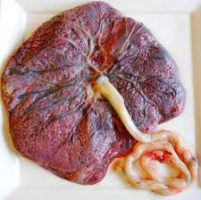
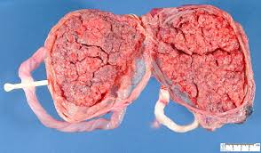
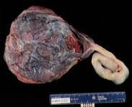
Types of cord insertion
Central insertion-in the middle of the placenta
Lateral insertion-not exactly at the Centre of the placenta
Battledore insertion-at the edge of the placenta
Velamentous insertion-on the membranes

Slide 4
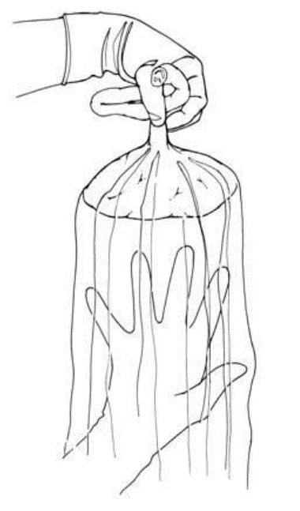
Check the membranes for completeness
Hold the cord with one hand and allow the placenta and the membranes to hang down
- Inserts the other hand inside the membranes, with the fingers spread out.
-inspect the membranes for completeness

Slide 5
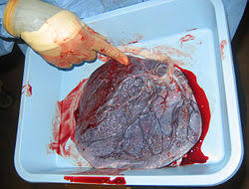
Maternal side fetal side

Slide 6
Examine the maternal and fetal surfaces
Maternal surface
Hold the placenta in the palms of the hands, with the maternal side facing upwards
Completeness of lobes
Diameter of placenta-18-22 cm average 20cm
Thickness-2-3cm av-2.5 cm
Maternal side is dark red in Colour while fetal surface is white shiny and covered by the amnion
Check for presence of crystal substances on maternal surface which would indicate post mature placenta
Check the lobes for completeness
Should be 18-22 average of 20 lobes
Presence of a hole is an evidence of a missing lobe

Slide 7
Maternal surface

Slide 8
Ct,,,
Fetal surface
branches of umbilical veins and arteries should be visible spreading out from central point of insertion.
Follow blood vessels to rule out extra lobe because lobes are usually linked by blood vessels
Examine the membranes
Chorion-thick opaque, friable peels to the edge of the placenta
Amnion-smooth tough,translucent,and peels to the insertion of the cord
Check for abnormalities in the placenta
Succenturiate lobe-an extra lobe that may be left behind and cause PPH and infections
Placenta bipatita-placenta divided into but joined together
Placenta circumvallate –placenta with double membranes

Slide 9
Ct…
Take the weight
Weight of the placenta should be 1/6 of babies weight
If the membranes or placenta is not complete, take immediate action
consult the woman about her culture practices, and then dispose of the placenta according to national protocols

Slide 10
Show video on placenta exam

Slide 11
Estimation of blood loss
Fully soaked gauze 10mls
Full soaked drape 20mls
Fully soaked bedsheet 100mls
Measure mls of fresh blood plus clots
Remove clots and measure the amount of liquid blood
To get amount of clots subtract total amount(liquidblood+clots)minus liquid blood
Clots mls x 2
Add to get the total estimated blood loss

Slide 12
Perineal tears
Lacerations that involve the perineum and the vulva following delivery
Prevention is by early episiotomy

Slide 13
classification
1st degree-involves vaginal mucosa and the skin of the perineum (fourchette only)
2nd degree-involves fourchette and the perineal muscles
3rd degree- involves those in 2nd plus anal sphincter muscles
4th degree- 3rd plus rectal mucosa

Slide 14
Predisposing factors
Rigid perineum especially in primigravida
Previous tears
Malpresentation large diameters distending the perineum
Large babies
Instrumental delivery

Slide 15
Management
1st and 2nd repair are under L/A while 3rd and 4th is under G/A
Repair should be immediate to prevent infections and permanent damage

Slide 16
Episiotomy
This an incision made through the perineal tissues to enlarge vaginal opening during delivery

Slide 17
Types of episiotomy
Medial –follows line of insertion of the perineal muscle
Mediolateral-begins at the middle of the fourchette and is directed 45 degrees to midline toward a point midway of ischial tuberosity and anus
It’s the best since it reduces the risk of damaging the anal sphincter and Bartholin's gland

Slide 18
Episiotomy

Slide 19
Indications
Shorten second stage ie fetal distress,maternal distress
Previous bad tear
Tight perineum
Malpresentation

Slide 20
Education to mother with episiotomy or perineal tear
Clean the area with warm saline at least 3 times a day
Clean herself after opening the bowel from front to back
Change pad frequently
Avoid sex till the area is well healed
Balanced diet to aid healing
Keep the area clean and dry at all times
Take exercise to ensure blood circulation
Watch for signs of infection and seek medical attention.

Slide 21
The end
Questions

