Slide 2
PRESENTATION ON
PROTON PUMP INHIBITOR
Welcome

Slide 3
Welcome
Presentation member
yyyyyyyyyy
KAMOL KRISHNA NANDY
SHAFAYET IMAM
Asiful Alam
id-xxxxxxxx
id-xxxxxxxx ID-xxxxxxxx
id-1431405672

Slide 4
Contents
Proton Pump
Proton Pump Inhibitor
Clinically Used PPIs Mechanism Of Action Of PPI Pharmacokinetics Of PPI Adverse Effects Of PPI Medical Uses Of PPI Therapeutic Uses Of PPI Comparison
Reference
AmjPfnroPthoanrPmuamcepuItnichaiblsitLoimr ited

Slide 5
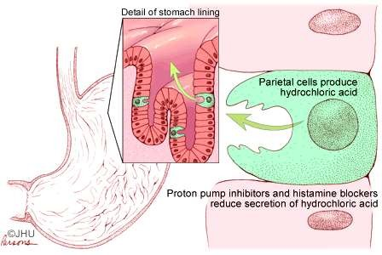
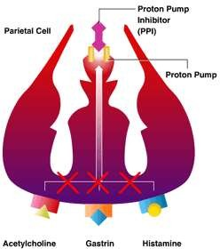
What is a proton pump?
an integral membrane protein in the parietal cells of the stomach.
“pumps" proton into the stomach.
By using ATP, an acidic hydrogen ion replaces a non-acidic potassium ion.

Slide 6
PrPorototonn-PPuummp IpnhIinbihtoirbitor
They are prodrugs that activate in acid environment.
After absorption, the active metabolite diffuses into the parietal cells and accumulates in the acidic secretory canaliculi.

Slide 7
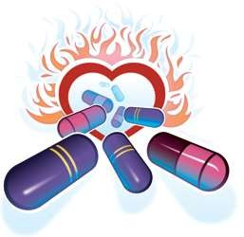
Clinically Used PPIs
Omeprazole Lansoprazole Esomeprazole Pantoprazole Rabeprazole

Slide 8
Mechanism Of Action

Slide 9
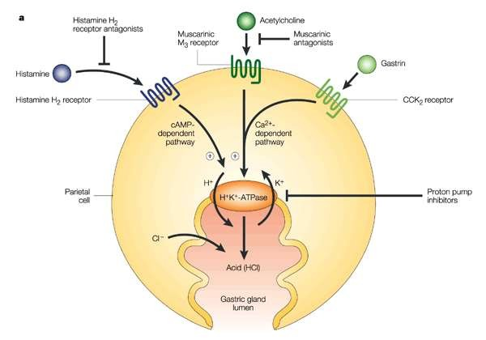
Mechanism Of Action

Slide 10
Blocking the H⁺/K ATPase
The consumption of food stimulates acid secretion and acid secretion activates PPIs.
Then activated PPI is converted to a sulfenamide in the acidic secretory canaliculi of the parietal cell.
The sulfenamide interacts covalently with sulfhydryl groups in the proton pump and make complex, thereby irreversibly inhibiting its activity.

Slide 11
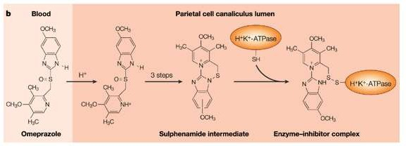
Consider Omeprazole

Slide 12
Pharmacokinetics
Pharmacokinetics

Slide 13
Pharmacokinetics
The rate of PPIs absorption is decreased by concomitant food intake.
The elimination half-life of PPIs ranges from 0.5 to 2.0 hr, but the effect of a single dose on acid secretion usually persists up to three days.
Since an acidic pH in the parietal cell acid canaliculi is required for drug activation, and since food stimulates acid production, these drugs ideally should be given about 30 minutes before meals.
Chronic renal failure does not lead to drug accumulation with once-a-day dosing of the proton pump inhibitors. Hepatic disease substantially reduces the clearance of esomeprazole and lansoprazole.
Code of Ethics : DRA VS RPS

Slide 14
Adverse effects
Short-term
The common adverse effects include: nausea, diarrhea, abdominal pain, fatigue, and
dizziness.
Because the body uses gastric acid to release vitamin B12 from food particles, decreased vitamin B12 absorption may occur with long-term use of PPIs, and may lead to vitamin B12 deficiency.

Slide 15
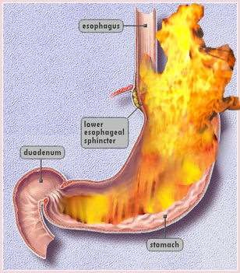
Adverse effects
In the specific but common case of the use of PPIs
as long-term treatment for managing GERD.
PPIs may cause dependency by increasing gastric symptoms if they are discontinued.
However, 12- week PPI therapy
had no impact on calcium, vitamin D, or bone metabolism in healthy young males.
Long-term PPI therapy also interferes with zinc absorption and zinc body
stores.
Long-term

Slide 16
Medical Uses
Dyspepsia
Peptic ulcer disease
Gastro esophageal reflux disease (GERD)
Laryngopharyngeal reflux
Stress gastritis prevention
Zollinger-Ellison syndrome (often 2-3x the regular dose is required as compared to the other indications)

Slide 17
Therapeutic Uses
Proton pump inhibitors are used principally to promote healing of gastric and duodenal ulcers and to treat gastroesophageal reflux disease (GERD).
Lansoprazole is FDA approved for treatment and prevention of recurrence of nonsteroidal antiinflammatory drug (NSAID)- associated gastric ulcers in patients who continue NSAID use.
In children, Omeprazole is safe and effective for treatment of erosive esophagitis and. Younger patients generally have increased metabolic capacity, which may explain the need for higher dosages of Omeprazole per kilogram in children compared to adults.

Slide 18
Comparison
Any Guesses?????

Slide 19
Comparative Analysis Of Pantoprazole With Other PPIs
Proton Pump Inhibitor | Bioavailabil ity (%) | Cmax (µmol/L) | Duration of Effect (Hrs) | Protein Binding (%) | Drug Interaction
Pantoprazole | 77 | 5.73 5 (40 mg) | 24-72 | 98 | None
Omeprazole | 30-40 | 0.70 5 (20 mg) | 24-72 | 95 | Diazepam, Warfarin, Digoxin, Phenytoin, Ketoconazole
Lansoprazole | 77-80 | 2.25 5 (30 mg) | 24 | 97 | Ketoconazol Theophylline
Rabeprazole | 52 | 0.48 6 (20 mg) | 24 | 96 | None
Esomeprazole | 64 | 1.86 2 (20 mg) | 24-72 | 97 | None

Slide 20
Reference
The Health Strategies Consultancy LLC (March 2005). "Follow The Pill: Understanding the U.S. Commercial Pharmaceutical Supply Chain". The Kaiser Family Foundation.
Sachs, G.; Shin, J. M.; Howden, C.W. (2006). "Review article: The clinical pharmacology of proton pump inhibitors". Alimentary Pharmacology and Therapeutics 23: 2–8. doi:10.1111/j.1365-2036.2006.02943.x. PMID 16700898.
Zajac, P; Holbrook, A; Super, ME; Vogt, M (March–April 2013). "An overview: Current clinical guidelines for the evaluation, diagnosis, treatment, and management of dyspepsia". Osteopathic Family Physician 5 (2): 79–85. doi:10.1016/j.osfp.2012.10.005.
"Five Things Physicians and Patients Should Question". American Gastroenterological Association.

Slide 21
you
Have a good
day……………….
Proton Pump Inhibitor
21

