Slide 2
GAMETOGENESIS
Reproduction control in males and females
General principles of Gametogenesis
Sex determination
Sex differentiation

Slide 3
Reproduction Control in males and females
FEATURE (and functions) | MALE | FEMALE
GONAD | Testes/testis | Ovaries/ ovary
1st function Production of gametes | Spermatozoa/ spermatazoan | Ova/ ovum
2nd function Secretion of sex hormones/ gonadal steriods | Testosterone | 1)Estradiol 2)progesterone

Slide 4
Testosterone
It belongs to a group of steroid hormones called
‘androgens’.
it is synthesized in the testes.
Other androgens are produced by the adrenal cortex.
E.g DHEA (dehydroepiandrosterone)

Slide 5
Estradiol and Progesterone
One of three major ‘estrogens’.
It is the predominant estrogen in the plasma. The two other major estrogens are
Estrone
Estriol
Progesterone is a major secretary product of the ovary in specific times of the menstrual cycle as well as from the placenta during pregnancy.

Slide 6
Control Of Reproductive Functions
For both male and female reproduction, the reproductive function is controlled by a chain of hormones. the first hormone in the chain is gonadotropin-releasing hormone (GnRH), released by the hypothalamus to stimulate the release of pituitary gonadotropins - follicle-stimulating hormone (FSH) and luteinizing hormone (LH) from the anterior pituitary gland. In both males and females these two hormones act to promote gametogenesis and androgen/estrogen secretion.

Slide 7
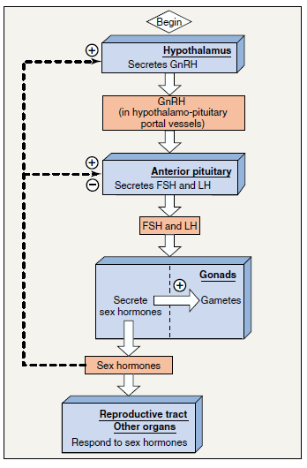
In addition the gonadal steroids exert feed back effects on the secretion of GnRH, FSH and LH.

Slide 8
General Principles Of Gametogenesis
Gametogenesis is the process of formation of gametes
from the germ cells in the testes and ovaries.
The first stage is the division of the primordial (immature) germ cells by mitosis.
The DNA of each nucleated cell with the exception of gametes, contains 46 chromosomes.
In this first stage, (mitosis) the 46 chromosomes of the dividing cell are replicated.
The end result are two daughter cells containing the full 46 chromosomes identical to those of the orginal cell.

Slide 9
In this manner mitosis of primordial germ cells, each containing 46 chromosomes provides a supply of identical germ cells for the next stages.
NB: in females the timing of mitosis of germ cells occurs during fetal development in the ovary.
in males mitosis occurs in the testes at puberty and usually continues throughout life.

Slide 10
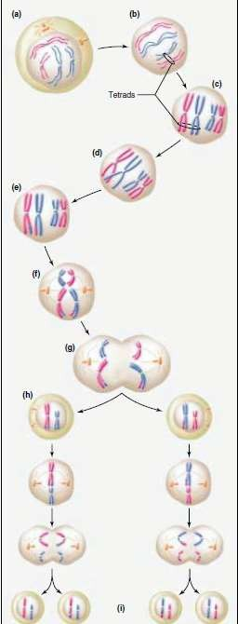
In the second stage (meiosis), each resulting gamete receives only 23 chromosomes from a 46- chromosome germ cell.
Because a sperm and ovulated egg has only 23 chromosomes, their union at fertilization results in a full 46 chromosomes in the cell.

Slide 11
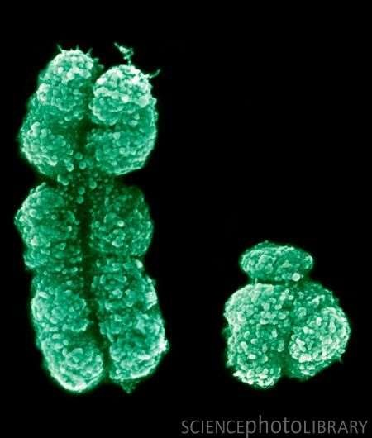
Sex Determination
Gender is determined by the genetic inheritance of two chromosomes called the sex chromosomes, X and Y.
Males posses one X (larger chromosome) and one Y chromosome. (heterogametic)
Females posses two X chromosomes. (homogametic)

Slide 12
Sex Determination cont’d
The ovum can contribute only an X chromosome , where as half of the sperm produced during meiosis are X and half are Y. When the sperm and egg join, 50%should have XX and 50% should have XY.
However sex ratios at birth are not exactly 1:1 there tends to be a slight predominance of male births due to the functional differences in sperm carrying the X vs Y chromosome.

Slide 13
Method for Determining Sex
The female pattern;
When two X chromosomes are present, only one functions and the non functional X chromosome condenses to form a nuclear mass termed sex chromatin (Barr Body).
Scrapings from the cheek mucosa or white blood cells are convenient cells to be examined.

Slide 14
Sex Differentiation
Even though gender is determined at conception, the fetus doesn’t develop its external sexual organs until the fourth month of pregnancy.
Sex differentiation may be defined as the multiple processes involved in the development of the reproductive system in the fetus.
In some cases, individuals with atypical chromosomal combinations manifest atypical sexual development.

Slide 15
Sex Differentiation cont’d
In other cases, individuals were found to have normal chromosomal combinations but abnormal appearance and function(phenotype).
In these people sex differentiation has been atypical- their phenotype may not correspond with their genotype.

Slide 16
Differentiation of the Gonads
The male and female gonads derive embryologically from the same site- the urogenetial ridge.
In the genetic male, testes begin to develop during the seventh week.
A gene on the Y chromosome (the SRY gene)is expressed at this time on the urogenital ridge cells and triggers this development.
In the absence of a Y chromosome , testes do not develop. Instead ovaries begin to develop in the same area at about 11 weeks.

Slide 17
Differentiation of External and Internal Genitalia
Before the functioning of the fetal gonads, the primitive reproductive tract includes a double genital duct system—Wolffian ducts and Müllerian ducts—and a common opening for the genital duct and urinary system to the outside.

Slide 18
If the embryo is female (XX), then no testosterone is made. The Wolffian duct will degrade, and the Mullerian duct will develop into female sex organs. The female clitoris is the remnants of the Wolffian duct.
If the embryo is a male (XY chromosomes), then testosterone will stimulate the Wolffian duct to develop male sex organs, and the Mullerian duct will degrade.

Slide 19
Male reproductive physiology Female reproductive physiology

Slide 20
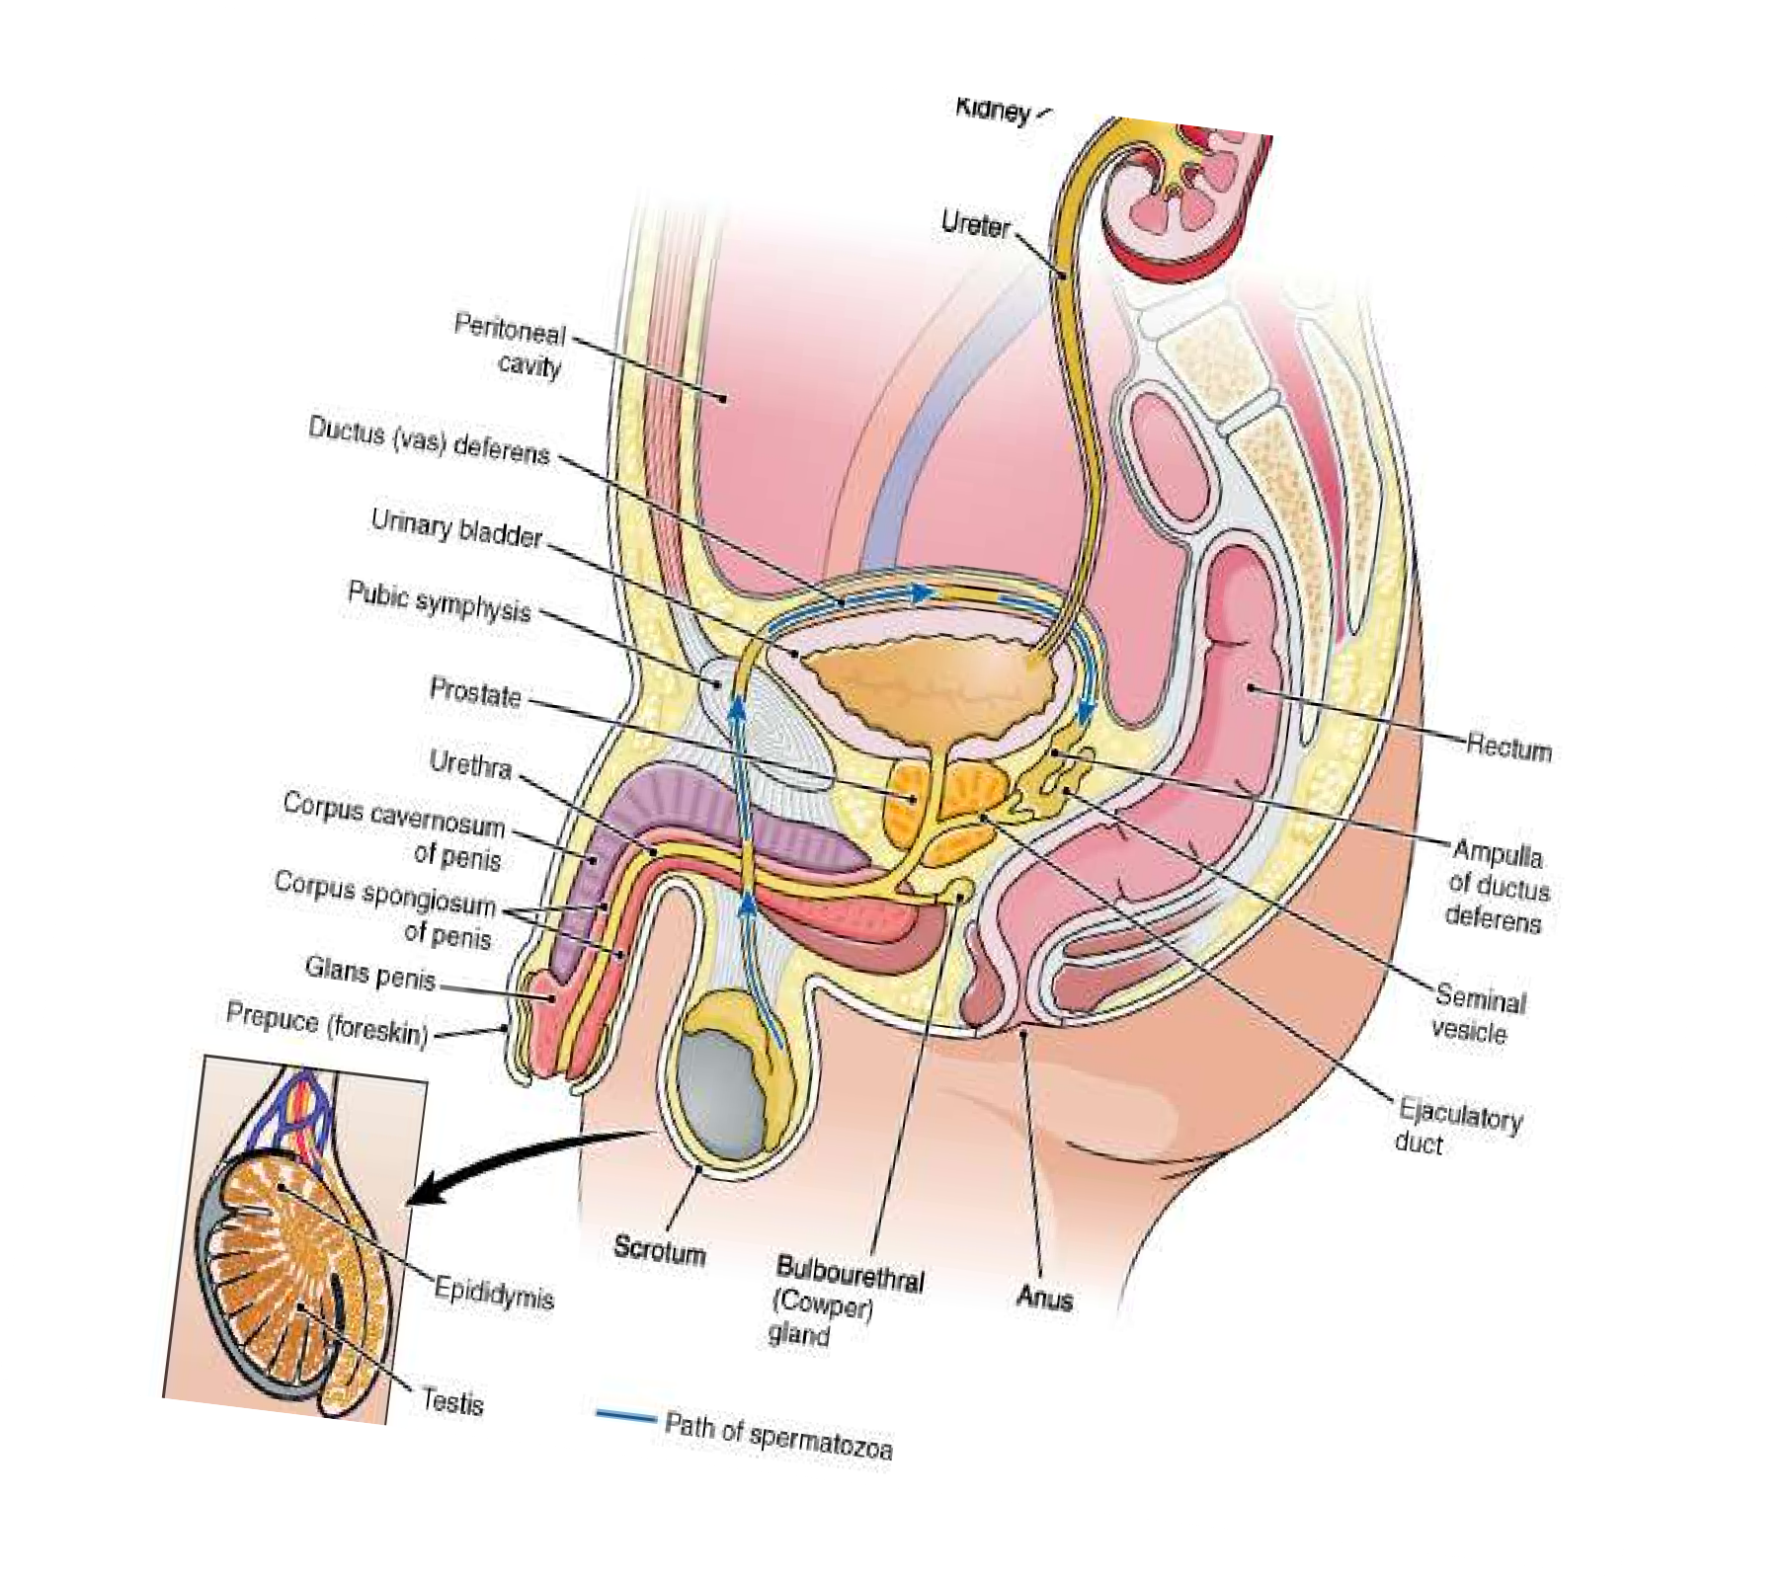
Testes
The functions of testes are spermatogenisis and secretion of testosterone.
It occuppies the scrotum and lies outside the body cavity. This is essential as it maintains a 1 degree to 2 degree for normal spermatogenisis.

Slide 21
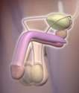
Male reproductive system
Divided into two groups
Primary Organs
Gonads or sex glands
Produce the germ cells and manufacture hormones
Male gonad is the Testis
Accessory Organs
Series of ducts that transport the germ cells as well as various exocrine glands

Slide 22
Seminiferous Tubules
80% of adult testis are composed of seminiferous tubules which are convoluted loops,120 to 300µm in diameter this is surrounded by connective tissue.
Epithelium lining of seminiferous tubules consist of three types of cells
Spermatogonia;stem cells
Spermatocytes;these are cells that are in the process to become sperm
Sertoli cells:support development of sperm

Slide 23
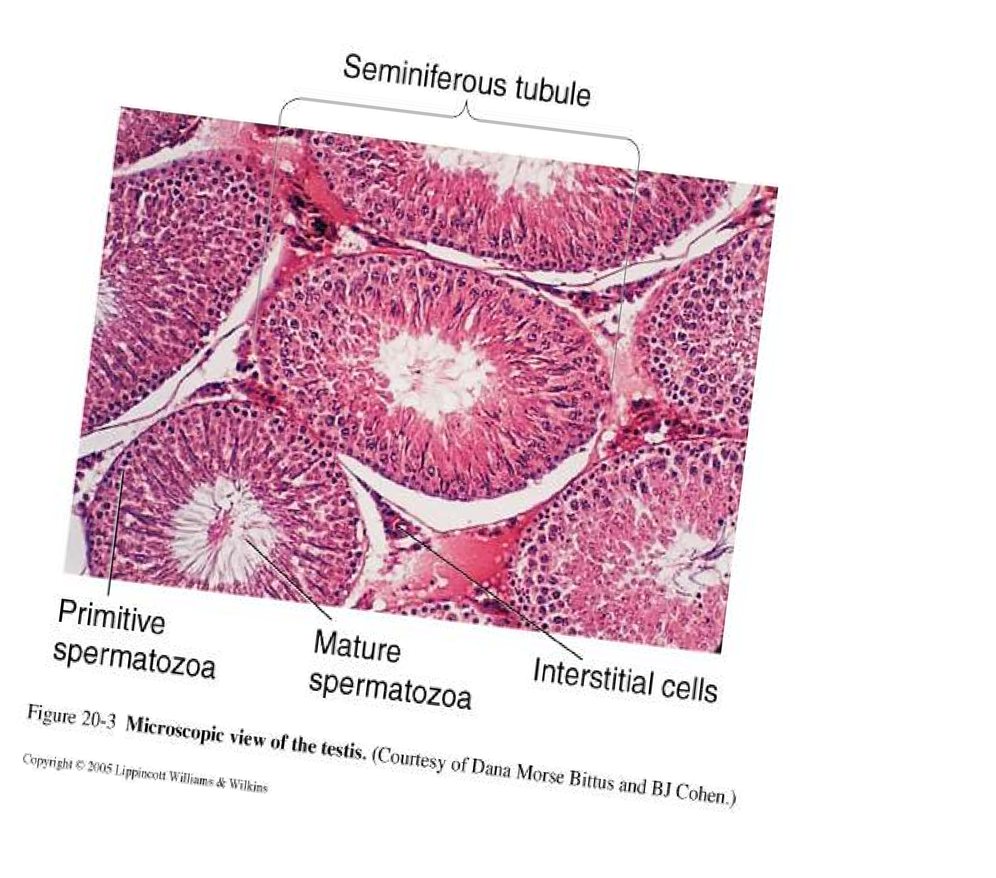

Slide 24
Functions of sertoli cells
Sertoli cells provide nutrients to diffrentiating sperm(which are isolated from the blood stream)
Sertoli cells form tight junctions with each other creating a barrier between the testes and the blood stream.
This is selectiely permeable admitting passage of some substances such as testesterone ,but prohibits noxious substance that may harm the sperm such as bacteria
Sertoli cells secrete aqueos fluid in the lumen of semineferous tubules which helps to transport sperm through the tubules of the epididymis.

Slide 25
Leydig Cells
Leydig cells is a connective tissues that in the next 20%
Leydig cells synthesises and secrete testosterone the male sex hormone.
Testosterone has paracrine effects that support spermatogenisis in the testicular sertoli cells and endocrine effects on other target organs

Slide 26
Testosterone
After it’s secretion, testosterone is absorbed directly into the blood stream
Hormone has 3 functions:
Development and maintenance of the reproductive structures
Development of spermatozoa
Development of secondary sex characteristics (traits that characterize male and females but not directly concerned with reproduction). Deepened voice, broad shoulders, narrow hips, muscle tissue and body hair

Slide 27
Development of spermatozoon
Mitotic division
Spermatogonia generate spermatocytes which become mature sperm
Phase 1
Meiotic Division
Meoitic division of spermatocytes which decreases chromosome number and produce haploid sprematids.
Phase 2
Spermigiogenisis
Sprematids are transformed into mature sperm through
loss of cytoplasm and development of flagella
Phase 3

Slide 28
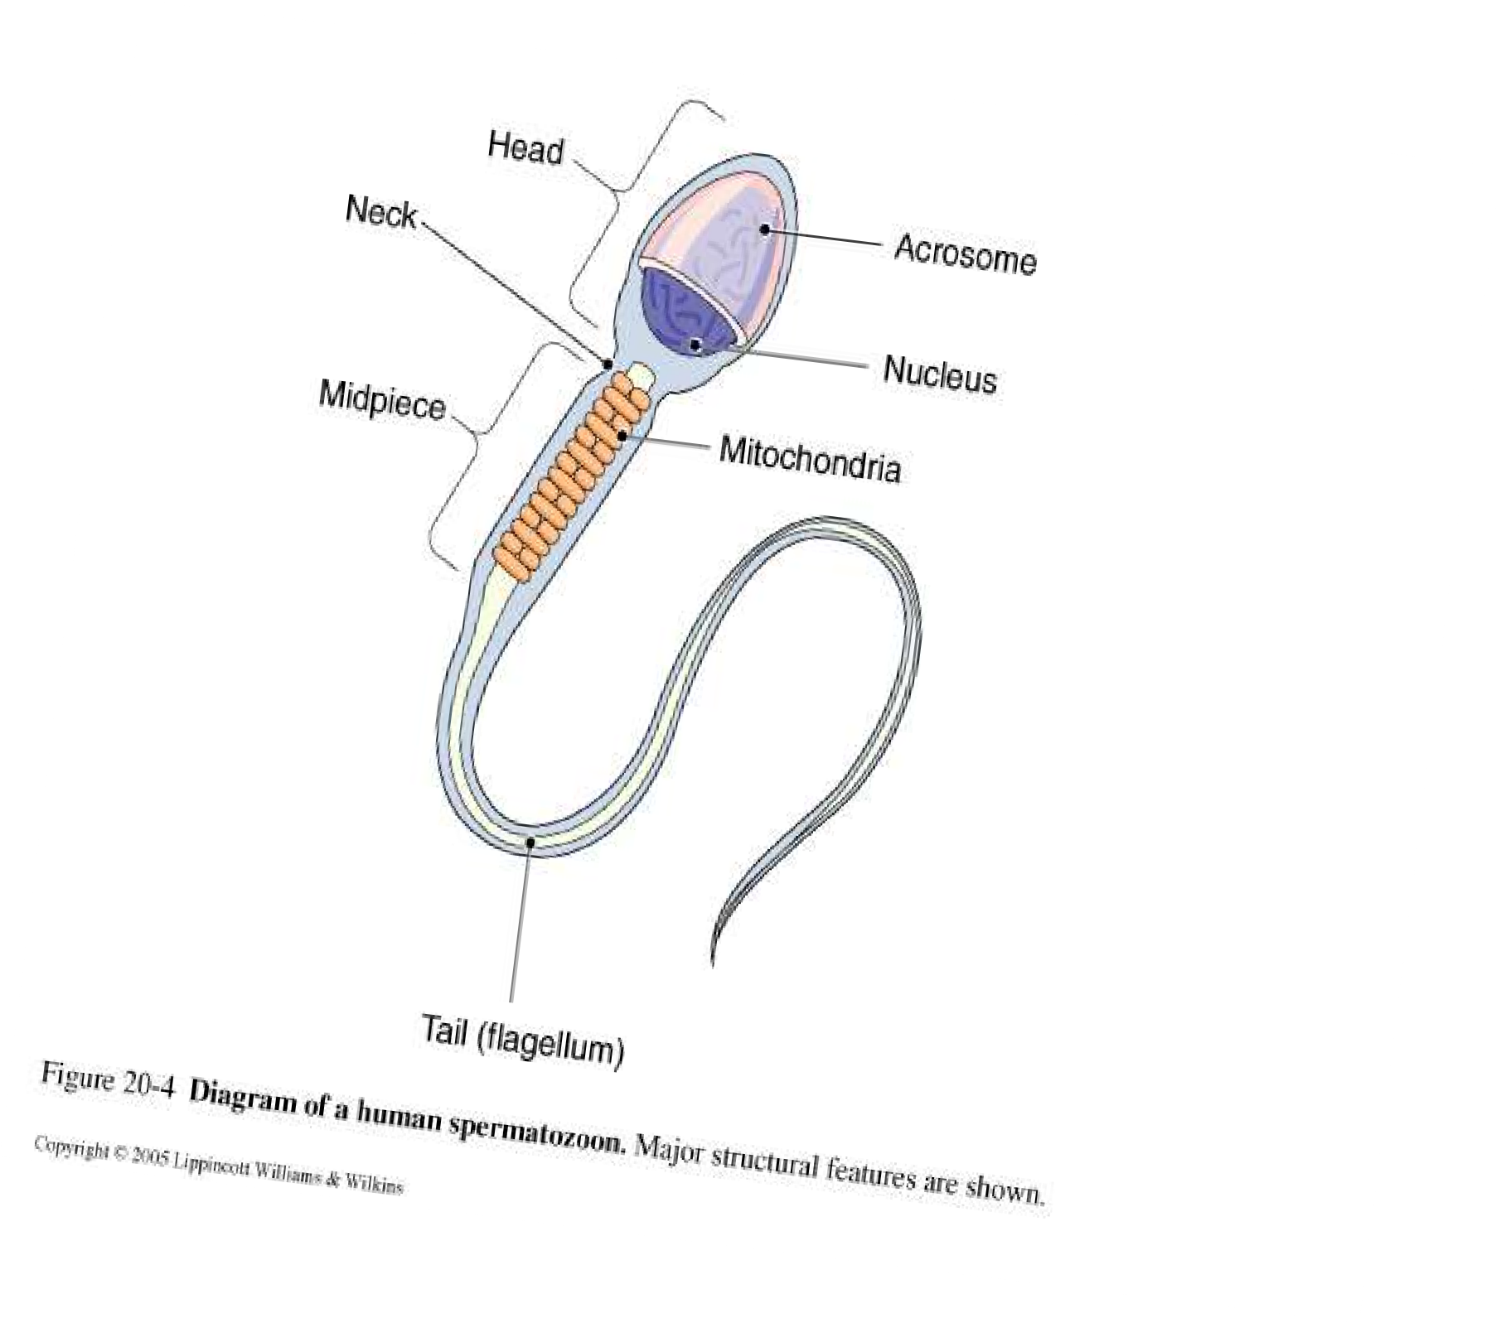
Spermatozoa(haplo
id 1n)

Slide 29
One full cycle of spermatogenosis requires about 64days.
Spermatogenic wave organises succesfull production of sperm in the spermatogenic cycle

Slide 30
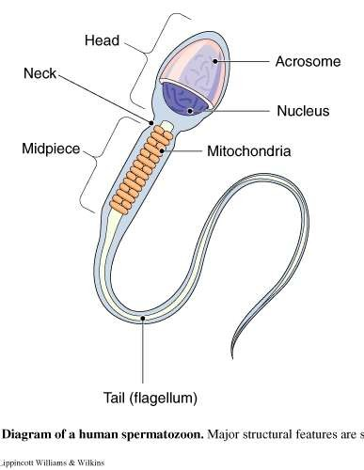
Spermatozoa
Tiny individual male sex cells
200 million contained in average ejaculation (release of semen)
After puberty, sperm cells are manufactured continuously in the seminferous tubules of the testes
Has an oval head
Largely nucleus containing chromosomes
The acrosome covers the head like a
cap
Contains enzymes that help sperm penetrate the ovum
Tail propels the sperm, with whip like movements, through the female reproductive system
Mid-piece of sperm contains many mitochondria to provide energy for movement
⚫
⚫
⚫

Slide 31
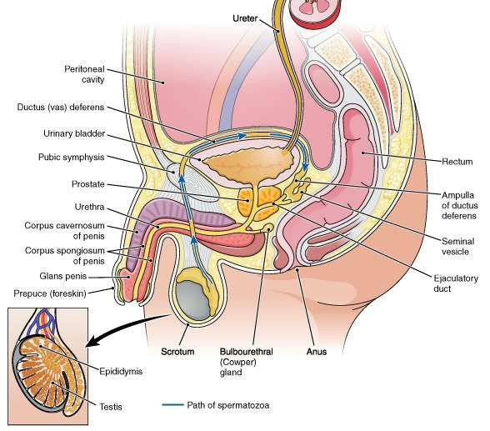
Accessory Organs
The ductus deferens separates from the remainder of the spermatic cord and curves behind the urinary bladder
It joins with the duct of the seminal vesicle on the same side to form the ejaculatory duct
Left and right ejaculatory ducts travel to the prostate gland and empty in to the urethra

Slide 32
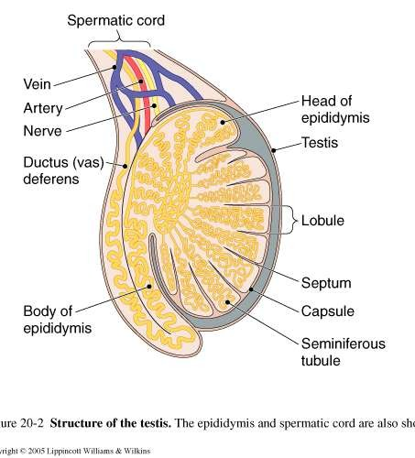
Accessory Organs
System of ducts that transport sperm beginning with tubules inside the testis
From these tubules the cells collect in a greatly coiled tube called the epididymis (located on the surface of the testis inside the scrotal sac)
Sperm cells mature in epididymis and are able to move by themsleves
Epidiymis extends upward as the ductus deferens (vas deferens)
Vas deferens is contained in the spermatic cord and continues l into the abdominal cavity

Slide 33
Seminal Vesicles
Twisted muscular tubes with many small out pouchings
About 3 inches long and are attached at the posterior of the urinary bladder
Produces a thick, yellow, alkaline secretion composed of fructose,citate,prostaglandins and fibrnogen.
Contains large quantities of simple sugars and other substances that provide nourishment for the sperm
Seminal fluid makes up a large
part of the semen’s volume.

Slide 34
Functions of Prostaglandins
Prostaglandins react with cervical mucus to make it more penetrable to sperm
Prostaglandins induce peristalic contractions in female reproductive tract(i.e uterus and fallopian tubes).this helps in sperm being propelled up the tract.

Slide 35
Lies immediately inferior
to the urinary bladder
Surrounds first part of urethra
Ducts form the prostate carry its secretions into the urethra.
Thin alkaline prostatic secretion helps neutralize the acidity of the vaginal tract and enhance the motility of the spermatozoa
Supplied with muscular tissue
Upon signals from the nervous system, muscles contract to aid in the expulsion of the semen from the body
Prostate Gland

Slide 36
Bulbourethral glands
Also called the Cowper glands
Pair of pea-sized organs located in the pelvic floor, inferior to prostate gland
Secrete mucus to lubricate the urethra and tip of the penis during sexual stimulation
Ducts of these glands empty into the urethra before it extends into the penis

Slide 37
Urethra & Penis
Male urethra conveys urine and reproductive cells to the outside
Ejection of semen into the receiving canal (vagina) of the female is made possible by the erection (stiffening and enlargement ) of the penis

Slide 38
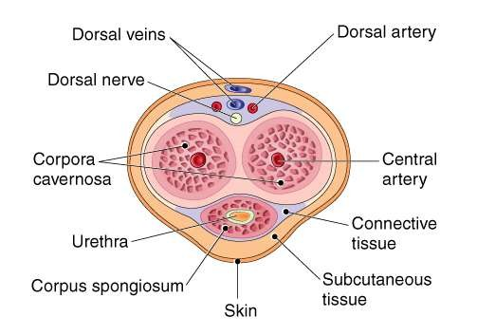
Urethra & Penis
Penis made of spongy tissue containing many blood spaces that are relatively empty when the organ is flaccid
Fill with blood and distend when the penis is erect
The penis and the scrotum make up the external genitalia of the male

Slide 39
Ejaculation
The forceful expulsion of
semen through the urethra to the outside
Process initiated by
reflex centers in the
spinal cord that
stimulates smooth
muscle contraction in the prostate
This is followed by
contraction of skeletal
muscle in the pelvic floor
which provides the force needed for expulsion
During ejaculation, the
involuntary sphincter at
the base of the bladder
closes to prevent the
release of urine

Slide 40
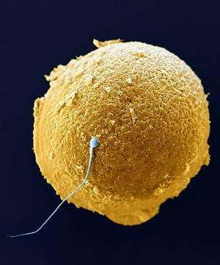
Ejaculation
Male can ejaculate 2-5ml of semen containing 50 million-150 million sperm cells per ml
Only one spermatozoa can fertilize an ovum
Remainder of cells live from only a few hours maximum of 3 days

Slide 42
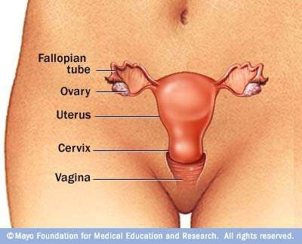
Female Reproductive System
Female gonads are the ovaries where the female sex cells or ova are formed
Remainder of female reproductive tract consists of:
an organ (uterus) to hold and nourish a developing infant
various passageways
External genital organs

Slide 43
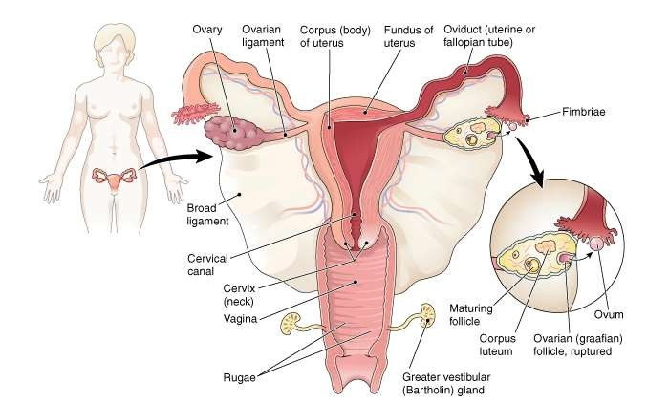
Ovaries
Small, somewhat flattened oval body
Like the testes, ovaries descend but only as far as the pelvic portion of the abdomen
Held in place by ligaments that attach them to the
uterus and body wall

Slide 44
Ova and Ovulation
Ovaries of a newborn female contain a large number of potential ova
Each month during the reproductive years, several ripen
but only one is released

Slide 45
Ova and Ovulation
Maturation of the ovum takes place in a small fluid-filled cluster of cells called the ovarian follicle (graafian follicle)
As the follicle develops, cells in its wall secrete estrogen which stimulates
growth of the uterine lining

Slide 46
When an ovum has ripened, the ovarian follicle may rupture and
discharge the egg cell from the ovary’s surface
The rupture of a follicle allowing the escape of an ovum is called ovulation.
Any ova that are not released degenerate
Released egg cell makes its way to the nearest oviduct
A tube that arches over the ovary and leads to the uterus

Slide 47
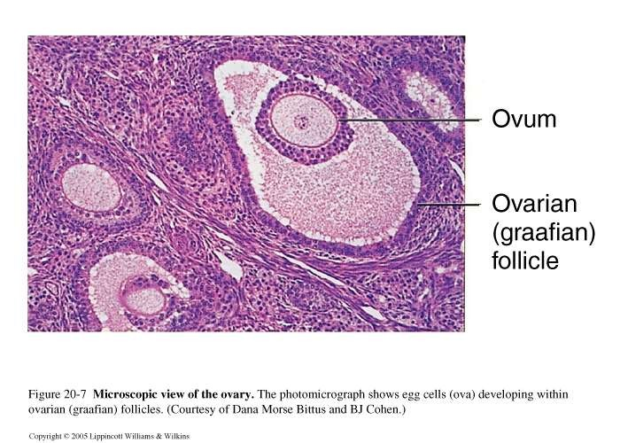

Slide 48
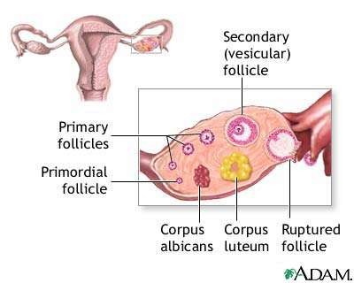
Corpus Luteum
After the ovum is expelled, the remaining follicle is transformed into a solid mass called the corpus luteum
Secretes estrogen and progesterone
Eventually shrinks and is replaced by scar tissue

Slide 49
Corpus Luteum
When a pregnancy occurs, however, the structure remains active
Sometimes during a normal ovulation, the corpus luteum persists and forms a small ovarian cyst
(fluid filled sac)
Resolves without treatment

Slide 50
Accessory Organs
Include :
oviducts
the uterus
vagina
greater vestibular glands
vulva
perineum

Slide 51
Oviducts
Tubes that transport the ova in the female reproductive system
Also known as the uterine tubes or fallopian tubes
No direct connection between ovary and this tube
Ovum is swept into oviduct by a current in the peritoneal
fluid

Slide 52
Peritoneal fluid produced by fimbriae (small, fringelike extensions located at the edge of the tube’s opening into the abdomen)
Ova can not move on own
Movement depends on sweeping action of cilia in the
oviduct’s lining and on peristalsis of the tube
Takes 5 days for an ovum to reach the uterus form the ovary
Oviducts

Slide 53
Uterus
Organ in which a fetus can develop to maturity
Oviducts lead to the uterus
Superior portion rests on upper surface of the urinary bladder
Inferior portion embedded in the pelvic floor between the bladder and the rectum

Slide 54
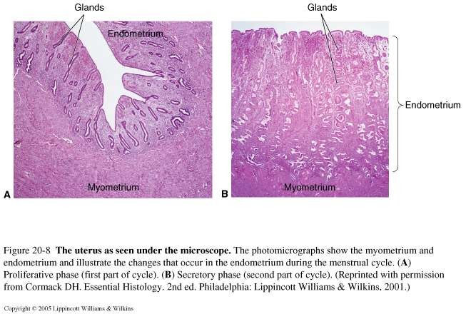
Uterus
The walls of the uterus include:
a muscular layer (myometrium)
an inner lining called the endometrium
The inner layer changes during menstrual cycle

Slide 55
Vagina
Distal part of the birth canal which opens to the outside of the body
Cervix (opening of the uterus) leads to the vagina
Muscular tube connecting the uterine cavity with outside
Lining of the vagina is a wrinkled mucous membrane similar to that found in the stomach
Rugae (folds) permit enlargement so that childbirth usually does not tear the lining
Vagina is an organ for child birth and also receives the penis during sexual intercourse
a fold of membrane, called the hymen, may sometimes be found near the vaginal canal opening

Slide 56
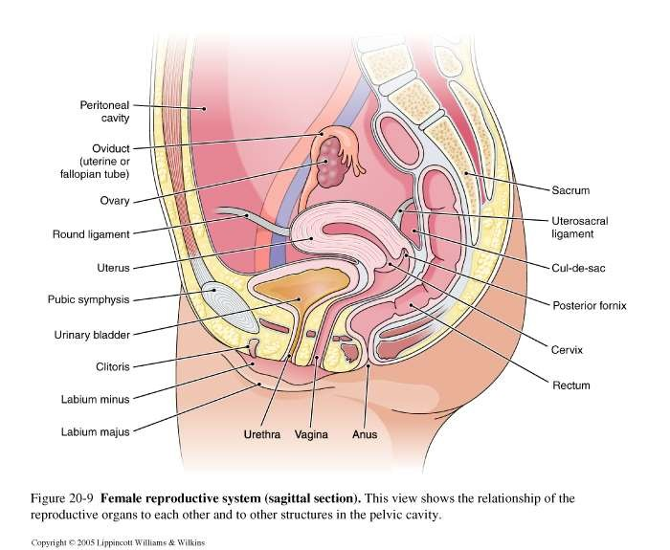

Slide 57
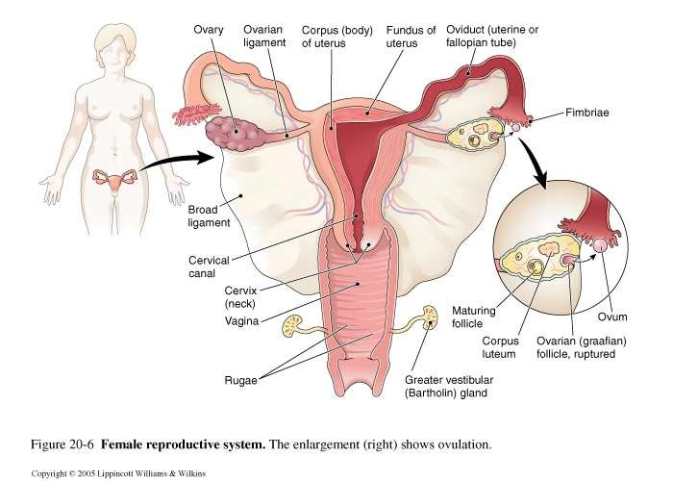

Slide 58
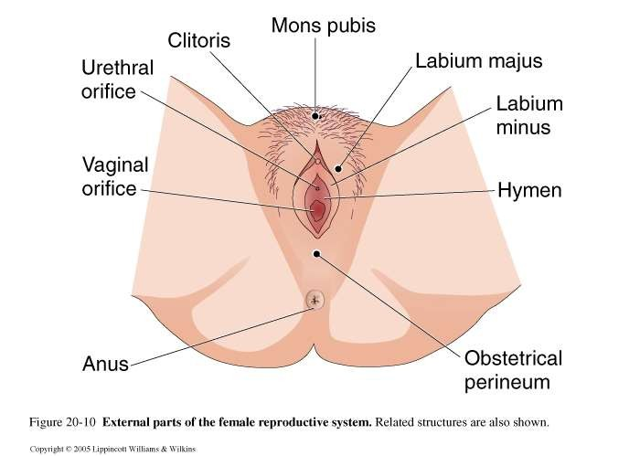

Slide 59
Greater Vestibular Glands
Just superior and lateral to the vaginal opening are the two mucus-producing greater vestibular glands
These glands secrete into an area near the vaginal opening known as the vestibule
These glands provide lubrication during intercourse

Slide 60
External parts of the female reproductive system comprise the vulva
Includes:
two pairs of lips (labia)
Clitoris (small organ of great sensitivity)
Entire pelvic floor in male and female referred to as perineum
However, in pregnant women, the area between the vaginal opening and the anus is referred to as the obstetrical perineum
Vulva & Perineum

Slide 61
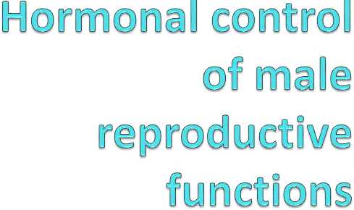
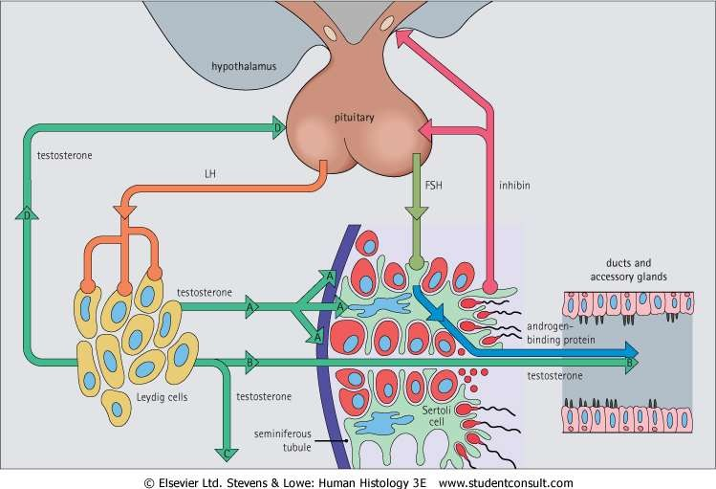

Slide 62
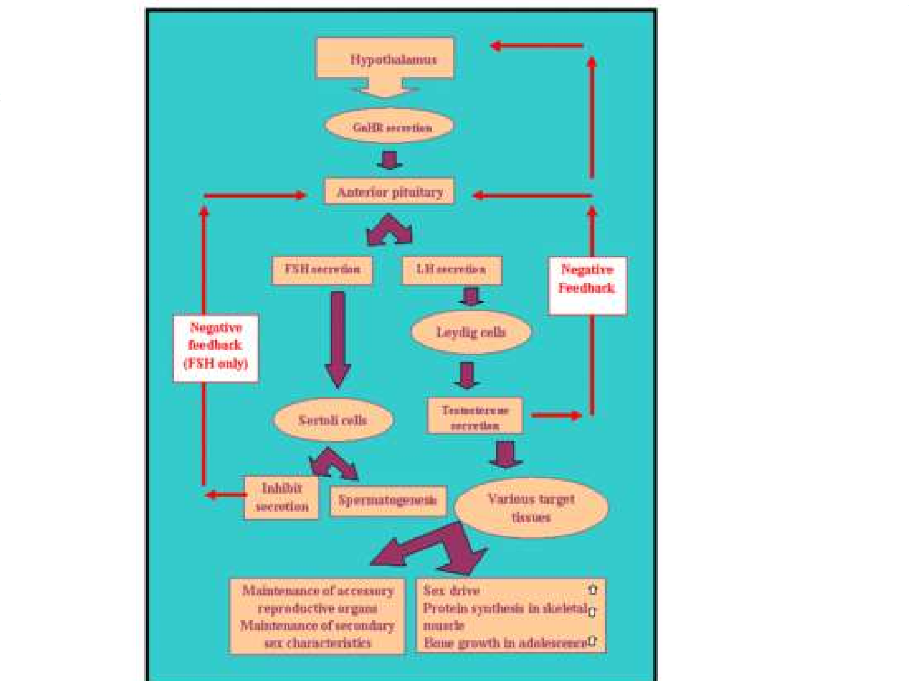

Slide 63
Control of the testes
GnRH secreting
FSH acts primarily on the Sertoli cells to stimulate the secretion of paracrine agents required for spermatogenesis.
LH acts primarily on the Leydig cells to stimulate testosterone secretion.
The testosterone secreted by the Leydig cells also acts locally, in a paracrine manner by diffusing from the interstitial spaces into the seminiferous tubules. It enters the Sertoli cells, where it facilitates spermatogenesis.
neuroendocrine cells in the hypothalamus fire a brief burst of action potentials approx. every 90min, secreting GnRH at these times.
The GnRH reaching the anterior pituitary gland via the hypothalamo-pituitary portal vessels during each periodic pulse triggers the release of both LH and FSH from the same cell type but not necessarily in equal amounts.

Slide 64
testes
^{C}Deºspi^{n}te t^{t}he^{r}aºbse^{l}ncºe o^{f}f a ^{t}di^{h}rec^{e}t effect on cells in the seminiferous tubules, LH exerts an essential indirect effect
because the testosterone secretion stimulated by LH is required for spermatogenesis.
Even though FSH and LH are produced by the same cell type, their secretion rates can be altered to different degrees by negative feedback inputs.
Testosterone inhibits LH
secretion in two ways:
1. It acts on the hypothalamus to decrease amplitude of GnRH bursts, which result in a decrease in gonadotropins
2. It acts directly on the anterior pituitary gland to decrease the LH response to any given amount of GnRH.
FSH stimulates Sertoli cells to increase both spermatogenesis and inhibin production, and inhibin decreases FSH release,this is a logical completion of a negative feedback loop.
Despite all these complexities the total amts of GnRH, LH, FSH, testosterone and inhibin secreted and sperm produced do not change dramatically from day to day.

Slide 65
testosterone
Effects of Testosterone in the Male
1.Required for initiation and maintenance of spermatogenesis(acts via Sertoli cells)
2.Decreases GnRH secretion via an action on the hypothalamus
3.Inhibits LH secretion via a direct action on the anterior pituitary gland
4.Induces differentiation of male accessory reproductive organs and maintain their function
5.Induces male secondary sex characteristics; opposes action of estrogen on breast growth
6. Stimulates protein anabolism, bone growth and cessation of bone growth
7. Required for sex drive and may enhance aggressive behaviour
8. Stimulates erythropoietin secretion by the kidneys

Slide 66
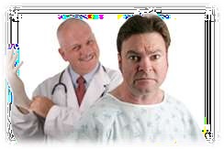
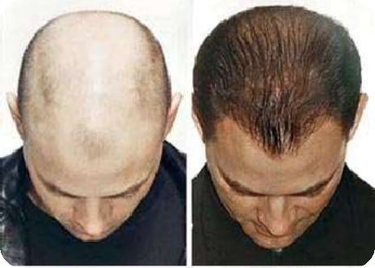
testosterone
Testosterone needs to undergo transformation in many(not all) of its target cells in order to be effective.
Depending on the target cells testosterone may act as testosterone, dihydrotestosterone(DHT) or estradiol.
Therapy for prostate cancer makes use of these facts because prostate cancer cells are stimulated by dihydrotestosterone, so the cancer can be treated with inhibitors of 5^{α} - reductase.
Male pattern baldness may also be treated with 5^{α} – reductase inhibitors because DHT tends to promote hair loss from the scalp.

Slide 67
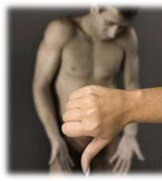
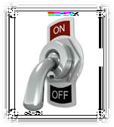
AThce cfetealsdisffoerernytiatrioen panrd olatder ugrocwtthivaned organs
function of the entire male duct system, glands,
and penis all depend upon testosterone.
When testicular function is loss, the accessory reproductive organs decrease in size, the glands markedly reduce their secretion rates and the smooth muscle activity of the ducts is diminished. Sex drive(libido) and ejaculation are usually impaired.
These defects lessen with the administration of testosterone. This would also occur
with castration(removal of gonads) which might be done to treat testicular cancer.

Slide 68
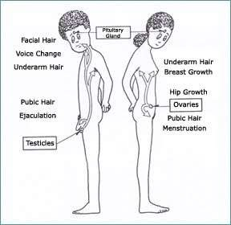

Slide 69
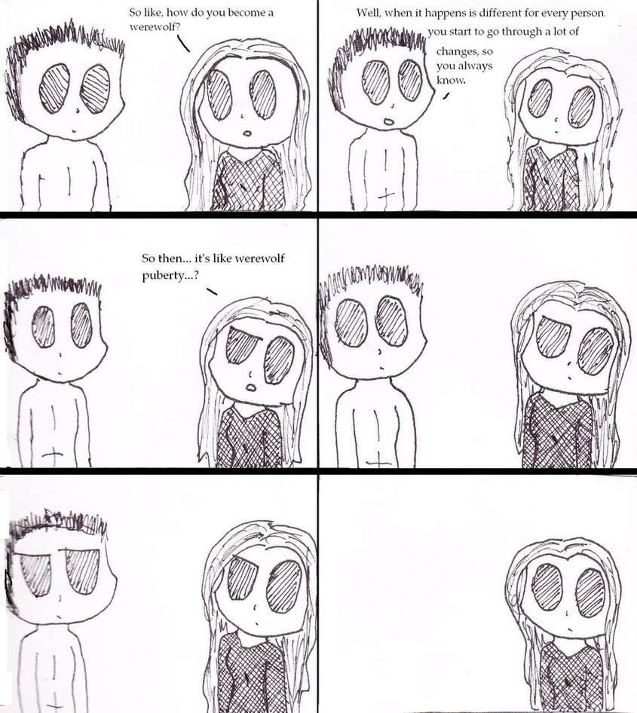

Slide 70
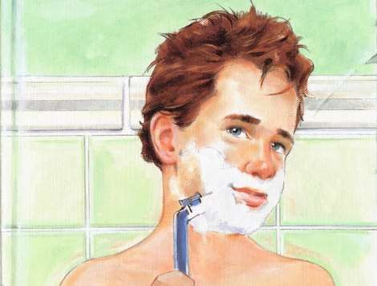
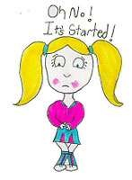
What is puberty?
Puberty is the period during which the reproductive organs mature and reproduction becomes possible.

Slide 71
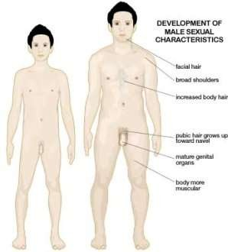
Puberty in males
Occurs between 12 and 16yrs of age.
The first signs of puberty are due to the increased secretion of adrenal androgens, under the stimulation of adrenocorticotropic hormone(ACTH)

Slide 72
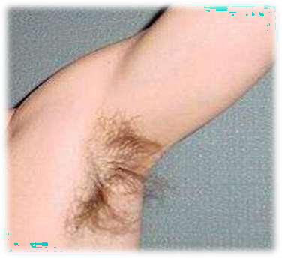
Puberty in males
These androgens cause the very early development of pubic and axillary (armpit) hair as well as the early stages of puberal growth spurt in concert with growth hormone and insulin-like growth factor I. However, all other developments in puberty are reflections of increased activity of the hypothalamic- anterior pituitary gland-gonadal axis.
Increased GnRH secretion at puberty causes increased secretion of pituitary gonadotropins, which stimulate the seminiferous tubules and testosterone secretion.

Slide 73
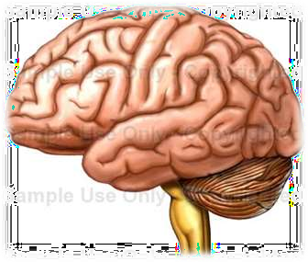
Puberty in males
Testosterone induces the puberal changes that occur in the accessory reproductive organs, secondary sex characteristics, and sex drive.
The mechanism of brain change that results in increased GnRH secretion is unknown.
However, the brain becomes less sensitive to the negative feedback effects of gonadal hormones at the time of puberty.

Slide 74
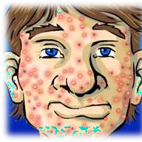
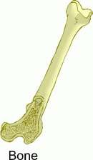
Puberty in males
Secondary Sex Characteristics and Growth
All male secondary sex characteristics are dependent on testosterone and its metabolite, DHT*.
Other androgen-dependent secondary sexual characteristics are:
Deepening of the voice-from the growth of the larynx
Thick secretion of the skin oil glands-often causing
acne
The masculine pattern of fat distribution.
Androgens also stimulate bone growth, through the stimulation of growth hormone secretion.
However,
they terminate bone growth by causing closure of the epiphyseal plates.

Slide 75
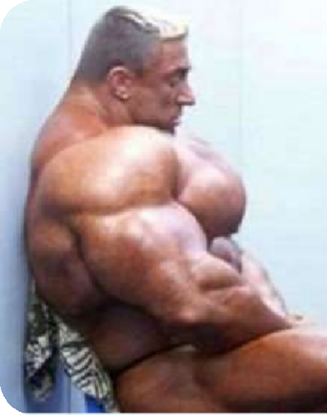
Puberty in males
Secondary Sex Characteristics and Growth
Androgens are “anabolic steroids” in that they exert
a direct stimulatory effect on protein synthesis in muscle.
They also stimulate the secretion of erythropoietin by the kidneys- this is a major reason why men have higher hematocrit* than women.
Behaviour
Androgens are essential for the development of sex drive at puberty, and play an important role in maintaining sex drive(libido) in adulthood.

Slide 76
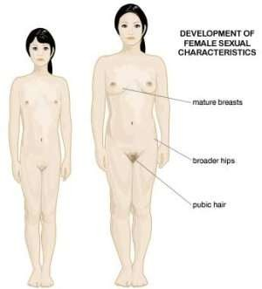
Puberty in females
Begins usually around ages 10 to 12 yrs.
GnRH, the pituitary gland gonadotropins, and estrogen are all secreted at very low levels during childhood. Therefore no follicle maturation occurs beyond the early antral stage and menstrual cycles do not occur.
The female accessory sex organs remain small and non- functional, and there are minimal secondary sex characteristics.

Slide 77
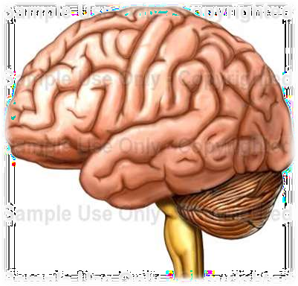
Puberty in females
The onset of puberty is caused by an alteration in brain function that increases the secretion of GnRH. This hypophysiotropic* hormone in turn stimulates the secretion of pituitary gland gonadotropins, which stimulate follicle development and estrogen secretion.

Slide 78
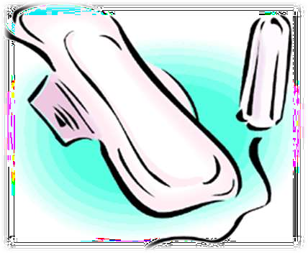
Estrogen^{P}, in^{u}ad^{b}dit^{e}ion^{r}t^{t}o ^{y}its ^{in females}
critical role in follicle
development, induces the changes in accessory sex organs and secondary sex characteristics associated with puberty. Menarche, the first menstruation, is a late event of puberty.
The mechanism of brain change that results in increased GnRH secretion in girls at puberty remains unknown.
The brain may become less sensitive to the negative feedback effects of gonadal hormones at the time of puberty.(averaging age 12.3)

Slide 79
Puberty in females
The adipose-tissue hormone leptin is known to stimulate the secretion of GnRH and may play a role in puberty. This may explain why the onset of puberty tends to correlate with the attainment of a certain level of energy stores(fat) in the girl’s body.
The failure to have a normal menstrual cycle is called amenorrhea. Primary amenorrhea is the failure to initial normal menstrual cycles at puberty(menarche), whereas secondary amenorrhea is defined as the loss of previously normal menstrual cycles(common causes pregnancy and menopause).
Excessive exercise and anorexia nervosa can cause both primary and secondary amenorrhea.

Slide 80
Precocious puberty
The age of normal onset of puberty is controversial. However, puberal onset before the age of 6-7 in girls and 8- 9in boys warrants clinical investigation.
Precocious puberty is defined as the premature appearance of secondary sex characteristics and is usually caused by an early increase in gonadal steroid production. This leads to an early onset of the puberty growth spurt, maturation of the skeleton, breast development(in girls) and enlargement of genitalia in boys. True precocious is caused by the premature activation of GnRH and LH and FSH secretion. Often caused by tumors or infections in the area of the central nervous system that control GnRH release. Treatments that decrease LH and FSH release are important to allow normal development.

Slide 81
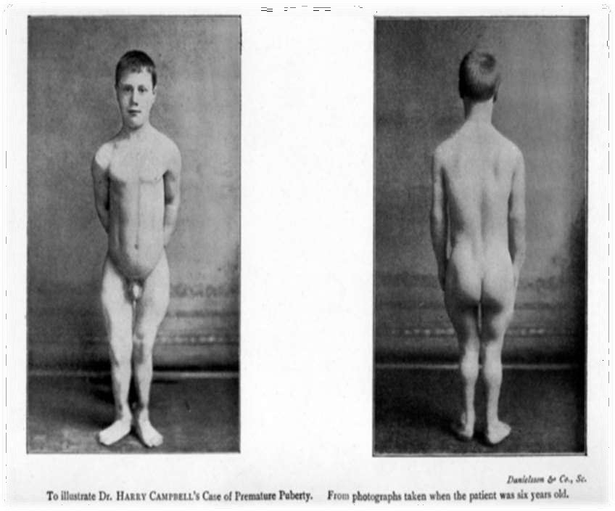

Slide 82
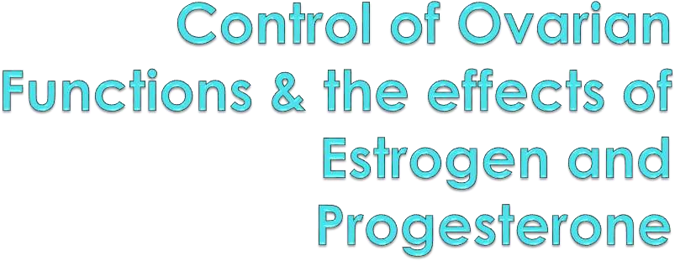

Slide 83
Control of Ovarian Functions
The ovaries have several functions
Oogenegis-the production of gametes during the
fetal period
Maturation of the oocyte
Expulsion of the mature oocyte(ovulation)
Secretion of the female sex steroid hormones (estrogen and progesterone). It also secretes the peptide hormone inhibin.

Slide 84
Control of Ovarian Functions
The major factors controlling the ovaries are
GnRH – Gonadotropin-releasing hormone FSH- Follicle stimulating hormone
LH- luteinizing hormone Estrogen
Progesterone

Slide 85
Control of Ovarian Functions
Gonadotropin-releasing hormone is secreted from the hypothalmus and it stimulates the anterior pituitary gland to secrete LH and FSH.
LH is released form the pituitary gland. Its main function is to cause ovulation and it causes the formation of the corpus luteum.
FSH is primarily responsible for stimulating the growth of the
ovarian follicle.
Estrogen is secreted from the ovary and it is involved in the thickening of the endometrium of the uterus and the growth of the uterus
Progesterone is cause the endometrium to secrete special proteins during the second half of the menstrual cycle, preparing it to receive and nourish an implanted fertilized egg.

Slide 86
Control of Ovarian Functions
During early in utero development, the primitive germ cells, or oogonia, undergo numerous mitotic divisions. Around the seventh month after conception, the fetal oogonia cease dividing.
During fetal life, all the oogonia develop into primary oocytes, which then begin a first meiotic division by replicating their DNA. They do not complete division in the fetus. The cells are said to be in a state of meiotic arrest. This state continues until puberty and the onset of renewed activity in the ovaries.

Slide 87
Control of Ovarian Functions
Only those primary oocytes destined for ovulation will ever complete the first meiotic division, for it occurs just before the egg is ovulated. Each daughterr cell receives 23 chromosomes, each with two chromatid. In this division, one of the two daughter cells, the secondary oocyte, retains virtually all the cytoplasm. The other called the first polar body is small and non-functional. Thus, the primary oocyte, which is already as large as the egg will be, passes on to the secondary oocyte just half of its chromosomes but almost all of its nutrient-rich cytoplasm.

Slide 88
Control of Ovarian Functions
The second meiotic division occurs in the fallopian tube after ovulation, but only if the secondary oocyte is fertilized. As a result of this second meiotic division, the daughter cells receive 23 chromosomes, each with a single chromatid.
Once again, the daughter cell, now called an ovum, retains nearly all the cytoplasm. The other daughter cell, the second polar body is very small and non-functional. The net result of oogenesis is that each primary oocyte can produce only one ovum.

Slide 89
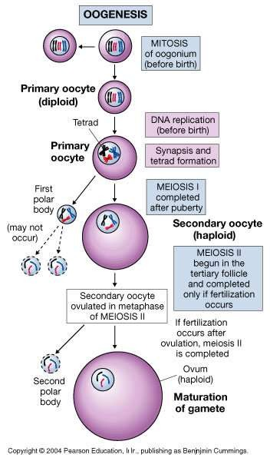

Slide 90
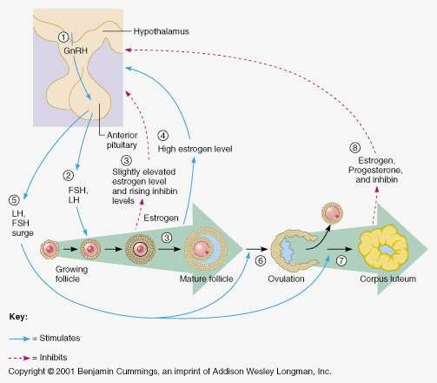

Slide 91
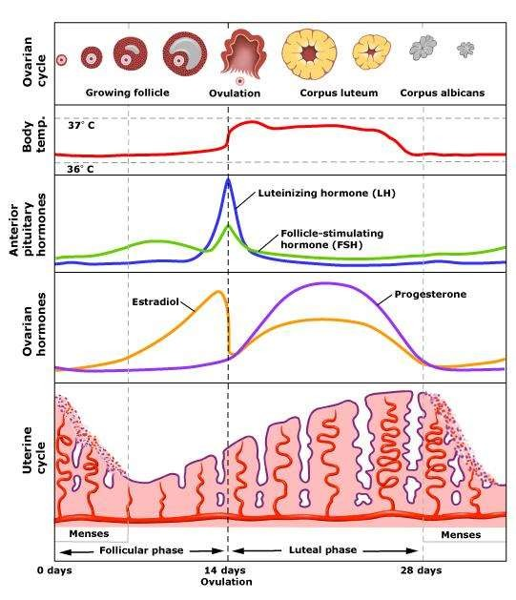

Slide 92
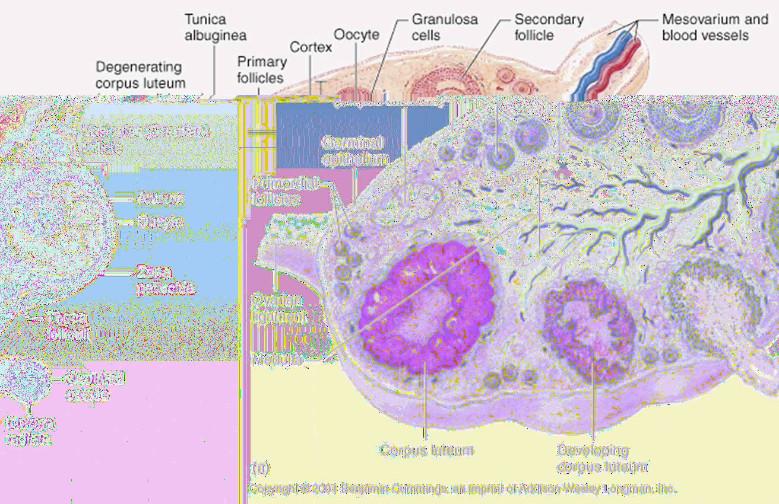

Slide 93
Control of Ovarian Functions
GnRH is secreted from the hypothalmus. This causes the secretion of LH and FSH from the anterior pituitary gland.
LH and FSH levels increase (slightly elevated levels of estrogen and inhibin exhibit little negative feedback)
Multiple antral follicles begin to enlarge and secrete estrogen. Estrogen concentration increase markedly.
FSH secretion and FSH plasma concentration decrease.
The increasing plasma estrogen concentration exerts a “positive” feedback on gonadotropin secretion
An LH and FSH surge is triggered

Slide 94
Control of Ovarian Functions
Ovulation occurs
The corpus luteum forms and begins to secrete large
amounts of both estrogen and progesterone.
Plasma concentrations of estrogen and progesterone increase
FSH and LH concentrations secretion are inhibited and their plasma concentrations decrease
The corpus luteum begins to degrenerate and decrease its hormone secretion
Plasma estrogen and progesterone concentrations decrease
FSH and LH concentrations begin to increase and a new cycle bgins

Slide 95
Effects of Estrogen & Progesterone
Estrogen
Stimulates the growth of the ovary and follicles
Stimulates external genitalia
Stimulates breast growth, particularly ducts and fat deposition in puberty
Stimulates female body configuration development during puberty: narrow shoulders, broad hips, female fat distribution (deposition on hips and breasts)
Vascular effects (deficiency produces hot flashes)
Stimulates prolactin secretion but inhibits
prolactin’s milk-inducing action on the breasts

Slide 96
Effects of Estrogen & Progesterone
Progesterone
Converts the estrogen primed endometrium to an actively secreting tissue suitable for implantation of the embryo
Decreases contraction of the fallopian tubes and myometrium
Increases body temperature
Decreases proliferation of vaginal epithelial cells
Induces thick, sticky cervical mucus
Inhibits milk producing effects of prolactin
Stimulates breast growth, particularly glandular tissue

Slide 97
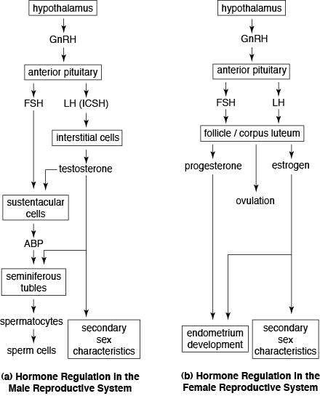

Slide 98
There are mainly 4 phases in the menstrual cycle:
Menstrual phase
Proliferative phase
Secretory phase
Menstrual or Premenstrual phase

Slide 99
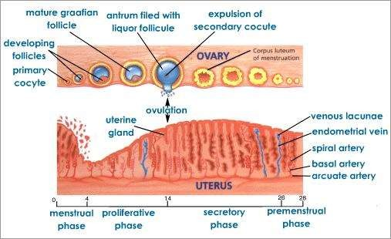
A diagram of the Menstrual cycle

Slide 100
Uterine changes are caused by changes in the plasma concentrations of estrogen and progesterone.

Slide 101
Menstrual phase
Lasts an average of 3-5days.
Endometrium degenerates resulting in the menstrual flow.
After the menstrual flow the endometrium begins to thicken due to the influence of estrogen.

Slide 102
Proliferative phase
Lasts approximately 10days.
Occurs between the end of the menstrual phase, during ovulation.
When flow ceases, the endometrium begins to thicken influenced by estrogen.
Estrogen stimulates growth of the endometrium and the uterine smooth muscle (myometrium) also inducing the synthesis of progesterone receptors on endometrial cells.

Slide 103
Secretory Phase
After ovulation the endometrium increases secretory activity under the influence of progesterone and estrogen, the formation of the corpus luteum, progesterone acts upon the endometrium to convert it to an actively secreting tissue.
The endometrial glands become coiled and filled with glycogen, the blood vessels become more numerous and enzymes accumulate in the glands and connective tissue. These changes are necessary for implantation and nourishment of a developing embryo.

Slide 104
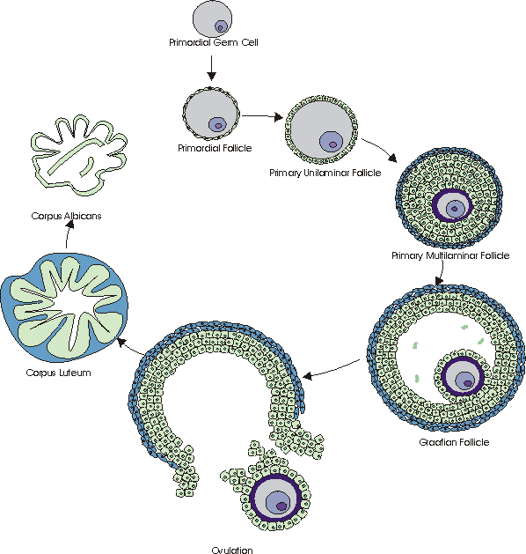

Slide 105
Table 1 summary of menstrual cycle
Day(s) | Major event
1-5 | Estrogen and progesterone are low because the previous corpus luteum is regressing. Therefore: (a) Endometrial lining sloughs. (b)Secretion of FSH and LH is released from inhibition, and their plasma concentrations increase. Several follicles are stimulated to mature.
7 | A single follicle (usually) becomes dominant.
7-12 | Plasma estrogen increases because of secretion by the dominant follicle. Therefore: Endometrium is stimulated to proliferate.

Slide 106
7-12 | LH and FSH decrease due to estrogen and inhibin negative feedback. Therefore: Degradation of nondominant follicle occurs.
12-13 | LH surge is induced by increasing plasma estrogen. Therefore: (a) Oocyte is induced to complete its first meiotic division and undergo cytoplasmic maturation. (b) Follicle is stimulated to secrete digestive enzymes and prostaglandins
14 | Ovulation is mediated by follicular enzymes and prostaglandins.

Slide 107
15-25 | Corpus luteum degenerates and, under the influence of low but adequate levels of LH, secretes estrogen and progesterone, increasing plasma concentrations of these hormones. Therefore: (a) Secretory endometrium develops (b) Secretion of FSH and LH is inhibited, lowering their plasma concentrations. No new follicles develop.
25-28 | Corpus luteum degenerates (if implantation of the conceptus does not occur). Therefore: Plasma estrogen and progesterone concentrations decrease. Endometrium begins to slough at conclusion of the 28th day and a new cycle begins.

Slide 108
Prostaglandins
Prostaglandins, are like hormones in that they act as chemical messengers, but do not move to other sites, but work right within the cells where they are synthesized.
Prostaglandins produced by the endometrium resulting in vasoconstriction and uterine contractions in response in a decrease in plasma estrogen and progesterone.

Slide 109
Table 2 shows some effects of female sex steroids.
Estrogen
1. Stimulates growth of ovary and follicles.
Stimulates growth of smooth muscle and proliferation of epithelial linings of reproductive tract. In addition Fallopian tubes –increase in contractions and ciliary activity. Uterus-Increases myometrial contractions and responsiveness to oxytocin. Stimulates secretion of abundant watery cervical mucus. Prepares endometrium for progesterone’s action by inducing progesterone receptors. Vagina-Increases layering of epithelial cells
3. Stimulates external genetailia growth, particularly during puberty.
4. Stimulates breast growth,particularly ducts and fat deposition during puberty.

Slide 110
5. Stimulates female body configuration development during puberty :narrow shoulders, broad hips, female fat distribution (deposition on hips and breast).
6. Stimulates fluid secretion from lipid (sebum) producing skin glands (sebaceous glands)
7.Stimulates bone growth and ultimate cessation of bone growth, protects against osteoporosis; does not have an anabolic effect on skeletal muscles.
8. Vascular effects (deficiencies produce ‘hot flashes’)
9. Has feedback effects on hypothalamas and anterior pituitary.
10. Stimulates prolactin secretion but inhibits prolactin’s milk-inducing action on the breasts.
11. Protects against atherosclerosis by effects on plasma cholesterol,blood vessels and blood clotting.

Slide 111
Progesterone
1. Converts the estrogen-primed endometrium to an actively secreting tissue suitable for implantation of an embryo.
2.Induces thick, sticky cervical mucus.
3. Decreases contractons of fallopian tubes and myometrium.
4. Decreases proliferation of vaginal epithelial cells.
5.Stimulates breast growth,particularly glandular tissue.
6. Inhibits milk inducing effects of prolactin.
7. Has feedback effects on hypothalamus and anterior pituitary.
8. Increase body temperature approximately 0.5°C.

Slide 112
phase)
In the brain(the hypothalamus secretes GnRH )
↓
GnRH triggers pituitary gland to release (FSH)
↓
FSH travels to ovaries in bloodstream & initiates growth of the follicle.
↓
A developed follicle generates estrogen.
↓
Estrogen levels peak approximately 1 day before ovulation (typically day13).
↓
There is a surge of LH from the pituitary gland. This acts on the ovarian follicle. A mature egg is released into fallopian tubes leaving behind the corpus luteum.

Slide 113
Menopause
Occurs around the age of 50.
It is where menstrual cycles become less regular and will eventually cease.
Perimenopause– The beginning of menstrual irregularities, involving emotional and physical changes.
Menopause is due to ovarian failure. Ovaries lose their ability to respond to gonadotropins because most ovarian follicles and eggs have disappeared.

Slide 114
After menopause there is usually a small amount of estrogen in the plasma.
The breasts and genital organs gradually atrophy to a large degree.
Estrogen is needed for bone growth, with little estrogen bone mass decreases (osteoporosis).
Women experience hot flashes.
There is the increase in incidence of Cardiovascular disease and coronary artery disease.

Slide 115
Administering estrogen increases the risk of developing uterine endometrial cancer and breast cancer.
Endometrial cancer can be treated with progesterone ,not breast cancer.
Drugs called selective estrogen receptor modulators (SERMs) are being used as hormone replacers. They activate estrogen receptor in certain tissues.
SERMs act as estrogen antagonists, therefore it could be used to treat osteoporosis, heart attacks and Alzheimer’s disease.

Slide 116
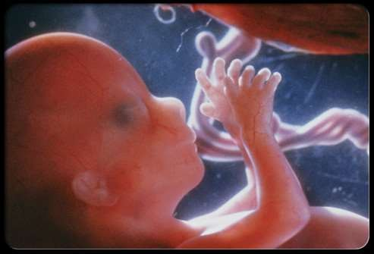
Pregnancy

Slide 119
^{P}⚫^{R}If^{E}o^{G}vu^{N}m^{AN}is^{C}fe^{Y}rtilized by a sperm the fertilized ovum begins to divide and becomes a fetus.
This period of the fetus is called pregnancy or gestation.
Lasts approx 40 weeks
Levels of estrogen and progesterone increase steadily

Slide 120
Their function are to:
Maintain the endometerium
Development of breasts for lactation
Suppression of development of new ovarian follicles.

Slide 121
EVENTS OF EARLY PREGNANCY
Fertilization
Takes place 24 hours after ovulation.
In a distal portion of the oviduct(ampulla).
4 days after ovulation, the fertilized ovum (blastocyst) arrives in the uterine cavity

Slide 122
Implantation
The blastocyst floats in the cavity for 1 day.
Then implants in the endometrium 5 days after ovulation.
A low estrogen/progesterone ratio is needed for the endometrium to be receptive to the fertilized ovum.
At implantation the blastocyst consists of an inner mass of cells. This is the fetus.
Outer rim of cells is called the trophoblast.
Trophoblast contributes the fetal portion of the placenta.

Slide 123
Trophoblastic cells proliferate and form the syncytiotrophoblast.
Its function is to allow the blastocyst to penetrate deep into the endometrium

Slide 124
Secretion of HCG
Trophoblast becomes the placenta.
Begins secreting HCG, 8 days after ovulation.
HCG “informs” the corpus luteum that fertilization has occurred.
Corpus luteum synthesizes progesterone and estrogen to maintain the endometrium for implantation.
High levels of estrogen and progesterone suppress the development of the next cohort of ovarian follicles.
The pregnancy test is based on the excretion of HCG in the
urine.

Slide 125
Hormones of pregnancy The First Tri-mester
HCG is produced by the trophoblast.
HCG also stimulates corpus luteal production of progesterone and estrogen.
Second and Third Tri-mesters
Progesterone is produced by the placenta.
Estriol (a major form of estrogen) is also produced.

Slide 127
PARTURITION
Delivery of the fetus.
The following events may contribute to parturition:
Fetus reaches a critical size.
Thus distention of uterus increases its contractility.
Braxton Hicks contractions begin approximately one month before parturition.
Cortisol increases estrogen/progesterone ratio.
This increases the sensitivity of the uterus to contractile stimuli.

Slide 128
Estrogen stimulates production of the prostaglandins.
Prostaglandins increase the intra-cellular calcium concentration of uterine smooth muscle.
This thereby increases contractility.
Oxytocin is used to induce labour.
The dilation of the cervix stimulates oxytocin secretion.

Slide 129
LACTATION
Estrogen and progesterone stimulate the growth and development of breasts.
Hence preparing them for lactation.
Estrogen stimulates prolactin secretion.
Prolactin is very high during pregnanc but lactation does not occur.
This is due because progesterone and estrogen block the action of prolactin.
After parturition, estrogen and progesterone levels fall therefore they no longer block the prolactin.

Slide 130
Hence lactation can now proceed.
Lactation is maintained by suckling.
This stimulates the secretion of oxytocin and prolactin.
During lactation there is a suppression of ovulation.
Prolactin inhibits GnRH secretion by the hypothalamus.
FSH and LH secretion by the anterior pituitary

Slide 132
MENOPAUSE
Occurs at approximately at 50 years
Several years preceding menopause anovulatory becomes common
The number of ovarian follicles also decreases
Estrogen secretion decreases and eventually declines
Due to the decreased levels there is a negative feedback on anterior pituitary

Slide 133
Symptoms of menopause are caused by:
Loss of ovarian source of estrogens
Thinning of the vaginal epithelium
Decreased vaginal secretions
Decreased breast mass
Accelerated bone loss
Vascular instability (*hot flashes*)
Emotional liability

Slide 134
NB//
estrogen can be produced from androgenic precursors in adipose tissue. Obese woman tend to be less symptomic than non obese women.
ESTROGEN REPLACEMENT THERAPY
Aims at replacing the ovarian source of estrogen, thus minimizing or preventing the symptoms of menopause.

Slide 135
ANDROPAUSE
Andropause or male menopause
sometimes colloquially called "man-opause"

Slide 136
This relates to the slow but steady reduction of the production of the hormones testoerone and dehydroepiandrosteronen in middle-aged men
Unlike women, middle-aged men do not experience a complete and permanent physiological shutting down of the reproductive system

Slide 137
This drop in testosterone levels is considered to lead in some cases to loss of energy and concentration, depression, and mood swings.
Many experience bouts of impotence
Premature andropause can occur in males who experience excessive female hormone stimulation through workplace exposure to estrogen

Slide 138
The following treatments have been found to be effective. These include:
Hormone replacement therapy
Exercise, dietary changes, stress reduction
Selective androgen receptor modulators have also been proposed.

