Slide 1
RETINOBLASTOMA
PRESENTED BY
KAREN KURU
OPHT/18001/ 013

Slide 2
RETINOBLASTOMA.
it is a Primary malignant neoplasm of the retina that arises from immature retina cells
It is the most common primary intraocular malignancy in children.
Most of the children survive this cancer or they may loose their vision in the affected eyes or need to have the eye removed
In unilateral cases only a single tumor is usually present in the affected eye
Bilateral cases multifocal tumors in both eyes .

Slide 3
CAUSES
It occurs when nerves cells in the retina develop genetic mutations
These mutations causes the cells to continue growing and multiplying when healthy cells would die.
This accumulating mass of cells forms a tumor.
Retinoblastoma cells can invade further into the eye and nearby structures and can spread to other areas of the body
It is not clear what causes the genetic mutations that leads to retinoblastoma but it is possible to inherit a genetic mutation from their parents

Slide 4
SINGS AND SYMPTOPMS
The most common sign is abnormal appearance of retina as viewed through the pupil known as leukocoria or amaurotic cats eye reflex.
Squint which can be convergent or divergent
An eye or eyes that appears larger than normal
red painful eye
Vision problem
Proptosis of the eye
Orbital cellulites

Slide 5
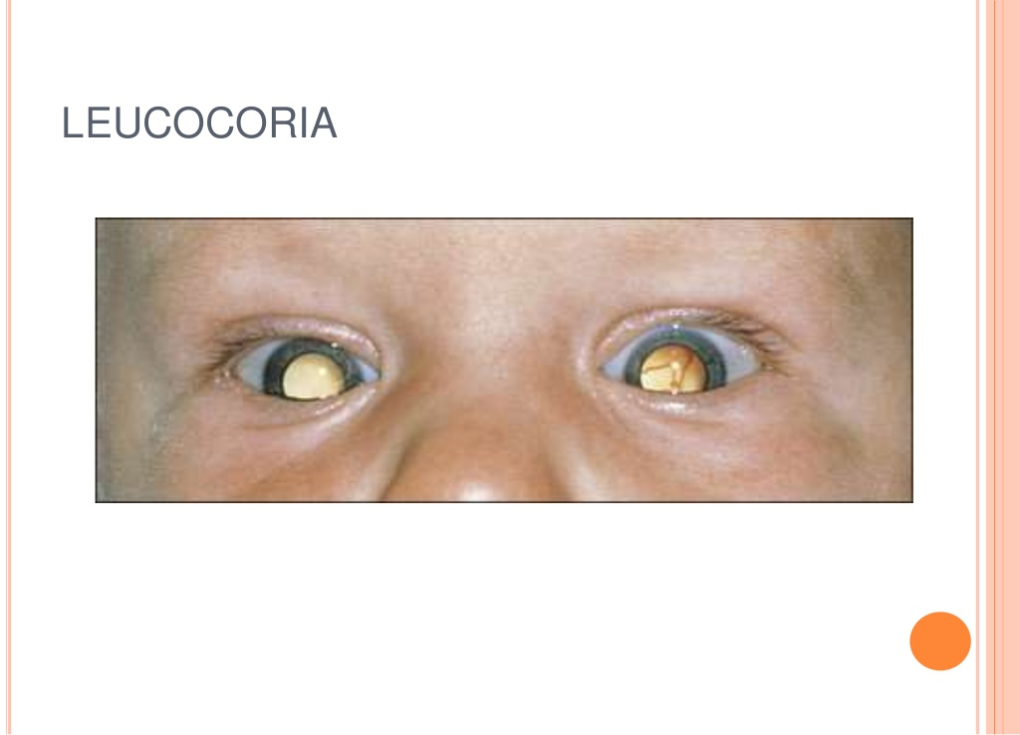

Slide 6
TYPES
Endophytic
Exophytic
Diffuse infiltrating tumor

Slide 7
ENDOPHYTIC
Arises from inner layers of retina
Grows into vitreous cavity
There is Visual disturbance and white eye reflex
The mass is Yellow white and fills vitreous cavity
It is associated with vitreous seeding
Retinal vessels not seen on the tumor surface

Slide 8
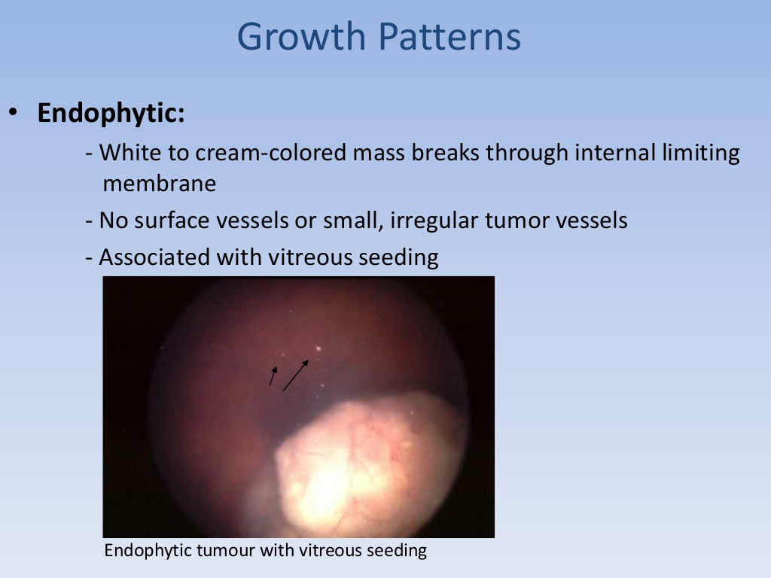

Slide 9
EXOPHYTIC
Arises from outer layers of retina
Tumors grow towards sub retinal space Causing retinal detachment
Retinal vessels are seen over the tumors

Slide 10
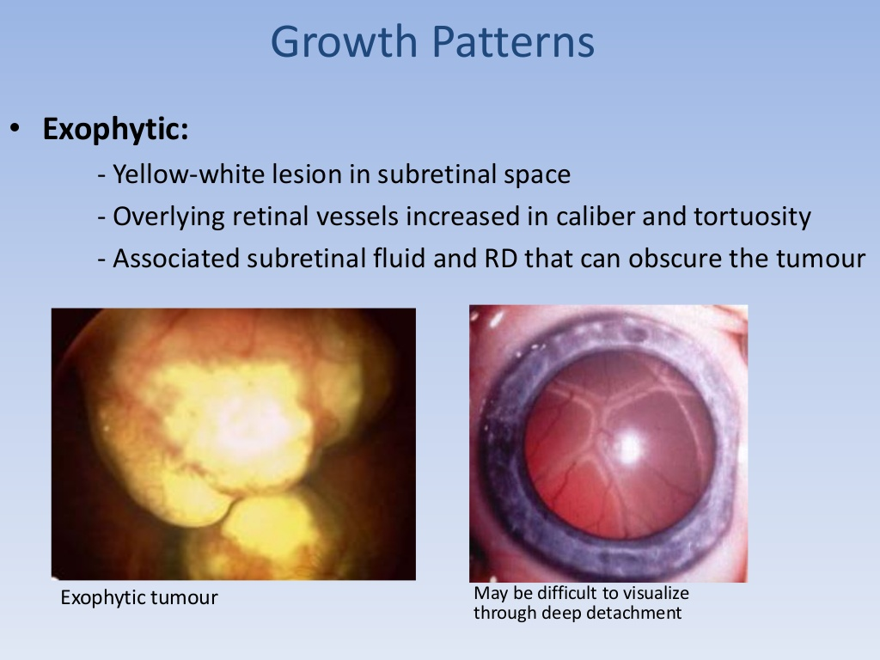

Slide 11
DIFFUSE INFILTRATING TUMOR
Tumors diffusely involves retina causing placoid thickness of retina (not mass)
Seen in older children

Slide 12
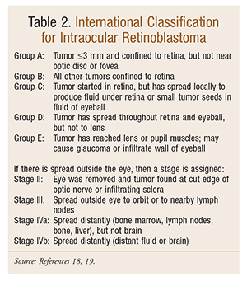

Slide 13
DIAGNOSIS
The diagnosis is based on history, examination under anesthesia and imaging.
ULTRASOUND
can confirm if tumors are present and assess the tumor size
MRI
Of the brain and spinal cord are indicated when there is gross invasion of optic nerve.

Slide 14
cont.
COMPUTERIZED TOMOGRAPY
Detect calcification
Not preferred as radiation can lead to second tumor

Slide 15
Cont.
Systemic assessment
Bone scan
Bone marrow aspiration
Lumber puncture for csf study

Slide 16
MANAGEMENT
GOAL OF TREATMENT
Save life
Preserve vision or salvage eye i.e. avoid enucleating
Minimize any complication or side effects of therapy
The exact course of treatment will depend on the individual case.

Slide 17
ENUCLEATION
It is the definitive treatment
It involves the removal; of the eye leaving behind lids and extraocular muscles but removing the longest possible segment (10 to 15mm)of optic nerve in continuity with the globe
After enucleating systemic therapy has been used to prevent development of metastatic disease in certain high risk factors asssed by pathology review after enuclation

Slide 18
cont
INDICATION
Tumors involving greater than 50% of the globe
Orbital or optic nerve involvement
Anterior segment involvement
Neovascular glaucoma
Limited visual potential.

Slide 19
VARIOUS TREATMENT MODALITIES
ENUCLEATION
Has a cure rate of 95%
Recommended for children who have unilateral advanced intraocular disease.
In bilateral cases is usually reserved for those have failed all known effective therapies or without useful vision.
EXTERNAL BEAM RADIOTHERAPY
Commonly indicated in young children with bilateral retinoblastoma who has active or recurrent disease after completion of chemotherapy and local therapies.

Slide 20
BRACHYTHERAPY
It involves placement of radioactive implant usually on the sclera adjacent to the tumor.
Used in patients with small tumors.
THERMOTHERAPIES
Involves application of heat directly to the tumor
Used in small tumors.

Slide 21
LASER PHOTOCOAGULATION
Recommended for small posterior tumors
Targets and destroys the blood vessels that supply the tumor.
CRYOTHERAPY
Works best for small tumors near the front of the eye
It freezes and kills cancer cells

Slide 22
VARIOUS TREATMENT MADALITIES
SYSTEMIC CHEMOTHERAPY
Is used to reduce the size of the tumor to allow local therapies including cryothearpy and laser photocoagulation or thermotherapy to eradicate the remaining disease
Recommended for large tumors that cannot be treated with local therapies alone in children with bilateral tumors.
Chemo drug are carboplatin ,vincristine etoposide and cyclosporine
4-9 cycles every 3 to 4 weeks
CRYOTHERAPY
Induces tumor tissue to freeze rapidly resulting in damage to vascular endothelium

Slide 23
Treatment
Small tumors less 3mm wide and 2mm thick
laser photocoagulation
Cryotherapy
Medium tumors 12mm wide and 6mmthick
brachytherapy
Chemotherapy
external beam radiation

Slide 24
Cont
Large tumors
chemotherapy
enucleating
Extraocular extension
chemotherapy
external beam radiotherapy
Metastatic disease
chemotherapy

Slide 25
GENETIC COUNSELLING
Parents and siblings of the affected child should be screened for evidence of retinoblastoma in all cases of retinoblastoma in order to indentify the hereditary cases of retinoblastoma

Slide 26
FOLLOWUP
Recurrence usually occurs within 3 years
The risk period for extraocular spread successful treatment is 12 to 18 months
Long term survivors should be followed for development of second malignancies
by Opthalmoscopic examination
First year every 2 months
second year every 3 months
3 to 5 years every 6 months
After5 years every one year

Slide 27
DIFFERNTIAL DIAGNOSIS
Coats disease
Retinopathy of maturity
Retinal dysplasia
Persistent hyperplastic primary vitreous.
Toxocariasis
Congenital cataract
Vitreous haemorrhage
Coloboma of choroid

Slide 28
THANKYOU

