Slide 1
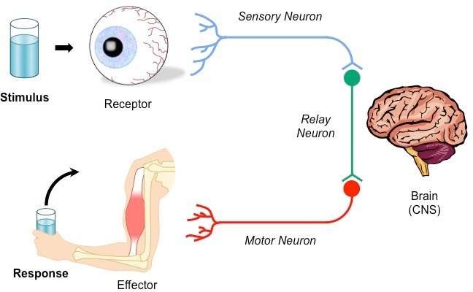
Sensory and motor pathway

Slide 2
Learning Outcomes
At the end of this session, the student would be able to:
List various general sensations and receptors responsible for it.
Describe sensory pathways in spinal cord and brain and the somatosensory cortex
Describe upper and lower motor neuron.
Describe primary motor area and name the motor tracts.
Describe the corticospinal or pyramidal tract the somatosensory cortex

Slide 3
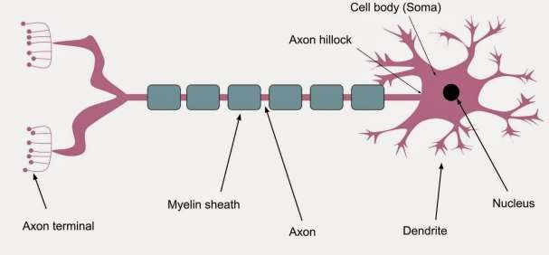
Myelinated and Non-myelinated Nerve Fibers
A motor neuron is a nerve that carries an impulse for a response from the CNS to an effector.
A mylinated neuron is covered by a myelin sheaths. A myelin sheath is membrane of a Schwann cell- the cell wraps itself around the axon of a neuron many times creating the sheath.

Slide 4
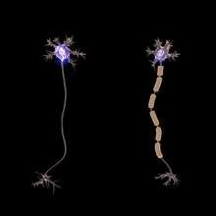
Myelinated and Non-myelinated Nerve Fibers
Non-myelinated fibers comprise the smaller axons of the CNS, in addition to peripheral postganglionic autonomic fibers, several types of fine sensory fibers (C fibers of skin, muscle and viscera), olfactory nerves, etc.

Slide 5
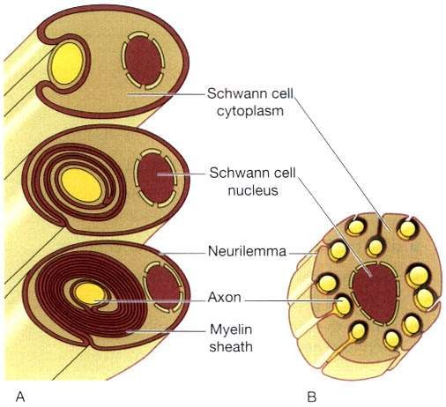
Myelinated and Non-myelinated Nerve Fibers
Nerve fibres: A. Myelinated. B. Non-myelinated.

Slide 6
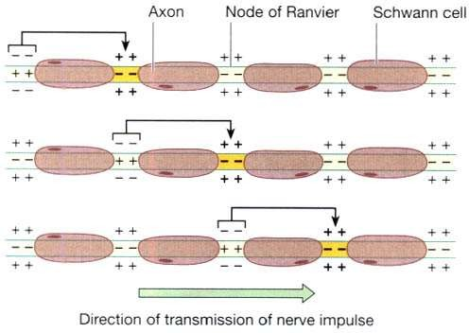
Myelinated and Non-myelinated Nerve Fibers
In myelinated neurones, the insulating properties of the myelin sheath prevent the movement of ions.
Therefore electrical changes across the membrane can only occur at the gaps in the myelin sheath, i.e. at the nodes of Ranvier.
When an impulse occurs at one node, depolarisation passes along the myelin sheath to the next node so that the flow of current appears to 'leap' from one node to the next.
This is called saltatory conduction.
Saltatory conduction of an impulse in a myelinated nerve fibre.

Slide 7
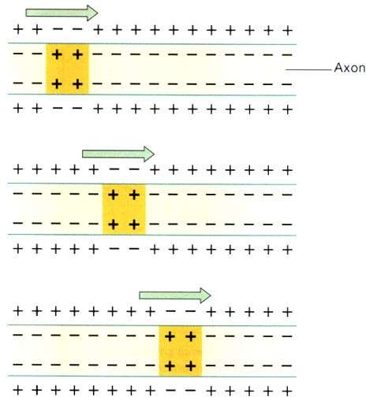
Myelinated and Non-myelinated Nerve Fibers
The speed of conduction depends on the diameter of the neurone: the larger the diameter, the faster the conduction.
Myelinated impulses unmyelinated
fibres faster fibres
conduct
than
because
saltatory conduction is faster than the complete conduction, or simple propagation.
The fastest fibres can conduct impulses
130 metres/ sec. (skeletal muscles)
while the slowest impulses travel at 0.5 metres/ sec.
Simple propagation of an impulse in a non- myelinated nerve fibre.

Slide 8
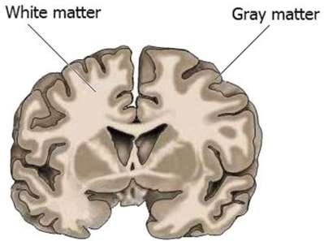
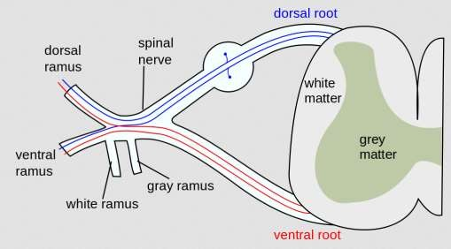
Sensory pathway
(Transmit action potentials from periphery to brain)

Slide 9
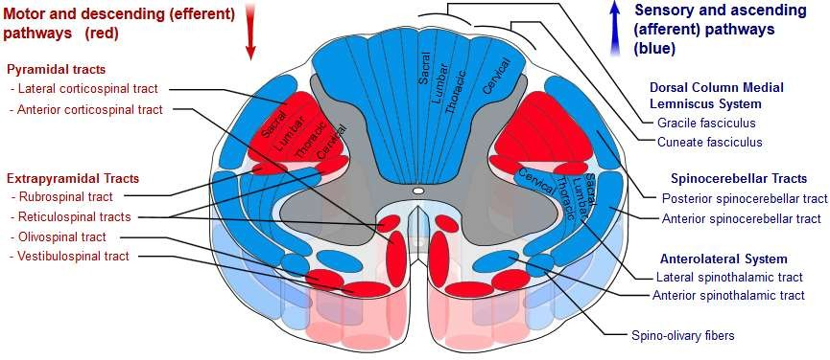
Motor pathways

Slide 10
Sensory nerve tracts (afferent or ascending) in the spinal cord
The white matter tracts
in the spinal cord are
highways for nerve impulse propagation. Sensory input travels along these tracts toward the brain, and motor output travels from the brain along these tracts toward skeletal muscles and other effector tissues.
The gray matter of the spinal cord receives and integrates incoming and outgoing information.

Slide 11
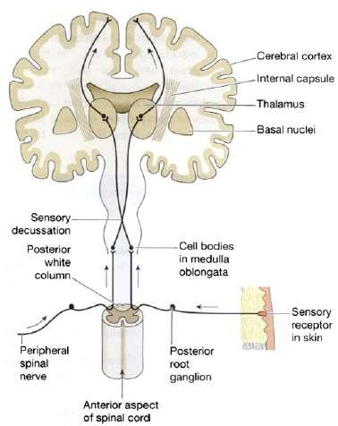
Sensory nerve tracts
There are two main sources of sensation transmitted to the brain via the spinal cord.
– SKIN: Sensory receptors (nerve
endings) in the skin,
cutaneous receptors,
called
are
stimulated by pain, heat, cold and touch, including pressure. Nerve impulses generated are conducted by three neurones to the sensory area in the opposite hemisphere of the cerebrum where the sensation.

Slide 12
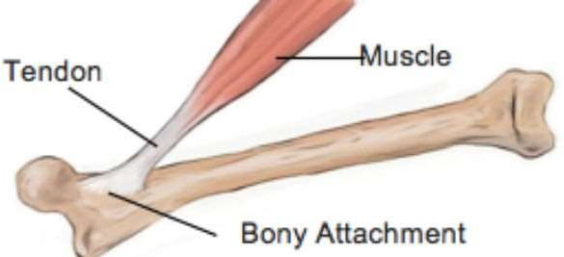
Sensory nerve tracts
There are two main sources of sensation transmitted to the brain via the spinal cord.
– Tendons, muscles and joints: Sensory receptors are nerve endings in these structures, called proprioceptors, and they are stimulated by stretch. Together with impulses from the eyes and the ears they are associated with the maintenance of balance and posture and with perception of the position of the body in space.

Slide 13
Sensory nerve tracts
Sensory nerve impulses: origins, routes, destination
Receptor | Route
Pain, touch, temperature | Neurone 1 -to spinal cord by posterior root
 | Neurone 2 - decussation on entering spinal cord then in anterolateral spinothalamic tract to thalamus
 | Neurone 3 -
Touch, proprioceptors | Neurone 1 -to medulla in posterior spinothalamic tract
 | Neurone 2 - decussation in medulla, transmission to thalamus
 | Neurone 3 -
Proprioceptors | Neurone 1 - to spinal cord
 | Neurone 2 -

Slide 14
Sensory and Motor Tracts
Extrapyramidal upper motor neurones: origins and tracts
Origin | Name of tract | Functions
Midbrain and pons | Rubrospinal tract decussates in brain stem | Control of skilled muscle movement
Reticular formation | Reticulospinal tract does not decussate | Coordination of muscle movement Maintenance of posture and balance
Midbrain and pons | Tectospinal tract decussates in midbrain
Midbrain and pons | Vestibulospinal tract, some fibres decussate in the cord

Slide 15
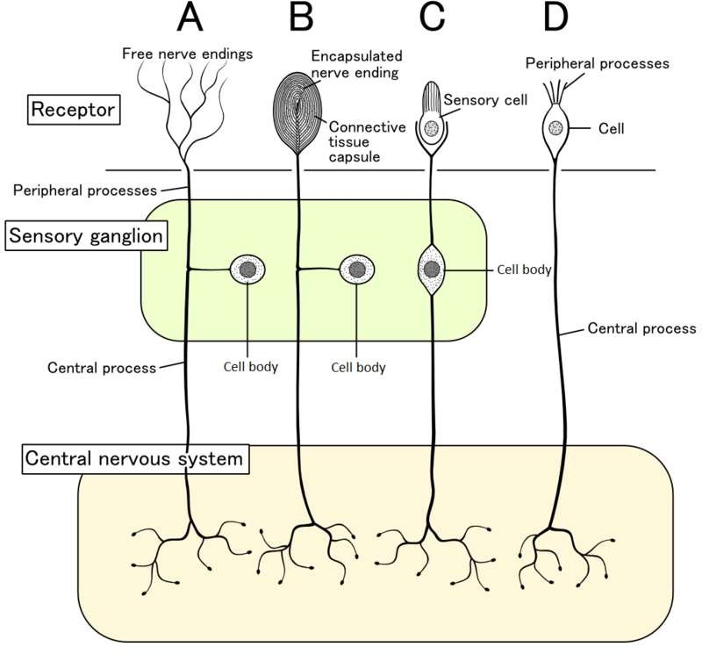
Types of sensory neuron

Slide 16
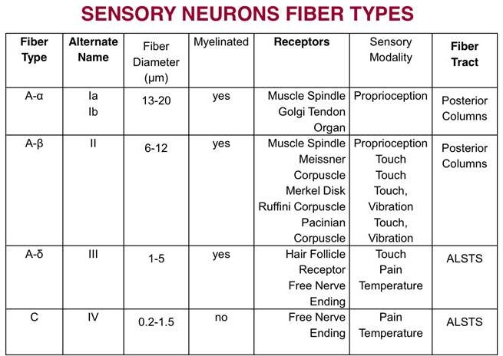
Types of sensory neuron

Slide 17
Sensory receptors
In a sensory system, sensory receptors serve as the front-liners because they are in contact with the stimulus.
E.g.: Taste or gustatory receptors, odor or olfactory receptors have receptor molecules which undergo a process of binding to chemicals in the stimuli.

Slide 18
Sensory receptors
Sensory Receptor | Adequate Stimulus (sensory receptor responds to…)
Ampullae of Lorenzini (electroreceptors) | electric fields, salinity, temperature
Baroreceptors | pressure in blood vessels
Chemoreceptors | chemical stimuli
Hydroreceptors | humidity changes
Mechanoreceptors | mechanical stress or mechanical strain
Nociceptors | damage to body tissues (which leads to pain perception)
Osmoreceptors | osmolarity of fluids
Photoreceptors | light
Proprioceptors | sense of position
Thermoreceptors | temperature, heat, cold or both
Electromagnetic receptors | electromagnetic waves
Pacinian Corpuscles | pressure on skin; weight of an object
Meissner’s Corpuscles | fine touch

Slide 19
Functions of sensory neuron
External
Smell (olfactory receptors)
Taste (gustatory receptors)
Vision
Auditory
Temperature (Thermoreceptors )
Mechanoreceptors (mechanoreceptors )
Internal
Blood (peripheral chemoreceptors )
Nociceptors

Slide 20
Motor pathway

Slide 21
Motor pathways
The motor system is the part of the central nervous system that is involved with movement. It consists of the pyramidal and extrapyramidal system.
Pyramidal tracts:
corticobulbar tract
corticospinal tract
Extrapyramidal tracts:
rubrospinal tract
pontine reticulospinal tract
medullary reticulospinal tract
lateral vestibulospinal tract
tectospinal tract

Slide 22
Motor pathways
Functions of pyramidal tracts:
nerves within the corticospinal tract are involved in
movement of muscles of the body.
The nerves within the corticobulbar tract are involved in
movement in muscles of the head.
The corticobulbar tract is also responsible for transmitting
facial expression.
Functions of extrapyramidal tracts:
It causing involuntary actions
Extrapyramidal tracts involved in reflexes, locomotion,
complex movements, and postural control.

Slide 23
Motor nerve tracts
Neurones which transmit nerve impulses away from the brain are motor (efferent or descending) neurones.
The motor pathways from the brain to the muscles are made up of two neurones [pyramidal (corticospinal), extrapyramidal].
Motor neurone stimulation results in:
contraction of skeletal (striated, voluntary) muscle
contraction of smooth (involuntary) muscle, cardiac muscle and the secretion by glands controlled by nerves of the autonomic nervous system

Slide 24
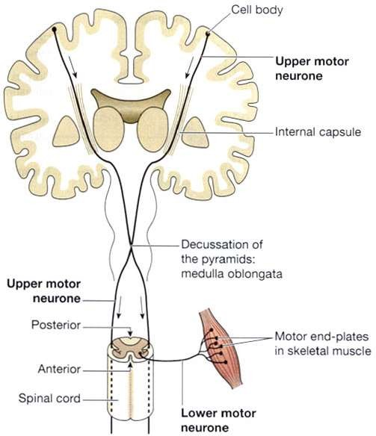
Motor nerve tracts – Voluntary muscle movement
The motor nerve pathways: upper
and lower motor neurones.

Slide 25
Motor nerve tracts – Voluntary muscle movement
The stimulus to contract originates at the level of consciousness in the cerebrum.
The upper motor neurone:
This has its cell body (Betz's cell) in the precentral sulcus area of the cerebrum.
The axons pass through the internal capsule, pons and medulla.
The axons of these upper motor neurones make up the pyramidal tracts and decussate in the medulla oblongata, forming the pyramids.
The lower motor neurone:
This has its cell body in the anterior horn of grey matter in the spinal cord.
The motor end-plates of each nerve and the muscle fibres they supply form a motor unit.

Slide 26
Motor nerve tracts – Involuntary muscle movement
The upper motor neurone:
Spinal reflexes:
– These consist of three elements (sensory
neurones,
connector neurones in the spinal cord and lower motor neurones).
simple reflex arc

Slide 27
Motor nerve tracts – Involuntary muscle movement
Spinal reflexes (Cont.,):
It is an involuntary and nearly instantaneous movement in
response to a stimulus.
In higher animals, most sensory neurons do not pass directly into the brain, but synapse in the spinal cord. This characteristic allows reflex actions to occur relatively quickly by activating spinal motor neurons without the delay of routing signals through the brain, although the brain will receive sensory input while the reflex action occurs.

Slide 28
Motor nerve tracts – Involuntary muscle movement
Stretch reflexes (Myotatic reflex):
The stretch reflex is a muscle contraction in response to
stretching within the muscle.
This reflex has the shortest latency of all spinal reflexes. It is a monosynaptic reflex that provides automatic regulation of skeletal muscle length.
Autonomic reflexes:
Autonomic reflexes are also known as visceral reflexes
because they often involve the internal organs of the body.
Eg: Urination and defecation, are spinal reflexes that can
take place without input from the brain.

Slide 29
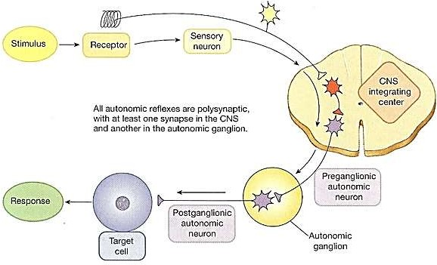
Motor nerve tracts – Involuntary muscle movement
Autonomic reflexes (Cont.,):
– Autonomic reflexes are all polysynaptic, with at least one synapse in the CNS between the sensory neuron and the preganglionic autonomic neuron, and an additional synapse in the ganglion between the preganglionic and postganglionic neurons.

Slide 30
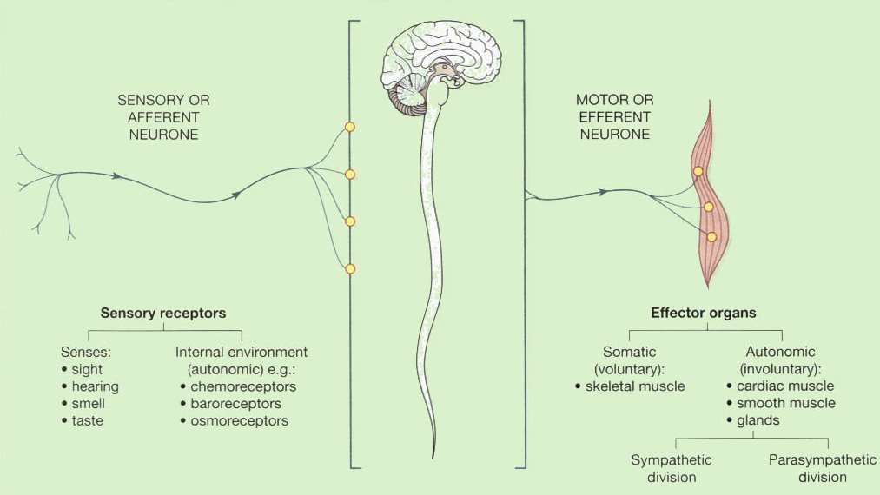
Thank you

