Slide 1

Special Senses
13/1/2022
by MUSYIMI.J.M

Slide 2

The Senses
General senses of touch (tactile)
  Temperature- thermoreceptors (heat)
  Pressure- mechanoreceptors (movement)
  Pain- mechanoreceptors
Special senses
  Smell- chemoreceptors (chemicals)
  Taste- chemoreceptors
  Sight- photoreceptors (light)
  Hearing- mechanoreceptors
  Equilibrium- (balance) mechanoreceptors

Slide 3
The Eye and Vision
70 percent of all sensory receptors are in the eyes
Each eye has over a million nerve fibers
Protection for the eye
  Most of the eye is enclosed in a bony orbit
made up of the lacrimal (medial), ethmoid (posterior), sphenoid (lateral), frontal (superior), and zygomatic and maxilla
(inferior)
A cushion of fat surrounds most of the eye

Slide 4
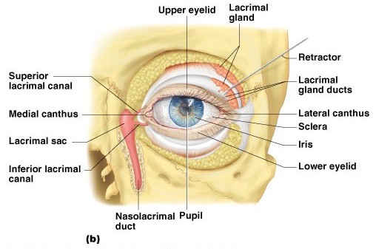
Accessory Structures of the Eye
Eyelids- brush particles out of eye or cover eye
Eyelashes- trap particles and keep them out of the eye

Slide 5
Accessory Structures of the Eye
Ciliary glands –
modified sweat glands between the eyelashes- secrete acidic sweat to kill bacteria, lubricate eyelashes

Slide 6
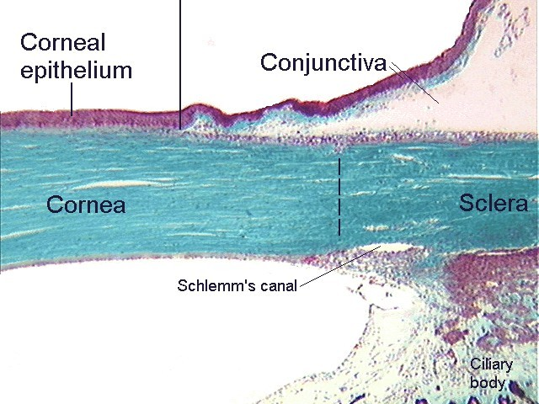
Accessory Structures of the Eye
Conjunctiva
Membrane that lines the eyelids
Connects to the surface of the eye- forms a seal
Secretes mucus to lubricate the eye

Slide 7
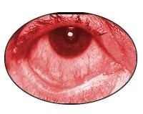
CONJUNCTIVITIS
Inflammation of the conjunctiva
Caused by bacterial or viral infection
Highly contagious

Slide 8
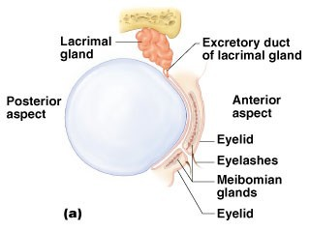
Accessory Structures of the Eye
Lacrimal
apparatus
Lacrimal gland –
produces lacrimal
fluid
Lacrimal canals –
drains lacrimal fluid from eyes

Slide 9
Accessory Structures of the Eye
Lacrimal sac – provides passage of lacrimal fluid towards nasal cavity

Slide 10
Accessory Structures of the Eye
Nasolacrimal duct – empties lacrimal fluid into the nasal cavity

Slide 11
Function of the Lacrimal Apparatus
Properties of lacrimal fluid
  Dilute salt solution (tears)
Contains antibodies (fight antigens- foreign substance) and lysozyme (enzyme that
destroys bacteria)
Protects, moistens, and lubricates the
eye
Empties into the nasal cavity

Slide 12
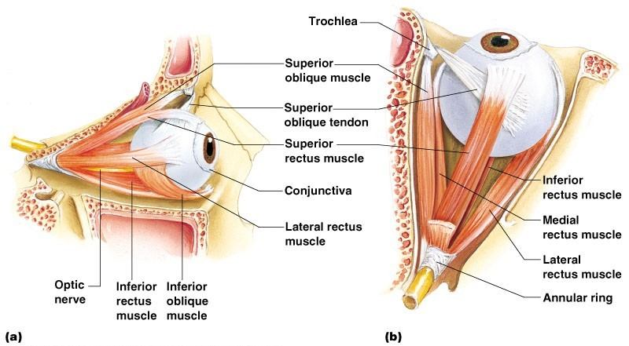
Extrinsic Eye Muscles
Muscles attach to the outer surface of the eye
Produce eye movements

Slide 13

When Extrinsic Eye Muscles Contract
Superior oblique- eyes look out and down
Superior rectus- eyes looks up
Lateral rectus- eyes look outward
Medial rectus- eyes look inward
Inferior rectus- eyes looks down
Inferior oblique- eyes look in and up

Slide 14
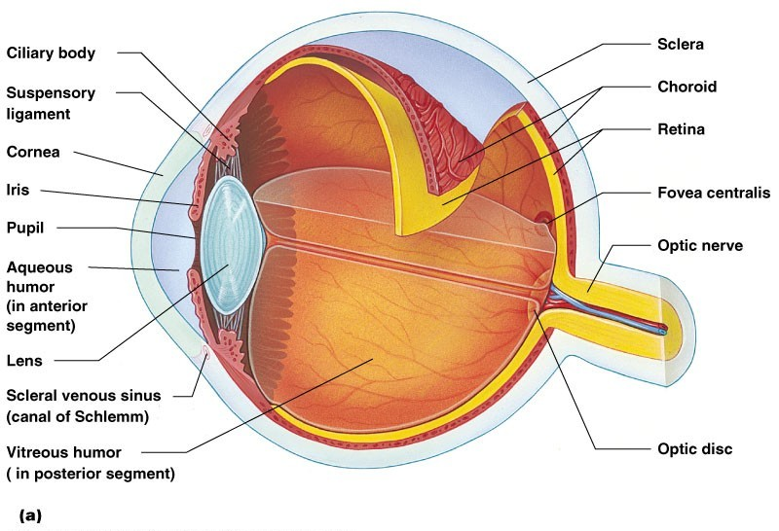
Structure of the Eye
The wall is composed of three tunics
  Fibrous tunic – outside layer
  Choroid – middle layer
  Sensory tunic – inside layer

Slide 15
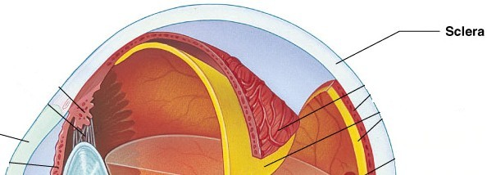
The Fibrous Tunic
Sclera
White connective tissue layer
Seen anteriorly as the “white of the eye”
Semi-transparent

Slide 16
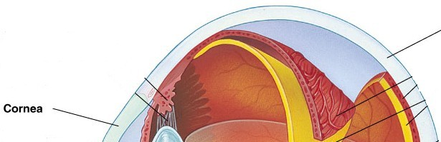
The Fibrous Tunic
Cornea
  Transparent, central anterior portion
  Allows for light to pass through (refracts, or bends, light slightly)
  Repairs itself easily
  The only human tissue that can be transplanted without fear of rejection

Slide 17
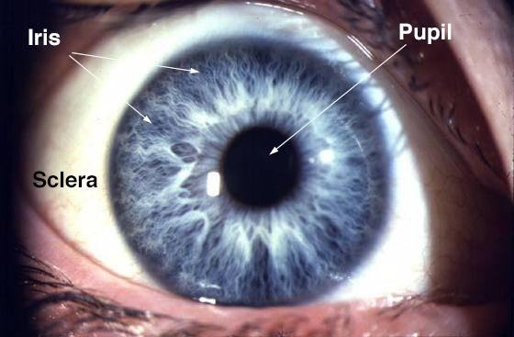

Slide 18
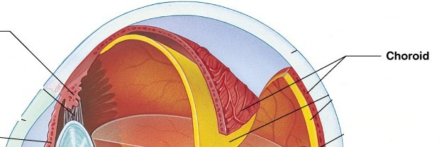
•Choroid Layer
Blood-rich nutritive tunic
Pigment prevents light from scattering (opaque- blocks light from getting in, has melanin)

Slide 19
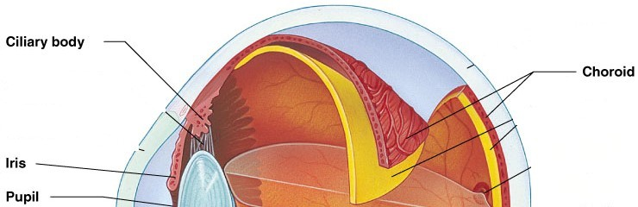
Choroid Layer
Modified interiorly into two structures
  Cilliary body – smooth muscle (contracts to
adjust the shape of the lens)
Iris- pigmented layer that gives eye color
(contracts to adjust the size of the pupil- regulates entry of light into the eye)
Pupil – rounded opening in the iris

Slide 20
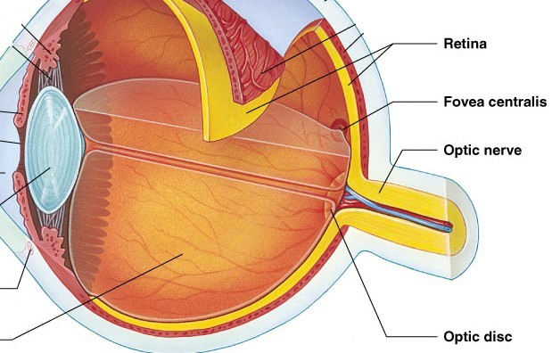
Sensory Tunic (Retina)
Contains receptor cells (photoreceptors)
  Rods
  Cones
Signals leave the retina toward the brain

Slide 21
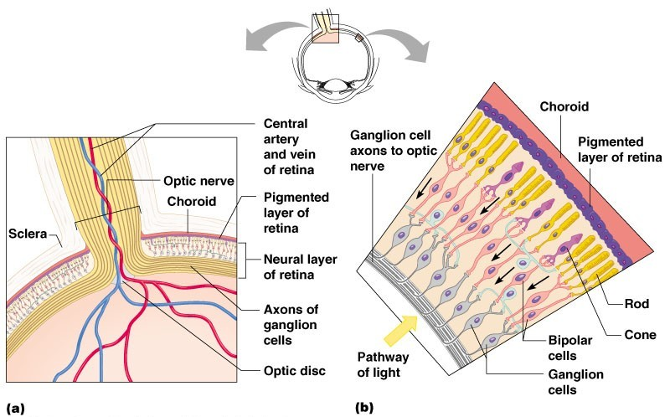
Sensory Tunic (Retina)
Signals pass from photoreceptors via a two-neuron chain
  Bipolar neurons and Ganglion cells

Slide 22
VISUAL PIGMENTS
Rhodopsin- visual purple, in high concentration in RODS
-Composed of opsin and retinal (a derivative of vitamin
A) proteins
-When light hits the protein it “bleaches”- turns yellow and then colorless. It straightens out and breaks down into opsin and retinal.
There are three different other opsins beside rhodopsin, with absorption for yellowish-green (photopsin I), green (photopsin II), and bluish-violet (photopsin III) light.

Slide 23
Neurons of the Retina and Vision
Rods
  Most are found towards the edges of the retina
  Allow dim light vision and peripheral vision (more sensitive to light, do not respond in bright light)
  Perception is all in gray tones

Slide 24
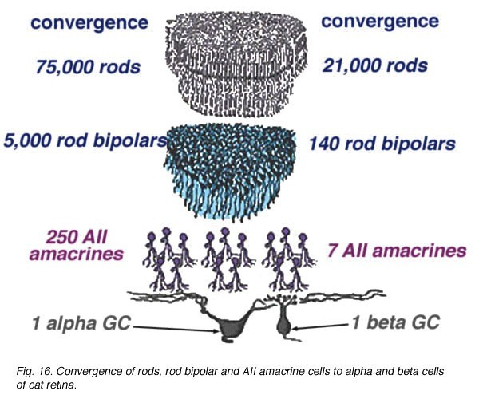
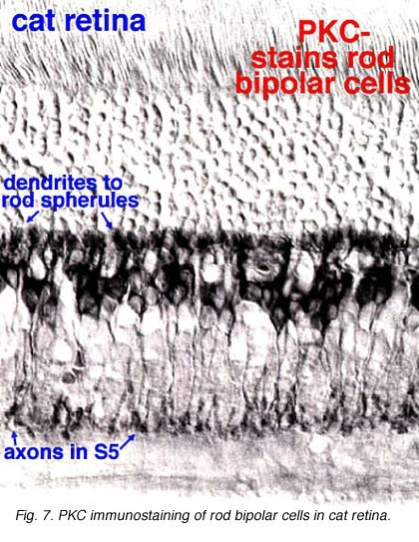
ROD CELLS

Slide 25
Neurons of the Retina and Vision
Cones
  Allow for detailed color vision
Densest in the center of the retina
Fovea centralis – area of the retina with
only cones
Respond best in bright light
No photoreceptor cells are at the optic disk, or blind spot

Slide 26
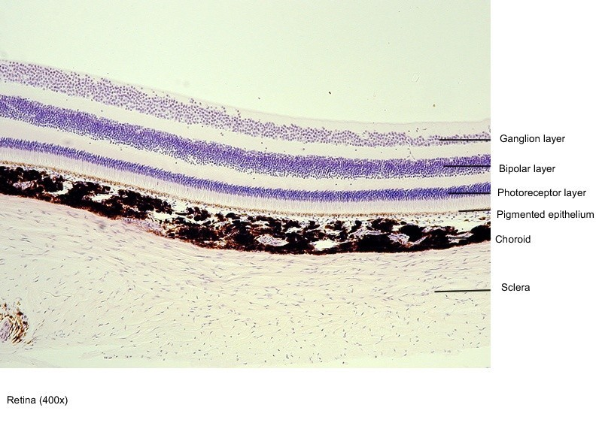

Slide 27
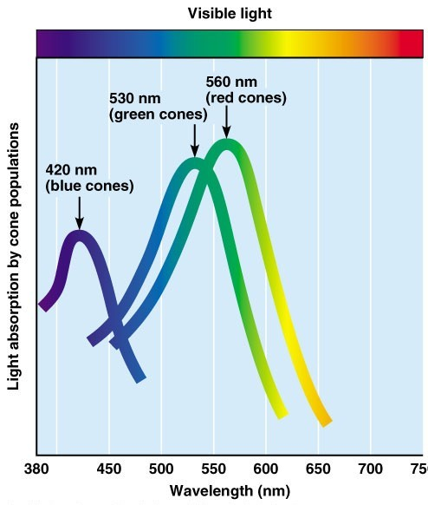
Cone Sensitivity
There are three types of cones
Different cones are sensitive to different wavelengths
  red- long
  green- medium
  blue- short
Color blindness is the result of lack of one or more cone type

Slide 28
How do we see colors?
To see any color, the brain must compare the input from different kinds of cone cells—and then make many other comparisons as well.
The lightning-fast work of judging a color begins in the retina, which has three layers of cells. Signals from the red and green cones in the first layer are compared by specialized red- green "opponent" cells in the second layer. These opponent cells compute the balance between red and green light coming from a particular part of the visual field. Other opponent cells then compare signals from blue cones with the combined signals from red and green cones.

Slide 29
COLORBLINDNESS
An inherited trait that is transferred on the sex chromosomes (23rd pair)- sex-linked trait
Occurs more often in males
Can not be cured or corrected
Comes from a lack of one or more types of color receptors.
Most are green or red or both and that is due to a lack of red receptors.
Another possibility is to have the color receptors missing entirely, which would result in black and white vision.

Slide 30
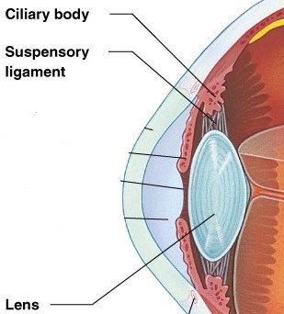
Lens
Biconvex crystal-like structure
Held in place by a suspensory ligament attached to the ciliary body
Refracts light greatly

Slide 31
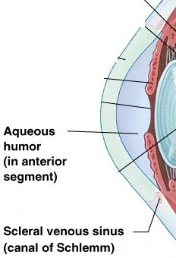
Internal Eye Chamber Fluids
Aqueous humor
Refracts light slightly
Watery fluid found in
chamber between the lens and cornea
Similar to blood
plasma
Helps maintain
intraocular pressure
Provides nutrients for the lens and cornea
Reabsorbed into venous blood through the canal of Schlemm

Slide 32
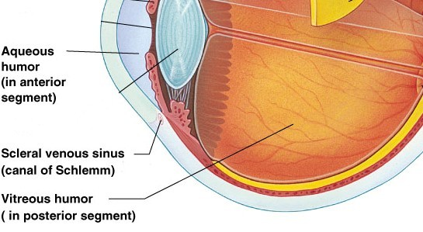
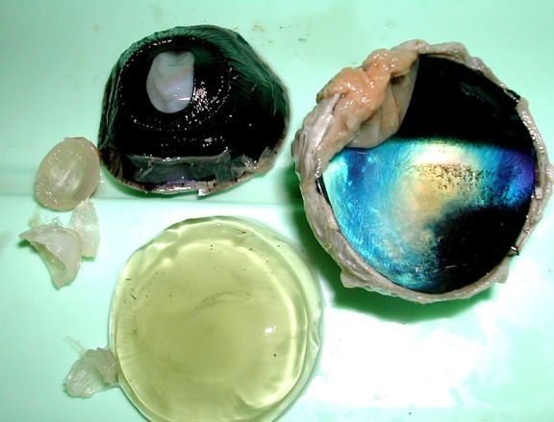
Internal Eye Chamber Fluids
Vitreous humor
Gel-like substance behind the lens
Refracts light
slightly
Holds lens and
Keeps the eye from collapsing
Lasts a lifetime and is not replaced
retina in place
http://faculty.washington.edu/kepeter/119/images/eye3.jpg

Slide 33
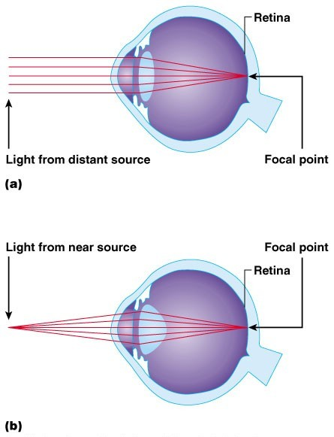
Lens Accommodation
Light must be focused to a point on the retina for optimal vision
The eye is set for distance vision
(over 20 ft away)
20/20 vision- at 20 feet, you see what a normal eye would see at 20 feet (20/100- at 20, normal person would see at 100)
The lens must change shape to focus for closer objects

Slide 34
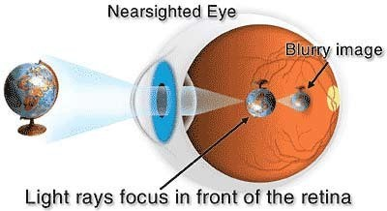
MYOPIA
Nearsightedness, or myopia is the difficulty of seeing objects at a distance.
Myopia occurs when the eyeball is slightly longer than usual from front to back. This causes light
rays to focus at a point in front of the retina,
rather than directly on its surface. Concave lenses are
used to correct the problem.

Slide 35
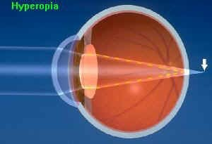
HYPEROPIA
Hyperopia, or farsightedness, is when light enterin the eye focuses behind the retina.
Hyperoptic eyes are shorter than normal.
Hyperopia is treated using a convex lens.
g

Slide 36
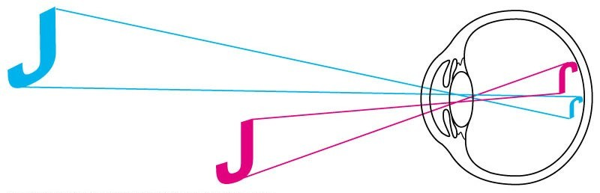
Images Formed on the Retina
If the image is focused at the spot where the optic disk is located, nothing will be seen. This is known as the blind spot. There are no photoreceptors there, as nerves and blood vessels pass through this point.

Slide 37
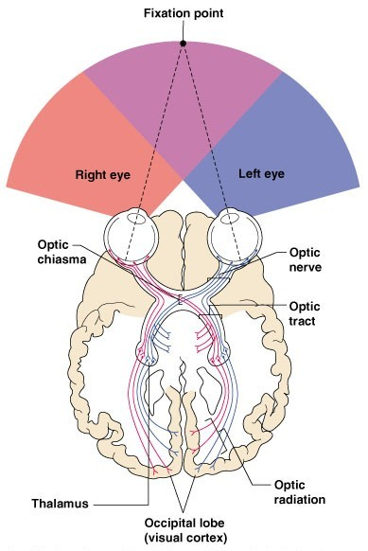
Visual Pathway
Photoreceptors of the retina
Optic nerve
Optic nerve crosses at the optic chiasma

Slide 38
Visual Pathway
Optic tracts
Thalamus (axons form optic radiation)
Visual cortex of the occipital lobe

Slide 39
Eye Reflexes
Internal muscles are controlled by the autonomic nervous system
Bright light causes pupils to constrict through action of radial (iris) and ciliary
muscles
Viewing close objects causes
accommodation
External muscles control eye movement to follow objects- voluntary, controlled at
the frontal eye field
Viewing close objects causes
convergence (eyes moving medially)

Slide 40
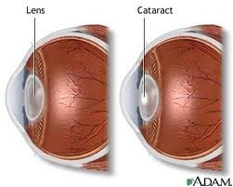
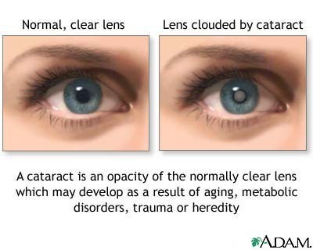
In youth, the lens is transparent and a
hardened jelly-like texture
As we age, it becomes increasingly hard and opaque
Cataracts

Slide 41
Cataracts cause vision to become hazy
and distorted, and eventually cause blindness
Risk factors: Type II diabetes, exposure to intense sunlight, heavy smoking
Current treatments: surgical removal, replacement lens implants or specialized glasses
Cataracts

Slide 42
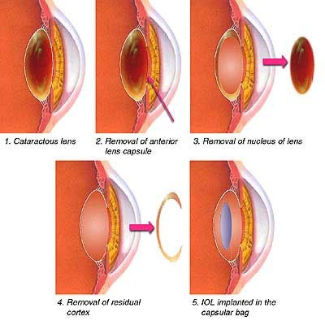
Cataract Surgery

Slide 43
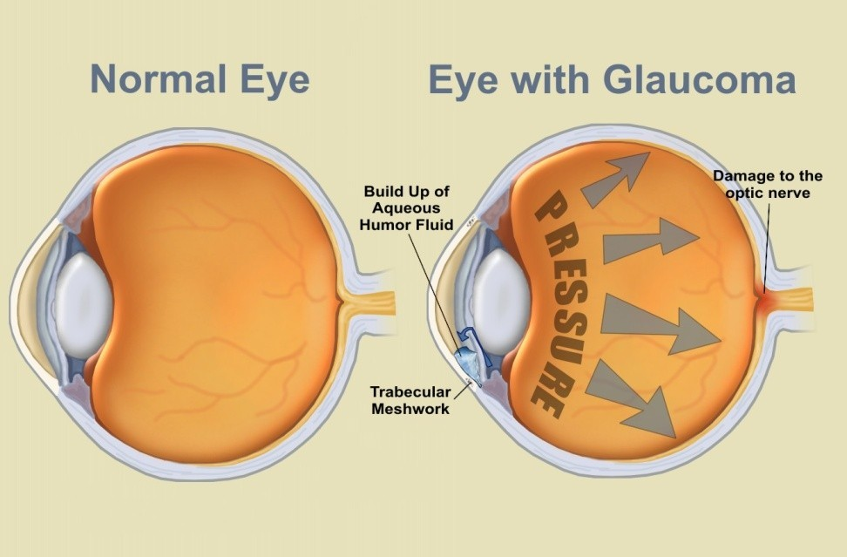
Occurs when the drainage of the aqueous
humor is blocked, and fluids back up
Pressure on the eye increases, compressing the retina and optic nerve
Glaucoma

Slide 44
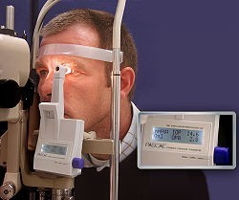
Glaucoma causes
pain and possible blindness
Progresses slowly and painlessly until the damage is done
Tonometer is used to test intraocular
Gplareusscuorema

Slide 45
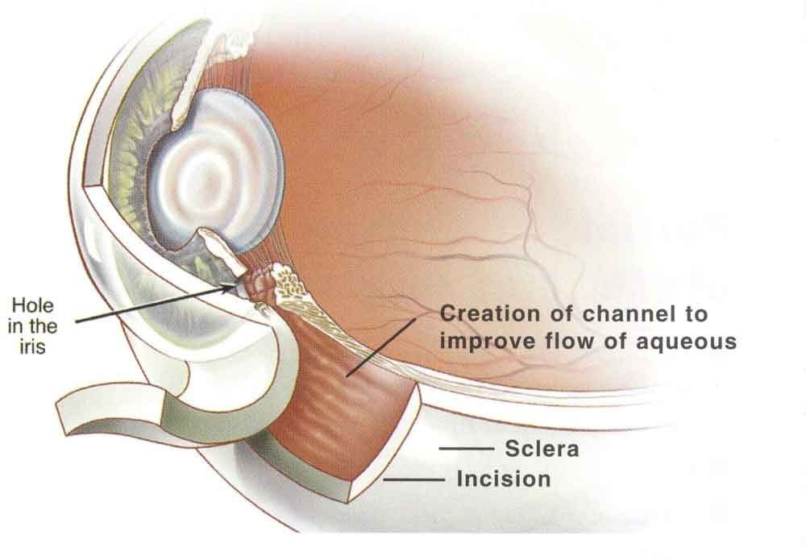
Glaucoma is commonly treated with
eyedrops that increase the rate of drainage
Laser or surgical enlargement of the drainage channel can also be used
Glaucoma

Slide 46
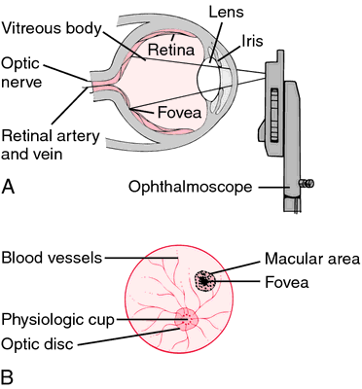
An ophthalmoscope is
an instrument used to illuminate the interior of the eyeball
Conditions such as diabetes, arteriosclerosis, and degeneration of the optic nerve and retina,
can be detected by
Oexpahmtinhaatilomn woisthcaonpe
ophthalmoscope

Slide 47
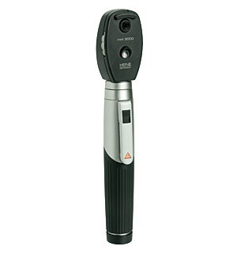
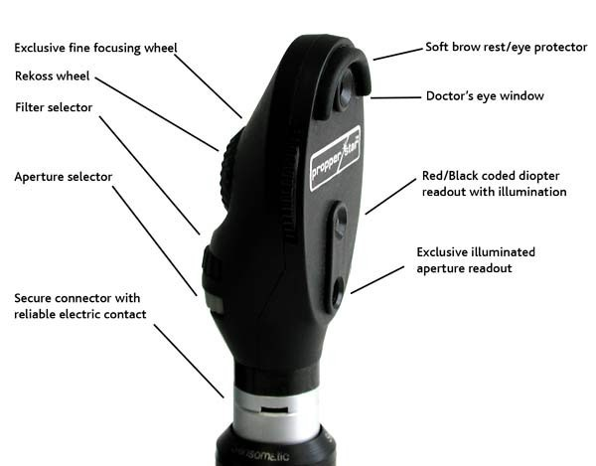
Ophthalmascope
Ophthalmascope

Slide 48
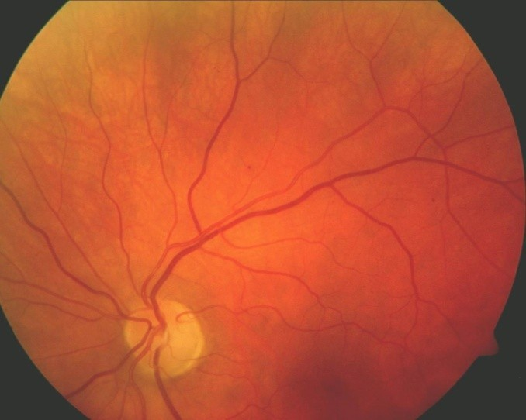
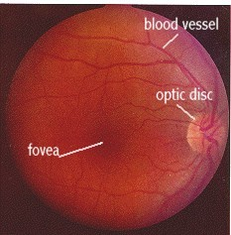
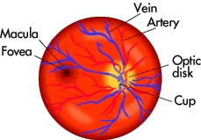
Ophthalmascope

Slide 49
The Ear
Houses two senses
  Hearing (interpreted in the auditory
cortex of the temporal lobe)
Equilibrium (balance) (interpreted in the
cerebellum)
Receptors are mechanoreceptors
Different organs house receptors for each sense

Slide 50
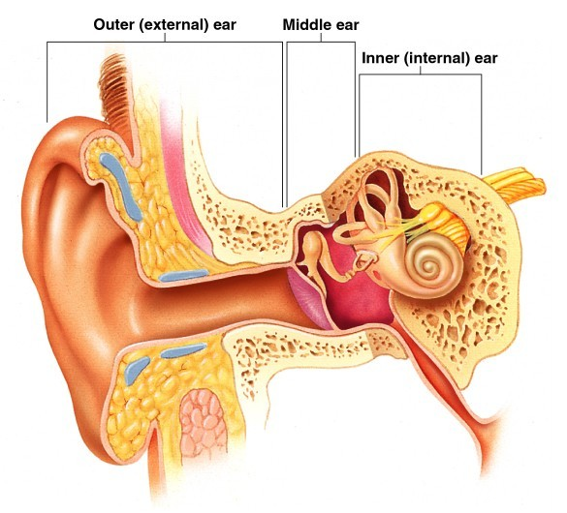
Anatomy of the Ear
The ear is divided into three areas
  Outer (external) ear
  Middle ear
  Inner ear
  (Add C. “INNER EAR” to notes)

Slide 51
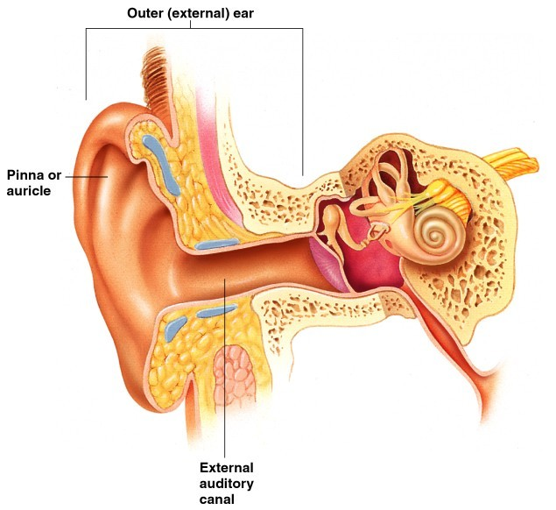
The External Ear
Involved in hearing only
Structures of the external ear
  Pinna (auricle)-
collects sound
  External auditory canal- channels sound inward

Slide 52
The External Auditory Canal
Narrow chamber in the temporal bone-
through the external auditory meatus
Lined with skin
Ceruminous (wax) glands are present
Ends at the tympanic membrane
(eardrum)

Slide 53
The Middle Ear or Tympanic Cavity
Air-filled cavity within the temporal bone
Only involved in the sense of hearing

Slide 54
The Middle Ear or Tympanic
T_{C}w_{a}o_{v}t_{i}u_{ty}bes are associated with the inner
ear
The opening from the auditory canal is covered by the tympanic membrane
(eardrum)
The auditory tube connecting the middle ear
with the throat (also know as the eustacian tube)
Allows for equalizing pressure during yawning
or swallowing
This tube is otherwise collapsed

Slide 55
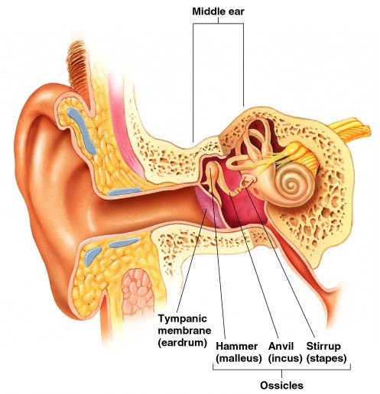
Bones of the Tympanic Cavity
Three bones span the cavity
  Malleus (hammer)
  Incus (anvil)
  Stapes (stirrip)

Slide 56
Bones of the Tympanic Cavity
Vibrations from eardrum move
the malleus
These bones
transfer sound to the inner ear

Slide 57
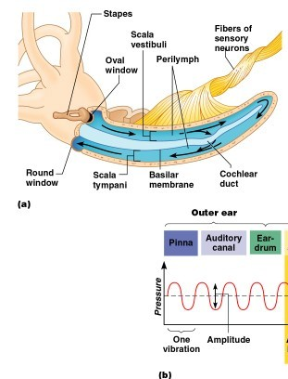
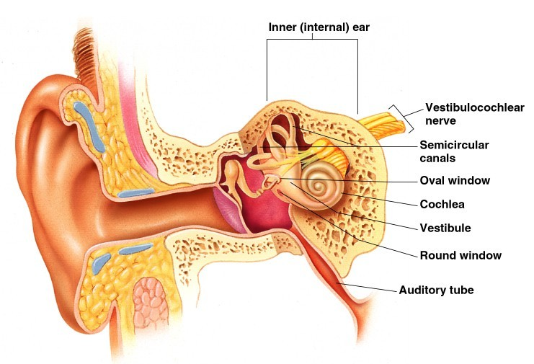
Inner Ear or Bony Labyrinth
Also known as osseous labyrinth- twisted bony tubes
Includes sense organs
for
hearing and balance
Filled with

Slide 58
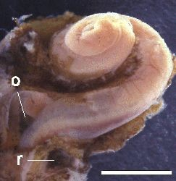
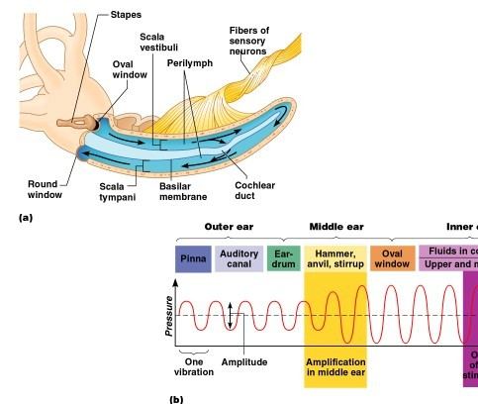
Inner Ear or Bony Labyrinth
Vibrations of the stapes push and pull
on the membranous oval window, moving
the perilymph through the
cochlea. The round window is a
membrane at the opposite end to relieve

Slide 59
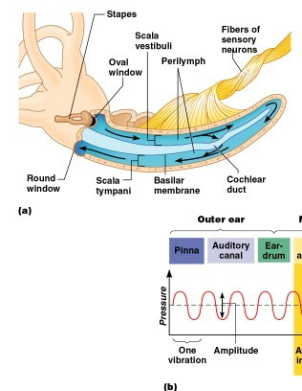
Inner Ear or Bony Labryinth
A maze of bony chambers within the temporal bone
  Cochlea
  Upper chamber is the scala
vestibuli
  Lower chamber
is the scala
tympani
  Vestibule
  Semicircular canals

Slide 60
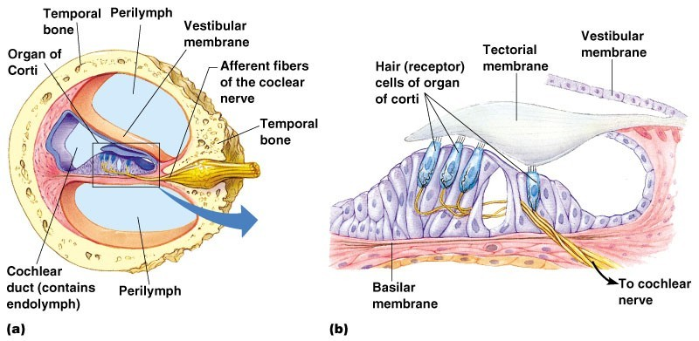
Organ of Corti
Located within the cochlea
Receptors = hair cells on the basilar membrane
Scala vestibuli
Scala tympani

Slide 61
Organ of Corti
Gel-like tectorial membrane is capable of bending hair cells (endolymph in the membranous labyrinth of the cochlear duct flows over it and pushes on the membrane)
Scala vestibuli
Scala tympani

Slide 62
Organs of Hearing
Organ of Corti
  Cochlear nerve attached to hair cells transmits nerve impulses to auditory cortex on temporal lobe
Scala vestibuli
Scala tympani

Slide 63
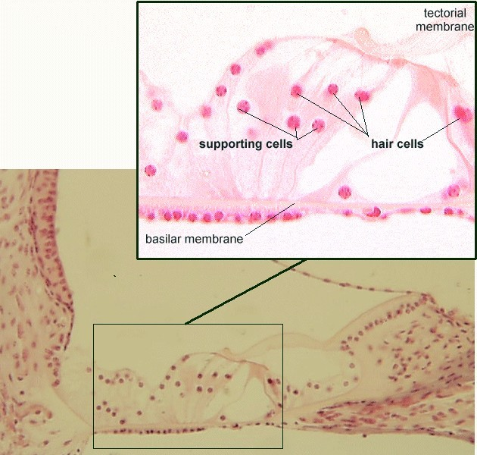
Mechanisms of Hearing
Vibrations from sound waves move tectorial membrane (pass through the endolymph fluid filling the membranous labyrinth in the cochlear duct)
Hair cells are bent by the membrane

Slide 64
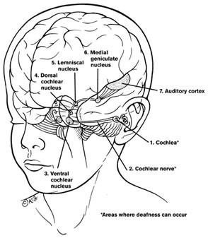
Mechanisms of Hearing
An action potential starts in the cochlear nerve
The signal is transmitted to the midbrain (for auditory reflexes and then directed to the auditory cortex of the temporal lobe)

Slide 65
Mechanisms of Hearing
Continued stimulation can lead to adaptation (over
stimulation to the brain
makes it stop interpreting the sounds)

Slide 66
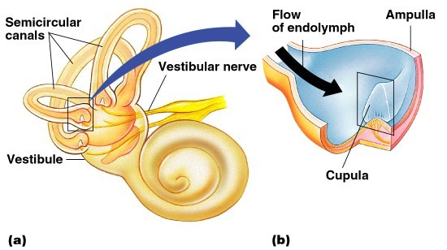
Organs of Equilibrium
Receptor cells are in two structures
  Vestibule
  Semicircular canals

Slide 67

Organs of Equilibrium
Equilibrium has two functional parts
  Static equilibrium- in the vestibule
  Dynamic equilibrium- in the semicircular canals

Slide 68

Static Equilibrium
Maculae – receptors in
the vestibule
Report on
the position of the head
Send information via the vestibular nerve

Slide 69
Static Equilibrium
Anatomy of the maculae
  Hair cells are embedded in the otolithic membrane
  Otoliths (tiny stones) float in a gel around the hair cells

Slide 70

Function of Maculae
Movements cause otoliths to bend
the hair cells (gravity moves the
“rocks” over and pulls the hairs)

Slide 71

Dynamic Equilibrium
Whole structure is the ampulla
Crista ampullaris – receptors in the semicircular canals
  Tuft of hair cells
  Cupula (gelatinous cap) covers the hair cells

Slide 72

Dynamic Equilibrium
Action of angular head movements
  The cupula stimulates the hair cells
  Movement of endolymph pushes the cupula over and pulls the hairs
  An impulse is sent via the vestibular nerve to the cerebellum

Slide 73
Chemical Senses – Taste and Smell
Both senses use chemoreceptors
  Stimulated by chemicals in solution
Taste has four types of receptors
Smell can differentiate a large range of
chemicals
Both senses complement each other
and respond to many of the same stimuli

Slide 74

Olfaction – The Sense of Smell
Olfactory receptors are in the roof of the nasal cavity
  Neurons with long cilia
  Chemicals must be dissolved in mucus for detection

Slide 75
Olfaction – The Sense of Smell
Impulses are transmitted via the olfactory nerve
Interpretation of smells is made in the cortex
(olfactory area of temporal lobe)

Slide 76

The Sense of Taste
Taste buds house the receptor organs
Location of taste buds
  Most are on the tongue
  Soft palate
  Cheeks

Slide 77
The Tongue and Taste
The tongue is covered
with projections called papillae
Filiform papillae – sharp
with no taste buds
Fungifiorm papillae –
rounded with taste buds
Circumvallate papillae – large papillae with taste
buds
Taste buds are found on
the sides of papillae

Slide 78


Structure of Taste Buds
Gustatory cells are the receptors
  Have gustatory hairs (long microvilli)
  Hairs are stimulated by chemicals dissolved in saliva

Slide 79

Structure of Taste Buds
Impulses are carried to the gustatory complex (pareital lobe) by several cranial nerves because taste buds are found in different areas
  Facial nerve
  Glossopharyngeal nerve
  Vagus nerve

Slide 80


Slide 81

Taste Sensations
Sweet receptors
  Sugars
  Saccharine
  Some amino acids
Sour receptors
  Acids
Bitter receptors
  Alkaloids
Salty receptors
  Metal ions
Umami
Glutamate, aspartate
(MSG, meats)

Slide 82
Developmental Aspects of the Special Senses
Formed early in embryonic development
Eyes are outgrowths of the brain
All special senses are functional at birth

