Slide 2
OPHTHALMOLOGY
WELCOME

Slide 3
Broad Objective
The enable the student promote health, prevent illness, manage and rehabilitate patients/clients with eye problems
Specific objeclmic tives
Perform ophthalmic procedure
Apply principles of ophthalmic nursing in managing patients with ophthalmic disorders

Slide 4
Module units
ophthalmic procedure 4
ophthalmic disorders and management 6

Slide 5
Content - ophthalmic procedure
Review the Anatomy and Physiology
Inspection of the eye
Eye irrigation
Concepts of opthamic nursing in instilling drops and ointment
Application of eye pad and bandages
Taking a conjactival swab
Removal of foreign body from conjactiva
Basic eye care
Measuring visual acuity (snellen’s)

Slide 6
Content –eye disorders and their management
Blepharitis
Stye
Conjunctivitis
Uveitis
Retinitis
Choroiditis
Keratitis
Glaucoma
Trachoma
Cataract
Eye tumors
Retinal detachment
Eye injury
Cyst of the eye

Slide 7
Teaching strategy
Interactive lectures
Brain storming
Group discussion
Demonstration

Slide 8
Assessment strategy
Formative
RATs, 2 CATs
30%
Summative
End of semester Exam
70%

Slide 9
Format of discussion
Definition
Epidemiology
Pathophysiology
Clinical manifestation
Assessment data (objective, subjective data)
Collaborative management
Diagnosis
Medical mx
Surgical mx
Complications
Nursing management

Slide 10
Reference
Lewis, heikemper (2011)Medical surgical nursing: assessment and management of clinical problem 8th ed
Shaw & lee (2016) ophthalmic nursing 5th ed
Hinkle & cheerer (2014) Brunner and suddarth textbook of medical surgical nursing 13th ed
Show, m & lee,a., (2016),ophthalmology nursing (5th ed), Britain: crc press

Slide 11
ophthalmic procedure

Slide 12
OPHTHALMOLOGY is the branch of medicine that deals with the anatomy, physiology and diseases of the eye Common eye problems.
Ophthalmology nursing-Taking care of patients with eye problems.

Slide 13
SIGHT AND EYE
Introduction
The eye is the organ of the sense of light situated in the orbital cavity
It is supplied by the optic nerve (2nd cranial nerve)
It is almost spherical in shape and is about 2.5 cm in diameter
The space between the orbital cavity and the eye is occupied by fatty tissue
The bony walls and the fatty tissue protects the eye from injury

Slide 14
Structurally the two eyes are separate, but some of their activities are coordinated to function as pairs
Hence it is possible to see with one eye but 3D vision is impaired when only one eye is used
The eyes move symmetrically (in the same direction at the same time).
These symmetrical movements are made possible through the coordination of the extra ocular muscles

Slide 15
Anatomy of the Eye

Slide 17
STRUCTURE
There are three concentric covering of the eyeball. They are:
The outer fibrous layer (tunic): sclera & cornea
The middle vasular layer (tunic): choroid, ciliary body and iris aka Uvea
The inner nervous tissue layer(tunic ): retina
Structures within the eye ball are the lens, aqueous humor and vitrous humor

Slide 18
a) The outer fibrous layer (tunic)
The sclera, or white of the eye, forms the outermost layer of tissue of the posterior and lateral aspect of the eyeball
It continues anteriorly with the transparent cornea
It consists of firm fibrous membranes that maintains the shape of the eye
It gives attachment to the extraocular or extrincic muscle of the eye

Slide 19
Anteriorly the sclera continues as a clear transparent epithelial membranecornea
The rays of light passes through the cornea to reach the retina
The cornea is convex anteriorly and is involved in the refracting or bending of the light rays to focus them on the retina

Slide 23
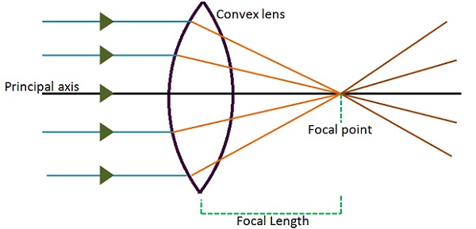

Slide 24
Balbar conjuctiva

Slide 25
Palpebral conjuctiva

Slide 26
b) The middle vascular layer (tunic
Choroid
It lines the posterior five sixths of the inner surface of the sclera
It is rich in blood vessels and is a deep chocolate brown in colour
Light enters the eye through pupil, stimulate the nerve endings then absorbed by the choriod

Slide 27
ii. Ciliary body
It is the anterior continuation of the choroid consisting of ciliary muscles and secretory epithelial cells
It gives attachment to the suspensory ligament which at its other end is attached to the capsule enclosing the lens
Contraction and relaxation of the ciliary muscles changes the thickness of the lens
This refracts light entering the eye to focus on the retina

Slide 28
The epithelial cells secrets aqueous fluid into the anterior segment of the eye
The ciliary body is supplied by the parasympathetic branches of the oculomotor nerve (3rd cranial nerve )
Stimulation causes contraction of the muscle and accommodation of the eye

Slide 29
The uvea is the pigmented middle layer of the eye, consisting of the iris, ciliary body and choroid.

Slide 30
iii. Iris
It is the visible colored part of the eye and it extends anteriorly from the ciliary body, lying behind the cornea but infront of the lense
It divides the anterior segment of the eye into the anterior and posterior chambers
The chambers contains aqueous fluid secreted by the ciliary body
Composed of pigmented cells and layers of radiating and circular muscles

Slide 31
In the centre there is an aperture, the pupil
The pupil varies in size depending on the light intensity
In bright light the circular muscle fibres of the iris contracts and constricts the pupil
In dim light the radiating muscle fibres contract dilating the pupil

Slide 33
The Iris is supplied by the parasympathetic( (acetylcholine) and sympathetic nerves (norepinephrine)
The parasympathetic stimulation, supplied by the occulomotor nerve, constricts the pupil
The sympathetic stimulation from the superior cervical ganglion dilates the pupil.

Slide 35
Color of the iris is determined genetically and is dependant on the number of pigmented cells present
Albinos have no pigment cells and people with blue eyes have fewer than those with brown eyes

Slide 36
Lens
It is a highly elastic circular biconvex transparent body, that lays immediately behind the pupil
It is suspended from ciliary body by the suspensory ligament
It is enclosed with a transparent capsule
Its thickness is controlled by the ciliary muscle through the suspensory ligament

Slide 37
The lens bends light rays that are reflected by the object in front of the eye
Its is the only structure which can vary its refractory power through change in thickness
When the ciliary muscles contract, it moves forward, releasing its pull on the lens, increasing its thickness
The nearer the object the thicker the lens

Slide 38
C) The inner nervous tissue layer(tunic): retina
It is the innermost layer of the wall of the eye
It is a delicate layer
It is adapted to be stimulated by the light rays
Composed of several layers of nerve cell bodies and their fibres lying on a pigmented layer of epithelial cells that attach to the choroid
The layer sensitive to light is the layer of rodes and cones

Slide 39
The lines about three quarters of the eyeball and its thickest at the back and thins out anteriorly to end just behind the ciliary body
Near the center of the posterior part there is an area that appear yellow in colour hence Macula lutea
In the center of the area there is a depression called the fovea centralis, that consists of the cone shaped cells only

Slide 40
Towards the anterior part of the retina there are fewer cone shaped cells than rod-shaped cells
The rodes and cones contains photosensitive pigments used in the conversion of light rays into nerve impulses
Rhodopsin (Visual purple) is a pigment that is found in rods
It is bleached when exposed to light and its regeneration requires the presence of vitamin A

Slide 41
The time taken for rhodopsin regeneration called dark adaptation, is experienced when an individual moves from and area of bright light to one of darkness.
Other pigments present if cones responds to different wavelength of visible light and are responsible for color vision
Rhodopsin is bleached by lower light intensity (dim light) than pigments in cones

Slide 42
About 0.5 cm to the nosal side of the macula lutea all the nerve fibers of the retina converge to form the optic nerve
The optic nerve passes through the sphenoid bone, eventally to reach the cerebral cortex in occipital lobe of the cerebrum
The small area of the retina where the optic nerve leaves the eye is the optic disc or blind spot
It has no light sensitive cells

Slide 45
Cont’

Slide 46
The anatomy of the Eye

Slide 48
Blood Supply To The Eye
Blood is supplied by the ciliary arteries and the central retinal artery
They are branches of opthalmic arteries
Venous drainage central retinal veins

Slide 49
Interior of the Eyeball
The anterior segments of the eye, i.e. the space between the cornea and the lens is incompletely divided into Anterior chamber and Posterior chamber by the Iris
Both chambers contain a clear aqueous fluid (humor) secreted in the posterior chamber by ciliary glands
It passes in front of the lens through the pupil to the anterior chamber

Slide 50
An returns to the venous circulation through the canal of schlemm in the angle between the iris and cornea
There is continuous drainage and production of humor but the intraocular pressure remains fairly constant between 1.3 and 2.6 kpa ( 10 to 20mmHg)
An increase in the pressure cause glaucoma

Slide 51
Aqueous fluid supplies nutrients and remove waste from the transparent structures in front of the eye that have no blood supply i.e the cornea, lens and lens capsule
Behind the lens and filling the cavity of the eyeball is the vitreous body (humor)
It is a soft, colorless, transparent, jelly-like substance composed of 99% water, salt and mucoproteins

Slide 52
It maintains sufficient intraocular pressure to support the retina against the choroid and prevent the collapse of the walls of the eye ball
The eye keeps in shape because of the intraocular pressure exerted by the vitreous body and the aqueous fluid
It remains constant throughout life

Slide 54
Optic Nerves
The fibers of the optic nerve originate in the retina of the eye
All the fibers converge to form the optic nerve about 0.5 cm to the nosal side of the macula lutea
Pierces the choroid and sclera an passes medially through the orbital cavity , through the optic foramen to the sphenoid bone to meet the nerve from the other eye at the optic Chiasma

Slide 55
Optic Chiasma
It is situated in front of the pituitary gland
At the Chiasma, the nerve fibers of the optic nerve from the nasal side of the retina cross over to the opposite side
The fibers from the temporal side do not cross but continue backwards on the same side.
This crossing provides both cerebral hemispheres with sensory input from each eye

Slide 57
Optic Tracts
They are optic nerves pathways
They are located posterior to the optic chiasma
Each tract consists of nosal retina nerve fibers of one eye and temporal retina nerve fibres of the other eye\
The optic tract pass backwards to synapse with nerve cells of lateral geniculate bodies of the thalamus

Slide 58
Cont’
From there the nerve fibers proceed backwards and medially as optic radiation to terminate in the visual area of the cerebral cortex in the occipital lobes of the cerebrum
Neurones originating in the lateral geniculate bodies transmits impulses from the eyes to the cerebellum
Together with impulses from semicircular canals of the ears and skeletal muscle joints they maintain posture and balance

Slide 59
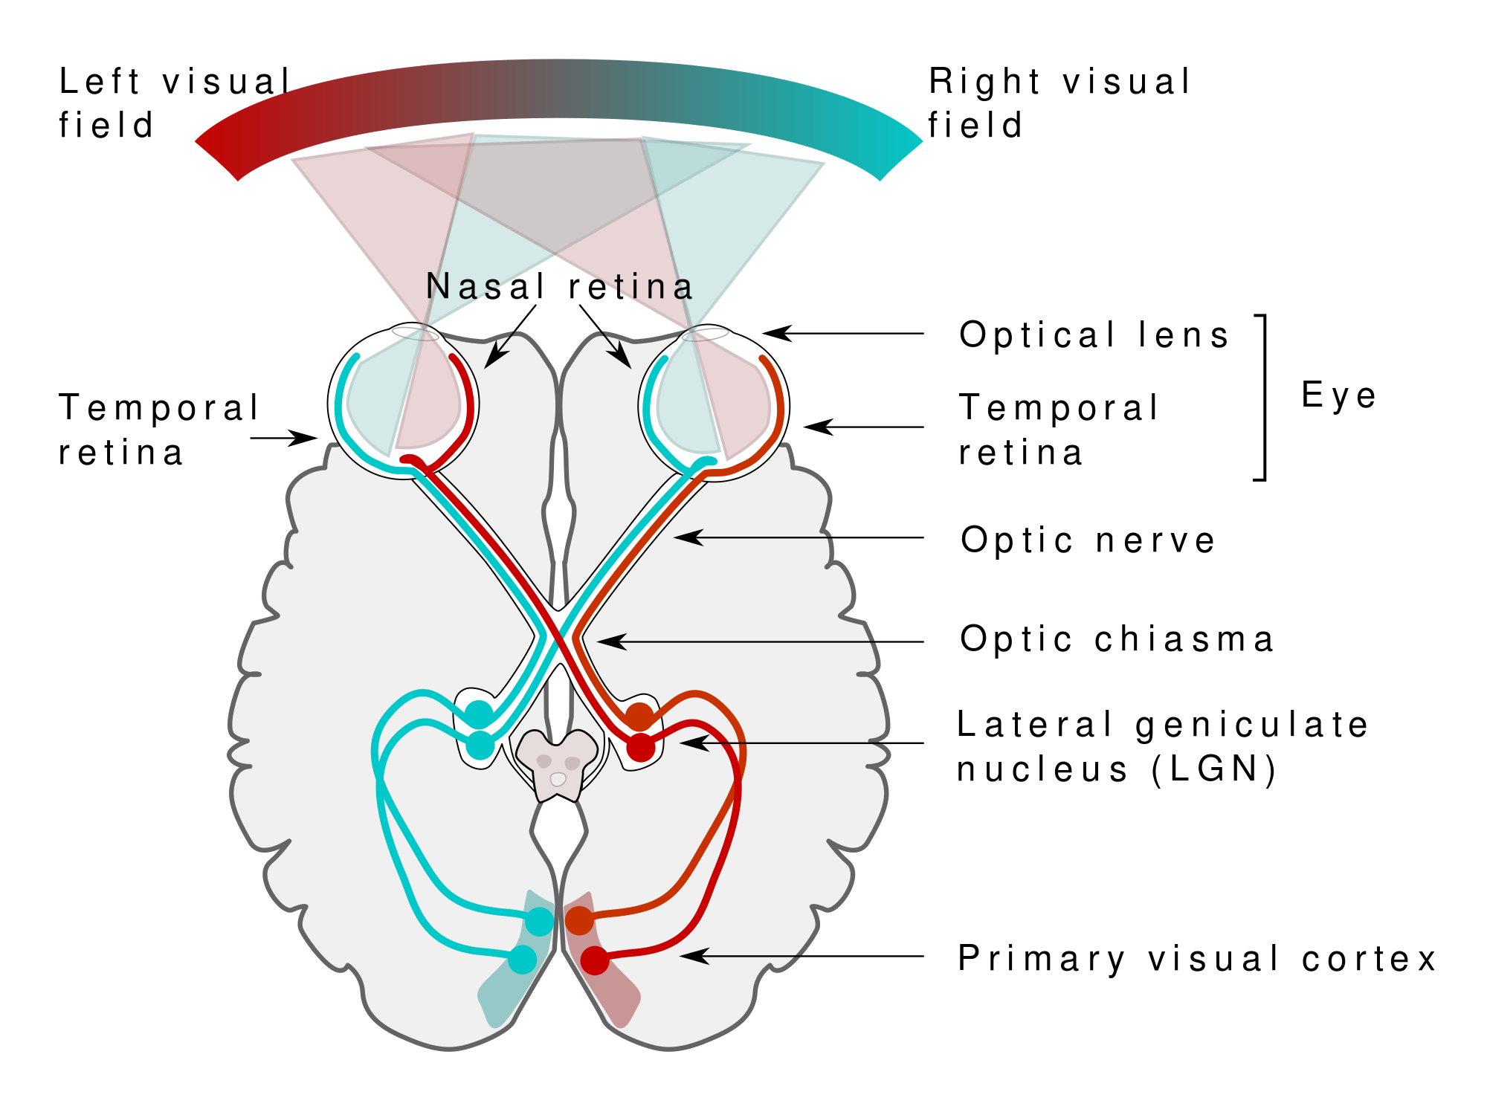

Slide 60
THE PHYSIOLOGY OF SIGHT
There are two spectrums which are
The Visual spectrum
The electromagnetic spectrum
Light is reflected into the eyes by objects within the field of vision
White light is a combination of all colors of visual spectrum (rainbow)
The red-light has the longest wavelength and violet has the shortest wavelength.

Slide 61
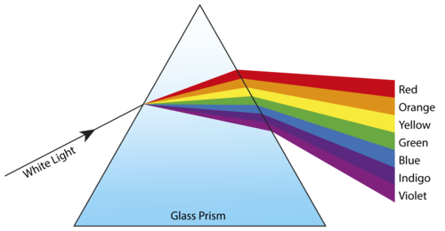

Slide 62
The Electro-magnetic Spectrum is broad but only small part is visible
Beyond the long wavelength light are infrared, microwaves and radio waves
Beyond the short wavelength light are the Ultraviolet (UV), X-rays and gamma rays.
UV is not visible because it is absorbed by the a yellow pigment in the lens
Following removal of lens, UV light is visible and lonterm exposure may damage retina

Slide 63
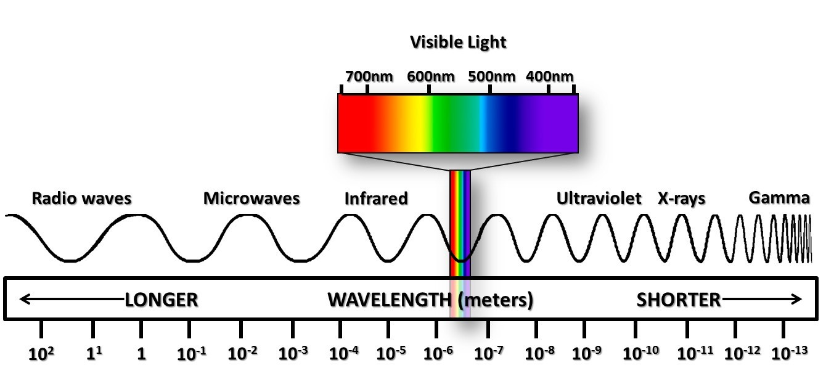

Slide 64
A specific color is perceived when only one wavelength is reflected by the object and all the others are absorbed
For instance, an object appears yellow when only the yellow wavelength is reflected
White when all the wavelengths are reflected
Black when they are all absorbed

Slide 65
To achieve a clear vision, light that is reflected from objects within the visual fields is focused onto the retina of each eye
The process involved to produce this clear vision are refraction of light rays, changing the size of the pupils and accommodation(adjustments of the lens for near vision)
Effective vision is reliant on their coordination even though it may be considered separate process

Slide 66
Refraction of light
When light passes through different densities they are bent (Refracted)
This principle is used to focus light on the retina
Before reaching the retina, light pass successively through the conjunctiva, cornea, aqueous fluid, lens etc
They all have different densities than air hence refraction

Slide 67
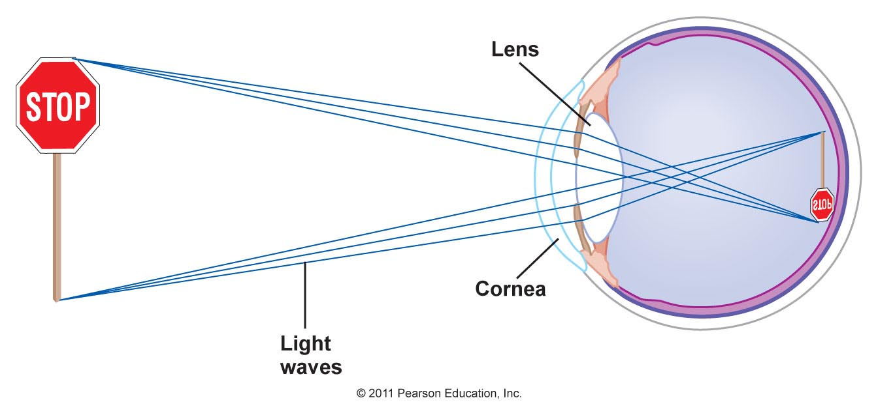

Slide 68
Focusing of an image on the retina
Light rays that are reflected from an object are refracted (bent) by the lens when they enter the eye
Although the image casted on the retina is upside down, the brain adapts to this early in life so that the image are perceived ‘ the right way up’.
Abnormal refraction is corrected using biconcave or biconvex lenses

Slide 69
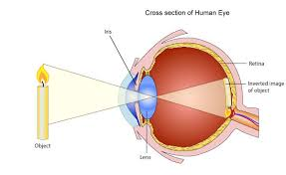

Slide 70
Lens
It is a biconvex elastic transparent body suspended behind the iris from the cilliary body by the suspensory ligament
It’s the only structure in the eye that changes its refractive power
Light from distant objects needs less refraction and as the object moves closer the amount of refraction needs to be increased

Slide 71
Cont’
To increase refractive power, ciliary muscles contract , it moves ciliary body towards the lens, relaxing the pull on the suspensory ligament
This allows the lens to bulge, increasing its convexity
This focuses light from near objects on the retina
When ciliary muscles relaxes it slips backwards, increasing its pull on suspensory ligament

Slide 72
Cont’
Making the ligaments thinner, this focuses light rays from distant objects on the retina
Pupils
The size of the pupil influences accommodation by controlling the amount of light entering the eye
In dim light the pupil are dilated while in bright light the pupils are constricted

Slide 73
The iris layers of circular and radiating muscles controls the dilatation and constriction of pupils
Contraction of the circular constricts the pupils and contraction of radiating muscles dilates it
The size of the pupil is controlled by autonomic nervous system: sympathetic dilates pupils while parasympathetic constricts

Slide 74
Accommodation
In order to focus on near object e.g. within about 6 meters, accommodation is required and the eye makes the following adjustments
Constriction of the pupil
Convergence (mvmnt of eyeball)
Changing the power of the lens
Objects more than 6 meters away from the eyes are focused on the retina without adjustments of lens or convergence of the eyes

Slide 75
Binocular vision/stereoscopic vision
It enables 3D views
The visual fields overlap in the middle but the left eyes sees more on the left than can be seen by the other eye and vice versa
The images from the two eyes are fused in the cerebrum so that one image is perceived
Binocular vision provides accurate assessment of one object relative to another

Slide 76
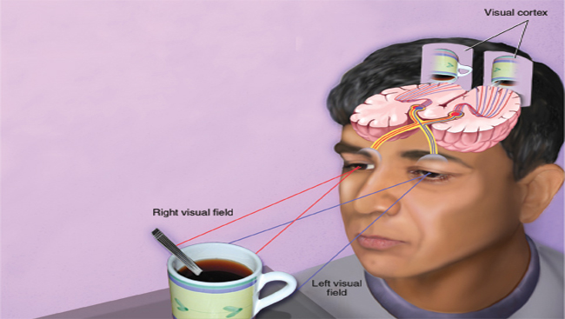

Slide 77
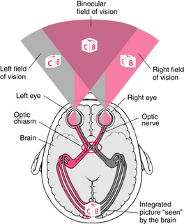

Slide 78
Extraocular/ Accesory organs
The eye is a delicate organ which is protected by various structures
Eyebrows- prevent sweat, dust etc from falling into the eye
Eyelid/palpabrae- protection of intraocular structures, Canthus- corner of the eye where lids meet. Medial and lateral
Eyelashes- filtering/ prevents dust from entering the eye
Palpebral fissure- elliptical open space between the eyelids

Slide 79
Cont’
Caruncle -small fleshy mass at the inner canthus containing sebaceous glands
Tarsal plates- strips of connective tissue on the upper eyelid that give it shape. Contains meibomian glands that are modified sebaceous glands that secrete an oily substance on the eyelids that delays tears evaporation
Conjunctiva-thin mucous membrane folded like an envelope between the eyelids and the eyeball
Lacrimal apparatus- provide constant irrigation to keep the conjunctiva and cornea moist and lubricated

Slide 80
Extra ocular muscles
Six muscle attach the eyeball to its orbit and direct the eye to its point of interest giving it straight and rotary movements:
Rectus muscles- four muscles: superior, inferior, lateral and medial rectus muscles.
Oblique muscles- two: superior oblique and inferior oblique muscles

Slide 81
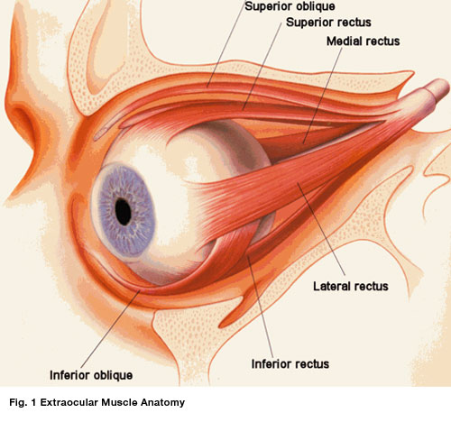

Slide 82
Moving the eye to look in a particular direction is under voluntary control (somatic)
But coordination of movement needed for accommodation and convergence is under involuntary control (Autonomic)
The occulomotor nerve supplies the intrinsic eye muscles
Assignment Read and make notes on the Extrinsic muscle of the eye their action and nerve supply

Slide 83
Visual pathways and visual fields
photons within visible spectrum enter the eye first by passing through the cornea
cornea bends or converges light as it passes through the anterior chamber and the
Iris opens and closes to constrict or dilate the pupil and regulate the amount of light.
Light is further converged by the lens located posterior to the iris.

Slide 84
It continues through the vitreous humor to converge at the retina, particularly fovea centralis of the macula.
Retina contains light sensing nerve cells, rods and cones, which trigger a series of electrical and chemical reactions
The reactions conduct are conducted through the optic nerve and optic tract to the visual cortex of the occipital lobe where signals are processed and interpreted as a visual image

Slide 85
Cones(centre of retina)-clear, sharp and central vision. Color and fine details in bright light
Rods-peripheral location. Detection of motion and dim light at night.

Slide 86
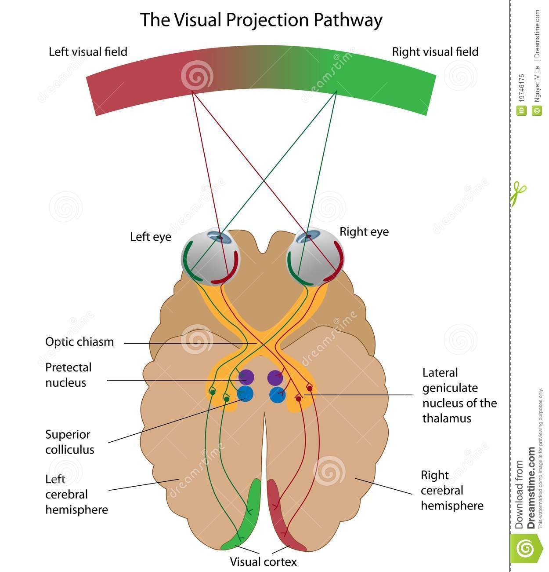

Slide 87
THE PROCESS OF EYE EXAMINATION
Inspection of the eye

Slide 88
Health history
Explore the clients health history for risk factors associated with eye disorders including;
Family history of eye diseases
Systemic medical conditions
Sports injuries
Laser surgery
Blows to the head
Vitamin A deficiency
Certain medications

Slide 89
Examination of the Eye
All structures are assessed using the modality of inspection.
Normal findings
Eyebrows
Symmetrical and in line with each other
Maybe black, brown or blond depending on race
Evenly distributed
Eyes
Evenly placed and inline with each other.
None protruding.
Equal palpebral fissure.

Slide 90
Eyelashes
Color dependent on race.
Evenly distributed.
Turned outward.
Eyelids & Lacrimal Apparatus
Inspect the eyelids for position and symmetry.
Palpate the eyelids for the lacrimal glands.
To examine the lacrimal gland, the examiner, lightly slide the pad of the index finger against the client’s upper orbital rim.
Inquire for any pain or tenderness.
Palpate for the nasolacrimal duct to check for obstruction.

Slide 91
To assess the nasolacrimal duct, the examiner presses with the index finger against the client’s lower inner orbital rim, at the lacrimal sac, NOT AGAINST THE NOSE.
In the presence of blockage, this will cause regurgitation of fluid in the puncta
Normal Findings
Eyelids
Upper eyelids cover the small portion of the iris, cornea, and sclera when eyes are open.
No PTOSIS noted. (Drooping of upper eyelids).
Meets completely when eyes are closed.
Symmetrical.

Slide 92
Lacrimal Apparatus
Lacrimal gland is normally non palpable.
No tenderness on palpation.
No regurgitation from the nasolacrimal duct.
Conjunctivae
The bulbar and palpebral conjunctivae are examined by separating the eyelids widely and having the client look up, down and to each side.
When separating the lids, the examiner should exert NO PRESSURE against the eyeball; rather, the examiner should hold the lids against the ridges of the bony orbit surrounding the eye.

Slide 93
In examining the palpebral conjunctiva, everting the upper eyelid in necessary and is done as follow:
Ask the client to look down but keep his eyes slightly open.
This relaxes the levator muscles, whereas closing the eyes contracts the orbicularis muscle, preventing lid eversion.
Gently grasp the upper eyelashes and pull gently downward.
Do not pull the lashes outward or upward; this, too, causes muscles contraction.
Place a cotton tip application about I can above the lid margin and push gently downward with the applicator while still holding the lashes. This everts the lid.

Slide 94
Hold the lashes of the everted lid against the upper ridge of the bony orbit, just beneath the eyebrow, never pushing against the eyebrow.
Examine the lid for swelling, infection , and presence of foreign objects.
To return the lid to its normal position, move the lid slightly forward and ask the client to look up and to blink. The lid returns easily to its normal position.
Normal Findings
Both conjunctiva are pinkish or red in color.
With presence of many minutes capillaries.
Moist
No ulcers
No foreign objects

Slide 95
Sclerae
The sclerae is easily inspected during the assessment of the conjunctivae.
Normal Findings
Sclerae is white in color (anicteric sclera)
No yellowish discoloration (icteric sclera).
Some capillaries maybe visible.
Some people may have pigmented positions.

Slide 96
Cornea
The cornea is best inspected by directing penlight obliquely from several positions.
Normal findings
There should be no irregularities on surface
Looks smooth.
The cornea is clear or transparent. The features of the iris should be fully visible through the cornea.
There is a positive corneal reflex.

Slide 97
Corneal Reflex
Trigerminal nerve is responsible for this
Tell the client to open the eyes and look straight ahead
Then a cotton tipped lubricator is brought from the back and touch the corneas simultaneously
Blinking and tearing indicate that the fifth cranial nerve is intact

Slide 98
Anterior Chamber and Iris
The anterior chamber and the iris are easily inspected in conjunction with the cornea.
The technique of oblique illumination is also useful in assessing the anterior chamber.
Normal Findings
The anterior chamber is transparent.
No any visible materials.
Color of the iris depends on the person’s race (black, blue, brown or green).
From the side view, the iris should appear flat and should not be bulging forward.
There should be NO crescent shadow casted on the other side when illuminated from one side.

Slide 99
Pupils
Examination of the pupils involves several inspections, including assessment of the size, shape reaction to light is directed is observed for direct response of constriction.
Simultaneously, the other eye is observed for consensual response of constriction.
The test for papillary accommodation is the examination for the change in papillary size as it is switched from a distant to a near object.
Ask the client to stare at the objects across room.
Then ask the client to fix his gaze on the examiner’s index fingers, which is placed 5 – 5 inches from the client’s nose.

Slide 100
Visualization of distant objects normally causes papillary dilation and visualization of nearer objects causes papillary constriction and convergence of the eye.
Normal Findings
Pupillary size ranges from 3 – 7 mm, and are equal in size.
Equally round.
Constrict briskly/sluggishly when light is directed to the eye, both directly and consensual.
Pupils dilate when looking at distant objects, and constrict when looking at nearer objects.
If all of which are met, we document the findings using the notation PERRLA, pupils equally round, reactive to light, and accommodate

Slide 101
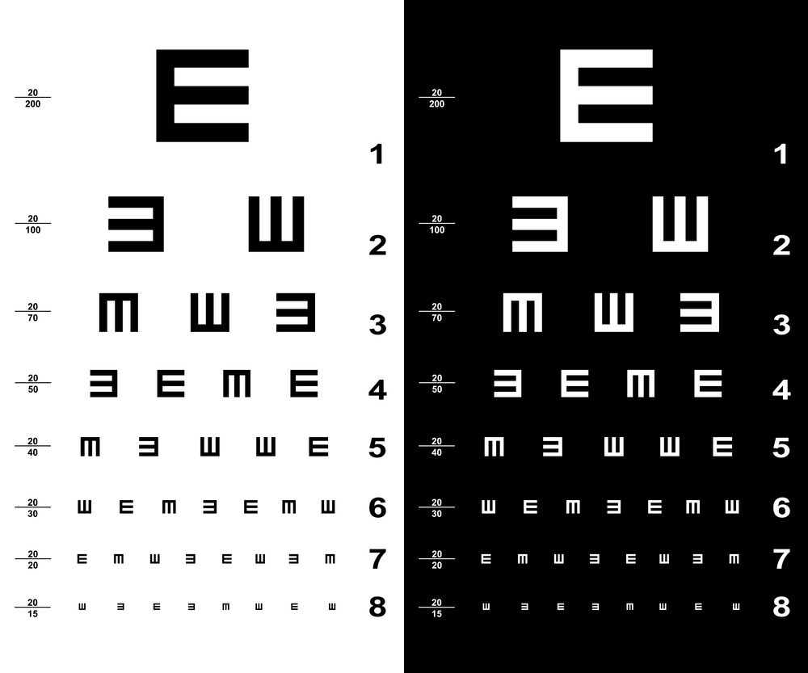

Slide 102
Visual Acuity
Is the degree to which details and contours of objects are perceived
Visual acuity determines the clarity of the cornea, lens, vitreous; determines function of visual pathways from retina to the brain. Snellen’s eye chart
Distant vision is tested with a chart with differently sized letters read from a distance of six metres away.
Someone who can read the second line of letters up from the bottom is said to have 6/6 vision.
This used to be called 20/20 vision when the test was done from 20 feet away before metric measures took over.

Slide 103
6/6 does not translate into perfect vision and does not indicate other important aspects of sight such as peripheral vision, the ability to identify colors or depth perception.
Having 6/12 vision means you can see at six metres what a person with normal vision can see at 12 meters away.
The numerator indicates the distance the person is standing from the chart,
Denominator gives the distance at which a normal eye could have read at the given distance.

Slide 104
Normal visual acquity is 20/20 (6/6).
A subject with 20/15 visual acquity has better than normal vision and one with 20/100 has subnormal vision

Slide 105
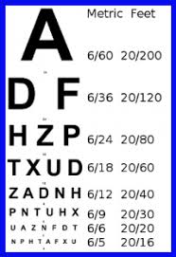

Slide 106
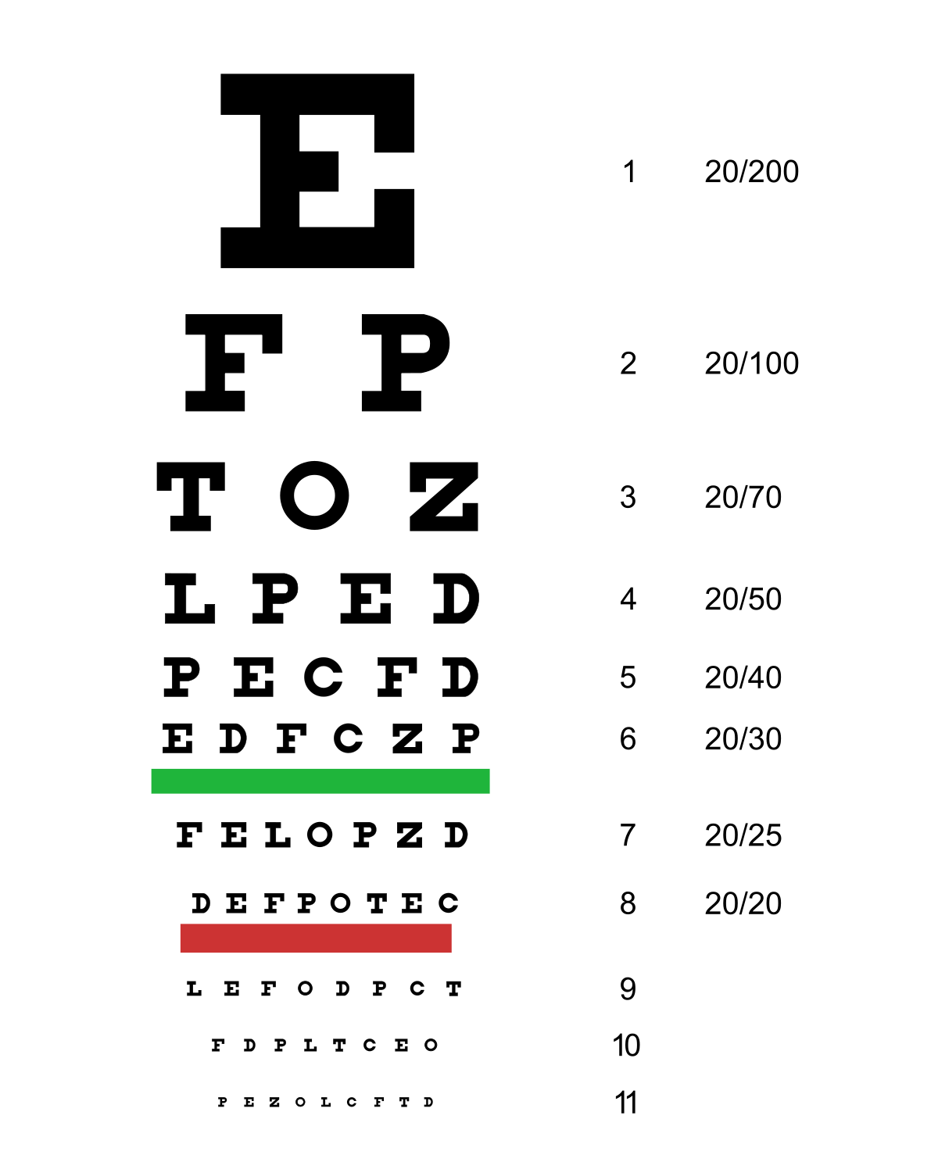

Slide 107
Illiterate charts: for children and those who cannot read English, different charts (the commonest is E) are used.
The letter faces different directions and the adult holds a wooden E, and is asked to turn it the same way as the one the examiner is pointing.
Note: if the patient cannot read, he may be asked to count fingers or point hand movements at 30 cm distance.
The examiner holds up a random number of fingers and asks the patient to count the number he or she sees.

Slide 108
If the patient correctly identifies the number of fingers at 3 feet, the examiner would record CF/3′.
If the patient is unable to count fingers, the examiner raises one hand up and down or moves it side to side and asks in which direction the hand is moving.
This level of vision is known as hand motions (HM).

Slide 109
A patient who can perceive only light is described as having light perception (LP).
The vision of a patient who is unable to perceive light is described as no light perception (NLP).

Slide 111
Visual fields (perimetry)
Refers to the total area in which objects can be seen in the side (peripheral) vision while you focus your eyes on a central point.
Confrontation visual field exam: This is a quick and basic check of the visual field.
Sitting directly in front of the client, ask them to cover one eye and stare straight ahead with the other.
cover your own eye opposite to the persons covered one.
Ask the client to tell when they can see your (examiner's) hand.

Slide 112
Normal results: about 50 degrees upwards, 90 degrees temporal, 70 degrees down, 60 degrees nasal
Perimetry testing evaluates the field of vision.
A visual field is the area or extent of physical space visible to an eye in a given position.

Slide 114
INTERNAL EYE
Is tested using the ophthalmoscope
Diagnostic tests
Ophthalmoscopy
Is the visualization of the fundus (posterior portion) of the eye and other structures using an ophthalmoscope (or funduscope).
It is crucial in determining the health of the retina and the vitreous humor.

Slide 115
Types
The direct ophthalmoscope is an instrument about the size of a small flashlight (torch) with several lenses that can magnify up to about 15 times.
An indirect ophthalmoscope, constitutes a light attached to a headband, in addition to a small handheld lens.
It provides a wider view of the inside of the eye.
Furthermore, it allows a better view of the fundus of the eye, even if the lens is clouded by cataracts.

Slide 116
Direct opthalmoscopy

Slide 117
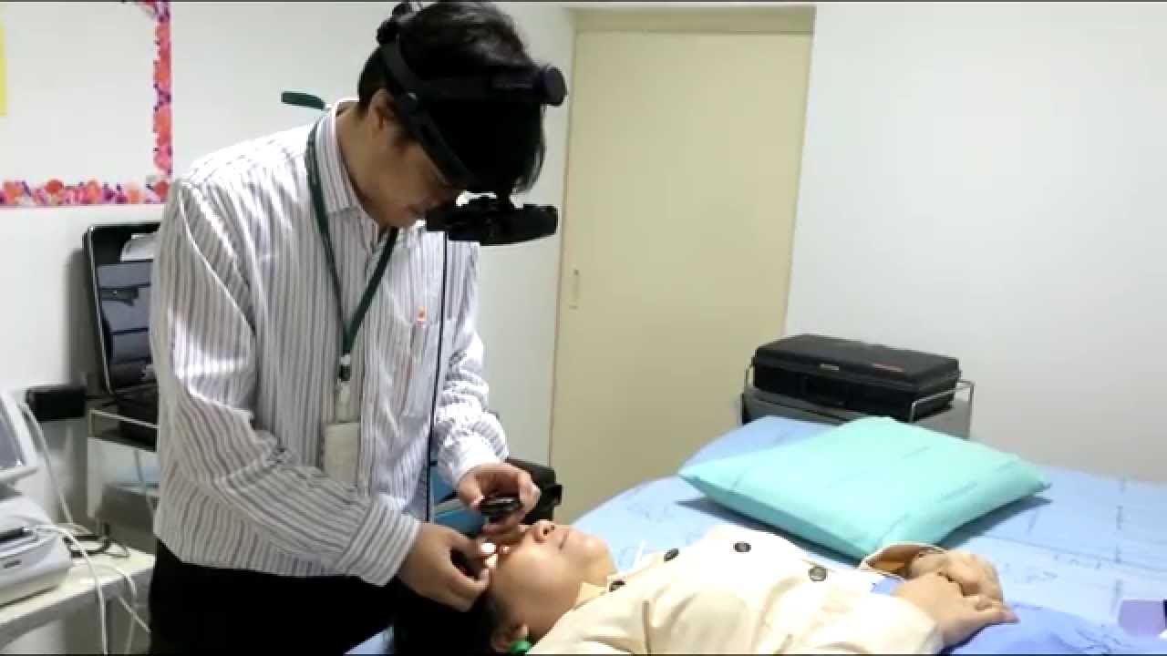
Indirect opthalmoscopy

Slide 118
III. Slit-lamp ophthalmoscopy (gonioscopy): advanced ,the health care provider will use the microscope part of the slit lamp and a tiny lens placed close to the front of the eye.
Can see about the same with this technique as with indirect ophthalmoscopy, but with higher magnification.

Slide 119
Slit-lamp ophthalmoscopy

Slide 120
Tonometry:
Measures IOP by determining the amount of force necessary to indent or flatten (applanate) a small anterior area of the globe of the eye.
Pressure is measured in millimeters of mercury (mm Hg). High readings indicate high pressure; low readings, low pressure.
The procedure is noninvasive and is usually painless. A topical anesthetic eye drop is instilled in the lower conjunctival sac, and the tonometer is then used to measure the IOP. Normal pressure is 10-20 mm Hg

Slide 121
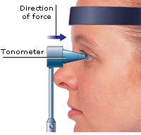

Slide 122
tonometry

Slide 123
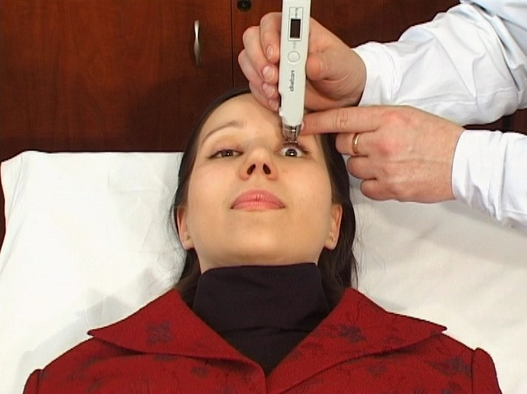
Tonometry

Slide 124
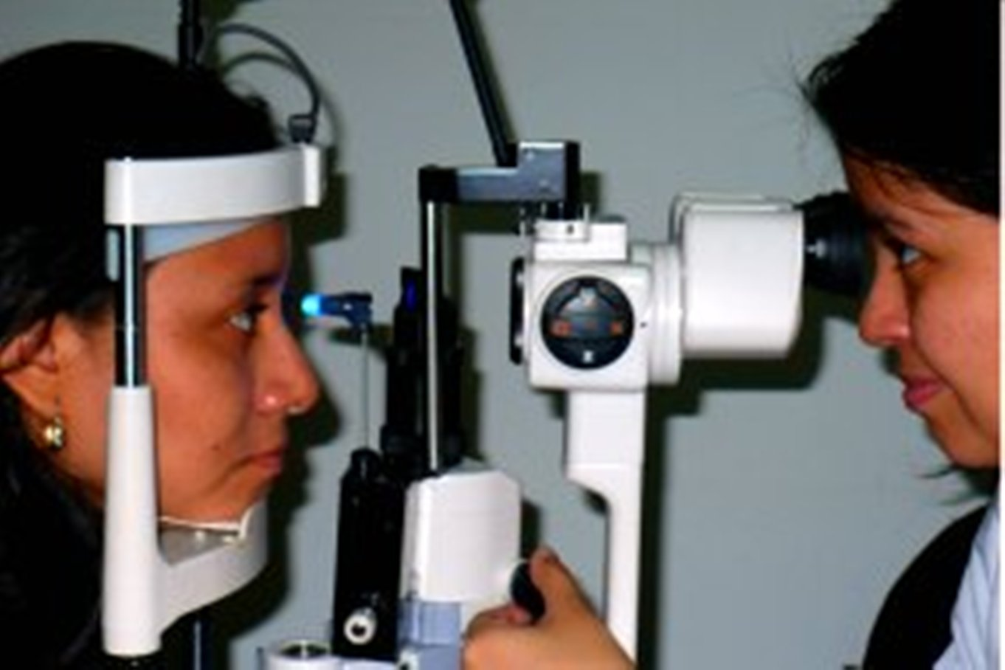

Slide 125
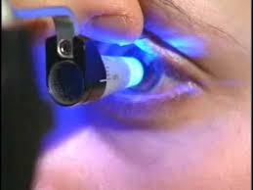

Slide 126
FLUORESCEIN ANGIOGRAPHY
Fluorescein angiography evaluates clinically significant macular edema, documents macular capillary non-perfusion, and identifies retina and choroidal neovascularization
(i.e.., growth of abnormal new blood vessels) in age-related macular degeneration.
It is an invasive procedure in which non-toxic fluorescein dye- sodium fluorescein, is injected, usually into an antecubital area vein (arm).
About 5 mls of dilute solution is used.
Within 10 to 15 seconds, this dye can be seen coursing through the retinal vessels.

Slide 127
Cont’
Over a 10-minute period, serial black-and-white photographs are taken of the retinal vasculature.
The dye may impart a gold tone to the skin of some patients
and urine may turn deep yellow or orange.
This discoloration usually disappears in 24 hours.

Slide 128
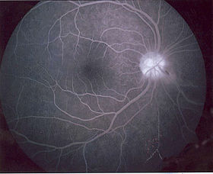

Slide 129
COLOR FUNDUS PHOTOGRAPHY
Fundus photography is a technique used to detect and document retinal lesions.
The patient’s pupils are widely dilated during the procedure, and visual acuity is diminished for about 30 minutes due to retinal “bleaching” by the intense flashing lights.

Slide 130
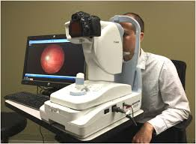

Slide 131
DROPS IN COMMON USE
MAJOR GROUPS
Mydriatics
Miotics (anti-glaucomas)
Local anaesthetics/Cycloplegics
Anti-infectives
Anti-inflammatory
Anti-septics
Mydriatics
They dilate the pupil in diseases like iritis for opthalmic examination of the fundus of the eye.

Slide 132
Examples:
Atropine sulphate ½ - 2%
Hyoscine hydrobromide 1/2 – 1% for rapid dilatation of the pupil
Homatropine hydrobromide ½ - 2% for rapid dilatation of pupil. Frequently combined with cocaine. Its antidote is Eserine.
Mydrilate 1% (cyclopentolate)- dilates the pupil in about 15 minutes.
Tropicamide 1% or 0.5% (mydriacyl)- powerful, quick acting, short-lasting.

Slide 133
Miotics
They constrict the pupil for treatment of glaucoma and after a cataract operation.
Example:
antidote to Homatropine -Eserine sulphate (physostigmine) 1/8 – 1%. It decomposes in light, therefore, usually dispensed in dark bottles. It irritates.
Pilocarpine nitrate ¼ - 4% -it is less powerful, less irritant. Used for mild glaucoma
Local anesthetics
e.g.. cocaine hydrochloride 2- 4%. Must be specially ordered(DDA)

Slide 134
Decicain
Butyn
Amethocaine for Tonometry
Pentocaine
Antibiotics
Penicillin
Tetracycline 1%
Chloramphenicol
Neomycin
Sophramycin
Antifungal
Antiviral
Anti-inflammatories

Slide 135
OPHTHALMIC CONDITIONS

Slide 136
DISORDERS OF REFRACTION

Slide 137
Introduction
Refraction refers to the bending of light rays as they enter the eye.
Focusing a clear image on the retina is essential for good vision.
In the normal eye (emmetropia), a parallel light rays that enter the eye from a distance of 6m (20ft) or more are refracted to form a clear upside image on the macula of the retina.
The brain can easily right the upside down image in our conscious perception but cannot correct an image not sharply focused.
If light does not bend or refract correctly and focus directly on the retina, the result is blurred vision, or a refractive error

Slide 139
a) Myopia
Refers to nearsightedness caused by focusing of light rays in front of the retina.
Occurs when the eyeball is elongated and the image focuses in front of the retina
Therefore the retina receives only fuzzy image.
Persons with myopia can see near objects clearly but blurred distant vision
It has a hereditary tendency and requires concave lens for correction

Slide 142
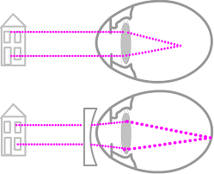

Slide 143
b) Hyperopia
Most common and Referred to as far sightedness
If the eye ball is shorter than normal to accommodate the power of the lens
Thus, the image focuses behind the retina, producing a fuzzy image.
There is blurred close vision with clear distant vision
It may result with aging and also associated with primary angle closure glaucoma
Requires a corrective convex lenses

Slide 144
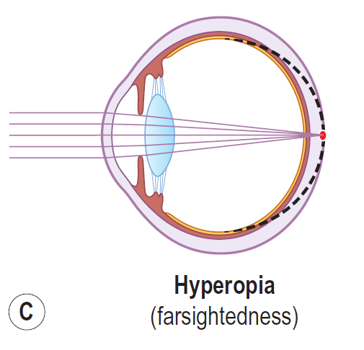

Slide 146
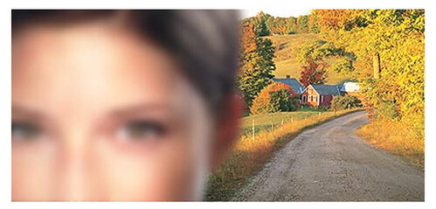

Slide 147
c) Astigmatism
A condition in which parallel light rays do not focus on a point because of irregular surface changes/ curvature in the cornea or lens.
the cornea is irregularly curved.
This irregular shape causes light to scatter and to bend, or refract, improperly as it passes through the cornea.
Instead of focusing directly on the retina, some light rays focus in front of and some focus behind the retina.

Slide 148
These multiple focal points distort vision.
In some cases, an irregularly curved lens produces minor degrees of astigmatism.
The focus of light is thus distorted and may result in myopic or hyperopic astigmatism
It may be inherited; may result from an injury, inflammation, or corneal surgery
The patients’ complains of headaches, eyestrain, fatigue, or blurred vision at certain distances.
Severe astigmatism produces distorted images and blurring at all distances.
Corrected by prescription glasses/ contact lens to neutralize the unequal curvature

Slide 149
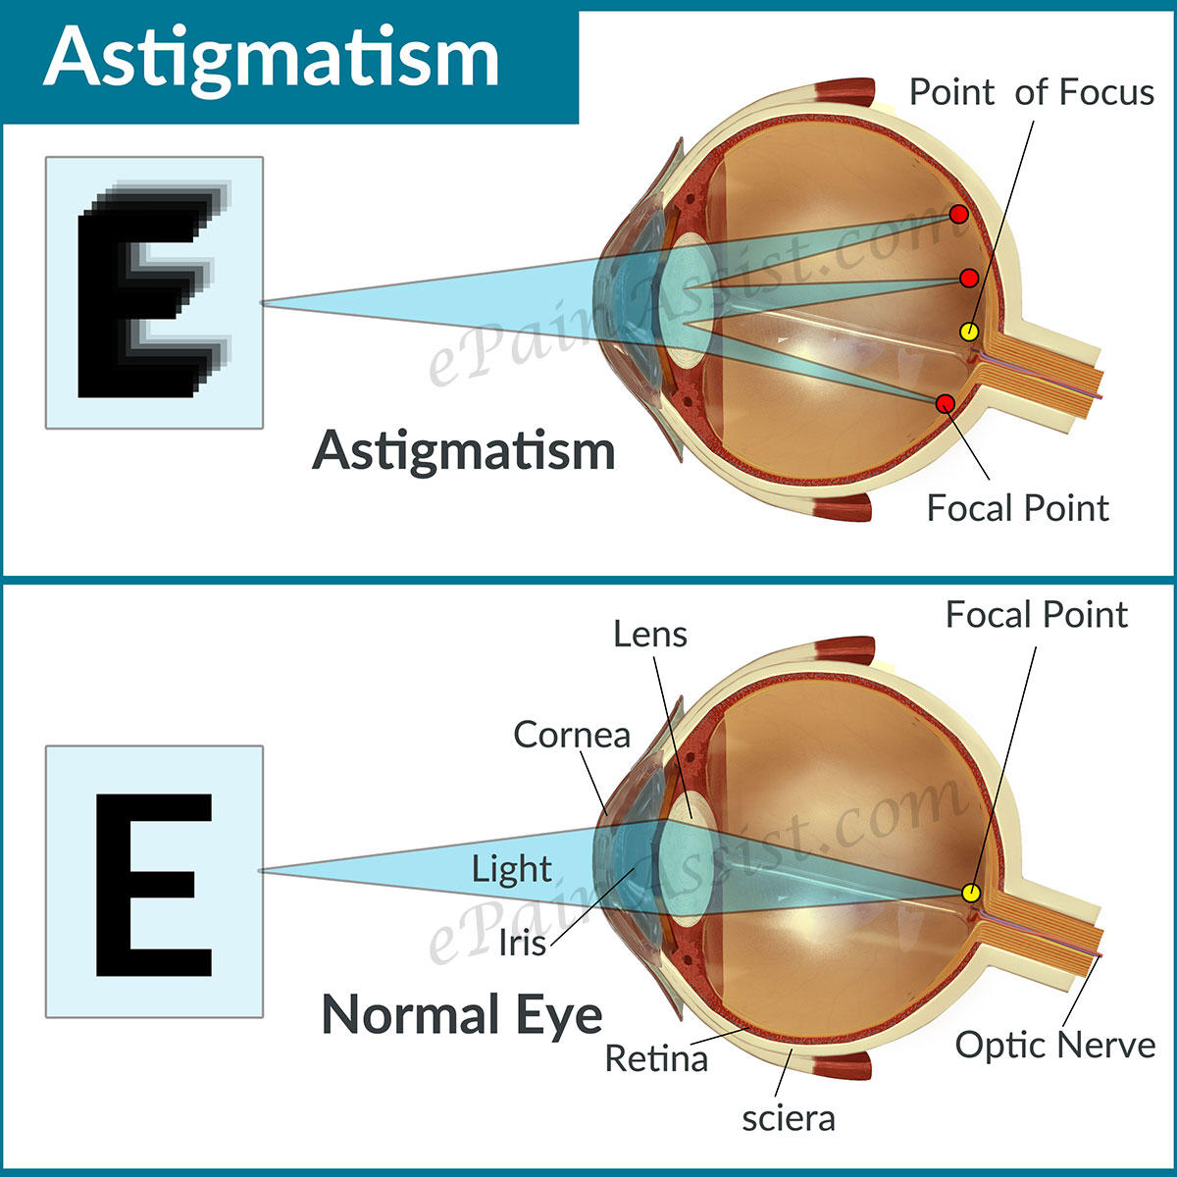

Slide 150
d) Presbyopia
literally means “old eye” in Greek.
Condition caused by the loss of elasticity of the crystalline lens and is associated with the aging process.
the crystalline lens has become less flexible and the eye muscles that support the lens and allow it to accommodate have weakened.
Accommodation is the change in the convexity of the lens to permit light rays to be refracted to focus on the retina.
This ability slows gradually with age and is most noticeable at 45-50yrs since the lens becomes hard and less able to change its shape.

Slide 151
It causes difficulty with close vision and complaints of eye strain, mild frontal headache and feeling of fatigue.
Blurry vision of close objects, difficulty reading small print, eye fatigue, especially when reading in poor lighting or at the end of the day, eyestrain and headache when doing close work and holding reading material at arm's length to see it clearly
These symptoms decrease with eye rest and use of appropriate lens (reading glasses)
People will tend to compensate for blurred vision by holding the object to be viewed further away

Slide 152
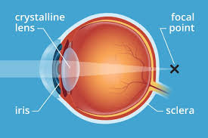

Slide 153
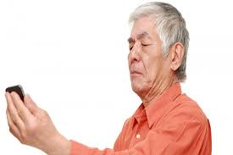

Slide 154
Strabismus (Squint/Amblyopia
A deviation of the eye which the person cannot control.
Normally the axes of both eyes fall together on the same point of the object being looked at. In cases of strabismus they do not, as one eye is directed away from this point.
A squint is either internal or external depending on which group of muscles is weakest. Sometimes both eyes may be affected as the squint seems to alternate.
A squinting eye endangers sight because it is passive and becomes increasingly lazy and weak-sighted.

Slide 155
NOTE: a child will not grow out of a squint-the longer it is left the more difficult it is to cure.
Causes
Paralysis due to damage to the nerves supplying the extrinsic muscles of the eyeball.
Mal-development or faulty insertion of one group of muscles
Uncorrected refractive error
Deflective vision in an eye(corneal scar/congenital cataract).
Eye strain( in prolonged exertion of the cilliary muscles of accommodation)

Slide 156
Types
Concomitant squint: degree of divergence of the eyes is the same in all positions of the gaze.
Incommitant squint: the degree of deviation varies with the direction of gaze.
Treatment
Covering of the normal eye to prevent double vision and make the child use the lazy eye.
Surgery to correct muscular deformity and return them to single vision.
Orthoptics (eye exercises) after surgery to improve the affected eye
Corrective spectacles for refractive error.

Slide 157
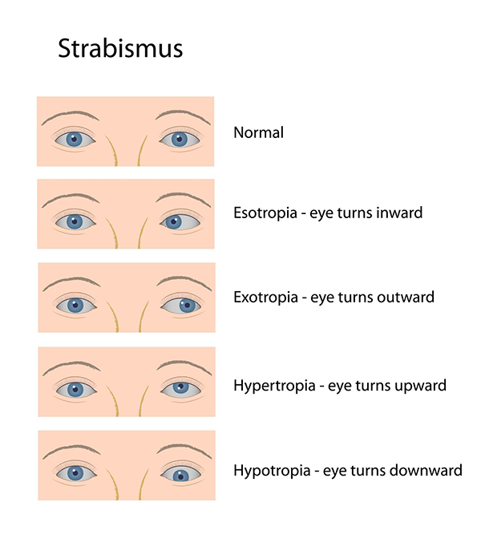

Slide 158
Assignment read and make notes on the following
Taking a conjunctival swab
Basic eye care

Slide 159
DISORDERS OF THE CONJUCTIVA
Some examples include conjunctivitis, trachoma, conjunctival nevus and tumors.
CONJUNCTIVITIS
Conjunctivitis, also known as pinkeye
Is an inflammation of the conjunctiva, the thin, clear tissue that lies over the white part of the eye and lines the inside of the eyelid.

Slide 160
Causes
1) Infectious.
Viruses Conjunctivitis- may accompany the common cold and other systemic viral infections (especially measles, but also chickenpox, rubella, and mumps).
Isolated viral conjunctivitis usually results from adenoviruses and sometimes enteroviruses.
Bacterial conjunctivitis -is usually caused by Staphylococcus aureus, Streptococcus pneumoniae, Haemophilus sp, or, less commonly, Chlamydia trachomatis.

Slide 161
Neisseria gonorrhoeae causes gonococcal conjunctivitis, which usually results from sexual contact with a person who has a genital infection.
Ophthalmia neonatorum is conjunctivitis that occurs in 20 to 40% of neonates delivered through an infected birth canal.
It can be caused by maternal gonococcal or chlamydial infection.
2) Irritants such as shampoos, dirt, smoke, a contact lens product, eyedrops, or eye ointments and pool chlorine
3) Allergies, like dust, pollen, or a special type of allergy that affects some contact lens wearers

Slide 162
Pinkeye(pink-eye) caused by some bacteria and viruses can spread easily from person to person, but are not a serious health risk if diagnosed promptly.
Clinical Manifestations
Itching and a burning sensation or sensation of foreign body
Redness ( hyperemia) of the conjunctiva
Serous or mucus discharge -Discharge may cause the eyes to crust overnight.
Lacrimation

Slide 163
N/B Itching and watery discharge predominate in allergic conjunctivitis.
Chemosis and papillary hyperplasia also suggest allergic conjunctivitis.
Irritation or foreign body sensation, photophobia, and discharge suggest infectious conjunctivitis
purulent discharge suggests a bacterial cause.
Severe eye pain suggests scleritis - Scleritis is inflammation involving the deep episclera and sclera.
Gonorrheal conjunctivitis; copious purulent discharge and lid swelling mainly in newborns;

Slide 164
MANAGEMENT OF CONJUCTIVITIS
Prevention
Most infectious conjunctivitis is highly contagious and spreads by droplet, fomites, and hand-to-eye inoculation.
To avoid transmitting infection, health workers must wash their hands thoroughly and disinfect equipment after examining patients.( Observe universal safety precautions)
Patients should wash their hands thoroughly after touching their eyes or nasal secretions, avoid touching the non infected eye after touching the infected eye, avoid sharing towels or pillows, and avoid swimming in pools.

Slide 165
Eyes should be kept free of discharge and should not be patched.
Change your pillowcase frequently.
Replace your eye cosmetics regularly with new ones, and do not share them with other people.
Always clean your contact lenses properly. In the case of disposable contacts, follow the instructions on the box and dispose when advised.
Small children with conjunctivitis should be kept home from school to avoid spread.

Slide 167
^{TREATMENT}
Viral conjunctivitis:
Supportive measures
highly contagious, and transmission precautions must be followed
is self-limiting, lasting 1 wk in mild cases to up to 3 wk in severe cases.
It requires only warm or cool compresses for symptomatic relief.
However, patients with severe photophobia or whose vision is affected may benefit from topical corticosteroids (eg, 1% prednisolone acetate 6 to 8 hrly).
Anti-inflammatory agents to relieve edema

Slide 168
Bacterial conjuctivitis
Antibiotics (topical for all causes except gonococcal)
very contagious, and standard infection control measures should be followed If neither gonococcal nor Chlamydia infection is suspected
presumptively with moxifloxacin 0.5% drops tid for 7 to 10 days or another fluoroquinolone or trimethoprim.
A poor clinical response after 2 or 3 days indicates that the cause is a resistant bacterium, a virus, or an allergy.
Culture and sensitivity studies determine subsequent treatment.

Slide 169
Adult gonococcal conjunctivitis requires a single dose of ceftriaxone 1 g IM. Bacitracin 500 U/g or gentamicin 0.3% ophthalmic ointment instilled into the affected eye may be used in addition to systemic treatment.
Sex partners should also be treated.
Because chlamydial genital infection is often present in patients with gonorrhea, patients should also receive a single dose of azithromycin 1 g or doxycycline 100 mg po bid for 7 days.

Slide 170
Ophthalmic neonatorum is prevented by the routine use of tetracycline, silver nitrate eye drops or erythromycin ointment at birth.
Infections that escape this treatment require systemic treatment.
For gonococcal infection, ceftriaxone 25 to 50 mg/kg IV or IM is given once/day for 7 days.
Chlamydial infection is treated with erythromycin 12.5 mg/kg po or IV qid for 14 days. The parents should also be treated.

Slide 171
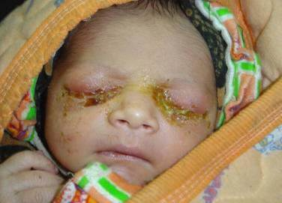

Slide 172
Allergic conjunctivitis
Symptomatic measures- withdrawal of allergen.
Topical antihistamines, vasoconstrictors, NSAIDs, mast cell stabilizers, or a combination
Topical corticosteroids or for recalcitrant (stuborn) cases

Slide 173
Supportive Management
Cool or warm compresses and acetaminophen or ibuprofen may make a client with pinkeye feel more comfortable.
You can clean the edges of the infected eye carefully with warm water and gauze or cotton balls. This can also remove the crusts of dried discharge that may cause the eyelids to stick together first thing in the morning.
If the client wears contact lenses and has conjunctivitis the contact lenses should not be worn until the infection is gone.
After the infection is gone, clean the lenses carefully.
If disposable contact lenses are used , throw away the current pair and use a new pair

Slide 174
Trachoma
Trachoma is a chronic conjunctivitis caused by Chlamydia trachomatis
It is characterized by progressive exacerbations and remissions.
It is the leading cause of preventable blindness worldwide.
The causative organism is Chlamydia trachomatis (serotypes A, B, Ba, and C).
Signs And Symptoms
Initial symptoms are conjunctival hyperemia, eyelid edema, photophobia, and lacrimation.
Later, corneal neovascularization and scarring of the conjunctiva, cornea, and eyelids occur.

Slide 175
It thrives best in situations of overcrowding, poor hygiene and dirty environments
Trachoma is highly contagious in its early stages and is transmitted by eye-to-eye contact, hand-to-eye contact, eye-seeking flies, or the sharing of contaminated items i.e. makeups
Repeat infections result in a chronic follicular conjunctivitis that leads to scarring in the conjunctiva and cornea.
Without prompt treatment trachoma involves the cornea resulting in decreased vision and blindness.

Slide 176
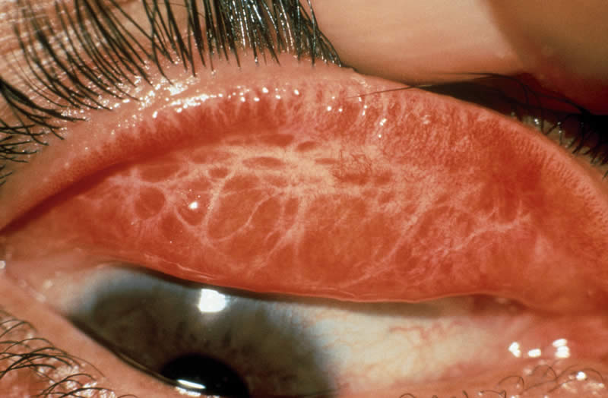

Slide 177
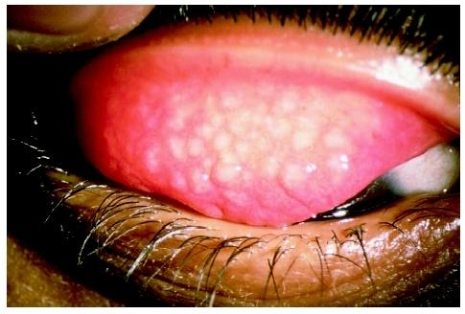

Slide 178
Classification of progress of trachoma
1. Mc Callan's classification
Stage I: incipient trachoma (early stage)
Stage of infiltration
Characterized by hyperemia of palpebral conjuctiva and immature follicles
Follicles are round swellings up to 3.0 mm in diameter. They are grey or creamy and are therefore paler than the surrounding conjunctiva.
Stage 2: established trachoma
Stage of florid infiltration
characterized by appearance of mature follicles & papillae and progressive corneal pannus

Slide 179
Stage 3: early conjunctival scarring (cicatrizing trachoma)
It is characterized by scarring of palpebral conjunctiva and the scars are easily visible as white bands.
Stage 4: smooth scarring of the upper (tarsal) conjunctiva
It is also called healed trachoma. The séquelle to cicatrisation cause symptoms

Slide 180
2.WHO classification
Trachomatous inflammation, follicular (TF) – Five or more follicles of >0.5 mm on the upper tarsal conjunctiva
Trachomatous inflammation, intense (TI) – Papillary hypertrophy and inflammatory thickening of the upper tarsal conjunctiva obscuring more than half the deep tarsal vessels
Trachomatous scarring (TS ) - Presence of scarring in tarsal conjunctiva.
Trachomatous trichiasis (TT) – At least one ingrown eyelash touching the globe, or evidence of epilation (eyelash removal)
Corneal opacity (CO) – Corneal opacity blurring part of the pupil margin

Slide 181
Symptoms and Signs
Trachoma usually affects both eyes.
After an incubation period of about 7 days, conjunctival hyperemia, eyelid edema, photophobia, gritty sensation in the eye and lacrimation gradually appear, usually bilaterally.
Small follicles develop in the upper tarsal conjunctiva
Intensely irritating foreign body sensation, as well as blepharospasm.
corneal scarring.
Corneal opacities or scars that cover any part of the pupil impair the patient's vision.

Slide 182
Treatment
Oral azithromycin 20 mg/kg (maximum 1 g) p. o as a single dose. Azithromycin is the drug of choice because it is easy to administer as a single oral dose
Alternatives are doxycycline 100 mg bid or tetracycline 250 mg qid for 4 wk.
Tetracycline 1% ophthalmic ointment applied bid for 6 weeks has been effective as treatment and prophylaxis
Community screening. If the patient lives in a hyperendemic area, the whole district (or whole community) is eligible for antibiotic treatment.

Slide 183
Reinfection due to re-exposure is common among endemic areas.
Better personal hygiene and environmental measures (eg, access to potable water) can reduce reinfection.
Eyelid deformities (eg, entropion, Trichiasis) should be treated surgically.
Improved personal and community hygiene and sanitation, wash of hands
Environmental improvements i.e improved water supply, controlling fly population

Slide 184
WHO New Approved Public Health Approach
Elimination programmes in endemic countries are being implemented using the WHO-recommended SAFE strategy.
Surgery to treat the blinding stage of the disease (trachomatous trichiasis)
Antibiotics to clear infection, particularly mass drug administration of the antibiotic azithromycin, which is donated by the manufacturer to elimination programmes, through the International Trachoma Initiative
Facial cleanliness
Environmental improvement, particularly improving access to water and sanitation.

Slide 185
Trichiasis
Trichiasis is defined as at least 1 eyelash rubs on the eyeball or evidence of recent removal of in-turned eyelashes.
This is a potentially blinding lesion that can lead to corneal opacification.
Trichiasis is due to subconjunctival fibrosis over the tarsal plate that leads to lid distortion.
Some vision can be restored with the successful correction of trichiasis.

Slide 186
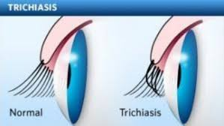

Slide 187
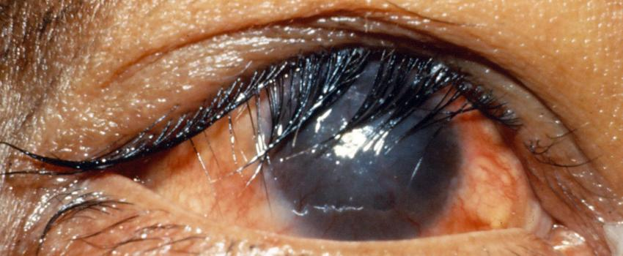

Slide 188
DISORDERS OF THE CORNEA
a) Corneal Abrasions
These are defects on the epithelial layer. Could be caused by:-
Trauma
Foreign bodies
Contact lenses worn for a prolonged period of time
Defects in the tear film
Difficulty in the eyelid closure
Malposition of the eye lids or eye lashes
Rubbing of the eye extensive
UV light exposure

Slide 189
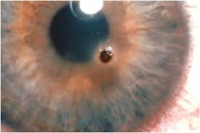

Slide 190
Symptoms
Eye pain which is exacerbated by eye movement
Photophobia
Foreign body sensation or gritty sensation in the eye
Excessive eye tearing
Blurred vision
Headache
Blepharospasm (involuntary tight closure of the eyelids.)

Slide 191
Management
Rule out retained foreign body in the cornea or upper lid
Do not wear contact until lesion is fully healed
Topical antibiotics 4 at least 48 hrs. for complicated cases use anti-pseudomonas e.g. Bacitricin, Erythromycin 0.5% ointment ½ inch ribbon b.d.
Other extended spectrum agents e.g. ciprofloxacin, Gentamycin ointment and Tobramycin
Topical NSAIDs ( these may delay healing time) Diclofenac (Voltaren), ketorolac(Acular)

Slide 192
Prevention
Use of safety goggles with adequate vents and side shields
Welders must use helmets with safety goggles
Outdoor workers should use sun glasses
Careful fitting, placement and care of contact lenses
Keep fingernails short
Perioperative corneal abrasion risk
Tape eyelids closed during surgery
Instill aqueous gel or soft contacts in sedated or ventilated patients in ICU
Remove all contact lenses

Slide 193
b) KERATITIS (CORNEAL ULCERS)
Inflammation of the cornea.
If it leads to loss of corneal tissue it results into corneal ulcer.
It could be acute or chronic, bilateral or unilateral and is sometimes recurrent.
The effects could be limited to one eye or be progressive in nature (spread to other eye structures).
The inflammation spreads deeper to the iris (iritis) resulting in formation of pus behind the cornea (hypopyon- pus in the anterior chamber)
It could occur in combination e.g. keratoconjuctivitis, keratouveitis-(cornea+ uveal duct- iris, ciliary muscles and choroid)

Slide 194
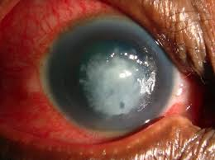

Slide 195
Causes / risk factors
Infection is the most common type (bacterial being the commonest)
Corneal trauma with foreign body. This break the surface layer of the cornea(epithelium)
Contact lenses especially with poor hygiene
Decrease in the quantity and quality of tears.
Lowered immunity e.g. prolonged use of corticosteroids, AIDS and chemotherapy.

Slide 196
Classification
Superficial keratitis- only affects the epithelial layer
Stroma /interstitial – affects deeper layers of the cornea
Symptoms
Pain
Blurred vision
Light sensitivity
Discharge
Redness of the eye
Increased lacrimation
Tearing

Slide 197
Management
Prevention of foreign bodies
Early treatment of scratches and infections
Dark glasses to relieve photophobia
Analgesics
Read on Exposure Keratitis and Microbial keratitis

Slide 198
KERATOCONUS
It refers to a non-inflammatory, progressive thinning (degeneration) of the structure of the cornea.
It assumes a conical configuration from its normal dome shape.
It affects women more than men.
Signs And Symptoms
Blurring
Distortion of vision
sensitivity to glare and light making simple tasks like driving, watching T.V, reading a book etc. difficult.
These symptoms first appear in teenage and early twenties.
It may progress for 10-20 yrs. then slow and stabilize. It May affect each eye differently.

Slide 199
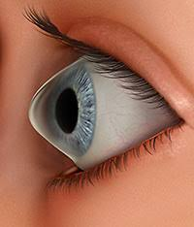

Slide 200
Causes
Though exact cause is unknown it is associated with a defect in collagen (The tissue that makes most of the cornea)
Risk factors
Genetic predisposition
Overexposure to ultraviolet rays of the sun
Excessive eye rubbing
History of poorly fitting contact lenses
Chronic eye irritation

Slide 201
Management
Eye glasses or soft contact lenses may be used to correct the mild nearsightedness and astigmatism caused in the early stages of keratoconnus
As the disorder progresses, rigid gas permeable contact lenses are generally prescribed to correct vision more adequately.
The contact lenses must be carefully fitted and frequent check-ups and lens changes may be needed to achieve and maintain good vision.
In severe cases, corneal transplant (a simple procedure that replaces the keratoconus cornea with a healthy donor) may be needed due to scarring, extreme thinning or contact lenses intolerance.

Slide 202
CONDITIONS OF THE LENS
a) CATARACT
A cataract is a clouding of the eyes natural lens, which lies behind the iris and the pupil.
It is opacity of the crystalline lens
It’s the leading cause of blindness in the world
Most cataracts are related to aging.
Cataracts are very common in older people.
A cataract can occur in either or both eyes

Slide 203
Individuals with a cataract in one eye usually go on to develop a cataract in the other eye as well.
A cataract is not contagious
Cataracts do not cause the eye to tear abnormally.
They are neither painful nor make the eye itchy or red

Slide 205
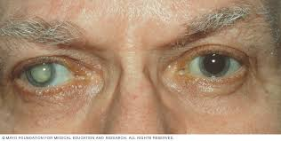

Slide 206
Classification Of Cataracts
Congenital cataract; rubella in pregnancy or congenital abnormalities e.g down syndrome
Senile cataract; resulting from loss of transparency of the crystalline lens that occur with aging it
Traumatic cataracts- could be a result of blunt trauma, thermal injury, electric shock, radiation or foreign bodies
Traumatic cataract develop rapidly and usually involve only the eye that was subjected to trauma.

Slide 207
Causes /risk factors
The lens is mostly made of water and protein.
The protein is arranged in a precise way that keeps the lens clear and let light pass through it.
As we age some of the protein may clump together and start to cloud a small area of the lens.
This is a cataract and over time, it may grow larger and clouds more of the lens, making it harder to see.
Trauma
Chronic diseases ie DM

Slide 208
Alcohol and smoking
Long use of corticosteroids medication e.g. prednisolone
Exposure to heat and radiation
Clinical Manifestations
Painless progressive diminished visual acuity
Glare from light visible as a white cloud over the lens
Disabling glare,
Dimmed
blurred vision
Distorted images
Poor night vision.

Slide 209
Management
Cataracts are removed surgically when visual impairment interferes with normal daily activities.
Dx is done by an ophthalmoscope.
Detailed evaluation is one through microscopic exam using a slit lamp biomicroscope
Conservative management with mydriatics and strong refraction to improve vision and increase image size.

Slide 210
Cataract surgery is indicated when best vision is 20/50 or worse and if visual acuity interferes with safety and quality of life.
Most operations are done under local anesthesia in an out pt setting.
Mydriatics meds are often instilled into the eye pre-operatively to dilate the pupil for surgical visualization.
Administration of a relaxant or tranquilizer such as diazepam
Using sunglasses to decrease glare and having better lighting to read can significantly alleviate their symptoms.
Magnifying lenses for close work and reading fine print may also be helpful.

Slide 211
The surgery could be;-
Extracapsular cataract extraction- removal of lens content and leaves the posterior capsule intact.
Intracapsular cataract extraction- a cryoprobe is used to remove the entire lens capsule and the contents.
Complications
There can be loss of vision, bleeding, double vision and infection.
Inflammation and fluctuating eye pressure can be a side effect of this surgery as well.

Slide 212
GLAUCOMA
Introduction
The aqueous and vitreous humor helps maintain sufficient IOP to prevent the eyeball from collapsing.
The aqueous humor is contained in the anterior cavity (anterior and posterior chambers)
The ciliary body actively secretes the aqueous humor into the posterior chamber but also passive filtration from capillary blood contributes to aqueous humor formation.

Slide 213
From the posterior chamber, aqueous humor moves from the area between the iris and the lens through the pupil into the anterior chamber.
It then drains into the canal of schlemm and moves on into small veins.
Normally, the aqueous humor drains out of the anterior chamber at the same rate at which it enters the posterior chamber
It is so that the amount of aqueous humor in the eyes remains relatively constant and so does the IOP

Slide 214
The production, flow and drainage of fluid is an active process needed for eye health.
Either excess formation or more often decreased drainage is seen as an immediate cause of IOP hence Glaucoma.
In other words the Imbalance in the production and drainage of the fluid of the eye – aqueous humor increasing eye pressure to unhealthy levels.

Slide 215
GLAUCOMA
Is a condition characterized by increased IOP that if unrelieved causes intraocular structural damage.
It leads to damage of the optic nerve. So if glaucoma is untreated it will lead to gradual loss of peripheral field of vision and subsequent blindness.
It is the third cause of blindness after cataract and trachoma.
Most cases of glaucoma however are asymptomatic until extensive and irreversible damage has occurred.
Glaucoma is often referred to as the “silent thief of sight” because most types typically cause no pain and produce no symptoms.

Slide 216
For this reason, glaucoma often progresses undetected until the optic nerve already has been irreversibly damaged with varying degrees of permanent vision loss.
Routine eye examination and screening play a vital role in detecting the disease though assessment of IOP, visual fields and optic nerve head assessment with an ophthalmoscope is vital

Slide 217
Glaucoma affects all ages but the following groups are at risk;-
African American over 40yrs
All adults after 60 yrs
Family history of Glaucoma
Diabetics
Previous eye trauma or surgery
Long term corticosteroid treatment
Farsightedness or nearsightedness
Elevated eye pressure
Past eye injury

Slide 218
Having a thinner central cornea
Not having eye examinations when they are recommended
Conditions that affect blood flow, such as migraines, diabetes and low blood pressure
The three cardinal signs of glaucoma are;-
cupping of the optic nerve
increased IOP (usually but not always)
loss of visual fields

Slide 219
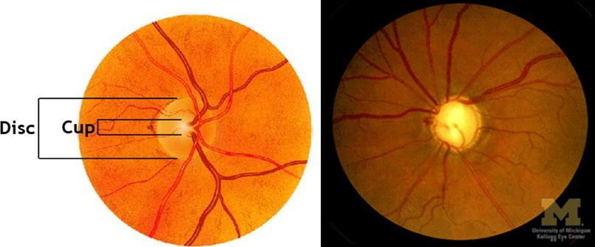

Slide 220
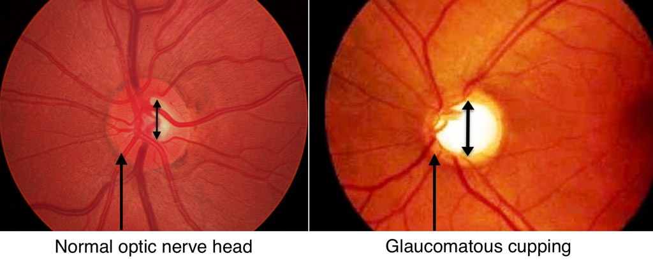

Slide 221
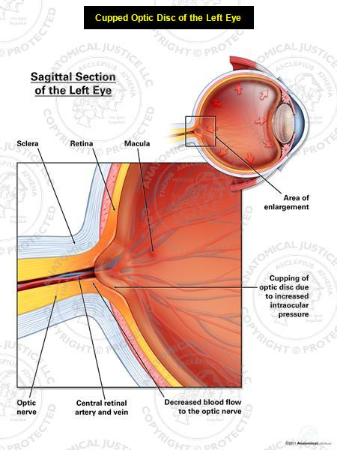

Slide 222
Diagnostic Tests
Tonometry- use of a tonometer to measure IOP
Imaging of the eyes optic nerve and internal structures( ultrasonography)
Visual field testing to monitor dev. of blind spots in the field of vision
Gonioscopy - Inspect eye’s drainage angle Ophthalmoscopy to view internal eye structures and make sure nothing unusual interferes with the outflow and drainage of eye fluids
Ultrasound bio microscopy used to evaluate how well fluids flow through related angles of the internal structure

Slide 223
Measure the thickness of cornea - Because the thickness of the cornea can affect eye pressure readings.
Pachymetry is used to measure corneal thickness.
A probe called a pachymeter is gently placed on the cornea to measure its thickness.
Ocular and medical history to include symptoms of elevated IOP, family history of eye disorders, medical history of eye disorders and surgeries and use of systemic steroids

Slide 224
Types Of Glaucoma
The two major types of glaucoma are
Chronic or primary open angle glaucoma (POAG)
Acute angle-closure glaucoma
The angle refer to the configuration of internal eye structures that drain fluids.
Other variation includes
congenital glaucoma,
secondary glaucoma
normal tension glaucoma.

Slide 225
1) Primary open angle glaucoma
This is the most common form of glaucoma.
It’s chronic in nature insidious onset, slow in progression. Its occurrence increases with age
Early signs are not noticeable to the patient until severe, irreversible damage/ vision loss has occurred
It occurs when aqueous humor is not adequately drained from the eye even when there is adequate space for drainage in the anterior chamber
In other words It occurs when the trabecular meshwork of the eye gradually becomes less efficient at draining fluid.

Slide 226
This increases pressure causing cupping of the optic disk, then destruction of the nerve fibers in the retina, causing painless visual loss in the affected areas.
Clinical manifestations
Usually the patient is symptoms free
There are changes in peripheral visual acuity
Progressive loss of peripheral vision
Bumping or stumbling into objects
The 3 cardinal signs on examination i.e. Increased IOP, cupping of the optic nerve and loss of visual fields.

Slide 227
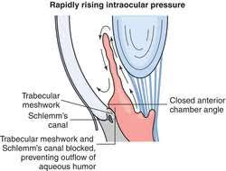

Slide 228
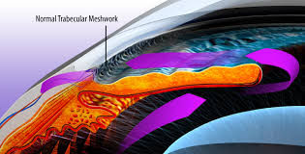

Slide 229
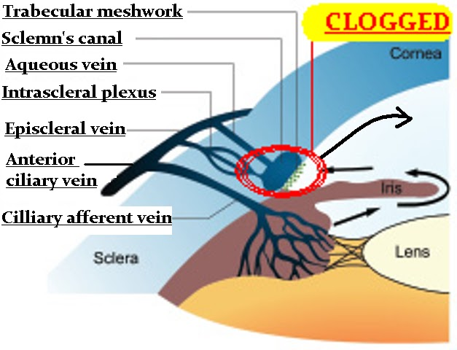

Slide 230
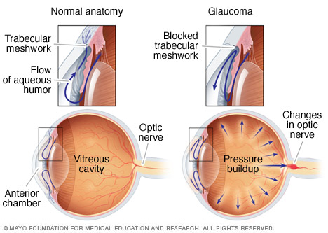

Slide 231
2) Angle- Closure Glaucoma
This type is acute in nature.
It results from the partial or total obstruction of the anterior chamber angle( junction between the iris and cornea) which blocks the trabecular meshwork.
This blockage causes a sharp increase in IOP causing severe ocular and facial pain and requires immediate medical intervention
The iris lies close to the drainage channel and bulges forward against the cornea creating a mechanical blockage of the trabecular meshwork.
The aqueous attempting to flow through the pupil may push the iris forward which can result in partial or total papillary blockage.

Slide 232
Acute angle closure occurs because of an abnormality of the structures in front of the eye.
In most of these cases, the space between the iris and the cornea is more narrow than normal leaving a smaller channel for the aqueous to pass through.
If the flow of aqueous becomes completely blocked, the IOP rises sharply causing a sudden angle closure attack.

Slide 233
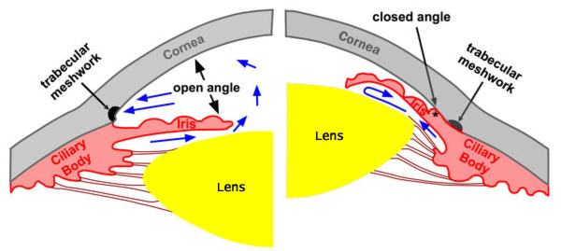

Slide 234
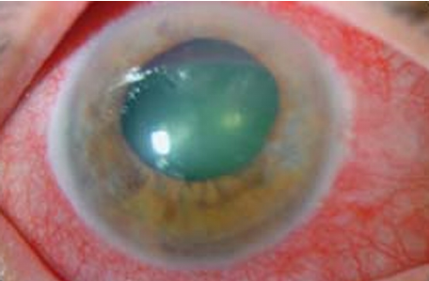

Slide 235
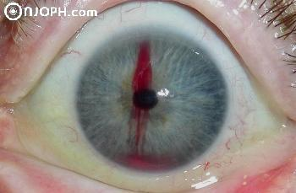

Slide 236
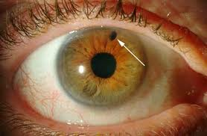

Slide 237
The causes of abnormal positioning of the iris include:-
1) Pupillary block- occurs if the back of the iris adheres to the lens inside the eye.
The papillary channel becomes blocked.
Fluid backs up behind the iris
pushing the iris forward until it closes the drainage angle in the anterior chamber.
2) Iris plateau- the iris is attached to the ciliary body too close to the trabecular meshwork where drainage occurs.
When the pupil dilates, peripheral iris tissue bulges up in the filtration angle and can cover up the drainage meshwork causing IOP to rise quickly.
This occur in conditions where the pupil dilates in dim lighting or when eye drops are used to intentionally enlarge the pupil

Slide 238
3) Hyperopic patients- these people have
shallow anterior chambers and narrow angles increasing their risk for angle closure glaucoma from pupil dilatation or aging changes in the eye
4) Tumors, eye disease and other causes- a tumor behind the iris,
swelling associated with inflammation of the cilliary body (intermediate uveitis)
alteration of the shape of the eye after retinal detachment surgery can also cause angle closure glaucoma.
5) Age- as one grow older, the lens inside the eye gets larger, increasing the risk for pupil block.
Also the anterior chamber tends to become increasingly shallow and the drainage angle may narrow as we age.

Slide 239
6)Persons who work in dark environments because of long term pupil dilatation resulting in blockage of the angle of iris
7) Race- Asians and Eskimos who have anatomically narrower anterior chambers than whites have a higher incidence of angle closure glaucoma.
8) Sex- more women than men are affected.

Slide 240
3) Congenital Glaucoma
This inherited form of glaucoma is present at birth with 80% of the cases diagnosed at age one.
These children are born with narrow angels or some other defect in the drainage system of the eye.
It is difficult to spot signs of congenital glaucoma because children are too young to understand what is happening to them.
If a cloudy, white hazy, enlarged or protruded eye in child is noted consult
Congenital glaucoma typically occurs more in boys than in girls.

Slide 241
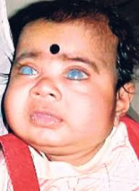

Slide 242
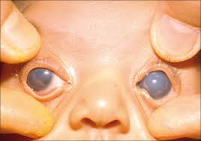

Slide 243
4) Secondary glaucoma
Develops when the eye conditions cause structural changes that interrupt the drainage of aqueous humor from the eye.
Symptoms of chronic glaucoma following an eye surgery could indicate secondary glaucoma which also may develop with;-
Inflammation of the eye
Infection
Tumor or an enlargement
Hemorrhage into the anterior chamber after trauma or surgery
Intraocular surgery
Long term use of topical steroids
Exophthalmoses from thyroid disease
Eye Injury

Slide 244
Abnormal blood vessel formation from diabetes or retinal blood vessel blockage;
Pigment dispersion, where tiny fragments or granules from the iris (the colored part of the eye) can circulate in the aqueous humor (the fluid within the front portion of the eye) and block the trabecular meshwork ( the tiny drain for the eye’s aqueous humor).

Slide 245
5) Normal- tension glaucoma
Like POAG, normal tension glaucoma (normal pressure glaucoma, low tension glaucoma, or low pressure glaucoma) is an open-angle type of glaucoma that can cause visual field loss due to optic nerve damage.
But in normal tension glaucoma, the eyes IOP remains within normal range.
Pain is also unlikely and permanent damage of the optic nerve may not be noticed until symptoms such as tunnel vision occur.
The cause is not known but it is believe it is related to poor blood flow to the optic nerve.
It is more common among Japanese, females or those with vascular disease.

Slide 246
Management
The goal is to maintain IOP at a reduced level to prevent further damage to intraocular structures.
Medications are used to create miosis and to reduce formation of aqueous by the ciliary body.
1) Topical medications include the following:-
Miotics (parasympathomimetics)–they increase the outflow of aqueous humor from the eye e.g. pilocarpine(carbachol) induces pupil constriction and pulls the iris away from the cornea, permitting drainage of aqueous humor
Prostaglandin Analogs- work near the drainage area of the eye to increase the secondary route of aqueous humor outflow to lower IOP.

Slide 247
Side effects include potential change in eye color and eyelash growth. Examples include Xalatan (latanoprost), Lumigan (travoprost), Travatan Z (travoprost) Beta Blockers
Beta blockers -lower the pressure in the eye by decreasing the production of the fluid in the eye.
These eye medications can impact heart rate and may cause problems in people with lung disease, diabetes or depression.
Some available beta blockers are Timoptic XE (timolol maleate), and Betoptic S (betaxolol).
Alpha-Adrenergic Agonists-Alpha-adrenergic agonist eye drops also decrease the formation of the fluid inside the eye.

Slide 248
Common side effects include red eye, itching and dilation of the pupil. Two of the available glaucoma medications in this class are Iopidine (apraclonidine) and Alphagan (brimonidine tartrate).
Carbonic Anhydrase Inhibitors- Carbonic anhydrase inhibitors decrease the amount of fluid inside the eye as well. This type of glaucoma medication usually is used in combination with other types of eye drops. Common side effects include burning and red eye. E.g. acetozolamide
Epinephrine compounds- Decreases the production of fluid in the eye and increases the outflow of the eye. These medications are generally used only in special cases or certain types of glaucoma.

Slide 249
Osmotic diuretics- Draws the fluid from the eye by osmosis. E.g. Mannitol
Analgesics and Antiemetics – when pain and vomiting persists
2) Surgical management
This may be performed first or after attempts to lower IOP with medication are tried.
Several types of surgery are available to treat patients with glaucoma.
The type and severity of the glaucoma, the patients other eyes problems and the patients health condition are all considerations in selecting the type of operation

Slide 250
Laser trabeculoplasty
A surgery called laser trabeculoplasty is often used to treat open angle glaucoma.
There are two types of trabeculoplasty surgery:
argon laser trabeculoplasty (ALT)
selective laser trabeculoplasty (SLT).
During ALT surgery, a laser makes tiny, evenly spaced burns in the trabecular meshwork.
The laser does not create new drainage holes, but rather stimulates the drain to function more efficiently.

Slide 251
Laser iridotomy
Laser iridotomy is recommended for treating people with closed angle glaucoma and those with very narrow drainage angles.
A laser creates a small hole about the size of a pinhead through the top part of the iris to improve the flow of aqueous fluid to the drainage angle.
This hole is hidden from view by the upper eyelid.

Slide 252
Peripheral iridectomy
When laser iridotomy is unable to stop an acute closed-angle glaucoma attack, or is not possible for other reasons, a peripheral iridectomy may be performed.
Performed in an operating room, a small piece of the iris is removed, giving the aqueous fluid access to the drainage angle again.
Because most cases of closed-angle glaucoma can be treated with glaucoma medications and laser iridotomy, peripheral iridectomy is rarely necessary.

Slide 253
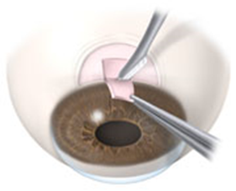

Slide 254
Assignment
read and make notes on
Trabeculectomy
Cyclophptpcoagulation
Aqueous shunt surgery

Slide 255
DEFECTS OF THE RETINA
Retinal Detachment
Risk increases with age from 40 years of age.
is a medical emergency requiring prompt surgical treatment to preserve vision.
The retina is the light-sensitive tissue that lines the inside back wall of your eye.
In retinal detachment, the retina is pulled away from the underlying choroid — a thin layer of blood vessels that supplies oxygen and nutrients to the retina.
Retinal detachment leaves retinal cells deprived of oxygen.
The longer the retina and choroid remain separated, the greater the risk of permanent vision loss in the affected eye.

Slide 256
The warning signs usually it’s painless
The sudden appearance of many floaters — small bits of debris in the field of vision that look like spots, hairs or strings and seem to float before your eyes
Sudden flashes of light in one or both eyes
A shadow or curtain over a portion of the visual field
A sudden blur in vision
Pain free
When macula is affected the visual loss is central
Types
Primary detachment
Secondary detachment

Slide 257
Primary or simple detachment
Separation of the retina in the form of a hole or tear
This allows vitreous humor to raise retina from its normal position
Causes include;
Recent or previous trauma (blunt or penetrating)
High myopia
Retinal degeneration
Aphakia
Vascular diseases

Slide 259
2) Secondary detachment
Due to the accumulation of the vitreous humor which pushes the retina from it normal position
Causes include;
Pressure from intraocular tumors or hemorrhages
Scar formation
Severe hypertension
Diabetic retinopaphy
Toxemia in pregnancy (PET)
Intraocular inflammation
Previous retinal detachment in one eye
A family history of retinal detachment

Slide 261
Management
examination with an ophthalmoscope
Ultrasound examination may be useful
This is an emergency thus admission is necessary
Bed rest to promote ocular rest thus retinal settling and prevent detachment from spreading; bilateral eye patching
Surgical management aims to return the retina to its original position, seal any breaks and remove any fluid between the retinal layers. The surgical procedure varies with the type and degree of defect.

Slide 262
Cryotherapy or laser photocoagulation is used to seal the breaks and holes
Pneumatic retinopexy. For a relatively uncomplicated detachment with the tear located in the upper half of the retina, usually done under local anesthesia.
The procedure often starts with cryopexy to treat the retinal tear.
Repair of the retinal detachment may require softening the eye by withdrawing a small amount of fluid from the space between the cornea and the iris.
Next, a bubble of expandable gas is injected into the vitreous cavity.

Slide 263
Over the next several days, the gas bubble expands, sealing the retinal tear by pushing against it and the detached area that surrounds the tear.
With no new fluid passing through the retinal tear, fluid that had previously collected under the retina is absorbed, and the retina is able to reattach itself to the back wall of your eye.
The gas eventually disappears after several weeks.

Slide 264
Sclera buckling used to reattach the retina.
A small inert material (silicon) is sutured onto the sclera over break.
This indentation reduces the traction on the retina and brings the separated layers of the retinal together.
Vitrectomy is done where an external syringe is used to drain sub-retinal fluid, this is necessary to bring the detached retina closer to the buckled area.
This helps remove blood, vitreo-retinal adhesions or other unwanted materials.

Slide 265
NURSING MANAGEMENT
Preoperative care
Complete bed rest position in a dependent position (prone)
Eye patching to minimize eye movement
Mydriatrics & cycloplegics are used to dilate and prepare the eye
Antibiotics prophylactically
A sedative

Slide 266
Post operative care
Analgesics
Dilation of pupils with mydratrics and cycloplegics 2-6 weeks
Antibiotics and steroids may be instilled
Pressure patch is applied for 12-24 hours post operatively then replaced with a dressing
Cold compressors over the eye to decrease the edema around the lids and conjunctiva and also promote comfort
Observe progressive ambulation
Restrict and teach the patient to avoid activities that increase IOP
Dependent position

Slide 267
Complications
Increased IOP
Infection
failure to reattach

Slide 268
b) Retinal Degeneration
Aka macular degeneration / maculopathy.
It is progressive damage of the macula - the central most vital area of the retina resulting in gradual loss of vision.
The incidence increases with age.
Likely causes include; artery or vein occlusion, diabetic retinopathy
Classification based on the site
1) Peripheral degeneration; the degeneration normally affects the periphery before affecting the central retina.
This precipitates retinal detachment from the formation of a hole in the weakened retina.
Has a hereditary tendency
2) Retinitis pigmentosa: this is the degeneration of the retinal nerve cells in both eyes.
3) Age Related Macular degeneration

Slide 270
The rods are destroyed slowly in the peripheral and later the entire retina is affected,
resulting in tunnel vision (the person can see centrally located objects but misses those located above, below, or the side).
Has a hereditary tendency.
The onset usually occurs in youth or young adulthood, although can be seen at any age.
The patient experiences night blindness (nyctalopia).
Later color vision is affected,
by 50 years, tunnel vision to total blindness results

Slide 271
Management;
No treatments currently are available for retinitis pigmentosa, although some practitioners believe that vitamin A may slightly delay vision loss.
Occupational therapy may be helpful, because it's easier to adjust to declining vision in earlier stages of vision loss.
Individuals with retinitis pigmentosa also might consider use of low visual devices that can help magnify and illuminate objects in home and work spaces.
Management- the treatment of other disorder such as glaucoma and myopia and vit A and E supplementation is thought to help

Slide 272
3) Age Related Macular degeneration
Caused by damage to or degeneration of the photoreceptors cells in the macula
Although this condition may cause significant reduction in vision it never leads to complete blindness
as it affects only the central part of the vision and the side, or peripheral, vision is always left intact.
If the fovea is affected, there is loss of central vision, and loss of contrast sensitivity, increased glare, and dimming of color vision.

Slide 273
Idiopathic though associated with:_
Cigarette smoking – the smoke has some toxins that have effects on the eye.
Aging process
Artificial lighting can destroy the fragile photoreceptors cells of the retina,
History of hypertension or cardiovascular disease,
Myopia,
Light skin,
Increased cholesterol levels in the body and high fat intake
Lens opacities (cataract)
Hereditary tendency / family history
Mutation of ATP synthase gene
Hypertension

Slide 274
Management
Supportive management; laser photocoagulation is used to arrest abnormal growth of blood vessels that cause bleeding, which can lead to a scarred retina
Supplemental vitamins and minerals such as vitamin A, zinc to slow the degenerative process
Drusen are related to increased cholesterol deposits hence cholesterol lowering agents make be helpful
Adaptation to the learning environment; use of optic aids and controlled illumination

Slide 275
Nursing Care
To compensate of sensory/ perception alterations, the patient uses special aids such as magniflying lens and maximum use of peripheral vision for central vision
Wearing sunglasses to protect the retina from ultraviolet light may help preserve vision.
Use resources such as audiocassettes, talking books to provide sensory stimulation
Referring to schools for the blind to assist with alteration of role performance.

Slide 276
The use of large print books and the prescription of a magnifying glass (low visual aid) are often necessary.
To maintain physical mobility, the patient is advised to use canes and wall security bars to promote independence in movement
Ensure maintenance of safety hazards at home
Introduce self, avoid non-verbal communication, and approach from unaffected eye
Genetic counseling may determine whether your children are at risk for this disease
Counseling for altered role performance, self esteem disturbance, body image disturbance and risk for social isolation

Slide 277
d) Diabetic Retinopathy
A microvascular disorder in which pathologic changes occur in the retinal blood vessels.
Common complications of diabetes mellitus include; cataract, glaucoma, diabetic retinopathy and retinal detachment
This is a cause of blindness
Risk increase in patients with type 1 diabetes mellitus and a long duration of diabetes.
Also during pregnancy, diabetic retinopathy may be a problem for women with diabetes.

Slide 278
Stages For Development
1)Nonproliferative :
Microaneurysms form on retinal capillary walls after capillary basement membrane thickening
These aneurysms may leak blood onto the central retina or macula
This causes edema leading to decreased visual acuity and color discrimination
Hard exudates (yellow) collect as the leaked blood is absorbed
Usually the patient still maintains their independence

Slide 279
2) Preproliferative
Characterized by spots, engorged and irregularly dilated veins and microvascular shunt formation to bypass vessels
The patients are at risk of advancing to the next stage
3) Proliferative
New blood vessels start growing into the retina and optic disc to increase blood supply there
New, fragile, vessels develop as the circulatory system attempts to maintain adequate oxygen levels within the retina.
This is called neovascularization.

Slide 280
Unfortunately, these delicate vessels hemorrhage easily.
Blood may leak into the retina and vitreous, causing spots or floaters, along with decreased vision.
The new vessels are fragile and commonly leak blood and protein into vitreous and retina
These vessels may also grow into the vitreous, which creates traction on the retina and retinal detachment can occur.
In the later phases of the disease, continued abnormal vessel growth and scar tissue may cause serious problems such as retinal detachment and glaucoma.
The patient may lose both central and peripheral vision

Slide 282
Pathophysiology
Changes results from biochemical, metabolic and hematologic changes influenced by accumulation of excess glucose in the tissues.
The sorbitol accumulates in tissues such as mural cells in the retinal capillaries causing their death.
This results into thickening of retinal capillary walls, formation of microaneurysms and constriction of retina blood vessels.
Thus, sluggishness of blood flow and occlusion of microcirculatory system within the retina.

Slide 283
Clinical manifestation
Asymptomatic
Decrease in central vision and color vision
Blurred vision (this is often linked to blood sugar levels)
Floaters and flashes
Sudden loss of vision

Slide 284
Diagnostic Evaluation
Diabetic retinopathy and macular edema are detected during a comprehensive eye exam that includes:
Visual acuity test. Use of the Snellen chart.
Dilated eye exam. Dilation of pupils using atropine then opthalmoscopy is done to examine the retina and optic nerve for signs of damage and other eye problems.
The checks for leaking blood vessels, retinal swelling (macular edema), pale, fatty deposits on the retina--signs of leaking blood vessels, damaged nerve tissue and any changes to the blood vessels.

Slide 285
Tonometry. An instrument measures the pressure inside the eye. Local anesthesia is applied.
Fluorescein angiogram- A contrast media is injected into a peripheral vein then pictures are taken as the dye passes through the blood vessels in the retina. The test allows one to identify any leaking blood vessels and recommend treatment.

Slide 286
Management
Comprehensive eye examination yearly
To prevent progression of diabetic retinopathy, people with diabetes should control their levels of blood sugar, blood pressure, and blood cholesterol.
Laser photocoagulation; direction of high-energy beam of light through the pupil onto the retina causing small burn that seal leaking aneurysms
Vitrectomy is done to treat long standing vitreous hemorrhage and traction retinal detachment during the proliferative stage. Surgical removal of the vitreous then replacement with silicon oil or basic salt solution
Sclera buckling
Antibiotics after the surgical procedures and eye patching

Slide 287
Nursing care
Patient assessment of visual acuity, fields, color discrimination, BP, degree of blood glucose level control and type, frequency of eye examination…
Patient education
After surgeries instruct patient to put on dark glasses to decrease light sensitivity

Slide 288
DISORDERS OF THE EYE LID
Hordeolum (Stye)
Chalazion (Meibomian Cyst)
Blepharitis
Entropion
Ectropon
Conjunctivitis (Pink Eye)

Slide 289
HORDEOLUM (STYE)
Mechanism
* Inflammatory Infection Of The Hair Follicle Of The Eye Lid
Etiology
* Staphylococcal Infection * Usually Associated With Blepharitis
Symptoms And Signs
* Occurs On The Outside * Pain/Swelling/Redness/Pus * Patient Feels Something In The Eye

Slide 290
Diagnosis
* Visual Exam * Culture If Needed
Treatment
* Hot Compress To Alleviate Pain * Topical Or Systemic Antibiotics

Slide 292
CHALAZION (MEIBOMIAN CYST)
Mechanism
* Collection Of Fluid Or Soft Mass Cyst
Etiology
* Blockage Of Meibomian Gland
Symptoms And Signs
* Pea Size Cyst * Painless Slow Swelling Of The Inner Part Of Eye Lid * Could Become Infected

Slide 294
Diagnosis
* Visual Examination
Treatment
* Small Ones Usually Disappear Spontaneously After A Month Or Two * Large Ones Usually Need Surgical Removal

Slide 295
BLEPHARITIS
Mechanism
* Inflammation Of The Margins Of The Eye Lids
Etiology
* Ulcerative: Staphy Infection * Nonulcerative: Allergies, Smoke, Dust, Chemicals, Seborrhea, Stye, Chalazions
SYMPTOMS AND SIGNS
* Persistent Redness & Crusting On Eyelids * Itching / Burning Sensation * Feeling Something In The Eye * Ulcers Can Cause Eye Lashes To Fall Out * Scales Can Get Into Eye Causing Conjunctivitis

Slide 297
Diagnosis
* Visual Examination * Culture (Confirm Staphy Infection)
Treatment
* Salt & Water Cleansing For 2 Weeks * If Unsuccessful - Local Antibiotics Or Sulfonamide

Slide 298
ENTROPION
Mechanism
* Inversion Of Eye Lid Into Eye
Etiology
* Aging (Course Fibrous Tissue)
Symptoms And Signs
* Foreign Body Sensation * Tearing / Itching / Redness * Continuous Rubbing Causes Conjunctivitis Or Corneal Ulcers * Decreased Visual Acuity If Not Corrected

Slide 300
Diagnosis
* Visual Examination
Treatment
* Clean Up On Its Own * If Not, Minor Surgery

Slide 301
ECTROPION
MECHANISM
* Outurned eye lids
ETIOLOGY
* elderly (weakness of eye lid muscles)
SYMPTOMS AND SIGNS
* dryness of the exposed part of the eye * tears run down the cheeks * if not treated can cause ulcers and permanent damage to cornea

Slide 303
DIAGNOSIS
* visual examination
TREATMENT
* minor surgery if doesn’t disappear

Slide 304
BLEPHAROPTOSIS (PTOSIS)
MECHANISM
* weakness of eye muscle that raises eyelid (superior rectus, superior oblique)
ETIOLOGY
* familial
* trauma * diabetes mellitus
* muscular dystrophy * myasthenia gravis
* brain tumors

Slide 306
SYMPTOMS AND SIGNS
* “drooping eye” * Blocks vision
DIAGNOSIS
* ophthalmic examination * blood work to rule out underlying disease
TREATMENT
* Surgery (strengthen muscles) * eye glasses with raised eyelid support * treat underlying disease

Slide 307
UVEITIS Inflammation of the uveal tract, can affect the iris, the ciliary body, or the choroid.
two types of uveitis:
nongranulomatous the most common type, which manifests as an acute condition with pain, photophobia, and a pattern of conjunctival injection, especially around the cornea. The pupil is small or irregular, and vision is blurred.
There may be small, fine precipitates on the posterior corneal surface and cells in the aqueous humor (ie, cell and flare). If severe, a hypopyon (ie, accumulation of pus in the anterior chamber) may occur.
The condition may be unilateral or bilateral and may be recurrent.

Slide 308
Repeated attacks can cause anterior synechia (ie, peripheral iris adheres to the cornea and impedes outflow of aqueous humor).
The development of posterior synechia (ie, adherence of the iris and lens) blocks aqueous outflow from the posterior chamber.
Secondary glaucoma can result from either anterior or posterior synechia.
Cataracts may also occur as a sequela to uveitis.

Slide 309
Granulomatous uveitis can have a more insidious onset and can involve any portion of the uveal tract. It tends to be chronic.
Symptoms such as photophobia and pain may be minimal.
The keratic precipitate may be large and grayish.
Vision is markedly and adversely affected.
Conjunctival injection is diffuse, and there may be vitreous clouding.
In a severe posterior uveitis, such as chorioretinitis, there may be retinal and choroidal hemorrhages.

Slide 310
Management
Photophobia wear dark glasses outdoors.
Ciliary spasm and synechia -avoided through mydriasis; cylopentolate (Cyclogyl) and atropine
Local corticosteroid drops, such as Pred Forte 1% and Flarex 0.1%, instilled QID to six times a day to decrease inflammation.
very severe cases, systemic corticosteroids, as well as intravitreal corticosteroids, may be used.
If the uveitis is recurrent, a medical workup should be initiated to discover any underlying causes.

Slide 311
This evaluation should include a physical examination, complete systems review, and diagnostic tests, including a complete blood cell count, erythrocyte sedimentation rate, antinuclear antibodies (ANA), VDRL, and Lyme disease titer.
Underlying causes include toxoplasmosis, herpes zoster virus, ocular candidiasis, histoplasmosis, herpes simplex virus, tuberculosis, and syphilis.

Slide 312
Retinitis pigmentosa
This is a group of hereditary diseases in which there is degeneration of the retina, mainly affecting the rods.
Progressive impairment of peripheral vision, especially in dim light, usually becomes apparent in early childhood.
Over time this leads to tunnel vision and, eventually, loss of sight.

Slide 313
Applying Eye Drop Medicine
STEP ONE: Tilt your head back. Using your middle finger, gently press the corner of the eye by the side of the nose.
STEP TWO: Use your index finger to pull down the lower lid. Then apply the eye drop medicine.
STEP THREE: After applying the eye drop, let go of your lower lid. Close the eye and keep the middle finger in place for at least two minutes. If you’re applying more than one type of drop, wait at least 15 minutes for the next application. Use a facial tissue to wipe away excess drops on eyelids.

Slide 314
BLINDNESS
Def: the inability to see. The marked reduction in visual field with varying degrees of visual impairment.
It is inability to see, usually defined as corrected visual acuity of 20/400 or less, or a visual field of no more than 20 degrees in the better eye
Causes
Trauma of the eye
Corneal ulcers
Infectious (viral, bacterial, gonococcal)
Cataracts
Glaucoma

Slide 315
Retinal defects
Dietary deficiency of vitamin A (night blindness)
Onchorcerciasis (from worm causing river blindness).

Slide 316
Predisposing factors
Poor hygiene
Poor sanitation
Poverty (dietary)
Incidence
28 million world-wide and 6 % developed countries
Prognosis
Depends on cause and availability of medical care.
Signs and symptoms
Blurred vision
Inability to identify objects
Unclear/ Non-black cornea

Slide 317
Prevention
Promotion of good eye health
Sufficient dietary intake of vitamin A
Identifying and treating the cause
Surgery in indicated conditions
Continuous visual assessment
Referral for unexplained loss of vision
TYPES OF BLINDNESS
Daltonism (protanopia/red blindness)
A defect in color vision in which a person cannot distinguish between reds and greens. The term used to refer to “color blindness” in general.

Slide 318
2. Day blindness (Hemeralopia)
Fairly good vision in poor light but poor vision in good lighting. Congenital with poor visual acuity and deflective color vision.
3. Night blindness (Nyctalopia)
Inability to see in dim light or at night due to a disorder of the rods of the retina that are responsible for vision in dim light.
It can result from a deficiency of vitamin A.
if untreated, it progresses to
Xerophthalmia: (dry, thickened, wrinkled cornea and conjunctiva), leading to blindness.
Keratomalacia: (soft cornea) which may perforate. The condition is very serious and blindness is usually inevitable.

Slide 320
THE NEWLY BLIND
Stages
Denial
Value changes: adapting to aids that one thought he/she would never need.
Independence: dependence conflict. Attempting to accept his/her place without becoming completely dependent.
Coping with stigma: such as being labelled helpless, unemployable etc.
Learning to communicate in social settings without visual cues

Slide 321
Rehabilitation involves
Need for healthy adjustment assisted by those skilled in rehabilitation of the blind e.g. machakos/Thika school for the blind
Mobility aids: these are the most basic need for the blind and include; canes, dogs, morvat sensors that emit ultrasounds from objects 3 – 4 meters Braille for reading
Goals for the patient
To accept the sightless condition by:
Adaptation to the use of helping aids
Acceptance of visual role without becoming completely dependent
Continuing with self-care

Slide 322
Coping with social stigma
Learning to communicate without visual clues
Adherence to prescribed therapeutic regimens
The nurse’s role
Patient teaching – about self care
Patient support – in fear and correcting mis-information
Patient care: treat with dignity, not pity. Things should remain in the same position. Doors should not be left half open. Rem: the sense of touch becomes very important.
Collaboration with the physician in patient care.
Referral when patient is declared legally blind.

Slide 323
TUMORS OF THE EYE
They may be benign or malignant, form in or metastasize to the eye.
TYPES
Retinoblastoma: a congenital malignant neoplasm found in children and spreads easily to the brain
Melanoma: common in the iris and choroid; grows slowly but metastasizes to the liver and lungs.

Slide 324
Important facts
Most common primary, malignant, intraocular tumour of childhood (1:20,000)
2. No sexual predilection
3. Presents before age of 3 years
(average 3 months)
4. Heritable (40%) or non-heritable (60%)

Slide 325
Can extend to the orbit & CNS.
Develops from immature retinal cells.
Bilateral in 30% of all cases.
Non-heritable in 60% of cases.
Heritable in 40% of cases.
Siblings of affected child should be examined.

Slide 327
Presentations of retinoblastoma
Leukocoria - 60%
Strabismus - 20%
Secondary glaucoma
Orbital invasion
Anterior segment invasion
Orbital inflammation

Slide 328
Early endophylitic retinoblastoma
White flat lesion
Placoid lesion

Slide 329
More advanced endophytic retinoblastoma
Friable white mass
Cottage cheese appearance
Fine surface blood vessels
Vitreous seedings

Slide 330
Exophytic retinoblastoma
Multiglobulated white mass with
overlying retinal detachment
May be difficult to visualize
through deep detachment

Slide 331
CT diagnosis of retinoblastoma
Calcification
Optic nerve involvement
Orbital and CNS extension
Pinealoblastoma

Slide 332
Signs and symptoms
Leukorrhea(In retinoblastoma, white pupillary reflex (an abnormal white appearance of the pupil which reflects light).
Severe pain,redness,watery and hazy cornea
Decreased vision
Strabismus
Retinal detachment
Headache
Visual disturbances
Nursing care
Support client and family in coping with the diagnosis

Slide 333
Observe for side effects of therapy, report and attempt to alleviate them.
Post-operative care in Enucleation
Maintain pressure dressings on the eye for 1-2 days to minimize hemorrhage.
Administer prescribed analgesics for pain
Monitor for signs of meningitis as a complication (headache, neck stiffness etc.)
Single eye vision-explain that this results in loss of depth of perception (acuity) and activities needing this should be performed cautiously.
Support adaptation to changes in body image in enucleation
Explain that an artificial eye may be inserted when healing is complete (6- 8weeks)

Slide 334
Treatment Options of Retinoblastoma
1. Small tumours
Laser photocoagulation
Transpupillary thermotherapy
Cryotherapy
5. Metastatic disease
2. Medium tumours
Chemotherapy
Brachytherapy
Chemotherapy
External beam radiotherapy
3. Large tumours
Chemotherapy followed by local treatment
Enucleation
4. Extraocular extension
External beam radiotherapy

Slide 335
Poor Prognostic Factors in Retinoblastoma
1. Optic nerve involvement
2. Choroidal invasion
3. Large tumour
4. Anterior location
5. Poor cellular differentiation
6. Older children

Slide 336
What is done if the child has tumor in both eyes? In these cases, generally the worse eye is enucleated and the other eye is tried to salvage by using other methods of treatment. However, unfortunately in a few cases, both eyes may have to be removed.
Why is early detection important? The safer and less destructive procedures may be taken when the tumor is in its early stage. By detecting and treating the tumor early, we may save the life, sight and eye of the child.

Slide 337
Nursing Management
Educate on proper eye care
Hand wash
Avoid rubbing
Rx as prescribed
Post-op
Avoid valsalva maneuver
Educate!!
Enucleation – pressure dress, artificial eye
Support + family therapy

Slide 338
EYE SURGERY
Indications
Intra-ocular foreign bodies
Penetrating eye injuries
Choroidal tears
Hemorrhage
Cataract
Glaucoma
Retinal detachment
Tumors

Slide 339
Pre-operative care
Orientation of the patient to his environment after admission as his eyes may be bandaged after operation.
Pre-op. medications ordered e.g.. ophthalmic ointments/drops to be given on time
Suppository (enema) if prescribed, to evacuate the lower bowel to prevent straining immediately post-op.
Clipping of eyes (if ordered)- petroleum jelly is applied to the blades of blunt-pointed scissors so that the eyelashes will adhere to the blade and not fall into the eye.
Explanation for bandaging of both eyes post-op i.e.., the unaffected eye is covered to keep the patient from moving his eyes (i.e.. rest) during the immediate post-op. period.

Slide 340
Continuation
Washing of eyes the evening before surgery and a sterile pad applied over the eye.
Respiratory infections or allergy that may cause coughing, sneezing should be notified to the surgeon. Surgery may have to be post-poned as such violent motions can cause hemorrhage/ rupture of the surgical incision
Other general pre-op. care and as ordered

Slide 341
Post-operative care
Post-operative care
Gentleness is the key in all types of eye surgery. All movements should be slow and gentle
The patient’s head must be firmly supported when he is transferred form the operating table or stretcher to his bed.
Small pillows may be used on either side of his head to support it in the supine position.
Speech should always be soft before touching the patient. Alert them when entering the room because if he is sleeping. May be frightened and move suddenly and violently when some-one touches him.

Slide 342
Uncooperative patients and children will need someone in constant attendance to prevent them pulling off the bandages.
Nausea and subsequent vomiting may cause severe damage to delicate suture lines. All food and liquids should be withheld, surgeon notified and an emetic drug ordered/given.
Sudden pain in the eye may indicate hemorrhage. Inform the surgeon immediately.( glaucoma as a post-op. complication )
External irrigation of the eye (there should be no contact with the eyeball) or wet compresses may be ordered to remove the exudates and reduce swelling. Eyelids are cleaned with care.

Slide 343
Consult
If the patient can be turned to one or both sides
Whether he will remain flat supine or pillow allowed, how high the head of the bed should be elevated and
Whether he can feed himself, or any restrictions on fluid/food intake.
If allowed out of bed, he must take care not to bang his head or move too suddenly.
All straining and lifting must be avoided
On discharge
Relatives and the patient should be encouraged to follow these instructions at home during convalescence so as not to endanger the success of the surgery.

Slide 344
Read and make notes on
Choroiditis
Congenital abnormalities
Primary eye care and basic eye care

