Slide 1
CLINICAL AND RADIOLOGICAL FEATURES OF FRACTURES
MR. KOROS E.K.,
BSc.N, UoN, BLS, ACLS, LECTURER.

Slide 2
Introduction
The presence of a fracture can nearly always be inferred from the history and clinical findings alone, but radiographs are necessary to establish its precise nature

Slide 3
Clinical Features of Fractures

Slide 4
History
Start by establishing rapport then take Complete, Accurate and Detailed History (remember the components of history taking?). Elicit the following ‘symptoms’;
History of injury followed by inability to stand, walk or use a limb after an injury arouse suspicion of a fracture
History of visible bruising, appearing a day or so after injury
Spontaneous onset of pain and disability (loss of function) without any causative injury
May suggest fatigue fractures or pathological fracture

Slide 5
Commonly Missed Fractures
Clinicians may sometimes be misled that no fracture exists by the fact that the patient has retained the use of that particular painful limb
This is because, in certain cases, reasonable function is preserved despite a fracture
Such fractures that may be overlooked include;

Slide 6
Cont’…
Impacted Fractures: the most common sites are the neck of the humerus, the lower end of the radius, and the neck of the femur
Fatigue fractures: most common sites are the second and third metatarsal bones, and the shaft of the tibia or fibula
Fractures of small bones e.g. carpal bones (scaphoid bone) likely to be overlooked
Rib fractures: despite local tenderness and restriction of respiration, rib fractures sometimes go unrecognized
Greenstick fractures: these are common in the forearm bones of children

Slide 7
Physical Examination Technique
GENERAL SIGNS;
First follow the ABCs:
look for, and if necessary attend to;
Airway obstruction;
Breathing problems;
Circulatory problems
Cervical spine injury
Secondary survey

Slide 8
GENERAL SIGNS Cont’…
Examine the main injury-
Ascertain the type of fracture,
Classify,
Plan a management protocol
Look out for complications
It will also be necessary to exclude other previously unsuspected injuries.

Slide 9
LOCAL SIGNS;
Familiar headings of clinical examination should always be considered (or damage to arteries, nerves and ligaments may be overlooked.)
A systematic approach is always helpful:
Examine the most obviously injured part
Test for artery and nerve damage
Look for associated injuries in the region
Look for associated injuries in distant parts.

Slide 10
LOOK (Inspect) for;
Swelling,
Bruising
Deformity
Examine whether the skin is intact or not
Colour of the skin.
Note also the posture of the distal extremity

Slide 11
FEEL/PALPATE;
The injured part is gently palpated for
localized tenderness
Vascular and peripheral nerve abnormalities
MOVE the injured part gently to check for;
Crepitus and abnormal movement may be present. More important to ascertain if the patient can move the joints distal to the injury.

Slide 12
Clinical Features of Fractures (‘signs’)
Deformity:
Visible or palpable deformity
Strong muscle pull may cause bone fragments to override hence alignment & contour change e.g. angulation, rotation when compared with opposite side.
Local Swelling: Oedema from localized serous fluid at the # site & extravasation of the blood into adjacent tissues.
Visible Bruising: (Ecchymosis) from subcutaneous bleeding i.e. escape of blood from the fracture surfaces and periosteum

Slide 13
4. Tenderness: marked local tenderness over the bone and pain over the # fracture site due to underlying injuries.
5. Impairment or Loss of normal functions: instability of the fractured bone, pain or muscle spasm. Paralysis may result from nerve damage.
6. Impaired sensations (numbness): From nerve damage or entrapment from oedema, bleeding or bony fragments.
7. Muscle spasms: involuntary muscle contractions near the fracture.

Slide 14
8. Abnormal mobility: Movement of a part that is normally immobile due to instability when long bones are fractured. May also be demonstrable movement between bone fragments
9. Crepitus or grating sensation: sounds felt or heard if the injured part is moved.
10. Hypovolemic shock: May result from massive blood loss as a result of bleeding due to fracture or other injuries

Slide 15
Additional Clinical Examination Findings
Open wound associated with fracture;
Presence of a wound in a fracture (open fracture) determines the need for a surgical emergency, and may influence greatly the treatment of the fracture itself.
Examine if there is a wound communicating with the fracture and document during the first clinical examination
This helps to avoid later accusations of clinician being blamed of having caused it by the treatment.

Slide 16
State of circulation distal to the fracture;
Impaired circulation is not a good sign as far as fractures are concerned
Signs of impaired circulation include:
Severe pain within an immobilized fracture
Marked swellings of digits
Colour Changes; blue, grey or white colour arouse suspicion of circulatory impairment. Pink colour is reassuring.
Cold digits (warm digits suggest a circulatory flow).
Weak or absent arterial pulses
Sluggish or absent capillary return
Loss of Nerve Sensitivity/Impulses due to ischaemia or trauma (Nerve function tests should be performed)
If there exists a doubt in clinical exam on state of circulation, doppler U/S or arteriography may be performed.

Slide 17
Evidence of Nerve Injury;
Tests that may be performed to determine injury to the nervous system (spinal cord and peripheral nerves) following a fracture include;
Nerve sensibility tests
Motor function tests
Sweating
Urinary bladder function (incontinence) may indicate injury to the spinal cord at cauda equina

Slide 18
Status of the Viscera;
Pelvic fractures (especially anterior pelvic fractures) may be associated with injuries to the viscera e.g. urinary bladder or urethra
Clinical examination should investigate the state of the bladder and urethra in every fracture.
Blood in the urine may suggest bladder or urethral injury

Slide 19
ANY QUESTIONS SO FAR ???

Slide 20
THIS IS THE END OF THE LESSON FOR NOW…
HOPE YOU ENJOYED IT !
THANK YOU ! ! !

Slide 21
Radiological Features of Fractures

Slide 22
Introduction
History alone, clinical findings alone, in many cases, do not provide absolute reliable evidence on which to distinguish between a fracture and a simple strain, contusion or soft tissue injury; however, these findings provide a guide towards suspicion of a fracture.
Radiographic examination must always be insisted upon when there is any suspicion of a fracture.
Describing a fracture is a basic requirement when making an assessment of a plain radiograph.

Slide 23
The standard radiographic technique is to take two projections in planes at right angles to one another – usually antero-posterior (A-P) and lateral planes
Special situations may require additional obligue or tangential projections especially in sites where a fracture is notoriously difficult to detect, such as head of radius and scaphoid bone
The films should always include a good length of bone above and below the site of suspected injury, including the adjacent joints.
There are many ways to approach the assessment of the radiograph; one such approach is as follows;

Slide 24
Key areas to consider when interpreting radiographic images;
Type of radiograph:
Is it an X-ray, CT Scan, MRI, Radioisotope Scan etc…?
Check the who, what, why, when, and where
Type or Class of fracture:
whether ordinary traumatic fracture, fatigue fracture, pathological fracture,
complete or incomplete etc.

Slide 25
Complete: breaks all the way through the bone
transverse: straight across the bone
oblique: an oblique line across the bone
spiral: looks like a corkscrew
comminuted: more than 2 parts to the fracture
Incomplete: the whole cortex is not broken
bowing: the long bone has been bent
buckle: the fracture is of the concave surface
greenstick: the fracture is on the convex surface
Salter-Harris: fractures that involve the growth plate (5 types: type I-V)

Slide 26
Location of fracture (where is the fracture?);
Proximal, mid-shaft or distal
Is it in the diaphysis, metaphysis or epiphysis?
Diaphysis: the shaft of the bone
Metaphysis: the widening portion adjacent to the growth plate
Epiphysis: the end of the bone adjacent to the joint
In some cases, the anatomical name may be used for a part of the bone, e.g. the metacarpals have a base, shaft, neck, and head.

Slide 27
Displacement;
This describes what happened to the bone during the fracture; whether fragments are displaced or not, and if displaced, then to which direction?
In general, when describing a fracture, the body is assumed to be in the anatomical position and the injury is then described in terms of the distal component displacement in relation to the proximal component.
Types of displacement include: angulation, translation, rotation, distraction or impaction

Slide 28
Evidence of associated injury or something else going on;
e.g. adjacent joint involvement or another fracture(s) of the neighboring bone
It is very important to determine whether the joint surface is involved by the fracture. If the fracture does extend to the joint, the patient will probably need to have a different treatment, and it is much more likely that they will need a surgical procedure.

Slide 29
Alignment of fracture fragments
Are the fracture fragments in satisfactory alignment ?
Evidence of union or not;
Union of a fracture refers to complete healing (fusion), or unity of fractured bone following a fracture with or without treatment.
Clinical tests of union include:
Absence of mobility between the fragments
Absence of tenderness on firm palpation over the site of fracture
Absence of pain when angulation stress is applied at the site of fracture
NB: these clinical tests, though reliable, should always be confirmed by radiological studies

Slide 30
Radiological criteria/indicators of union
Visible callus on a radiograph bridging the fracture and blending with both fragments
Continuity of bone trabeculae across the fracture as visible on a radiograph (see page 27)
NB: Delayed union, non-union or mal-union are examples of complications of fractures

Slide 31
Examples of how to describe a fracture based on the above considerations;
Transverse fracture of the mid-to-distal third of the right tibia. No significant angulation, but ventral (80%) and lateral (10%) translation.
Spiral fracture of the distal third of the left tibia. Mild varus angulation, lateral translation and angulation. The fracture does not extend to the joint surface.
Buckle fracture of the left distal radius with no significant displacement.

Slide 32
Imaging Techniques and Interpretation of Fracture Radiographs

Slide 33
Introduction
Fractures are generally imaged using plain radiographs (X-ray), however, there are a number of situations in which CT or MRI or bone scans are useful:
When 3D anatomy is complex (e.g. joints, wrists, feet, base of skull, spine)
When plain films are insensitive to non-displaced fractures (e.g. base of skull, spine, sacrum, or proximal neck of femur)
When a pathological fracture is suspected

Slide 34
Cont’…
Both plain radiographs (X-ray) and CT rely on identification of discontinuity of bone at the fracture site.
In contrast, MRI relies primarily on visualizing soft tissue and bone marrow changes, whereas nuclear medicine (e.g. bone scans) visualizes bone metabolic changes.
Ultrasound is generally insensitive to fractures although it can also sometimes detect cortical deficiencies.
NB: When interpreting any radiograph, it is important to identify the body site or location of the radiograph taken i.e. whether Brain/Skull, Abdomen, Chest, Axial Skeleton, Appendicular skeleton or the Whole skeleton

Slide 35
RTA STANDARD IMAGING
The following five radiographic imaging are recommended standard and baseline that must be done among major trauma patients;
Skull X-ray/CT scan
Cervical & Spinal X-ray/CT scan
Chest X-ray (CXR)
Pelvic X-ray/CT scan
X-ray of injured extremity if any on P.E.

Slide 36
X-Ray

Slide 37
Definition: X-ray involves the use of invasive electromagnetic radiations with short wavelength (0.01-10nm) that can pass through soft tissues to provide information regarding the anatomic location and appearance of high density structures such as the bones.
Uses:
Diagnosis of broken bones (fractures), infections e.g. pneumonia, renal calcifications, some tumors
High energy x rays help to fight against cancer (radiation therapy)
Pre-procedure Precaution: Remove all jewelry and other metal objects from the chest area.
Contraindicated in early pregnancy

Slide 38
Fracture description in X Ray;
Key points about bones and fractures
Fracture description depends on the class of bone and the direction of the fracture line
A long bone fracture is described according to its direction in relation to the shaft of the bone
There are 4 anatomical classes of bone - long, short, flat and irregular.
Features of fractures that can be seen in a typical X-ray film include appearance of high density structures such as the bones and low density structures e.g. muscles and connective tissues (soft tissues); this is due to the ability of x-rays to penetrate soft tissues more than bone tissue hence the difference in densities

Slide 39
'Long bone' fractures
Long bone fractures are described with reference to the direction of the fracture line in relation to the shaft of the bone. For example, a fracture passing perpendicular across the bone shaft is described as 'transverse'.
Other fractures passing across a long bone include, 'oblique' and 'spiral' fractures.
If a fracture passes along the shaft of a long bone then it can be described with reference to the plane in which it passes, for example coronal or sagittal.
X-ray shows fractures and whether they are displaced or not

Slide 40
Assignment:
Identify and name the fractures in the following radiographs….

Slide 41
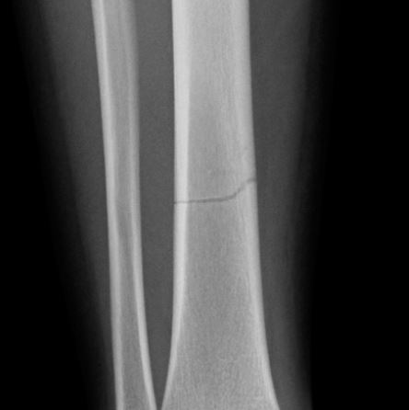
Example 1
Transverse fracture of mid-to-distal third shaft of right tibia
The fracture passes at right angles to the shaft of the long bone

Slide 42
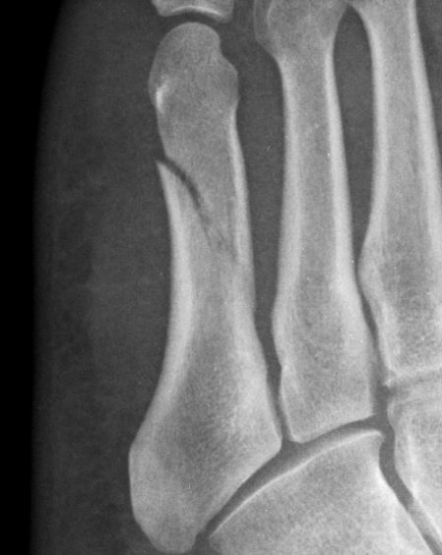
Example 2
Oblique fracture of 5th metartarsal
The fracture passes at an angle obligue to the shaft of the long bone

Slide 43
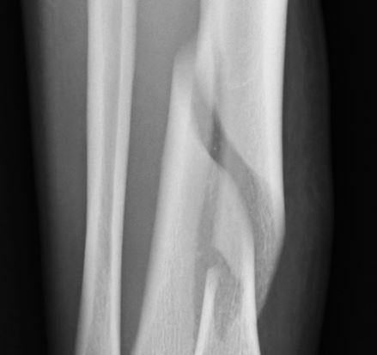
Example 3
Spiral fracture of mid-shaft of right tibia
This fracture resulted from a twisting injury
The fracture line spirals along the shaft of the long bone

Slide 44
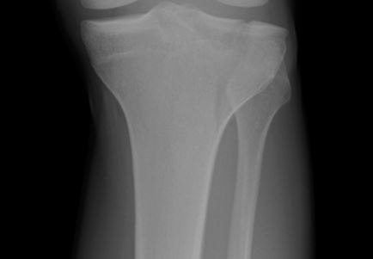
Example 4

Slide 45
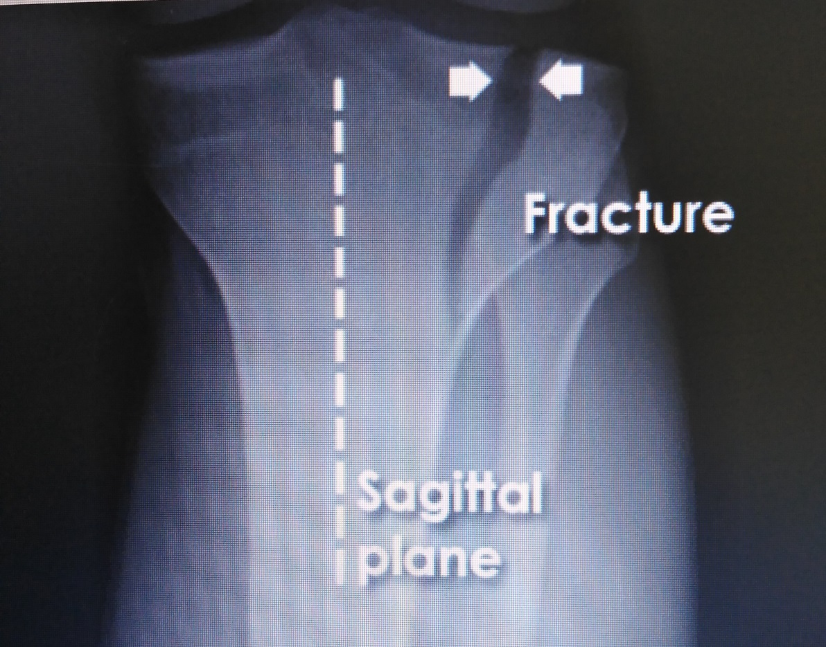
Example 4
Sagittal plane proximal fracture of lateral condyle of left tibia;
The fracture line passes longitudinally along the long bone shaft in the sagittal plane

Slide 46
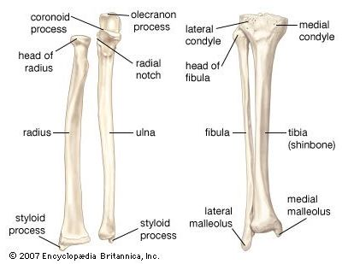

Slide 47
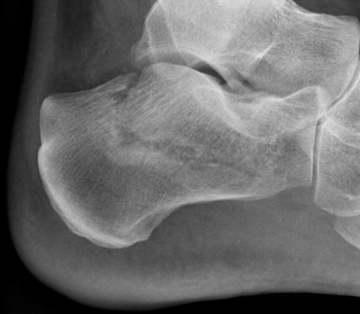
Example 5

Slide 48
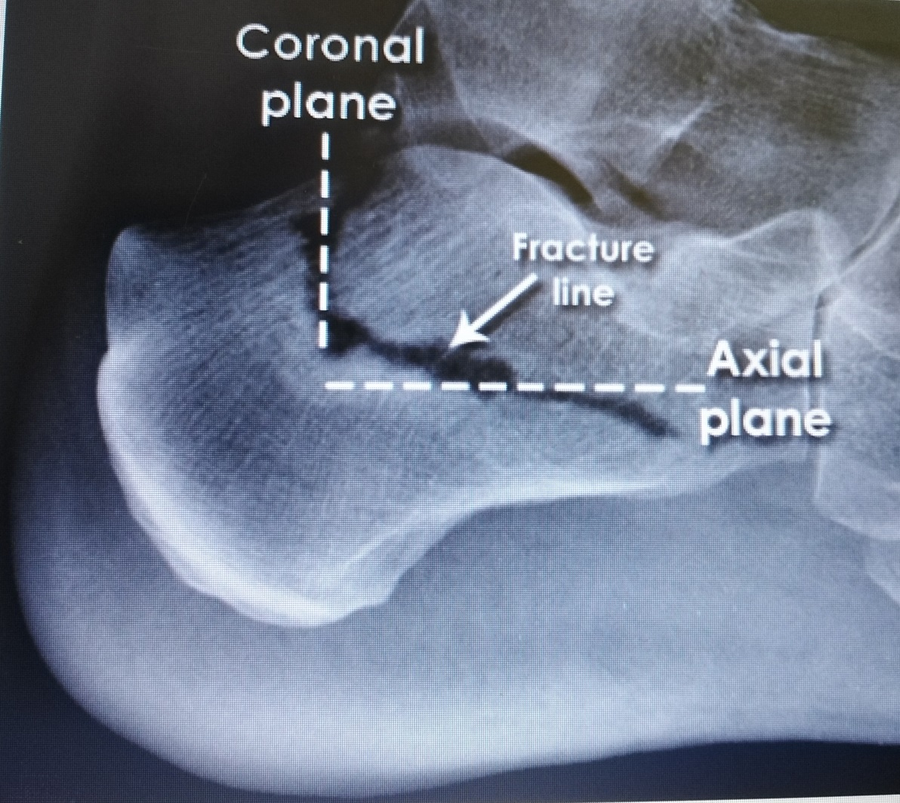
Example 5
Multidirectional fracture of the Calcaneus
A fracture line passes through the calcaneus body in both the coronal and axial planes

Slide 49
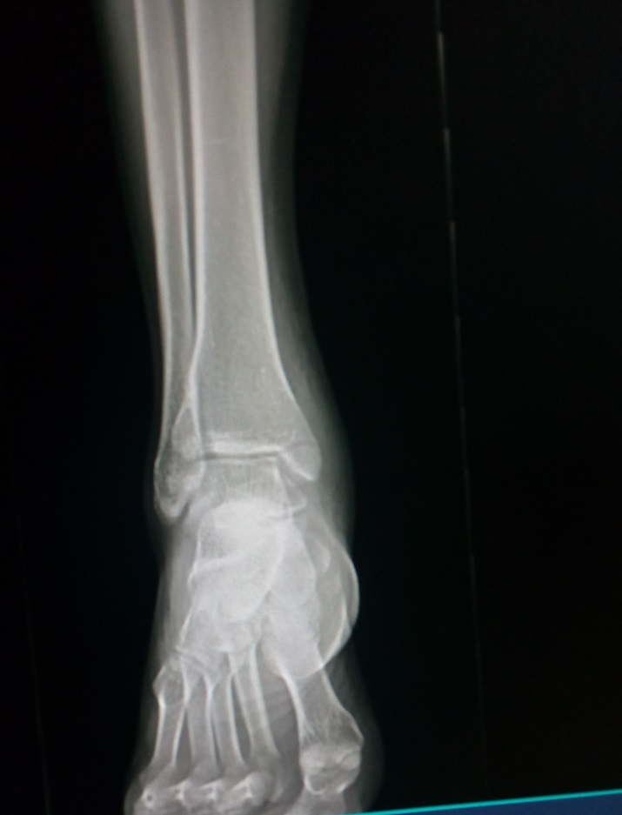
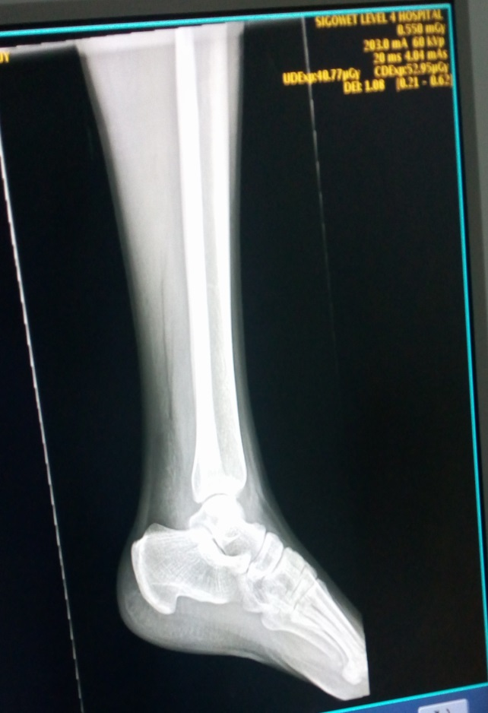
Example 6
Non-displaced Transverse # of the Medial Malleollus
A fracture line passes across the medial malleolus of the tibia at right angle to the shaft of the tibia.

Slide 50
Computerized Tomography Scan
(CT Scan)

Slide 51
Definition: CT scan is an invasive form of tomography in which a computer is used to control the motion of the X-ray source and detectors, processes the data and produces a more detailed anatomical image of internal organs such as brain, chest or abdomen
Diagnoses intracranial bleeding, neoplasms, brain abscesses, hematomas, space occupying lesions, cerebral edema, infarctions, hydrocephalus, cerebral atrophy and shifts of brain structures.
A contrast media/dye may be used to enhance CT scan
Contraindications: Pregnant women, obesity >300lbs, claustrophic patients, allergy to dye and patients with unstable vital signs.

Slide 52
Cont’…
CT Scan provides viewing of Images in three planes and even in three-dimensions
This makes planning of surgical treatment easier
Shows fracture—useful when patient’s body part cannot be turned or positioned for imaging (e.g. the neck).
NB: CT scan assists in investigations of fractures of the spine and pelvis, as well as fracture-dislocations of spine/vertebral column (see page 25)

Slide 53
Magnetic Resonance Imaging
(MRI)

Slide 54
MRI is a non-invasive procedure that uses magnetic field nuclei to identify types of tissues, tumours and vascular abnormalities.
It is similar to CT scan but provides more detailed pictures and does not expose the client to ionizing radiation. Provides cross-sectional images of brain tissues.
Determine if patient has a pacemaker, implanted defibrillator, or metal implants such as hip prosthesis or vascular clips-as test cannot be performed on them.
Provide precaution for client who is attached to pulse oximetry because it can cause a burn during testing if coiled around body.

Slide 55
Provides improved imaging of soft tissues, including neurological structures
Expensive, but available
Available in Major Trauma Centres
Allows rapid assessment of the patient with multiple injuries without the need for frequent movement and repositioning
Smaller scanners for imaging arm or leg available nowadays
(see page 26)

Slide 56
Radioisotope Scanning

Slide 57
This is the use of a radiolabelled isotope molecule injected intravenously to be taken up by cell metabolism (metabolically active cells) for diagnostic purposes especially when the existence of a fracture is in doubt.
The presence of a fracture would be evidenced by an area of increased uptake in the scan. Bone scan will show increased cellular activity in area of fracture—useful for sites where fracture not easily seen or for hairline fractures not previously diagnosed.
Radiation detected is reconstructed into a cross-sectional image by the same technique as for CT scan.
Expensive, though widely available.
Examples of fractures that can be aided by this method include fractures of the scaphoid bone, and fatigue or stress fractures, particularly at unusual sites

Slide 58
Uses of Radioisotope Scanning
Cancer staging e.g. lung cancer staging by use of radiolabelled 18-flurodeoxyglucose (FDG) to detect regional and mediastinal lymphadenopathy and suitability for surgery in patients with lung cancer
Helps to determine myocardial perfusion (‘viability’) using N ammonia and glucose analogue in patients with heart failure

Slide 59
THANK YOU ! ! !

Slide 60
References/ Further Readings
David, L., Hamblen, A., Hamish, R. and Simpson, W. (2007.) Adam’s Outline of Fractures, 12th Ed. Churchill Livingstone, Elsevier.
Dandy, D. and Edwards, D. (2009). Essential Orthopaedics and Trauma. 5th Ed. Churchill Livingstone, Edinburgh
Kenneth, A, et al (2010). Handbook of Fractures. 4th Ed. Wolters Kluwer, Philadelphia
McRae, S. and Esser, M. (2008). Practical Fracture Management. 5th Ed. Elsevier Churchill Livingstone, Edinburg
Sherry, E. and Bokor, D. (1997). Sports Medicine – Problems and Practical Management. Greenwich Medical Media, London
Louis, S., David, W. and Selvadurai, G. (2010). Apley’s Syetem of Orthopaedics and Fractures, 8th Ed.

