Slide 1
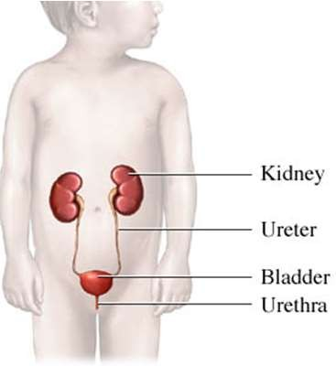

Slide 2
Prevalence and Etiology:
Urinary tract infections (UTIs) occur in 1-3% of girls and 1% of boys.
In girls, the first UTI usually occurs by the age of 5 yr, with peaks during infancy and toilet training.
In boys, most UTIs occur during the 1st yr of life; UTIs are much more common in uncircumcised boys, especially in the 1st years of life.

Slide 3
Prevalence by Age
The prevalence of UTIs varies with age.
During the 1st yr of life, the male : female ratio is 2.8-5.4 : 1.
Beyond 1-2 yr, there is a female
preponderance, with a male : female ratio of 1 : 10.

Slide 4
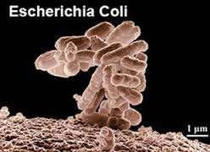
Etiology
UTIs are caused mainly by colonic bacteria.
In girls, 75-90% of all infections are caused by Escherichia coli, followed by Klebsiella spp and Proteus spp.
Some series report that in boys >1 yr of age, Proteus is as common a cause as E. coli; others report a preponderance of gram-positive organisms in boys.
Staphylococcus saprophyticus and enterococcus are pathogens in both sexes.

Slide 5
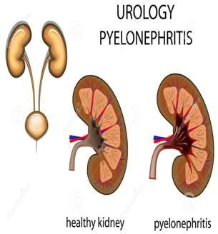
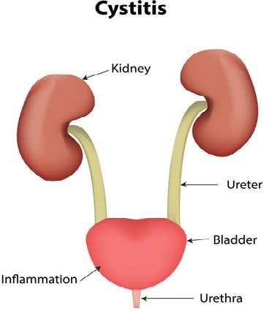
Clinical Manifestations and Classification:
The 3 basic forms of UTI are :
pyelonephritis,
cystitis, and
asymptomatic bacteriuria.

Slide 6
Clinical Pyelonephritis:
Clinical pyelonephritis is characterized by any or all of the following:
abdominal, back, or flank pain; fever; malaise; nausea; vomiting; and, occasionally, diarrhea. Fever may be the only manifestation.
Newborns can show nonspecific symptoms such as poor feeding, irritability, jaundice, and weight loss.

Slide 7
Pyelonephritis is the most common serious bacterial infection in infants <24 mo of age who have fever without an obvious focus.
These symptoms are an indication that there is bacterial involvement of the upper urinary tract.
Involvement of the renal parenchyma is termed acute pyelonephritis, whereas if there is no parenchymal involvement, the condition may be termed pyelitis.
Acute pyelonephritis can result in renal injury, termed pyelonephritic scarring.
Clinical Pyelonephritis:

Slide 8
Cystitis:
Cystitis indicates that there is bladder involvement; symptoms include dysuria, urgency, frequency, suprapubic pain, incontinence, and malodorous urine.
Cystitis does not cause fever and does not result in renal injury.
Malodorous urine is not specific for a UTI.

Slide 9
Pathogenesis and Pathology:
Most UTIs are ascending infections.
The bacteria arise from the fecal flora, colonize the perineum, and enter the bladder via the urethra.
In uncircumcised boys, the bacterial pathogens arise from the flora beneath the prepuce.
In some cases, the bacteria causing cystitis ascend to the kidney to cause pyelonephritis.
Rarely, renal infection occurs by hematogenous
spread, as in endocarditis or in some neonates.

Slide 10
RISK FACTORS FOR URINARY TRACT INFECTION:
Uncircumcised male | Tight clothing (underwear)
Female gender | Pinworm infestation
Vesicoureteral reflux | Constipation
Toilet training | Bacteria with P fimbriae
Voiding dysfunction | Anatomic abnormality (labial adhesion)
Obstructive uropathy | Neuropathic bladder
Urethral instrumentation | Sexual activity
Wiping from back to front in girls | Pregnancy
Bubble bath?

Slide 11
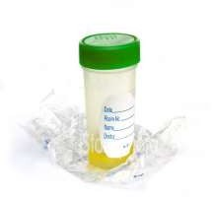
Diagnosis:
UTI may be suspected based on symptoms or findings on urinalysis, or both;
a urine culture is necessary for confirmation and appropriate therapy.
In toilet-trained children, a midstream urine sample usually is satisfactory; the introitus should be cleaned before obtaining the specimen.
In uncircumcised boys, the prepuce must be retracted.
In children who are not toilet trained, a catheterized urine sample should be obtained.

Slide 12
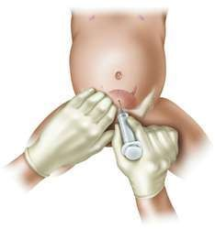
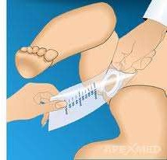
Alternatively, the application of an adhesive, sealed, sterile collection bag after disinfection of the skin of the genitals can be useful only if the culture is negative or if a single uropathogen is identified.
However, a positive culture can result from skin contamination, particularly in girls and uncircumcised boys.
If treatment is planned immediately after obtaining the urine culture, a bagged specimen should not be the method because of a high rate of contamination often with mixed organisms.
A suprapubic aspirate generally is unnecessary.

Slide 13
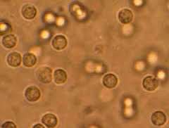
Pyuria (leukocytes in the urine) suggests infection, but infection can occur in the absence of pyuria; this finding is more confirmatory than diagnostic. Conversely, pyuria can be present without UTI.
Sterile pyuria (positive leukocytes, negative culture) occurs in partially treated bacterial UTIs, viral infections, renal tuberculosis, renal abscess, UTI in the presence of urinary obstruction, urethritis due to a sexually transmitted infection (STI) , inflammation near the ureter or bladder (appendicitis, Crohn disease), and interstitial nephritis (eosinophils).
Diagnosis

Slide 14
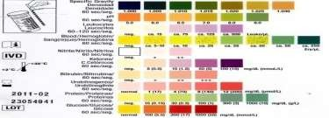
Nitrites and leukocyte esterase usually are positive in infected urine.
Microscopic hematuria is common in acute cystitis, but microhematuria alone does not suggest UTI.
White blood cell casts in the urinary sediment suggest renal involvement, but in practice these are rarely seen.
If the child is asymptomatic and the urinalysis result is normal, it is unlikely that there is a UTI. However, if the child is symptomatic, a UTI is possible, even if the urinalysis result is negative.
Diagnosis

Slide 15
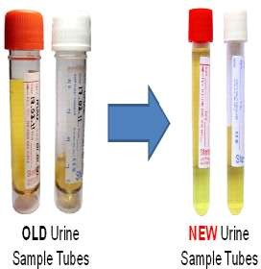
Prompt plating of the urine sample for culture is important, because if the urine sits at room temperature for more than 60 min, overgrowth of a minor contaminant can suggest a UTI when the urine might not be infected.
Refrigeration is a reliable method of storing the urine until it can be cultured.
Diagnosis

Slide 16
If the culture shows >100,000 colonies of a single pathogen, or if there are 10,000 colonies and the child is symptomatic, the child is considered to have a UTI.
In a bag sample, if the urinalysis result is positive, the patient is symptomatic, and there is a single organism cultured with a colony count >100,000, there is a presumed UTI.
If any of these criteria are not met, confirmation of infection with a catheterized sample is recommended.
With acute renal infection, leukocytosis, neutrophilia, and elevated serum erythrocyte sedimentation rate and C-reactive protein are common.
Diagnosis

Slide 17
Treatment:
Acute cystitis should be treated promptly to prevent possible progression to pyelonephritis.
treatment is started pending results of the culture.
If treatment is initiated before the results of a culture and sensitivities are available, a 3- to 5-day course of therapy with trimethoprim-sulfamethoxazole (TMP- SMX) or trimethoprim is effective against most strains of E. coli.
Nitrofurantoin (5-7 mg/kg/24 hr in 3-4 divided doses) also is effective and has the advantage of being active against Klebsiella and Enterobacter organisms.
Amoxicillin (50 mg/kg/24 hr) also is effective as initial treatment but has no clear advantages over sulfonamides or nitrofurantoin.

Slide 18
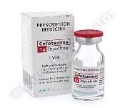
In acute febrile infections suggesting pyelonephritis, a 10- to 14-day course of broad-spectrum antibiotics capable of reaching significant tissue levels is preferable.
Children who are dehydrated, are vomiting, are unable to drink fluids, are ≤1mo of age, or in whom urosepsis is a possibility should be admitted to the hospital for IV rehydration and IV antibiotic therapy.
Parenteral treatment with ceftriaxone (50- 75 mg/kg/24 hr, not to exceed 2 g) or
Cefotaxime (100 mg/kg/24 hr), or
ampicillin (100 mg/kg/24 hr) with an aminoglycoside such as gentamicin (3-5 mg/kg/24 hr in 1-3 divided doses) is preferable.
Treatment

Slide 19
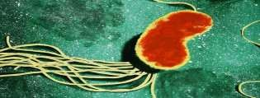
Treatment with aminoglycosides is particularly effective against Pseudomonas spp, and alkalinization of urine with sodium bicarbonate increases its effectiveness in the urinary tract.
Oral 3rd-generation cephalosporins such as cefixime are as effective as parenteral ceftriaxone against a variety of gram-negative organisms other than Pseudomonas, and these medications are considered by some authorities to be the treatment of choice for oral outpatient therapy.
Treatment

Slide 20
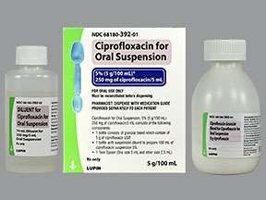
The oral fluoroquinolone ciprofloxacin is an alternative agent for resistant microorganisms, particularly Pseudomonas, in patients >17 yr.
It also has been used on occasion for short- course therapy in younger children with Pseudomonas UTI.
However, the clinical use of fluoroquinolones in children should be restricted because of potential cartilage damage.
Treatment

Slide 21
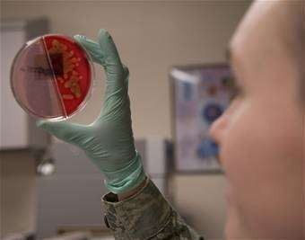
A urine culture 1 wk after the termination of treatment of a UTI ensures that the urine is sterile but is not routinely needed.
A urine culture during treatment almost invariably is negative.
Treatment

Slide 22
There is interest in probiotic therapy, which replaces pathologic urogenital flora, and
Cranberry juice, which prevents bacterial adhesion and biofilm formation, but these agents have not proved beneficial in preventing UTI in children.
Treatment

Slide 23
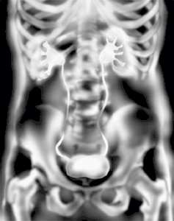
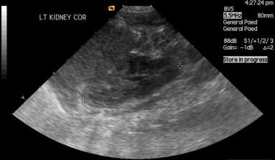
Recommendations for imaging
Previous guidelines have recommended routine radiological imaging for all children with UTI.
Current evidence has narrowed the indications for imaging.

Slide 24
Imaging Studies:
The goal of imaging studies in children with a UTI is to:
identify anatomic abnormalities that predispose to infection,
determine whether there is active renal involvement, and
to assess whether renal function is normal or at risk.

Slide 25
Imaging Studies: lower urinary tract
In children with ≥1 infection of the lower urinary tract (dysuria, urgency, frequency, suprapubic pain), imaging is usually unnecessary.
Instead, assessment and treatment of bladder and bowel dysfunction is important.
If there are numerous lower urinary tract infections, then a renal sonogram is appropriate, but a VCUG rarely adds useful information.

Slide 26
Sonogram
In children with their 1st episode of clinical pyelonephritis—
those with febrile UTI,
in infants,
those with systemic illness—and a positive urine culture, irrespective of temperature, a sonogram of kidneys and bladder should be performed
All children less than 3 years of age
Children above 3 years of age
with:
poor urinary stream,
seriously ill with UTI,
palpable abdominal masses,
raised serum creatinine,
non E coli UTI,
febrile after 48 hours of antibiotic treatment, or
recurrent UTI.

Slide 27
Micturating cystourethogram (MCUG)
Infants with recurrent UTI.
Infants with UTI and the
following features:
poor urinary stream, seriously ill with UTI, palpable abdominal masses, raised serum creatinine, non E. coli UTI, febrile after 48 hours of antibiotic treatment.
Children less than 3 years old with the following features:
Dilatation on ultrasound.
Poor urine flow.
Non E. coli infection.
Family history of VUR.
In children with a second febrile UTI who previously had a negative upper tract evaluation, a VCUG is indicated, because low- grade reflux predisposes to clinical pyelonephritis.

Slide 28
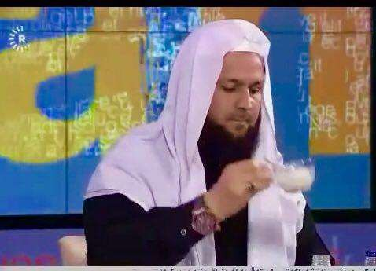
Thank You

